Slide 2
Deploying Microsoft SharePoint on Windows Azure VMs
SES-B320
Paolo Pialorsi - DevLeap paolo@pialorsi.com
@PaoloPia

Slide 3
Agenda
Cloud explained: on-premises, IaaS, PaaS, SaaS
Windows Azure VMs
Architecture
How it works
Deployment tips and tricks
SharePoint 2013 on Azure VMs
Suggested topology
Practical guide
Notes from the fields

Slide 4
Cloud explained

Slide 5
Hosting Models
Business Model
Software
(as a Service)
On Premises
Infrastructure
(as a Service)
Platform
(as a Service)
Customizations
Applications
Applications
You manage
Applications
Applications
Data
You manage
Data
Data
Data
Runtime
Runtime
Runtime
Runtime
Managed by Microsoft
You manage
Middleware
Middleware
Middleware
Middleware
Managed by Microsoft
O/S
O/S
O/S
O/S
Virtualization
Virtualization
Managed by Microsoft
Virtualization
Virtualization
Servers
Servers
Servers
Servers
Storage
Storage
Storage
Storage
Networking
Networking
Networking
Networking

Slide 6
What about SharePoint?
On-premises
Full hardware/software control
Roll your own HA/DR/scale rules
Infrastructure as a Service
Managed IT infrastructure
Easy to move from on-prem
Roll your own HA/DR/scale rules
Software as a Service
Microsoft Office 365
Externally managed
Auto and managed HA/DR/scale rules

Slide 7
Windows Azure VMs

Slide 8
Windows Azure VMs
IaaS offering in Windows Azure
It is released to market, fully functional, and ready to go!
Allows creating VMs in custom virtual networks
With private networking inside and public outside
You can manage domains, app servers, VPN to on-premises infrastructures, etc.
You can start from scratch or from VM models provided out of the box, or of your own
Completely remotely manageable (via PowerShell)
Deployment and maintenance processes can be automated by PowerShell scripts

Slide 9
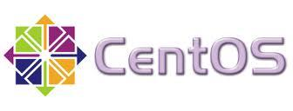
Flexibility of Azure Virtual Machines
Multiple ways to get started…
Variety of images to select…
Persisted
in Storage…
Boot VM from New Disk
Published Standard
Management Portal
>_
Blob Storage
Scripting
(Windows, Linux and Mac)
Cloud
REST API

Slide 10
Main VM models based on Windows OS
Windows Server 2012 Datacenter
Windows Server 2008 R2 SP1
SQL Server 2008 R2 SP2 (Std., Ent.)
SQL Server 2012 SP1 (Web, Std., Ent.)
BizTalk Server 2013 (Std., Ent., Eval)
SharePoint Server 2013 (Trial – Expire on 10/16/2013)

Slide 11
Creating a Virtual Machine from Management Portal
Paolo Pialorsi

Slide 12
How it Works
Log in to
Windows Azure
Management Portal
Create new VM from
image gallery
The image is copied to
your blob storage account
Virtual Machine booted. Changes copied to blob storage

Slide 13
Virtual Machine Sizes
VM Size | CPU Cores | Memory | Bandwidth | # Data Disks (up to 1TB each) | Maximum IOPS (500 max x disk)
Extra Small (A0) | Shared | 768 MB | 5 (Mbps) | 1 | 1 x 500
Small (A1) | 1 | 1.75 GB | 100 (Mbps) | 2 | 2 x 500
Medium (A2) | 2 | 3.5 GB | 200 (Mbps) | 4 | 4 x 500
Large (A3) | 4 | 7 GB | 400 (Mbps) | 8 | 8 x 500
Extra Large (A4) | 8 | 14 GB | 800 (Mbps) | 16 | 16 x 500
A6 | 4 | 28 GB | 1.000 (Mbps) | 8 | 8 x 500
A7 | 8 | 56 GB | 2.000 (Mbps) | 16 | 16 x 500

Slide 14
Business Continuity and SLA
VMs sometime can reboot/restart
To apply patches
For hardware upgrades
For issues (sometime it happens)
The guaranteed SLA
99.95% of external connectivity for VMs with two or more instances in the same Availability Set
It means downtime about 4.38hr/year
99.9% of availability for Virtual Network Gateways
For further details on SLA
http://www.windowsazure.com/en-us/support/legal/sla/

Slide 15
Virtual Machine Availability Sets
Fault Domain
Fault Domain
Rack
Rack
Availability Set
Virtual Machine
Virtual Machine
IIS1
IIS2
Availability Set
Virtual Machine
Virtual Machine
SQL1
SQL2

Slide 16
SharePoint 2013 on Windows Azure VMs

Slide 17
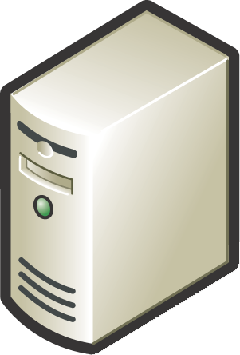
A Reliable SharePoint 2013 Farm
SP2013-SP-WFE-AV
SP2013-SP-APP-AV
SP2013-SQL-AV
SP2013WFE01 [A4]
Windows Server 2012
SP2013 Web Front End
SP2013APP01 [A4]
Windows Server 2012
SP2013 App Server
SP2013SQL01 [A4]
Windows Server 2012
SQL Server 2012 (Std/Ent)
Mirroring Node 1 or Always On Node 1
SP2013SQL02 [A4]
Windows Server 2012
SQL Server 2012 (Std/Ent)
Mirroring Node 2 or Always On Node 2
SP2013SQL03 [A1]
Windows Server 2012
SQL Server 2012 (Std/Ent)
SQL Mirroring Witness (optional)
SP2013-DC-AV
SP2013WFE02 [A4]
Windows Server 2012
SP2013 Web Front End
SP2013APP02 [A4]
Windows Server 2012
SP2013 App Server
SP2013DC01 [A1]
Windows Server 2012
Domain Controller, DNS1
SP2013DC02 [A1]
Windows Server 2012
Domain Controller, DNS2

Slide 18
SharePoint 2013 Farm Deployment on Windows Azure IaaS
Paolo Pialorsi

Slide 19
Notes from the fields

Slide 20
For Better Performances
Use Affinity Groups
The Fabric Controller will keep Compute and Storage services «as close as possible»
Within the same Container or Cluster
For aggregating services, reducing latency, and lowering costs
Leverage Disks Caching
None, Read-Only Cache, Read/Write Cache
Working with PowerShell you can choose it during VM creation
Can be configured within the Management Portal
Cache can be enabled for up to 4 data disks per VM
Change to caching requires VM restart to take effect
Turn OFF Write Cache on SQL Server data disks
For huge I/O requirements keep in mind that you have max 500 IOPS on each disk
Remember that VM bandwidth depends on VM size …

Slide 21
Managing Snapshots and Backups
VM Snapshots are not available
You can leverage blob snapshots, through third party tools or custom scripting
You can upload backup files on blob storage
Using PowerShell or the REST API
And a bunch of PowerShell scripting
Useful for SQL Backups, as well as other backups
You can use a VPN to your private network
To store backup data locally (on-premises)
But you should have bandwidth enough …

Slide 22
Reusing VMs and Creating Models
Prepare VHDs on Azure (Capture VHD)
SysPrep needed
Removes the source machine
Or upload VHDs to blob storage
You can use CSUpload, or any other tool
Remember SysPrep
Leverage Export/Import capabilities
You can export VMs configuration, to automate deletion and creation
Or you can power-off and deallocate unused or lab VMs

Slide 23
Related content
MDC-B370 - Building Your Lab, Dev, and Test Scenarios in Windows Azure Infrastucture Services (IaaS)
MDC-B212 - Infrastructure Services on Windows Azure: Virtual Machines and Virtual Networks with Mark Russinovich
MDC-B213 - IaaS: Hosting a Microsoft SharePoint 2013 Farm on Windows Azure
WAD-H301 - Build Your Microsoft SharePoint Server 2013 Lab in the Cloud with Windows Azure
Find Me Later At The Microsoft Booth

Slide 24
Resources
Learning
Sessions on Demand
Microsoft Certification & Training Resources
http://channel9.msdn.com/Events/TechEd
www.microsoft.com/learning
TechNet
msdn
Resources for IT Professionals
Resources for Developers
http://microsoft.com/technet
http://microsoft.com/msdn

Slide 25
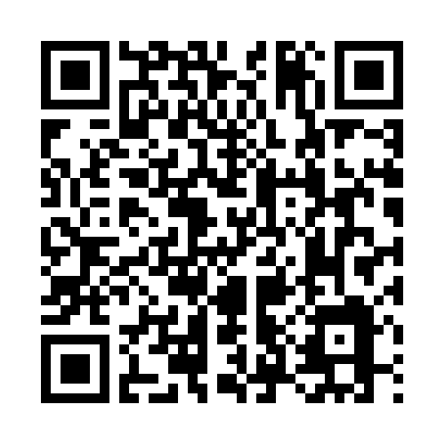
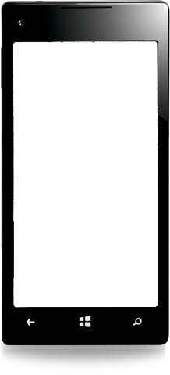
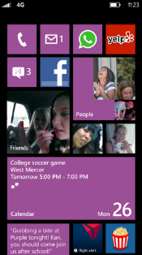
Evaluate this session
Required Slide
*delete this box when your slide is finalized
Your MS Tag will be inserted here during the final scrub.
Scan this QR code to
evaluate this session.

Slide 26
© 2013 Microsoft Corporation. All rights reserved. Microsoft, Windows and other product names are or may be registered trademarks and/or trademarks in the U.S. and/or other countries.
The information herein is for informational purposes only and represents the current view of Microsoft Corporation as of the date of this presentation. Because Microsoft must respond to changing market conditions, it should not be interpreted to be a commitment on the part of Microsoft, and Microsoft cannot guarantee the accuracy of any information provided after the date of this presentation. MICROSOFT MAKES NO WARRANTIES, EXPRESS, IMPLIED OR STATUTORY, AS TO THE INFORMATION IN THIS PRESENTATION.

