Slide 2
Optimizing SQL Server 2012 for SharePoint 2013
SES-B326
Brian Alderman

Slide 3
Who am I?
Brian Alderman
MCSE, MCT, MCITP: SQL Server & SharePoint
www.microtechpoint.com
Brian@microtechpoint.com
@brianalderman & @microtechpoint
Co-Author SharePoint 2010 Administrator’s Companion, SharePoint 2013 Expert Administration, SharePoint 2013 Inside Out

Slide 4
Session Agenda
SQL Server Introduction
SharePoint and SQL Server Integration
Demo: SQL Server Configurations to Improve SharePoint Performance
SQL Server Instance Configurations
SQL Server Database Configurations
SQL Server Best Practices for Optimizing SharePoint

Slide 5
SQL Server Introduction
Multiple Instances of SQL Server on one Physical Server
One Default Instance and Multiple Names Instances
Each Instance Managed Individually
Share SQL Server Management Tools
Instances Share Server Resources
Minimum of Two Files Created per Database
.MDF (Master Data File)
.LDF (Transaction Log File)
.NDF (Optional Files(s) used to Extend Database)

Slide 6
SQL Server System Databases
Master
Configuration Database of SQL Server
Msdb
SQL Server Automation
Tempdb
Temporary Storage Work Area
Model
Template for All New Databases

Slide 7
SharePoint and SQL Server Integration
All SharePoint Versions and SQL Server Versions
Majority of SharePoint Content Stored in SQL Server
Farm Configuration Information Stored in Configuration Database in SQL
Central Administration Content Stored in Own Content Database
Most Service Applications Have At Least One Content Database
All Web Apps Have at Least One Content Database

Slide 8
SharePoint Content Databases
Farm Has Several Databases (Spousal Installation – 20 DB’s if Run Farm Configuration Wizard)
Site Collections Reside in Only One Content Database
Content Databases Can Contain Many Site Collections
Control Size of Databases from Within SharePoint
Quota Templates
Maximum Number of Site Collections

Slide 9
Planning Site Collections and Databases Need 800 Site Collections at 500MB Each
Web Application
200GB
200GB
200GB
200GB
250
250
250
250
Site Collection
Site Collection
Site Collection
Site Collection
HR
Sites
Projects
Sites
Sales
Sites
Student
Sites

Slide 10
SQL Server Configurations
Model Database File Settings
Increase Initial Size
Increase Autogrowth Settings (Use MB not %)
Tempdb Database Settings
Increase Initial Size
Increase Autogrowth Settings (Use MB not %)
Use Simple Recovery Model
Place on Drive Different Than Content Databases

Slide 11
SQL Server Configurations cont…
SQL Server Instance Settings
Default Database File Locations (Move off C:\ Drive)
Set Minimum and Maximum Memory
Collation – Latin1_General_CI_AS_KS_WS
During Installation

Slide 12
Demo
Configuring SQL Server Settings

Slide 13
Best Practices for SharePoint SQL Server
Dedicated Server / Instance with SQL Server Alias
No Spousal Installations
Content Databases < 200 GB
Modify Model DB Settings
Use Database Autogrowth Sparingly
Reduces Fragmentation
Improves Performance
Spread Data Files and Transaction Log Files Across Multiple Physical Drives or Locate on RAID 5/10

Slide 14
Best Practices for SQL Server cont…
Create Multiple TempDB Files on Multiple Disks
Avoid Shrinking Database Files
Generate Database Maintenance Plans
Configuration of MDOP
Monitor Disk Seconds Per Read/Write (<20ms)
Defragment Drives Containing Content Database Files
Perform Regular Backups of Database and Transaction Logs

Slide 15
Keep in Touch…
Web Site: www.microtechpoint.com
Phone: (877) 687-3853
Email: brian@microtechpoint.com
Twitter: @brianalderman & @microtechpoint
Blog: http://brianalderman.wordpress.com

Slide 16
Related content
Breakout Sessions
DBI-B205 - Microsoft SQL Server Management Basics for Non-DBAs
Hands-on Labs
SES-H321 - Introduction to Windows PowerShell with Microsoft SharePoint Server 2013
Exam Preparation Session –
EXM09 - Exam Prep: 70-331 and 70-332 - MCSE: SharePoint (Microsoft SharePoint Server 2013)

Slide 17
Resources
Learning
Sessions on Demand
Microsoft Certification & Training Resources
http://channel9.msdn.com/Events/TechEd
www.microsoft.com/learning
TechNet
msdn
Resources for IT Professionals
Resources for Developers
http://microsoft.com/technet
http://microsoft.com/msdn

Slide 18
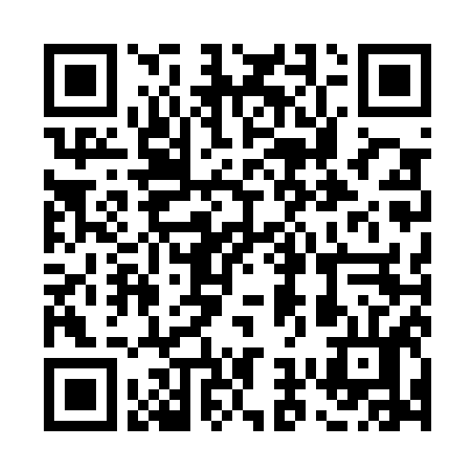
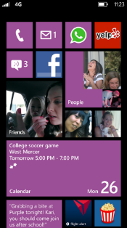
Evaluate this session
Required Slide
*delete this box when your slide is finalized
Your MS Tag will be inserted here during the final scrub.
Scan this QR code to
evaluate this session.

Slide 19
© 2013 Microsoft Corporation. All rights reserved. Microsoft, Windows and other product names are or may be registered trademarks and/or trademarks in the U.S. and/or other countries.
The information herein is for informational purposes only and represents the current view of Microsoft Corporation as of the date of this presentation. Because Microsoft must respond to changing market conditions, it should not be interpreted to be a commitment on the part of Microsoft, and Microsoft cannot guarantee the accuracy of any information provided after the date of this presentation. MICROSOFT MAKES NO WARRANTIES, EXPRESS, IMPLIED OR STATUTORY, AS TO THE INFORMATION IN THIS PRESENTATION.

