Slide 2
Authentication and Authorization Infrastructure in Microsoft SharePoint 2013
SES-B402
Paolo Pialorsi - DevLeap paolo@pialorsi.com
@PaoloPia

Slide 3
Agenda
Authentication
Users’ Authentication
Federation
Apps Authentication
Custom ClaimsProvider
Authorization
Users’ Authorization
Apps Authorization
Server to Server

Slide 4
Authentication

Slide 5
SharePoint 2013 Users’ Authentication
It works almost like SharePoint 2010
-Classic
-Claims
NT Token Windows Identity
NT Token Windows Identity
ASP.NET (FBA) SQL, LDAP, Custom …
SAML 1.1 ADFS, ACS, etc.
SAML Token
Claims Based Identity
SPUser

Slide 6
Supported Authentication Modes
Classic-mode
It’s deprecated!
For backward compatibility only
Available only through PowerShell
No more available in SharePoint Central Administration
Claims-based
It’s the default mode
And the only one available in SPCA
Use it … and move to it

Slide 7
Claims-based Authentication Methods
Anonymous
Windows
Basic, NTLM, Kerberos
Forms Based Authentication (FBA)
Membership API (ASPNET SQL)
LDAP Provider
Custom Provider (developed in .NET)
Trusted Identity Provider
Active Directory Federation Services 2.0 (ADFS 2.0)
Windows Azure Access Control Services (ACS)
Windows Azure Active Directory Services (AAD, via ACS)
Custom IP/STS (developed in .NET or any other compliant platform)

Slide 8
SharePoint 2013 Authentication
Paolo Pialorsi

Slide 9
Identity Claims Representation
Windows Account: i:0#.w|devleap\paolo
FBA Account: i:0#.f|fbamembership|paolo
SAML Account: i:05.t|devleap-acs|paolo@pialorsi.com

Slide 10
How it works
Claim Issuer
w = Windows
s = Local STS
m = ASP.NET Membership Provider
r = ASP.NET Role Provider
t = Trusted Identity Provider
c = Claim Provider
f = Forms Authentication
ǵ = Custom Claims Provider
Claim Type
# = logon name
5 = email
ǻ = username
? = name identifier
! = identity provider
- = Role
Get-SPClaimTypeEncoding
Claim Value or Original Issuer
Windows and Local STS = Claim Value
Others = Original Issuer Name
Claim Value
(not for Windows and Local STS)
Claim Value Type
. = String
+ = RFC822 Name
: = Separator 0 = Reserved
i = Identity Claim
c = Other Claim
devleap-acs
paolo@pialorsi.com
i
:0
5
.
t
|
|
For further details read: SharePoint Protocols

Slide 11
Trusting an external Identity Provider

Slide 12
Windows Azure ACS
Identity Provider and Security Token Service
Leverages external IP
Microsoft Account (aka Windows LiveID)
Facebook
Google
Yahoo!
ADFS 2.0
Windows Azure Active Directory
Custom WS-Federation
It’s available for free!
You simply need to have a valid Windows Azure subscription

Slide 13
Specs Supported by ACS
Protocols
WRAP
OAuth 2.0
WS-Trust
WS-Federation
Tokens
SAML 1.1/2.0
Simple Web Token (SWT)
JSON Web token (JWT)

Slide 14
Federating with Windows Azure ACS
Paolo Pialorsi

Slide 15
PeoplePicker, Claims, Augmentation, etc.
When you trust an external IP you get claims
Sometime you need to augment them
Sometime you need to search for them in the PeoplePicker
Often you need to authorize based on them

Slide 16
Claims Providers
What you need is a claims provider
Claims augmentation (custom claims to extend issued security tokens)
Names resolution (search, resolve, friendly values for claims, people, and roles)
Available out of the box
SPActiveDirectoryClaimProvider
SPFormsClaimProvider
SPTrustedClaimProvider

Slide 17
Custom Claims Providers
Inherit from SPClaimProvider
Microsoft.SharePoint.Administration.Claims
Implement/Override methods for
Name resolution
Claims augmentation
Support hierarchies
Resolve claims
Search claims

Slide 18
Custom Claims Provider Deployment
Requires a farm-level solution (.WSP)
Not suitable for Microsoft Office 365
Leverages a dedicated feature with a receiver
SPClaimProviderFeatureReceiver
Must be activated via PowerShell onto the target Web Application

Slide 19
Developing a Custom ClaimProvider (Quick Overview)
Paolo Pialorsi

Slide 20
SharePoint 2013 Apps Authentication

Slide 21
The OAuth Protocol
The OAuth 2.0 authorization framework enables a third-party application to obtain limited access to an HTTP service, either on behalf of a resource owner by orchestrating an approval interaction between the resource owner and the HTTP service, or by allowing the third-party application to obtain access on its own behalf.
http://tools.ietf.org/html/rfc6749

Slide 22
SharePoint 2013 Apps’ Authentication
Start
User credentials provided?
Yes
Is the endpoint outside of an app web?
Yes
Set user context
No
No
OAuth token present?
Yes
Is endpoint CSOM?
Yes
Does the token include user info?
Yes
Set app and user context
No
No
No
Set App-Only context
Use anonymous context
End

Slide 23
SharePoint Apps OAuth Flow
7- Access token
STS (ACS)
2. Request context token
3. Signed context token
6. Refresh token
Subject
8. Request – Access token
1. Request
4. Page - IFrame
9. SharePoint data
SharePoint Server
5. Request IFrame contents
App Server
10. IFrame contents

Slide 24
Authorization

Slide 25
SPUser and SPGroup
Almost the same as in SharePoint 2010
Define user or group principals
Inherit from SPPrincipal
You can give explicit permissions (authorization)
Target: site, lists/libraries, items/folders
Authorization leverages Permission Levels
ReadOnly, Limited Access, Edit, Design, Full Control
Permission Levels can be customized
Permission Levels are made of Permissions
Manage Lists, Add Items, Edit Items, Delete Items, etc.
Are a bitmask of native and basic permissions

Slide 26
App permissions
Are different from user permissions
Are granted as all or nothing
App can include permissions requests in application manifest
Installing user grants/denies permissions during installation
If permissions request denied, SharePoint does not install the app
Users can grant only permissions that they have
You must be at least a Site Owner to install an App
Cannot be changed after assignment
Permissions can only be revoked

Slide 27
More about App Permissions
App has full control over its app web
But no other default permissions
Permissions are made of Scope and Right
Permission Scopes
Site Collection, Web Site, List, Tenant, Services (Search, Managed Metadata, User Profile, etc.)
Permissions applied to a target scope, apply also to all the children of that scope
Permission Rights
Read-Only, Write, Manage, Full Control
Other specific rights for Services
Apps Rights and Scopes are not customizable

Slide 28
SharePoint 2013 Authorization
Paolo Pialorsi

Slide 29
S2S High Trust Scenario
High Trust != Full Trust
Alternative to OAuth
Leveraged by apps and infrastructural services
Workflow Manager, Exchange, etc.
Direct trust relationship between SP2013 and the external service
Based on X.509 certificates
One certificate for each app (avoid sharing certs across apps)
Available for Provider-hosted apps
Supported by wizard of Visual Studio 2012 and Office Developer Tools for VS2012
A little bit «complicated» to configure, using PowerShell

Slide 30
Related content
SES-B307 - Microsoft Office 365 Identity Solutions: Notes from the Field
Related Certification Exams: 70-331, 70-332
Find Me Later At Microsoft Booth

Slide 31
Resources
Learning
Sessions on Demand
Microsoft Certification & Training Resources
http://channel9.msdn.com/Events/TechEd
www.microsoft.com/learning
TechNet
msdn
Resources for IT Professionals
Resources for Developers
http://microsoft.com/technet
http://microsoft.com/msdn

Slide 32
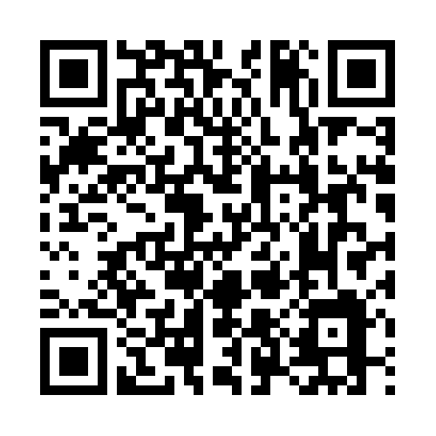
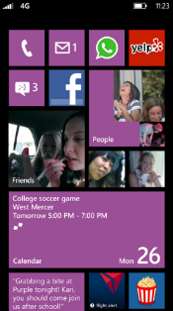
Evaluate this session
Required Slide
*delete this box when your slide is finalized
Your MS Tag will be inserted here during the final scrub.
Scan this QR code to
evaluate this session.

Slide 33
© 2013 Microsoft Corporation. All rights reserved. Microsoft, Windows and other product names are or may be registered trademarks and/or trademarks in the U.S. and/or other countries.
The information herein is for informational purposes only and represents the current view of Microsoft Corporation as of the date of this presentation. Because Microsoft must respond to changing market conditions, it should not be interpreted to be a commitment on the part of Microsoft, and Microsoft cannot guarantee the accuracy of any information provided after the date of this presentation. MICROSOFT MAKES NO WARRANTIES, EXPRESS, IMPLIED OR STATUTORY, AS TO THE INFORMATION IN THIS PRESENTATION.

