Slide 2
HP Insight Control for Microsoft System Center
SP02
Paul Gavin
HP Training Manager

Slide 3
Agenda
Overview of HP Insight Control for System Center
HP Insight Control integrations for SCOM 2012
HP Insight Control integrations for SCVMM 2012
HP Insight Control integrations for SCCM 2012
Conclusion
Next steps

Slide 4
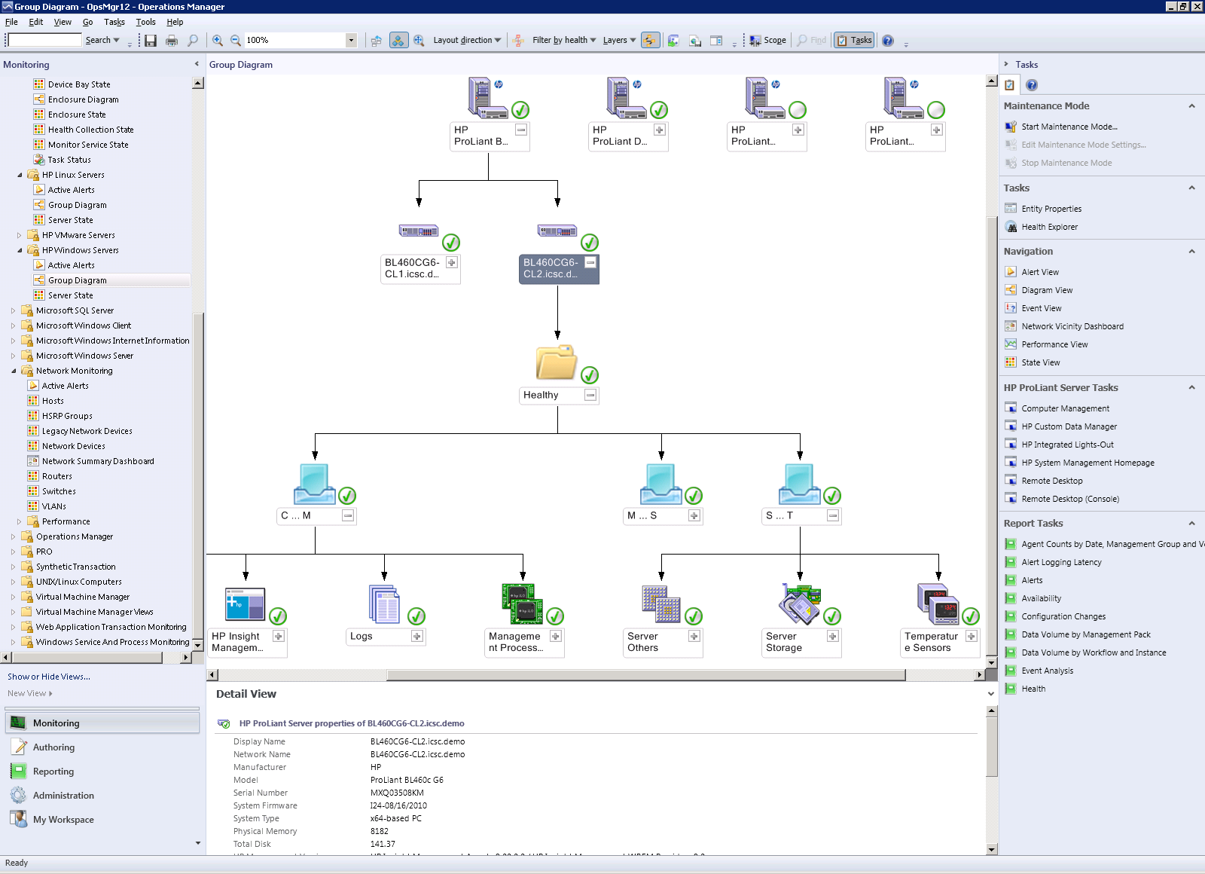
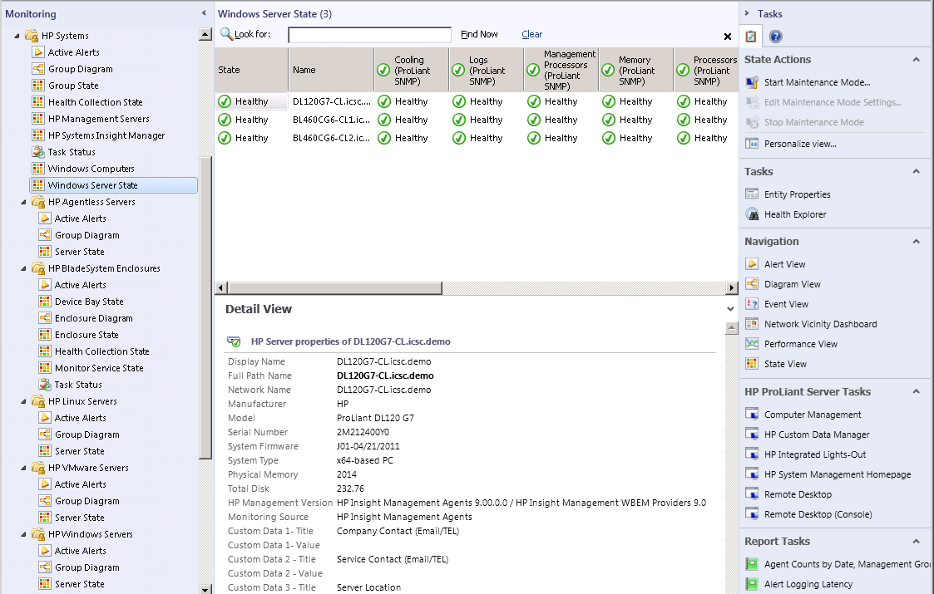
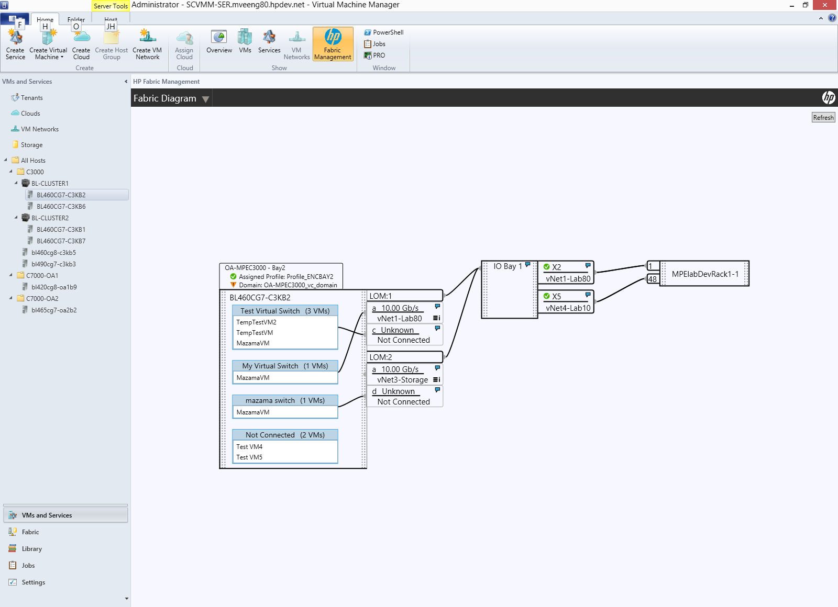
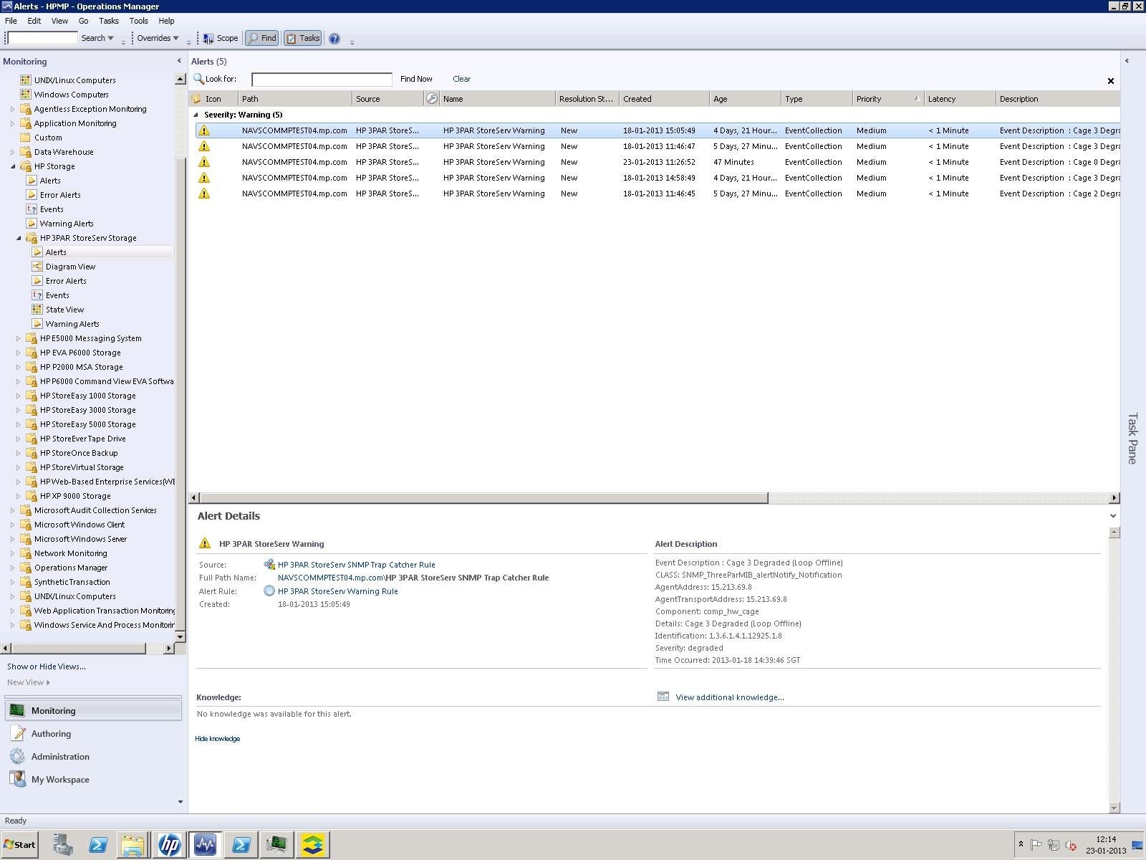
Seamless management for virtual and physical environments
System Center Consoles
Servers
Management
software
Network
Consolidated management for your HP Converged Infrastructure
Storage*
* Provided separately from Insight Control for System Center

Slide 5
HP Insight Control for Microsoft System Center
Brings the native manageability of HP hardware to System Center environments
Ideal for customers who have standardized on Microsoft System Center as their management platform
Licensed and included with HP Insight Control
Integrate directly into System Center consoles
SCOM
SCVMM
SCCM
Provides comprehensive system health, configuration management, and software deployment

Slide 6
Key features and benefits
Prevent problems from occurring by proactively monitoring and managing the health of ProLiant servers and BladeSystem enclosures
Quickly and reliably deploy bare metal servers, including pre-deployment hardware and BIOS configuration, and post-OS driver installation updates
Ensure consistency and maximize uptime with simplified driver and firmware updates
Provide detailed component level inventory of every managed server

Slide 7
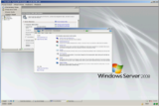
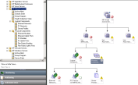
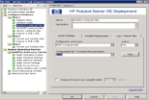
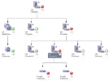
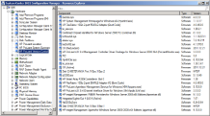
Power of Insight Control delivered to System Center
Comprehensive health monitoring
IC 7.3
Virtual Connect
Agentless Gen8
Windows
Linux
Microsoft System Center
Blade enclosures
Bare metal OS deployment
Total remote control via iLO Advanced
Provides comprehensive system health, configuration management, and software deployment
Driver and firmware updates
Virtual Connect Fabric Visualization
Detailed HP inventory
IC 7.3

Slide 8
HP Insight Control for SCOM integrations

Slide 9
System Center Operations Manager Integrations
Proactive monitoring of hardware health and intelligent response to hardware events
Common views across all management packs
Alert View
Diagram View
State View
New Virtual Connect Management Pack monitors logical and physical VC components
Agentless monitoring of ProLiant Gen8 servers
Context sensitive launch of iLO, SMH, VCM, and OA
HP Device Monitor used as proxy for non-Windows devices
SCOM Management Packs | SCOM 2007 | SCOM 2012
Virtual Connect | Y | Y
ProLiant Server (Windows) | Y | Y
BladeSystem Enclosure | Y | Y
ProLiant Agentless (Gen8) | Y | Y
ProLiant Linux | Y | Y
ProLiant VMware ESX* | Y | Y
* Note: The VMware ESX Management Pack does not support VMware ESXi. Use the Agentless Management Pack on ProLiant Gen8 servers to get VMware ESXi support.
New Virtual Connect Management Pack

Slide 10
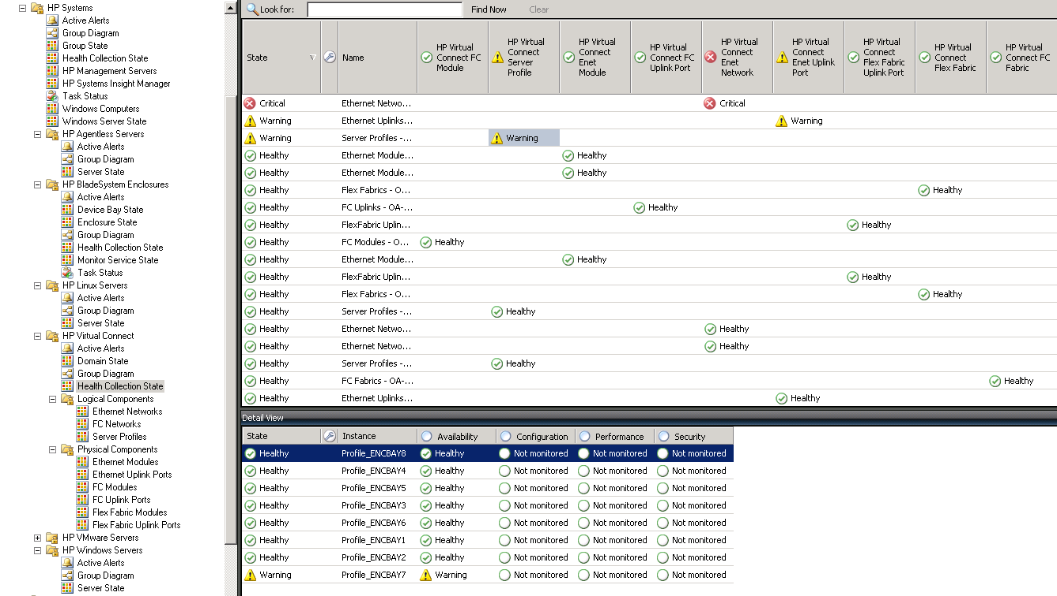
HP SCOM Management Packs
SCOM 2007
SCOM 2012
HP Systems
HP Agentless
HP BladeSystem
HP Linux
HP Virtual Connect
HP VMware ESX
HP Windows

Slide 11
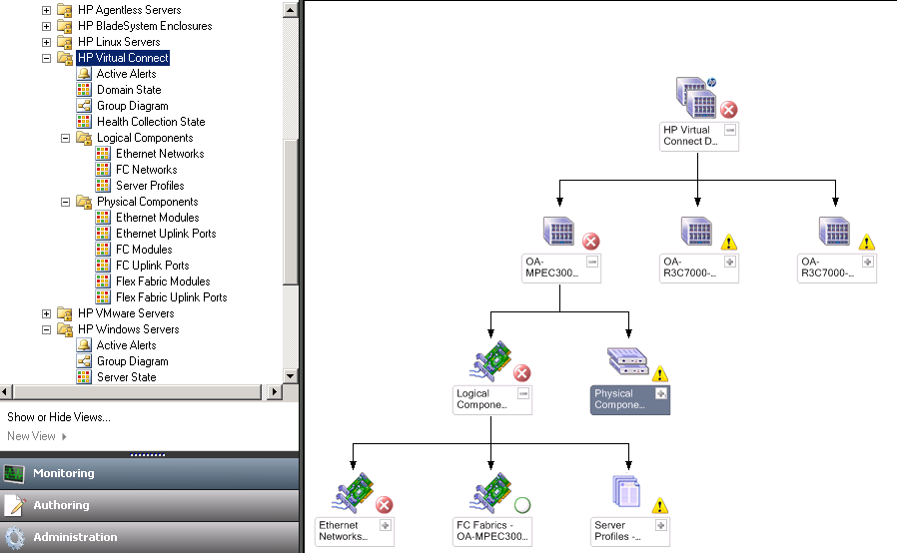
Virtual Connect Management Pack
SCOM 2007
SCOM 2012
Extending Converged Infrastructure support
New
Provides health monitoring and alerting
Domain State view
Diagram views
Logical component monitoring
Ethernet networks
Fibre Channel networks
Server Profiles
Physical component monitoring
Ethernet modules and uplink ports
Fibre Channel modules and uplink ports
FlexFabric modules and uplink ports

Slide 12
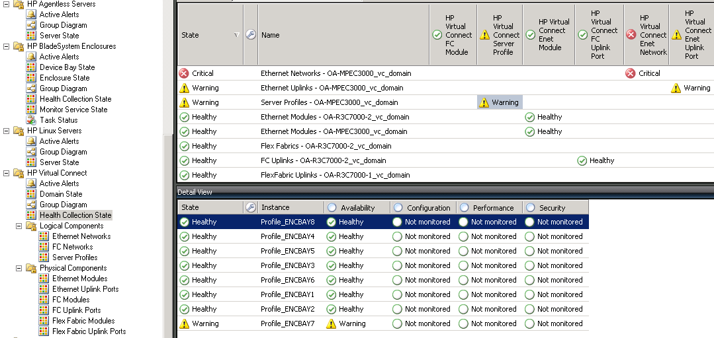
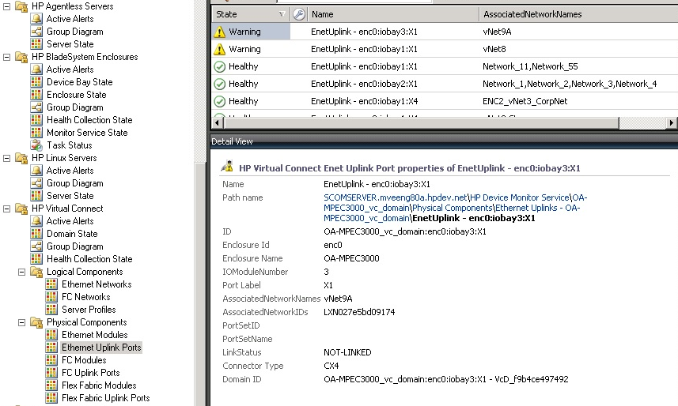
Virtual Connect Management Pack
SCOM 2007
SCOM 2012
Assists with troubleshooting Virtual Connect problems
Health monitoring, configuration information, and alerts
Uses HP Device Monitor to register Virtual Connect domains
New
Health Collection State
Ethernet Uplink Ports

Slide 13
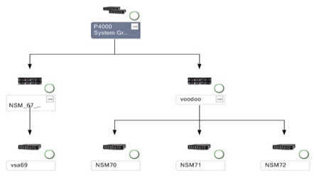
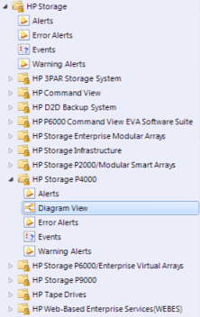
HP Storage Management Pack for SCOM
SCOM 2007
SCOM 2012
HP Storage management in SCOM
Automated installation and discovery
Supports both SCOM 2007 and SCOM 2012
Monitor HP storage directly from SCOM
Events and Alerts for HP Storage hardware
Diagram/Topology Views
Not included with HP Insight Control for System Center
Download from https://h20392.www2.hp.com/portal/swdepot/displayProductInfo.do?productNumber=SCOM
SCVMM 2012 can use SMI-S Providers for storage provisioning of Hyper-V clusters

Slide 14
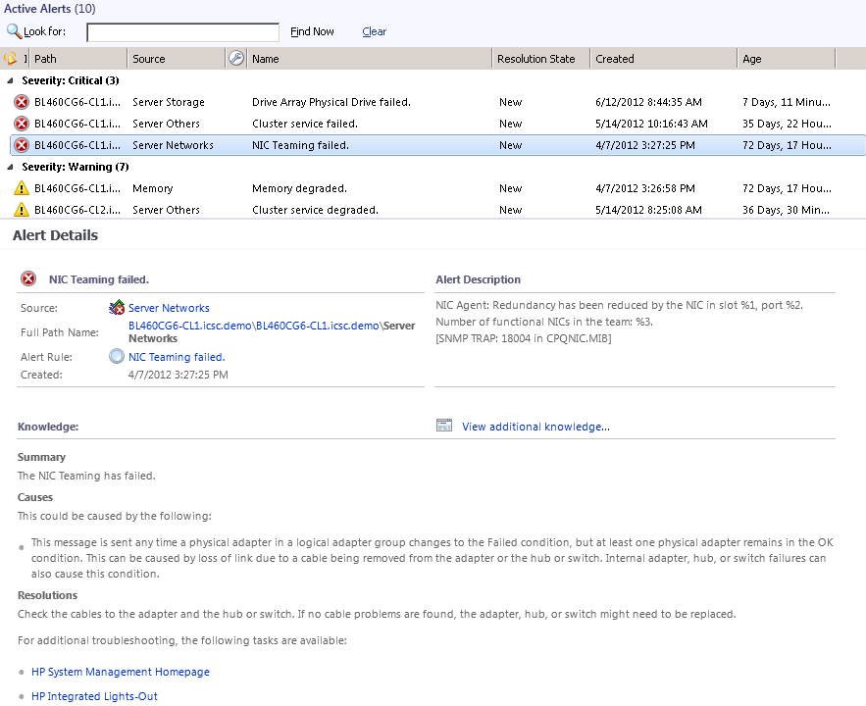
Alert View
SCOM 2007
SCOM 2012
HP hardware alerts generated by SNMP, WBEM, or iLO
Description
Source and time
Knowledge
Resolution with embedded console tasks
Causes
Summary
Provides detailed descriptions about HP hardware alerts

Slide 15
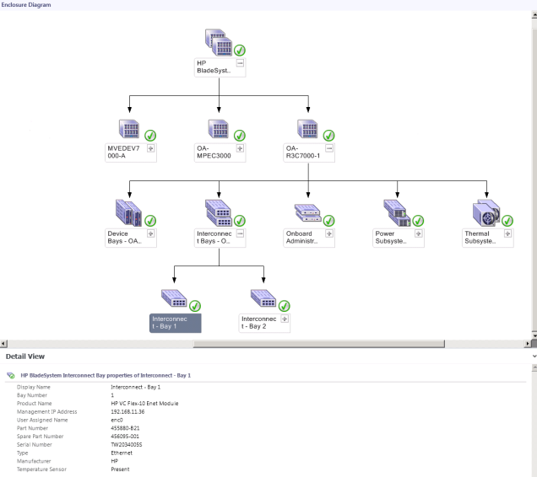
Diagram View
SCOM 2007
SCOM 2012
Graphical display of groups and components
ProLiant servers and subsystems
BladeSystem enclosures and components
Shows group or component roll up health state

Slide 16
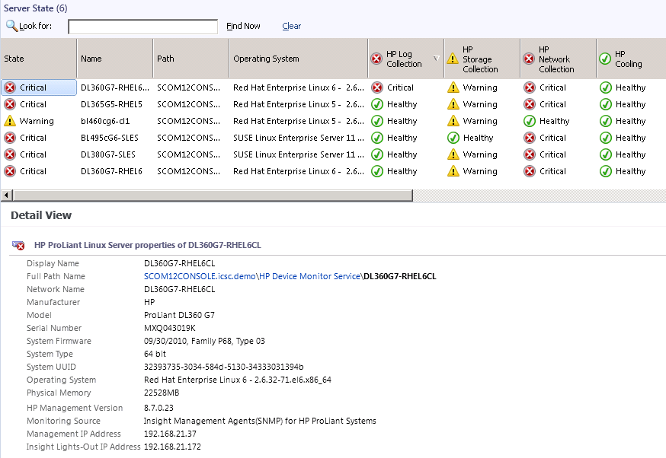
State View
SCOM 2007
SCOM 2012
Health state at a glance
Master state is a roll up of individual components
Customizable and sortable columns

Slide 17
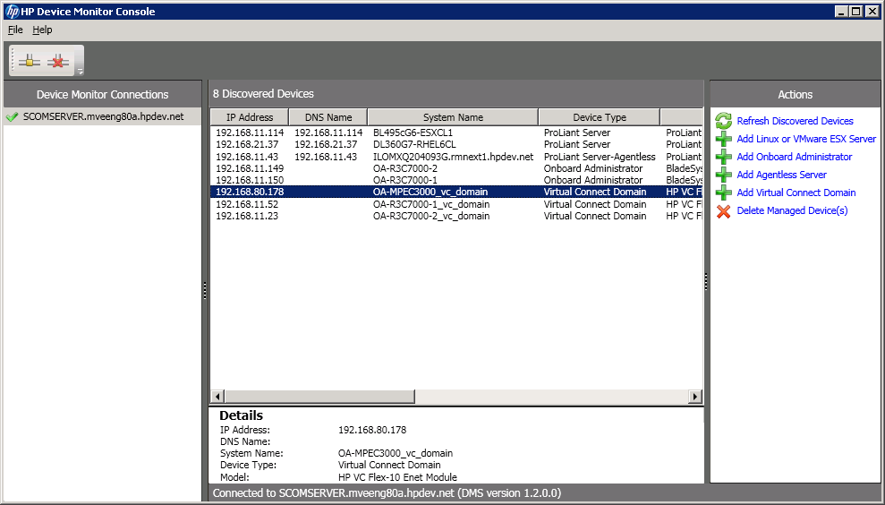
HP Device Monitor Console
SCOM 2007
SCOM 2012
Register non-Windows devices with Device Monitor Service
DMS as acts a proxy for non-Windows devices
Can connect to multiple instances of DMS service
Add/remove devices
Virtual Connect domains
Agentless servers (via iLO)
Linux or VMware ESX servers
BladeSystem Enclosure Onboard Administrator (OA)
Can also add/delete via PowerShell
DMS
instances
Add/Delete
List of registered devices

Slide 18
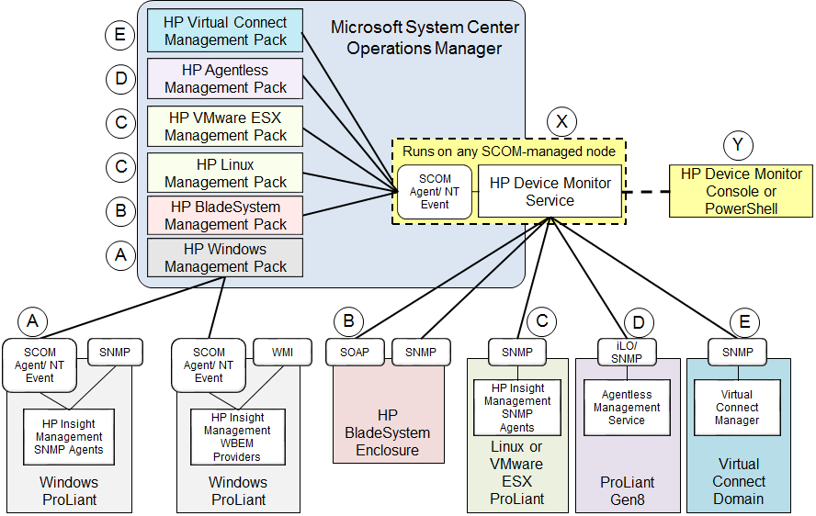
DMS Architecture

Slide 19
HP Insight Control for SCVMM integrations

Slide 20
System Center Virtual Machine Manager Integrations
New
HP SCVMM 2012 Console Kit
HP Fabric Management Add-in provides Virtual Connect visualization from the VM to the network edge in SCVMM
HP SCVMM 2012 Console Kit – New!
HP SCVMM 2012 Integration Kit
HP ProLiant Updates Catalog
HP SCVMM 2012 Integration Kit
Provides HP WinPE and production drivers for ProLiant servers in SCVMM Library
Assists with OS deployment via SCVMM 2012
New servers supported for deployment
ProLiant SL4540 Gen8, SL4545 Gen8
SCVMM Integrations | SCVMM 2012
Fabric Management Add-in* | Y
OS Deployment | Y
HP ProLiant Updates | Y
HP ProLiant Updates Catalog
Simplified Windows driver and firmware updates via a rotating, automated workflow for Hyper-V clusters
*Note: Requires SCVMM 2012 SP1

Slide 21
HP Fabric Management Add-in for SCVMM
SCVMM 2012
Extends view of HP Converged Infrastructure elements which will provide:
Summary view
Diagram view from VM to external switch
Must be installed on each instance of SCVMM console (not on SCVMM server)
Meet Microsoft requirement for SCVMM Add-ins (e.g. SP1 with U1)
Each Virtual Connect domain must be registered
Uses special version of HP DMS
Do not install on a system that has the regular DMS for SCOM management packs
New

Slide 22
Initial launch from SCVMM
SCVMM 2012
New
Launch HP extension
Select physical host

Slide 23
Summary View
SCVMM 2012
New
Launch button
Host Summary
Fabric and Profile
Host VMs

Slide 24
Fabric Diagram View
SCVMM 2012
New
Enclosure/Profile
I/O Module
FlexNICs
Server
vSwitch
VMs
External Switch
Uplink Ports
Downlink Ports
Actions
Launch Tools
iLO Console
iLO Web
VCM Console
OA Console

Slide 25
Fabric Diagram - Complex
SCVMM 2012
New
Click for details

Slide 26
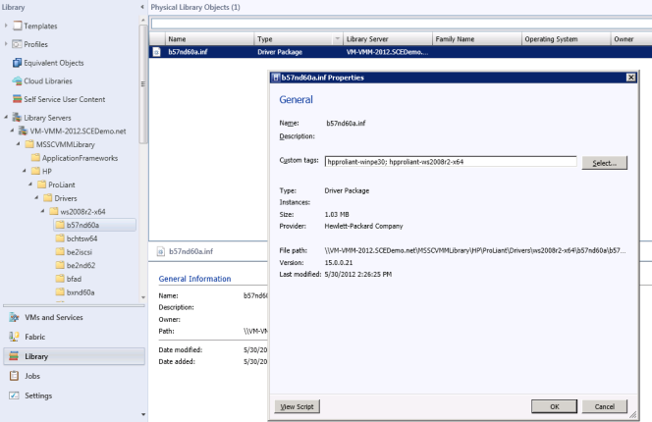
HP SCVMM 2012 Integration Kit
SCVMM 2012
Assists with SCVMM OS deployment
Provides drivers for deploying ProLiant servers (WinPE and production)
Puts drivers into SCVMM Library share
Adds HP default tag names to drivers
Drivers are from HP Service Pack for ProLiant (SPP)
Customers can easily upgrade to the latest drivers by simply installing a newly released integration kit
Ensures latest HP drivers are readily available for SCVMM OS deployment process

Slide 27
HP Storage Management Pack for SCVMM
Managing storage systems within System Center 2012 Virtual Machine Manager
Integration simplifies management of Microsoft Hyper-V environments
Rapidly provision new Virtual Machines
Storage Management
Discovery
Manage HP 3PAR Virtual Volumes
Manage HP 3PAR Snapshots
27

Slide 28
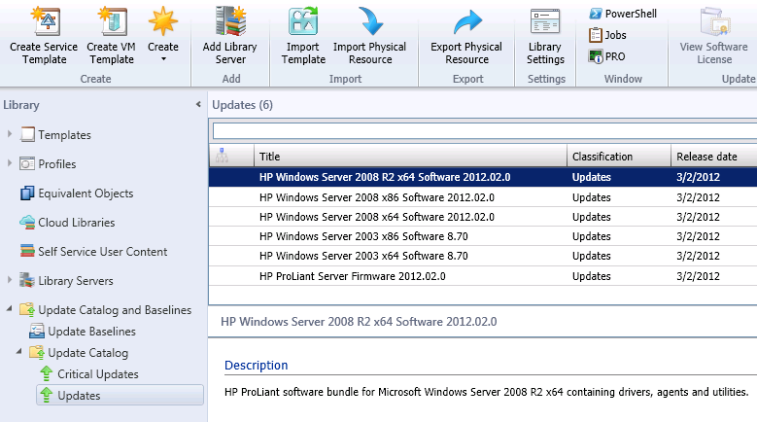
SCVMM and HP ProLiant Updates Catalog
SCVMM 2012
SCVMM driver and firmware updates
SCVMM 2012 can use a Windows Server Update Services (WSUS) server to manage updates for:
Virtual Machine Hosts
SCVMM Library Servers
SCVMM Management Server
PXE Servers
WSUS Servers
Cannot be used for other server roles, VMs, or VHDs
HP ProLiant Updates Catalog integrated into WSUS
For Hyper-V clusters, it performs a rotating update using an automated workflow
Ensures latest HP drivers are readily available for SCVMM firmware and driver updates

Slide 29
HP Insight Control for SCCM integrations

Slide 30
System Center Configuration Manager Integrations
HP SCCM Integration Kits (2007/2012)
OS Deployment feature provides quick and reliable Windows deployment to bare metal HP servers
Inventory Tool provides detailed component level inventory of every managed HP Windows server
HP SCCM 2007 Integration Kit
HP SCCM 2012 Integration Kit
HP ProLiant Updates Catalog
HP ProLiant Updates Catalog
Simplified Windows driver and firmware updates
SCCM Integrations | SCCM 2007 | SCCM 2012
HP ProLiant Updates | Y | Y
OS Deployment | Y | Y
HP Inventory Tool | Y | Y
New Servers supported for deployment
Deployment of Windows Server 2012 to ProLiant G6 servers with SCCM
ProLiant DL360 G6, DL380 G6, BL460 G6, ML350 G6, SL4540 Gen8, SL4545 Gen8

Slide 31
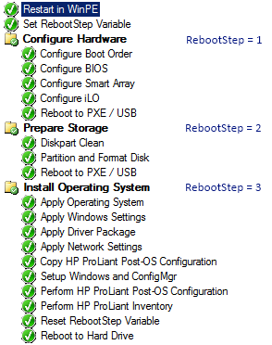
HP OS deployment
SCCM 2007
SCCM 2012
Quickly and reliably deploy bare metal servers
Wizard driven HP deployment task sequence
Includes WinPE image with HP drivers
No manual download and injection of drivers
Thoroughly tested by HP
Supported OSes for deployment
SCCM 2007 – Windows Server 2008 x64, Windows Server 2008 R2
SCCM 2012 – Windows Server 2008 R2
SCCM 2012 SP1 – Windows Server 2008 R2, Windows Server 2012
HP task sequence ensures reliable and consistent OS deployments

Slide 32
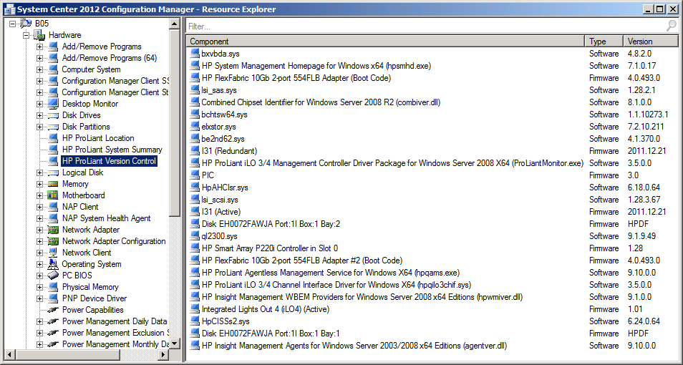
HP Inventory Tool for SCCM 2012
SCCM 2012
Detailed HP hardware and software inventory
Useful for inventory, troubleshooting, and compliance
Runs as part of standard SCCM inventory collection
Viewed through Configuration Manager Resource Explorer
Data available in SCCM SQL database
Customizable reporting fields
Provides detailed HP hardware and software inventory

Slide 33
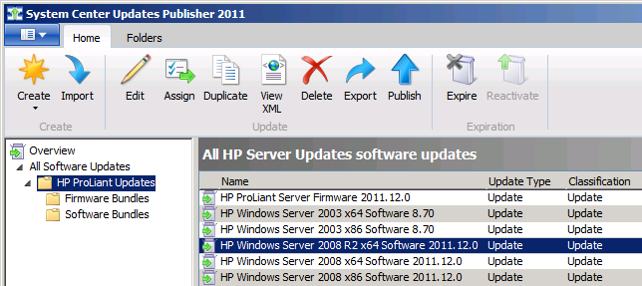
HP ProLiant Updates Catalog
SCCM 2007
SCCM 2012
Server driver and firmware updates
Uses drivers and firmware from HP Service Pack for ProLiant
OS-based driver bundles
Single ProLiant firmware bundle
Replaces PSP-based HP Server Updates Catalog
Download Catalog in SCUP from Microsoft third party partner catalog
Ensure consistency and maximize uptime with simplified driver and firmware updates

Slide 34
Insight Control for Microsoft System Center
Extends the best-managed ProLiant experience for customers who have standardized on a Microsoft
Fully integrated into System Center means one less tool to learn and manage
Increase IT staff efficiency by automating routine tasks and providing faster incident response
Cost savings and improved ROI leaves more time for innovation
All backed by HP 24x7 Technical Support and Software Updates

Slide 35
Summary/call to action
Insight Control for Microsoft System Center 7.3 key updates include support for:
System Center 2012 SP1
Windows Server 2012
Service Pack for ProLiant (SPP) 2013.2.0
Current Insight Control customers with valid support agreement can download the new version at no charge
New customers can download a 60 day trial version (as part of Insight Control trial)

Slide 36
Additional information
HP Insight Control for Microsoft System Center
www.hp.com/go/icsc
Product information
Links to recorded demos
Product download and trial version
Technical documentation

Slide 37
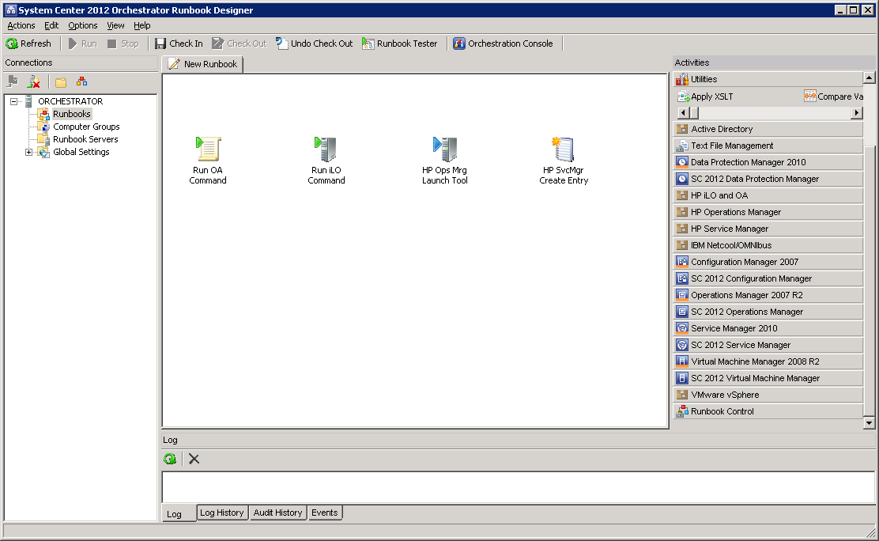
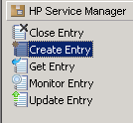
Integrations for System Center Orchestrator 2012
Delivered by Microsoft
Use as Orchestrator runbook tasks
iLO and OA Integration Pack
Manage users, start/stop system, get/set config, manage networking, etc.
http://technet.microsoft.com/en-us/library/hh771475.aspx
HP Service Manager
Retrieve, create, update and monitor tickets in HP Service Manager
http://technet.microsoft.com/en-us/library/hh771464.aspx
HP Operations Manager
Automate the consolidation and correlation of fault and performance events
http://technet.microsoft.com/en-us/library/hh533440.aspx

Slide 38
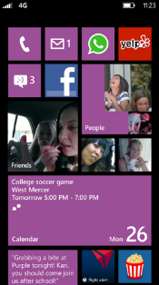
Evaluate this session
Required Slide
*delete this box when your slide is finalized
Your MS Tag will be inserted here during the final scrub.
Scan this QR code to
evaluate this session.

Slide 39
© 2013 Microsoft Corporation. All rights reserved. Microsoft, Windows and other product names are or may be registered trademarks and/or trademarks in the U.S. and/or other countries.
The information herein is for informational purposes only and represents the current view of Microsoft Corporation as of the date of this presentation. Because Microsoft must respond to changing market conditions, it should not be interpreted to be a commitment on the part of Microsoft, and Microsoft cannot guarantee the accuracy of any information provided after the date of this presentation. MICROSOFT MAKES NO WARRANTIES, EXPRESS, IMPLIED OR STATUTORY, AS TO THE INFORMATION IN THIS PRESENTATION.

