Slide 1

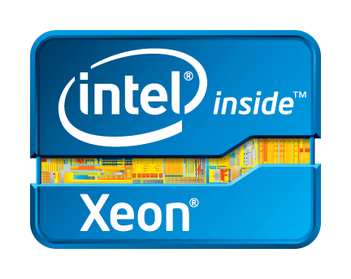
Cisco Nexus 1000V for Hyper-V
Appaji Malla
Sr. Product Marketing Manager
Cloud Networking & Services Group
Cisco Systems Inc.
Cisco UCS with
Intel® Xeon® processors
Intel, the Intel logo, Xeon and Xeon Inside are trademarks or registered trademarks of Intel Corporation in
the U.S. and/or other countries. All other trademarks are the property of their respective owners.

Slide 2
Legal Disclaimer
Many of the products and features described herein remain in varying stages of development and will be offered on a when-and-if-available basis. This roadmap is subject to change at the sole discretion of Cisco, and Cisco will have no liability for delay in the delivery or failure to deliver any of the products or features set forth in this document.

Slide 3
Agenda
Cisco Virtual Networking Vision
Cisco Nexus 1000V (N1KV) Overview
WS2012 & SC2012 SP1 Networking
Cisco N1KV Integration with SC2012 SP1
Cisco Virtual Security Gateway

Slide 4
Agenda
Cisco Virtual Networking Vision
Cisco Nexus 1000V (N1KV) Overview
WS2012 & SC2012 SP1 Networking
Cisco N1KV Integration with SC2012 SP1
Cisco Virtual Security Gateway

Slide 5





Customer Issues in virtualized environments
Operational Complexity
Maturing Hypervisor market
Virtual Services
Public Cloud
Resource Utilization
Managing networks across physical & virtual environments
Economics
Use-cases requiring different hypervisors
Secure virtual environment
Rich network services
Security concerns for public cloud
Mobility concerns
VM Mobility across DC
Mobility across DCs
Mobility across clouds
Consistent Operational Model
Multi-hypervisor Support
Multi-services support with vPath
Multi-cloud support
Overlay Technology Support
Diverse Virtualization Requirements for DataCenter Customers

Slide 6
Physical → Virtual → Cloud Journey
Cisco UCS with
Intel® Xeon® processors
PHYSICAL WORKLOAD
VIRTUAL WORKLOAD
CLOUD
WORKLOAD
One app per Server
Static
Manual provisioning
Many apps per Server
Mobile
Dynamic provisioning
Multi-tenant per Server
Elastic
Automated Scaling
HYPERVISOR
VDC-1
VDC-2
CONSISTENCY: Policy, Features, Security, Scale, Management
Nexus 7K/5K/3K/2K
Nexus 1000V, VM-FEX
WAAS, ASA, NAM
vWAAS, VSG*, ASA 1000V
UCS** for Bare Metal
UCS** for Virtualized Workloads
* Virtual only, ** With Intel® Xeon® processors

Slide 7
Cisco Virtual Networking Vision
Nexus 1000V
Multi-Cloud
Multi-Services
Multi-Hypervisor

Slide 8

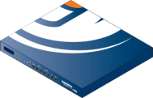



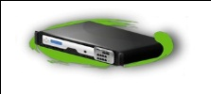



Cisco Cloud Networking Services
Tenant A
Virtualized/Cloud
Data Center
Imperva
SecureSphere
WAF
ASA 1000V
Cloud
Firewall
Cisco Virtual Security Gateway
Cloud Services Router 1000V
Citrix
NetScaler
VPX
Servers
vWAAS
WAN Router
Switches
Zone A
Zone B
Physical Infrastructure
vPath
Nexus 1000V
Multi-Hypervisor (VMware, Microsoft,….)
Nexus 1000V
VSG
ASA 1000V
vWAAS
CSR 1000V
(Cloud Router)
Ecosystem
Services
Distributed switch
NX-OS consistency
VM-level controls
Zone-based FW
Edge firewall, VPN
Protocol Inspection
WAN optimization
Application traffic
WAN L3 gateway
Routing and VPN
Citrix NetScaler VPX virtual ADC
Imperva Web App. Firewall

Slide 9


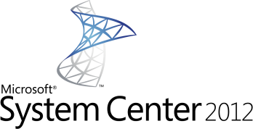
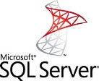


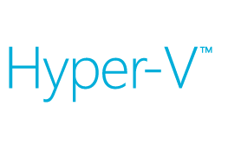

Cisco Delivers Optimum IT Infrastructure For Your Microsoft Windows Server 2012 Environment
Compute
Networking
Manageability
Cisco Unified Computing (UCS) with Intel® Xeon® processor
Cisco Nexus 1000V
Cisco UCS VM-FEX
Cisco UCS Manager
Cisco UCS PowerTool
Certified for various Microsoft applications
Cisco UCS with
Intel® Xeon® processors

Slide 10
Agenda
Cisco Virtual Networking Vision
Cisco Nexus 1000V (N1KV) Overview
WS2012 & SC2012 SP1 Networking
Cisco N1KV Integration with SC2012 SP1
Cisco Virtual Security Gateway

Slide 11



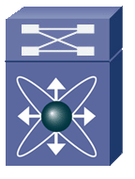
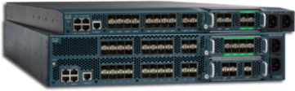
Cisco Virtual Networking Solutions
Cisco Nexus 1000V and UCS VM-FEX
Cisco UCS with
Intel® Xeon® processors
Bring network to the hypervisor
(Cisco Nexus 1000V Switch)
Bring VM awareness to physical network
(Cisco UCS VM-FEX)
Windows Server 2012
Hyper-V
Windows Server 2012
Hyper-V
Cisco Nexus 1000V
UCS VIC
Adapter
UCS
Server
VM-FEX
Server
UCS
Fabric Inter-connect
IEEE 802.1Q Network

Slide 12
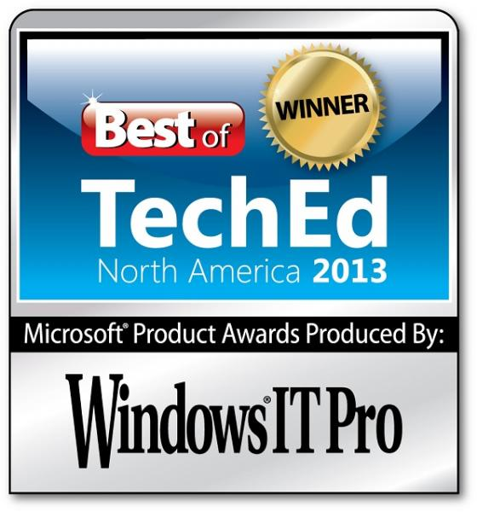
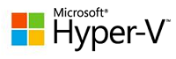
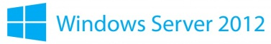
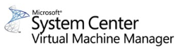
Cisco Nexus 1000V
Award Winning Networking Platform for Hyper-V
Advanced NX-OS feature-set
Innovative Services architecture (vPath)
Consistent operational model
SCVMM Integration
VM
VM
VM
VM
Extensible vSwitch
VNICs
Nexus 1000V VSM
Nexus 1000V VEM
Forwarding
Capture
Filtering
PNICs

Slide 13
Cisco Nexus 1000V Architecture
Consistent across physical & virtual environments
Virtual Appliance
Network
Admin
VSM-1 (active)
NX-OS
Control Plane
VSM-2 (standby)
Supervisor-1 (Active)
Supervisor-2 (StandBy)
Back Plane
Linecard-1
Linecard-2
…
NX-OS
Data Plane
Linecard-N
Modular Switch
VEM-1
VEM-2
VEM-N
WS 2012 Hyper-V
WS 2012 Hyper-V
WS 2012 Hyper-V
VSM: Virtual Supervisor Module
VEM: Virtual Ethernet Module
Server
Admin

Slide 14
Cisco Nexus 1000V Features
Switching
L2 Switching, 802.1Q Tagging, Rate Limiting (TX)
IGMP Snooping, QoS Marking (COS & DSCP)
Policy Mobility, Private VLANs w/ local PVLAN Enforcement
Access Control Lists (L2–4 w/ Redirect), Port Security
Dynamic ARP inspection*, IP Source Guard*, DHCP Snooping*
Security
Network Services
Virtual Services Datapath (vPath) support for traffic steering & fast-path off-load [leveraged by Virtual Security Gateway (VSG) and other services]
Provisioning
Full integration with System Center – VM Manager (SCVMM)
Faster network policy provisioning through port profiles
Live Migration Tracking, NetFlow v.9 w/ NDE, CDP v.2
VM-Level Interface Statistics
SPAN & ERSPAN (policy-based)
Visibility
VM Network Provisioning (port-profiles), CiscoWorks, Cisco DCNM
Cisco CLI, Radius, TACACs, Syslog, SNMP (v.1, 2, 3)
Hitless upgrade, SW Installer
Management
* Only with Advanced Edition

Slide 15
Port Profiles: Faster VM Deployment
Cisco Virtual Networking
Policy-Based
VM Connectivity
Mobility of Network and Security Properties
Non-Disruptive
Operational Model
Port Profiles
Defined Policies
WEB Apps
HR
DB
DMZ
VM
VM
VM
VM
VM
VM
VM
VM
Nexus
1000V
VEM
Nexus
1000V
VEM
Hypervisor
Hypervisor
VM Connection Policy
Defined in the network
Applied in SCVMM
Server
Server
VM Mgmt Station
Nexus 1000V VSM
Notes:
15

Slide 16
Port Profiles: Policy Mobility
Cisco Virtual Networking
Policy-Based
VM Connectivity
Mobility of Network and Security Properties
Non-Disruptive
Operational Model
VM
VM
VM
VM
VM
VM
VM
VM
VM
VM
VM
VM
VMs Need to Move
VM Migration
Resource Scheduling
SW upgrade/patch
Hardware failure
Nexus
1000V
VEM
Nexus
1000V
VEM
Hypervisor
Hypervisor
VM Networking
Mobility
Live Migration
Ensures VM security
Maintains connection state
Server
Server
VM Mgmt Station
Nexus 1000V VSM
Notes:
16

Slide 17
Cisco Nexus 1000V Pricing
Tiered Licensing – Essential & Advanced Editions
 | Essential ($0) | Advanced ($695/cpu)
VLANs, ACL, QoS |  | 
vPath |  | 
LACP |  | 
Multicast |  | 
Netflow, SPAN, ERSPAN |  | 
Management (SNMP etc.) |  | 
SCVMM Integration |  | 
DHCP Snooping |  | 
IP Source Guard |  | 
Dynamic ARP Inspection |  | 
Virtual Security Gateway** |  | 
** Only supports network-attributes

Slide 18
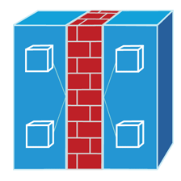
Cisco Nexus 1100 Series
Consistent architecture across hypervisors
Nexus 1100 Series
VSM
VSG
NAM
VSG
VSM
VEM-1
VEM-2
VEM-1
VEM-2
vPath
vPath
vPath
vPath
VMware ESX
VMware ESX
Hyper-V
Hyper-V
Existing Nexus 1010 will support multi-hypervisor environments

Slide 19
Frequently Asked Questions
Does Nexus 1000V work with all versions of Hyper-V?
  N1KV requires Windows Server 2012 and System Center Virtual Machine Manager 2012 SP1.
Is Cisco Virtual Security Gateway (VSG) available for Hyper-V?
  Yes. VSG comes bundled with the advanced edition of N1KV.
Can the same Nexus 1000V manage both ESX & Hyper-V?
  No. Separate N1KV switches should be deployed for different hypervisor environments.

Slide 20
Agenda
Cisco Virtual Networking Vision
Cisco Nexus 1000V (N1KV) Overview
WS2012 & SC2012 SP1 Networking
Cisco N1KV Integration with SC2012 SP1
Cisco Virtual Security Gateway

Slide 21
Microsoft SCVMM Networking Concepts
Multiple user-defined constructs
Logical Networks
Network Sites
VM Networks
Port Classification
IP-Pools

Slide 22


Microsoft SCVMM Networking Concepts
Logical Networks & Network Sites
Logical Network
Madrid
Barcelona
Host1
Host2
Host3
Host4
Host5
Host6
Network Site1
Network Site2
Network Site3
VM
VM
VM
VM
VM
VM
VM
VM
VM
VM
VM
VM
VM
VM
VM
VM
VM
VM
Logical Network represents a network with a certain type of connectivity characteristics (for eg. DMZ network, intranet, isolation)
An instantiation of a Logical network on a set of host-groups (for eg. hosts in a POD) is called a network-site

Slide 23
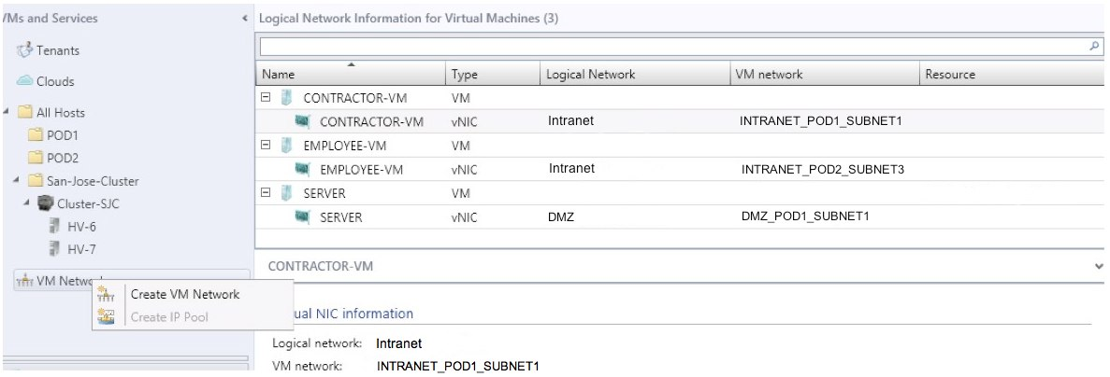
Microsoft SCVMM Networking Concepts
VMs are bound to VM Networks
VM Networks can be backed by either VLANs or other overlay networks (e.g. NVGRE segments). The first release of the Cisco Nexus 1000V Switch only supports VLAN-backed VM-networks.

Slide 24
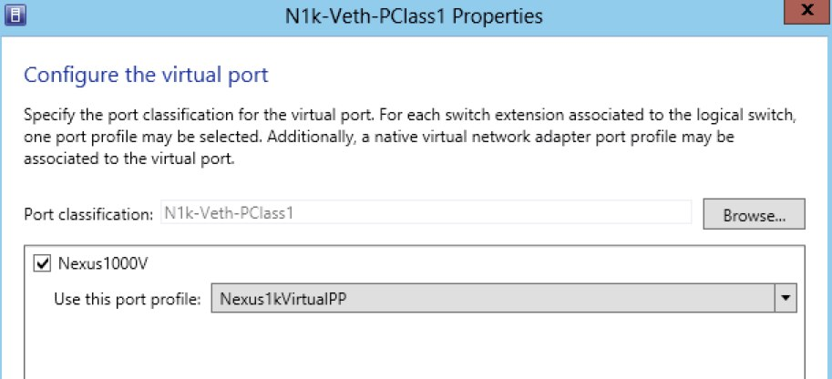
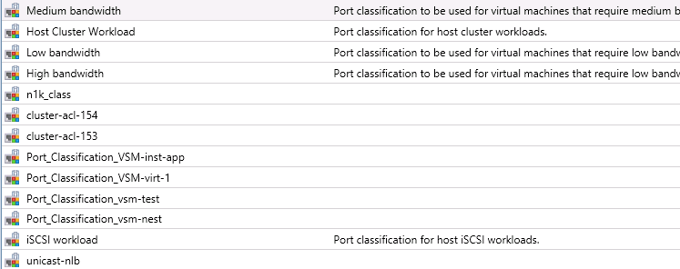
Microsoft SCVMM Networking Concepts
Port-Classifications
VM
VM
VM
VM
Extensible vSwitch
VNICs
Forwarding
Bundling of profiles from each extension is the port-classification
Capture
Filtering
PNICs

Slide 25
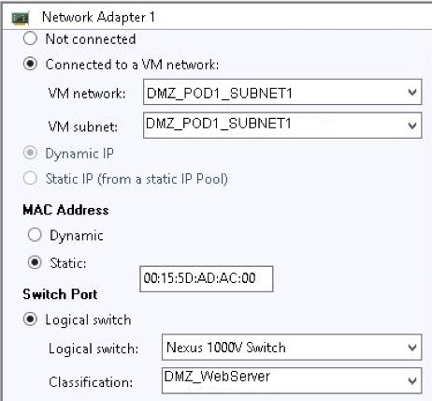
Microsoft SCVMM Networking Concepts
Associating VM VNICs to VM Networks & Port-classifications
Choose network
  VM Network
  VM Subnet is tied to the Network (1:1)
Choose IP address type
  Can be dynamic (DHCP) or statically assigned
  Choose IP pool for static IPs
Choose Port Profile Classification
  Policy (QoS, Security, Monitoring)
  A Classification refers to a Port Profile

Slide 26
Microsoft SCVMM Networking Concepts
Putting everything together
Logical Network ‘DMZ’
Port-profiles
Privileged Client
Clients
Guests
Servers
Intranet Client
VM
VM
VM
VM
VM
VM
VM
Guest Access
Application Server
DMZ_Pod1_Subn1
DMZ_Podz2_Subnet1
Network-site ‘DMZ_POD1’
Network-site ‘DMZ_POD2’
DMZ_Pod1_Subn2
DMZ_Pod2_Subnet2
IP-Pool1
DMZ_Pod1_Subn3
DMZ_Pod2_Subnet3
IP-Pool4
IP-Pool2
IP-Pool5
IP-Pool3
IP-Pool6

Slide 27
Agenda
Cisco Virtual Networking Vision
Cisco Nexus 1000V (N1KV) Overview
WS2012 & SC2012 SP1 Networking
Cisco N1KV Integration with SC2012 SP1
Cisco Virtual Security Gateway

Slide 28
Cisco Nexus 1000V Terminology
SCVMM Terminology | Cisco Nexus 1000V Terminology
Logical Networks | Logical Networks
Network Sites | Network Segment Pools
VM Network Definitions | Network Segments
IP-Pools | IP-Pools & IP-Pool Templates
Port-Classifications | Port-profiles

Slide 29
Cisco Nexus 1000V for Hyper-V
Defining “Network sites” and “VM Networks”
nsm logical-network DMZ
# nsm network-segment-pool DMZ_POD1
# member-of logical network DMZ
# nsm network-segment DMZ_POD1_SUBNET1
member-of network segment pool DMZ_POD1
switchport mode access
switchport access vlan 20
ip-pool import template DMZ_POD1_Pool1
# nsm network-segment DMZ_POD1_SUBNET2
member-of network segment pool DMZ_POD1
switchport mode access
switchport access vlan 21
ip-pool import template DMZ_POD1_Pool2
# network-segment DMZ_POD1_SUBNET3
member-of network segment pool DMZ_POD1
switchport mode access
switchport access vlan 22
ip-pool import template DMZ_POD1_Pool2
Logical network “DMZ”
Network Site “DMZ_POD1”
VM Network DMZ_POD1_SUBNET1
VM Network DMZ_POD1_SUBNET2
VM Network DMZ_POD1_SUBNET3

Slide 30

Cisco Nexus 1000V for Hyper-V
Operational Model with SCVMM
SCVMM manages the placement and live-migration of the VMs based on the constraints between VM networks and the network sites.
VM
VM
VM
VM
4
Server
Admin
Nexus
1000V
VEM
SCVMM
3
Adds hosts to N1KV
Connects VMs (VNICs) to VM Networks
WS 2012 Hyper-V
5
2
Networks & policies synced to SCVMM
Configuration data and
policies sent to N1KV VEM
Server
1
Network
Admin
Create networks and policies (logical networks, network sites, VMnetworks)
Nexus 1000V
VSM

Slide 31
Cisco Nexus 1000V REST API Support
URI: http://<VSM-IP-address>/api/<object-locator>
CRUD Operations through VSM RESTful APIs
Create an object* | HTTP POST
Read an object | HTTP GET
Update an object | HTTP POST
Delete an object | HTTP DELETE
*Objects can be VM networks, Port-profiles, IP-Pools etc.
Write/Update Operations are only supported on limited set of objects
Construct the URL using the above template
Arguments are passed to APIs in JSON format
Use a web-browser or Powershell to query VSM
Parse XML response to get the required information

Slide 32
Cisco Nexus 1000V for Hyper-V
Accessing N1KV with Powershell 3.0
Basic Parameters Required for API Calls
CREATE Object
$User = "admin"
$Password = ConvertTo-SecureString –String "Secret123" –AsPlainText -Force
$VSMIPaddress = "10.105.228.108"
$URI = "http://"+ $VSMIPaddress + “/api/”
$Credentials = New-Object –TypeName System.Management.Automation.PSCredential –ArgumentList $User, $Password
#Create IP-Pool on Nexus 1000V - HTTP POST
$IPPURI=$URI +"hyper-v/ip-address-pool"
$IPPArg = '{"name":"pool1", "addressRangeStart":"192.168.0.2", "addressRangeEnd":"192.168.0.16"}‘
ConvertFrom-Json -InputObject $IPPArg
Invoke-RestMethod -Uri $IPPURI -Credential $Credential -Method Post -Body $IPPArg
UPDATE Object
READ Object
#Update IP-Pool Information - HTTP POST
$IPPURI=$URI +"hyper-v/ip-address-pool/pool1"
$IPPArg = '{ "addressRangeStart":"192.168.0.5", "addressRangeEnd":"192.168.0.20"}‘
ConvertFrom-Json -InputObject $IPPArg
Invoke-RestMethod -Uri $IPPURI -Credential $Credential -Method Post -Body $IPPArg
#Read VSEM Information - HTTP GET
$VersionURI = $URI + "/api/hyper-v/vsem-system-info“
Invoke-RestMethod -Uri $VersionURI -Credential $Credential -Method Get -Outfile testout.xml
DELETE Object
#$VMNURI = $URI +"hyper-v/vm-network-definition/vmn4"
$VMNArg = '{"name":"VMN4"}‘
ConvertFrom-Json -InputObject $VMNArg
Invoke-RestMethod -Uri $VMNURI -Credential $Credential -Method Delete -Body $VMNArg

Slide 33
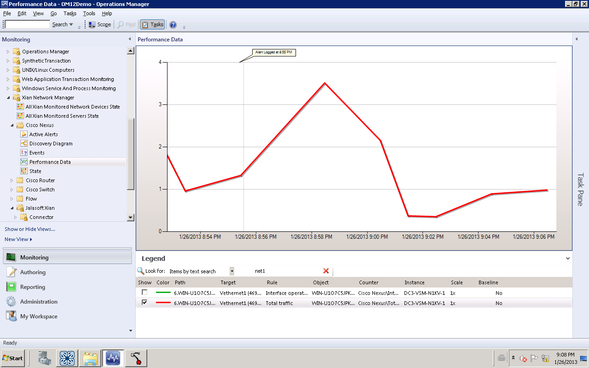
Cisco Nexus 1000V for Hyper-V
SCOM Plugin from Jalasoft
Xian SCOM Plugin for Nexus 1000V
Monitors various metrics:
  Availability (ICMP and SNMP)
  TCP Connections
  Uptime
  Traffic, total, error etc.
  Bandwidth

Slide 34
Agenda
Cisco Virtual Networking Vision
Cisco Nexus 1000V (N1KV) Overview
WS2012 & SC2012 SP1 Networking
Cisco N1KV Integration with SC2012 SP1
Cisco Virtual Security Gateway

Slide 35
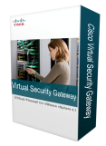





Defense in Depth Security Model
VM
VM
VM
VM
Virtual Security
Policy applied to VM zones
Dynamic, scale-out operation
VM context based controls
VSG
Segment internal network
Policy applied to VLANs
Application protocol inspection
Virtual Contexts
Internal Security
ASA-SM
ASA 55xx
Internet
Edge
Filter external traffic
Extensive app protocol support
VPN access, Threat mitigation
ASA 55xx

Slide 36



Cisco Virtual Security Gateway (VSG)
Context-based, Multi-tenant, Workload Segmentation
Cisco VSC
VM
VM
VM
VM
VM
VM
VM
VM
VM
VM
VM
VM
VM
VM
VM
VM
VM
VM
VM
Nexus 1000V
Distributed Virtual Switch
vPath
VSG
(active)
Secure Segmentation
(VLAN agnostic)
Efficient Deployment
(secure multiple hosts)
Dynamic policy-based provisioning
Transparent Insertion
(topology agnostic)
High Availability
Mobility aware
(policies follow Migration)
Log/Audit
VSC: Virtual Services Controller

Slide 37


Cisco Virtual Security Gateway
Intelligent Traffic Steering with vPath
VM
VM
VM
VM
VM
VM
VM
VM
VM
VM
VM
VM
VM
VM
VM
VM
VM
VM
VM
Virtual Security Gateway (VSG)*
4
Nexus 1000V
Distributed Virtual Switch
vPath
Decision
Caching
3
2
Flow Access Control
(policy evaluation)
Initial Packet
Flow
1
Log/Audit
* First version only supports network attributes

Slide 38
Cisco Virtual Security Gateway
Performance Acceleration with vPath
VM
VM
VM
VM
VM
VM
VM
VM
VM
VM
VM
VM
VM
VM
VM
VM
VM
VM
VM
Virtual Security Gateway (VSG)*
Nexus 1000V
Distributed Virtual Switch
vPath
ACL offloaded to
Nexus 1000V
(policy enforcement)
Remaining packets from flow
Log/Audit
* First version only supports network attributes

Slide 39
Summary

Slide 40
Cisco Nexus 1000V: Customer Benefits
Consistent
Networking Features
  NX-OS feature across multiple hypervisors & across physical
  Advanced NX-OS switching features, including security, visibility, QoS, segmentation, port channel, …
Consistent
Operational Model
  NX-OS CLI across multiple hypervisors & across physical
  Separation of duties between network & server admins
  Dynamic provisioning and VM mobility awareness
  Leverage existing monitoring and management tools
Consistent
Network Services
  Leverage existing virtual services
    Virtual Security Gateway, Virtual WAAS, Virtual ASA, NAM on Nexus 1010
  Services can be hosted on Nexus 1010

Slide 41
Start using Cisco Nexus 1000V today
Essential Edition – No licensing or procurement needed
Download Software from cisco.com
(go/1000v/hyper-v)
Install N1KV
Using Installer App
Create Port Profiles
& Start Using N1KV
Advanced Edition – you can get a free trial for 60 days when you use essential
Download Software
from cisco.com (go/1000v/hyper-v)
Install Nexus 1000V
Using Installer App
Change Switch mode to Advanced*
& Start Using N1KV

Slide 42
Additional Resources
Cisco Nexus 1000V for Microsoft Hyper-V: http://www.cisco.com/go/1000v/hyper-v
Cisco Nexus 1000V (N1KV): http://www.cisco.com/go/1000v
Cisco Virtual Security Gateway: http://www.cisco.com/go/vsg
Cisco N1KV Portfolio: http://www.cisco.com/go/1000v
N1KV Powershell Cmdlets: http://developer.cisco.com/web/n1k/hyperv
Cisco-Microsoft Partnership: http://www.cisco.com/go/microsoft

