Slide 2
HP Cloud Solutions for Microsoft
WAD-B291
Paul Gavin HP Training Manager
Joe Sullivan HP Engineering Manager

Slide 3

Agenda
    Design challenges for building a Microsoft private cloud
    Solving the challenges with HP VirtualSystem VS3 for Microsoft®
    HP VirtualSystem product architecture overview
    HP VirtualSystem benefits
    Conclusion
    Q&A

Slide 4

The world has changed
Major technology innovations
  Then
    Predictable workloads
    Physical computing
  Traditional IT
    Project-driven
    Focus on servicing and maintaining technology in non-standard, non-shared environments
    Predominately manual activities
    Management by walking around
    Security
  Now
    Virtualization
    IT-as-a-Service
    Bring your own
    device, mobility

Slide 5


Maturing your capabilities with HP Converged Cloud
Moving from servers to services
Become a service broker
in a hybrid environment
Self-service applications with full lifecycle management
Self-service infrastructure
Virtualize and automate
Standardize and consolidate
IT transformation to “strategic service broker”

Slide 6




Implementing a Private Cloud
  Cloud
    Service-driven via Self Service Portal
    Scalable and Elastic
    High degree of automation
    Show/Charge back capabilities
HP Converged
Cloud
Private cloud
Public cloud
Managed cloud

Slide 7
HP Converged Infrastructure—transforming the industry
2013
Next generation HP Converged Systems portfolio
2012
HP CloudSystem optimized for partners
HP AppSystems for Information Optimization
Launched HP CloudSystems,
HP VirtualSystems and HP AppSystems
2011
2010
Appliances for Microsoft SQL Server
Introduced HP Converged Infrastructure (CI)
enabled by CI sizers and CI reference architectures (RAs)
2009

Slide 8
HP Converged Cloud solution choices for Microsoft
HP Converged Cloud for Microsoft
HP Cloud Solution for Microsoft
HP CloudSystem
optimized for Microsoft
When standardizing on Microsoft management for cloud environments:
When standardizing on CloudSystem Matrix for IAAS :
VS3 v2.2 for Microsoft configurations
Factory Express
WS2012 /SC2012SP1+
HP technical Services
CloudSystem Matrix Starter Kit
Factory Express +HP Cloud Map for Microsoft Hyper-V Cluster Server Autoflexing
WS2012/SC2012SP1 +
HP Technical Services

Slide 9
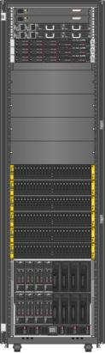
The HP and Microsoft solution: HP VirtualSystem VS3 for Microsoft
Increases reliability and simplifies deployment
    Certified Microsoft Private Cloud Fast Track configuration
    Integrates with your existing environment
    Accelerates your journey to the cloud
HP VirtualSystem VS3 for Microsoft

Slide 10
Architecture and Design Details

Slide 11
VS3 Architecture Design Goals
Multiple design models
Flexible and Scalable
Highly Available by design
DR expandability
Designed for virtualization
  Workload drives technology

Slide 12
VS3 v2.2 configuration design models
Designed for flexible scalability and growth
Single-rack design
    Provides an integrated rack with compute, storage, network, and management resources
    Provides better utilization of data center floor space
    Provides a more cost effective, lower entry price point option
Multi-rack design
    Provides a seamless scaling option for resource growth
    Provides a common building block design from a build perspective
    Provides more flexibility in scaling server and storage independently and enabling multi-enclosure high availability designs
    Conforms to split row customer data center designs

Slide 13
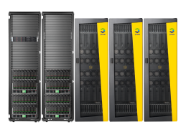


VS3 v2.2 for Microsoft configurations
Designed to grow as your needs grow
Configuration/growth options
    Scale from 4–16 blades
    Scale from 24–240 drives with different mix of SSD/NL/SAS as needed
    Scales across HP StoreServe 3PAR 7000 series storage options
    HP Virtual Connect FlexFabric
    HP Networking 5000 series switches
Configuration/growth options
    Scale from 4–64 blades across two compute racks
    Scale from 24–480 drives (mix of SSD/NL/SAS) in storage rack
    HP StoreServe 3PAR 7400 Storage option
    HP Virtual Connect FlexFabric
    HP Networking 5000 series switches
Configuration/growth options
    Scale from 8–64 blades across two compute racks
    Scale across HP StoreServe 3PAR 10000 series storage options
    HP Virtual Connect FlexFabric
    HP Networking 5000 series switches

Slide 14
Base VS3 VM Sizing Ranges
Single Rack | Min | Max
Total Number of VMs* | 256 | 1024
Blades | 4 | 16
Total Physical Cores | 64 | 256
Total Memory (GB) | 1024 | 4096
Array Drive Cages | 2 | 10
IOPS/VM** | 33 | 41
Multi-Rack | Min | Max
Total Number of VMs* | 512 | 4096
Blades | 8 | 64
Total Physical Cores | 128 | 1024
Total Memory (GB) | 2048 | 16384
Array Drive Cages | 6 | 20
IOPS/VM** | 50 | 21***
* Total VMs based on assumptions outline in the notes
** Based on a single tier of 300GB 15k SAS drives (fully populated cages)
*** To achieve higher IOPS per VM in the maximum configuration an SSD tier is required (This is included in the default recommended whiteboards)

Slide 15
HP VirtualSystem - Highly available by design
  Designed from the ground up to be fully redundant
    N+N power redundancy
      Designed to handle the loss of a power feed to the rack
    Complete network redundancy leveraging IRF technology
    Redundant compute nodes configured as a Microsoft Windows Server 2012 failover cluster
    Redundant management servers configured as a Microsoft Windows Server 2012 failover cluster
    Storage fabric redundancy
    Redundancy built into HP StoreServ technology

Slide 16

HA - Network Design Logical View
Virtual Machines
Hyper-V Virtual NICs
Production
Hyper-V Virtual Switches
Management
Hyper-V Virtual FC Switch
Fabric A
Fabric B
Network Team Instances
Team
Management
Team
Production
••••••••
HP Virtual Connect
Flex-NICs (4 Channels)
CSV
Live Migration
HP Flex-Fabric LOM and Mezz – 4 Ports

Slide 17
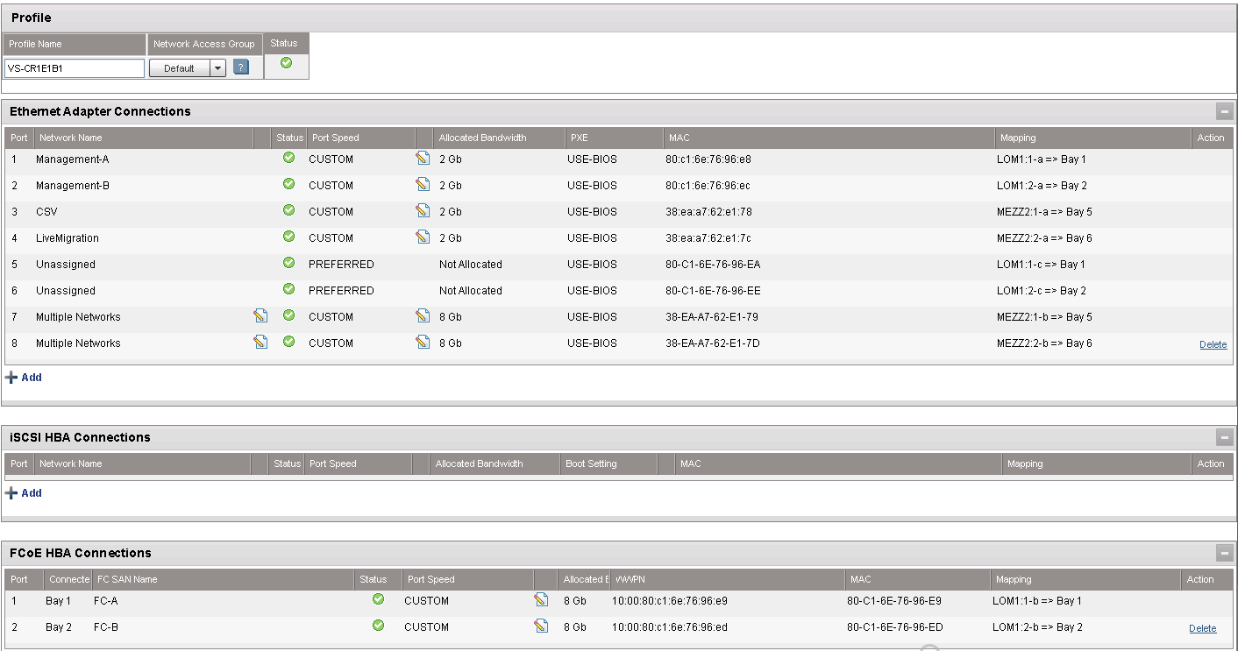
Virtual Connect Server Profile

Slide 18
HP VirtualSystem - Extensible to support a range of disaster recovery options
  Disaster-recovery driven:
    By required recovery time objectives and recovery point objectives
  Architected for extensibility and support for a wide range of disaster recovery scenarios:
    Operating system and application-level disaster recovery
      Hyper-V replica
      Application mirroring (SQL Always-On Failover, Exchange DAGs, etc.)
      Host-based replication solutions
    Hardware-based disaster recovery
      HP StoreServ Remote Copy and Replication Suite
      HP StoreServ geo-clustering with CLX

Slide 19
Deeply integrated management

Slide 20
Primary VS3 software components
    Microsoft Windows Server 2012 Data Center edition*
    Microsoft System Center 2012 SP1⁴
    HP Insight Control for System Center management packs
    HP Storage Management Pack for System Center Operations Manager
    HP 3PAR StoreServ software suites
      Default – Operating System Suite (includes Thin Provisioning)
      Optional – Replication Suite, Data Optimization Suite, Reporting Suite, Security Suite, and Application Suite
    Certified HP firmware/driver package for VS3 components based on HP Service Pack for ProLiant releases
    ^{4,} Licenses not part of VS3 SKU; must be purchased separately

Slide 21
Microsoft System Center 2012 SP1
Orchestration run book automation and integration
CMDB, incident, problem, release management, and service request
Virtual workload provisioning, multi- hypervisor, and cloud management, self-service
Backup and disaster recovery
Performance, health, network, application monitoring, and best practices
OS/software deploy, patching and settings management, security, and third-party OS

Slide 22
HP Virtual System VS3 management cluster
  Separate management fabric cluster
    Hosting System Center and HP management VMs
  2 x HP ProLiant DL360p Servers in compute rack
    Second pair of management servers in second compute rack is optional
  Management VMs, based on FT v3 requirements for features, performance, and availability
    SQL Server 2012 Failover Cluster (x2)
    System Center Virtual Machine Manager (x2)
    System Center Operations Manager and Reporting Server (x3)
    System Center Service Manager, Portal, DW (x4)
    System Center Orchestrator (x2)
    System Center App Controller (x1)
    Additional VMs as necessary for other management tasks
    3PAR management
    Reporting Server
    Etc.

Slide 23
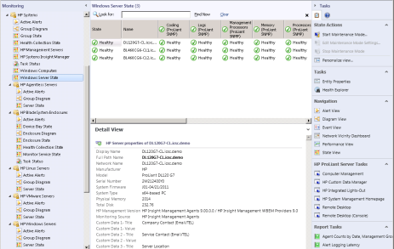
HP Insight Control for Microsoft System Center
  Brings the native manageability of HP hardware to System Center environments
    Ideal for customers who have standardized on Microsoft System Center as their management platform
    Licensed and included with HP Insight Control
    Integrate directly into System Center consoles
      SCOM
      SCVMM
      SCCM
Provides comprehensive system health, configuration management,
and software deployment capabilities

Slide 24
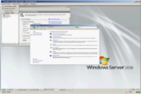
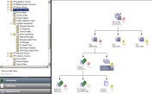

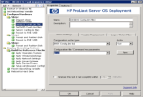
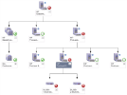

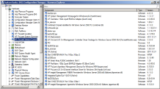
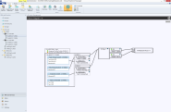
Power of Insight Control delivered to System Center
Comprehensive
health monitoring
IC 7.3
Virtual Connect
Agentless Gen8
Windows
Linux
Microsoft System Center
Blade enclosures
Bare metal OS deployment
Total remote control via iLO Advanced
Provides comprehensive system health, configuration management,
and software deployment
Driver and
firmware updates
Virtual Connect Fabric Visualization
Detailed HP inventory
IC 7.3

Slide 25
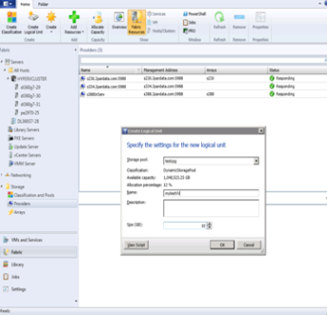
Microsoft System Center-VMM integration
SMI-S providers
  Integration simplifies management of Microsoft Hyper-V environments
    Rapidly provision new virtual machines
    Manage the storage ecosystem
      Discovery
      HP 3PAR Virtual Volumes
      HP 3PAR Snapshots

Slide 26
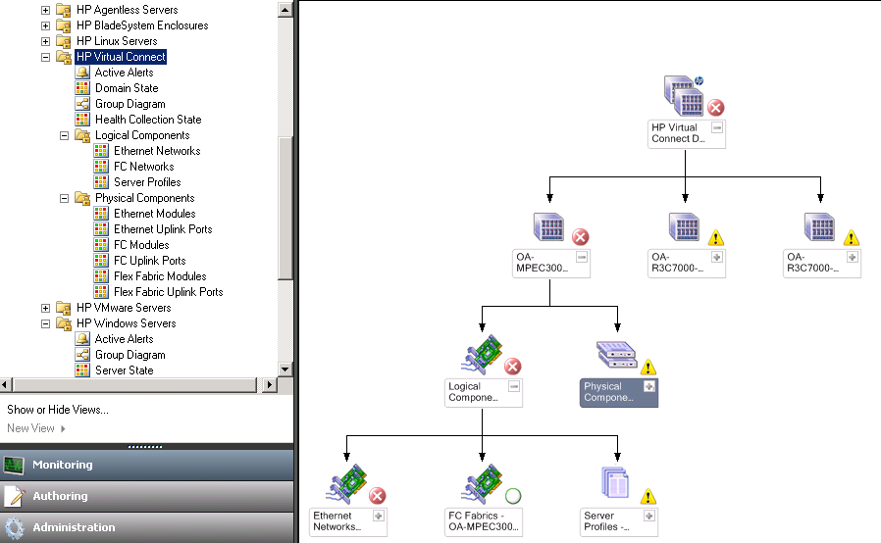
Virtual Connect Management Pack
Extends Converged Infrastructure support
Provides health monitoring and alerting
    Domain State view
    Diagram views
    Logical component monitoring
      Ethernet networks
      Fibre Channel networks
      Server Profiles
    Physical component monitoring
      Ethernet modules and uplink ports
      Fibre Channel modules and uplink ports
      FlexFabric modules and uplink ports
New

Slide 27

Fabric Diagram View
SCVMM 2012
New
Enclosure/Profile
I/O Module
FlexNICs
Server
vSwitch
VMs
External
Switch
Uplink Ports
Downlink
Ports
Actions
Launch Tools
iLO Console
iLO Web
VCM Console
OA Console

Slide 28
Built for the Microsoft cloud

Slide 29
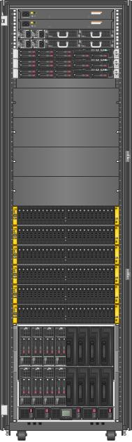
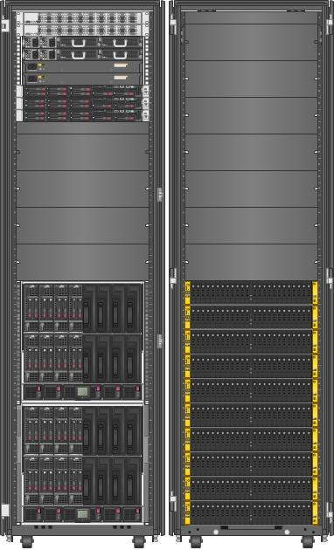
HP Cloud Solution for Microsoft powered by HP VirtualSystem
Microsoft Private Cloud Fast Track certified solution
HP VirtualSystem options
Configuration details
    Flexible compute and storage design model to scale with business requirements
    Built on HP Converged Infrastructure
      HP BladeSystem
      HP Virtual Connect FlexFabric technology
      HP networking and FC SAN switches
      HP StoreServ storage arrays
    Microsoft Windows Server 2012
    System Center 2012 SP1
    HP Insight Control for System Center integration
    Integrated acceleration service to deliver a turn-key Fast Track solution
Single rack
Multi rack

Slide 30
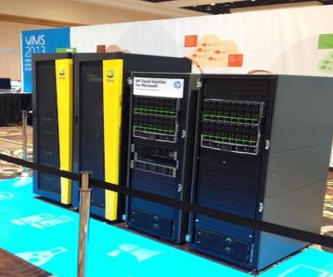
HP VS3 – Proof point for performance and scalabity
VS3 solution powers Microsoft Management Summit (MMS) Serverquarium
  16,000 individual lab sessions over four days
  50,000 VMs over four days
  3,500 concurrent VMs during lab use
  1,200 VMs set up in eight minutes
  More than 8,300 concurrent VMs in performance testing

Slide 31
HP Converged Cloud solution choices for Microsoft
HP Converged Cloud for Microsoft
HP Cloud Solution for Microsoft
HP CloudSystem
optimized for Microsoft
When standardizing on Microsoft management for cloud environments:
When standardizing on CloudSystem Matrix for IAAS :
VS3 v2.2 for Microsoft configurations
Factory Express
WS2012 /SC2012SP1+
HP technical Services
CloudSystem Matrix Starter Kit
Factory Express +HP Cloud Map for Microsoft Hyper-V Cluster Server Autoflexing
WS2012/SC2012SP1 +
HP Technical Services

Slide 32



HP CloudSystem optimized for Microsoft private cloud
HP makes the Microsoft private cloud work for you
    Based on HP CloudSystem Matrix
    Integration of infrastructure provisioning with Hyper-V cluster deployment for private cloud workloads
    Accelerate the cloud infrastructure design of HP Cloud Maps for Microsoft Hyper-V Cluster Server auto flexing
    Flex physical infrastructure to cloud service level demands
    Manage the cloud from infrastructure to applications
    Deploy virtualization cloud services with HP Insight Control for System Center
Cloud Maps
Service catalog
Orchestration
Provisioning
and monitoring
HP Converged
Infrastructure

Slide 33

HP Cloud Maps for Microsoft Hyper-V cluster server auto flexing for Microsoft with HP CloudSystem Matrix
CloudSystem Optimized for Microsoft
  What is HP CloudSystem optimized for Microsoft?
    HP CloudSystem Matrix + auto flexing + System Center 2012 SP1
  What is HP Cloud Maps for Microsoft Hyper-V cluster server auto flexing for Microsoft?
    Provides capability for infrastructure provisioning and Hyper-V cluster creation within CloudSystem and coordination System Center
    Provides capability to flex Hyper-V cluster from CSM
  How will the auto flexing feature for Microsoft be delivered?
    Via HP Cloud Maps downloadable by customers
    Available on HP Cloud Maps website
Auto flexing Feature
HP Cloud System Matrix

Slide 34
Delivering a complete solution

Slide 35
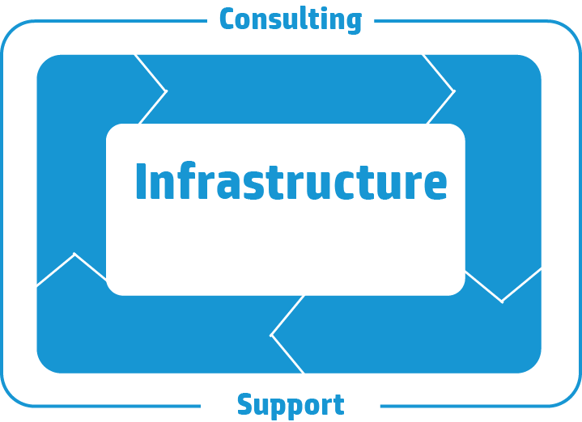
Services throughout the lifecycle
Continual
improvement
Strategy
Design
Operation
Implementation

Slide 36


Factory Express and on-site startup services
Get your solution configured, customized, and deployed
  Need to build and operate VirtualSystem quickly?
    Solution built in ISO quality-certified HP factory
    Factory configuration and integration of hardware and software, including Microsoft management stack
    On-site deployment and startup for hardware, software, virtualization stack, and HP Insight Control environment
    End-to-end deployment and startup by Factory Express Project Manager
  Benefits
    Seamless project management across factory and on site, mitigating deployment and startup risks of VirtualSystem
    Accelerated adoption of virtualization
    Minimal impact on business operations while you transition to VirtualSystem
  Factory Express Level 5
    On-site startup service for:
      Microsoft System Center
      Insight Control Environment
      3PAR storage
© Copyright 2013 Hewlett-Packard Development Company, L.P. The information contained herein is subject to change without notice.

Slide 37
HP VirtualSystem VS3 for Microsoft v2.2 Deployment Accelerator Service
    Complete setup and delivery of a Fast Track certified Microsoft Private Cloud environment5
    Includes the following high-level procedures:
    Integration into customer network environment
    Setup of management and compute nodes
    Configuration of the System Center management fabric including setup/configuration of the following:
      SQL Server cluster
      System Center Virtual Machine Manager cluster
      System Center Operations Manager
      System Center Service Manager
      System Center Orchestrator
      System Center App Controller
      Installation of HP Insight Control for System Center and HP storage management packs
    As-built handover document
⁵ Additional services required to build out the function of the private cloud itself.

Slide 38
Extend VS3 to the Microsoft Private Cloud
Strategy, planning, and implementation
  Base cloud services
  Based on Virtual System VS3, which provides a compute platform with all the management and provisioning components you would expect in a private cloud:
    HP transformation experience workshop for Microsoft Private Cloud - For direction and strategy for your cloud implementation.
    HP Virtualization Assessment Service - Four-week standard service, collect data to plan virtualization, and develop a summary business case.
    HP virtualization implementation - Plan a tailored virtualization approach, including migrating workloads to HP VS3 for Microsoft.
    HP Consulting Services for the Microsoft Private Cloud - Extend HP VS3 for Microsoft to the Microsoft Private Cloud by developing a private cloud strategy, roadmap, and service catalog, and implementing the automation required to deliver the private cloud experience.

Slide 39
Support experience for HP VirtualSystem VS3
Support that is personalized, proactive, and simple
Typical support needs
  A superior solution-level support experience when you need help
  Help to identify and prevent problems before they cause downtime or performance reduction
What HP delivers
  Direct access to advanced specialists and a single point of contact for entire solution-level support, including Microsoft software
  Proactively identify and mitigate risk in the environment to address problems before they occur

Slide 40
Recommended support services
Resolve problems quickly and improve operational efficiency
  HP Proactive Care
    Hardware and software
    (HP and third-party) support
    Rapid access to Advanced Technical Center
    Comprehensive reports: proactive scans, health checks, and incidents
    Advisory support on firmware, software, and patch updates
  HP Personalized Support option
  (with HP Proactive Care)
    An assigned Account Support Manager*
    Tailored/personalized services
    Proactive support planning, delivery, and review, best practice sharing, and operational and technical advice
  HP Proactive Select Credits
    Services based on industry best practices for operational efficiency and improvements
    Flexibility to identify, plan, and schedule engineering time as needed
    Implementation of firmware, software, and patch updates
Proactive problem prevention with periodic reviews of environment
Proactive Revision Management
Flexible and Personalized Support Experience

Slide 41
Critical service for HP VirtualSystem VS3
Designed to help minimize the business impact of downtime in mission-critical environments
Mission-critical team
Helping to…
    Proactively minimize downtime risk
    Reduce operational costs
    Implement best practices
    Manage change and complexity
Holistic-based
delivery
Best practices
Specialized technical expertise
Proactive problem prevention
Access to HP Global Mission Critical Solution Center
Assigned account support team
Proactive planning and advice
ITIL best practices
Mission Critical Reactive Support with six-hour call-to-repair

Slide 42
HP Technology Services
The know-how to make technology work for you
    1,000+ converged infrastructure and CloudSystem implementations
    48,000 Microsoft-trained professionals
    12,000+ Microsoft-certified professionals
    Ability to deliver private cloud in 30 daya
    Delivered 100,000+ storage area networks worldwide
    Highest mission-critical customer loyalty: 95+ percent
  Support available:
    24x7x365 days per year
    Covering 24 time zones
    In 30+ languages
    HP presence in 180 countries
    2,500+ ServiceOne partners

Slide 43
Conclusion

Slide 44
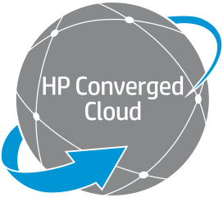





Microsoft virtualization and clouds run best with HP
Open, leading partnerships and built-in HP intellectual property accelerate your journey to the cloud
Private cloud
Managed cloud
Traditional
Public cloud
clouds run best on HP
  Optimized converged infrastructure
    Delivering increased performance, availability, and capacity
  Deeply integrated management
    Manage your entire environment from a single console
  Agile solutions for private cloud
    Large range of performance/capacity options to meet your needs
  Comprehensive cloud services
    Expertise and resources stand ready to help

Slide 45

Take the next step
Accelerate your journey to the cloud—your cloud, your way
    Learn more about virtualization and private cloud solutions from HP and Microsoft :
      hpmicrosoftprivatecloud.com
      privatecloudmadeeasy.com
      hp.com/solutions/microsoft/virtualizationconvergedcloud
      hp.com/solutions/microsoft/virtualsystem
    Schedule and attend a Transformation Experience Workshop for Microsoft Private Cloud
    Contact your HP sales or partner sales representative
    Get started with a private cloud solution based on HP Converged Infrastructure and Microsoft Windows Server, Hyper-V, and System Center
© Copyright 2013 Hewlett-Packard Development Company, L.P. The information contained herein is subject to change without notice.

Slide 46
Key links
  Independent Microsoft Windows IT community
  covering HP/Microsoft private cloud:
  hpmicrosoftprivatecloud.com
  HP and Microsoft private cloud site:
  privatecloudmadeeasy.com
  HP services for Microsoft solutions:
  hp.com/services/microsoft
  HP services and support:
  hp.com\services\proactivecare
  hp.com\services\proactiveselect
  HP ProLiant Gen8 servers:
  hp.com/go/Proliant
  HP 3PAR storage:
  hp.com/go/3PAR
Microsoft Hyper-V Cloud Fast Track: microsoft.com/virtualization/en/us/hyperv-cloud-fasttrack.aspx
Compare with VMware:
microsoft.com/vmwarecompare
Microsoft virtualization:
microsoft.com/virtualization
Microsoft Hyper-V:
microsoft.com/hyper-v
Microsoft application virtualization: microsoft.com/systemcenter/appv
Microsoft cloud:
microsoft.com/cloud

Slide 47
Thank you

Slide 48



Evaluate this session
Required Slide
*delete this box when your slide is finalized
Your MS Tag will be inserted here during the final scrub.
Scan this QR code to
evaluate this session.

Slide 49

© 2013 Microsoft Corporation. All rights reserved. Microsoft, Windows and other product names are or may be registered trademarks and/or trademarks in the U.S. and/or other countries.
The information herein is for informational purposes only and represents the current view of Microsoft Corporation as of the date of this presentation. Because Microsoft must respond to changing market conditions, it should not be interpreted to be a commitment on the part of Microsoft, and Microsoft cannot guarantee the accuracy of any information provided after the date of this presentation. MICROSOFT MAKES NO WARRANTIES, EXPRESS, IMPLIED OR STATUTORY, AS TO THE INFORMATION IN THIS PRESENTATION.

