Slide 2
Cloud-powered Load Testing with Team Foundation Service
WAD-B304
Anu Bharadwaj

Slide 3
Top challenges with load testing …
Provision/setup machines: Painful and Slow
Cost: High
App hosted in Azure: Challenges

Slide 4
Agenda
Load Testing using Visual Studio - 101
Introducing Cloud-powered Load Testing
Architecture/Roadmap/Next steps
Q & A

Slide 5
Load Testing using Visual Studio - 101

Slide 6
Performance & Load Testing
Performance Testing
Load Testing
Stress Testing
Capacity/Scale Testing

Slide 7
Demo: Performance and Load Testing using Visual Studio

Slide 8
Demo re-cap
0. Configure test environment
Author tests – web tests, load tests
Run tests
Analyze results
Fix performance/scale problems

Slide 9
Introducing Cloud-powered Load Testing

Slide 10
Demo: Run load tests using Team Foundation Service

Slide 11
Demo re-cap
0. Configure test environment
Author tests – web tests, load tests
Run tests
Analyze results
Fix performance/scale problems

Slide 12
Demo: Scale up seamlessly

Slide 13
Architecture/Roadmap/ Next steps

Slide 14
Architecture
Test Agent Pool - Dynamic
Load Test Web Service
Worker
Azure Tables
Visual Studio
Results database
Azure Blobs

Slide 15
Early adopters…
12 internal teams, since last 7 months
Including Team Foundation Service and Skype
10 external (MVPs), since last 1 month
Florida State elections (app built on Azure)

Slide 16
On our backlog …
Collect perf counters from service under test
Richer analysis/reporting for runs in-progress
Scheduling of load tests
Geo-distributed load generation
…..

Slide 17
Next steps
Try it out, with Visual Studio 2013 Preview
Provide us feedback
Free to try/use during Preview
Limits on usage per month
Join the early adopter program
More usage and work closely with product team

Slide 18
Top challenges with load testing …
Provision/setup machines: Painful and Slow
Cost: High
App hosted in Azure: Challenges

Slide 19
Challenges no more …
Provision/setup machines: Super-easy and quick
Cost: Pay only for usage
App hosted in Azure: It just works

Slide 20
Q n A Darshan.Desai@microsoft.com

Slide 21
More questions …
Find Me Later At... VS/ALM Product demo station
Email: Darshan.Desai@microsoft.com

Slide 22
Resources
Learning
Sessions on Demand
Microsoft Certification & Training Resources
http://channel9.msdn.com/Events/TechEd
www.microsoft.com/learning
TechNet
msdn
Resources for IT Professionals
Resources for Developers
http://microsoft.com/technet
http://microsoft.com/msdn

Slide 23
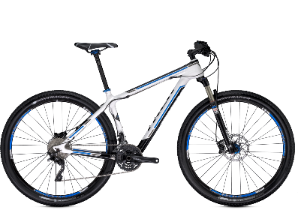
Track Resources & Calls To Action
Get Started with Windows Azure
Develop and Test in VMs, Build Websites, Extend on-premises applications
http://www.windowsazure.com
MSDN Subscribers: you’ve got it, now use it
Activate your MSDN Benefit & try it by 9/30
You could win* an Aston Martin V8 Vantage!
Go to: http://aka.ms/AzureContest
Drop by the Windows Azure booth to participate in the Windows Azure Challenge for even more prizes!
*No purchase necessary. Open to eligible Visual Studio Professional, Premium or Ultimate with MSDN subscribers as of June 1, 2013. Ends 11:59 p.m. PT on September 30, 2013. For full official rules including odds, eligibility and prize restrictions see website. Sponsor: Microsoft Corporation. Aston Martin is a trademark owned and licensed by Aston Martin Lagonda Limited. Image copyright Evox Images. All rights reserved.

Slide 24
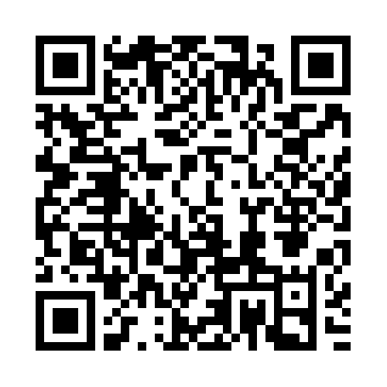
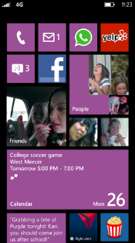
Evaluate this session
Required Slide
*delete this box when your slide is finalized
Your MS Tag will be inserted here during the final scrub.
Scan this QR code to
evaluate this session.

Slide 25
Q n A Darshan.Desai@microsoft.com

Slide 26
© 2013 Microsoft Corporation. All rights reserved. Microsoft, Windows and other product names are or may be registered trademarks and/or trademarks in the U.S. and/or other countries.
The information herein is for informational purposes only and represents the current view of Microsoft Corporation as of the date of this presentation. Because Microsoft must respond to changing market conditions, it should not be interpreted to be a commitment on the part of Microsoft, and Microsoft cannot guarantee the accuracy of any information provided after the date of this presentation. MICROSOFT MAKES NO WARRANTIES, EXPRESS, IMPLIED OR STATUTORY, AS TO THE INFORMATION IN THIS PRESENTATION.

