Slide 2
Securing Rich Client Applications Using OAuth 2.0 and Windows Active Directory
WAD-B307
Caleb Baker
Senior Program Manager

Slide 3
Agenda
Why use AD or AAD to secure mobile apps?
What are the challenges and opportunities?
Writing a Windows Store app that uses AD and AAD
Touch's on the writing a backing Web API
Implementing the protocol
How to implement on other platforms

Slide 4
Identity challenges with devices and cloud services

Slide 5
What is Azure Active Directory?

Slide 6
The AD identity store
Active Directory identity infrastructure as a service
Securely connecting apps devices and people

Slide 7
The AD identity store
Active Directory identity infrastructure as a service
Securely connecting apps devices and people

Slide 8
2.9 million businesses, government bodies and schools using Azure Active Directory

Slide 9
Impact of major industry trends
Mobile and BYOD
More devices, that more critical to getting the job done
Cloud Services
Moving resources off premises
Hybrid Enterprise
Identity spanning the gap from on premise to the cloud

Slide 10
BYOD on-premise identities
Windows
Active Directory

Slide 11
Cloud services and on-premise identity
Windows
Active Directory

Slide 12
Cloud based identity and services
Windows Azure Active Directory
Todo List Service
Todo List Client

Slide 13
Hybrid identity
Windows Azure Active Directory
Windows
Active Directory

Slide 14
Many combinations

Slide 15
A common approach

Slide 16
OAuth 2.0

Slide 17
What is OAuth 2.0 (RFC 6749)
It’s not a Protocol

Slide 18
OAuth 2.0 is authorization framework
Provide common patterns for delegated authorization
With extensive security review
Designed for HTTP services
Lightweight easy to implement
Provides a foundation of concepts that can be reused to create interoperable profiles like OpenID Connect

Slide 19
Windows Store App with AD
Windows
Active Directory
Todo List Service
Todo List Client

Slide 20
Azure Authentication Library (AAL)
Authentication/Authorization library specifically for ADFS and AAD
AAL is not a protocol library
NuGet package available now, in dev preview
For Windows Store

Slide 21
Authentication Context
Authenticate user
AuthenticationContext aCtx =
new AuthenticationContext(“https://sts.contoso100.com/adfs");
AuthenticationResult result =
await aCtx.AcquireTokenAsync(“https://target.com", clientID);
Call the Service
HttpClient httpClient = new HttpClient();
httpClient.DefaultRequestHeaders.Authorization = new AuthenticationHeaderValue("Bearer", result.AccessToken);
//...

Slide 22
On-premise Windows Store application

Slide 23
Securing the service
Service establishes a relationship with the token issuer
Must get the issuer public key from a trusted source
Validate token target and lifetime
Required to ensure validity of the token
Understand user claims
Name id is primary user key
JSON Web Token Handler (General Availability)

Slide 24
Windows Store App with AAD
Windows Azure Active Directory
Todo List Service
Todo List Client

Slide 25
Updating the service and app to use AAD

Slide 26
Summary
We used AD accounts from a mobile app
With minimal updates, switched to AAD
Also updated the service to accept AAD issued tokens

Slide 27
But wait there is more…
Benefit from new features. Examples:
Device registration
Multi-factor authentication

Slide 28
Device Registration
With ADFS in Windows Server 2012 R2 “workplace” join is supported in Windows 8.1
This allows a user to provision a certificate identity for a device
It all just works with the OAuth 2.0 flow

Slide 29
Using multi-factor Authentication

Slide 30
Multi-factor authentication
No updates to client or service
Using a browser dialog abstracts away this complexity

Slide 31
How to implement the protocol

Slide 32
Advice: when possible use a library
Except sometimes you can’t
Available now (in developer preview)
AAL for Windows Store apps
AAL for .NET
Coming Next
??

Slide 33
OAuth 2.0 test client
Simple tool to make OAuth 2.0 requests
not using AAL .NET in order to illustrate protocol behavior

Slide 34
OAuth 2.0 authorization code
Code grants represent one of the core OAuth 2.0 profiles
It is used for delegated access
Allows for long term access, by proving a refresh token
Azure AD developer preview

Slide 35
OAuth 2.0 code flow
Device
STS
Browser
App
Authorization Endpoint
Token
Endpoint
Resource
Request code
Request code
User Authenticates
Code response
Code response
Token request
Token response
Resource access
Resource response

Slide 36
OAuth 2.0 test client

Slide 37
JSON Web Token (JWT, pronounced ‘jot’)
Token format in common use, currently in the standardization process
Core component of OpenID Connect

Slide 38
Decoding a JWT

Slide 39
Claim mapping
sub
http://schemas.xmlsoap.org/ws/2005/05/identity/claims/nameidentifier
oid
http://schemas.microsoft.com/identity/claims/objectidentifier
tid
http://schemas.microsoft.com/identity/claims/tenantid
upn
http://schemas.xmlsoap.org/ws/2005/05/identity/claims/upn

Slide 40
Summary
There Lots of opportunity in internet scale identity
Using Active Directory and Azure Active Directory it is simple to write mobile apps that can take advantage of these identity services

Slide 41
Sessions
WCA-B334 Secure Anywhere Access to Corporate Resources Such as Windows Server Work Folders Using ADFS
WAD-B306 Securing Cloud Line-of-Business and SaaS Web Applications Using Windows Azure Active Directory
WAD-B308 Deep Dive into the Windows Azure Active Directory Graph API: Data Model, Schema, Query, and More
OUC-B341 Microsoft Office 365 Directory and Access Management with Windows Azure Active Directory

Slide 42
Links
JSON Web Token Handler
Windows Azure Authentication Library .NET Beta
Windows Store Application Walkthrough
Active Authentication Blog Post
Azure Active Directory Numbers Blog Post
https://graphexplorer.cloudapp.net/
http://jwt.calebb.net
https://github.com/kaylubbaycur/OAuthTestClientTool

Slide 43
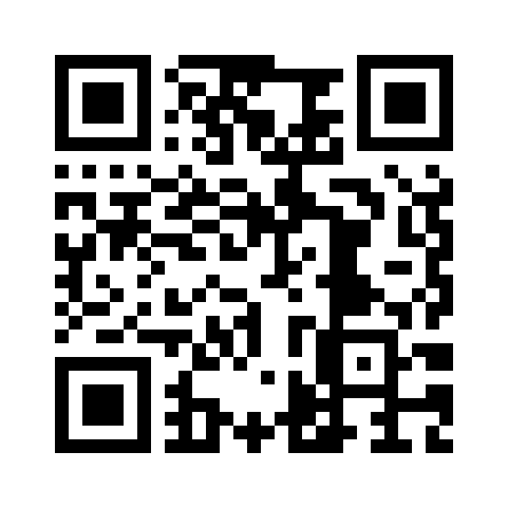
Links Site
http://jwt.calebb.net/TechEd2013.html

Slide 44
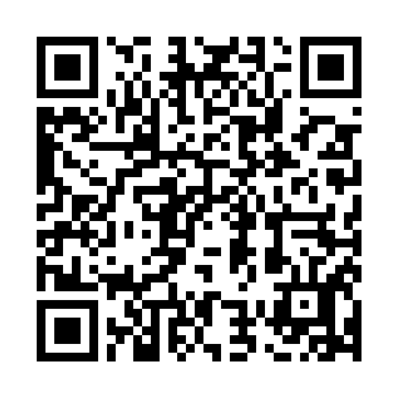
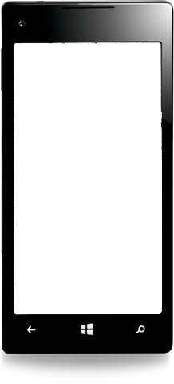
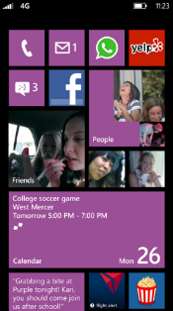
Evaluate this session
Scan this QR code to
evaluate this session.

Slide 45
© 2013 Microsoft Corporation. All rights reserved. Microsoft, Windows and other product names are or may be registered trademarks and/or trademarks in the U.S. and/or other countries.
The information herein is for informational purposes only and represents the current view of Microsoft Corporation as of the date of this presentation. Because Microsoft must respond to changing market conditions, it should not be interpreted to be a commitment on the part of Microsoft, and Microsoft cannot guarantee the accuracy of any information provided after the date of this presentation. MICROSOFT MAKES NO WARRANTIES, EXPRESS, IMPLIED OR STATUTORY, AS TO THE INFORMATION IN THIS PRESENTATION.

