Slide 2
Building Media Workflows in the Cloud with Windows Azure Media Services
WAD-B317
Xavier Pouyat
xpouyat@microsoft.com
Senior Program Manager
Microsoft

Slide 3


Agenda
Overview of media industry
What’s Windows Azure Media Services?
Video-on-demand service
Demo: Windows Azure Media Services Portal
New Feature - Dynamic packaging
        Demo: using .NET SDK to upload, encode and stream with dynamic packaging
Summary

Slide 4



Evolution of online video
Victoria’s Secret fashion show 1999
First major online broadcast
28.8 kbps
1999
2004
2007
2008
2009
2012
Future

Slide 5

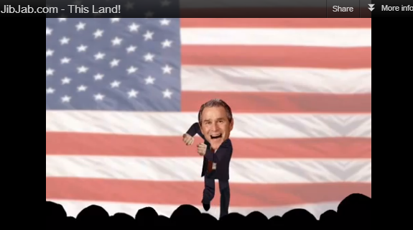
Evolution of online video
<1Gps
1999
2004
2007
2008
2009
2012
Future

Slide 6


Evolution of online video
<1Gps
1999
2004
2007
2008
2009
2012
Future

Slide 7
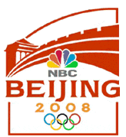

Evolution of online video
2,200 hours of live and 4,400 hours of VOD
150 million viewers for live streaming
237 million views for on-demand
<1Gps
1999
2004
2007
2008
2009
2012
Future

Slide 8

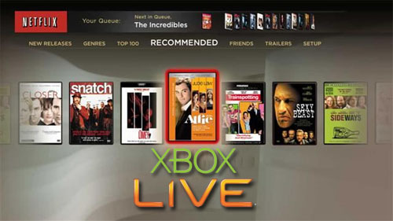

Evolution of online video
444Gbps
<1Gps
1999
2004
2007
2008
2009
2012
Future

Slide 9
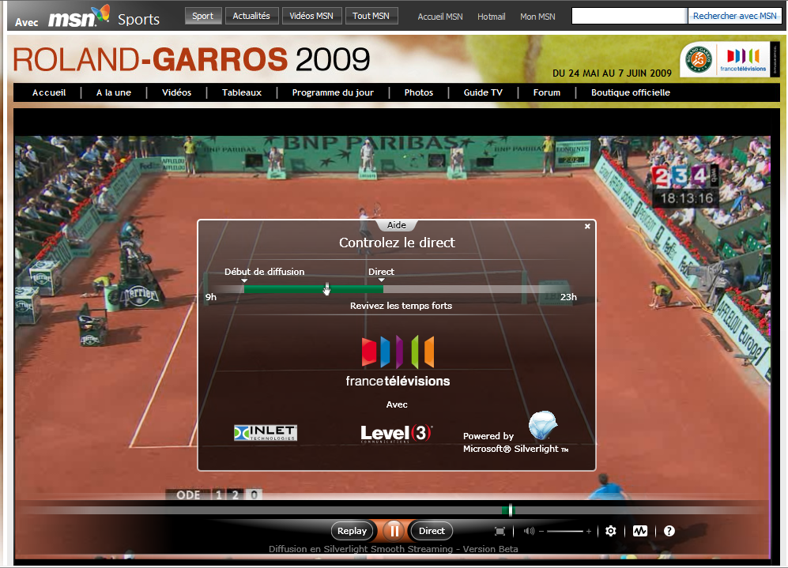
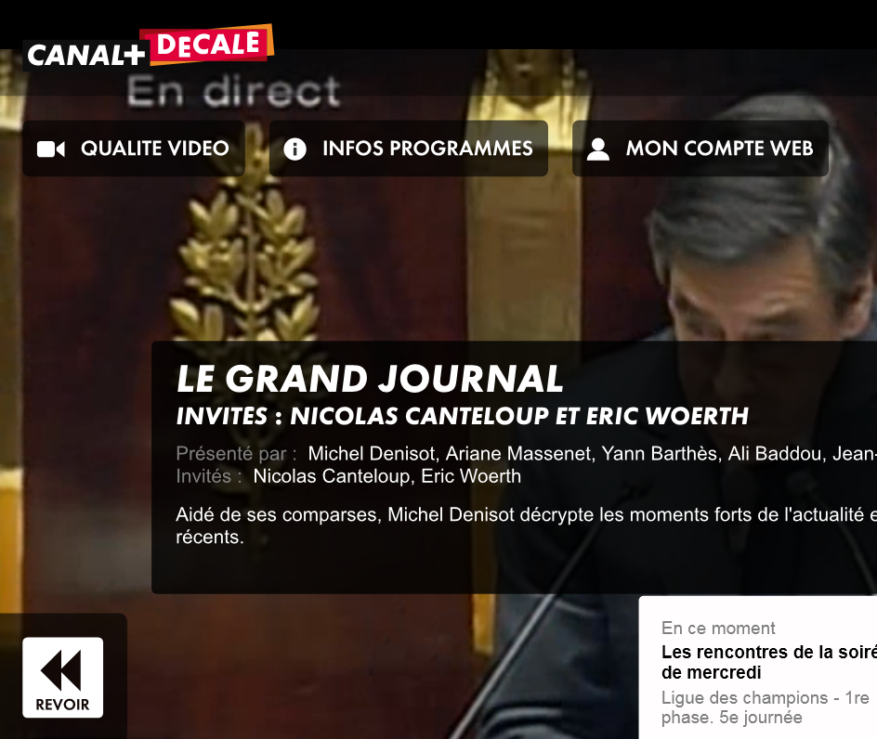
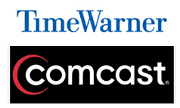
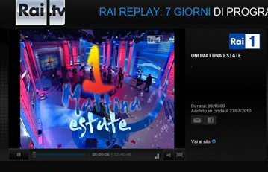
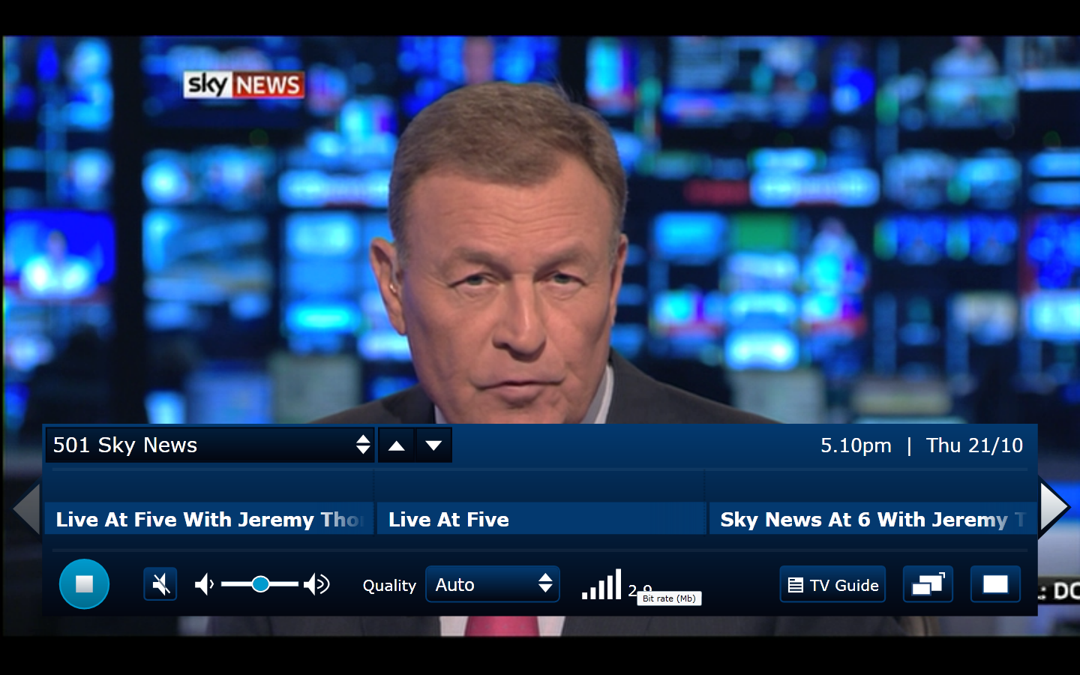
Evolution of online video
444Gbps
<1Gps
1999
2004
2007
2008
2009
2012
Future

Slide 10


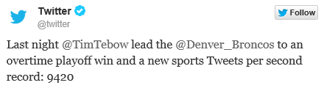
Evolution of online video
>1Tbps
3,500 hours of live coverage
102.6 million videos
15M unique mobile users
First live streaming event in the cloud
444Gbps
<1Gps
1999
2004
2007
2008
2009
2012
Future

Slide 11




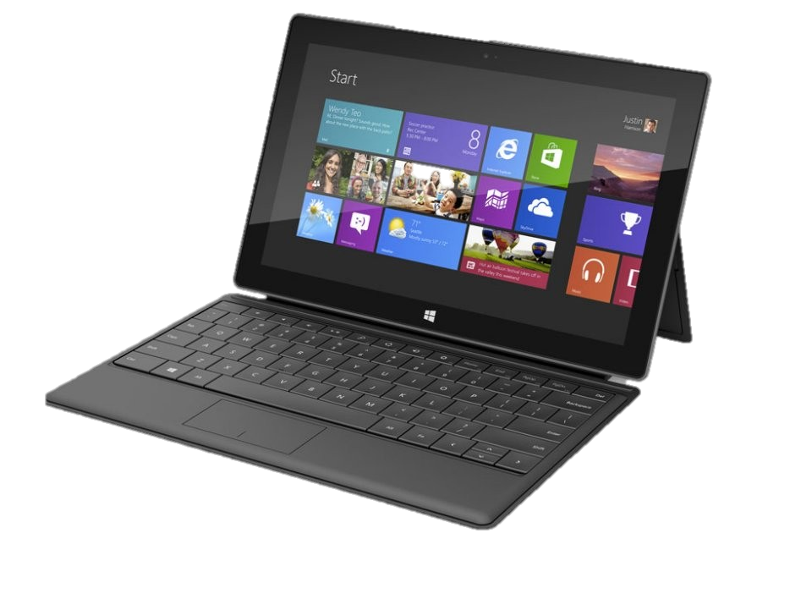
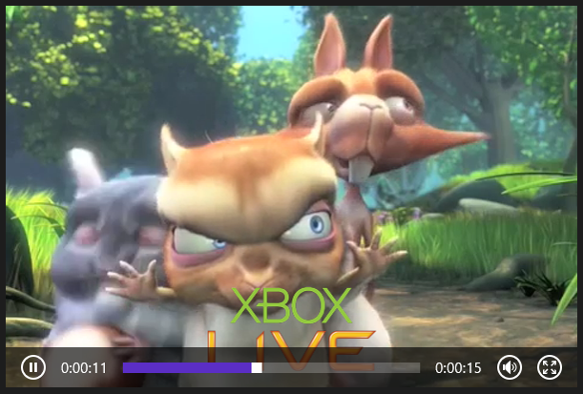




Challenges
Infrastructure costs
Managing costs
Monetizing contents
Digital Rights Management
Security
High Quality videos for any device
Anywhere and Anytime
Multiple formats, multiple bitrates

Slide 12
What is Windows Azure Media Services?

Slide 13



















Media Services Architecture
Client Libraries
“Build-On” Media Partners and Customers
Partner CDNs
REST APIs
iOS
Media Services
XBOX 360
Secure
Media Ingest
Encoding
On-Demand
Origin
Live Ingest
Live Origin
Advertising
HTML 5
Media Job
Scheduling
Static/Dynamic Packaging
Content
Protection
Live Encoding
Analytics
Identity Management
Windows
Phone
Azure CDN
Android
Partner Technologies (Media Processors, Origin Servers, Live Encoders etc.)
Flash
(Fabric, Storage, Compute, Database)
Origin
Adaptive Streaming
Porting Kits
Caching
Released
Coming Soon
Partners

Slide 14





















Components and technologies from Microsoft and 3rd parties that are ready-to-use and integrated into a single platform that simplifies the creation of an end-to-end media solution
Windows Azure Media Services
Your choice of components for building custom media workflows that scale in the cloud
Freewheel

Ingest
Encoding
Format
Conversion
Content Protection
On-Demand
Streaming
Live
Streaming
Advertising
Analytics
Content
Management
Distribution
Players

Slide 15
Video On Demand
Services

Slide 16






Video-On-Demand Workflow
Ingest
Encode
Package
Encrypt
Deliver

Slide 17


Step 1: Ingest Content
ASSET
INGEST
Azure Blob
Different options of Ingesting a Mezzanine Asset
  Pre-encrypt files prior to uploading (AES 256)
  Secure HTTPS upload
  Network level peering for fast HTTP into Azure
  Fast upload using UDP with Aspera

Slide 18
Step 2: Encode, Package or Encrypt
Queue
Encode
Azure Blob
Azure Blob

Slide 19
Step 2: Encode, Package or Encrypt
Encoding Reserved Units
Encode
Encode
Azure Blob
Azure Blob
Encode
Windows Azure Media Encoder
Supports encoding to H.264 or VC-1 video
Encodes audio to AAC-LC, HE-AAC, Dolby DD+, WMA
Packages to Smooth Streaming, HLS, DASH
Encrypts with PlayReady, Common Encryption, AES
Encoding with third-parties
Partner SDK for enabling ‘build-in’ encoders

Slide 20
Step 3: Deliver Content
Asset
Encode
Stream
Ingest
Azure Blob
Origin Server
Managed streaming service… it just works!
  Guaranteed bandwidth
  Auto recovery, redundancy and failover
  High Availability
Azure and 3rd party CDN support
IP Whitelisting

Slide 21
Pricing and SLA
Encoding Service | Free Trial (3mths) | Shared | Reserved
Encoding Price | Free (100GB limit) | €1.482 Per GB | €1.482 Per GB + €73.73 per month/RU
Encoding SLA | NA | Availability = 99.9% Measured as REST API availability No guarantee on wait time between tasks | Availability = 99.9% Measured as REST API availability Media tasks running concurrently = Number of reserved units
Streaming Service | Free Trial (3mths) | Shared | Reserved
Streaming Price | Free (100GB limit) | Standard Egress Rates | Standard egress rates + €148.20 per month
Streaming SLA | NA | Availability = NA No bandwidth guarantee | Availability = 99.9% Measured as server availability based on response time Peak bandwidth of 200 Mbps per Reserved Unit allocated for Origin

Slide 22
Demo
Using Windows Azure Media Services Portal

Slide 23





New Feature - Dynamic packaging
Allows you to re-use your encoded content and bring it to various streaming formats without repackaging the content.
Traditional Encode and Package
Package
HLS
Encode
Package
Video sources
Multi-bitrates Mp4
Smooth
Streaming
Origin Server
Dynamic Packaging
Dynamic
Packaging
HLS
Encode
Smooth
Streaming
MPEG
DASH
Video sources
Multi-bitrates Mp4
Origin Server

Slide 24
New Feature - Dynamic packaging
Allows you to re-use your encoded content and bring it to various streaming formats without repackaging the content.
Dynamic Packaging
Dynamic
Packaging
HLS
Input format: Mp4 or Smooth Streaming
Output format: Smooth Streaming, Http-Live-Streaming v4 and MPEG-DASH
Encode
Smooth
Streaming
MPEG
DASH
You need to have at least 1 reserved streaming unit to enable dynamic packaging!
Video sources
Multi-bitrates Mp4
Origin Server

Slide 25

Media Services APIs and SDKs
REST API for all platforms
.NET library
https://nuget.org/packages/windowsazure.mediaservices
JAVA library
http://www.windowsazure.com/en-us/develop/java/java-home Windows / Mac / Linux
Open Source libraries available with source code on GitHub
https://github.com/WindowsAzure/azure-sdk-for-media-services
https://github.com/windowsazure/azure-sdk-for-java/
We released .NET Open Source on GitHub

Slide 26
Code Walkthrough

Slide 27
Upload, Encode, and Dynamic packaging
Full demo code at:
Demo - how to create HLS and Smooth Streaming assets using dynamic packaging By Mingfei Yan
Other readings:
Dynamic packaging and Encoding and Reserved units By Nick Drouin

Slide 28
Code Walkthrough for dynamic packaging
Get authorization
Create an Asset and AssetFile(s)
Upload a file
Source Asset
Demo.exe
Media Services SDK
Access Control Service REST
Storage SDK
Media Service REST
Storage REST
Media Services Data
Source Asset

Slide 29

Code Walkthrough for dynamic packaging
Create a job
Encode an asset to multi-bitrate Mp4
Demo.exe
Media Services SDK
Media Service REST
Storage REST
Media Services Data
Encode
Source Asset
Multi-Bitrate
Mp4

Slide 30
Code Walkthrough for dynamic packaging
Create a locator
Provision origins
Dynamic packaging and serve requests
Demo.exe
Media Services SDK
Origin Streaming Locator
Media Service REST
http://teched.origin.mediaservices.windows.net
/3f82cf6f-41ee-4cc4-8d9e-2c85bf827604/
azure_1900.ism/manifest
Media Services Data
GUID
File Name/type
Storage REST
SAS Locator
https://techedmedia.blob.core.windows.net/
asset-b4c12696-2b39-4d67-acf7-b68985ba0915/
azure_650.mp4?
sv=2012-02-12&se=2014-05-26T11%3A47%3A37Z&sr=c&si=28869964-40a1-41de-a58b-d4c67bfc6164&sig=gYDilJeX4IfqexW9nzZg%2Bg2yVviIYKsk3LUd5W5S%2FEQ%3D
Container
/manifest
(format=m3u8)
Source Asset
HLS
Multi-Bitrate
Mp4
Origin
File Name/type
Smooth
/manifest
Shared Access Signature

Slide 31
Upload, Encode, and Dynamic packaging
Full demo code at:
Demo - how to create HLS and Smooth Streaming assets using dynamic packaging By Mingfei Yan
Other readings:
Dynamic packaging and Encoding and Reserved units By Nick Drouin

Slide 32

Summary

Slide 33
Key Takeaways
Media Services are easy, flexible, and powerful
Customers can reach any device using any protocols
Partner Ecosystem, easily build-in or build-on
Content protection and authentication across all clients
Ad workflow ensured to work across all clients
Pay for what you use, easy to understand billing
Any media, on any device, delivered from the cloud

Slide 34

Resources
Learning
  Sessions on Demand
  Microsoft Certification & Training Resources
http://channel9.msdn.com/Events/TechEd
www.microsoft.com/learning
TechNet
msdn
  Resources for IT Professionals
  Resources for Developers
http://microsoft.com/technet
http://microsoft.com/msdn

Slide 35



Evaluate this session
Required Slide
*delete this box when your slide is finalized
Your MS Tag will be inserted here during the final scrub.
Scan this QR code to
evaluate this session.

Slide 36

© 2013 Microsoft Corporation. All rights reserved. Microsoft, Windows and other product names are or may be registered trademarks and/or trademarks in the U.S. and/or other countries.
The information herein is for informational purposes only and represents the current view of Microsoft Corporation as of the date of this presentation. Because Microsoft must respond to changing market conditions, it should not be interpreted to be a commitment on the part of Microsoft, and Microsoft cannot guarantee the accuracy of any information provided after the date of this presentation. MICROSOFT MAKES NO WARRANTIES, EXPRESS, IMPLIED OR STATUTORY, AS TO THE INFORMATION IN THIS PRESENTATION.

