Slide 2
Microsoft App-V 5 Migration and Co-Existence App-V 4.6
WCA-B208
Matthijs Gates
Senior Program Manager

Slide 3
Migrating to App-V 5
Session Intro:
App-V 5.0 Pillars and What’s changed
Package Conversion:
Package Conversion with PowerShell
Notes and Considerations for Package Conversion
Using the Sequencer:
When to use the Sequencer during migration
Co-Existence:
What is Co-Existence and how does it work

Slide 4
App-V 5 Pillars
Integrated Platform
Modern Management
Flexible Virtualization

Slide 5
Key Changes
App-V 4.6
Uses dedicated drive letter (Q: drive)
4GB package limit
Isolated from local applications
Share middleware with Dynamic Suite Composition
Read-only Shared Cache supports VDI/RDS environments
Limited command-line scripting
Installed management console
App-V 5
No dedicated drive letter required
No 4GB limit
Virtual Application Extension
Share peer applications with Virtual Application Connection
Shared Content Store can be updated with normal App-V workflow
Rich PowerShell scripting for sequencer, client and server
Web-based management

Slide 6
Migration Workflow
4.6 App-V Server
5 Package Converter
5.0 App-V Server
App-V 4.6 SP2 Client
App-V 5 Client

Slide 7
Package Conversion

Slide 8
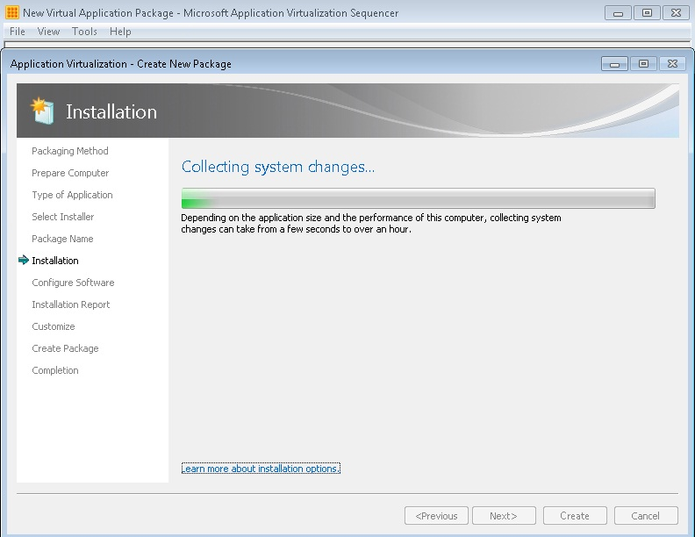
APP-V 5: PACKAGING AND PACKAGE CONVERSION
Sequencer
Similar UI from App-V 4.6 SP2
Package Converter
App-V 4.5+ packages
Carry forward existing investments by converting packages
New package file format
Can validate that packages are compatible before conversion
PowerShell interface supports batch/ bulk conversion

Slide 9
Test
Convert-From
AppVLegacyPackage

Slide 10
Demo
App-V Package Converter

Slide 11
Package Converter: Test
Test a Single Package
> Test-AppvLegacyPackage –Source C:\content\AdobeReader
Test Multiple Packages
> $packages = “C:\content\AdobeReader”, “C:\content\WinZip”
> Test-AppvLegacyPackage –Source $packages

Slide 12
Package Converter: Convert
Convert Single package:
> ConvertFrom-AppvLegacyPackage –Source C:\content\AdobeReader –Destination Path C:\NewPackages
Convert Multiple packages:
> $packages = “C:\content\AdobeReader”, “C:\content\WinZip”
> ConvertFrom-AppvLegacyPackage –Source $packages –DestinationPath C:\NewPackages

Slide 13
Package Conversion Checklist
App-V 4.5+ Package
Opens in App-V 4.6 Sequencer
Runs in App-V 4.6 Client
.NET/VC Runtime versions match

Slide 14
Package Converter Messages
Source : \\domain\packages\old\Adobe Reader X
Errors : {
The package converter detected one or more applications in your package that is targeted for an unsupported operating system. This package cannot be converted unless the target operating system restriction is removed from the .osd file
}
Warnings : {}
Information: {}

Slide 15
Package Conversion Considerations
Use Dynamic Configuration
OSD Scripts are not converted
Use Virtual Application Connection
DSC Configuration is not converted
OSD Registry settings are not converted
OSD Environment vars are not converted

Slide 16
Dynamic Configuration

Slide 17
App-V 5: Dynamic Configuration
Modifies a Package’s Virtual Environment
Virtual subsystem overrides
Disable virtual subsystems
Scripts
Dynamic Configuration Types
Dynamic Deployment Configuration
Dynamic User Configuration
Can combine
No Package Update Is Needed
Modify existing package content
Add to an existing package

Slide 18
Virtual Application Extension
Extension Point is registered natively with Windows
Global Visibility
Native –to– Virtual
Virtual –to– Virtual
Supported Subsystems
Shortcuts
File Type Associations (FTA)
AppPath
URL Protocols
Software Clients
Set Program Access and Computer Defaults (SPAD)
COM Local Servers

Slide 19
Demo
Dynamic Configuration

Slide 20
Dynamic Configuration
Deployment Configuration
Global scope: all users on the machine
Specify Dynamic Deployment Configuration file per package on the machine
Stored when the package is added
User Configuration
User scope: affects the user on the machine
Specify Dynamic User Configuration file per user, per package on the machine
Stored when the package is published

Slide 21
Sequencing (during migration)

Slide 22
When would you Sequence during migration?
Packages that didn’t work on 4.6
Want new Extension points

Slide 23
Demo
Capturing Virtual Application Extensions

Slide 24
Package Upgrade Command
Update a package via PowerShell
PS C:\Users\AppV\Desktop> Update-AppvSequencerPackage -InputPackagePath C:\content\Package.appv -Installer .\blank.bat -Name AdobeReader_2 -Path .\UpdatedPackages

Slide 25
Co-Existence

Slide 26
What is co-existence?
Install and run App-V 5 side-by-side with App-V 4.6 SP2
Stage your migration
Smart take-over of Extensions
Auto-migrate extensions from
4.6 SP2
Granular control over which apps

Slide 27
CO-EXISTENCE IN ACTION
4.6 App-V Server
5.0 Package Converter
5.0 App-V Server
4.6 SP2 App-V Client
5.0 App-V Client

Slide 28
Demo
Co-Existence

Slide 29
Co-Existence
Why
Stage the migration
How
Upgrade App-V 4.6 SP2, then Install App-V 5
Easiest with converted packages
Granular control
Dynamic Configuration: ManagingAuthority
Same Package name (GUID)
App-V 5 client config: MigrationMode=1
TakeOverExtensionFrom46=true

Slide 30
Migrating to App-V 5
Method 1
Co-Existence
Over time: convert and deploy
Method 2
Co-Existence
Over time: sequence and deploy
Combine
Method 1
Method 2

Slide 31
Key Takeaways
Convert App-V 4.6 packages to App-V 5
Scripting support streamlines the conversion process
May need to prep the 4.6 packages prior to conversion
Package Upgrade to get the new extensions
App-V 4.6 and 5 can co-exist
Stage App-V 5 deployment
App-V 5
Windows 7+
Windows Server 2008 R2+

Slide 32
App-V 5 vNext
Ongoing Microsoft investment in App-V
Upcoming releases include features such as
Support for Shell extensions
Improved VC Runtime support & deployment
Improved Publishing/Refresh user experience
We value your feedback!

Slide 33
Related content
Breakout Sessions (session codes and titles)
MDC-B343 | Top 5 Server Application Deployment and Servicing Problems Addressed by Server App-V and System Center 2012 SP1 - Virtual Machine Manager | Tuesday 13:30 -14:45
WCA-B203 | Microsoft Application Virtualization 5.0 and Microsoft Office: Better Together | Tuesday 16:45-18:00
WCA-B206 | The Replaceable PC | Wednesday 10:15-11:30
WCA-B319 | Implementing Microsoft Application Virtualization 5.0: Lessons Learned from a Production Rollout | Wednesday 10:15-11:30
WCA-B209 | What's New with Windows 8 BitLocker and Microsoft BitLocker Administration and Management (MBAM) 2.0 | Wednesday 13:30-14:45
WCA-B325 | Making PC Recovery Easier with the Microsoft Diagnostics and Recovery Toolset (DaRT) | Thursday 15:15-16:30
WCA-B359 | Microsoft User Experience Virtualization (UE-V): How to Manage and Deploy UE-V across an Enterprise | Thursday 10:15-11:30
WCA-B324 | Integrating the New Microsoft Application Virtualization 5.0 with other Virtualization Solutions | Friday 10:15-11:30

Slide 34
Windows Track Resources
Windows Enterprise: windows.com/enterprise
Windows Springboard: microsoft.com/springboard
Microsoft Desktop Optimization Package (MDOP): microsoft.com/mdop
Desktop Virtualization (DV): microsoft.com/dv
Windows To Go: microsoft.com/windows/wtg
Outlook.com: tryoutlook.com

Slide 35
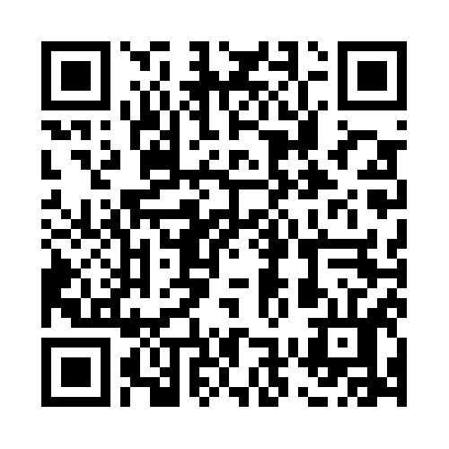
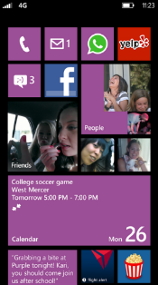
Evaluate this session
Required Slide
*delete this box when your slide is finalized
Your MS Tag will be inserted here during the final scrub.
Scan this QR code to
evaluate this session.

Slide 36
© 2013 Microsoft Corporation. All rights reserved. Microsoft, Windows and other product names are or may be registered trademarks and/or trademarks in the U.S. and/or other countries.
The information herein is for informational purposes only and represents the current view of Microsoft Corporation as of the date of this presentation. Because Microsoft must respond to changing market conditions, it should not be interpreted to be a commitment on the part of Microsoft, and Microsoft cannot guarantee the accuracy of any information provided after the date of this presentation. MICROSOFT MAKES NO WARRANTIES, EXPRESS, IMPLIED OR STATUTORY, AS TO THE INFORMATION IN THIS PRESENTATION.

