Slide 2
Demonstrations of Windows Assessment and Deployment Kit Tools
WCA-B309
Michael Niehaus
Senior Product Marketing Manager

Slide 3
What is the Assessment and Deployment Kit?
It’s the new version of the Windows Automated Installation Kit (AIK)
Released with support for Windows 8 and Windows Server 2012
Integrates tools that used to be separate downloads
Adds new assessment tools (hence the “assessment” part of the name)
Download the bootstrapper, remaining components are downloaded on the fly
Includes x86 and x64 components, but not ARM
Can only be installed on Windows 7, Windows Server 2008 R2, Windows 8, and Windows Server 2012
It contains lots of stuff…

Slide 4
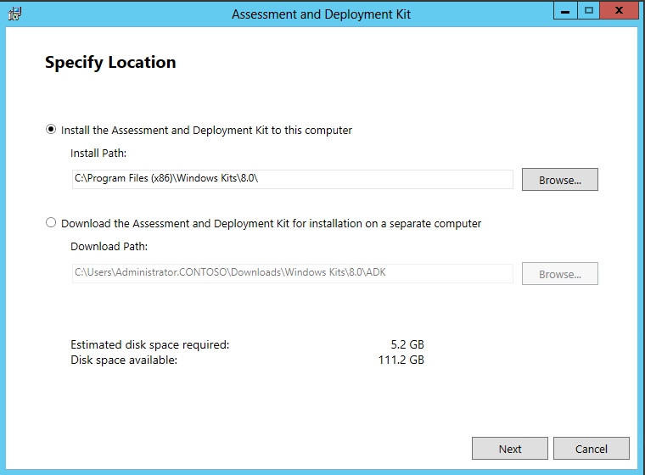
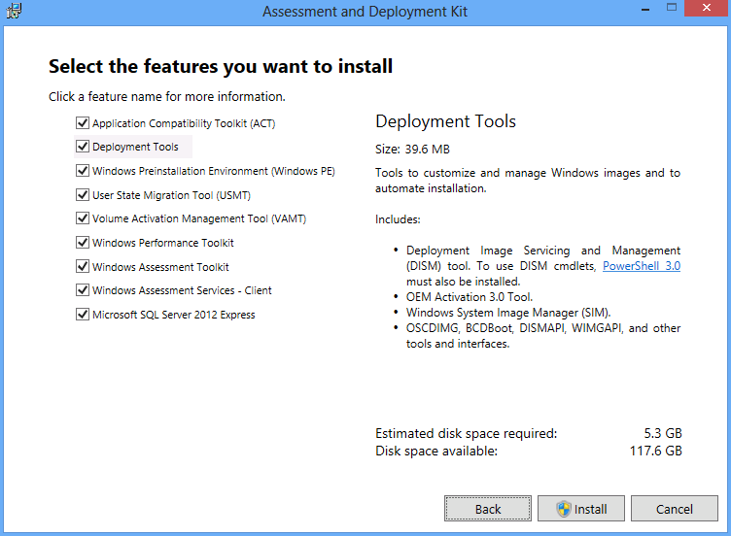

Slide 5
ADK Tools
Application Compatibility Toolkit
Application Compatibility Manager
Compatibility Administrator
Standard User Analyzer
Deployment Tools
BCDBoot, BCDEdit, Bootsect
DISM (and ImageX)
OSCDImg
WDSMCAST
Windows System Image Manager
User State Migration Tool
Scanstate
Loadstate
UsmtUtils
Volume Activation Management Tool
Windows PE
CopyPE
SetSANPolicy
MakeWinPEMedia
Windows Performance Toolkit
Wpa
Wpr
XBootMgr
Windows Assessment Services
Windows Assessment Toolkit

Slide 6
Demo

Slide 7
Windows Track Resources
Windows Enterprise: windows.com/enterprise
Windows Springboard: windows.com/ITpro
Microsoft Desktop Optimization Package (MDOP): microsoft.com/mdop
Desktop Virtualization (DV): microsoft.com/dv
Windows To Go: microsoft.com/windows/wtg
Outlook.com: tryoutlook.com

Slide 8
Resources
Learning
Sessions on Demand
Microsoft Certification & Training Resources
http://channel9.msdn.com/Events/TechEd
www.microsoft.com/learning
TechNet
msdn
Resources for IT Professionals
Resources for Developers
http://microsoft.com/technet
http://microsoft.com/msdn

Slide 9
For More Information
System Center 2012 Configuration Manager
http://technet.microsoft.com/en-us/evalcenter/hh667640.aspx?wt.mc_id=TEC_105_1_33
Windows Intune
http://www.microsoft.com/en-us/windows/windowsintune/try-and-buy
Windows Server 2012
http://www.microsoft.com/en-us/server-cloud/windows-server
Windows Server 2012 VDI and Remote Desktop Services
http://technet.microsoft.com/en-us/evalcenter/hh670538.aspx?ocid=&wt.mc_id=TEC_108_1_33
http://www.microsoft.com/en-us/server-cloud/windows-server/virtual-desktop-infrastructure.aspx
More Resources:
microsoft.com/workstyle microsoft.com/server-cloud/user-device-management

Slide 10
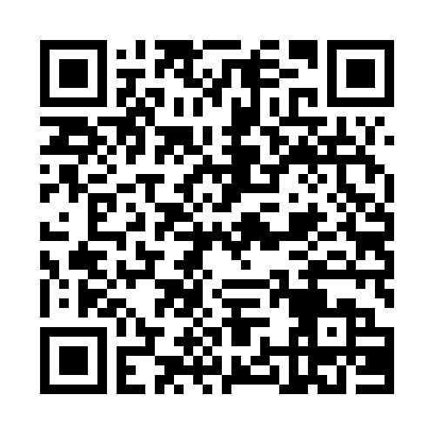
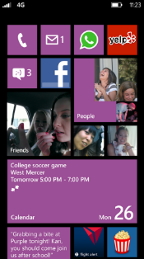
Evaluate this session
Required Slide
*delete this box when your slide is finalized
Your MS Tag will be inserted here during the final scrub.
Scan this QR code to
evaluate this session.

Slide 11
© 2013 Microsoft Corporation. All rights reserved. Microsoft, Windows and other product names are or may be registered trademarks and/or trademarks in the U.S. and/or other countries.
The information herein is for informational purposes only and represents the current view of Microsoft Corporation as of the date of this presentation. Because Microsoft must respond to changing market conditions, it should not be interpreted to be a commitment on the part of Microsoft, and Microsoft cannot guarantee the accuracy of any information provided after the date of this presentation. MICROSOFT MAKES NO WARRANTIES, EXPRESS, IMPLIED OR STATUTORY, AS TO THE INFORMATION IN THIS PRESENTATION.

