Slide 2
Deploying and Configuring Mobile Device Management Infrastructure with Microsoft System Center 2012 SP1 Configuration Manager and Windows Intune
WCA-B310
Craig Morris
Ramya Chitrakar

Slide 3
Three sessions this week on unified device management
Wednesday @10:15am: Infrastructure Setup
WCA-B310 – Deploying and Configuring Mobile Device Management Infrastructure with Microsoft System Center 2012 SP1 Configuration Manager and Windows Intune
Wednesday @5:00pm: Settings and Enrollment
WCA-B343 - Unified Modern Device Management with Microsoft System Center 2012 SP1 Configuration Manager Integrated with Windows Intune
Friday @10:15am: Application Management
WCA-B304 - Application Delivery with Microsoft System Center 2012 SP1 Configuration Manager and Windows Intune

Slide 4
Agenda
Getting started
Signing into Windows Intune service
Active Directory, DirSync and ADFS
Creating Configuration Manager objects
Windows Intune subscription
Onboarding of mobile device platforms
Windows Intune connector
Setting up a lab or POC environment

Slide 5
Today’s challenges
Users
Devices
Apps
Data
Users expect to be able to work in any location and have access to all their work resources.
The explosion of devices is eroding the standards-based approach to corporate IT.
Deploying and managing applications across platforms is difficult.
Users need to be productive while maintaining compliance and reducing risk.

Slide 6
People-centric IT
Enable your end users
Allow users to work on the devices of their choice and provide consistent access to corporate resources.
Unify your environment
Deliver a unified application and device management on-premises and in the cloud.
Users
Devices
Apps
Data
Protect your data
Help protect corporate information and manage risk.
Management. Access. Protection.

Slide 7
Selecting the Management Platform
Unified Device Management
System Center 2012 R2 Configuration Manager with Windows Intune
Build on existing Configuration Manager deployment
Full PC management (OS Deployment, Endpoint Protection, application delivery control, rich reporting)
Deep policy control requirements
Scale to 100,000 devices
Extensible administration tools (RBA, PowerShell, SQL Reporting Services)
Cloud-based Management
Standalone Windows Intune
No existing Configuration Manager deployment
Simplified policy control
Less than 7,000 devices and 4,000 users
Simple web-based administration console

Slide 8
Windows Intune integrated with System Center 2012 R2 Configuration Manager
Windows PCs
(x86/64, Intel SoC),
Windows to Go
Windows Embedded
Mac OS X
IT
Single Admin
Console
Windows 8 RT
Windows 8.1 Windows Phone 8 iOS, Android

Slide 9
Integration points of Configuration Manager and Windows Intune
Intune provides cloud based infrastructure to provide settings management and software distribution to mobile devices
All administrative tasks are performed via Configuration Manager console

Slide 10
Platform Support
New Platforms
Windows 8 RT
Windows Phone 8
iOS (5.x, 6.x)
Android (2.1 and later)
Windows 8.1 (x86/x64 and RT)
Features fully integrated in to ConfigMgr
Over the air device enrollment
Available user targeted applications
User and device settings management
Device inventory
Remote device retirement
Remote device wipe (full and selective)
Company branding
Web apps and remote apps
VPN/Wi-Fi/certificate profiles
Additional settings

Slide 11
Platform Support in ConfigMgr R2
OS Platform | Management Agent | End User Experience
Windows 8.1 PC | ConfigMgr Agent Or Management Agent(OMA-DM) | Software Center/Application Catalog Windows Company Portal app
Windows PC (Win8,Win7,Vista,XP) | ConfigMgr Agent | Software Center/Application Catalog
Windows RT | Management agent (OMA-DM) | Windows Company Portal app
Windows Phone 8 | Management agent (OMA-DM) | Windows Phone 8 Company Portal app
iOS | Apple MDM Protocol | Native iOS Company Portal App
Android | Android MDM agent (OMA-DM) | Native Android Company Portal App
Mac | ConfigMgr Agent | Limited self service experience
Linux/Unix | ConfigMgr Agent | N/A

Slide 12
Getting Started

Slide 13
Overview of Process
Create Windows Intune Account
Add Public DNS details
Verify Public Domain UPNs for users
AD Federation Services (ADFS 2.0)
AD Directory Synchronization
Connect Configuration Manager to Windows Intune

Slide 14
Create Windows Intune Account
This can be performed as a Volume License agreement, through those normal channels.
If your company does not have a volume license agreement for Configuration Manager you may create a Windows Intune subscription directly from www.WindowsIntune.com .
Once complete login with the admin account created to the Windows Intune Account Portal account.manage.microsoft.com

Slide 15
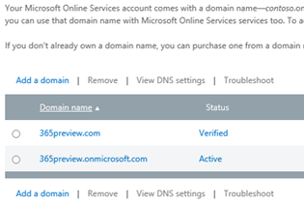
Create Verifiable Public Domain
Ensure users will synchronize correctly create a verified public domain within Windows Intune Account Portal.
This is a public domain for the company, something like company1.com
This domain must be able to be verified as a registered domain by an external source
For device enrollment ensure you have a public DNS CNAME record directing EnterpriseEnrollment to manage.microsoft.com

Slide 16
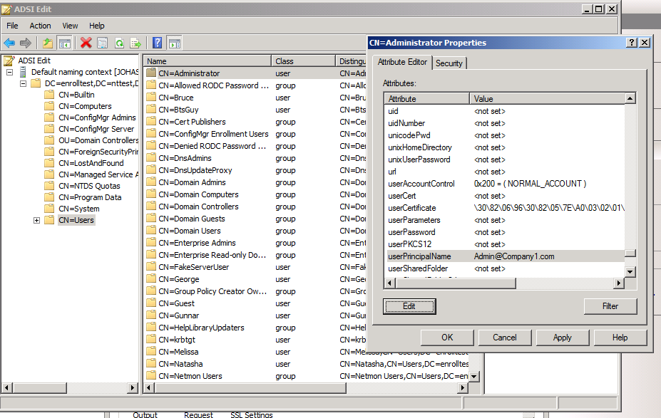
Verify User Details and Perform AD User Discovery
Ensure users that will be managed have this Public Domain as their primary Universal Principal Name (UPN) in Active Directory.
To add UPNs for each user, either edit via ADSI or script, similar to that shown in here: http://blogs.technet.com/b/heyscriptingguy/archive/2004/12/06/how-can-i-assign-a-new-upn-to-all-my-users.aspx
Once confirmed perform AD User Discovery in Configuration Manager 2012 SP1 or R2

Slide 17
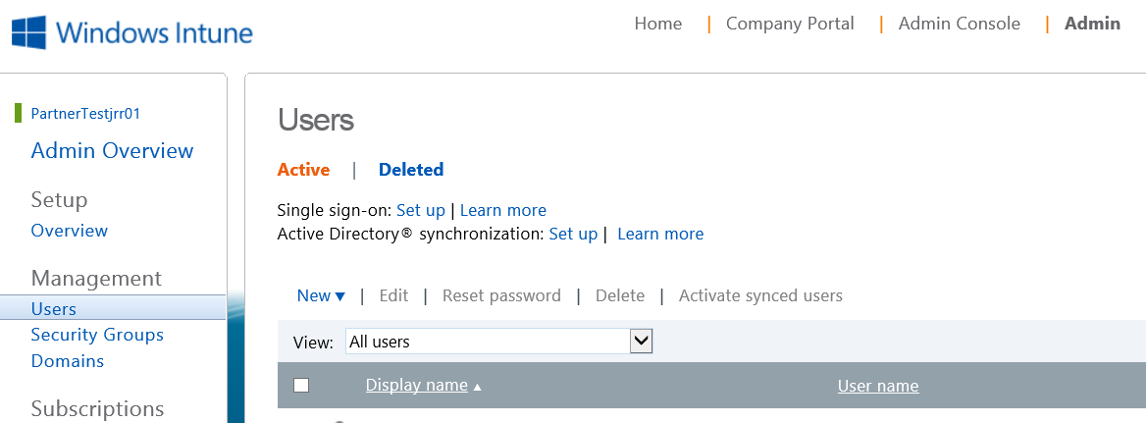
Deploy and Configure AD Federation Services
Not required but strongly recommended!
When you set up single sign-on (also known as identity federation), your users can sign in with their corporate credentials to access the services in Windows Intune.
Follow the Steps outlined in the Windows Intune Account Portal, under Users.
Prepare for Single Sign-on: http://technet.microsoft.com/en-us/library/jj151786
Secondly you need to deploy ADFS 2.0: http://technet.microsoft.com/en-us/library/jj151794 .

Slide 18
Deploy and Configure AD Directory Synchronization
Next, configure the on-premise AD Directory Synchronization with Microsoft Online.
To deploy and configure DirSync follow the steps outlined in the Windows Intune Account Portal (account.manage.microsoft.com).
Select Users, and then select the option to Setup Active Directory® synchronization . This will allow Intune to retrieve the user details from Microsoft Online.
TechNet series on DirSync that outlines the entire set of steps needed. http://technet.microsoft.com/en-us/library/hh967629.aspx

Slide 19
Reset User Microsoft Online Password
Once configured, AD DirSync will happen immediately and then every 3 hours.
User should then be visible in the Windows Intune Account Portal (in the Users node) – shown in previous slide
If not using ADFS, need to set a Microsoft Online password for each user:
In order for the users to be able to login into the Windows Intune service (and Microsoft Online), they need a Microsoft Online/Azure AD password set
You may perform these activities for an individual user or in bulk via the Windows Intune Account Portal. Or leverage powershell to programmatically activate them. Details in the link below
http://aka.ms/aadposh

Slide 20
Connecting to Windows Intune Account Portal
Ramya Chitrakar

Slide 21
Creating Configuration Manager Objects

Slide 22
Functions of Configuration Manager Windows Intune Objects
Windows Intune Subscription, used by admin to:
Retrieve certificate needed by connector to connect to Windows Intune Service (background process)
Define User Collection that enables members to enroll mobile devices
Define and configure mobile platforms organization wants to support
Windows Intune Connector
Connects to Windows Intune Cloud Server
Sends policy for Settings Mgt and Software Distribution
Receives state/status messages back from clients
Windows Intune Service (not visible to admin)
Contains DMP like functionality
MP with local DB for storage of Policies
Gateway/Proxy to communicate to Mobile Devices

Slide 23
Platforms and Certificates/Keys
Platform | Certificates or keys | How you obtain
Windows Phone 8 | Code signing certificate: All sideloaded apps must be code-signed. | Buy a code signing certificate from Symantec http://www.symantec.com/verisign/code-signing/windows-phone
Windows | Sideloading Keys: Windows devices have to be provisioned with sideloading keys to enable installation of sideloaded apps. All sideloaded apps must be code-signed. | Buy sideloading keys from Microsoft, link below has more details http://technet.microsoft.com/en-us/library/hh852635.aspx
iOS | Apple Push Notification service certificate | To enable app management for iOS, you must follow these steps. Download a Certificate Signing Request from Windows Intune. This certificate signing request lets you apply to Apple’s certification authority for an Apple Push Notification service certificate. Request an Apple Push Notification service certificate from the Apple website. To Download a Certificate Signing Request from Windows Intune In the Configuration Manager console, click Administration. In the Hierarchy Configuration, right-click Windows Intune Subscriptions and select Create APNs certificate request. Select a location and then click Download. In the Windows Intune sign in page, enter your organizational account and password. After you sign in, the certificate signing request is downloaded to the location that you specified. To request an Apple Push Notification service certificate Connect to the Apple Push Certificates Portal. Sign in and continue in the wizard.
Android | None

Slide 24
Creating Windows Intune Subscription & Connector in Configuration Manager
Ramya Chitrakar

Slide 25
Setting up a Lab
Things to consider when deploying a lab environment
Sign up for Windows Intune trial account (30 days)
AD DirSync is still needed
Default domain is Onmicrosoft.com, modify on-prem UPN
Download Support Tool for Windows Intune Trial Management of Window Phone 8

Slide 26
Troubleshooting the Windows Intune Subscription and Connector
Ramya Chitrakar

Slide 27
In Review: Session Objectives And Takeaways
Session Objective(s):
Outline System Center SP1/R2 Configuration Manager and Windows Intune support for mobile device management
Key Takeaways
A better understanding of the configuration requirements to manage mobile devices
Knowledge of setup procedures required to deploy the solution

Slide 28
Additional Resources
TechNet Documentation
How to Manage Mobile Devices by Using the Windows Intune Connector in Configuration Manager: http://technet.microsoft.com/en-us/library/jj884158.aspx
Using Windows Intune for Direct Management of Mobile Devices: http://technet.microsoft.com/en-us/library/jj733632.aspx

Slide 29
Related content
Breakout Sessions (session codes and titles)
WCA-B304 - Application Delivery with Microsoft System Center 2012 SP1 Configuration Manager and Windows Intune
WCA-B313 - Deploying Microsoft System Center 2012 SP1 Configuration Manager with Windows Intune at Microsoft
WCA-B328 - Microsoft System Center 2012 SP1 Configuration Manager Overview
WCA-B343 - Unified Modern Device Management with Microsoft System Center 2012 SP1 Configuration Manager Integrated with Windows Intune
WCA-B356 - Windows Intune Overview

Slide 30
Resources
Learning
Sessions on Demand
Microsoft Certification & Training Resources
http://channel9.msdn.com/Events/TechEd
www.microsoft.com/learning
TechNet
msdn
Resources for IT Professionals
Resources for Developers
http://microsoft.com/technet
http://microsoft.com/msdn

Slide 31
Q and A

Slide 32
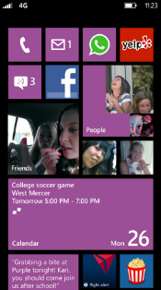
Evaluate this session
Required Slide
*delete this box when your slide is finalized
Your MS Tag will be inserted here during the final scrub.
Scan this QR code to
evaluate this session.

Slide 33
© 2013 Microsoft Corporation. All rights reserved. Microsoft, Windows and other product names are or may be registered trademarks and/or trademarks in the U.S. and/or other countries.
The information herein is for informational purposes only and represents the current view of Microsoft Corporation as of the date of this presentation. Because Microsoft must respond to changing market conditions, it should not be interpreted to be a commitment on the part of Microsoft, and Microsoft cannot guarantee the accuracy of any information provided after the date of this presentation. MICROSOFT MAKES NO WARRANTIES, EXPRESS, IMPLIED OR STATUTORY, AS TO THE INFORMATION IN THIS PRESENTATION.

Slide 34
Additional Slides for future reference

Slide 35
Screenshots for Windows Intune Subscription (SP1)

Slide 36
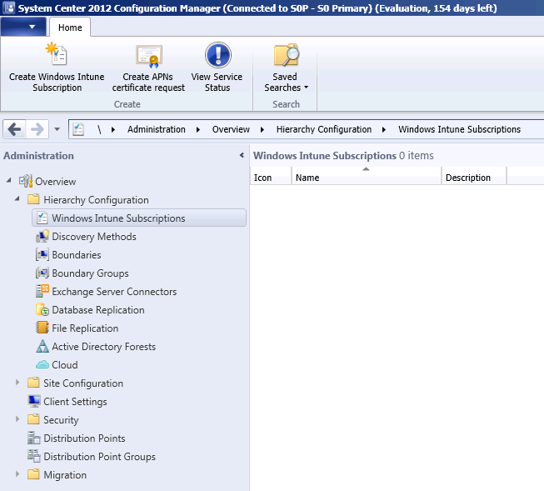

Slide 37
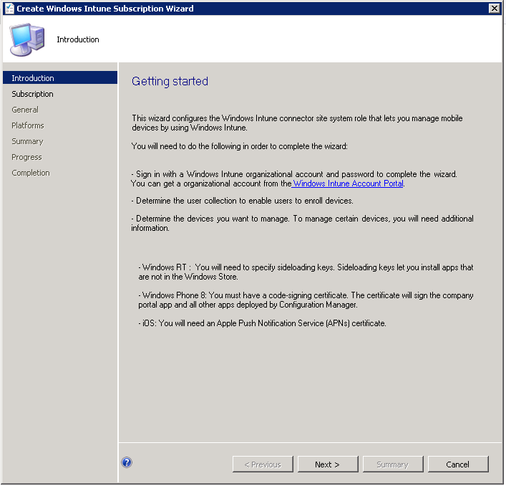

Slide 38
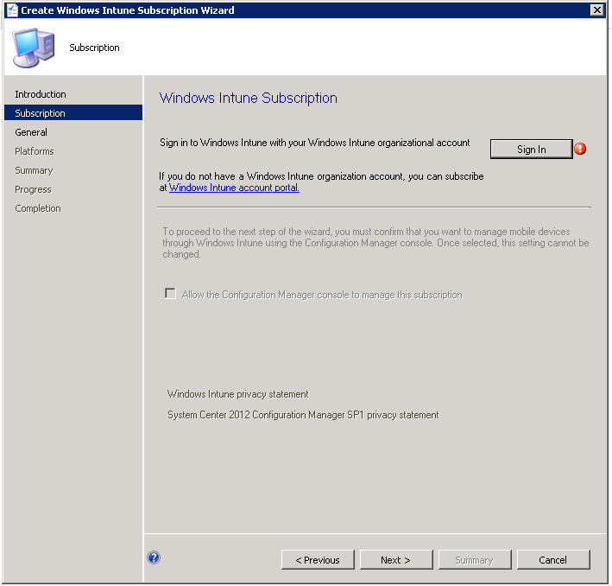

Slide 39
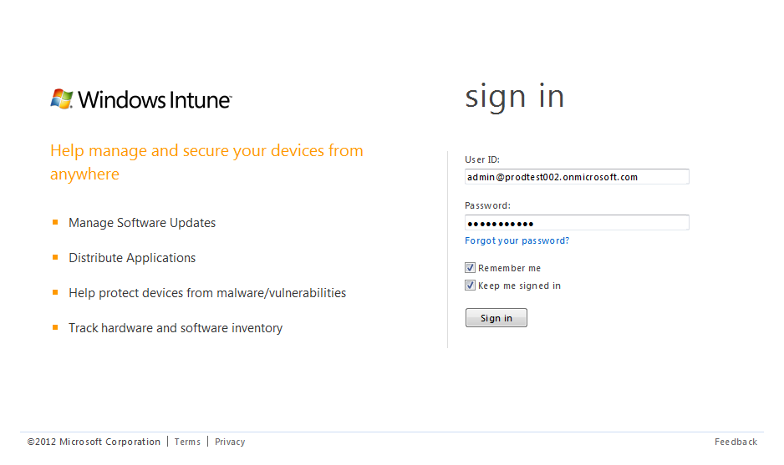
Sign In

Slide 40
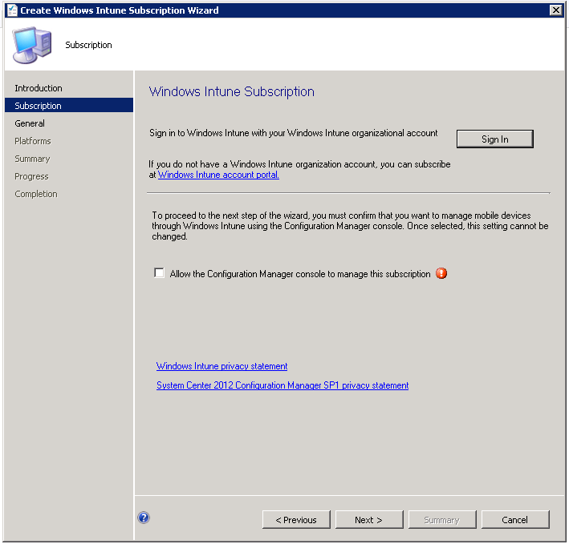

Slide 41
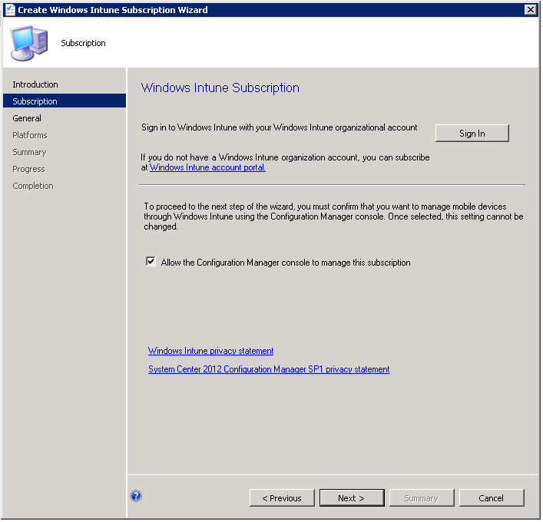

Slide 42
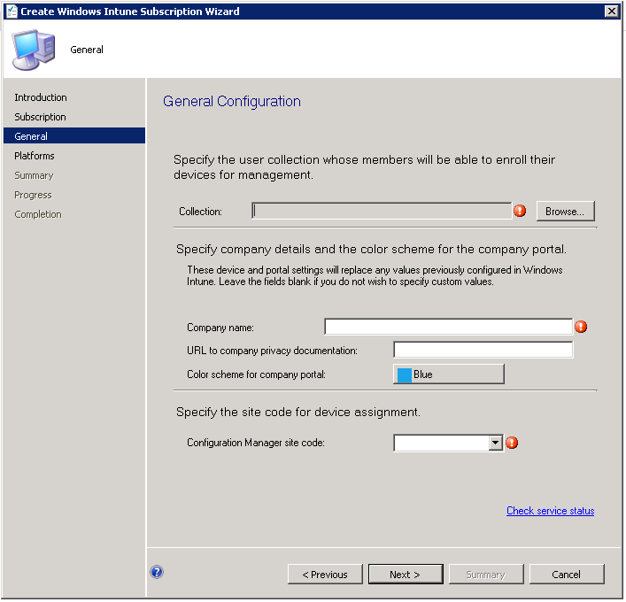

Slide 43
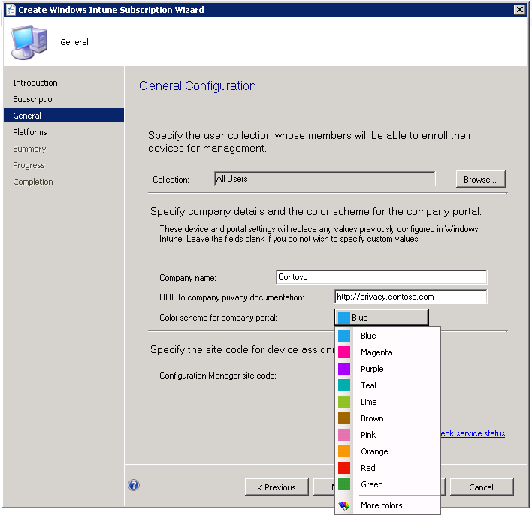

Slide 44
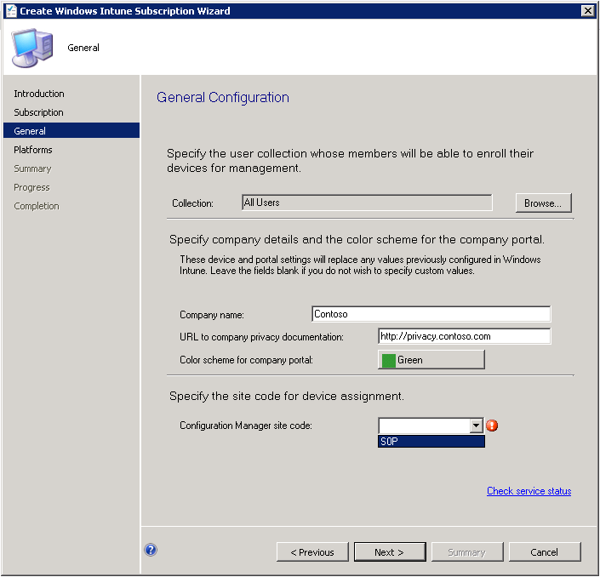

Slide 45
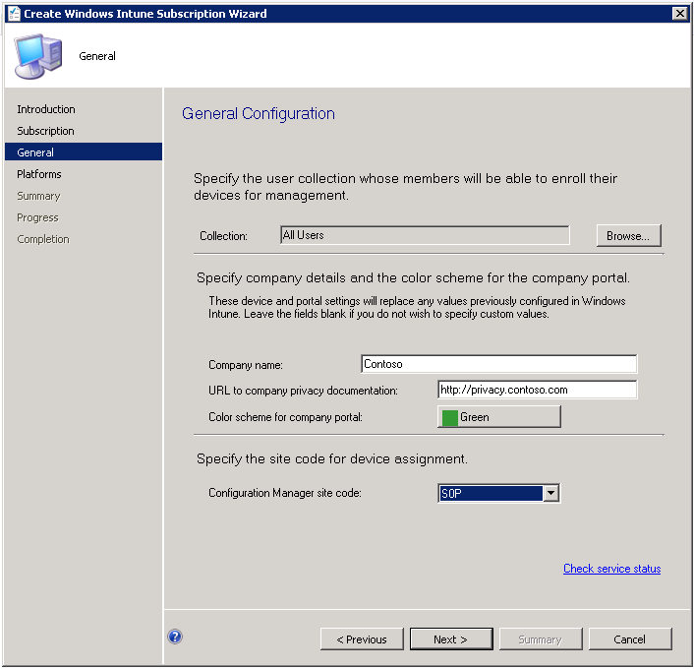

Slide 46
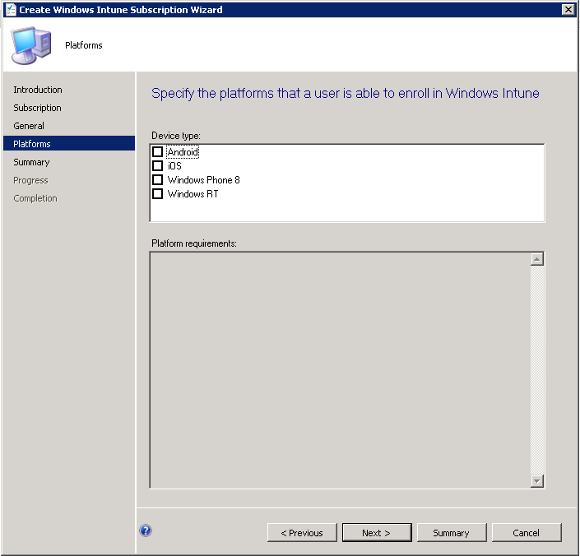

Slide 47
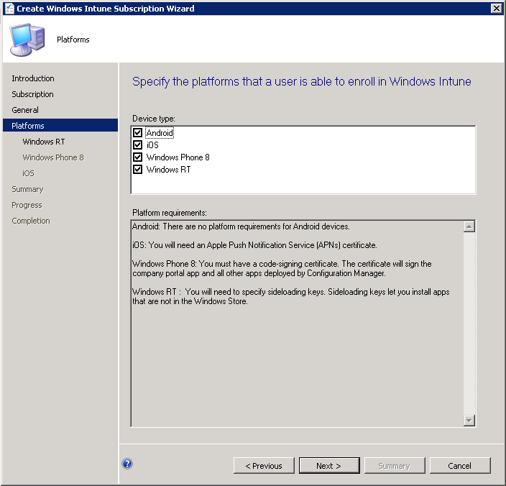

Slide 48
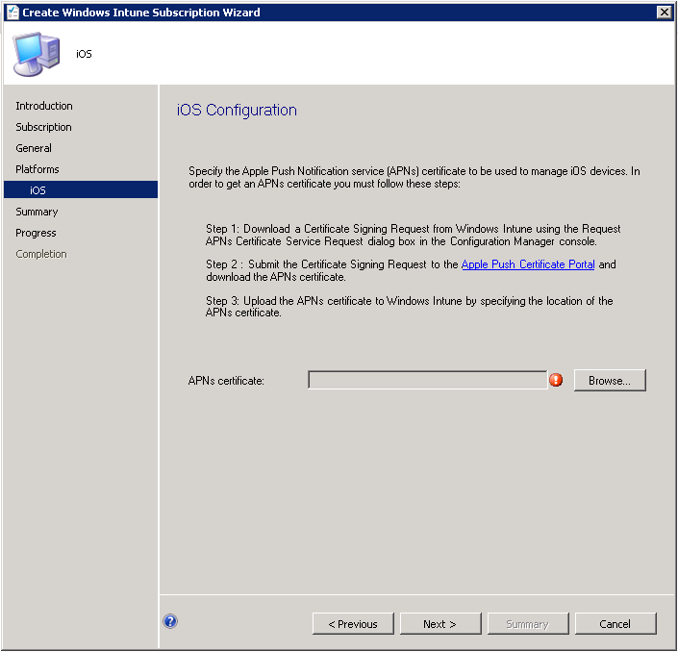

Slide 49
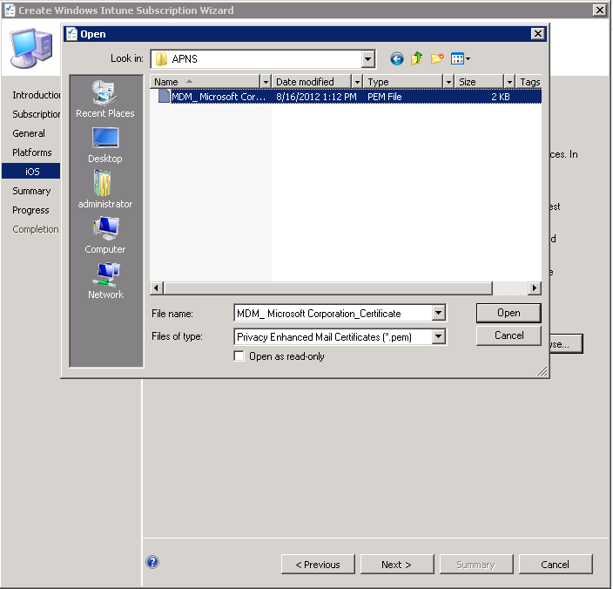

Slide 50
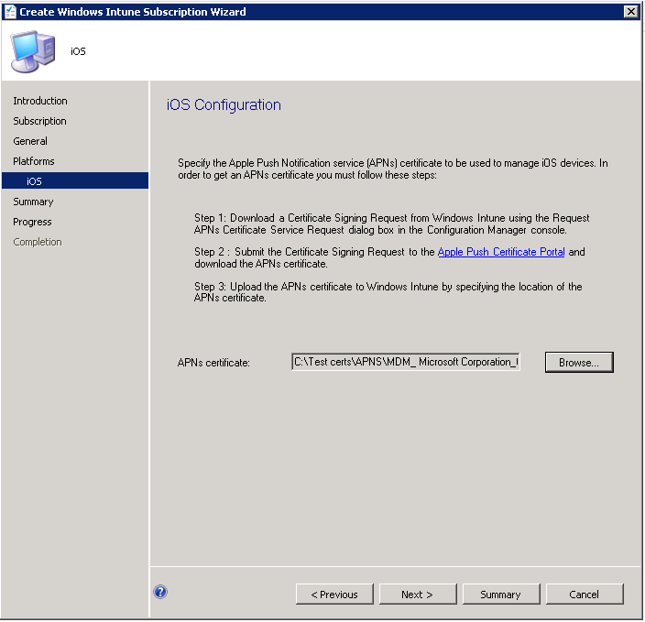

Slide 51
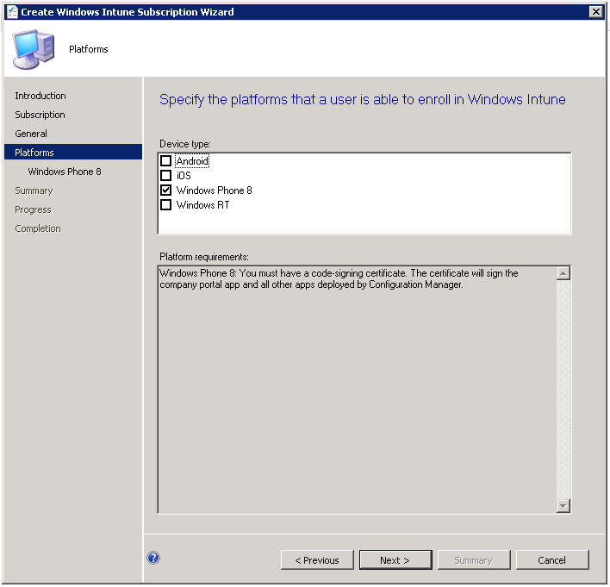

Slide 52
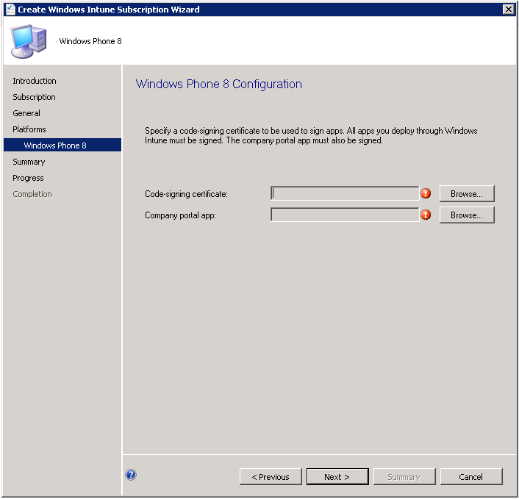

Slide 53
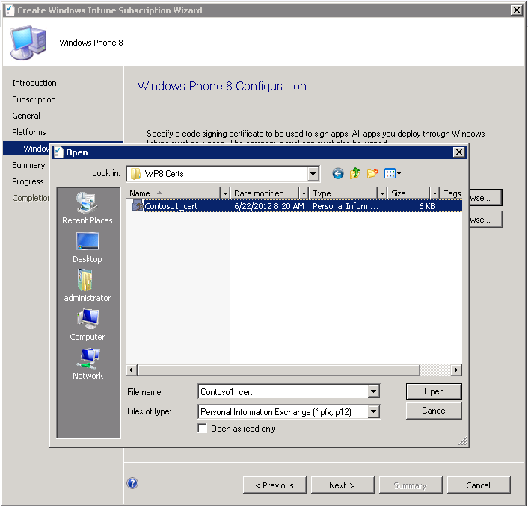

Slide 54
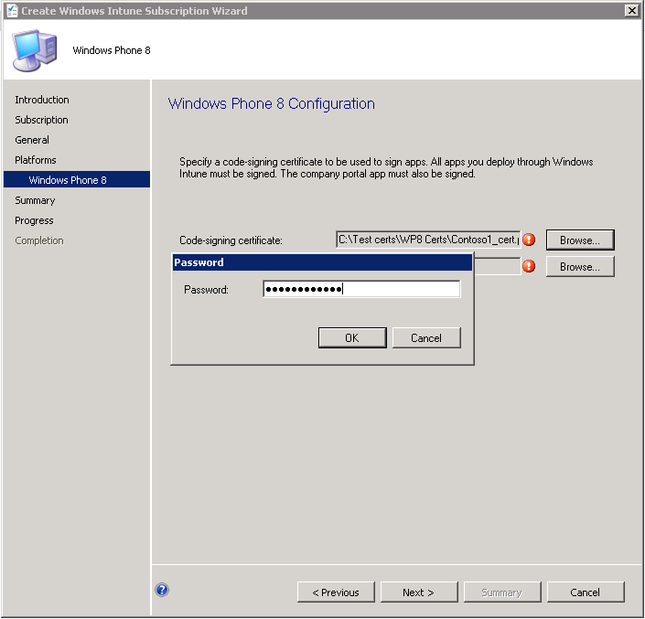

Slide 55
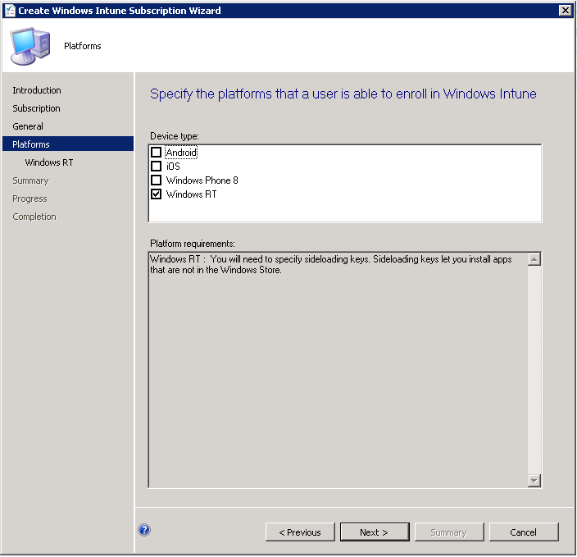

Slide 56
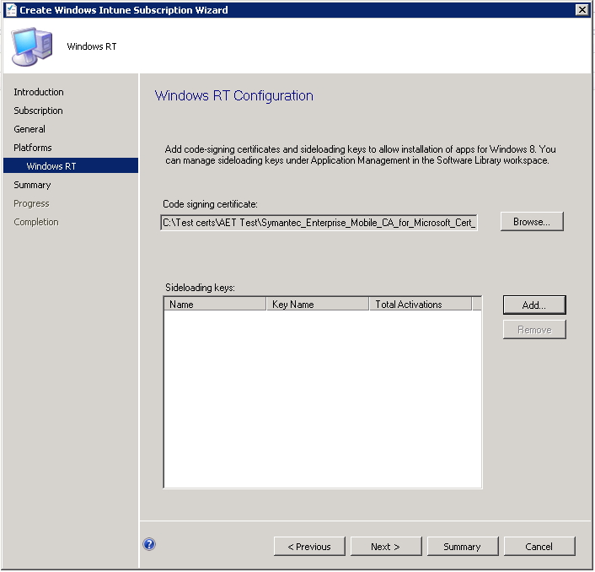

Slide 57
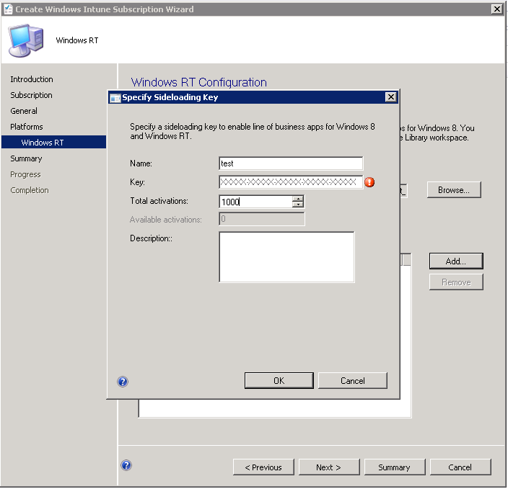

Slide 58
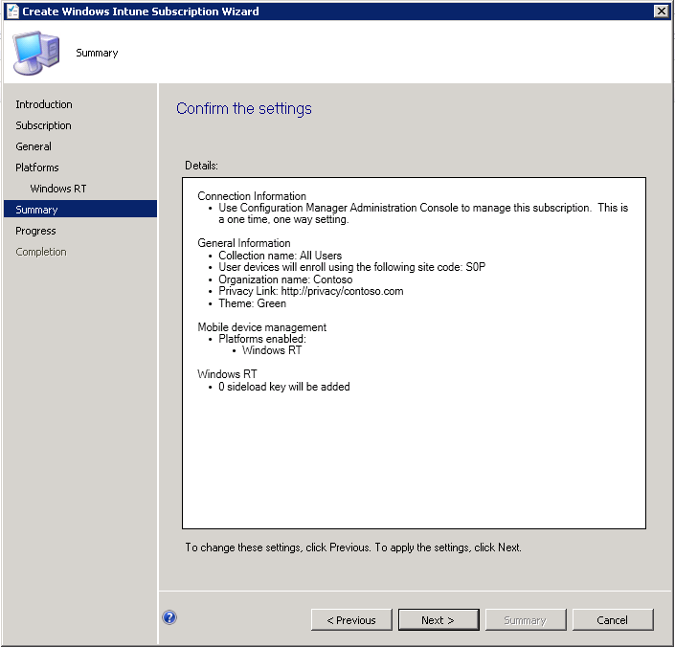

Slide 59
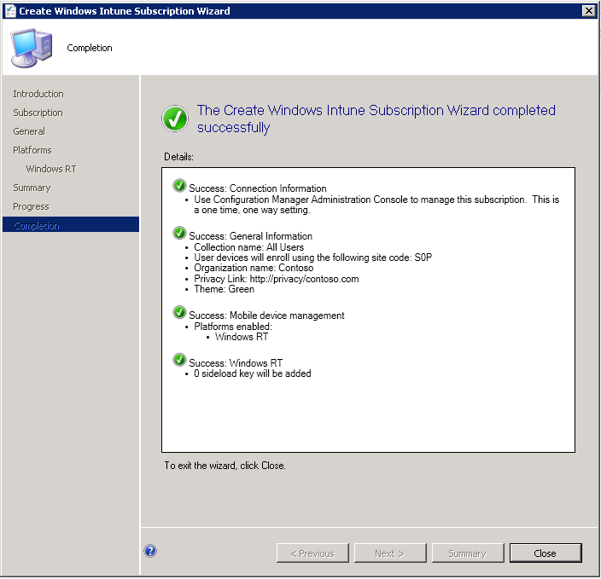

Slide 60
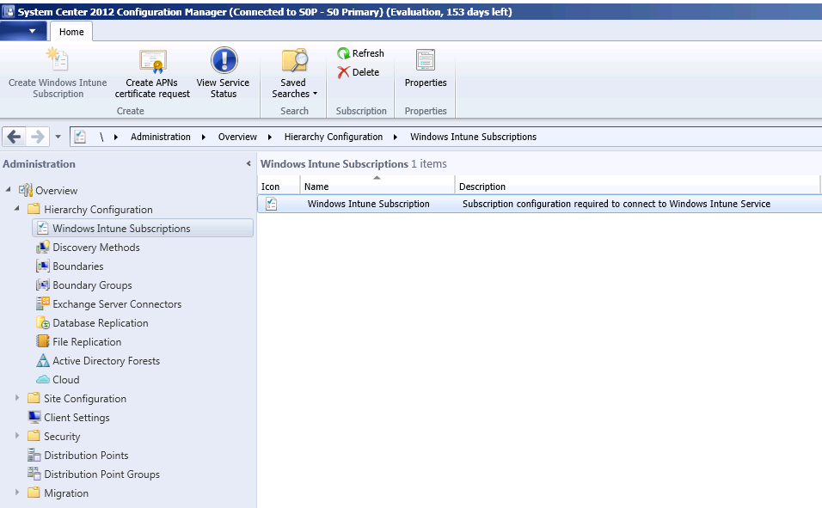

Slide 61
Screenshots for Windows Intune Connector (SP1)

Slide 62
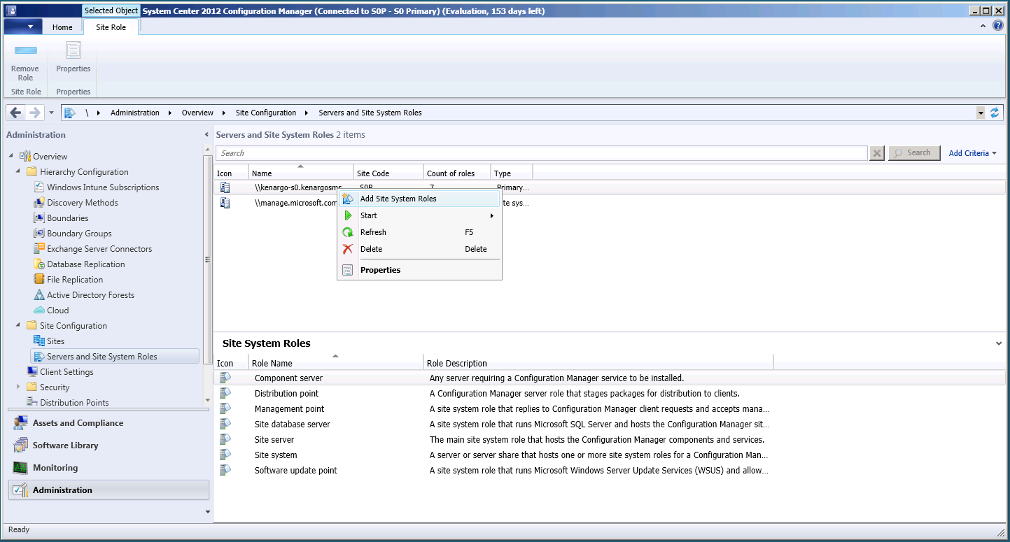

Slide 63
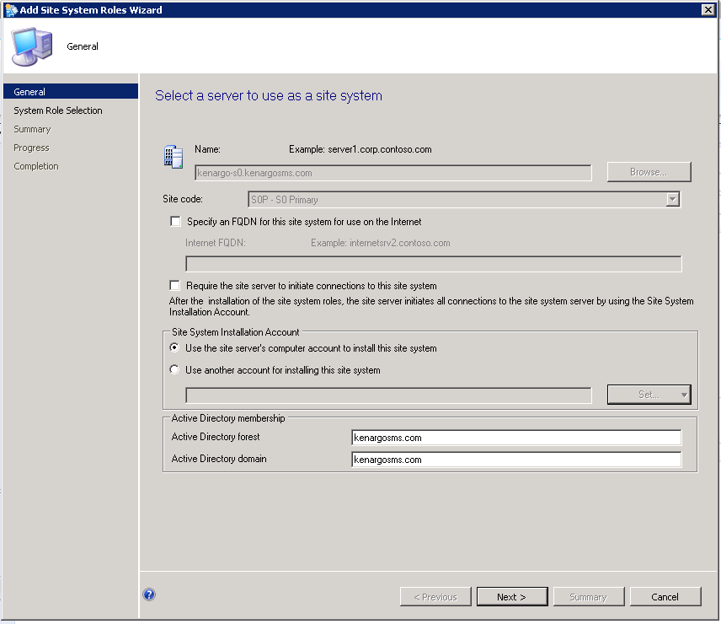

Slide 64
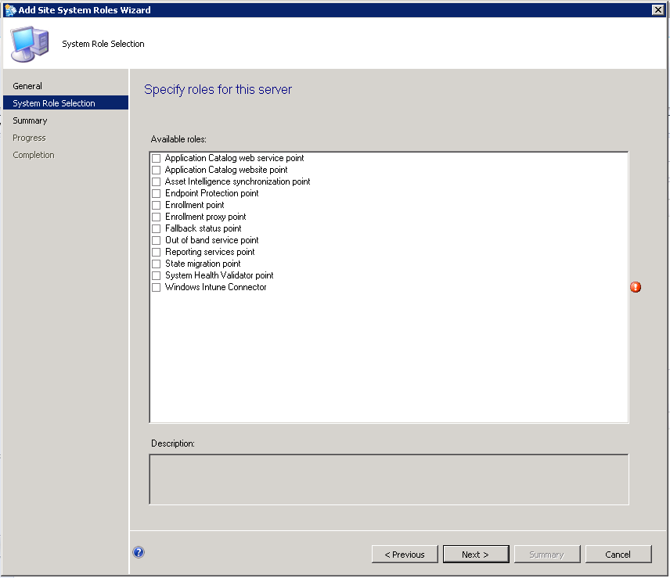

Slide 65
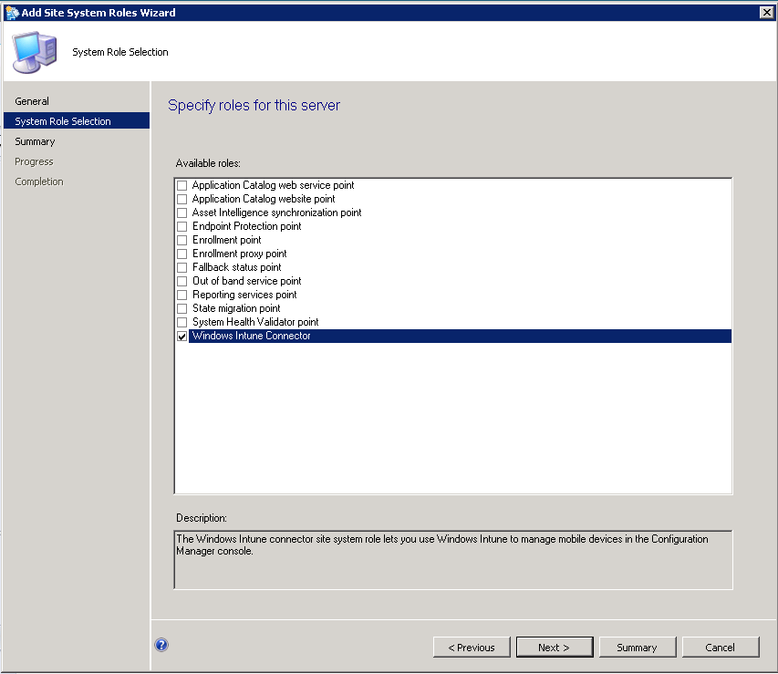

Slide 66
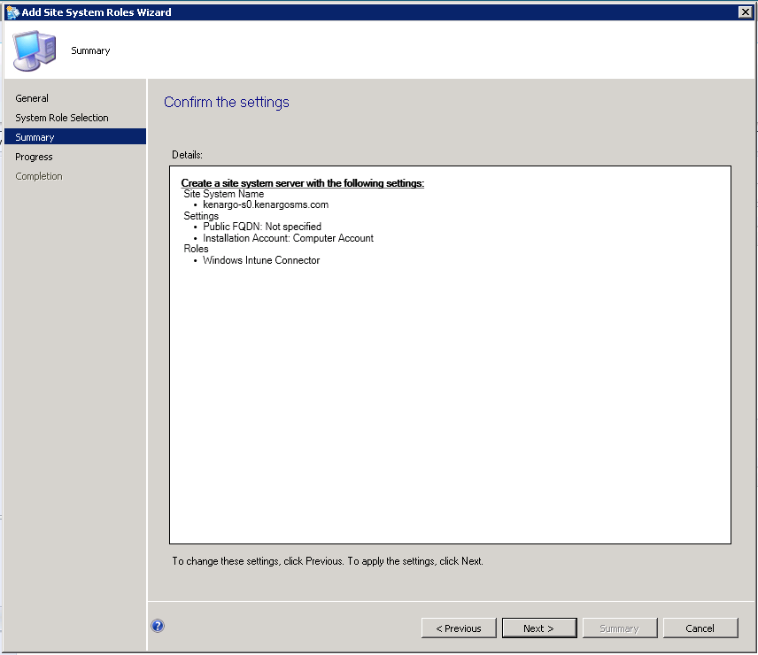

Slide 67
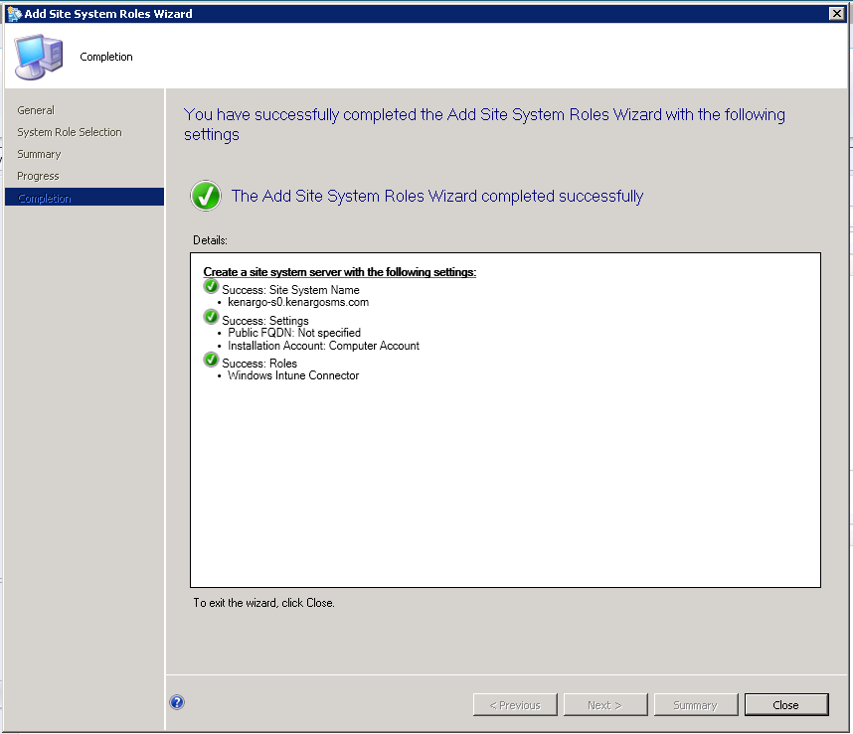

Slide 68
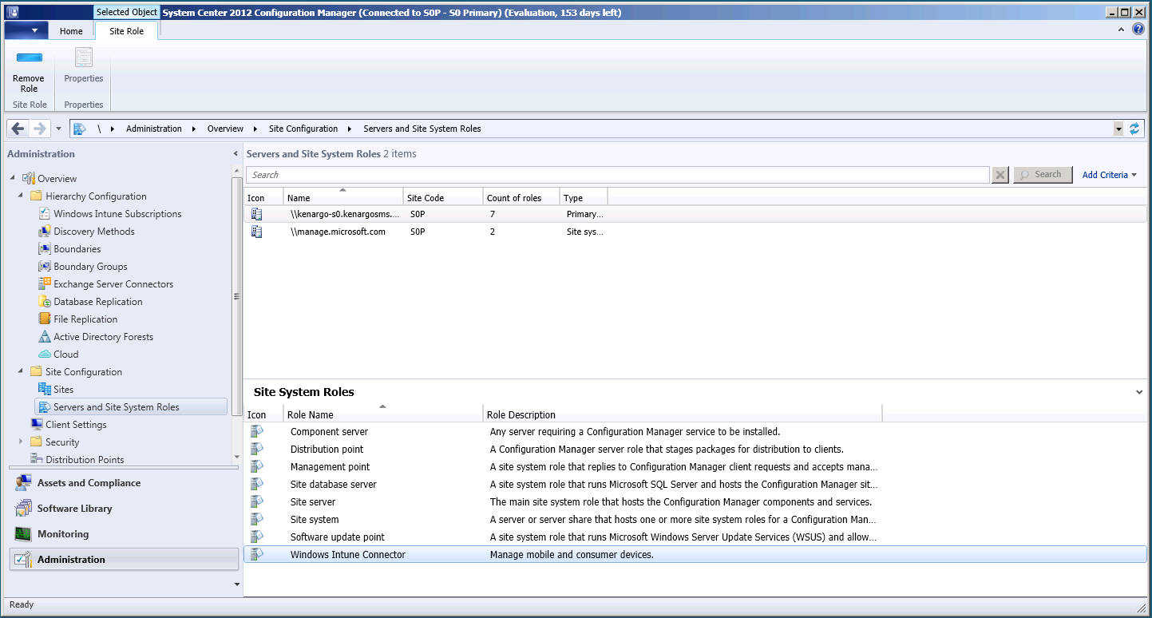

Slide 69
Active Directory DirSync and ADFS

Slide 70
AD Integration
User identities and SGs are created / modified in AD
DirSync delta syncs on-prem userid (no pwd) to MSODS every 3 hours
Federation between on-premise AD and Org ID allowing users to use their on prem username and pwd to login
All Identities and group memberships flow down to Intune via Sync Daemon
Identity Services
Exchange Online
On Premise Infrastructure
Trust
Authentication platform
All Identities and group memberships flow down to Intune via Sync Daemon
Active Directory Federation Server 2.0
SharePoint Online
IdP
IdP
Admin Portal/
PowerShell
AD
Windows Intune
MS Online Directory Sync (DirSync)
Provisioning
platform
Directory
Store
To learn more about ADFS, design and deployment visit Windows Server ADFS homepage and Preparing for single sign on.
For more details on AD Directory Synchronization visit Directory Synchronization roadmap.
For details on attributes DirSync’d see this KB
Microsoft Online Services

Slide 71
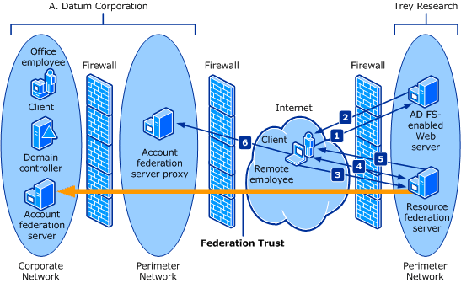
The following illustration and corresponding steps provide a description of the client application request process in AD FS using TLS/SSL.
The remote employee uses the Web browser to open the application on the AD FS-enabled Web server. 2. The AD FS-enabled Web server refuses the request because there is no AD FS authentication cookie. The AD FS-enabled Web server redirects the client browser to sign-in on the resource federation server. 3. The client browser requests the logon Web page from the resource federation server. 4. The Web page on the resource federation server prompts the user for account partner discovery.
The resource federation server redirects the client browser to the logon Web page on the account federation server proxy.
The Web browser requests the logon Web page from the account federation server proxy.

Slide 72
DirSync Installation Details
Supported Operating Systems
Prerequisites
Microsoft Windows Server 2008
Microsoft Windows Server 2008 R2
Microsoft Windows Server 2003 SP2
Microsoft .NET Framework 3.5 (reboot) and Microsoft Windows PowerShell™ v1.0 (no reboot)
Not a domain controller
Domain-joined machine
Source Forest Synchronization
Single file download
DirSync can synchronize from source forests running the following versions of Windows Server:
Microsoft Windows Server 2008 R2
Microsoft Windows Server 2008
Microsoft Windows Server 2003
Microsoft Windows Server 2000
Microsoft SQL Server® 2008 R2 Express
Microsoft Identity Lifecycle Manager 2007 (version created specifically for Microsoft Online)
No customer purchase beyond providing a server
To learn more about ADFS, design and deployment visit Windows Server ADFS homepage and Preparing for single sign on.
For more details on AD Directory Synchronization visit Directory Synchronization roadmap.
For details on attributes DirSync’d see this KB

