Slide 2
Integrating the New Microsoft Application Virtualization 5.0 with other Virtualization Solutions
WCA-B324
Steve Thomas - Senior Consultant
Alfred Ojukwu - Senior Consultant
Henry Schulman - Consultant

Slide 3






Are You Ready?
Get Up!!!
YAAAWWWN!
Get Ready for…
App-V 5.0

Slide 4



Session Objectives
Introduction to App-V 5.0
Demonstrations
Why App-V Matters
Virtualization Optimization

Slide 5
But first…. A Quote
Reject the Tyranny of the "Or," and Embrace the Genius of the "And."

Slide 6
Agenda
Microsoft App-V 5.0
Working with Citrix
Virtual Application Delivery with System Center
Desktop Virtualization
User Experience Virtualization
Storage Virtualization
Service Virtualization
Summary
Questions

Slide 7
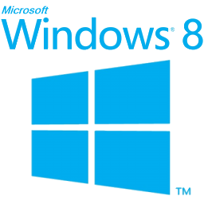








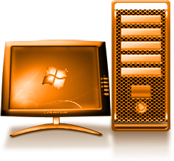


App-V Over the Years 3.x – 5.0
2013
Citrix XenApp 7
App-V 5.0 SP2 Beta
2012
App-V 4.6 SP2 & 5.0
2011
2012
App-V 4.6 SP1
2010
App-V 4.6 RTM
Citrix Integration
2009
App-V 4.5 SP1
2008
App-V 4.5 RTM
2006
2007
SoftGrid 3.0
SoftGrid 4.2
Microsoft
SoftGrid for Desktops
SoftGrid for Terminal Servers
MDOP 2008 R2
MDOP 2009 R2
MDOP 2010
MDOP 2011
MDOP 2012
MDOP 2013

Slide 8

Microsoft
App-V 5.0

Slide 9








App-V 5.0
Microsoft Application Virtualization (App-V)
Virtual Desktop
How does it Work?
Anywhere Productivity
Access to applications on any device without installs
Avoid Business Disruptions
Log in to retrieve applications and restore productivity
Accelerate Deployment
Faster provisioning of virtual applications on demand
Reduce application testing time
Login xxx
Login xxx
Local Desktop
End Point

Slide 10

App-V 5.0 Design Goals Achieved
App-V 5.0
Increased Integration
  SFTTray.exe not required
  Local storage of Virtual File System (VFS)
  Simplified Troubleshooting
Increased Flexibility
  Virtual Application Connection Groups
  Virtual Application Extensions
  Co-existence with previous version (4.6 SP2)
Increased Manageability
  Flexible deployment
  Enable full support automation
  Provide a Unified Experience

Slide 11
Working with Citrix

Slide 12
Citrix Partnership
Partners for over 23 years
Creates the ability to work together in the field
Latest Release – Citrix XenApp 7.0
Provides integration of Citrix XenApp and XenDesktop

Slide 13
XenApp and Microsoft Integration
Integration Scenarios…
MS RDP & Remote Apps for Windows shops on high bandwidth networks
MS and Citrix for Windows shops when you need a lighter client for lower bandwidth environments
MS and Citrix for work from anywhere on any device

Slide 14
XenApp and Microsoft App-V integration
App Delivery Methods…
Publish App-V packages directly from XenApp
Manage App-V client plug-in using Citrix Receiver
Subscribe to App-V packages using Citrix Receiver

Slide 15
XenDesktop 7 Integration with App-V 5.0
App-V 5.0 is now the preferred streaming engine
Integration with Citrix Studio
4.X requires manual publishing

Slide 16
Demo
Taking advantage of the XenApp Connector

Slide 17
Benefits of App-V & Citrix
App-V 5 Shared Content Store is perfect for non-persistent desktops
Citrix XenApp 6.5 integration with Microsoft Configuration Manager 2012
Deploy App-V 5 apps with SCCM 2012, PowerShell, GPO or as stand alone
Run multiple versions of the same application on the same server. No more need for silos
Run the same App-V 5 package on various platforms
App-V 5 Sequencer Ease of use. Let the Application Managers be responsible for their software

Slide 18
App-V 5.0 and XenApp 6.5
Integration can still be accomplished
Known Issues
    Publishing Process
      Length issues
      Custom Integration (AppPaths with ShellExecute)
    Profile Management/User Profile Disk configuration

Slide 19
Virtual Application Delivery with System Center

Slide 20








Configuration Manager and App-V
Configuration Manager Site Server
App-V Sequencer
Configuration Manager Distribution Point
Remote Desktop Services
App-V Applications
Physical Applications
App-V Applications
VDI
Delivery Overview
Physical Devices

Slide 21




Using Configuration Manager 2012 SP1
Application (e.g. Adobe Reader)
  Metadata about the application, information that is used to display the application in the Portal
  Deployed to machine and user collections
  Contains a set of Deployment Types
Deployment Types
Windows Installer (MSI)
App-V
Windows Script
Windows Mobile (CAB)
Nokia (SISX)
XenApp (to be released)
Deployment Types
Windows app packages (APPX/Windows Store Link)
App-V 5.0
Adobe Reader
(MSI)
XenApp
(with XenApp Connector – to be released)
Adobe Reader
(App-V)
Adobe Reader
(APPX/ Windows Store Link)

Slide 22

App-V in Configuration Manager 2012
What has Changed?
New Application Model User Centric Features
  Instant Icon Gratification for unlock events
  Application Virtual Environments
Integration with Remote Desktop Services (RDS) to target user sessions on RDS servers
Content Improvements
      Streaming Improvements
      Reduce virtual app footprint when using Download and execute
Integration requires App-V 4.6 SP2 or 5.0 Client
Change is Good!!!
    Enable support for application dependencies
    Improved update behaviors
    Selective publishing of components
  Dynamic Suite Support

Slide 23
Microsoft Application Virtualization in Configuration Manager SP1
App-V 4.6 SP2 support:
  Needed for Windows 8
  Same feature functionality
App-V 5.0:
  New Deployment Type for App-V 5.0 applications
  Integrated with App-V Connection

Slide 24

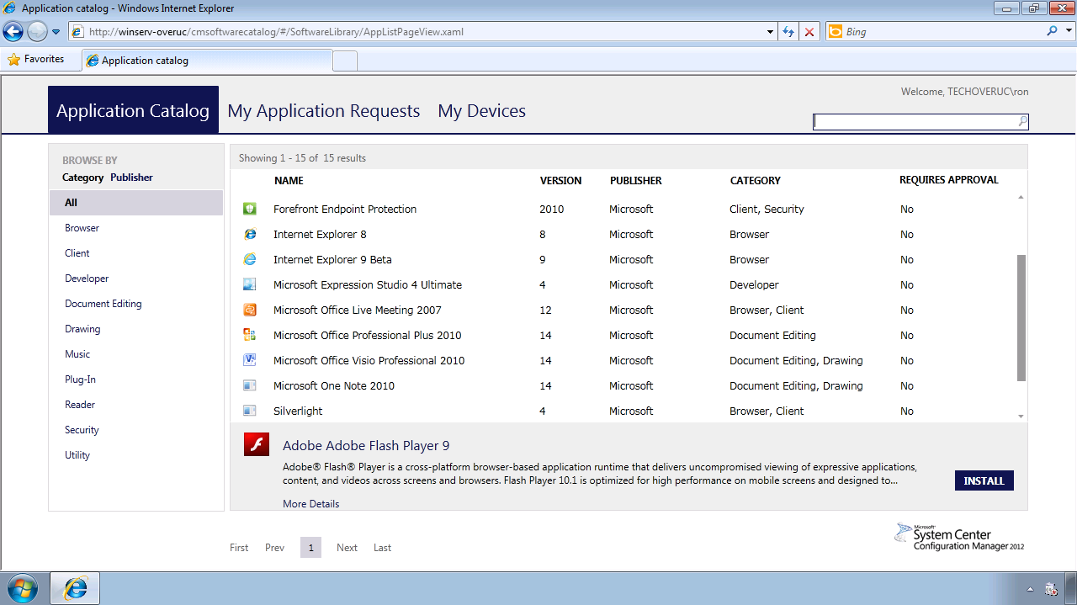

Application Web Catalog
Administrators publish software titles to catalog, complete with metadata to enable search
Deliver best user experience
on each device
IT Admin
“Available” deployments enable user invocation from the Application Web Catalog including administrator approval prior to publishing App-V and traditional applications.
Users can browse, select and install directly from Catalog
Application model determines format and policies for delivery
App-V
User

Slide 25



Virtual Application Connection
Next Generation DSC
  App-V Packages can be deployed in multiple
  Virtual Application Connection Groups
  Configuration is separate from the packages
Integrated with App-V Management Server and ConfigMgr
  Create and configure via Server User Interface or PowerShell
  Know the dependencies
Manage in
Standalone Mode
  Can use PowerShell to create and manage
Supported Configurations
  Applications + Plugins
  Applications + Middleware
  Applications + Applications

Slide 26
Desktop Virtualization

Slide 27







Microsoft Desktop Virtualization
Centralized and Unified Management
User State
Applications
Operating System
User State
Change the Device,
Keep your Experience
Virtually Any Application, Anywhere
Windows
Everywhere
Applications
User Experience
Virtualization (UE-V)
Folder Redirection
Applicaion
Virtualization (App-V)
RemoteApp
Microsoft VDI
Client Hyper-V
MED-V
Operating System
Deliver virtualization to the user through a more comprehensive platform!

Slide 28
Desktop Virtualization
Pure Microsoft Stack
Hybrid Stack
  Citrix XenDesktop
  VMWare View
Client-Hosted
  MED-V

Slide 29
User Experience Virtualization

Slide 30
What is User Experience Virtualization?
Developed as a replacement for Roaming User Profiles (RUP)
Provides a consistent Windows Experience
  Enterprise Scalable Solutions
  Options like toolbar and desktop help define the experience
Virtualizes and Roams User Experiences
  Experience follows the user from device to device
  Virtualizes across boundaries (Surface to Desktop to Session)
  Crosses App Formats (Native/AppV)
  Cross-Modern OS Experience
Smart Synchronization Policies
  Logon and Log-off, Lock\Unlock, Connect\Disconnect RDP Session
  Opening and Closing of the Application

Slide 31
Integrated & Scalable: Deployment Overview
Settings Storage Location
  AD Home Directory
  Standard Network Share
UE-V Agent
  User Interface Coming
  Enterprise Software Distribution (ESD)
  Configure as part of the base Windows image
UE-V Setting Location Templates
  Template Catalog Path
  Enterprise Software Distribution (ESD)

Slide 32
Integrated & Scalable: UE-V Requirements
Operating System | System Architecture | .NET Framework
Windows 7 | 32-bit or 64-bit | .NET 3.5
Windows Server 2008 R2 | 64-bit | .NET 3.5
Windows 8 | 32-bit or 64-bit | .NET 4.0 or 3.5
Windows Server 2012 | 64-bit | .NET 4.0 or 3.5
Windows 8 Modern App Support Coming

Slide 33

Benefits of and App-V & UE-V Integration
Great compliment with App-V
VDI Improvements Coming
Smart Login and Synchronization
Supports IE9 and IE10
Manages User File and Registry Settings across physical and virtual applications
Very simple to configure
Minimal infrastructure required
Replacement for PKG files

Slide 34
Other User Experience Virtualization Solutions
AppSense
    AEM
RES
    Workspace Manager
  Immidio
    Flex Profiles

Slide 35
Reasons to Use Partners
Rollback
Mandated Settings
Reporting
XP Migration

Slide 36
Storage Virtualization

Slide 37
The Shared Content Store – File System Abstraction
Improvement of App-V 4.6 Shared Content Store
Allows for streaming of Application Content directly from the store
Speeds up Rapid Provisioning for VDI

Slide 38
Flexibility
SCS Can be used in most App-V 5 implementations
  Even CM 2012 SP1
More Device Flexibility than 4.6 Shared Cache
  SAN
  NAS
  File Share\DFS
  Web Server
NAS protocols
  CIFS\SMB
  SMB3
  HTTP

Slide 39
Demo
Using UE-V and SCS to Enhance the App-V Experience

Slide 40
Service Virtualization

Slide 41
Server App-V Mission Statement
Dramatically simplify the deployment and management of Data Center applications by providing a consistent, predictable experience without requiring a rewrite.

Slide 42
Server Virtualization Benefits?
Simplify deployment of applications
    Run through a lengthy, multi-installer process once
    Consistent, repeatable deployments across multiple environments
    Take advantage of VMM Service Templates
    Enable image-based servicing
Virtual app state separation from virtual app and OS
  Allows for seamless OS updating and patching
  Application portability

Slide 43
Rapid App-V Infrastructure Deployment and Scale-out
App-V Server Roles
    Management Server
    Publishing Server
    SSRS (Reporting Server)
Remote App Packager
Retroactive Sequencing
Building Service Tiers with Server App-V and VMM

Slide 44
Demo
Server App-V in Action

Slide 45
Session Objectives: In Closing
Introduction to App-V 5.0
Demonstrations
Why App-V Matters
Virtualization Optimization

Slide 46
In Summary
App-V has a great story to tell when it comes to integration
Consider the best practice scenario that works for you in your organization
Embrace the App-V Integration story to simply your virtualization solution

Slide 47

Related content
Breakout Sessions (session codes and titles)
MDC-B343 | Top 5 Server Application Deployment and Servicing Problems Addressed by Server App-V and System Center 2012 SP1 - Virtual Machine Manager | Tuesday 13:30 -14:45
WCA-B203 | Microsoft Application Virtualization 5.0 and Microsoft Office: Better Together | Tuesday 16:45-18:00
WCA-B208 | Microsoft Application Virtualization 5.0 Migration and Co-Existence with 4.6 | Tuesday 13:15-14:30
WCA-B206 | The Replaceable PC | Wednesday 10:15-11:30
WCA-B319 | Implementing Microsoft Application Virtualization 5.0: Lessons Learned from a Production Rollout | Wednesday 10:15-11:30
WCA-B209 | What's New with Windows 8 BitLocker and Microsoft BitLocker Administration and Management (MBAM) 2.0 | Wednesday 13:30-14:45
WCA-B325 | Making PC Recovery Easier with the Microsoft Diagnostics and Recovery Toolset (DaRT) | Thursday 15:15-16:30
WCA-B359 | Microsoft User Experience Virtualization (UE-V): How to Manage and Deploy UE-V across an Enterprise | Thursday 10:15-11:30
WCA-B324 | Integrating the New Microsoft Application Virtualization 5.0 with other Virtualization Solutions | Friday 10:15-11:30

Slide 48

Resources
Learning
  Sessions on Demand
  Microsoft Certification & Training Resources
http://channel9.msdn.com/Events/TechEd
www.microsoft.com/learning
TechNet
msdn
  Resources for IT Professionals
  Resources for Developers
http://microsoft.com/technet
http://microsoft.com/msdn

Slide 49
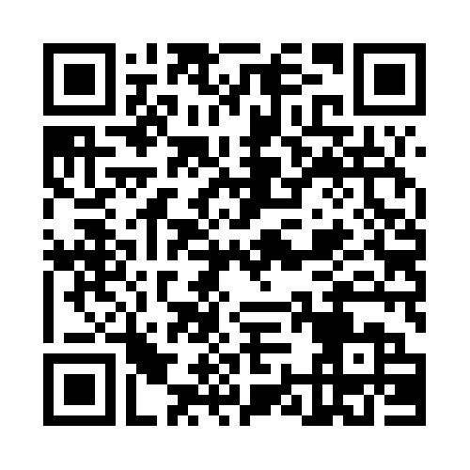


Evaluate this session
Required Slide
*delete this box when your slide is finalized
Your MS Tag will be inserted here during the final scrub.
Scan this QR code to
evaluate this session.

Slide 50

© 2013 Microsoft Corporation. All rights reserved. Microsoft, Windows and other product names are or may be registered trademarks and/or trademarks in the U.S. and/or other countries.
The information herein is for informational purposes only and represents the current view of Microsoft Corporation as of the date of this presentation. Because Microsoft must respond to changing market conditions, it should not be interpreted to be a commitment on the part of Microsoft, and Microsoft cannot guarantee the accuracy of any information provided after the date of this presentation. MICROSOFT MAKES NO WARRANTIES, EXPRESS, IMPLIED OR STATUTORY, AS TO THE INFORMATION IN THIS PRESENTATION.

