Slide 2
Enable work from anywhere without losing sleep: Remote Access with Web Application Proxy
WCA-B333
Shai Kariv & Avi Carmon
shaik@microsoft.com
avicar@microsoft.com

Slide 3
Agenda
WSSC 2012 R2 “work from anywhere“: the big picture
WAP drill down: scenarios, flows, architecture
Demos
Operability and design considerations
Relation to UAG, TMG, ARR, Intune, VPN, DRS
Call to action, Q&A

Slide 4







WSSC Work From Anywhere
Users can enroll devices for access to the Company Portal for easy access to corporate applications
IT can publish Desktop Virtualization (VDI) resources for external access
Users can work from anywhere on their device with access to their corporate resources.
Client VM
Session
host
RDS Gateway
IT can publish access to resources with the Web Application Proxy based on device awareness and the users identity
Published Apps
Web Application Proxy
Users can register devices for single sign-on and access to corporate data with Workplace Join
LOB Apps
Files
Remote Access
IT can provide seamless corp. access with DirectAccess and automatic connections with app-triggered VPNs.
Active Directory

Slide 5
Agenda
WSSC 2012 R2 “work from anywhere“: the big picture
WAP drill down: scenarios, flows, architecture
Demos
Operability and design considerations
Relation to UAG, TMG, ARR, Intune, VPN, DRS
Call to action, Q&A

Slide 6


Introducing: Web Application Proxy
Access corpnet apps from every device from everywhere, Windows and non-Windows
The IW device can be un-managed, dis-joined
(and even not workplace-joined)
SSO
IW:
Productivity
Selectively publish apps form corpnet
Control access per app, user, device, location
Better protection with pre-authentication
No changes in existing apps
No changes in devices (clientless)
IT Pro:
Manage Risk

Slide 7
Reverse proxy services
Network Isolation: incoming web traffic cannot directly access BE server
(even after pre-authentication, and even in pass-through)
Publishing is selective per internal application endpoint
Web protocols only: HTTP, HTTPS
DOS protection for BE server: incoming traffic is throttled and queued, to protect BE servers
URL translation: well-written corpnet apps can remain with internal non-FQDN URLs (http://hr); 2012 R2 provides HTTP header level translation
HTTPS-only endpoints are published externally (even in pass-through)
HTTPS to HTTP translation: internal URLs can remain HTTP
ADFS Proxy services: connecting through to internal ADFS, DRS

Slide 8
Pre-authentication services
Pre-authentication is optional
Pre-authentication is done before the client can access BE server
Pre-authentication is based on user identity, device identity, application being accessed, network location
Pre-authentication is done by consuming a dedicated security token from AD FS; there is a hard dependency on AD FS server
SSO: Avoid requesting credentials again, after first pre-authentication
The pre-authentication is flexible per AD FS policy, for example:
  MFA: Smart card, Phone authentication
  Soft password lockout

Slide 9
Pre-authentication schemes
Pre-authentication is supported for apps with the following authentication schemes:
  Browser-based apps:
    IWA with Kerberos (the WAP works in KCD mode)
    Claims aware
  Office (MS-OFBA)
  Modern apps (OAuth)
  Legacy rich clients/NTLM/Basic: pass-through mode
Active Directory Domain Controller
1. Obtain KCD service ticket for
IWA AuthN
Web Application Proxy
Backend Server
2. Access the app on behalf of the user

Slide 10
Network topology
AD FS
AuthN
Active Directory Domain Controller
AuthN Web UI
Config. Store
Client
(browser, Office client or modern app)
HTTP/S
Config. API over HTTPS
Obtain KCD ticket for IWA AuthN
AD FS Proxy
Firewall
Web Application Proxy
Firewall
Load Balancer
HTTP/S
Claims, IWA or pass-through AuthN
Backend Server
Load Balancer
Backend Server
Backend Server
Internet
DMZ
Corporate Network

Slide 11
WS 2012 R2 “edge server” deployment
Web Application Proxy
Admin Layer:
UI
PSH
WMI
Configuration
Windows Server Manager
Pre-Authentication layer:
Detect flow authentication
(claims, IWA, OAuth, Pass-thrugh)
Perform pre-authentication
Set session cookies
Windows Server Remote Access: VPN Server
Windows Server RDS Gateway
Core layer:
Listen on URLs
Networks isolation
Hostname translation
Logging and tracing
http.sys

Slide 12

Internet
Perimeter network
Internal network
`
AD
https://sts.fabrikam.com
AD FS
https://sts.fabrikam.com
App Policies
User
Web Application Proxy
WAP
LOB app
(Windows authN)
http://lob

Slide 13
Internet
Perimeter network
Internal network
`
AD
https://sts.fabrikam.com
AD FS
App Policies
User
https://sts.fabrikam.com
Web Application Proxy
WAP
LOB
https:/lob.fabrikam.com
LOB app
(Windows authN)
http://lob

Slide 14
Internet
Perimeter network
Internal network
`
AD
https://sts.fabrikam.com
AD FS
App Policies
User
https://sts.fabrikam.com
Web Application Proxy
WAP
LOB
https:/lob.fabrikam.com
LOB app
(Windows authN)
http://lob

Slide 15
Internet
Perimeter network
Internal network
`
AD
https://sts.fabrikam.com
AD FS
App Policies
User
https://sts.fabrikam.com
Web Application Proxy
WAP
LOB
https:/lob.fabrikam.com
? 302
LOB app
(Windows authN)
http://lob

Slide 16
Internet
Perimeter network
Internal network
`
AD
https://sts.fabrikam.com
?
AD FS
App Policies
User
https://sts.fabrikam.com
Web Application Proxy
WAP
LOB
?
https:/lob.fabrikam.com
LOB app
(Windows authN)
http://lob

Slide 17
Internet
Perimeter network
Internal network
`
AD
https://sts.fabrikam.com
AD FS
App Policies
User
https://sts.fabrikam.com
Web Application Proxy
WAP
LOB
https:/lob.fabrikam.com
Edge
Policies
LOB app
(Windows authN)
http://lob
Application
Policies

Slide 18
Internet
Perimeter network
Internal network
`
AD
https://sts.fabrikam.com
AD FS
App Policies
User
https://sts.fabrikam.com
Web Application Proxy
WAP
LOB
https:/lob.fabrikam.com
LOB app
(Windows authN)
http://lob

Slide 19
Internet
Perimeter network
Internal network
`
AD
https://sts.fabrikam.com
AD FS
App Policies
User
https://sts.fabrikam.com
Web Application Proxy
WAP
LOB
https:/lob.fabrikam.com
LOB app
(Windows authN)
http://lob

Slide 20
Internet
Perimeter network
Internal network
`
AD
https://sts.fabrikam.com
AD FS
App Policies
User
https://sts.fabrikam.com
Web Application Proxy
WAP
LOB
https:/lob.fabrikam.com
LOB app
(Windows authN)
http://lob

Slide 21
Internet
Perimeter network
Internal network
`
SSO
Proxy
AD
https://sts.fabrikam.com
AD FS
Query
String
SSO
Proxy
App Policies
User
https://sts.fabrikam.com
Web Application Proxy
WAP
LOB
Query
String
https:/lob.fabrikam.com
LOB app
(Windows authN)
http://lob

Slide 22
Internet
Perimeter network
Internal network
`
AD
https://sts.fabrikam.com
AD FS
App Policies
User
https://sts.fabrikam.com
Web Application Proxy
WAP
LOB
Proxy
https:/lob.fabrikam.com
Query
String
SSO
LOB app
(Windows authN)
http://lob

Slide 23
Internet
Perimeter network
Internal network
`
AD
https://sts.fabrikam.com
AD FS
App Policies
User
https://sts.fabrikam.com
Web Application Proxy
WAP
LOB
Proxy
https:/lob.fabrikam.com
Query
String
SSO
?
LOB app
(Windows authN)
http://lob
Proxy

Slide 24
Internet
Perimeter network
Internal network
`
AD
https://sts.fabrikam.com
AD FS
App Policies
User
https://sts.fabrikam.com
Web Application Proxy
WAP
LOB
Proxy
https:/lob.fabrikam.com
Query
String
SSO
LOB app
(Windows authN)
http://lob
Proxy

Slide 25
Internet
Perimeter network
Internal network
`
AD
https://sts.fabrikam.com
AD FS
App Policies
User
https://sts.fabrikam.com
Web Application Proxy
WAP
LOB
Proxy
https:/lob.fabrikam.com
Query
String
SSO
LOB app
(Windows authN)
http://lob

Slide 26
Internet
Perimeter network
Internal network
`
AD
https://sts.fabrikam.com
AD FS
App Policies
User
https://sts.fabrikam.com
Web Application Proxy
WAP
LOB
https:/lob.fabrikam.com
SSO
LOB app
(Windows authN)
http://lob
? 401

Slide 27
Internet
Perimeter network
Internal network
`
AD
https://sts.fabrikam.com
AD FS
Kerberos
Constrained
Delegation
App Policies
User
https://sts.fabrikam.com
Web Application Proxy
WAP
LOB
https:/lob.fabrikam.com
SSO
LOB app
(Windows authN)
UPN
Proxy
http://lob

Slide 28
Internet
Perimeter network
Internal network
`
AD
https://sts.fabrikam.com
AD FS
App Policies
User
https://sts.fabrikam.com
Web Application Proxy
WAP
LOB
https:/lob.fabrikam.com
SSO
LOB app
(Windows authN)
http://lob
AP_REQ(tckt)

Slide 29
Internet
Perimeter network
Internal network
`
AD
https://sts.fabrikam.com
AD FS
Proxy
App Policies
User
https://sts.fabrikam.com
Web Application Proxy
WAP
LOB
lob
https:/lob.fabrikam.com
SSO
LOB app
(Windows authN)
lob
http://lob

Slide 30
Internet
Perimeter network
Internal network
`
AD
https://sts.fabrikam.com
AD FS
App Policies
User
https://sts.fabrikam.com
Web Application Proxy
WAP
LOB
https:/lob.fabrikam.com
SSO
LOB app
(Windows authN)
Proxy
lob
http://lob

Slide 31
Internet
Perimeter network
Internal network
`
AD
https://sts.fabrikam.com
AD FS
https://enterpriseenrollment.fabrikam.com
https://sts.fabrikam.com
App Policies
User
Web Application Proxy
WAP
https://enterpriseenrollment.fabrikam.com
DRS
LOB
https:/lob.fabrikam.com
LOB app
(Windows authN)
http://lob

Slide 32
Agenda
WSSC 2012 R2 “work from anywhere“: the big picture
WAP drill down: scenarios, flows, architecture
Demos
Operability and design considerations
Relation to UAG, TMG, ARR, Intune, VPN, DRS
Call to action, Q&A

Slide 33
Agenda
WSSC 2012 R2 “work from anywhere“: the big picture
WAP drill down: scenarios, flows, architecture
Demos
Operability and design considerations
Relation to UAG, TMG, ARR, Intune, VPN, DRS
Call to action, Q&A

Slide 34
Operability and design considerations
Deployment as part of RRAS server role
Managed by Windows Server Manager Remote Access
  Full admin stack: WMI, PSH, UI
  Cluster management consistent with VPN servers
  Operability can be constrained to network admin persona
BPA: contains ~10 BPA rules to avoid common deployment and configuration mistakes
SCOM pack: provides health status monitoring for Web Application Proxy and AD FS Proxy components
Standard Windows event logs, trace logs
Stateless architecture; enables scaling out edge servers
NDJ edge server – unless KCD is required

Slide 35
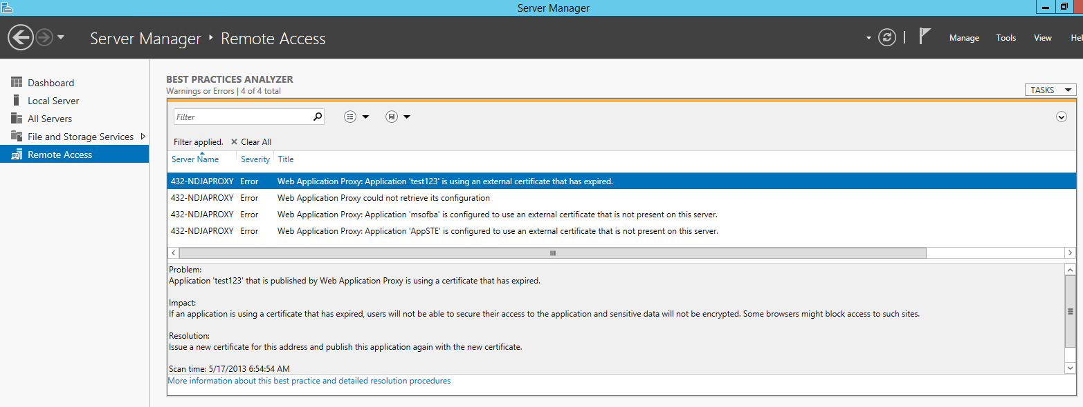
BPA
WAP Service is down (check only the WAP service settings – controller is dependant).
ADFS Proxy service is down
Client certificate validation relevant events
Internal and external URLs are different and host translation is disabled
DA is installed when using WAP cluster
Machine is configured but not in the cluster machine list
RP reference is not valid – object ID doesn’t match
Warning: Polling interval is too high
Certificate covers external URL

Slide 36
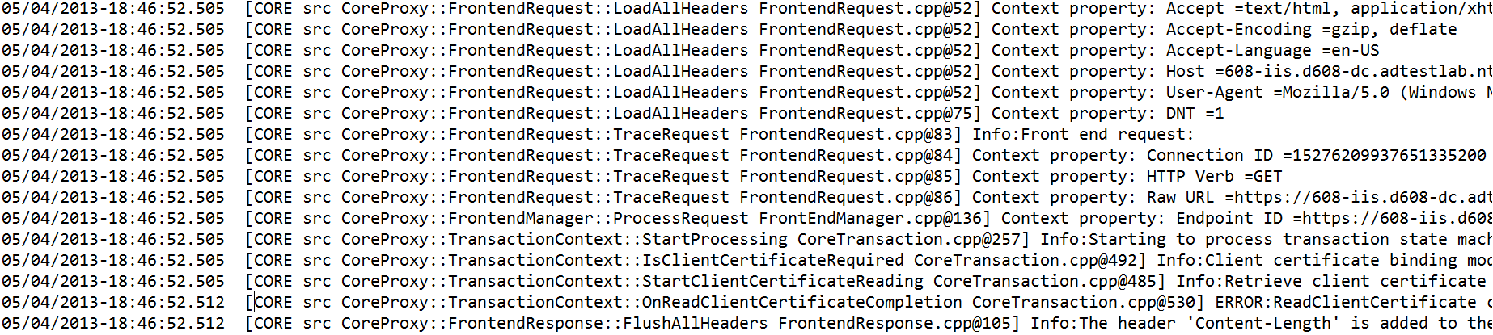
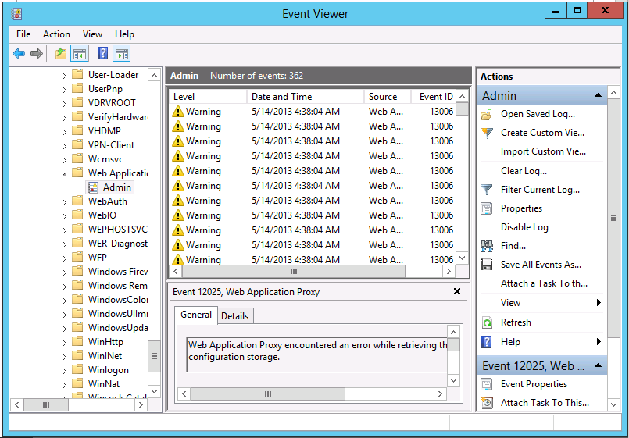
Events, traces

Slide 37
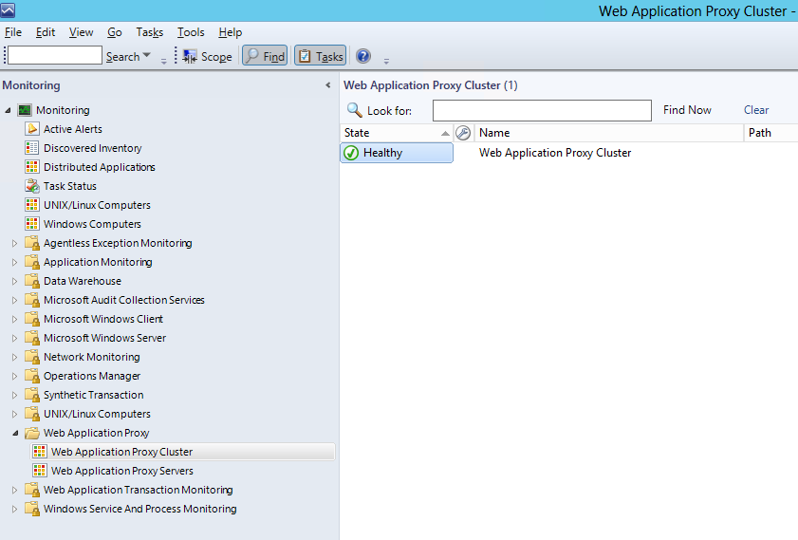
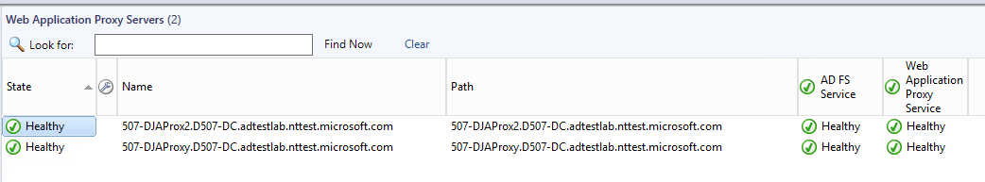
SCOM health monitoring

Slide 38
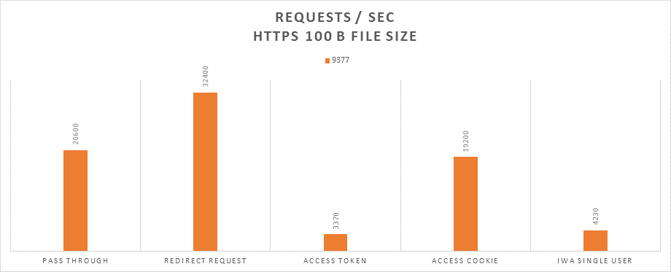
Performance and capacity
Throughput: thousands of requests per second

Slide 39
Agenda
WSSC 2012 R2 “work from anywhere“: the big picture
WAP drill down: scenarios, flows, architecture
Demos
Operability and design considerations
Relation to UAG, TMG, ARR, Intune, VPN, DRS
Call to action, Q&A

Slide 40
Relation to UAG
UAG is a mature product, managing traditional access
  Fully supported, continuously serviced, mainstream support through 4/2015
  No new statements today about UAG roadmap
  WAP is focused on modern access: selective publishing, pre-authentication of corporate applications to workplace-joined devices
  WAP is part of a broader BYO Access platform alongside AD, AD FS, Intune
  DA and VPN continue to evolve within Windows Server
  We are not building all of UAG functionality into Windows Server
New deployments should evaluate WS 2012 R2
  Start with WAP, give us feedback what is missing
  We’re already in planning for next release
  UAG and WAP cannot work side-by-side on the same box or same data flow

Slide 41
Relation to TMG, ARR
TMG is commonly used for publishing
  Especially Exchange publishing scenarios with client certificate authentication
  You can help identify critical capabilities in TMG required for great publishing experience for WAP scenarios
IIS ARR is occasionally mentioned as reverse proxy
  Especially for Lync 2013 and for URL translation scenarios
  The intended enterprise offering for web publishing is WAP, as part of Windows Server 2012 conditional access platform

Slide 42
Relation to Intune, VPN, DRS
Windows Intune: MDM service that adds value on top of access and identity, including client agent
VPN: role service within RRAS server role that can operate side-by-side with WAP
DRS: new device registration service as part of AD FS 2012 R2, required to workplace-join a BYO device

Slide 43
Agenda
WSSC 2012 R2 “work from anywhere“: the big picture
WAP drill down: scenarios, flows, architecture
Demos
Operability and design considerations
Relation to UAG, TMG, ARR, Intune, VPN, DRS
Call to action, Q&A

Slide 44

Related content
WCA-B204: AD Enables End User Productivity & IT Risk Management across a Variety of Devices
WCA-B334: Secure Anywhere Access to Corporate Resources Such as Windows Server Work Folders using AD FS
WCA-B207: Understanding Access and Information Protection
WCA-B322: Information Protection in 2013: Hybrid RMS, Generic Protection, and iOS/Android/WinRT support
FDN03: Enabling People Centric IT

Slide 45
Track resources
AD FS Content Map
  http://social.technet.microsoft.com/wiki/contents/articles/2735.ad-fs-2-0-content-map.aspx
Active Directory Blog
  http://blogs.msdn.com/b/active_directory_team_blog/

Slide 46
Windows Track Resources
Windows Enterprise: windows.com/enterprise
Windows Springboard: windows.com/ITpro
Microsoft Desktop Optimization Package (MDOP): microsoft.com/mdop
Desktop Virtualization (DV): microsoft.com/dv
Windows To Go: microsoft.com/windows/wtg
Outlook.com: tryoutlook.com

Slide 47

Resources
Learning
  Sessions on Demand
  Microsoft Certification & Training Resources
http://channel9.msdn.com/Events/TechEd
www.microsoft.com/learning
TechNet
msdn
  Resources for IT Professionals
  Resources for Developers
http://microsoft.com/technet
http://microsoft.com/msdn

Slide 48



Evaluate this session
Required Slide
*delete this box when your slide is finalized
Your MS Tag will be inserted here during the final scrub.
Scan this QR code to
evaluate this session.

Slide 49

© 2013 Microsoft Corporation. All rights reserved. Microsoft, Windows and other product names are or may be registered trademarks and/or trademarks in the U.S. and/or other countries.
The information herein is for informational purposes only and represents the current view of Microsoft Corporation as of the date of this presentation. Because Microsoft must respond to changing market conditions, it should not be interpreted to be a commitment on the part of Microsoft, and Microsoft cannot guarantee the accuracy of any information provided after the date of this presentation. MICROSOFT MAKES NO WARRANTIES, EXPRESS, IMPLIED OR STATUTORY, AS TO THE INFORMATION IN THIS PRESENTATION.

