Slide 2
Understanding Windows To Go: Supported use cases, hardware considerations, and deployment options in the Enterprise
WCA-B342
Craig Ashley
Sr. Product Manager
Microsoft

Slide 3
Session Objectives And Takeaways
Session Objective(s):
  Review key deployment scenarios and associated licensing guidance
  Understand key differences between Windows and Windows To Go
  Provide guidance regarding deployment options for Windows To Go

Slide 4










Unique Work styles
Contingent Staff
Ultra Mobile
BYOD

Slide 5
Windows To Go, Your Portable Workspace
A consistent Windows 8 experience on any device with Windows To Go
App-V
UE-V
Folder
Re-Direct
BENEFITS
Consistent Windows 8 Experience*
Works online or offline
Easy to use and personalize
Local data is protected
Easy to deploy and manage
FIREWALL
App-V
UE-V
Folder
Re-Direct
App-V
UE-V
Folder Re-Direct
01100111
01100111
11010011
11010011
11001001
11001001
10001001
10001001
Booting from
Internal hard drive
Booting from
External USB drive
BitLocker
  * Any device certified for use with Windows 7 or Windows 8, regardless of the OS running on the host machine. Software Assurance (SA) for Windows required .

Slide 6
Demo:
User Experience

Slide 7
Supported Use Cases

Slide 8




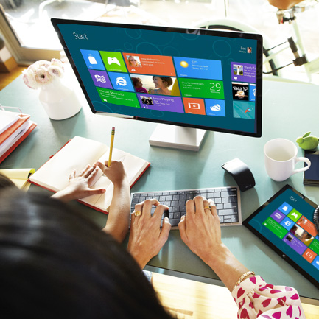

Cost Effective and Lightweight Solution
Windows To Go: Windows in your back pocket
Contractors
Bring Your Own Device (at work)
Travel Light / Work from Home
Shared PCs
Up and Running on Windows 8

Slide 9









Travel Light: At work, at home, on the road
  Software Assurance (SA) for Windows
  Software Assurance (SA) for Windows
  Branch Office
  Corporate Office
  Covered under SA roaming rights* (no additional license required)
  Library/Coffee house
  Covered under SA roaming rights* (no additional license required)
  Home
  *Roaming rights provide the primary user of an SA covered device rights to run Windows To Go or VDI from non-corp devices while off premise.

Slide 10


Bring Your Own Device; Employees and Contingent Staff
  Primary Device
  Windows VDA or Software Assurance (SA) for Windows
  Work Location
  Secondary Device
  Companion Subscription License (CSL)*
  *Windows CSL provides the primary user of an SA or VDA covered device rights to run Windows To Go or VDI from secondary non-corp owned devices.

Slide 11

Shared PCs
  Software Assurance (SA) for Windows
  Multiple Users
  Single or Multiple Locations
  Shared PCs

Slide 12
Windows To Go vs. Windows

Slide 13

Protecting Corporate Data
Supports BitLocker drive encryption
New Password Key Protector
Pre-OS password to unlock Windows To Go
Trusted Platform Module (TPM) is not used
MDOP 2013 and MBAM
Protection with Trusted Boot
Protects Windows boot process and anti-malware software
Protection with Windows
Can take advantage of all Windows security offerings, just like a laptop
For example, remote connectivity solutions still enforce the same security requirements

Slide 14
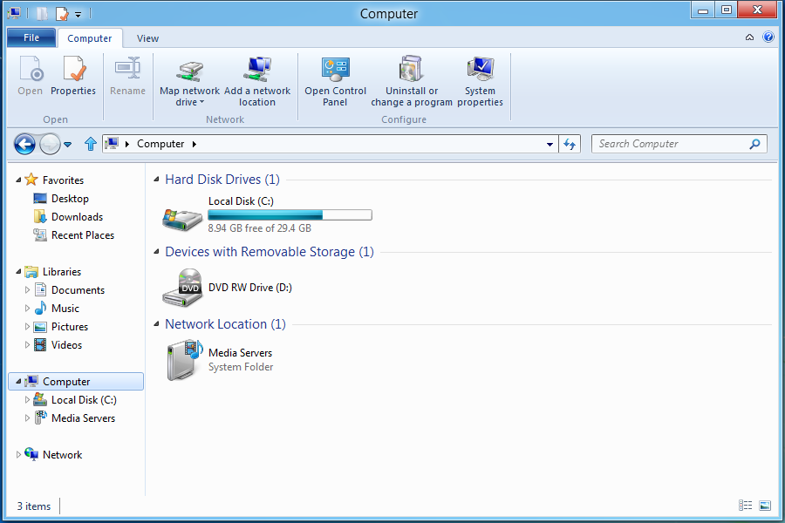
Internal disks are offline
Separation from host PCs internal hard drive
Makes the host’s internal hard drive offline
External Storage Devices are still accessible
Utilizes SAN policy
  Can be controlled by Group Policy
Host PC’s internal Hard Drive not visible

Slide 15
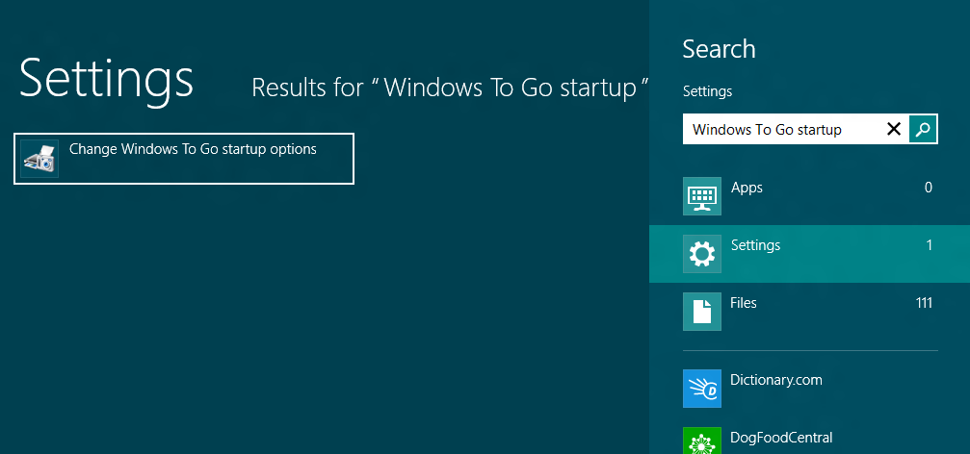
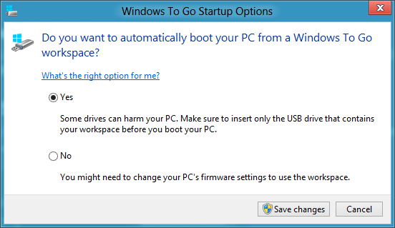
Booting from USB
Windows To Go Startup Options
Allows host PCs to automatically boot from USB
Only available on Windows 8 Hosts
2 Easy Steps in Windows 8
        Search for “Windows To Go Startup options”
        Select “Yes”
Not Running Windows 8
        USB boot “hotkeys”
        Configure BIOS to boot from USB

Slide 16
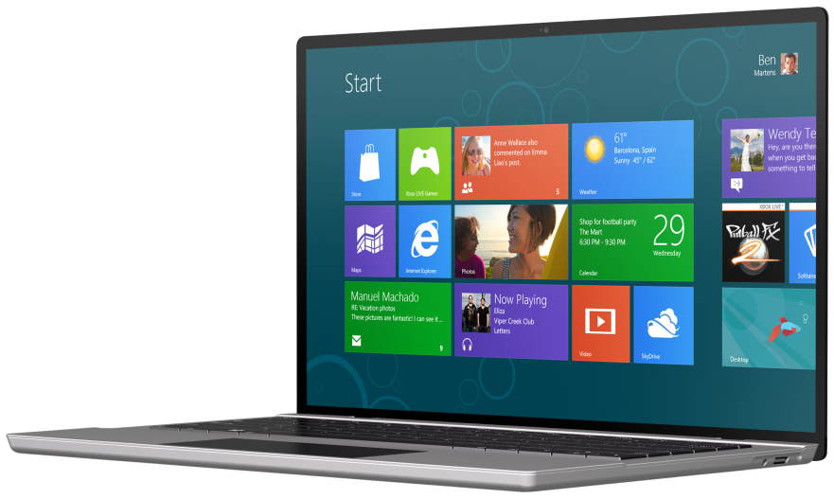
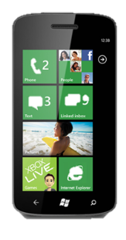
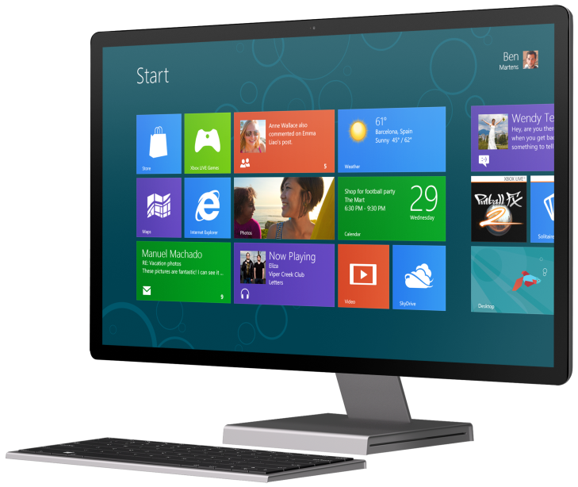
Full fidelity experience
High performance
Full native hardware access on the host machine
Same peripheral support as Windows 8
Touch enabled, mouse and keyboard aware
Windows 8: New Windows apps in the enterprise
Windows Store is disabled by default
For users that don’t roam, GP can enable the store
Enterprise sideloading of LOB metro-style apps works regardless
Windows 8.1: New Windows apps in the enterprise
Windows Store is enabled by default
Enterprise sideloading of LOB metro-style apps continues to work

Slide 17
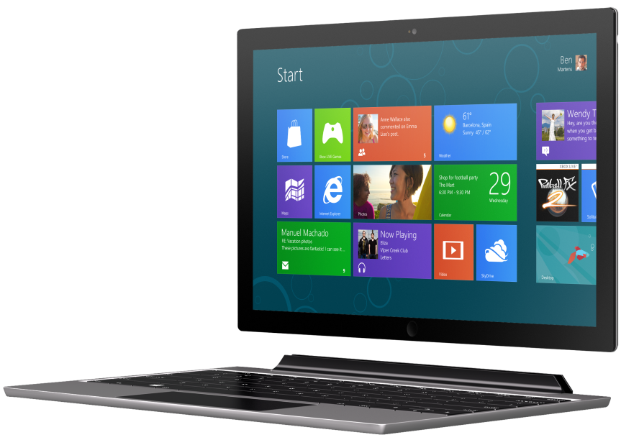
Moving between machines
Work Across Multiple PCs
On a new PC drivers are installed on first boot
Identifies computer from characteristics of machine firmware
Stores configuration to boot faster on previously used PCs
Work Across system Firmware
        Can be configured to boot on both UEFI and Legacy BIOS
        Both sets of boot components are placed on a system partition
        Doesn’t solve architecture incompatibility

Slide 18
Other differences
Windows Recovery
Windows Recovery environment is not available
Refresh or Reset your PC is not available
Special Considerations
        Hibernate is disabled by default
        Don’t insert the Windows To Go drive into a running PC
        Always shut down Windows and wait for shutdown to complete before removing a Windows To Go drive
        Supported on PCs certified for use with Windows 7 or 8, regardless of the OS on the machine

Slide 19
Windows To Go Drives

Slide 20
Windows To Go Certified Drives
Why is the use of a certified drive important?
Certified drives are optimized to meet the necessary requirements for booting and running Windows 8 from a USB drive:
  Built for high random read / write speeds
  Support thousands of random access I/O per second
  Provide wear-leveling features improving drive longevity
  Tuned to ensure they boot and run on hardware certified for use with either Windows 7 or Windows 8
Only certified and optimized drives are supported

Slide 21
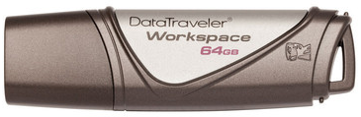
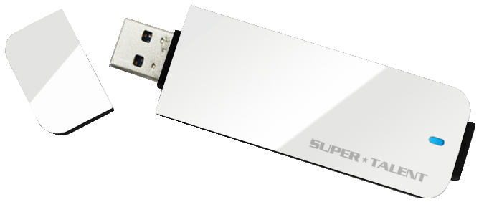

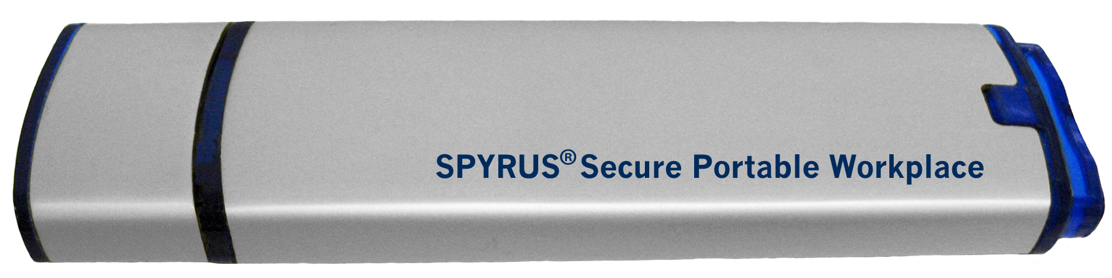

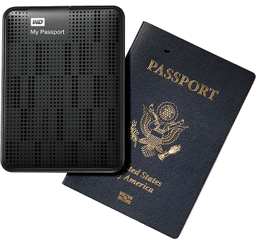
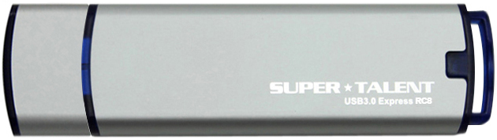
Windows To Go Certified Drives
Optimized for booting and running Windows 8 Enterprise on hardware certified for use
with Windows 7 or Windows 8.
Manufacturer
Storage size
Manufacturer
Storage size
Kingston® DataTraveler® Workspace
www.kingston.com/wtg
32, 64, 128 GB
Super Talent RC4
www.supertalent.com/wtg
32, 64, 128, 256 GB
Imation IronKey® Workspace W300
www.imation.com/wtg
32, 64, 128 GB
SPYRUS Portable Workplace™
www.spyruswtg.com
32, 64, 128 GB
Beta: Imation IronKey® Workspace W500
www.imation.com/wtg
32, 64, 128 GB
SPYRUS Secure Portable Workplace™
www.spyruswtg.com
32, 64, 128 GB
Super Talent Express RC8
www.supertalent.com/wtg
32, 64, 128 GB
WD My Passport Enterprise
www.wd.com/wtg
500 GB
*Microsoft only supports certified drives.

Slide 22
Evaluation

Slide 23
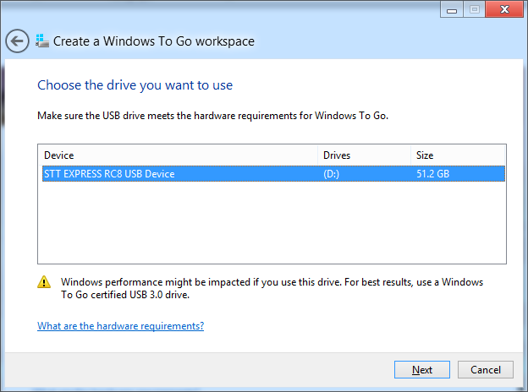
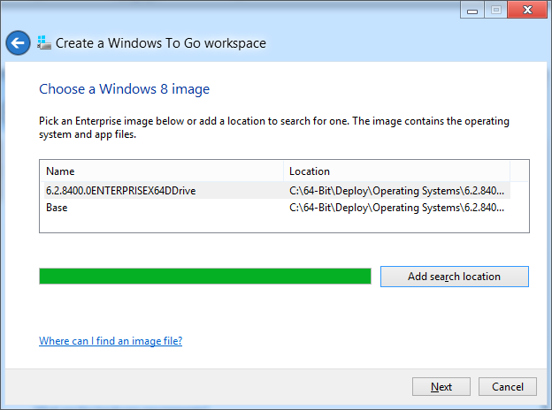
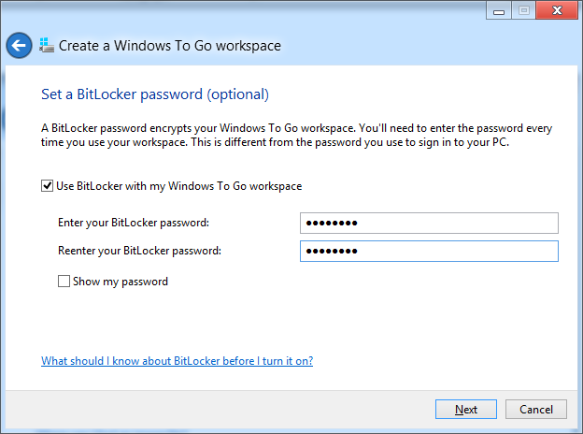
Evaluation: Self Provision with the Creator Tool
Windows To Go Creator in Windows 8 Enterprise
Provision single drive with an Enterprise Image only
Need admin access
Can be custom WIM or pointed at media
Can enable BitLocker
Select Drive
Select Image
Enable BitLocker

Slide 24
Demo:
Use the Creator for Evaluation Drives

Slide 25
Deployment

Slide 26



Deployment Scenarios
IT Provisioning for central deployment
IT scripts the creation of drives
Users pick up Windows To Go stick from central location
Users boot at work to join domain and enable BitLocker
Windows To Go is ready to use
User Self-Provisioning
        System Center 2012 Configuration Manager SP1

Slide 27
IT Provisioning for central deployment
IT Admin Experience
Uses PowerShell scripts to provision from Windows 8
Provision from Windows 7 with cmd scripts
Can use same tools and image for laptops and Windows To Go
Advanced options like BitLocker at deployment time or Offline Domain Join
(Standard) User Experience
        User receives device from IT admin
        First boot of the device may occur at home if DirectAccess and Offline Domain Join is utilized
        Run Windows To Go device for necessary scenarios

Slide 28
Demo:
Central Provisioning

Slide 29
Duplication: IT Provisioning
USB Duplicator
Specialized USB duplication hardware
All drives are identical - user specialization occurs as separate step
Certified drive partners offer duplication services
PowerShell + USB Hub
        Use PowerShell’s multiple process capabilities
        Parallel provisioning of all drives attached to a machine
        Allows for unique drive creation (e.g. using Offline Domain Join)

Slide 30

Deployment : User Self Provisioning
IT Admin Experience
Uses existing Windows 8 deployment for Windows To Go
Creates prestaged media
Creates a package with self service tool (provided)
Deploys the Windows To Go package to the appropriate users
(Standard) User Experience
        Browse the ConfigMgr Application Catalog
        Receives a UI that walks through basic inputs
        Reboots on CorpNet and completes the provisioning process

Slide 31
Screen Capture Walk Through: System Center Provisioning

Slide 32
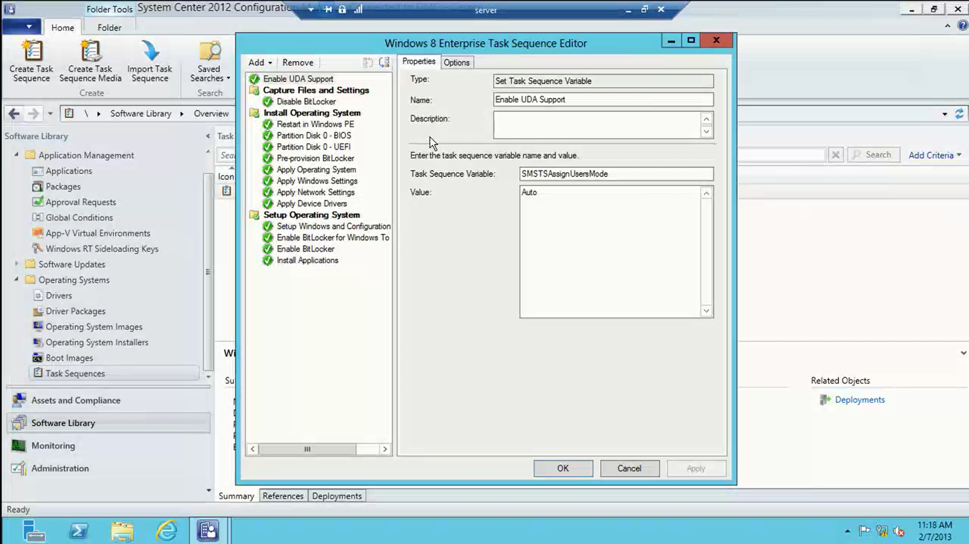

Slide 33
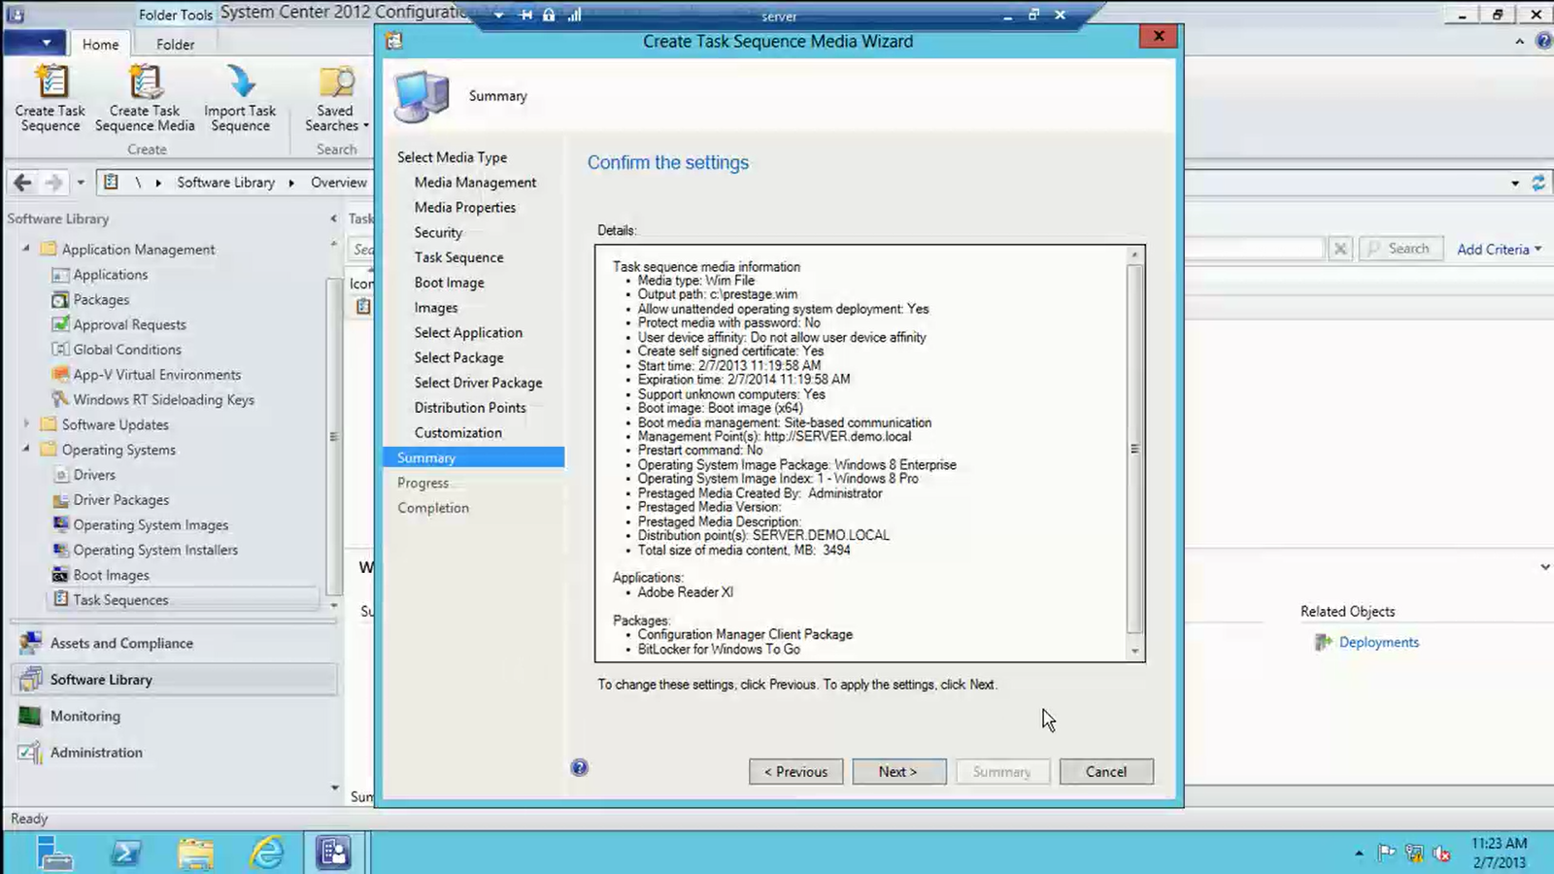

Slide 34
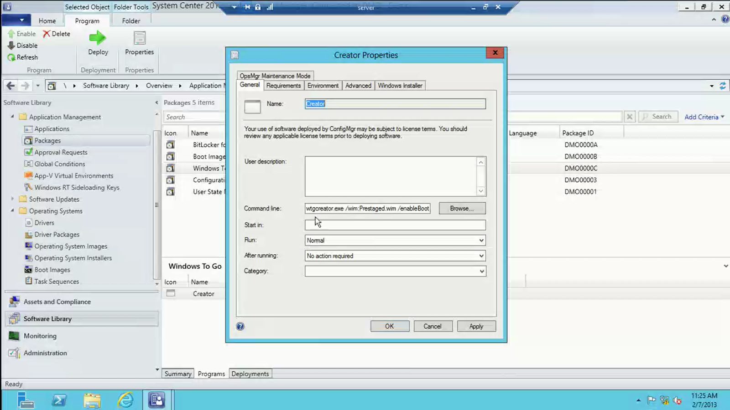

Slide 35
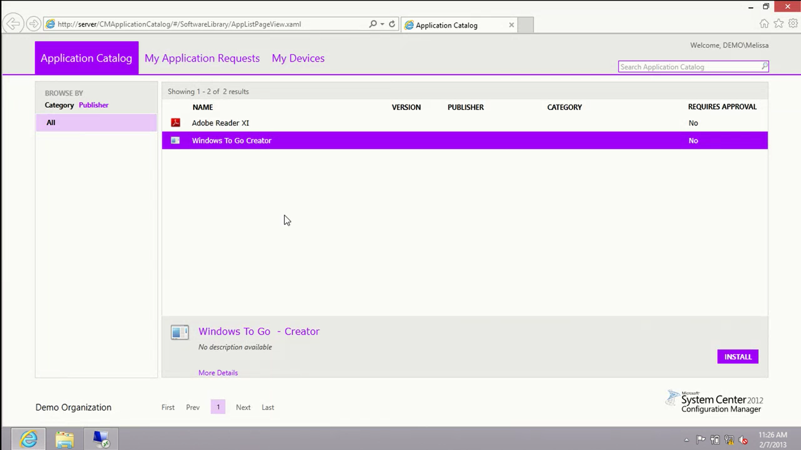

Slide 36
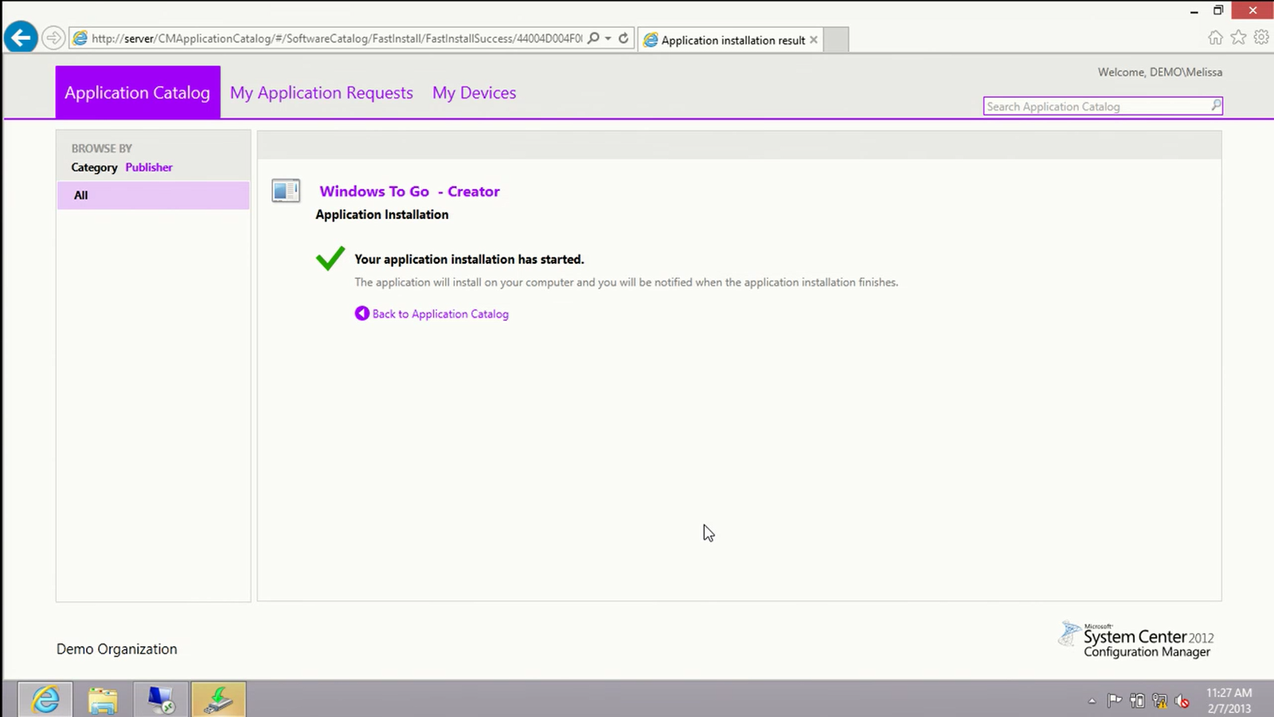

Slide 37
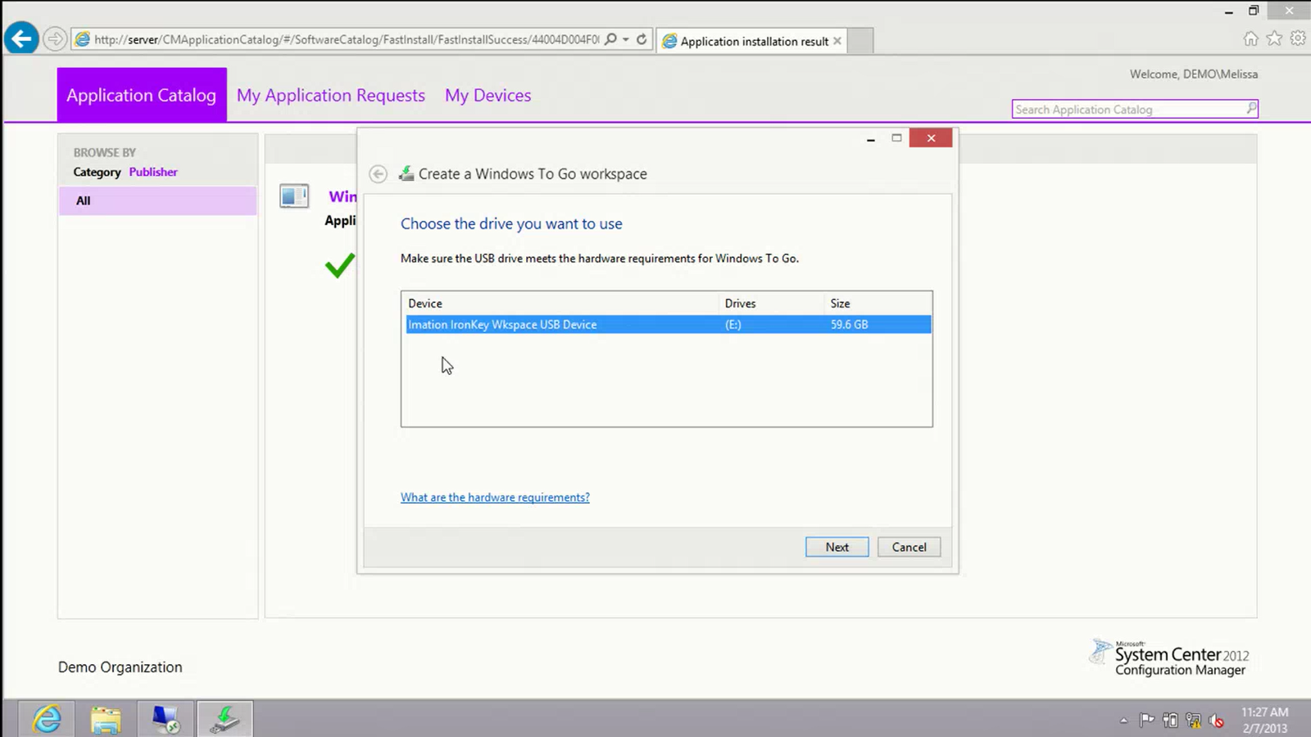

Slide 38



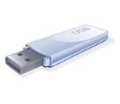

Manageability
Configure user and system settings with Group Policy
        Group Policies introduced specific to Windows To Go
        Power Policy (hibernate and sleep)
        Store Policy
        Windows To Go startup options
System Center Configuration Manager SP1
Inventory software and hardware
Deploy applications and software updates
Settings compliance

Slide 39


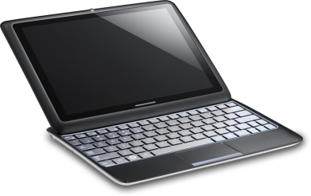


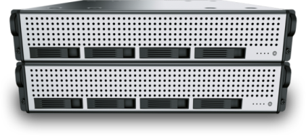
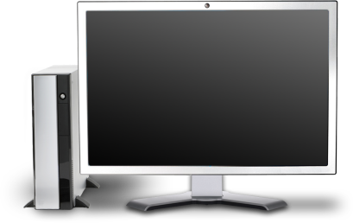

How Windows To Go works
IT
User
+
Create & Deploy
Home
Windows 8
Line of Business Applications
Physical or Virtual
System Center / Creator Tool
Office
Work Across
Certified
USB Drive
Manage
Management Tools
System Center
Branch
Boot from managed and unmanaged PCs
Activate
Microsoft
License Activation

Slide 40

Related content
Breakout Sessions
  WCA-B201 Everything You Ever Wanted to Know about Windows, But Were Afraid to Ask
  WCA-B349 What’s New in Windows 8 Deployment
  WCA-B210 Securing Windows 8 Clients and Resources from Threats
  WCA-B357 Windows RT in the Enterprise
Windows Booth
Find Me Later At…
  Ask the Experts
  Mobility center at the Windows Booth

Slide 41
Windows Track Resources
Windows Enterprise: windows.com/enterprise
Windows Springboard: windows.com/ITpro
Microsoft Desktop Optimization Package (MDOP): microsoft.com/mdop
Desktop Virtualization (DV): microsoft.com/dv
Windows To Go: microsoft.com/windows/wtg
Outlook.com: tryoutlook.com

Slide 42

Resources
Learning
  Sessions on Demand
  Microsoft Certification & Training Resources
http://channel9.msdn.com/Events/TechEd
www.microsoft.com/learning
TechNet
msdn
  Resources for IT Professionals
  Resources for Developers
http://microsoft.com/technet
http://microsoft.com/msdn

Slide 43


For More Information
System Center 2012 Configuration Manager
http://technet.microsoft.com/en-us/evalcenter/hh667640.aspx?wt.mc_id=TEC_105_1_33
Windows Intune
http://www.microsoft.com/en-us/windows/windowsintune/try-and-buy
Windows Server 2012
http://www.microsoft.com/en-us/server-cloud/windows-server
Windows Server 2012 VDI and
Remote Desktop Services
http://technet.microsoft.com/en-us/evalcenter/hh670538.aspx?ocid=&wt.mc_id=TEC_108_1_33
http://www.microsoft.com/en-us/server-cloud/windows-server/virtual-desktop-infrastructure.aspx
More Resources:
  microsoft.com/workstyle
  microsoft.com/server-cloud/user-device-management

Slide 44
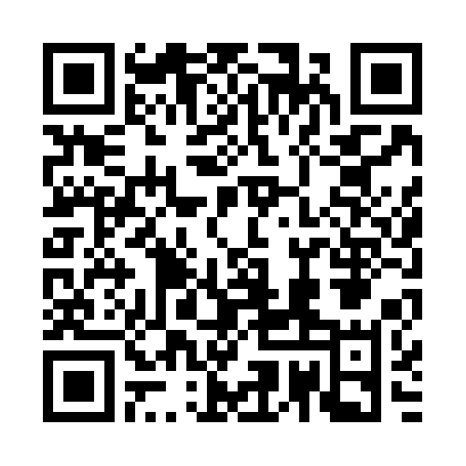


Evaluate this session
Required Slide
*delete this box when your slide is finalized
Your MS Tag will be inserted here during the final scrub.
Scan this QR code to
evaluate this session.

Slide 45

© 2013 Microsoft Corporation. All rights reserved. Microsoft, Windows and other product names are or may be registered trademarks and/or trademarks in the U.S. and/or other countries.
The information herein is for informational purposes only and represents the current view of Microsoft Corporation as of the date of this presentation. Because Microsoft must respond to changing market conditions, it should not be interpreted to be a commitment on the part of Microsoft, and Microsoft cannot guarantee the accuracy of any information provided after the date of this presentation. MICROSOFT MAKES NO WARRANTIES, EXPRESS, IMPLIED OR STATUTORY, AS TO THE INFORMATION IN THIS PRESENTATION.

