Slide 2
What's New in Infrastructure: Microsoft System Center 2012 SP1 - Configuration Manager Infrastructure Improvements and Hierarchy Design
WCA-B348
Wally Mead

Slide 3




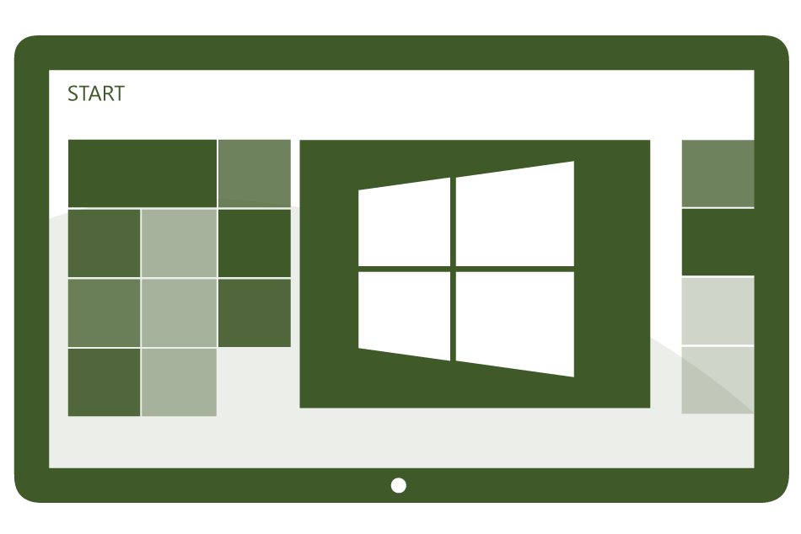

Today’s Challenges
Users
Devices
Apps
Data
Users expect to be able to work in any location and have access to all their work resources.
The explosion of devices is eroding the standards-based approach to corporate IT.
Deploying and managing applications across platforms is difficult.
Users need to be productive while maintaining compliance and reducing risk.

Slide 4

People-centric IT
Empower users
Allow users to work on the devices of their choice and provide consistent access to corporate resources.
Unify your environment
Deliver a unified application and device management on-premises and in the cloud.
Users
Devices
Apps
Data
Protect your data
Help protect corporate information and manage risk.
Management. Access. Protection.

Slide 5










Simplifying Management Across Platforms
Devices & Platforms
Windows PCs
(x86/64, Intel SoC),
Windows to Go
Windows Embedded
Mac OS X
  Single admin
  console
Windows 8.1 PCs & RT
Windows Phone 8
iOS
Android
IT

Slide 6
Session Objectives And Takeaways
Session Objectives
Discuss continued Hierarchy Simplification in Configuration Manager 2012 R2
Discuss improvements in Content management in Configuration Manager 2012 R2
Discuss improved reporting system in Configuration Manager 2012 R2
Discuss improved Infrastructure management in Configuration Manager 2012 R2

Slide 7
Simplifying Hierarchies
Configuration Manager 2012:
New SQL Global Replication
New support for multiple domain site roles
New granular role based security
Doubled per site and hierarchy scale limits

Slide 8
Simplifying Hierarchies
Configuration Manager 2012 SP1:
Site Expansion
Migration from Configuration Manager 2012 SP1
Multiple Software Update Points
Configuration Manager 2012 R2:
Multiple Network Access Accounts
Reports - Role based security

Slide 9
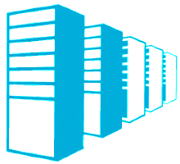

Site Expansion
Grow your hierarchy with your organization
Freedom to use a standalone primary as long as you need
Central Administration Site
Primary Site
Global Data initialized
Primary Site

Slide 10
Site Expansion
After you expand:
  Immediately after expansion, there will be a spike in Software Update Management activity when the new Central Administration Site synchronizes with the original primary site
  The original standalone primary will have a separate “default” Boot WIM for OSD – the original boot WIM for that site.
  Packages created at the original standalone primary site will still be handled by the Distribution Manager service on the standalone primary, not the CAS

Slide 11
Site Attach vs. Site Expansion
Configuration Manager 2007 |  | Configuration Manager 2012
Scenario |  | Equivalent
 | Join site to a hierarchy Mergers & Acquisitions Handle hierarchy changes Fix problematic attach |  | New Site setup Migration Redeploy/Less of an issue with simplified hierarchies N/A

Slide 12

Migration Between 2012 SP1 Hierarchies
ConfigMgr 2012 SP1
ConfigMgr 2012 SP1
Migrate
CAS
CAS
Primary Site
Primary Site
Primary Site
Primary Site
New objects
Migrate collection using object migration
Application Migration
App-V Virtual Environment Migration
Saved Search Migration

Slide 13
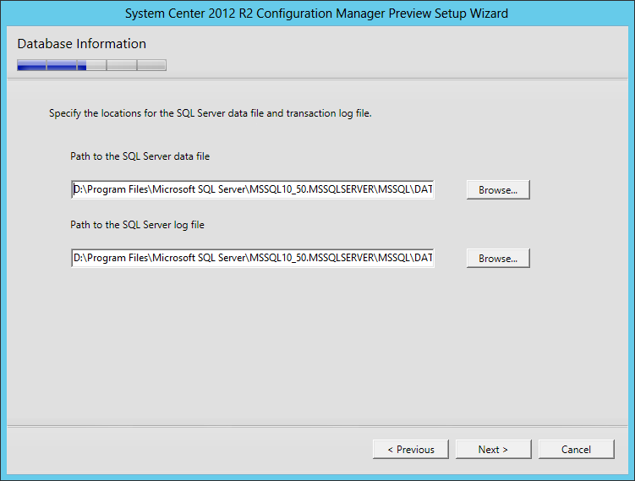
SQL Server Flexibility In Setup
Specify locations for database and transaction log
Restore to a different SQL Server instance
  Requires same SQL Server version
New in ConfigMgr 2012 R2 and Next Major Intune version

Slide 14
Expansion and Migration
Migration
Central Administration Site
Primary Site (40,000 clients)
Primary Site (80,000 clients)
New Primary Site

Slide 15
Easy Client Mobility
Scenario: I installed a new primary site in my hierarchy and would like to move some or all of the clients from an existing site to the new site (e.g. load-balancing, server replacement).
Solution: Client reassignment
  Supports single or multi-select client reassignment
  Enforces proper client/site versioning
  Uses standard client policy channel (no client notification)
Note: This will not work for disaster recovery scenarios.
New in ConfigMgr 2012 R2 and Next Major Intune version

Slide 16
Multiple Network Access Accounts
Problem: How do I deploy OSD or applications that require access in multiple untrusted domains if I have only one Network Access Account for a given primary site?
Solution: multiple network access accounts per site
  Supports backward compatibility for SP1 clients
  Troubleshooting assistance provided through dts.log
New in ConfigMgr 2012 R2 and Next Major Intune version

Slide 17
Upgrade Overview
Upgrades must be top-down (i.e. start with the CAS)
You will need to install new Windows Assessment and Deployment Toolkit (ADK) components on appropriate site systems
  Deployment Tools – All sites and providers
  Windows PE – All sites and providers
  USMT – Top-level site only
SP1 clients cannot be assigned to RTM sites
Always run TestDBUpgrade validations against a copy of your database
For ConfigMgr 2012 to ConfigMgr 2012 SP1, hierarchies are in interoperability mode (ConfigMgr 2012 SP1 to ConfigMgr 2012 R2 have no interoperability considerations)

Slide 18
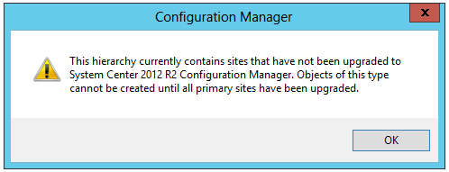
Service Pack 1 Interoperability Mode
User upgrades CAS to SP1
Schema is replicated throughout the hierarchy
Hierarchy is now in Interoperability Mode
All primaries must be upgraded to get out of interop mode
Interop: Off
Primary Site
Interop: On
Primary Site
This hierarchy currently contains sites that have not been upgraded to System Center 2012 Configuration Manager SP1. Objects of this type cannot be created until all primary sites have been upgraded.

Slide 19
Replication Configuration Improvements
Replication traffic compression
  Decrease CAS traffic size ~ > 70%
  Increase SQL CPU ~ < 11%
  Default on for all links
Change SQL Server Service Broker Ports
  Ease management for security
Configure replication retention threshold
  Allow for extended outages
  Configure for problematic networks

Slide 20
Distributed Views
Well connected site servers
  Typically located in same physical location
  “Always” connected
  Reduce site data replication
  Reduce SQL server replication loads
  Improve SQL server performance
  Improve network bandwidth
*Notes:
  Single provider supported at the CAS
  Single SRS at the CAS

Slide 21
Schedule Site Data
Well connected site servers
  Protect business critical network applications
  Use excess bandwidth
  Reduce site data replication frequency
  Reduce SQL server replication loads
  Improve SQL server performance
  Improve network bandwidth
*Note: Distributed views and scheduling are mutually exclusive

Slide 22
Link Status
Customize replication link alerts per link
  Allowances for sub-optimal networks
  Adjust to support server performance capability
  Modify for “known” network issues

Slide 23
Replication Improvements

Slide 24
Pull Distribution Point
What is a Pull Distribution Point?
  A regular distribution point but they will pull content from other distribution points/site server, rather than having the content pushed from the site server
  It is not a BDP!
Pull DPs leverage distribution point framework for communication

Slide 25
Pull DP Hub And Spoke Model Example
Distribution Point (Source)
Pull Distribution Point
Pull Distribution Point
Pull Distribution Point
Pull Distribution Point
Site Server
Pulll
Pulll
Pushl
Pulll
Pulll

Slide 26
Cloud Distribution Point
What are the operational benefits of Cloud DP?
  No need to deploy HW to each location
  Add remove resources on demand
  Server roles in Windows Azure are automatically patched.
  99.9% availability of servers hosted in Azure
What are the deployment benefits of Cloud DP?
  Significant decrease in ConfigMgr deployment time
  Can keep existing tools/automation/3rd party tools ecosystem
  Integrated with existing experience (cloud services appear same as on-premise resources)

Slide 27
Improved Content Management
In-console monitoring improvements
    Pull DP on par with standard DP
    Clearer and more detailed messages
    Cancel/Redistribute
Pull DP improvements
  Source DP ordering and randomization
  Improved scalability (no more polling)
  Migration of branch DP’s to pull DP’s
General content improvements
  Content download optimizations (client side) for superseded applications
  Content distribution optimizations (priority, send requests in SQL, versioning auto-cancel)
  New report: Distribution Point Usage
New in ConfigMgr 2012 R2 and Next Major Intune version

Slide 28
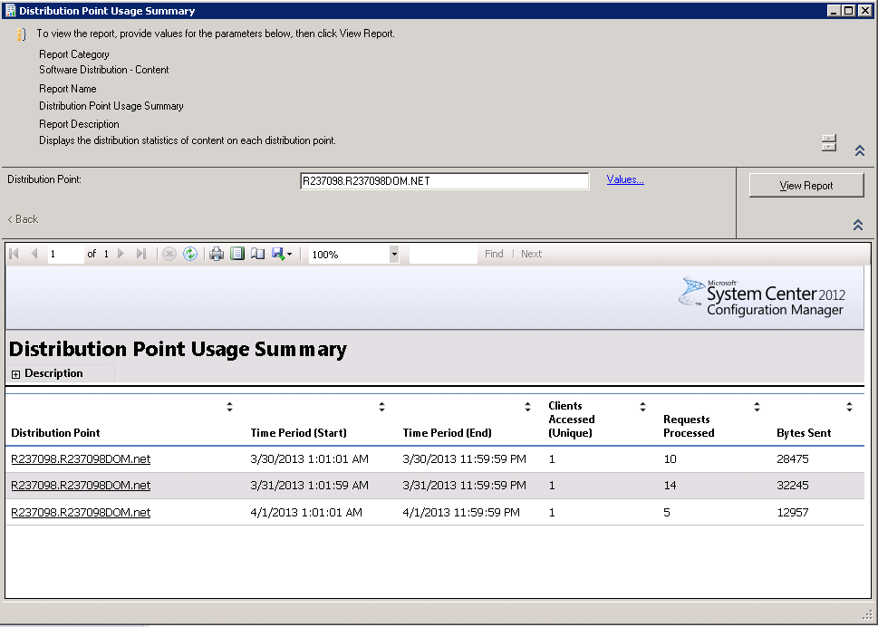
Distribution Point Usage Report
New in ConfigMgr 2012 R2 and Next Major Intune version

Slide 29
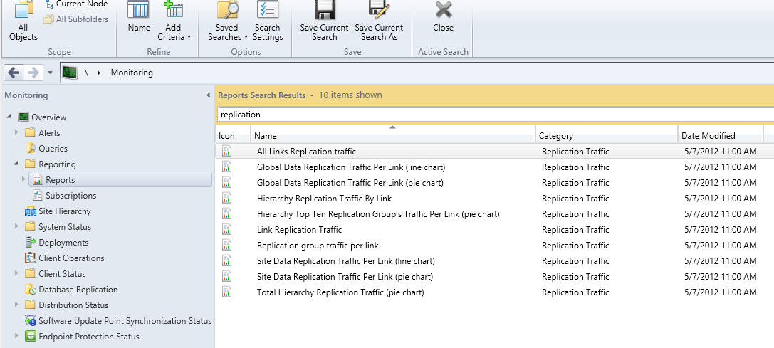
Replication Traffic Reports

Slide 30
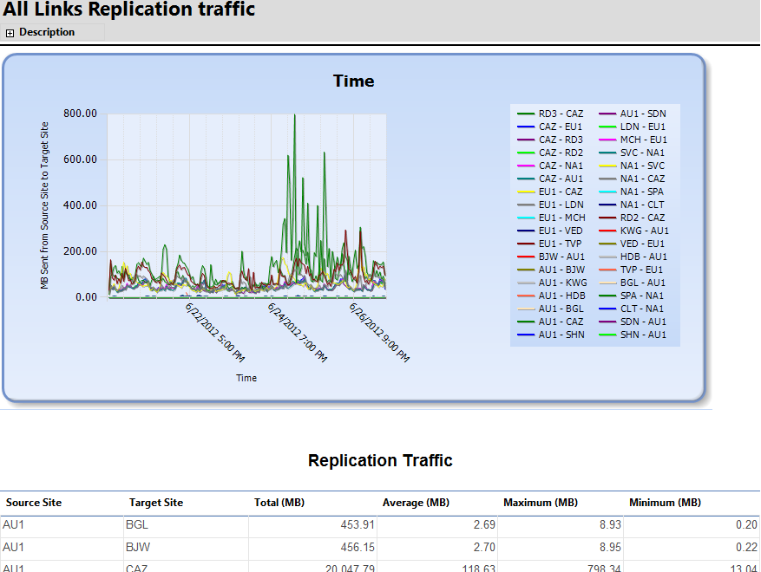
Replication Traffic Reports

Slide 31
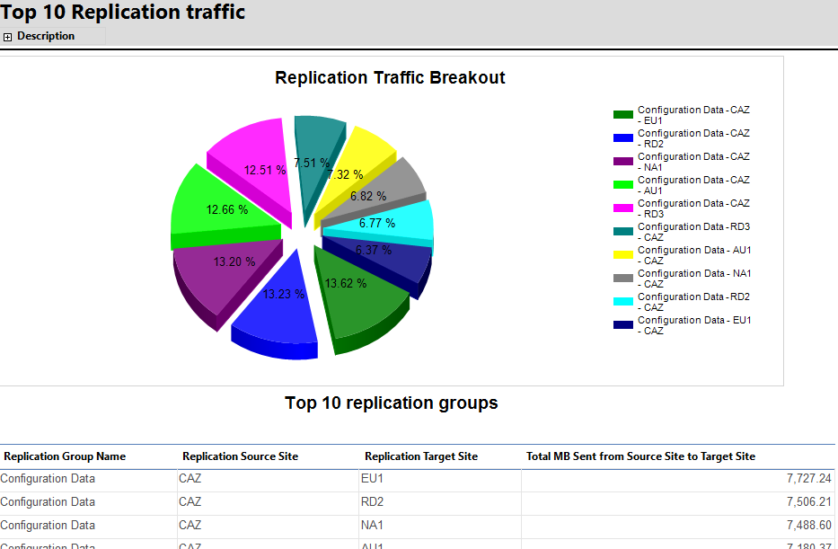
Replication Traffic Reports

Slide 32
Role-Based Administration For Reporting
ConfigMgr 2012 introduced Role-Based Administration
Reporting built on SQL Reporting Services, not RBA-aware
With ConfigMgr 2012 R2, all reports updated to use RBA configuration
  All views have been replaced by fn_rbac_<view name>
  Custom reports should reference new functions if RBA required
Consistent with ConfigMgr console/”show me” behavior
New in ConfigMgr 2012 R2 and Next Major Intune version

Slide 33
Role-Based Administration for Reporting

Slide 34
Secondary Site Recovery
Easy secondary site recovery
Prepare secondary site hardware with all prerequisites as if new installation
Approach: Deploy seconday site “like new” but perform reinit with existing data
  Potential loss of local DP content library
  All secondary site remote DP content for that secondary remain intact
  Will recover existing content library if intact
  *NOTE: Must install same version of SQL as prereq

Slide 35
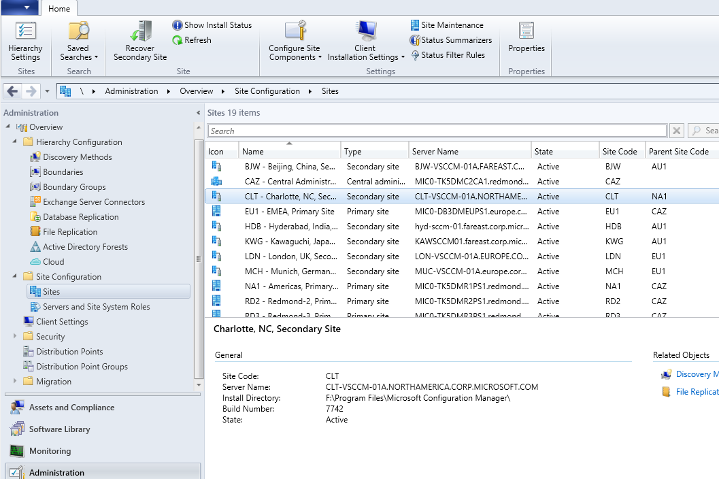
Secondary Site Recovery

Slide 36
In Review: Session Objectives / Takeaways
Session Objectives
Discuss continued Hierarchy Simplification in Configuration Manager 2012 R2
Discuss improvements in Content management in Configuration Manager 2012 R2
Discuss improved reporting system in Configuration Manager 2012 R2
Discuss improved Infrastructure management in Configuration Manager 2012 R2

Slide 37
Related content
Session ID | Title | Speakers | Time
WCA-B304 | Application Delivery with Microsoft System Center 2012 - Configuration Manager SP1 and Windows Intune | Mark Florida; Nilesh Bhide | S14 6/28 10:15-11:30
WCA-B310 | Deploying and Configuring Mobile Device Management Infrastructure with Microsoft System Center 2012 - Configuration Manager SP1 and Windows Intune | Craig Morris; Ramya Chitrakar | S05 6/26 10:15-11:30
WCA-B312 | Deploying and Managing Windows 8 with Microsoft System Center 2012 - Configuration Manager SP1 | Aaron Czechowski; Jason Githens | S09 6/27 10:15-11:30
WCA-B328 | Microsoft System Center 2012 Configuration Manager SP1 Overview | Wally Mead; Mark Florida | S04 6/26 8:30-9:45
WCA-B343 | Unified Modern Device Management with Microsoft System Center 2012 - Configuration Manager SP1 Integrated with Windows Intune | Nilesh Bhide | S08 6/26 17:00-18:15
WCA-B347 | What’s New with Microsoft Deployment Toolkit 2012 Update 1 | Aaron Czechowski; Jason Githens | S16 6/28 14:45-16:00
WCA-B348 | What's New in Infrastructure: Microsoft System Center 2012 - Configuration Manager SP1 Infrastructure Improvements and Hierarchy Design | Wally Mead | S16 6/28 14:45-16:00
WCA-B356 | Windows Intune Overview | Nilesh Bhide | S07 6/26 15:15-16:30

Slide 38

Windows Track Resources
Windows Enterprise: windows.com/enterprise
Windows Springboard: windows.com/ITpro
Microsoft Desktop Optimization Package (MDOP): microsoft.com/mdop
Desktop Virtualization (DV): microsoft.com/dv
Windows To Go: microsoft.com/windows/wtg
Outlook.com: tryoutlook.com

Slide 39

Resources
Learning
  Sessions on Demand
  Microsoft Certification & Training Resources
http://channel9.msdn.com/Events/TechEd
www.microsoft.com/learning
TechNet
msdn
  Resources for IT Professionals
  Resources for Developers
http://microsoft.com/technet
http://microsoft.com/msdn

Slide 40



Evaluate this session
Required Slide
*delete this box when your slide is finalized
Your MS Tag will be inserted here during the final scrub.
Scan this QR code to
evaluate this session.

Slide 41

© 2013 Microsoft Corporation. All rights reserved. Microsoft, Windows and other product names are or may be registered trademarks and/or trademarks in the U.S. and/or other countries.
The information herein is for informational purposes only and represents the current view of Microsoft Corporation as of the date of this presentation. Because Microsoft must respond to changing market conditions, it should not be interpreted to be a commitment on the part of Microsoft, and Microsoft cannot guarantee the accuracy of any information provided after the date of this presentation. MICROSOFT MAKES NO WARRANTIES, EXPRESS, IMPLIED OR STATUTORY, AS TO THE INFORMATION IN THIS PRESENTATION.

