Slide 2
Windows Intune Overview
WCA-B356
Nilesh Bhide
Dilip Radhakrishnan

Slide 3
Session Objectives
Session Objectives
Learn about Windows Intune
Learn about usage scenarios for Intune
Key Takeaways
Windows Intune – A comprehensive device management service for Enterprise and SMBs

Slide 4
What is Windows Intune?
A world class cloud-based device management service.
A service you can TRUST
ISO/IEC 27001:2005 certified = Industry standard information security practices
A service you can RELY on
Financially backed SLA - 99.9% uptime

Slide 5
Windows Intune – Usage Scenarios
Enterprise
Designed for Device Admin
Attaches to Config Manager
Extends your Configuration Manager deployment to enable Unified Device Management(UDM)
Enterprise Scale - 100,000 mobile devices
Administration Experience - Feature rich on-premise Configuration Manager console
Small and Medium Businesses (SMB)
Designed for IT Generalist
Cloud-only Unified Device Management
Simplified management scenarios
SMB scale – Up to 4,000 users and 7,000 devices
Simple web-based administration console

Slide 6
Scenario 1 - Enterprise Unified Device Management with Configuration Manager and Windows Intune

Slide 7
Windows Intune for the Enterprise - Unify Your Environment
Market-leading client management extended with cloud-based MDM
Simplified, user-centric application management
Comprehensive settings management across platforms
Common identity across on-premises and in the cloud
Enable consumerization of IT without compromising compliance

Slide 8
Windows Intune for the Enterprise
Windows PCs
(x86/64, Intel SoC),
Windows to Go
Windows Embedded
Mac OS X
IT
Single Admin
Console
Windows RT, Windows Phone 8 iOS, Android
Unified infrastructure enables IT to manage devices “where they live”
Comprehensive settings management across platforms, including certificates, VPNs, and wireless network profiles
IT can manage the device and application lifecycle

Slide 9
Demo Attaching Windows Intune to Configuration Manager

Slide 10
Scenario 2 – SMB Cloud only Unified Device Management with Windows Intune

Slide 11
Windows Intune for SMB
Windows PCs
(x86/64, Intel SoC)
Windows RT, Windows Phone 8 iOS, Android
IT
Web-based Admin
Console
Manage up to 4,000 users and 7,000 devices

Slide 12
SMB CHALLENGES IN MANAGING PC’S
Security
Workers in many locations
Non-domain joined desktops
Workers “offline” for extended periods
Compromised security on remote PCs
Multiple configurations, versions
Lack of insight into PCs & inventory
Infrastructure investments required
Reliability

Slide 13
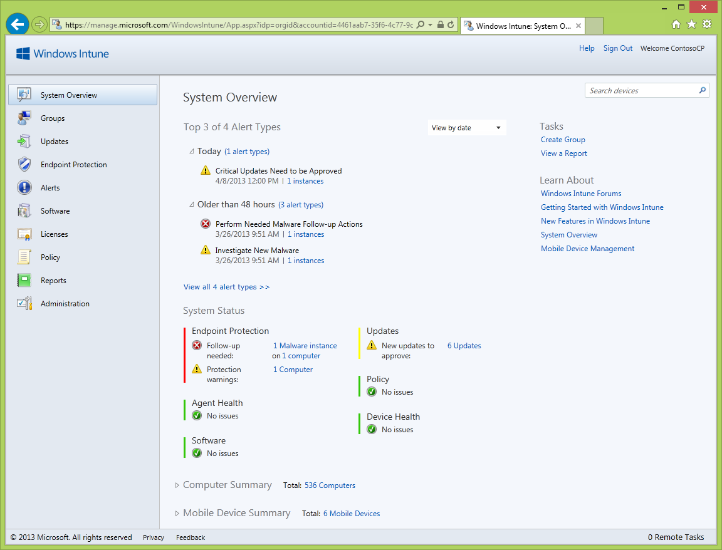
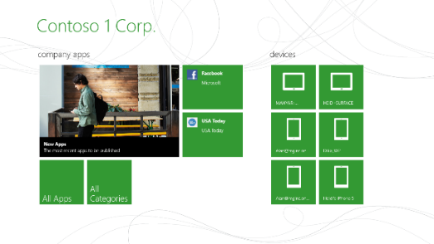
Manage and Secure PCs Anywhere
Simple web-based Administration Console and a richer experience for Information Workers
Latest Release
Help protect PCs from malware
Manage updates
Distribute software
Proactive monitoring and alerts
Provide remote assistance
Inventory hardware and software
Monitor & track licenses
Increase insight with reporting
Set security policies

Slide 14
Managing PCs with Windows Intune

Slide 15
Mobile Device Management with Windows Intune
Integration with O365/Exchange
Basic security for non MDM devices accessing email
Directory services integration with Azure AD
Common user identity and single sign on
Native MDM
Heterogeneous device support (Windows,iOS,Android)
Richer MDM features that leverage native OS MDM protocols
Apps & Settings
Corporate Line of Business App catalog
Rich mobile application experience with native SSPs
Granular security settings across mobile OS platforms
Data Protection
Retire or Wipe

Slide 16
Mobile Device Management with Windows Intune
On-Prem | Microsoft Cloud
Azure Active Directory
Sync AD user data into the cloud
Directory Synchronization
Active Directory
Sync user data to Windows Intune & O365
Users
O365
Mobile devices

Slide 17
Demo Attaching O365 to Intune

Slide 18
Mobile Device Inventory
Hardware properties for mobile devices are collected through the Device Management Authority as well as Exchange ActiveSync (for Android).
No software inventory for mobile devices to respect the Information Worker’s privacy on their personal device.
IT Pros can track storage on mobile devices which help them anticipate/troubleshoot issues.

Slide 19
Settings Management
Security policy on devices (iOS, Windows RT and WP8) Direct management and Exchange ActiveSync.
Recommendation: Manage policy through only one management authority
Reporting available on each setting whether it is applicable, conformant or has an error.
The same security policy template is used for both Direct Management and EAS to help Admins
Android and Windows Phone 7 devices can be managed through EAS

Slide 20
Demo Mobile Device Management

Slide 21
Mobile Device Settings
Setting name | EAS (Activesync) | WinRT/ WinPh8 | iOS
Require a password to unlock mobile devices | √ | √ | √
Required password type | √ | √ | √
Minimum password length | √ | √ | √
Allow simple passwords | √ | √ | √
Number of repeated sign-in failures before device is wiped | √ | √ | √
Minutes of inactivity before device screen is locked | √ | √ | √
Password expiration (days) | √ | √ | √
Remember password history | √ | √ | √
Allow convenience logon (WindowsRT only) |  | √
Allow camera | √ |  | √
Allow web browser | √ |  | √
Allow backup to iCloud (iOS only) |  |  | √
Allow documents sync to iCloud (iOS only) |  |  | √
Allow photostream sync to icloud (iOS only) |  |  | √
Maximum size of e-mail attachments | √
E-mail synchronization for last (days) | √
Allow mobile devices that don’t fully support these settings to synchronize with Exchange | √
Require encryption on mobile device | √
Require encryption on storage cards | √
Password
Device restrictions
Email
Encryption

Slide 22
Mobile Device Inventory
Property | Win RT | WP8 | iOS | Android (EAS)
Device name | Y | Y | Y | Y
Unique device ID | Y | Y | Y
Serial number |  |  | Y
Email address | Y | Y | Y | Y
OS type | Y | Y |  | Y
OS version | Y | Y | Y | Y
OS language |  | Y |  | Y
Total storage space (GB) | Y |  | Y
Free Storage space (GB) | Y |  | Y
System enclosure Chassis |  |  |  | Y
System enclosure IMEI |  |  |  | Y
Manufacturer | Y | Y
Model | Y | Y | Y | Y
Phone number (masked except last 4 digits) |  |  | Y | Y
Subscriber carrier |  |  | Y
Cellular technology(none, GSM, CDMA) |  |  | Y
WiFI MAC | Y |  | Y
Enrolled date (local time) | Y | Y | Y
Last contact (local time) | Y | Y | Y | Y
Last Exchange status |  |  |  | Y
Last Policy update status |  |  |  | Y
Access State |  |  |  | Y
Access state reason |  |  |  | Y
Management state |  |  |  | Y
ActiveSync ID |  |  |  | Y

Slide 23
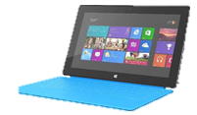
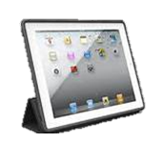
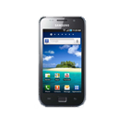
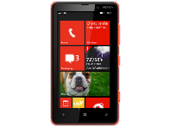
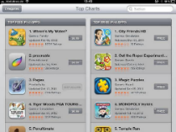
Application Management on Mobile Devices
Platforms | Windows 8/Windows RT | Windows Phone 8 | iOS | Android
Sideload to install | *.appx | *.xap | *.ipa | *.apk
Deep links to store apps – install from store

Slide 24
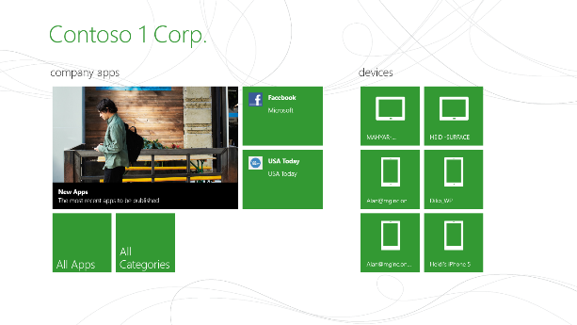
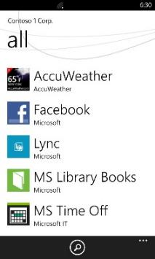
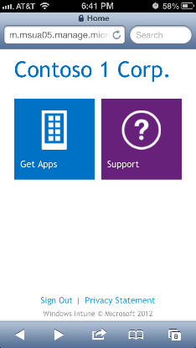
End User Experience
Consistent Company Portal experiences across mobile platforms
Windows RT
Company Portal
Windows Phone 8
Company Portal
iOS/Android
Company Portal
Native Windows app package (.appx)
Available in the Windows Store
Native Windows Phone 8 app (.xap)
Needs to be sideloaded
Web based portal
Hosted in Windows Intune

Slide 25
Demo Mobile Application Management

Slide 26
Software Distribution Summary
Platform | Desktop Apps (.msi, .exe) | Modern App Types
 |  | Side loading |  |  |  | Deep Links | web apps
 |  | .appx | .xap | .ipa | .apk
Windows 8 Pro/Ent | √ | √ |  |  |  | √ | √
Windows RT | ** | √ |  |  |  | √ | √
iOS |  |  |  | √ |  | √ | √
Android |  |  |  |  | √ | √ | √
WP8 |  |  | √ |  |  | √ | √
Windows 7 and below | √ |  |  |  |  |  | √
** | Windows 8 SSP on WinRT will show MSI/EXE apps that can remotely install to other PCs linked to the user, but not installable on the local Window RT device

Slide 27
Corporate Data Protection – Retire and Wipe
All devices and PCs can be retired
Retiring a device removes the record of the device from Intune management
Retiring a device impacts application distribution and policies on the retired device
Wipe option depends on the platform
iOS & WP8 - Complete wipe and reset to factory defaults
Android - EAS mailbox removal only
Windows RT & Windows 8 - Only EAS mailbox removal if managed through EAS

Slide 28
Retire Only Summary
 | Windows 8 Ent/Pro | Windows RT | Windows Phone 8 | iOS | Android (EAS managed)
Device record removed from Intune DB and UI | Yes | Yes | Yes | Yes | Yes
Device record removed from Exchange (no email) | No (see note below) | No (see note below) | No | No | Yes
Removal of Side-loaded keys | No | Yes | Yes (Application Enrollment Token is removed) | -- | --
Already installed applications | Side-loaded apps wont run | Side-loaded apps wont run | Side loaded apps are uninstalled | Installed apps will still run | Installed apps will still run
Installing new applications | Apps cannot be installed | Apps cannot be installed | SSP is uninstalled so no apps are available | Apps cannot be installed | Apps can be installed from the MIWP
Policies | Existing Intune policies are removed during uninstall of Windows Intune agent | Intune policies are retained on the device even after the uninstall of the agent | Expected behavior is similar to Windows RT | Expected that policy will be removed | Intune Policy is removed from Exchange server and the device receives the default Exchange server policy
Note: When a device is managed natively and through EAS, retiring a device also removes the device record from Exchange as well as Intune.

Slide 29
Retire with Wipe Summary
 | Windows 7 and below | Windows 8 Ent/Pro | Windows RT | Windows Phone 8 | iOS | Android (EAS managed)
Management agent removed | Yes | Yes | -- | -- | -- | --
Data removed | No | No | No | Yes | Yes | No
Mailbox removed | No | Yes (EAS mailbox only) | Yes (EAS mailbox only) | Yes | Yes | Yes

Slide 30
Recap: MDM Features per Platform
Management Feature | Windows RT | Windows Phone 8 | iOS | Android
Over-the-air Enrollment | Y | Y | Y
Inventory | Y | Y | Y | Y
Settings Management | Y | Y | Y | Y
Software Distribution | Y | Y | Y | Y
Remote Wipe |  | Y | Y | Y

Slide 31
Flexible Licensing that Fits Your Needs
Per User Licensing
Up to 5 devices/user
Don’t Have Configuration Manager
Windows Intune
(includes ConfigMgr license)
($6 per user per month)
Windows Intune & Windows Enterprise
(includes ConfigMgr license)
($11 per user per month)
Already have Configuration Manager
Windows Intune
(Add-On)
($4 per user per month)

Slide 32
Recap: Session Objectives
Session Objectives
Learn about Windows Intune
Learn about usage scenarios for Intune
Key Takeaways
Windows Intune – A comprehensive device management service for Enterprise and SMBs

Slide 33
Related content
Session ID | Title | Speakers | Time
WCA-B304 | Application Delivery with Microsoft System Center 2012 - Configuration Manager SP1 and Windows Intune | Mark Florida; Nilesh Bhide | S14 6/28 10:15-11:30
WCA-B310 | Deploying and Configuring Mobile Device Management Infrastructure with Microsoft System Center 2012 - Configuration Manager SP1 and Windows Intune | Craig Morris; Ramya Chitrakar | S05 6/26 10:15-11:30
WCA-B312 | Deploying and Managing Windows 8 with Microsoft System Center 2012 - Configuration Manager SP1 | Aaron Czechowski; Jason Githens | S09 6/27 10:15-11:30
WCA-B328 | Microsoft System Center 2012 Configuration Manager SP1 Overview | Bryan Keller; Mark Florida | S04 6/26 8:30-9:45
WCA-B343 | Unified Modern Device Management with Microsoft System Center 2012 - Configuration Manager SP1 Integrated with Windows Intune | Nilesh Bhide, Dilip Radhakrishnan | S08 6/26 17:00-18:15
WCA-B347 | What’s New with Microsoft Deployment Toolkit 2012 Update 1 | Aaron Czechowski; Jason Githens | S16 6/28 14:45-16:00
WCA-B348 | What's New in Infrastructure: Microsoft System Center 2012 - Configuration Manager SP1 Infrastructure Improvements and Hierarchy Design | Wally Mead | S16 6/28 14:45-16:00
WCA-B356 | Windows Intune Overview | Nilesh Bhide, Dilip Radhakrishnan | S07 6/26 15:15-16:30

Slide 34
Windows Track Resources
Windows Enterprise: windows.com/enterprise
Windows Springboard: windows.com/ITpro
Microsoft Desktop Optimization Package (MDOP): microsoft.com/mdop
Desktop Virtualization (DV): microsoft.com/dv
Windows To Go: microsoft.com/windows/wtg
Outlook.com: tryoutlook.com

Slide 35
For More Information
System Center 2012 Configuration Manager
http://technet.microsoft.com/en-us/evalcenter/hh667640.aspx?wt.mc_id=TEC_105_1_33
Windows Intune
http://www.microsoft.com/en-us/windows/windowsintune/try-and-buy
Windows Server 2012
http://www.microsoft.com/en-us/server-cloud/windows-server
Windows Server 2012 VDI and Remote Desktop Services
http://technet.microsoft.com/en-us/evalcenter/hh670538.aspx?ocid=&wt.mc_id=TEC_108_1_33
http://www.microsoft.com/en-us/server-cloud/windows-server/virtual-desktop-infrastructure.aspx
More Resources:
microsoft.com/workstyle microsoft.com/server-cloud/user-device-management

Slide 36
Resources
Learning
Sessions on Demand
Microsoft Certification & Training Resources
http://channel9.msdn.com/Events/TechEd
www.microsoft.com/learning
TechNet
msdn
Resources for IT Professionals
Resources for Developers
http://microsoft.com/technet
http://microsoft.com/msdn

Slide 37
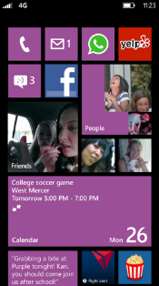
Evaluate this session
Required Slide
*delete this box when your slide is finalized
Your MS Tag will be inserted here during the final scrub.
Scan this QR code to
evaluate this session.

Slide 38
© 2013 Microsoft Corporation. All rights reserved. Microsoft, Windows and other product names are or may be registered trademarks and/or trademarks in the U.S. and/or other countries.
The information herein is for informational purposes only and represents the current view of Microsoft Corporation as of the date of this presentation. Because Microsoft must respond to changing market conditions, it should not be interpreted to be a commitment on the part of Microsoft, and Microsoft cannot guarantee the accuracy of any information provided after the date of this presentation. MICROSOFT MAKES NO WARRANTIES, EXPRESS, IMPLIED OR STATUTORY, AS TO THE INFORMATION IN THIS PRESENTATION.

