Slide 2
Windows RT in the Enterprise
WCA-B357
Michael Niehaus
Senior Product Marketing Manager

Slide 3



Choosing a Business Tablet
Windows 8 tablets with Intel Core
64-bit processors
Windows 8 tablets with Intel Atom
32-bit processors
Windows RT tablets with ARM processors

Slide 4
What capabilities are needed?
Know the Choices of Windows-Powered Tablets
Determine Customer’s
Device Needs
Choose a Device Based on Capabilities
1
2
3
Windows 8 Tablets
with Intel Core Processors
Mobility
Weight | Battery Life
CAPABILITIES | CHOICE OF TABLETS
Mobility | Best Mobility: Windows 8 Tablets with Intel Atom processors or Windows RT Tablets
Workload | More Intensive Workloads: Windows 8 Tablets with Intel Core processors
Apps | Desktop Apps: Windows 8 Tablets with Intel Core or Intel Atom processors Dedicated LOB Apps: Windows 8 Tablets with Intel Core or Intel Atom processors or Windows RT Tablets
Connectivity | Best Connectivity: Windows 8 Tablets with Intel Core or Intel Atom processors running Windows 8 Enterprise (DirectAccess) Occasional Connectivity: Windows 8 Tablets with Intel Core or Intel Atom processors that can automatically sync files using SkyDrive or SkyDrive Pro Through VPN Connections: All Windows 8 and Windows RT* tablets Always On: Windows 8 Tablets with Intel Atom processors or Windows RT Tablets
Manageability | Full Manageability: Windows 8 Tablets with Intel Core or Intel Atom processors Simple Manageability: All Windows 8 or Windows RT Tablets managed by Windows Intune Governance: All Windows 8 and Windows RT Tablets with Exchange ActiveSync policies
Windows 8 Tablets
with Intel Atom Processors
Workload
Casual | Intensive
Windows RT Tablets
with ARM Processors
Apps
Desktop apps | Windows Store apps
LOB apps | Remote apps
Connectivity
Corporate Access | Always On
Manageability
Full | Simple | Governance
Organizations need to choose based on capabilities
People often choose based on the allure of the device

Slide 5

Windows RT Devices
Long battery life. Thin, light, and sleek.
  Runs on low-power ARM processors
High quality and predictable experience over time
  Preconfigured system on certified hardware
Commonality and shared code with Windows 8
  New UI, including desktop
  Windows Store apps* run on both Windows RT and x86
  Compatible with peripherals certified for Windows RT
  http://www.microsoft.com/en-us/windows/compatibility/winrt/CompatCenter/Home
* Windows apps that run on the new WinRT developer platform (vs. Win32 apps)

Slide 6
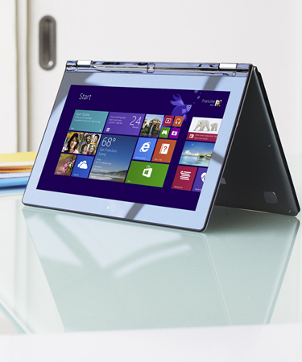








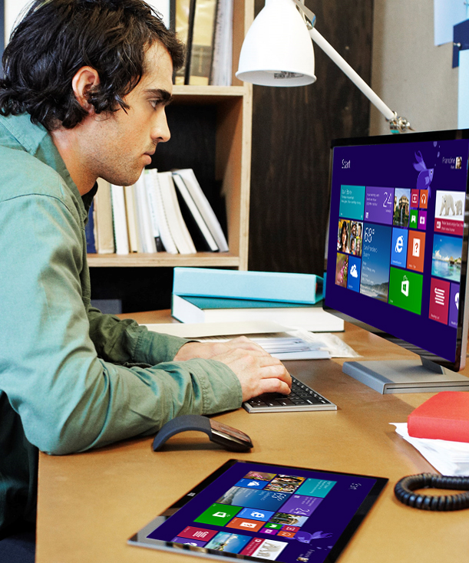


















































Windows RT 8.1 Investments for the Enterprise
Best Business Tablet and More
Windows Apps
for Business
Enterprise
Grade Security
Empower
BYOD
Mobility for
the Enterprise
Start screen improvements
Variable snap view
Simple update deployment
To be shared
at //build
June 26th
Remote Business Data Removal
Biometrics
Malware resistance
Assigned access
Workplace Join
Open MDM
RDS Enhancements
VPN clients
Mobile broadband
Broadband tethering
Auto-triggered VPN
Many Windows 8.1 features also apply to Windows RT 8.1

Slide 7
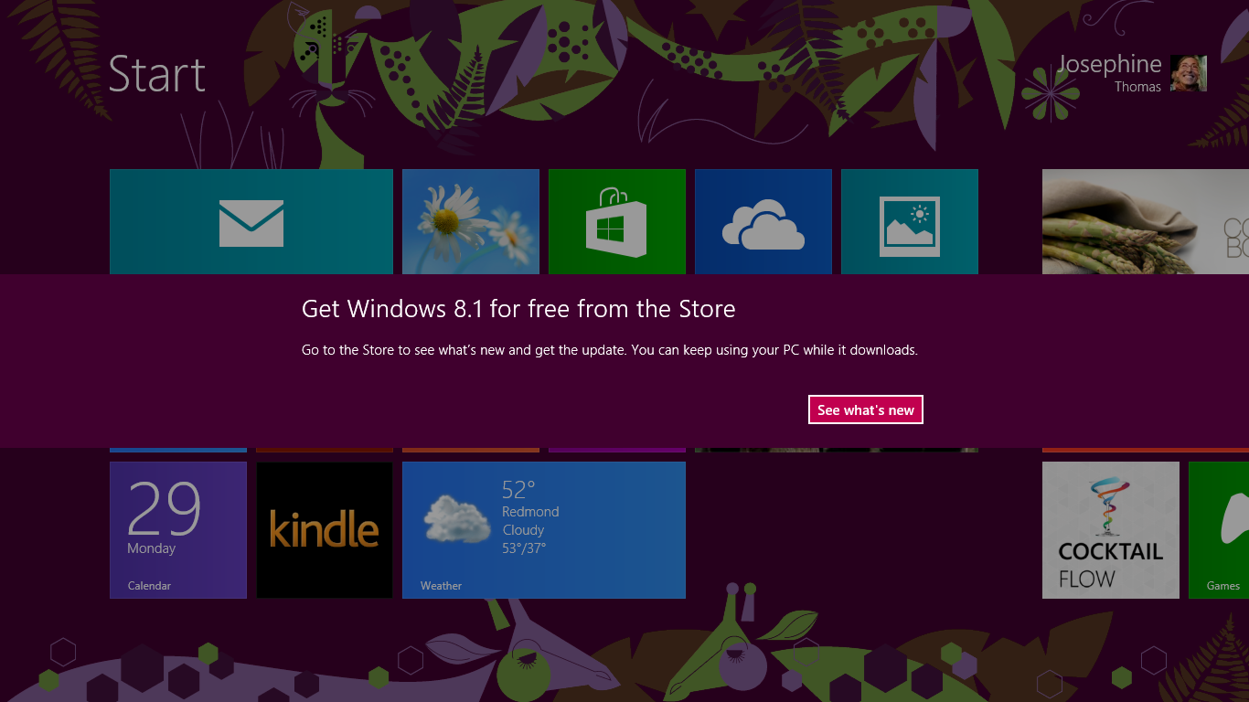
Updating to Windows RT 8.1
From the Windows Store:

Slide 8
Managing Windows Devices
Governance
Full Control
Exchange
ActiveSync
Mobile Device Management
via OMA-DM
Enterprise
Management
ConfigMgr
Group Policy
Windows 8.1 provides choices
Choose by device based on scenario or capabilities needed
Consider employee versus organization-owned, BYOD, connectivity
Organizations may choose all three

Slide 9
User Experience on Windows RT Devices
Thin, light, and sleek
Long battery life
Includes class drivers for most peripherals
Secure by default (UEFI, TPM)
Hardware and Software Innovation
WinRT apps
Run on both Windows RT and x86
Leverage existing developer language and tools
Sideloading (for line-of-business WinRT apps) and Windows Store
Integrated engineering with ecosystem
Predictable and reliable over time
  Pre-configured environment on certified hardware
High Quality Over time
Work and Life
New UI, including desktop
Office Home and Student 2013 RT is included
Inbox Mail client
Touch, mouse, keyboard
Multiple user accounts

Slide 10
Demo
Windows RT Overview

Slide 11

Office Home & Student 2013 RT
Preinstalled on ARM-based Windows RT devices
Includes new Office applications: Word, Excel, PowerPoint, OneNote
Office Home & Student 2013 RT commercial use rights are included in:
Office 365* or
Office Standard/Professional Plus 2013 (as secondary use right) or
Commercial use license via Volume Licensing
* Rights included in Office 365 ProPlus, Office 365 Small Business Premium, Office 365 Midsize Business, and Office 365 Enterprise E3/E4.

Slide 12
Demo
Office 2013 Home & Student RT

Slide 13
Connectivity
VPN connection
Inbox VPN client for Microsoft server is included
Inbox VPN client can interoperate with 3rd party VPN servers via PPTP, L2TP, and IKEv2.
Multiple ways of configuration (client UX, scripts, or management infrastructure)
NEW in Windows RT 8.1: Third-party VPN clients from F5, Dell SonicWall, CheckPoint and Juniper
Multi-factor authentication
Smartcard (PIV, GIDS)
Virtual smartcard
    Easy-to-deploy and cost effective way of enabling strong multi-factor authentication
NEW in Windows RT 8.1: Better APIs for virtual smart cards

Slide 14
Data and App Access
  RemoteApp
  Grant access to line-of-business applications and data
  Seamlessly launch apps from Windows RT
  Secure corporate data: avoid storing enterprise data on consumer devices
  Ensure compliance requirements
  VDI
  Full VDI experience supported
    Rich experience everywhere (RemoteFX, USB redirection, Multi-touch remoting)
    Best value for VDI (Fairshare)
    Efficient management

Slide 15
Security and Manageability
Security capabilities on Windows RT devices
  Secured Boot, Trusted Boot
  Device Encryption
  Picture password, Credentials Locker
  Windows Firewall, Windows Defender
  NAP (Network Access Protection) supported
Governance through Exchange ActiveSync (EAS)*
  Password requirements (e.g., password complexity, picture password, device lock, password expiration etc.)
  Multiple EAS accounts & settings
  Report on device encryption status
  Remote Content Wipe (by user or admin)
    * Enabled through Mail app

Slide 16
Security and Manageability
Cloud-based management with Windows Intune
Single pane-of-glass administration through System Center Configuration Manager 2012 SP1
Features:
    Distribute and manage new Windows apps (via sideloading)
    Push configurations (e.g., VPN config)
    Enforce more governance settings
    Ensure compliance (e.g., monitor security settings)
    Collect inventory information (e.g., which LOB apps are installed)
Diagnostics and troubleshooting
  Windows PowerShell supported
    Scripting language, cmdlets, providers, and management capabilities
    .NET Scripting tailored for power and reliability

Slide 17
Windows RT Management Details
 | Windows RT Direct Management via Windows Intune | Exchange ActiveSync
Setting
Allow convenience logon policy | ü | û
Alphanumeric password required policy | ü | ü
Attachments enabled | ü | ü
Hardware inventory | ü | ü¹
Maximum inactivity time lock | ü | ü
Password management | ü | ü
Require device encryption | ü | ü
Capability
Application publishing | ü | û
Deep-link into public application stores | ü | û
User self-service portal | ü | û
VPN Client configuration | ü² | û
¹ - Limited details depending on device implementation
² - Defined through Configuration Manager

Slide 18
Demo
Managing Windows RT with Windows Intune

Slide 19
For More Information
See the “Windows RT in the Enterprise” whitepaper:
http://aka.ms/windowsrt4enterprise
Learn more on the Windows RT home page:
http://windows.microsoft.com/en-US/windows/rt-welcome
Evaluate Windows RT 8.1!

Slide 20

Windows Track Resources
Windows Enterprise: windows.com/enterprise
Windows Springboard: windows.com/ITpro
Microsoft Desktop Optimization Package (MDOP): microsoft.com/mdop
Desktop Virtualization (DV): microsoft.com/dv
Windows To Go: microsoft.com/windows/wtg
Outlook.com: tryoutlook.com

Slide 21


For More Information
System Center 2012 Configuration Manager
http://technet.microsoft.com/en-us/evalcenter/hh667640.aspx?wt.mc_id=TEC_105_1_33
Windows Intune
http://www.microsoft.com/en-us/windows/windowsintune/try-and-buy
Windows Server 2012
http://www.microsoft.com/en-us/server-cloud/windows-server
Windows Server 2012 VDI and
Remote Desktop Services
http://technet.microsoft.com/en-us/evalcenter/hh670538.aspx?ocid=&wt.mc_id=TEC_108_1_33
http://www.microsoft.com/en-us/server-cloud/windows-server/virtual-desktop-infrastructure.aspx
More Resources:
  microsoft.com/workstyle
  microsoft.com/server-cloud/user-device-management

Slide 22

Resources
Learning
  Sessions on Demand
  Microsoft Certification & Training Resources
http://channel9.msdn.com/Events/TechEd
www.microsoft.com/learning
TechNet
msdn
  Resources for IT Professionals
  Resources for Developers
http://microsoft.com/technet
http://microsoft.com/msdn

Slide 23



Evaluate this session
Required Slide
*delete this box when your slide is finalized
Your MS Tag will be inserted here during the final scrub.
Scan this QR code to
evaluate this session.

Slide 24

© 2013 Microsoft Corporation. All rights reserved. Microsoft, Windows and other product names are or may be registered trademarks and/or trademarks in the U.S. and/or other countries.
The information herein is for informational purposes only and represents the current view of Microsoft Corporation as of the date of this presentation. Because Microsoft must respond to changing market conditions, it should not be interpreted to be a commitment on the part of Microsoft, and Microsoft cannot guarantee the accuracy of any information provided after the date of this presentation. MICROSOFT MAKES NO WARRANTIES, EXPRESS, IMPLIED OR STATUTORY, AS TO THE INFORMATION IN THIS PRESENTATION.

