Slide 2
Microsoft User Experience Virtualization: How to manage and deploy UE-V across an enterprise
WCA-B359
Tim Crabb
Sr. Program Manager
Microsoft

Slide 3
Session Objectives And Takeaways
Session Objectives:
  Learn how Microsoft User Experience Virtualization (UE-V) enables user state virtualization
  Learn how to deploy, configure and manage UE-V
Session Takeaways
  UE-V offers straight-forward deployment options
  Existing infrastructure and tools can be used to manage UE-V

Slide 4
UE-V and
User State Virtualization

Slide 5


Change the Device, Keep the Experience
Personal
& flexible
App and OS personalization roam across Windows
Syncs are smart and logins are fast
Application or OS reconfiguration not required
Simple
& versatile
Templates automate identification of settings location
Custom templates define which applications should roam settings
Ability to roll back settings to initial state
Integrated
& scalable
Use existing tools to simplify deployment
ConfigMgr 2012 DCM pack to keep client configuration consistent
Seamlessly integrates with Microsoft Desktop Virtualization products

Slide 6

UE-V compared to other Microsoft solutions
Feature | Roaming Profiles Windows 7 | Roaming Profiles Windows 8 | Microsoft Account | UE-V
Roam settings between multiple computers
Roam settings between physical and virtual apps
Roam Windows 8 application settings
Manage via WMI
Sync settings changes on a regular basis
Little configuration needed to setup
Supported on non-domain joined machines
Supports Primary Machine AD attribute
Roams settings between VDI/RDS and rich desktops
Unlimited setting storage space
Choice in which app settings to roam

Slide 7




Introducing UE-V
Granular control
  Application settings – templates define what to sync
  OS settings – Windows 7 and Windows 8
Mixed desktop environments
  Traditional desktops
  Virtual desktops
Mixed application types
  Traditional applications
  Virtual applications – App-V 4.6 and 5.0
UE-V Settings Storage
Physical Desktops
VDI / RDS

Slide 8
Key Features in UE-V 2.0 beta
Tighter integration with Windows 8
  Support for Windows 8 apps settings synchronization
  Detection of Microsoft Account Linking
New end-user interface
  Users can control what settings are being synchronized
  Users can manage what they want to synchronize
Improvements to the Synchronization Engine
  Offline Files is no longer required
  Improved performance – faster loading and more reliable
Just Announced!

Slide 9

UE-V Overview
App Monitoring
  Desktop applications - Templates
  Windows 8 apps - App List
App Settings
  Monitors for changes only
  Looking only as local user
Settings Actions
  Triggers detect settings
  Initial and current settings locally
  Sync Controller moves the settings
Settings Storage Path
  SMB share on the network
  No server components
  Can be defined as ADhome or config
2
Registry
Local Files
1
Triggers
Local App Data
Sync Controller
3
UE-V
Settings Storage Path
4

Slide 10
UE-V Overview
App Monitoring
  Desktop applications - Templates
  Windows 8 apps - App List
App Settings
  Monitors for changes only
  Looking only as local user
Settings Actions
  Triggers define when settings are captured and applied
  Settings are stored for both current and initial settings locally
  Sync Controller moves the settings
Settings Storage Path
  SMB share on the network
  No server components
  Can be defined in AD or config
2
Registry
Local Files
1
Triggers
Local App Data
Sync Controller
3
UE-V
Settings Storage Path
4

Slide 11
UE-V demo

Slide 12
Deployment

Slide 13
Deployment Methodology
Configure a settings storage location
Configure workstations with the UE-V agent
Select / create settings location templates
Deploy / manage settings location templates

Slide 14
Configuring a Settings Storage Location
UE-V does not include a server component
  Nothing is required to be installed on the server
  Package Size Average is ~5MB per user
Two options for settings storage:
  Active Directory home directory
  Create a settings storage share

Slide 15
Creating a settings storage share
Create a new folder grant the UE-V users permissions
(SMB) permissions for the setting storage folder:
  Everyone - No Permissions
  Security Group of UE-V Users - Full Control
NTFS permissions
  Creator/Owner - Full Control - Subfolders and files only
  Security group of UE-V users - List Folder / Read data, Create folders / Append Data
The UE-V agent creates and secures the user’s folder
More details can be found here: http://technet.microsoft.com/en-us/library/jj680024.aspx

Slide 16
Deployment Methodology
Configure a settings storage location
Configure workstations with the UE-V agent
Select / create settings location templates
Deploy / manage settings location templates

Slide 17
Configuring the UE-V Agent
.exe or .msi
Configuration via command line, GPO, or Config Manager
AD User Home Directory or specify a SettingsStoragePath
Pre-req checks for Offline Files and .NET
Requires a reboot for OS settings roaming
Operating System | System Architecture | .NET Framework
Windows 7 | 32-bit or 64-bit | .NET 3.5
Windows Server 2008 R2 | 64-bit | .NET 3.5
Windows 8 | 32-bit or 64-bit | .NET 4.0 or 3.5
Windows Server 2012 | 64-bit | .NET 4.0 or 3.5

Slide 18
UE-V Agent deployment examples
Scenario 1: Standard deployment – default templates and AD home
AgentSetup.exe /quiet
Scenario 2: Settings storage location – mandatory if AD home directory isn’t set
AgentSetup.exe /quiet SettingsStoragePath="\\Server\SettingsShare\%username%"
Scenario 3: VDI deployment
AgentSetup.exe /quiet SyncMethod="None"
Scenario 4: Per user enablement
AgentSetup.exe /quiet EnableSync="False"

Slide 19
Deployment Methodology
Configure a settings storage location
Configure workstations with the UE-V agent
Select / create settings location templates
Deploy / manage settings location templates

Slide 20




Template Overview
Templates describe where settings are stored:
  registry
  file locations
Templates are XML-formatted files which include:
  Application name & unique ID
  Application process & version identification
  Location of registry and file-based settings to capture and apply
In-Box
Custom
Community

Slide 21
In-Box Templates
Installed by default with the agent
Built and supported by Microsoft
The in-box templates are for the following:
Applications:
Office 2010 & 2007
Browser Options (IE8, IE9 & IE10)
Windows Accessories
  WordPad
  Notepad
  Calc
Windows Settings:
Desktop Settings:
  Start Menu
  Taskbar
  Folder Options
  Region & Language
  Background
Ease of Access Settings
Office 2013 templates are not shipped with UE-V. Please use the native Office Sign in experience as part of Office 365.
See KB2841206

Slide 22
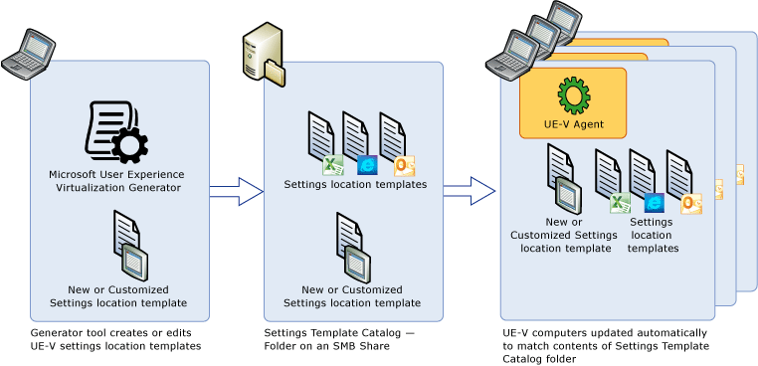
Creating Custom Templates

Slide 23
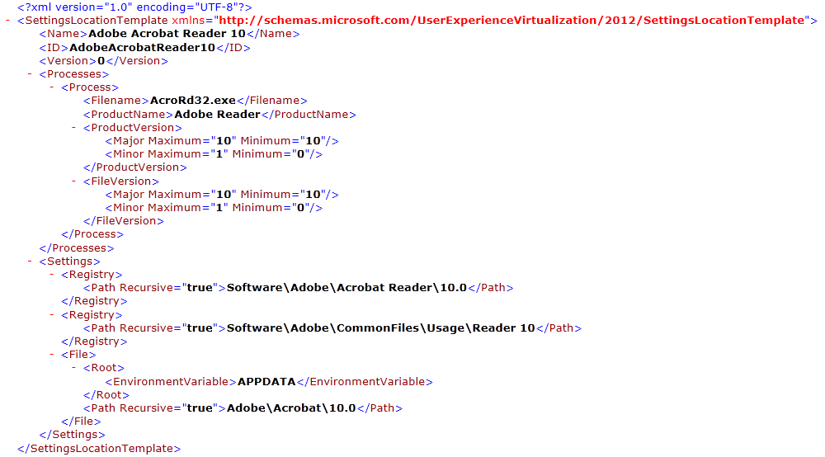
XML Template Example

Slide 24

Customizing Custom Templates
Can manually edit the XML but validate against the XSD or with the Generator
Manual template settings:
  Registry and File Exclusions
  Architecture Separation
  Shell Process Designation
  File and registry paths based on known folders & registry values

Slide 25
Creating Templates

Slide 26
Deployment Methodology
Configure a settings storage location
Configure workstations with the UE-V agent
Select / create settings location templates
Deploy / manage settings location templates

Slide 27
UE-V Template Management - Catalogs
Catalogs are a central way to store and distribute templates
Templates are placed in a common location and the UE-V agents pull the templates down locally
  Scheduled task – ApplySettingsTemplateCatalog.exe
  Run nightly
Catalog Considerations
  Custom Templates
  In-Box Templates

Slide 28
Windows 8 & 8.1 apps
UE-V synchronizes in-box Windows 8 apps (Default)
To sync additional Windows 8 apps, these must be added to the Windows 8 app list
Windows 8 app settings are set at development time (no template required)

Slide 29
Managing Settings for Windows 8 apps

Slide 30
Management

Slide 31

Manage UE-V in the enterprise
Configuration Pack for UE-V
Group Policy
PowerShell Cmdlets

Slide 32
Group Policy for UE-V
Available as part of the MDOP ADMX Templates
  The templates available on Download Center
Settings include:
  Do not use Offline Files
  Roam Windows settings
  Settings package size warning threshold
  Synchronization timeout
  Settings storage path
  Settings template catalog path
  Use User Experience Virtualization
  Applications - In-box applications - settings roaming

Slide 33
Configuration Pack for UE-V
Available for Configuration Manager 2012
Monitors and remediates client settings for UE-V
The settings that are monitored include:
  Is Offline Files Service Running
  Is UEV Agent Enabled
  Is UEV Agent Service Running
  Has Template Catalog Been Applied
  Max Package Size Exceeded
  Is Settings Storage Path Configured*
  Is Settings Template Catalog Configured*
  * Requires script modification for enforcement

Slide 34
PowerShell and WMI
PowerShell cmdlets help administrators perform various UE-V tasks.
You can manage UE-V agent configuration and synchronization behavior.
Manage settings location templates using PowerShell or WMI.

Slide 35
Order of precedence for UE-V settings
Group Policy
  User-targeted settings
    HKEY_CURRENT_USER\Software\Policies\Microsoft\Uev\Agent\Configuration
  Computer-targeted settings
    HKEY_LOCAL_MACHINE\Software\Policies\Microsoft\Uev\Agent\Configuration
PowerShell or WMI
  Configuration settings defined by the current user
    HKEY_CURRENT_USER\Software\Microsoft\Uev\Agent\Configuration.
  Configuration settings defined for the computer
    HKEY_LOCAL_MACHINE \Software\Microsoft\Uev\Agent\Configuration.

Slide 36
Management Demo

Slide 37
PowerShell Examples for UE-V
//Import the UEV Module
import-module uev
//Get list of UE-V Cmdlets
get-command -module uev
//Check the UE-V configuration
get-uevconfiguration
//Export the UE-V configuration
Export-UevConfiguration config.uev
//View registered templates and whether they are enabled
get-uevtemplate |format-table TemplateVersion,TemplateID,Enabled -autosize
//Register a UE-V template
Register-UevTemplate -Path <template.xml>
//Unregister a UE-V Template
Unregister-UevTemplate -ID <template ID>

Slide 38
In Review: Session Objectives & Takeaways
Session Objective(s):
  Learn how Microsoft User Experience Virtualization (UE-V) enables user state virtualization
  Learn how to deploy, configure and manage UE-V
Session Takeaways
  UE-V offers straight-forward deployment options
  Existing infrastructure and tools can be used to manage UE-V

Slide 39

Related content
Breakout Sessions (session codes and titles)
MDC-B343 | Top 5 Server Application Deployment and Servicing Problems Addressed by Server App-V and System Center 2012 SP1 - Virtual Machine Manager | Tuesday 13:30 -14:45
WCA-B208 | Microsoft Application Virtualization 5.0 Migration and Co-Existence with 4.6 | Tuesday 13:30 -14:45
WCA-B203 | Microsoft Application Virtualization 5.0 and Microsoft Office: Better Together | Tuesday 17:00-18:15
WCA-B206 | The Replaceable PC | Wednesday 10:15-11:30
WCA-B319 | Implementing Microsoft Application Virtualization 5.0: Lessons Learned from a Production Rollout | Wednesday 10:15-11:30
WCA-B209 | What's New with Windows 8 BitLocker and Microsoft BitLocker Administration and Management (MBAM) 2.0 | Wednesday 12:00-13:15
WCA-B359 | Microsoft User Experience Virtualization (UE-V): How to Manage and Deploy UE-V across an Enterprise | Thursday 10:15-11:30
WCA-B325 | Making PC Recovery Easier with the Microsoft Diagnostics and Recovery Toolset (DaRT) | Thursday 15:15-16:30
WCA-B324 | Integrating the New Microsoft Application Virtualization 5.0 with other Virtualization Solutions | Friday 10:15-11:30

Slide 40
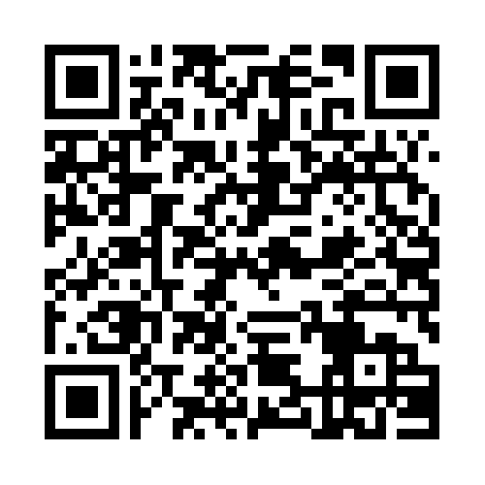


Evaluate this session
Required Slide
*delete this box when your slide is finalized
Your MS Tag will be inserted here during the final scrub.
Scan this QR code to
evaluate this session.

Slide 41

© 2013 Microsoft Corporation. All rights reserved. Microsoft, Windows, Windows Vista and other product names are or may be registered trademarks and/or trademarks in the U.S. and/or other countries.
The information herein is for informational purposes only and represents the current view of Microsoft Corporation as of the date of this presentation. Because Microsoft must respond to changing market conditions, it should not be interpreted to be a commitment on the part of Microsoft, and Microsoft cannot guarantee the accuracy of any information provided after the date of this presentation. MICROSOFT MAKES NO WARRANTIES, EXPRESS, IMPLIED OR STATUTORY, AS TO THE INFORMATION IN THIS PRESENTATION.

