Slide 2
What’s New in Blue Security
WCA-B370
Chris Hallum
Senior Product Manager
Windows Client Security
Microsoft Corporation

Slide 3
Agenda
Windows 8 Security
Windows 8 Security - Results So Far
Changing Threat Landscape
Security Investments for Windows 8.1

Slide 4
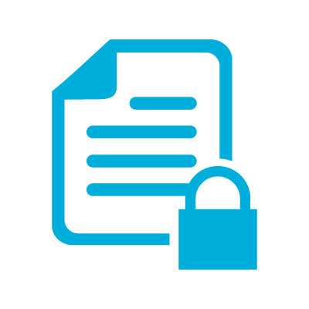
Windows 8 Security Capabilities
Malware Resistance
Securing the Boot
Securing the Code and Core
Securing the Desktop
Protect Sensitive Data
Securing Data With Encryption
Modern Access Control
Securing the Sign-In
Secure Access to Resources
Trustworthy Hardware
Universal Extensible Firmware Interface (UEFI )
Trusted Platform Module (TPM)

Slide 5
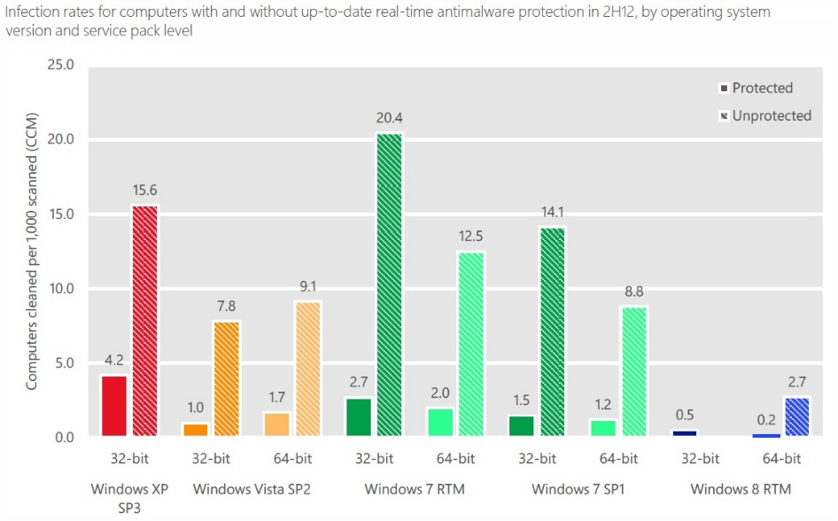
Measuring Windows 8 Security Success
The largest investments that we’ve ever made are producing great results!

Slide 6
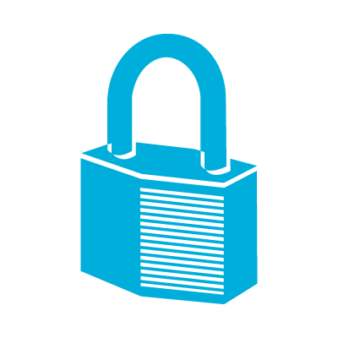
Re-Assessing The Threat

Slide 7
Those who realize they’ve been hacked.
There are two types of enterprises.
Those who haven’t yet realized they’ve been hacked.

Slide 8
There are threats that are familiar
and those that are modern.

Slide 9
Familiar
Modern
Script Kiddies; Cybercrime
Cyber-espionage; Cyber-warfare
Cybercriminals
State sponsored actions; Unlimited resources
Software solutions
Hardware rooted trust the only way
Secure the perimeter
Assume breach. Protect at all levels
Attacks on fortune 500
All sectors and even suppliers getting targeted
Hoping I don‘t get hacked
You will be hacked. Did I successfully mitigate?

Slide 10
“Commercial based antivirus and security products are designed for and focus on protecting you from prevalent classes of in the wild threats coming from criminals, thugs and digital mobsters (and it's a constant battle). It is not designed to protect you from the digital equivalent of Seal Team Six. So if you're the guy that finds himself in the crosshairs… you're not safe.”
-- F-Secure “News from the Lab”, May 30, 2012
A Lockheed Martin official said the firm is “spending more time helping deal with attacks on the supply chain” of partners, subcontractors and suppliers than dealing with attacks directly against the company. “For now, our defenses are strong enough to counter the threat, and many attackers know that, so they go after suppliers. But of course they are always trying to develop new ways to attack.”
-- Washington Post “Confidential report lists U.S. weapons system designs compromised by Chinese cyberspies”, May 27, 2013
“When discussing the importance of information security we’ve probably heard excuses such as “we’re too small to be a target” or “we don’t have anything of value”, but if there is anything this report can teach us, is that breaches can and do occur in organizations of all sizes and across a large number of industries.”
-- TechRepublic speaking on the 2013 edition of Verizon’s Data Breach Investigations Report (DBIR).

Slide 11
Moving forward, there will be two types of organizations

Slide 12
Those who adapt to the modern threat environment.

Slide 13
Those who don’t.

Slide 14
Windows 8 and 8.1 Security Capabilities
Modern Access Control
Securing the Sign-In
Secure Access to Resources
Malware Resistance
Securing the Boot
Securing the Code and Core
Securing the Desktop
Protect Sensitive Data
Securing Device with Encryption
First Class Biometric Experience
Multifactor Authentication for BYOD
Trustworthy Identities and Devices
Single Sign-On to Service Providers
Provable PC Health
Improved Windows Defender
Improved Internet Explorer
Improved System Core Hardening
Pervasive Device Encryption
Selective Wipe of Corp Data
Trustworthy Hardware
UEFI
Modern Biometric Readers
TPM
UEFI
TPM

Slide 15
Modern Hardware
Trusted Platform Module (TPM)

Slide 16
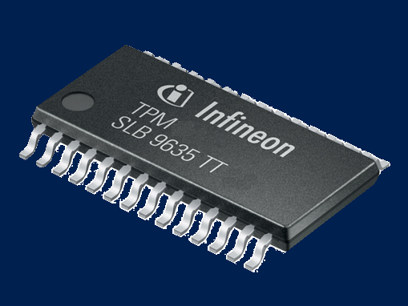
Trusted Platform Module in Windows 8.1
The Opportunity
Dramatically improve security for Consumer and BYOD
Leverage in innovative ways to address modern threats
History in Windows
TPM is currently optional component
Pervasive on Commercial Devices, and most tablets
Our Goal in Windows 8.1
Drive adoption of Connected Standby arch with OEM’s
Work with Intel to make PTT pervasive on all proc’s
Add TPM requirement to 2015 Windows cert reqs
Secure approval in regions such as Russia and China

Slide 17
Modern Access Control
First Class Biometric Experience
Multifactor Authentication for BYOD
Trustworthy Identities and Devices
Single Sign-On to Service Providers

Slide 18
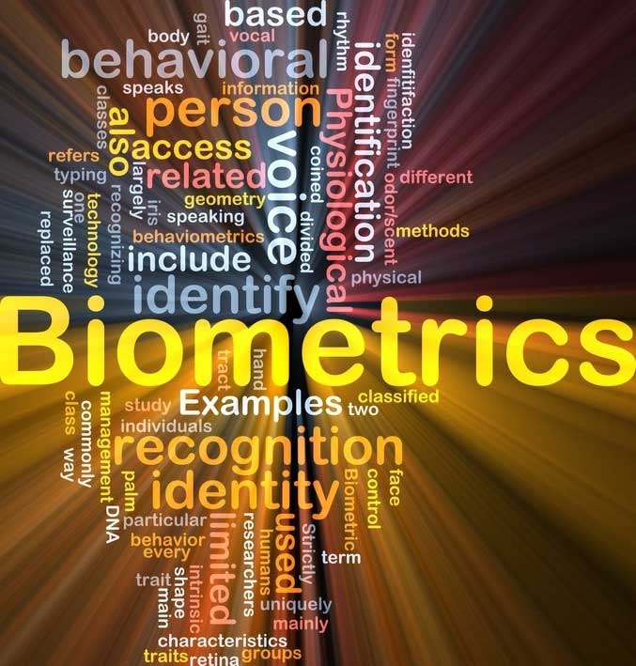
Biometrics In Windows 8.1
The Opportunity
Move forward with strategy to replace for passwords
Reduced friction and improve experience
History in Windows
First added Biometrics capability in Windows XP
Windows Biometric Framework added to Windows 7
3rd parties provide enrollment and drivers
Adoption
Not available in most PC’s, OEM’s use to differentiate
Few users have ever experienced it
Our Goal in 8.1
Make Biometrics the best experience for auth
Create condition where users prefer and use it
Drive adoption in Consumer and Enterprise

Slide 19
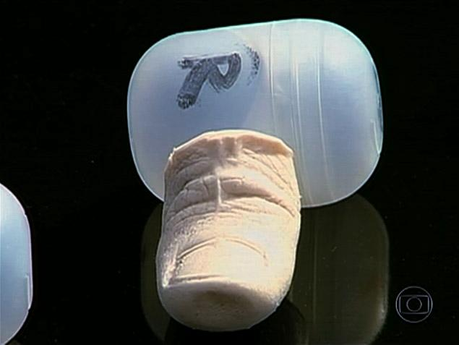
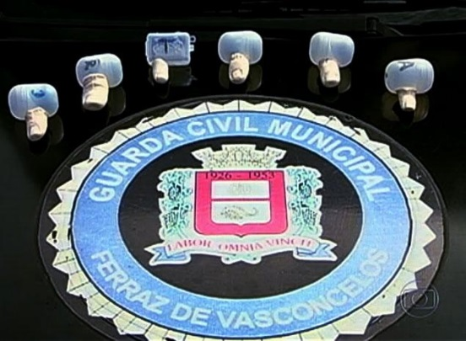
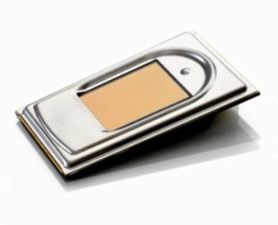
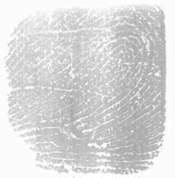
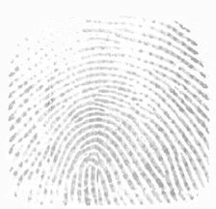
Finger Print Device Options for Windows 8.1
Technology Choices
Optical Readers
Thermal Readers
Ultrasound Readers
Capacitive Readers (CMOS)
Characteristics of a Modern Reader
Touch
Liveness Detection

Slide 20
End to End Support For Fingerprint Biometrics
Common enrollment experience
PC Settings -> Users -> Create Fingerprint Sign-In
Experience optimized based on devices capability
Biometrics sign-in in all Windows experiences
Windows sign-in
Remote Access sign-in
All remaining authentication prompts (e.g.: UAC)
“Touch to Buy” added to:
Windows Store
Xbox Music
Xbox Video

Slide 21
Protecting Resources with Biometrics
Challenge
Devices designed primarily for a single user are frequently shared
Once a user is signed-into a device they have full access to system
Gating access to apps and data with a password creates too much friction
Solution
Ability to auth using an “authentic user gesture” for Apps and Identities
Biometrics fingerprint experience for enrollment, sign-in, purchases, etc
Scenarios - User verification is used to protect:
app start-up or specific tasks within it (Windows Store Apps)
apps able to protect highly confidential information
apps able to validate a user’s presence before releasing credentials

Slide 22
Demo Finger Print Enrollment Sign-In and Authentication Application Start-Up and Task Verification

Slide 23
Modern Access Control
First Class Biometric Experience
Multifactor Authentication for BYOD
Trustworthy Identities and Devices
Single Sign-On to Service Providers

Slide 24
Virtual Smart Cards Now Ready for BYOD
What are Virtual Smart Cards
TPM virtualized as a Smart Card for auth, encryption, signing, etc
Address key challenges with existing MFA solutions
Easy to deploy, cost effective, always ready on the device
Top challenges with Virtual Smart Cards
Enrollment process for BYOD (non-domain joined) too complex
Solution for Windows 8.1
API support for provisioning to BYOD (non-domain joined; all arch)
Working with ISV’s to incorporate (e.g.: Intercede)

Slide 25
Demo Enroll Windows RT device with a Virtual Smartcard

Slide 26
Modern Access Control
First Class Biometric Experience
Multifactor Authentication for BYOD
Trustworthy Identities and Devices
Single Sign-On to Service Providers

Slide 27
The Need for Trustworthy PKI
Challenges with certificate trustworthiness
Breaches in security difficult to detect and devastating in impact
Increased dependency on PKI, making it the single point of failure
DigiNotar Breach
Duped into issuing authentic certs
Stuxnet Malware
Signed malware with stolen certs
Flame Malware
Signed malware
with hacked certs
Mimikatz
Export certs from compromised devices

Slide 28
Assumptions and the Opportunity
What did these breaches depend on? Assumptions that:
a certificate that looks un-tampered is authentic
certificate issued from a CA in MSFT Root CA Program are trustworthy
which web servers are issuing authentic certificates is not relevant
Certificates issues to clients are secure and can’t be stolen
The Opportunity
Increase trust worthiness of private and public PKI system
Help manage and drive crypto-hygiene within ecosystem
Prevent theft of user and device identities

Slide 29
Securing Private Certificates and Keys
Challenge
If keys not protected by hardware, they may be exportable
If you have access to a private key you own that machine or identity
Compromised private keys can be used from any device (replayable)
Today we assume they have remained secure. Sometimes they’re not!
Solution - TPM KSP + Key Attestation
Create a strong binding between private key and hardware (TPM)
Create condition where private keys are inoperable if exported
Provide way to attest if a key was secured with TPM

Slide 30
Securing Public Certificates and Keys
What can we do to protect them?
create cloud based service crawls web for certificate telemetry
User opt-in option anonymously send certificate data (SmartScreen)
create analysis services for detecting fraudulent certificates
What is the impact on the ecosystem?
Able to detect when certificates are being issued by unexpected sources
Able to investigate anomalies and quickly initiate remediation/revoke
Help clean up ecosystem by informing CA’s and/or organizations
Prevent export and reuse of stolen identities

Slide 31
Protecting Sensitive Data
Pervasive Device Encryption
Selective Wipe of Corp Data

Slide 32
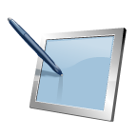
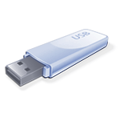
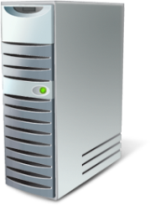
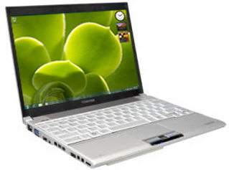
Full Disk Encryption Going Mainstream
Changing landscape
Traditionally only on business editions of Windows
Critical for business; Increasing demand for consumer
BYOD putting consumer devices in business scenarios
Being used to protect system itself, not just the data
Challenges in making it pervasive
TPM will soon become standard equip, but not there yet
Performance on low end devices not sufficient
Microsoft’s direction
Device Encryption now available on all editions of Windows
Requires Connected Standby certified devices

Slide 33
Device Encryption vs. BitLocker
Device Encryption
Encryption of OS volume is automatic and configured out of the box
Protection is enabled once an administrator uses a Microsoft Account to sign-in
If unmanaged Recovery Key Password is stored in the SkyDrive
Can quickly be configured to use BitLocker features (Pro and Ent only)
BitLocker and BitLocker To Go – Windows Pro, and Enterprise
Enables encryption of fixed disk (BitLocker) and removable disks (BitLocker to Go)
Protection is enabled through imaging, mgmt solutions (e.g.: MBAM), or end user
Recovery Keys can be stored in AD or mgmt solutions (e.g.: MBAM)
FIPS Support

Slide 34
Protecting Sensitive Data
Pervasive Device Encryption
Selective Wipe of Corp Data

Slide 35
Your organization’s data is at risk!
Your company data is probably leaking
Email, File Sharing, Instant Messaging, Removable Storage, Network
Scary stats (e.g.: 40% have taken corporate data specify to use in a new job)
Challenges with today’s solutions
Container model easy to wipe but too restrictive for PC’s
“Policy and discovery” model effective but complex
User opt-in model to protect data not always used
Expensive, complex, targeted at sophisticated customers
Challenges we will address in Windows 8.1
Process of identifying corporate vs. user data
Simplify encryption and access revocation process for corporate data
Better control over corp data when full DLP solution is not an option

Slide 36
Introducing Selective Wipe
Selective Wipe (SW) is a platform feature that:
enables services to request that corp data be secured
client receives request and uses EFS to generate key and protect data
offers more control to organizations that are unable to invest in full DLP
offers platform capability that can simplify DLP solution implementations
How it works
Server app implement API which can be used to set SW policy
Client apps implements API. Client receives policy and protects data (EFS)
EAS and OMA-DM used to trigger SW revoke access command
Revoke command destroys encryption key making data inaccessible

Slide 37
Selective Wipe in Windows 8.1 and Beyond
Ship the following end to end scenarios:
Wipe Mail app data via EAS
Wipe Mail attachments saved locally via EAS or OMA-DM
Wipe WorkFolders data via EAS or OMA-DM
Secure adoption commitments with MSFT apps
Drive adoption with 3rd party apps and DLP products

Slide 38
Malware Resistance
Provable PC Health
Improved Windows Defender

Slide 39
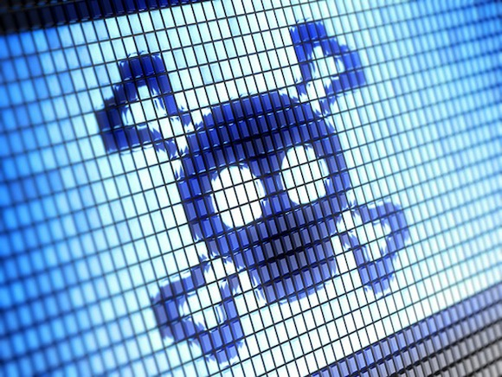
Provable PC Health
The Challenge
UEFI and Trusted Boot very effective, no promises
Malware still able to hide by turn off defenses
No great way for devices to vet themselves
Opportunities
Remote Attestation
API’s available for Boot Integrity Security Status
Adoption
ISV’s not delivering Remote Attestation services
IS’s building for niche well funded customers
Our Goal in Windows 8.1
Deliver Remote Health Analysis service for Windows
Provide remediation and notification services

Slide 40
Introducing Provable PC Health
Secure Data
Client send periodic heartbeat with state data
Measured Boot
Action Center Status
Cloud service consumes data and analyzes it
If issue is detected cloud sends message to Client with remediation recommendation
Client responds to recommendation
Machine Remediation
Account Remediation
Windows Cloud Service
Analysis and Response
2
1
3
Windows Client
4a
4b
Machine
Remediation
Account
Remediation

Slide 41
Malware Resistance
Provable PC Health
Improved Windows Defender and Internet Explorer

Slide 42
Enhancements to Windows Defender and Internet Explorer
Windows Defender
Malware almost always designed to talk to world, that’s their weakness
Adding high performance behavior monitoring
Identifies malicious patterns of behavior based (file, registry, process, thread, network)
Activity log sent to cloud for analysis, signatures may be issued later
Internet Explorer
Malicious websites attempt to exploit vulns in binary extensions (e.g.: ActiveX)
Binary extensions are executed immediately bypassing AM
API available that enables AM solutions to scan before execution

Slide 43
Blues Security Addresses Emerging Threats
Modern Access Control
Securing the Sign-In
Secure Access to Resources
Malware Resistance
Securing the Boot
Securing the Code and Core
Securing the Desktop
Protect Sensitive Data
Securing Device with Encryption
First Class Biometric Experience
Multifactor Authentication for BYOD
Trustworthy Identities and Devices
Provable PC Health
Improved Windows Defender
Improved System Core Hardening
Pervasive Device Encryption
Selective Wipe of Corp Data
Trustworthy Hardware
Trusted Platform Module (TPM) becoming pervasive in 2014

Slide 44
Windows Track Resources
Windows Enterprise: windows.com/enterprise
Windows Springboard: windows.com/ITpro
Microsoft Desktop Optimization Package (MDOP): microsoft.com/mdop
Desktop Virtualization (DV): microsoft.com/dv
Windows To Go: microsoft.com/windows/wtg
Outlook.com: tryoutlook.com

Slide 45
For More Information
System Center 2012 Configuration Manager
http://technet.microsoft.com/en-us/evalcenter/hh667640.aspx?wt.mc_id=TEC_105_1_33
Windows Intune
http://www.microsoft.com/en-us/windows/windowsintune/try-and-buy
Windows Server 2012
http://www.microsoft.com/en-us/server-cloud/windows-server
Windows Server 2012 VDI and Remote Desktop Services
http://technet.microsoft.com/en-us/evalcenter/hh670538.aspx?ocid=&wt.mc_id=TEC_108_1_33
http://www.microsoft.com/en-us/server-cloud/windows-server/virtual-desktop-infrastructure.aspx
More Resources:
microsoft.com/workstyle microsoft.com/server-cloud/user-device-management

Slide 46
Related content
Breakout Sessions
WCA-B370R - What’s New in Blue Security (Repeat Session)
WCA-B210 - Securing Windows 8 Client and Resources from Threats
WCA-B201 - What’s new with BitLocker and MBAM 2.0
ATC-B301 – What passwords do when nobody is looking
ATC-B314 - The Inside Man – Surviving the Ultimate Cyber Threat
ATC-B307 - Hackers (Not) Halted
Find Me Later At Windows Security Booth
Monday, 6/3: 10:15am - 12:15pm
Tuesday, 6/4: 12:15pm - 2:30pm
Thursday, 6/6: 10:45am - 12:45p

Slide 47
Resources
Learning
Sessions on Demand
Microsoft Certification & Training Resources
http://channel9.msdn.com/Events/TechEd
www.microsoft.com/learning
TechNet
msdn
Resources for IT Professionals
Resources for Developers
http://microsoft.com/technet
http://microsoft.com/msdn

Slide 48
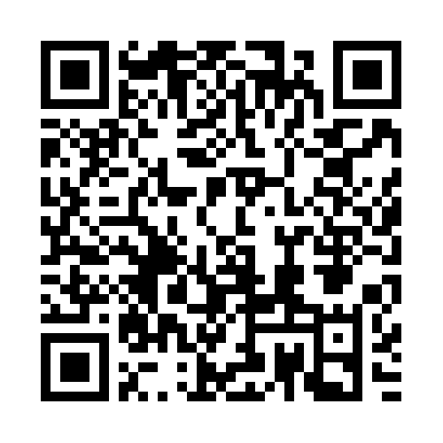
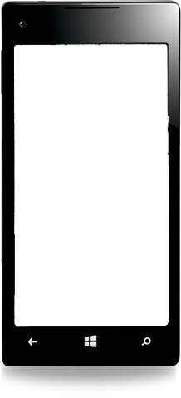
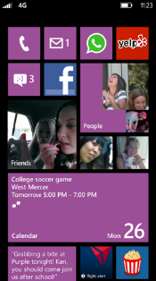
Evaluate this session
Required Slide
*delete this box when your slide is finalized
Your MS Tag will be inserted here during the final scrub.
Scan this QR code to
evaluate this session.

Slide 49
© 2013 Microsoft Corporation. All rights reserved. Microsoft, Windows and other product names are or may be registered trademarks and/or trademarks in the U.S. and/or other countries.
The information herein is for informational purposes only and represents the current view of Microsoft Corporation as of the date of this presentation. Because Microsoft must respond to changing market conditions, it should not be interpreted to be a commitment on the part of Microsoft, and Microsoft cannot guarantee the accuracy of any information provided after the date of this presentation. MICROSOFT MAKES NO WARRANTIES, EXPRESS, IMPLIED OR STATUTORY, AS TO THE INFORMATION IN THIS PRESENTATION.

