Slide 2
Creating Windows Phone 8 apps for SharePoint
WPH-B307
Jeremy Thake
Chief Architect, AvePoint Inc. SharePoint MVP

Slide 3
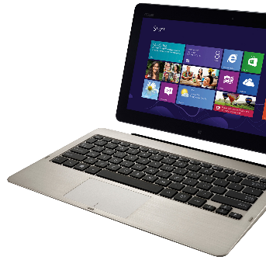
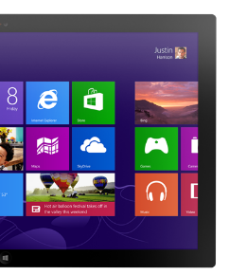
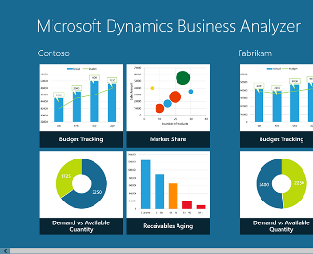
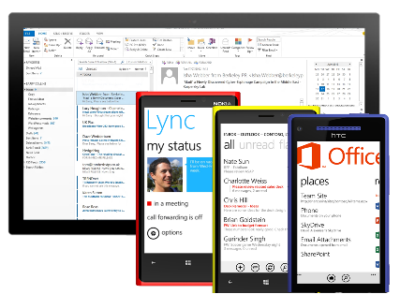
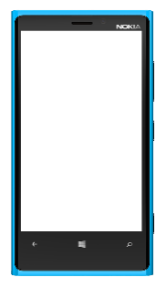
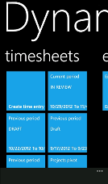
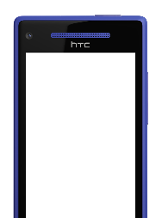
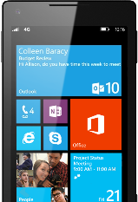
Windows Phone The Right Choice for Business
Great, consistent experience across devices
Productive and connected
Robust platform for mobile apps
Unified app and device management
Common core and security architecture

Slide 4
Session Objectives And Takeaways
Cloud App Model Overview
Phone Development Basics
Push Notifications
Geo-Location

Slide 5
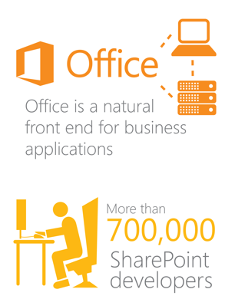
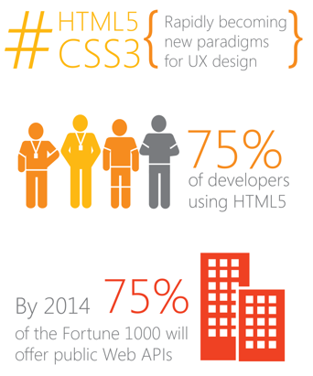
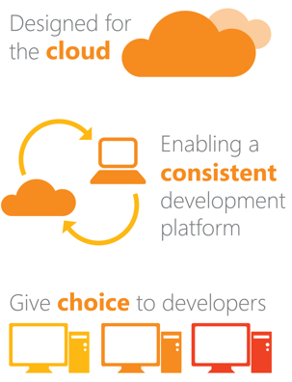
Our Vision: Modernizing the platform
Vision: Modernizing the Office Platform
Today’s Market
Today’s Trends
Our Principles

Slide 6
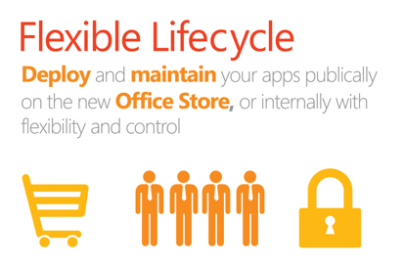
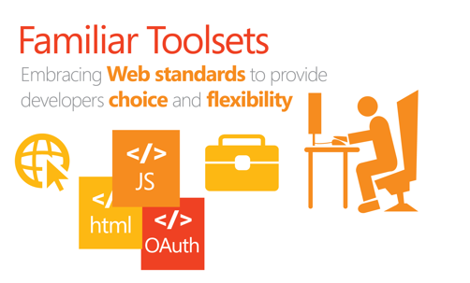
The result: a new cloud app model

Slide 7
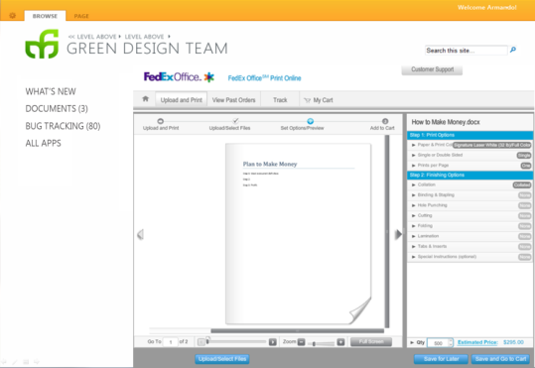
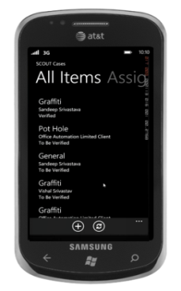
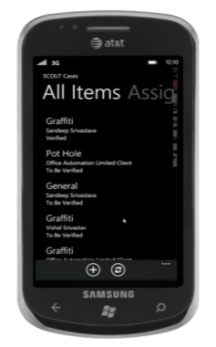
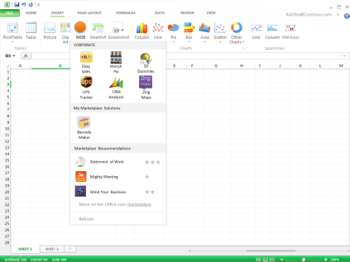
App Model: Past, Present and Future
Azure, IIS, LAMP, etc…
SharePoint 2010
SharePoint 2007
SharePoint
2013
SharePoint
Sandbox
SharePoint
_api

Slide 8
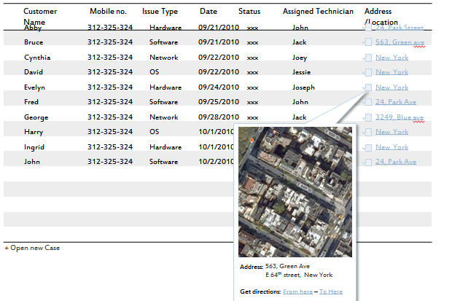
Mobile Apps and SharePoint
List Apps
OOB Lists
Custom Lists
External Lists
General Apps
Silverlight CSOM

Slide 9
Types of Mobile Apps
Simple SharePoint List Apps
Use a SharePoint list as the data source
Push Notification Apps
Receive List Item events
Receive Workflow state-change events
Location-Aware Apps
Utilizes the new Location field type

Slide 10
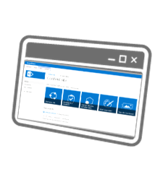
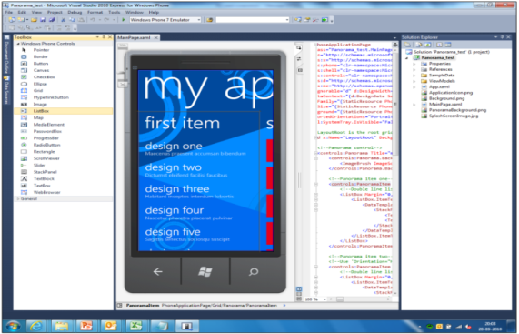
Roles
SharePoint Developers
SharePoint Developer
Browser, SPD, or VS
Creates List
Optionally Utilize Location Field
Phone Developer
VS, Blend
List Wizard, Templates
CSOM
SharePoint & Visual Studio
Phone developers
Visual Studio

Slide 11
Security
Supported Authentication
Forms-Based
Office 365 (Azure AD)
Basic
Cross-Firewall Connectivity
User Access Gateway
Alternate Access Mapping

Slide 12
Phone Development

Slide 13
SharePoint Development Environment
Cloud Supported Environment
Office 365 SharePoint Online
Windows 8
Visual Studio 2010 or 2012
SharePoint 2013 Client Components SDK
Office 2013 Dev Tools for Visual Studio 2012
Local Supported Environment
Windows 8
Visual Studio 2010 or 2012
Virtual Machine
Windows Server 2008 R2/2012
SQL 2008 R2/2012
SharePoint 2013
SharePoint 2013 development is not supported
on client operating systems.

Slide 14
Phone Development Environment
Supported Environment
Windows 7 or 8
Visual Studio 2010 or 2012
Installation Process
Windows Phone 7.1 or 8 SDK
SharePoint SDK for Windows Phones
Phone development is not now
and will not be supported
on server operating systems.
Visual Studio Project Templates only available for C#

Slide 15
SharePoint Developer Role
Browser Development
Custom Lists
SharePoint Designer Development
Custom Lists
External Lists
Visual Studio Development
Apps
Custom List Definitions
External Content Types

Slide 16
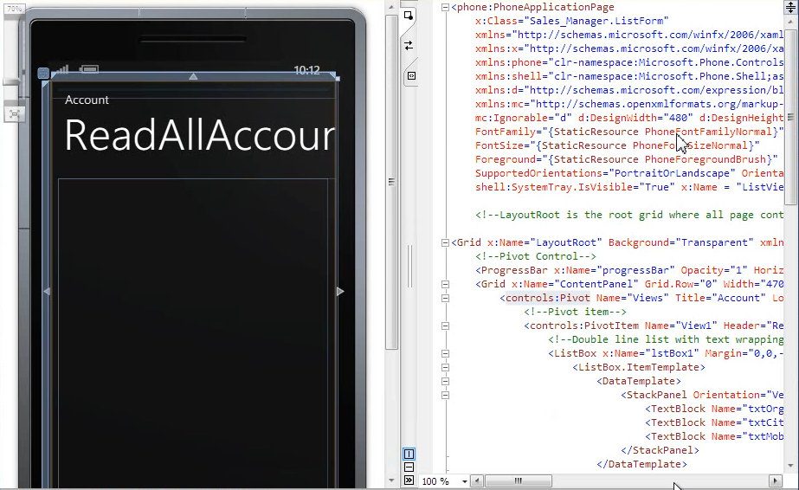
Phone Developer Experience
Windows Phone SharePoint List Application
Launches a Wizard
Select List
Select View
Select Operations
Select Fields
Order the Fields
Project is Created

Slide 17
Model-View-ViewModel Pattern
Client
Server
View
ViewModel
Model

Slide 18
Project Files
Key File | Description
App.xaml | Handles application lifetime
DisplayForm.xaml | Defines the UI for displaying a list item on the phone
EditForm.xaml | Defines the UI for editing a list item on the phone
NewForm.xaml | Defines the UI for creating a new list item on the phone
List.xaml | Defines the UI for the All Items view on the phone
ListViewModel | Data source for the All Items view
DisplayFormViewModel | Data source for the display item view
EditFormViewModel | Data source for the edit item view
NewFormViewModel | Data source for the new item view
DataCache | Supports data caching and off-line access

Slide 19
Silverlight Client Object Model on the Phone
ClientContext context = new ClientContext(ListUrl); Authenticator at = new Authenticator(); at.UserName = "pkmacct"; at.Password = "test!"; at.AuthenticationMode = ClientAuthenticationMode.FormsAuthentication; at.CredentialCachingEnabled = true; at.CookieCachingEnabled = true; context.Credentials = at; ListItemCollection items = context.Web.Lists.GetByTitle(ListName).GetItems(CamlQuery.CreateAllItemsQuery()); context.Load(items); context.ExecuteQueryAsync(succeed, failure);

Slide 20
OData Model on the Phone
ODataAuthenticator oat = new ODataAuthenticator(); oat.UserName = "pkmacct"; oat.Password = "test!"; oat.AuthenticationMode = ClientAuthenticationMode.FormsAuthentication; oat.CredentialCachingEnabled = true; oat.CookieCachingEnabled = true; oat.AuthenticationCompleted += new EventHandler<SendingRequestEventArgs>(OnAuthenticationCompleted); // The Authenticate method will raise the AuthenticationCompleted event. oat.Authenticate("My_service_URL");

Slide 21
Phone Development
Name

Slide 22
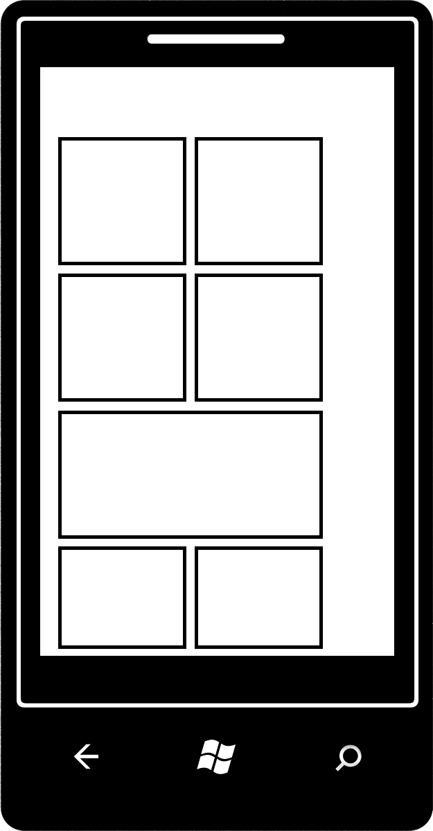
Push Notifications - Architecture
SharePoint
3. Phone registers with registration API, which writes information to subscription list in App.
Server App
The subscription list in the app is provisioned as part of feature
Registration API
Subscription Store (list in the app)
1. Get URI
Notification API
app
4. When an app event is fired, the app looks up the subscription list in app & then calls the notification API for all phones that need to be notified
PNS
2. Return URI
5. PNS notifies the phones

Slide 23
Push Notifications

Slide 24
Notification Types
Toast Notifications
Displayed at the top of the screen for 10 seconds
Tapping the notification launches the App
Tile Notifications
Updates the a Tile on the Start area
Raw Notifications
Received when the target app is running

Slide 25
SharePoint Server Configuration
Push Notification Feature
Allows a phone to register with the SPWeb
Custom Code
Developer must write code to send notifications
SPWeb.PushNotificationSubscribers contains registrations

Slide 26
Push Notifications - Registering for Notifications
clientContext.Web.RegisterPushNotificationSubscriber( SPPhoneNotificationSubscriberType.WP7, d231398c-f26b-4e5c-af57-ec7c5f694eb6, httpChannel.ChannelUri.AbsoluteUri); clientContext.ExecuteQueryAsync(onRegisterQuerySucceeded, onRegisterQueryFailed);

Slide 27
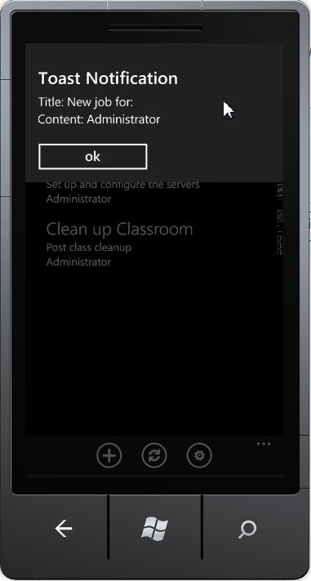
Push Notifications - Sending a Toast Notifications
<?xml version="1.0" encoding="utf-8"?>
<wp:Notification xmlns:wp="WPNotification">
<wp:Toast>
<wp:Text1>Title</wp:Text1>
<wp:Text2>Message</wp:Text2>
<wp:Param>Parameter</wp:Param>
</wp:Toast>
</wp:Notification>

Slide 28
Push Notifications
Name

Slide 29
Location

Slide 30
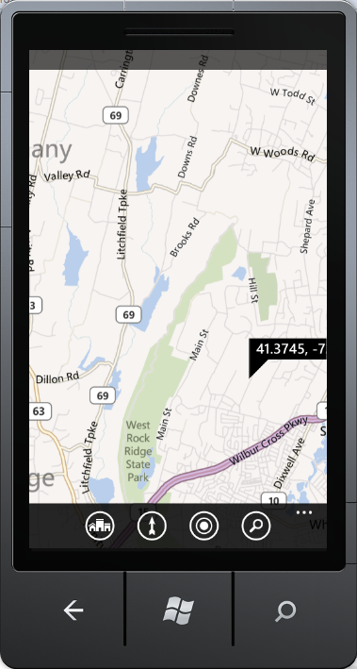
Location Fields: SharePoint Lists
New Type of Field
Contains Lat/Long
Location Picker
Map Type
Ideal for Mobile Apps

Slide 31
Location Fields - Adding a Location Field
public override void FeatureActivated(SPFeatureReceiverProperties properties)
{
SPWeb site = properties.Feature.Parent as SPWeb;
SPList list = site.Lists.TryGetList("Service Calls");
if (list != null)
{
list.Fields.AddFieldAsXml(
"<Field Type='Geolocation' DisplayName='Location'/>",
true,
SPAddFieldOptions.Default);
list.Update();
}
}

Slide 32
Adding a Bing Maps key
PowerShell
Set-SPBingMapsKey –BingKey <key>
Client-Side OM
ClientContext ctx = new ClientContext("http://contososerver");
Web web = ctx.Web;
web.AllProperties["BING_MAPS_KEY"] = <key>;
web.Update();
ctx.ExecuteQuery();
Server-Side OM
using (SPSite siteCollection = new SPSite("http://contososerver"))
{
SPWeb site = siteCollection.RootWeb;
site.AllProperties["BING_MAPS_KEY"] = <key>;
site.Update();
}

Slide 33
Location Demo

Slide 34
In Review: Session Objectives And Takeaways
Cloud App Model Overview
Phone Development Basics
Push Notifications
Geo-Location

Slide 35
Windows Phone Breakout Sessions
Tuesday, June 25:
1:30pm - The phone that has everything the enterprise needs: Windows Phone 8
3:15pm – The top down guide for developers: Windows Phone 8
5:00pm – The power of collaboration: Integrating Windows Phone with Office 365, Exchange and SharePoint Online
Wednesday, June 26:
8:30am – All aboard for the future of HTML5 mobile & hybrid web apps for Windows Phone 8 and Windows Tablets
10:15am – The Windows Phone 8 networking survival kit
12:00pm – Build it once for both: Writing code and designing for Windows 8 and Windows Phone 8
3:15pm – Mobile Security in the Enterprise: Windows Phone 8 Answers the Call
5:00pm – Using C and C++ in your Windows Phone 8 Applications

Slide 36
Windows Phone Breakout Sessions
Thursday, June 27:
10:15am – Developing large-scale enterprise mobile apps for Windows Phone 8
12:00pm – Speechifying your Windows Phone 8 applications
3:15pm – Secrets of using background agents for Windows Phone 8
5:00pm – Manage Windows Phone enterprise apps
Friday, June 28:
8:30am – Support your demanding LOB apps with SQLite and Windows Phone 8
10:15am – Creating Windows Phone 8 apps for SharePoint
4:30pm – Windows Phone: How to make money with your applications and games

Slide 37
Windows Phone Hands On Labs
Porting Windows 8 to Windows Phone 8
Windows Phone 8: File and Protocol Association
Windows Phone 8: Lock Screen Wallpaper
Windows Phone 8: Voice Command
Windows Phone 8: Tiles
Windows Phone 8: Purchase
Windows Phone 8: Wallet
Windows Phone 8: Running Tracker

Slide 38
Windows Phone Booth
Device Bar featuring the latest Windows Phones in the marketplace
Expert Area – Stop by the booth to get all your Windows Phone questions answered by Windows Phone experts
Theater Presentations:
The Windows connected experience
Build Mobile Apps Using Familiar Development Tools
Why Windows Phone in the Enterprise?

Slide 39
Windows Phone Promotions
Attend a Windows Phone theater session to be entered into a drawing for Windows Phones.
Windows Phone Breakout Sessions – Attend Windows Phone breakout sessions and be entered into a drawing to win a Windows Phone.

Slide 40
Track resources
For more information about Windows Phone:
http://www.windowsphone.com/business

Slide 41
Track Resources
For more information about Windows Phone:
http://www.windowsphone.com/business

Slide 42
Resources
Learning
Sessions on Demand
Microsoft Certification & Training Resources
http://channel9.msdn.com/Events/TechEd
www.microsoft.com/learning
TechNet
msdn
Resources for IT Professionals
Resources for Developers
http://microsoft.com/technet
http://microsoft.com/msdn

Slide 43
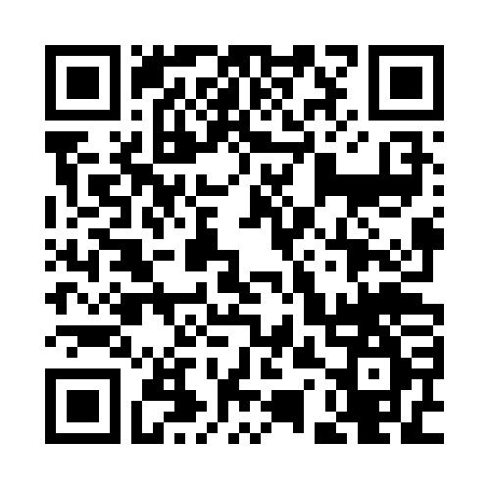
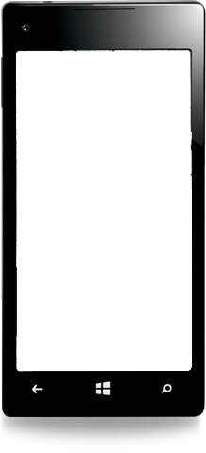
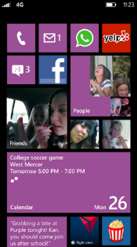
Evaluate this session
Required Slide
*delete this box when your slide is finalized
Your MS Tag will be inserted here during the final scrub.
Scan this QR code to
evaluate this session.

Slide 44
© 2013 Microsoft Corporation. All rights reserved. Microsoft, Windows and other product names are or may be registered trademarks and/or trademarks in the U.S. and/or other countries.
The information herein is for informational purposes only and represents the current view of Microsoft Corporation as of the date of this presentation. Because Microsoft must respond to changing market conditions, it should not be interpreted to be a commitment on the part of Microsoft, and Microsoft cannot guarantee the accuracy of any information provided after the date of this presentation. MICROSOFT MAKES NO WARRANTIES, EXPRESS, IMPLIED OR STATUTORY, AS TO THE INFORMATION IN THIS PRESENTATION.

