Slide 2
Monetize your investment on Apps
WPH-B318
Emilio Salvador/Matthijs Hoekstra
Developer Experience Windows Phone

Slide 3
Setting the stage
Takes work to make get more revenue
Many devs making money with the Store
150K apps: more competition
What works?
What does not work?
Maximize your revenue opportunities
Insights from highest revenue apps

Slide 4
One equation: multiple variables
Higher user monetization
Reach More Users
Global Store
Payment Methods
Increase Downloads
Market your app
Choose A Business Model
Paid
In-app purchase
Mobile Ads
X
X
=

Slide 5
Reach more users Global apps

Slide 6
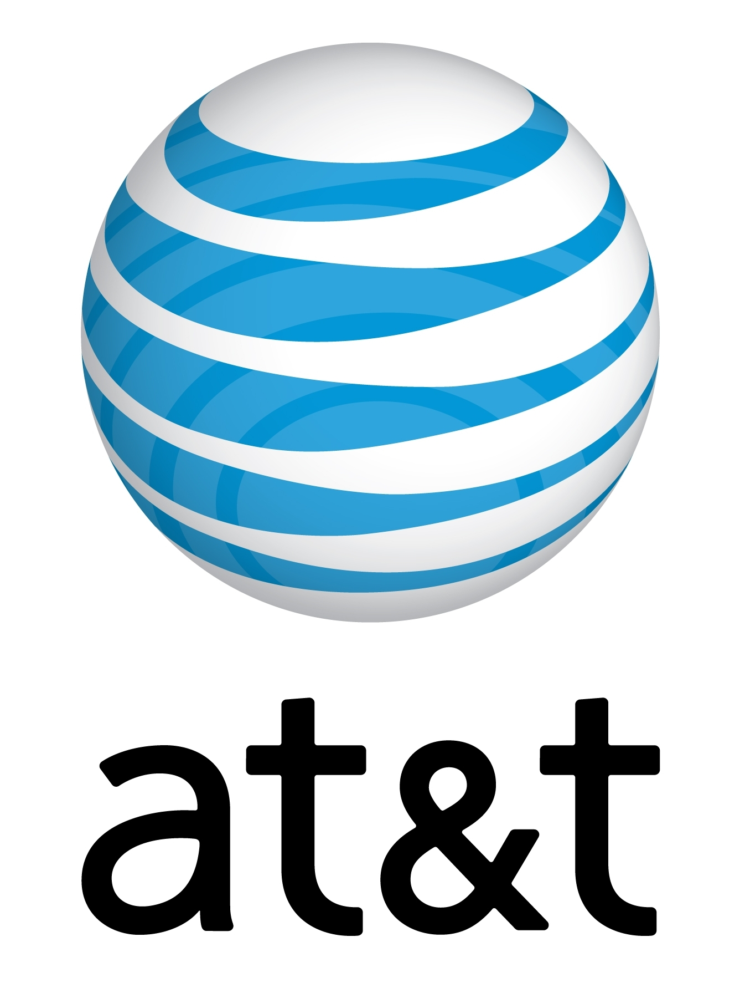
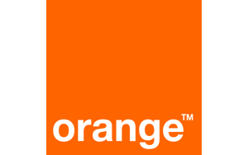
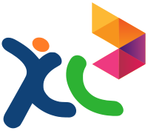
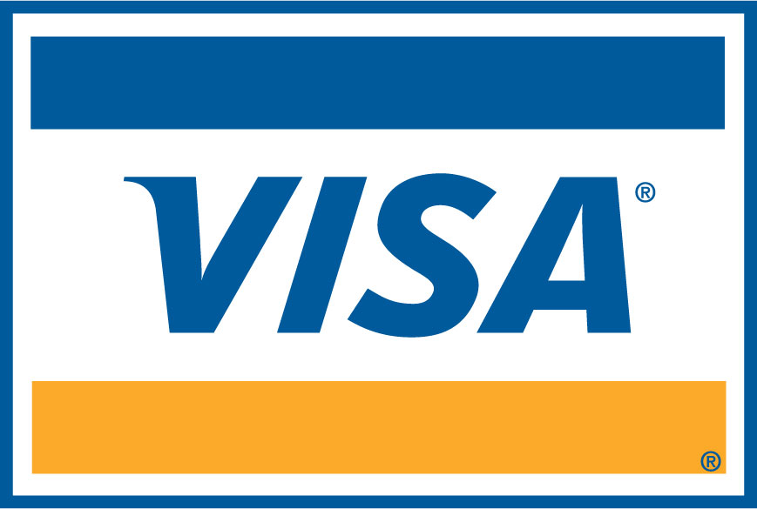
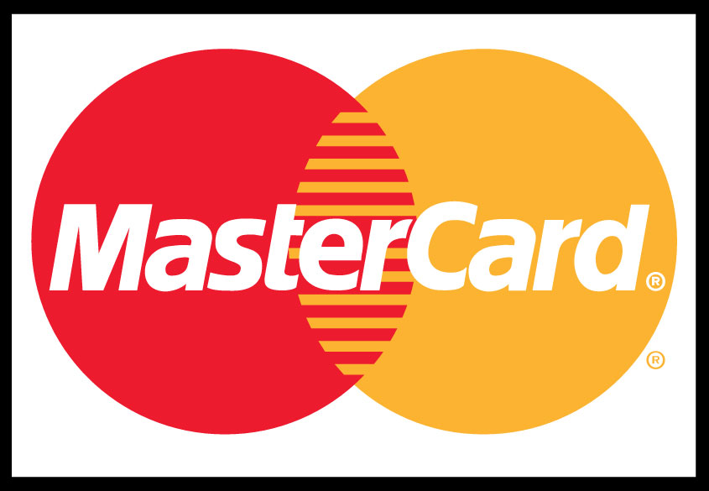
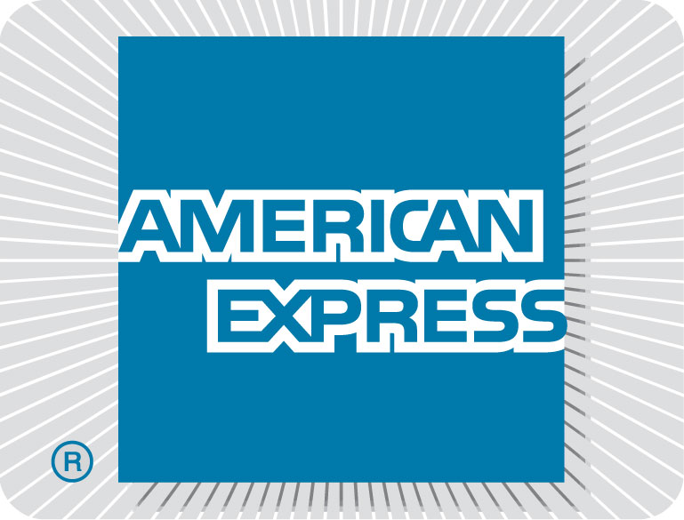
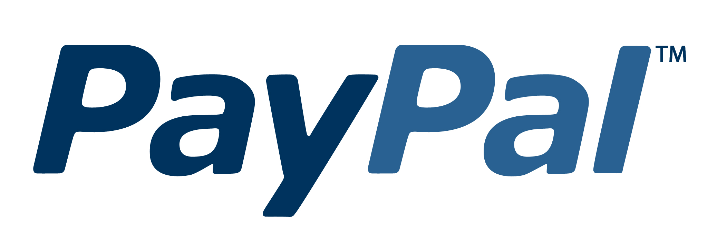
Global Market, Global Payments
191 Markets
20x China purchases:
Alipay
4x WW purchases enabling MO billing
30 MO Billing partners
Now more MO partners than Google
MO list: http://msdn.microsoft.com/library/windowsphone/help/jj215902(v=vs.105).aspx

Slide 7
Publish your app in all markets App downloads per market, CY2013
Alipay Support
12 of top 15 apps are published in >= 187 markets.
Are your apps published in the 191 markets?
Reaching to more countries requires complying with additional content requirements.

Slide 8
Optimize for Windows Phone 8
Windows Phone 8 taking off
50% of downloads in only 6 months
Windows Phone 8 users download 200% more apps than Windows Phone 7 users
Include features that improve monetization
In-app Purchase
Native development (C++)
Tile and Lock Screen Notifications
Faster controls, including Long List Selector
Bluetooth and NFC
Speech
Camera APIs

Slide 9
Support several languages
Top 15 highest grossing apps: avg 8 languages
Top 50 highest grossing apps: avg 6 languages
Do full loc or partial loc (add resources, localize metadata)
Reaching to more countries requires complying with additional content requirements.

Slide 10
Increase Downloads Market your app

Slide 11
No magic formula……
..but some fundamentals
Differentiation
Design
Reliability
Listen and learn
Market your app

Slide 12
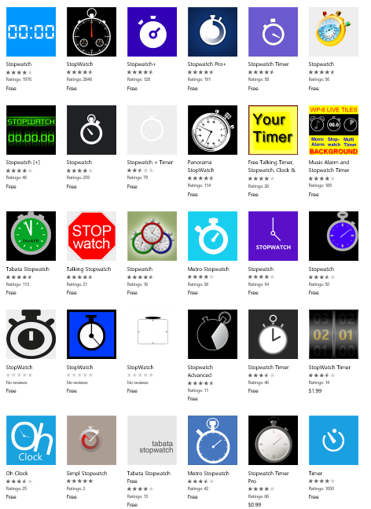
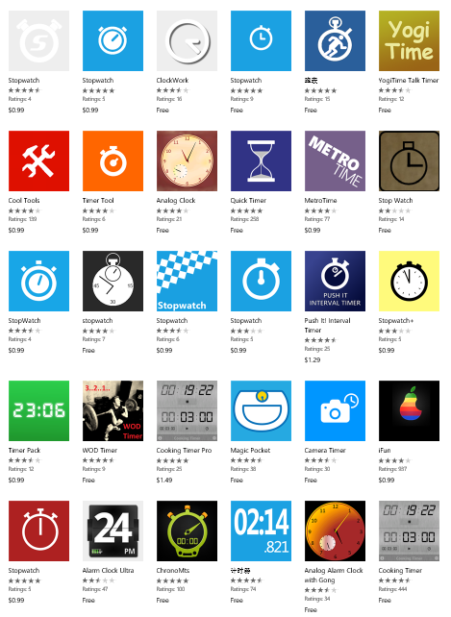
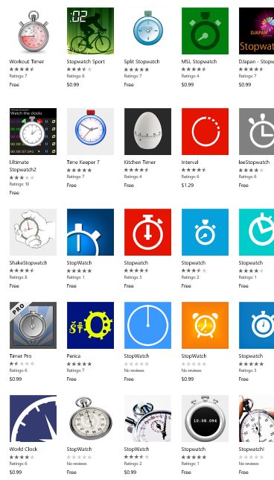
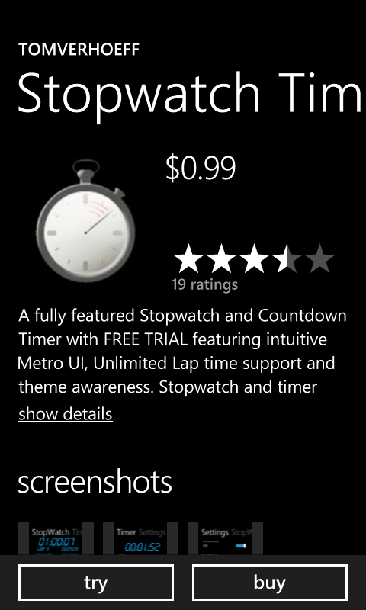
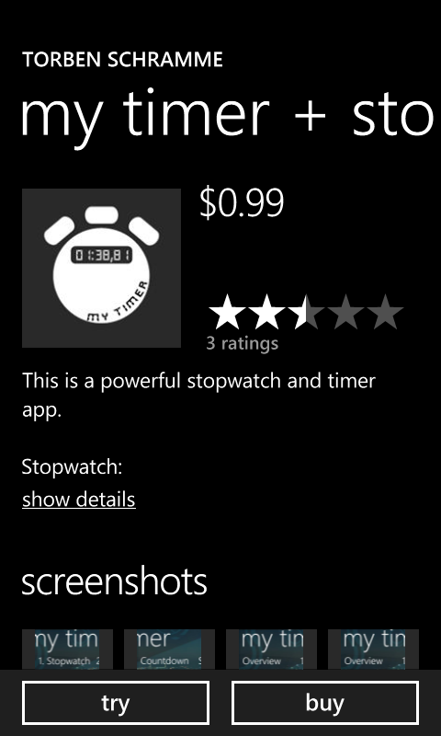
Differentiation

Slide 13
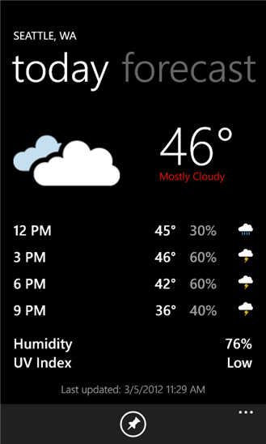
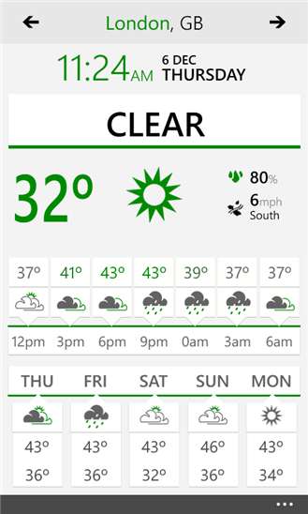
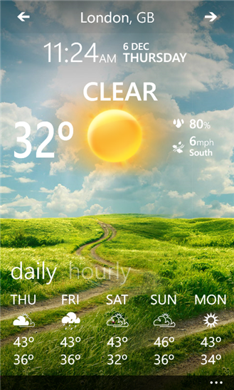
Design

Slide 14
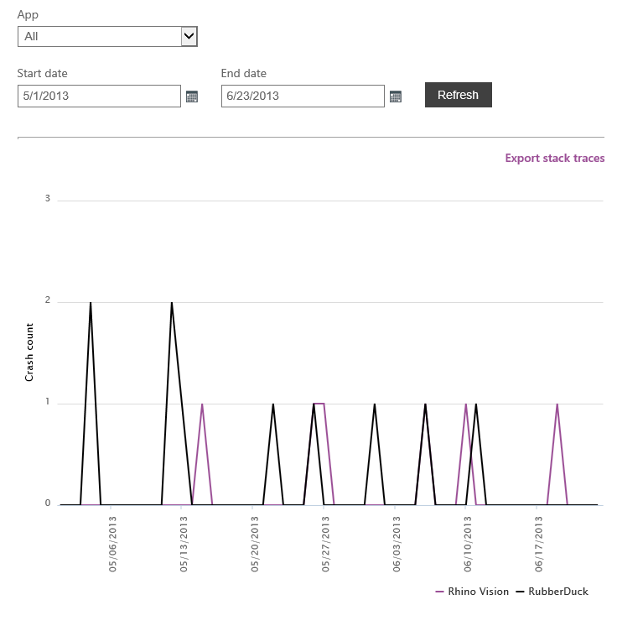
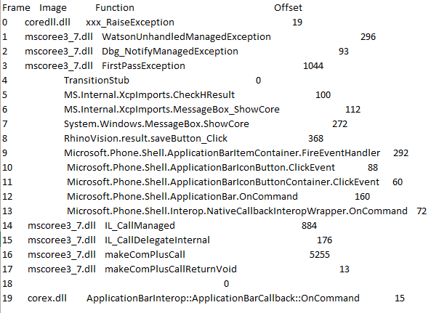
Reliability

Slide 15
Listen and learn
Feedback from users is critical
Ranking
Ratings
Analytics
Measure usage & adoption
Improve user experience
Improve quality
Know your users!

Slide 16
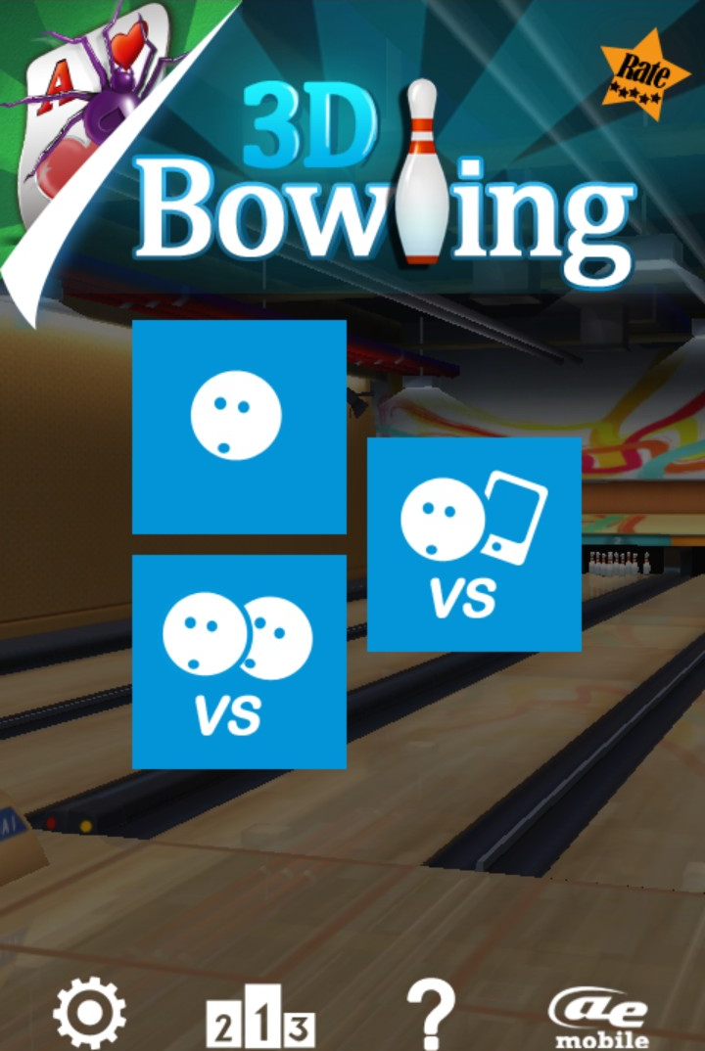
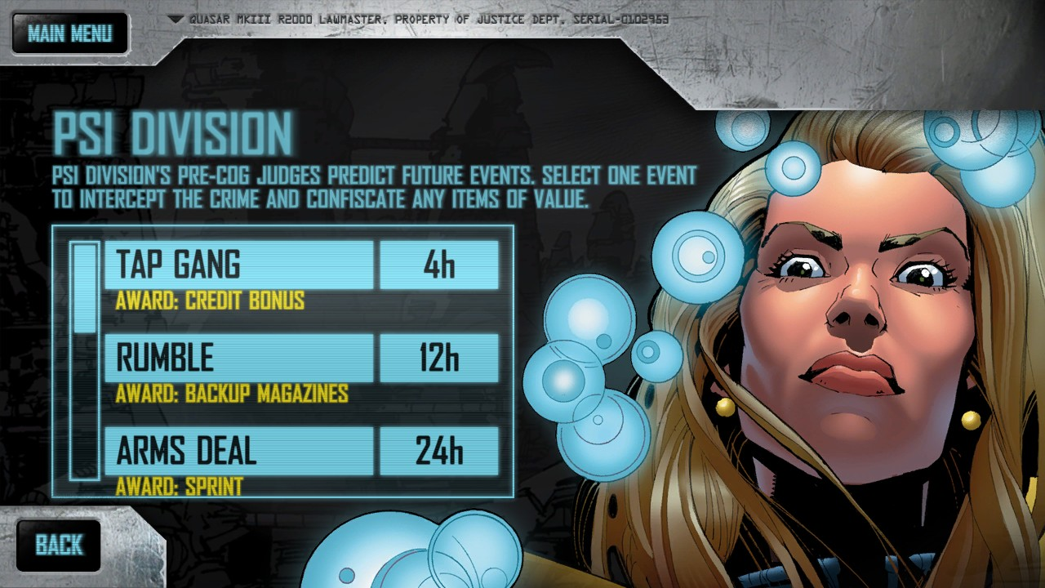
Market your app
Promote via web, social media, advertisement
Maintain the relationship with the user (Achievements, Daily Deals, Live Tile, Notifications, …)
Promote inside your app
Live Tile
Use social media
Weather Flow (Gergely Orosz)
MyTrips (Ace Widgets)
Use the Badge (link to graphics)
Buy Ads (AdDuplex, others)
Dredd vs. Zombies (Rebellion)
Daily Deals
3D Bowling (AE Mobile)

Slide 17
Demo Analytics
Matthijs Hoekstra

Slide 18
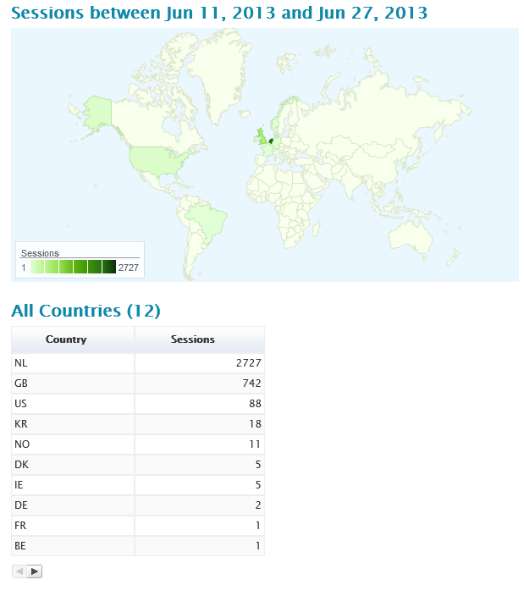
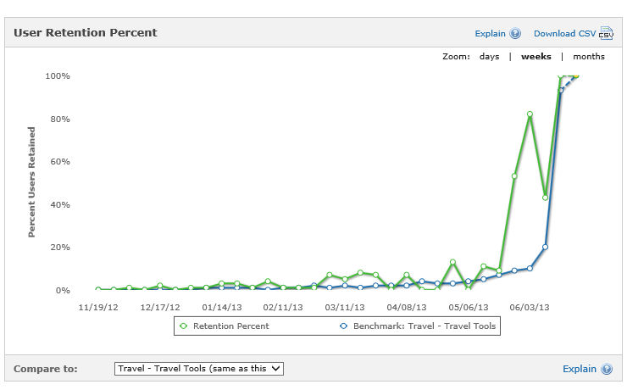
Sample data
mtiks
flurry

Slide 19
Getting more reviews (app.xaml.cs)
private void Application_Launching(object sender, LaunchingEventArgs e)
{
IsolatedStorageSettings.ApplicationSettings["askforreview"] = false;
int started = 0;
if (IsolatedStorageSettings.ApplicationSettings.Contains("started"))
{
started = (int)IsolatedStorageSettings.ApplicationSettings["started"];
}
started++;
IsolatedStorageSettings.ApplicationSettings["started"] = started;
if (started == 5)
{
IsolatedStorageSettings.ApplicationSettings["askforreview"] = true;
}
}

Slide 20
Getting more reviews (MainPage.xaml.cs)
protected override void OnNavigatedTo(NavigationEventArgs e)
{
base.OnNavigatedTo(e);
var askforReview = (bool)IsolatedStorageSettings.ApplicationSettings["askforreview"];
if (askforReview)
{
//make sure we only ask once!
IsolatedStorageSettings.ApplicationSettings["askforreview"] = false;
var returnvalue = MessageBox.Show("Thank you for using APPNAME for a while now, would you like to review this app?", "Please review my app", MessageBoxButton.OKCancel);
if (returnvalue == MessageBoxResult.OK)
{
var marketplaceReviewTask = new MarketplaceReviewTask();
marketplaceReviewTask.Show();
}
}

Slide 21
Choose a business model Paid – IAP – Mobile ads

Slide 22
Use Trial: 2x revenue. 94% of top 50 apps use it
Adoption of Trial functionality in top N highest grossing apps
1% – 5%
conversion rate

Slide 23
Top Apps: Conversion Trial to Paid
Examples
Pro Shot (Rise Up Games)
Purple Cherry GBC (Samuel Blanchard)
Amazing Weather HD (EizSoft)
Photo manipulation
Trial: no save photos
GameBoy Emulator
Trial: no save games
Weather App
Trial: 72-hour limit

Slide 24
Choose a business model Paid – IAP – Mobile ads

Slide 25
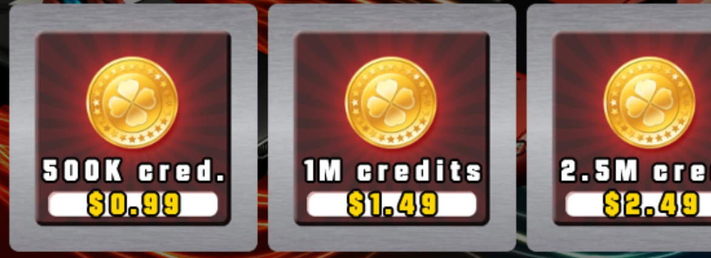
In-app purchase adds value to the app
Examples
Sleep
Brutal Chase 3D
Show users the value of the app: multiple sounds.
Extend the value with sound packs.
Show users how to advance in the game with “credits”.
Offer credit packs to accelerate obtaining credits and advance faster in the game.
Sleep (microhaxo)
Brutal Chase 3D (Mutant Bear Games)

Slide 26
How top apps generally use in-app products
Games
Non games
Consumables
Accelerate obtaining game currency (game gold, coins, etc.)
Durables
Purchase persistent game items (maps, weapons, new puzzle levels, etc.)
Consumables
Offer content: book chapters, ringtones, etc.
Durables
Upgrade to premium version(s) with additional features.

Slide 27
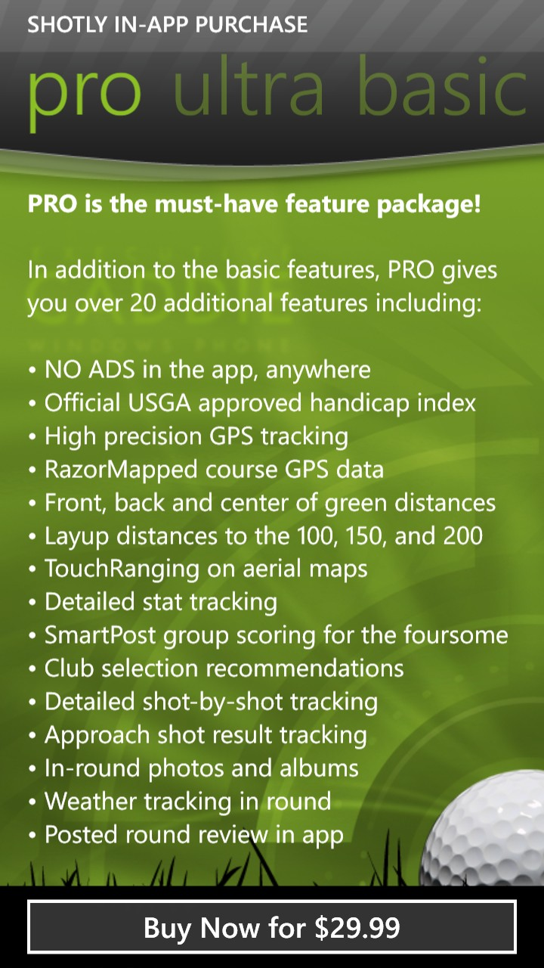
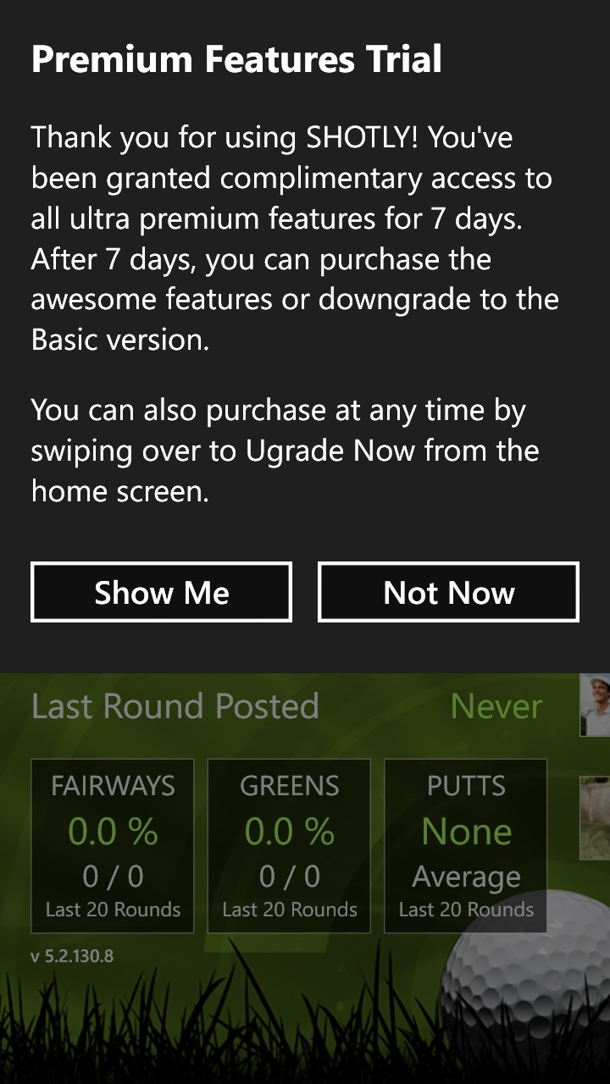
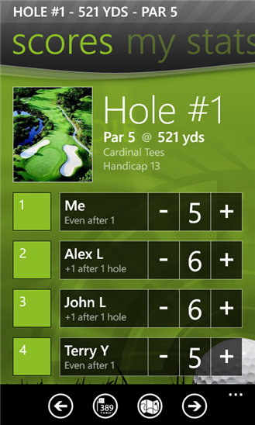
Top app example: Shotly Golf (Vertisan)
Freemium model Apps are free, can be used for free, and extend value through in-app purchase
Offers version for Windows Phone 7 Free version with no IAP: it is the Free Mobile edition (base functionality)
In-app options Basic, Pro, Ultra – each with more functionality

Slide 28
Implementing Trial and in-app purchases
Matthijs Hoekstra

Slide 29
Implementing Trial mode
using Microsoft.Phone.Marketplace;
LicenseInformation info = new LicenseInformation(); if ( info.IsTrial() ) { // running in trial mode }
MarketplaceDetailTask _marketPlaceDetailTask = new MarketplaceDetailTask();
_marketPlaceDetailTask.Show();

Slide 30
Choose a business model Paid – IAP – Mobile ads

Slide 31
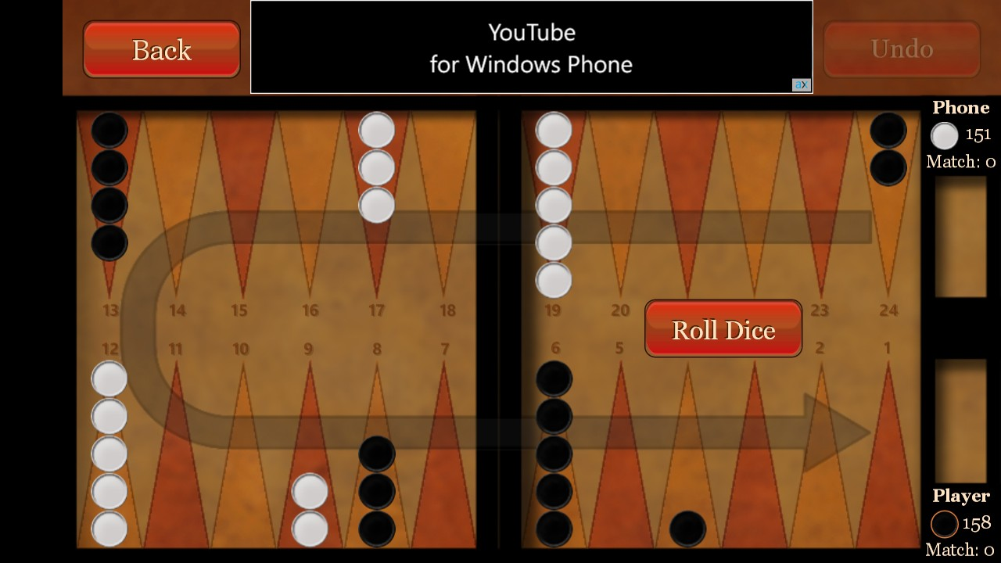
Highest grossing ad-based apps
Best practices
Design the graphics around the ad
Don’t show too many ads (1 per page)
Test
Show your own ad or other Ad Control if there is no Ad from MS Ad Control (catch the exception and take action)
Business model for apps that are used many hours per day per user
Backgammon Pro (Bernardo Zamora)

Slide 32
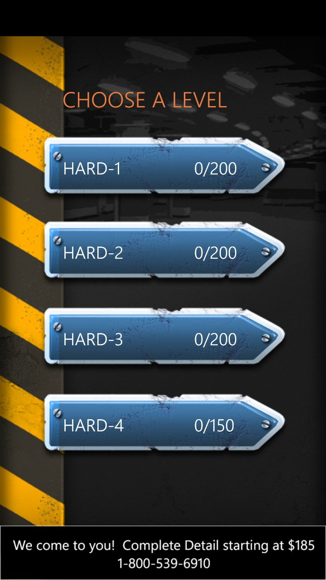
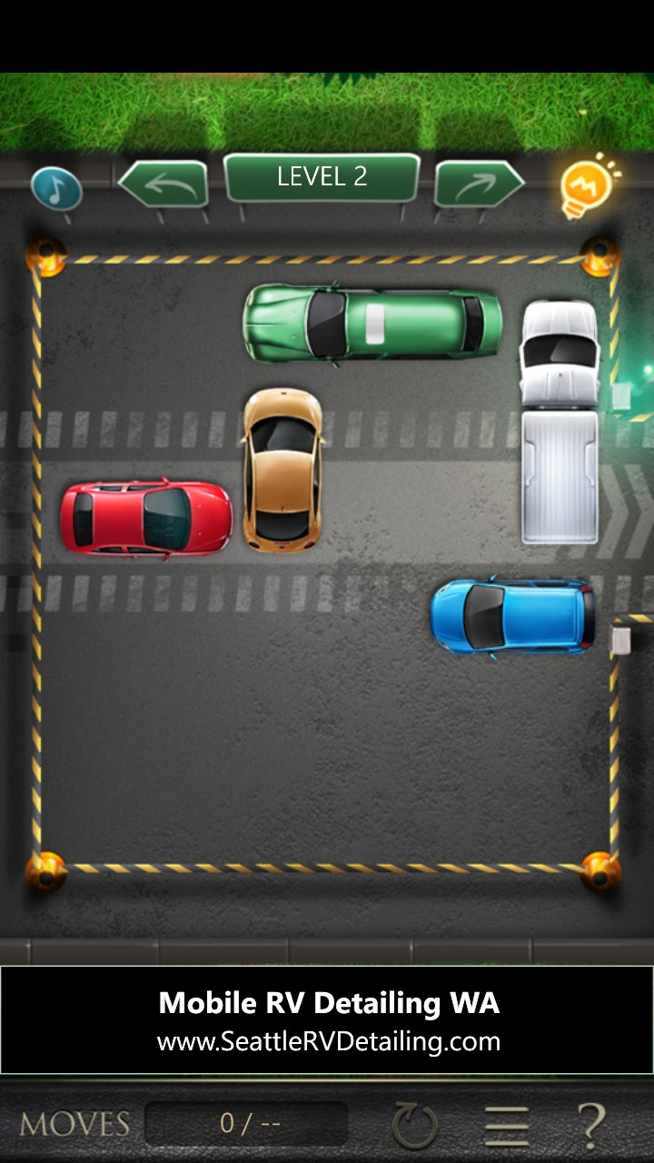
Example: Parking Car (SlickDroid)
For a wide range of users Easy to use, good for users of many ages and cultures
Ads are not intrusive
Ads integrated in the app.
App aware of ad not being shown: hides Ad
Hours of gameplay
3000+ puzzles
Ad Goes Here
Ad Goes Here

Slide 33
Demo Adding ads to your app
Matthijs Hoekstra

Slide 34
Addind Ad Control
<UI:AdControl
ApplicationId="test_client"
AdUnitId="Image480_80"
HorizontalAlignment="Left"
Height="80"
VerticalAlignment="Top"
Width="480"
/>

Slide 35
Third Party Ad controls are supported
Elements to consider
Third Party Ad Controls on Windows Phone
View current market coverage and results in PubCenter*
Test Third Party Ad controls in some of these markets
Market report: in PubCenter view Reports→Create Report → Ad Unit Performance →Include This Data →Market→Download.

Slide 36
Remember…
1) Choose the Best Business Model
4) Optimize your App
2) Publish your App
3) Market your App
Learn for next app
Create app
Put today’s ideas in Action!
Higher
Revenue
Learn from app performance
Choose widest audience possible

Slide 37
Resources
MSDN
NEWS
Design | http://aka.ms/wp8devdesign
Develop | http://aka.ms/wp8devdoc
Test | http://aka.ms/wp8testing
Publish | http://aka.ms/wp8publishing
Samples | http://aka.ms/wp8samples
Portal | http://dev.windowsphone.com
Blog | http://wpdev.ms/developerblog
Channel 9 | http://wpdev.ms/insidewp
Twitter | http:/twitter.com/wpdev
TRAINING
Absolute Beginners | http://wpdev.ms/beginvids
Jump Start | http://aka.ms/wp8js
Design Boot Camp | http://aka.ms/wp8designbootcamp
Training Kit | http://aka.ms/wp8hol

Slide 38
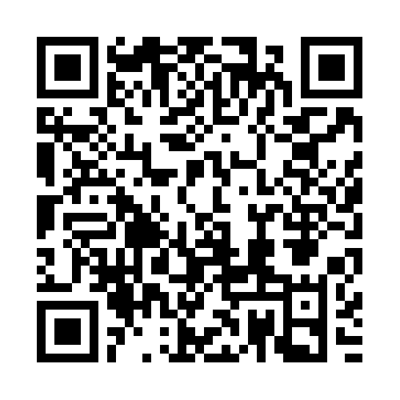
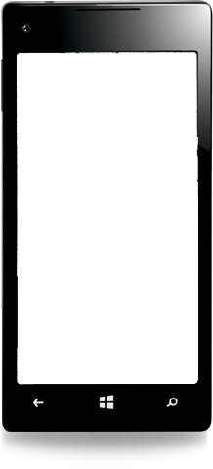
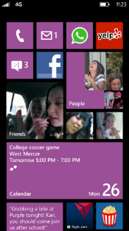
Evaluate this session
Required Slide
*delete this box when your slide is finalized
Your MS Tag will be inserted here during the final scrub.
Scan this QR code to
evaluate this session.

Slide 39
© 2013 Microsoft Corporation. All rights reserved. Microsoft, Windows and other product names are or may be registered trademarks and/or trademarks in the U.S. and/or other countries.
The information herein is for informational purposes only and represents the current view of Microsoft Corporation as of the date of this presentation. Because Microsoft must respond to changing market conditions, it should not be interpreted to be a commitment on the part of Microsoft, and Microsoft cannot guarantee the accuracy of any information provided after the date of this presentation. MICROSOFT MAKES NO WARRANTIES, EXPRESS, IMPLIED OR STATUTORY, AS TO THE INFORMATION IN THIS PRESENTATION.

