Slide 1


Slide 2

Azure Active Directory Explained
CDP-B210
Nasos Kladakis
Sr. Product Marketing Manager
Enterprise Mobility – Azure Active Directory

Slide 3
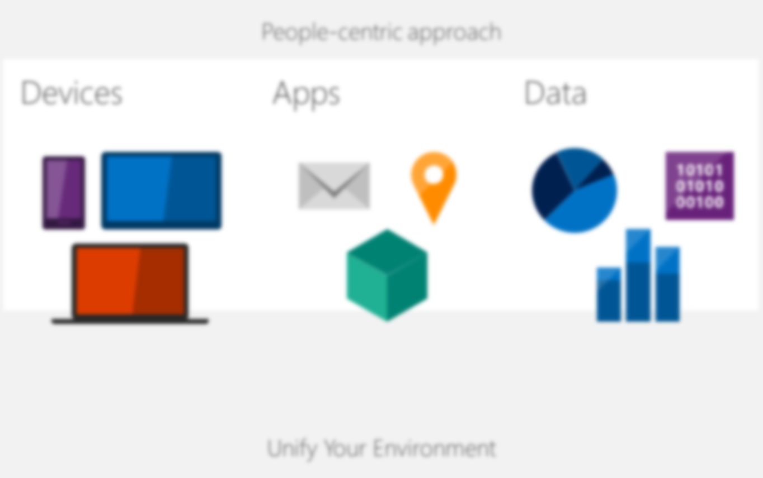


Empowering enterprise mobility
Enable
your users
Protect
your data
Desktop
Virtualization
User
IT
Access & information protection
Hybrid
identity
Mobile device & application management

Slide 4





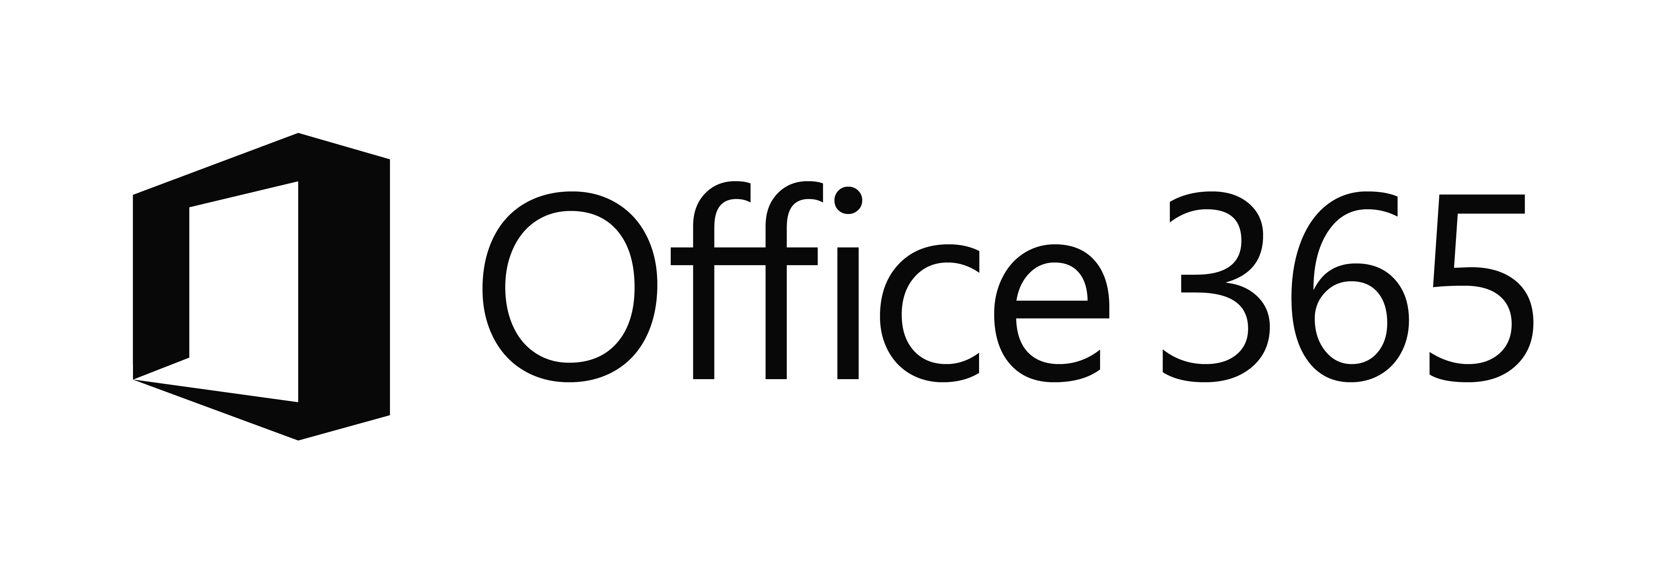
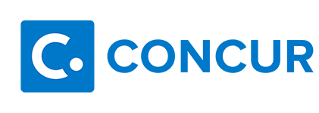

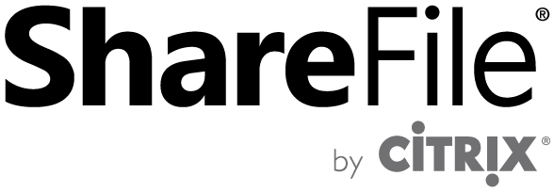





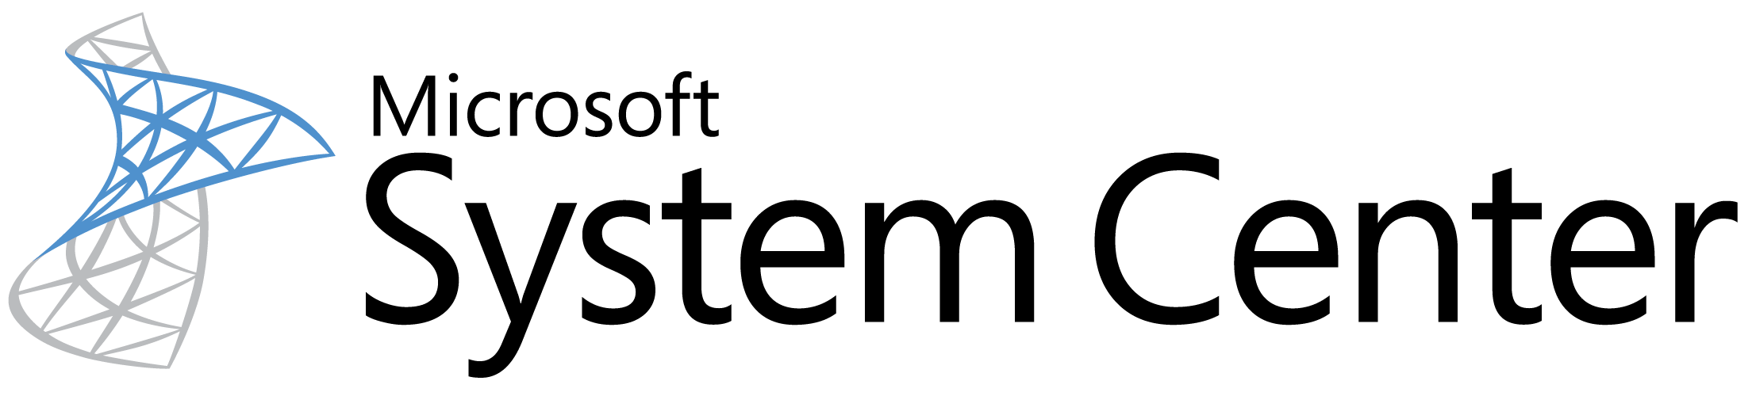

The current reality…
EC2
On-Premises
Managed devices
Private Cloud

Slide 5
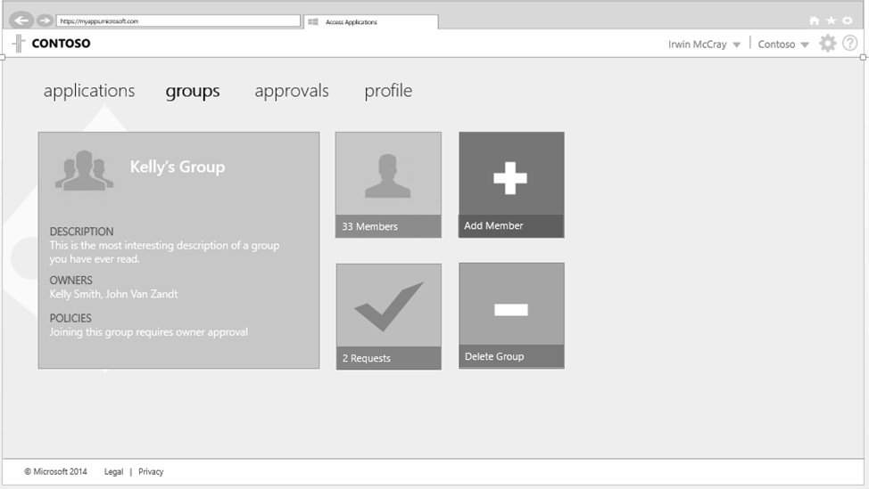
Identity as the control plane
Simple connection
Self-service
Single
sign on
Windows Server
Active Directory
Username
•••••••••••
Other
Directories
SaaS
Azure
Public
cloud
Office 365
On-premises
Cloud
Microsoft Azure Active Directory

Slide 6
What is Azure Active Directory?
A comprehensive identity and access management cloud solution.
It combines directory services, advanced identity governance, application access management and a rich standards-based platform for developers
It is available in 3 editions: free, Basic and Premium

Slide 7
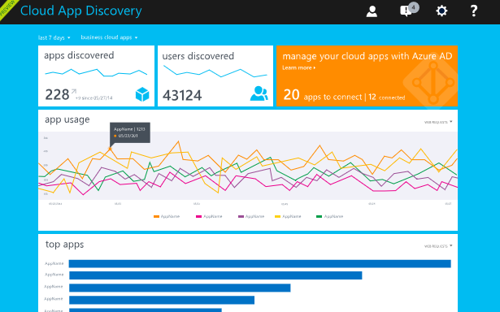
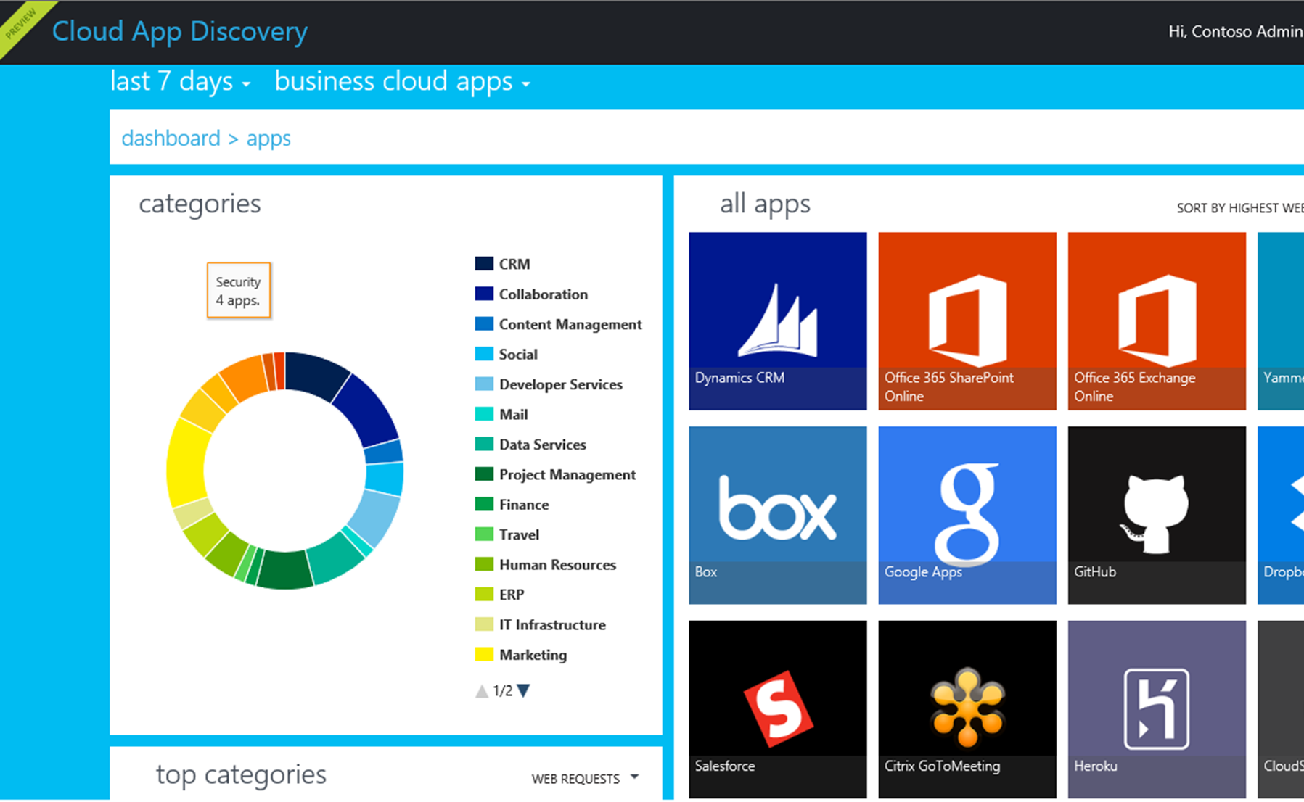
Discover all SaaS apps in use within your organization
10x
as many Cloud apps are in use than IT estimates
Source: Help Net Security 2014
Microsoft Azure Active Directory
Cloud App Discovery
Comprehensive
reporting
  SaaS app category
  Number of users
  Utilization volume

Slide 8
Your Directory on the cloud
Centrally managed identities and access.
Monitor and protect access to cloud applications.
Empower Users

Slide 9
Your Directory on the cloud
Centrally managed identities and access.
Monitor and protect access to cloud applications.
Empower Users

Slide 10
Your Directory on the cloud
Connect and Sync on-premises directories with Azure.
Azure Active Directory Connect
*
*
PowerShell
Microsoft Azure
Active Directory
SQL (ODBC)
LDAP v3
Web Services
( SOAP, JAVA, REST)
Other Directories

Slide 11

Making hybrid identity simple
DirSync
Azure Active Directory Connect
Azure Active Directory Connect
  Consolidated deployment assistant for your identity bridge components
  Progressive learning while configuring the components
  ADFS is optional
Azure Active Directory Sync
Sync Engine
FIM+Azure Active Directory Connector
ADFS
ADFS

Slide 12


Delivering a seamless user authentication experience
Active Directory
Microsoft Azure
Identity Synchronization with password hash sync
User attributes are synchronized using Identity Synchronization services including a password hash, Authentication is completed against Azure Active Directory
Identity Synchronization
Microsoft Azure
User attributes are synchronized using Identity Synchronization tools, Authentication is passed back through federation and completed against Windows Server Active Directory
AD FS

Slide 13
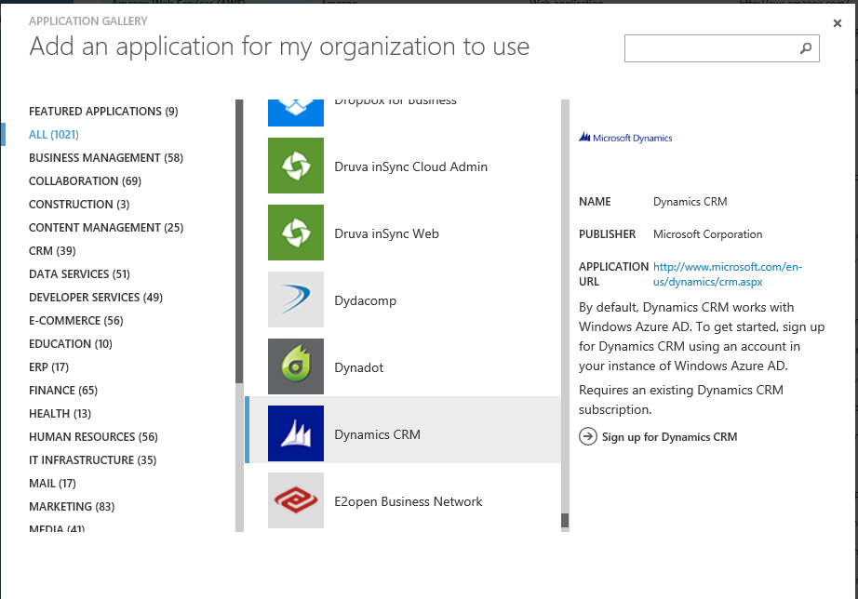
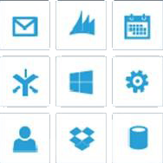
Your Directory on the cloud
Connect and Sync on-premises directories with Azure.
2400+ Preintegrated popular
SaaS apps.
Microsoft Azure
Active Directory
SaaS apps
Other Directories

Slide 14
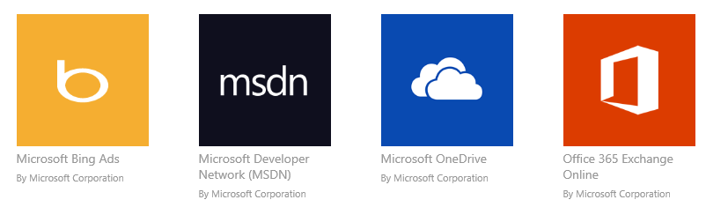
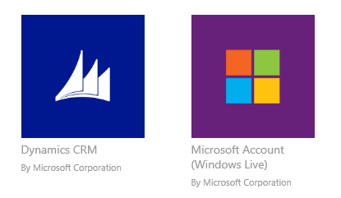
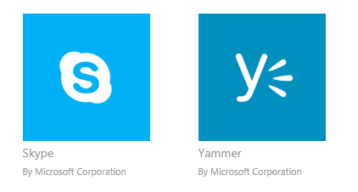
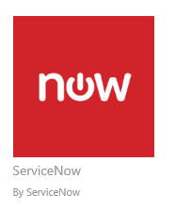
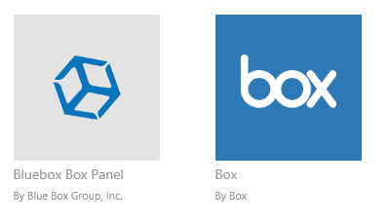
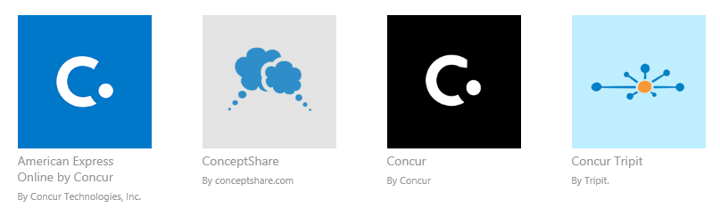
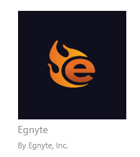


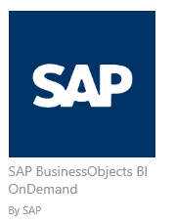
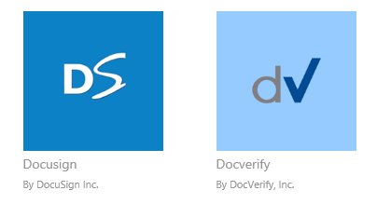
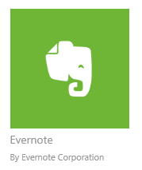
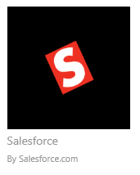

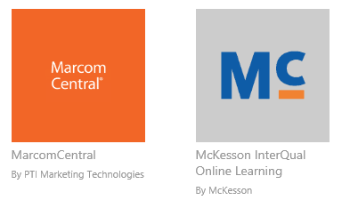
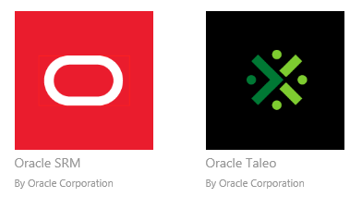
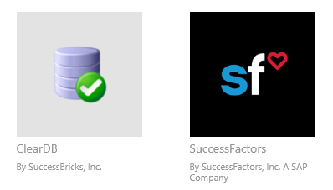

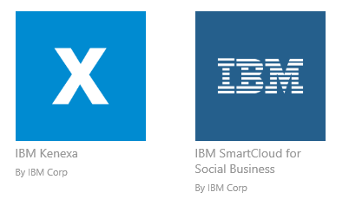
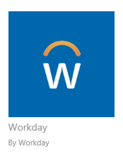
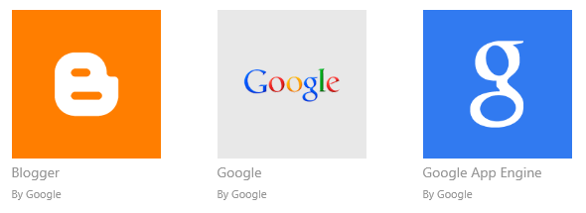
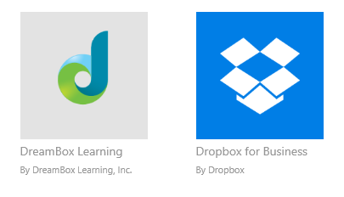
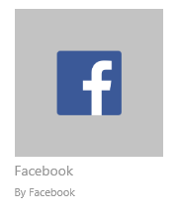
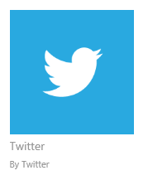
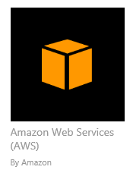

Preintegrated SaaS apps in the application gallery

Slide 15
Your Directory on the cloud
Connect and Sync on-premises directories with Azure.
Other Directories
2400+ Preintegrated popular
SaaS apps.
Microsoft Azure Active Directory
Easily publish on-prem web apps via Application Proxy + Custom apps
through a rich standards-based platform.
SaaS apps
Web Apps
(Azure Active Directory Application Proxy)
Integrated
custom apps
Identities and applications in one place.

Slide 16
Azure Active Directory Application Proxy
Microsoft Azure
Active Directory
A connector that auto connects to the cloud service
https://app1-contoso.msappproxy.net/
Application Proxy
Multiple connectors can be deployed for redundancy, scale, multiple sites and different resources
Connectors are deployed usually on corpnet next to resources
Users connect to the cloud service that routs their traffic to the resources via the connectors
DMZ
Corporate Network
Connector
Connector
Resource
http://app1
Resource
Resource

Slide 17
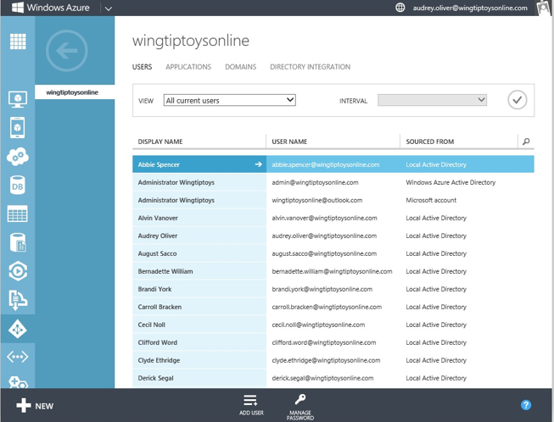
Centrally managed identities and access
Comprehensive identity and
access management console.
Centralized access administration for preintegrated SaaS apps and other Cloud-based apps.
SaaS apps
Secure business processes with advanced access
management capabilities.
IT professional
Your cloud apps ready when you are.

Slide 18
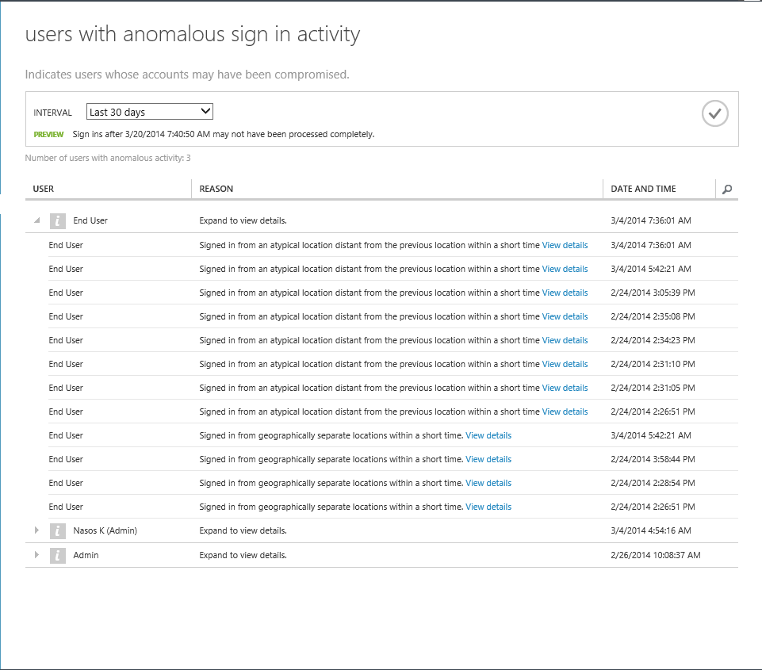
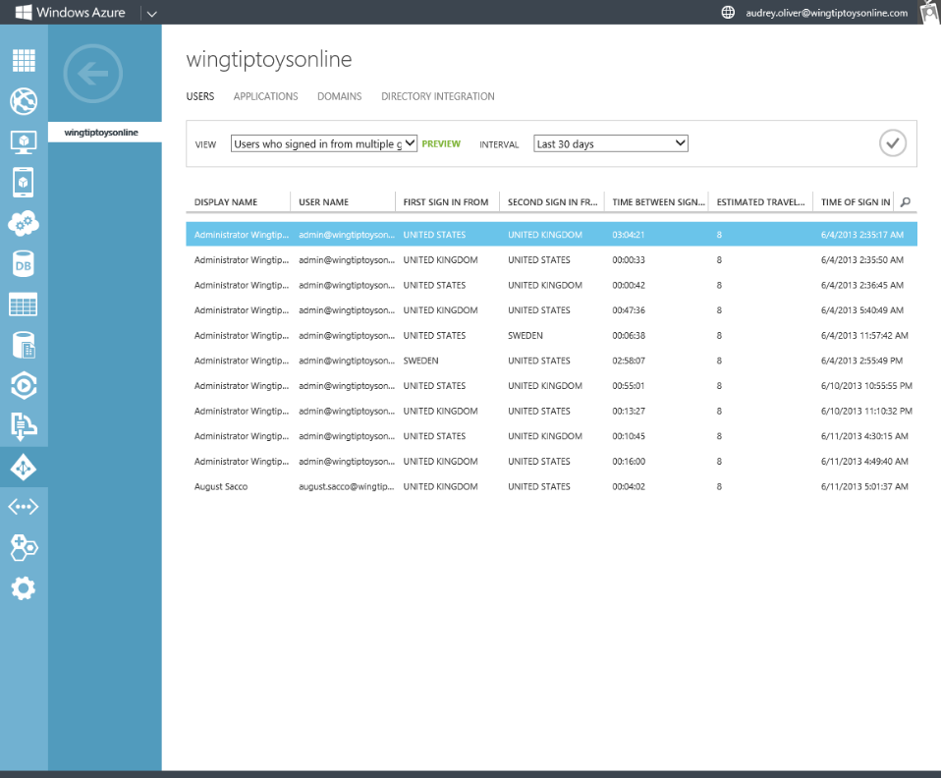

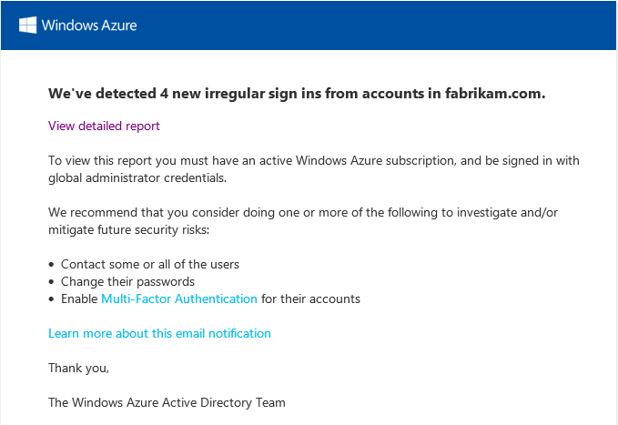
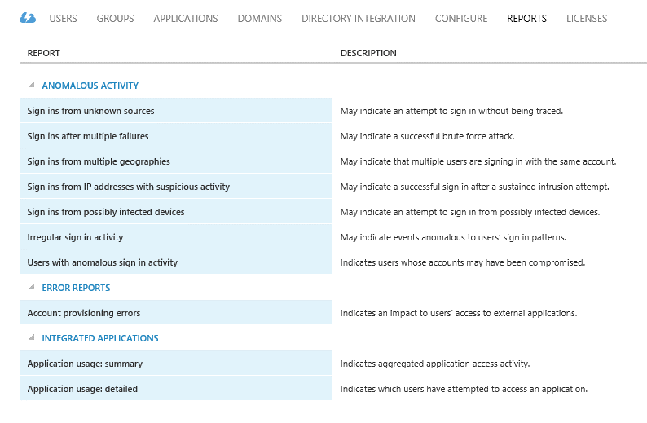
Monitor and protect access to enterprise apps
Built-in security features.
Security reporting that tracks inconsistent access patterns, analytics and alerts.

Slide 19
Monitor and protect access to enterprise apps
Built-in security features.
XXXXX
Security reporting that tracks inconsistent access patterns, analytics and alerts.
XXXXX
Step up to Multi-Factor authentication.
XXXXX

Slide 20
How it works
Mobile apps
Phone calls
Text messages
1 4 5 6 7 6
ALERT

Slide 21
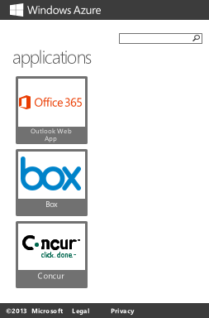
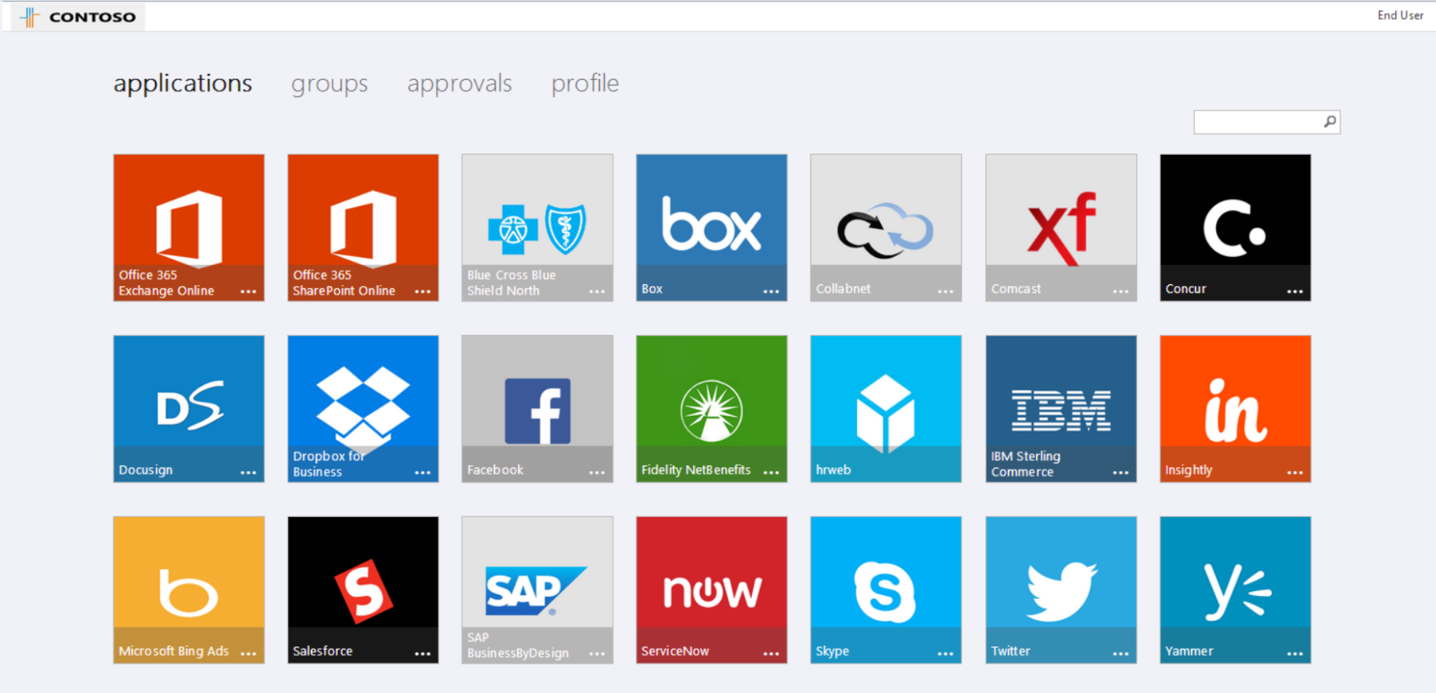
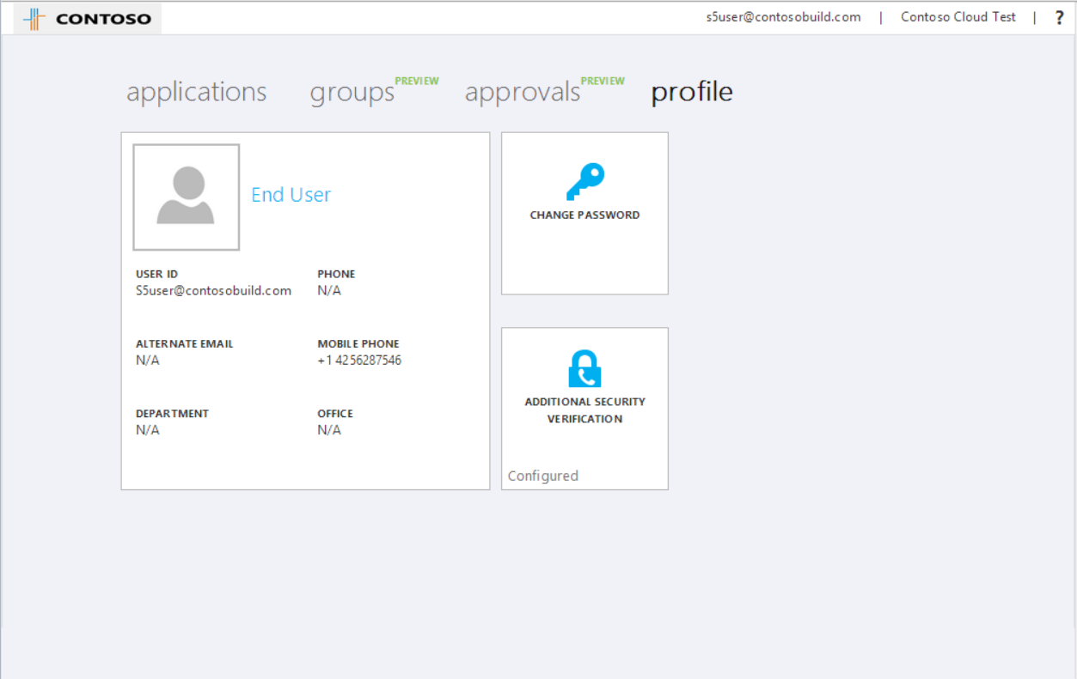
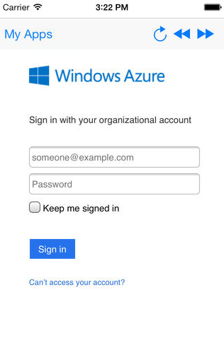
Empower Users
Company branded, personalized application Access Panel :
http://myapps.microsoft.com
+ Mobile Apps
Manage you account

Slide 22
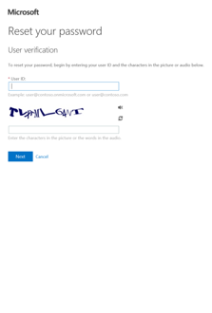
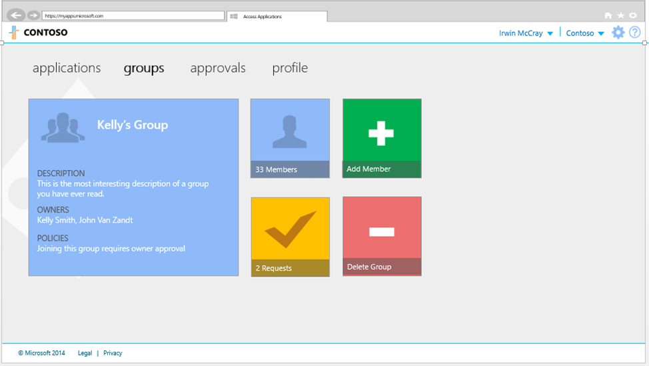
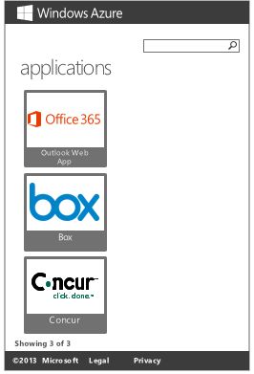
Empower Users
Company branded, personalized application Access Panel :
http://myapps.microsoft.com
+ Mobile Apps
Manage your account
Self Service Password Reset and delegated group management
for cloud users

Slide 23
Standards based integrations
Custom LOB applications that integrate with Azure Active Directory
Sign in to Active Directory-integrated applications with cloud identities
Active Directory-integrated applications can access Office 365 and other web APIs
Applications can extend Azure Active Directory schema
Cross-platform support (iOS, Android, and Windows)
Open Standards
(SAML, OAuth 2.0, OpenID Connect, Odata 3.0)
OAuth2 &
OpenID Connect
SAML
WS-Federation
REST based Graph API
Microsoft Azure
Active Directory
SCIM

Slide 24
Demo
Azure Active Directory

Slide 25
Azure Active Directory editions feature comparison + Office 365 IAM features
 |  | Azure Active Directory Free | Azure Active Directory Basic | Azure Active Directory Premium | Office 365 IAM features
Common Features | Directory as a Service | 500,000 Object Limit | No Object Limit | No Object Limit | No Object limit for Office 365 user accounts
 | User/Group Management (add/update/delete) | Yes | Yes | Yes | Yes
 | SSO to pre-integrated SAAS Applications /Custom Apps | 10 apps per user | 10 apps per user | No Limit | 10 apps per user
 | User-Based access management/provisioning | Yes | Yes | Yes | Yes
 | Self-Service Password Change for cloud users | Yes | Yes | Yes | Yes
 | Identity Synchronization Tool (Windows Server Active Directory integration, Multi Forest) | Yes | Yes | Yes | Yes
 | Security Reports | 3 Basic Reports | 3 Basic Reports | Advanced Security Reports | 3 Basic Reports
 | Cloud App Discovery* | Yes(Basic) | Yes(Basic) | Yes(Advanced)** | Yes(Basic)
Premium+ Basic Features | Group-based access management/provisioning |  | Yes | Yes
 | Self-Service Password Reset for cloud users |  | Yes | Yes
 | Company Branding (Logon Pages/Access Panel customization) |  | Yes | Yes
 | SLA |  | Yes | Yes | Yes
Premium Features | Identity Synchronization Tool advanced write-back capabilities * (FY15 Roadmap) |  |  | Yes
 | Self-Service Group Management |  |  | Yes
 | Self-Service Password Reset/Change with on-premises write-back |  |  | Yes
 | Advanced Usage Reporting |  |  | Yes
 | Multi-Factor Authentication (Cloud and On-premises (MFA Server)) |  |  | Yes | Limited Cloud only features for accessing Office 365
 | Azure Active Directory Application proxy* |  |  | Yes
 | MIM CAL + MIM Server |  |  | Yes
 | Administrative Delegation* (FY15 Roadmap) |  |  | Yes
*Features in Preview (Sept 2014) or in the roadmap
** Advanced functionality on Cloud App Discovery is in the roadmap for FY15 H2
10 Apps per user : Every user can have a different set of Apps, up to ten. MS Online apps (e.g. O365) are counted among these 10.

Slide 26
Azure Active Directory 12-month investments
Business to Business
Device Registration
Business to Consumers
Administrative Units
Conditional Access
Cloud Domain Joined (Windows 10)

Slide 27
Administrative Units: In private preview
Global admins
Org-wide permissions
Manage global settings
Create structure and policy
Delegate permissions and resources
Support for distributed organizational models
Autonomous mgmt. while keeping common identity and org boundary
Delegate administration to subsidiaries
User management
App procurement and mgmt.
Scope policy
Contoso
North Am
Europe
Asia
Regional admins
Manage regional users, devices, and applications
Set local policy
US East
Germany
India
Regional policy and app management
“Must login with MFA”
“Have license/access to regional apps”
Azure Active Directory

Slide 28
B2B: cross-organization collaboration
B2B: cross-organization collaboration
“I need to let my partners access my company’s apps using their own credentials.”
Share without complex configuration or duplicate users.
A user at a large partner may log into my company’s apps with their Active Directory usernames and passwords.
A user at a smaller partner may log into my company’s apps with their Office 365 usernames and passwords.
Admin configures sharing for cloud apps.
“I can’t email my 25 MB file and need to share it with a partner using Box.com.”
Seamlessly provide Azure Active Directory to customers & partners
For example, a user at a partner can set up everyone in their company.
Users can bring their own email-based or social identities.

Slide 29



Azure Active Directory B2C(Business-to-Consumer )
Azure Active Directory B2C offering is tailored for enterprises who serve large populations (100’s of thousands to millions) of individual customers, and whose business success depends upon consumer adoption of web applications for improving customer satisfaction and reducing operational costs.
Azure Active Directory B2C will include :
  Self-Service User registration
  Login with Social IdP or create your own credentials
  Optional MFA
  Bulk user import tools
  SSO to multiple web sites
  User interface customization

Slide 30
Cloud Domain Join
Cloud Domain Join makes it possible to connect work-owned Windows devices to your company’s Azure Active Directory tenancy in the cloud. Users can sign-in to Windows with their cloud-hosted work credentials and enjoy modern Windows experiences.
Apps in Azure
3rd party apps & clouds
Enterprise compliant Services
  Roaming Settings, Windows backup/Restore, Store access…
  Data stored in enterprise compliant backend services on Azure.
  No need to add a personal Microsoft account.
SSO from the desktop to org resources
  SSO from desktop to Office 365 and 1,000’s of enterprise apps, websites and resources.
  Access enterprise-curated Store and install apps using a work account.
Management
  Automatic MDM enrollment during first-run experience.
Support for hybrid environments
  Traditional Domain Joined PCs also benefit from Cloud Domain Join functionality when the on-prem Active Directory is connected with an Azure Active Directory in the cloud.
Cloud Domain Joined Devices

Slide 31
Identity as the control plane
Simple connection
Self-service
Single
sign on
Windows Server
Active Directory
Username
•••••••••••
Other
Directories
SaaS
Azure
Public
cloud
Office 365
On-premises
Cloud
Microsoft Azure Active Directory

Slide 32
Enterprise Mobility Suite
Hybrid identity
Microsoft Azure Active Directory Premium
security reports, and audit reports, multi-factor authentication
Self-service password reset and group management
Connection between Active Directory and Azure Active Directory
Mobile device management
Windows Intune
Mobile device settings management
Mobile application management
Selective wipe
Access & Information protection
Microsoft Azure Rights Management service
Information protection
Connection to on-premises assets
Bring your own key

Slide 33
Related content
Tue, Oct 28 3:15 PM-4:30 PM | EM-B214 | Privileged Access Management for Active Directory
Wed, Oct 29 8:30 AM-9:45 AM | EM-B316 | Directory Integration: Creating One Directory with Active Directory and Azure Active Directory
Wed, Oct 29 3:15 PM-4:30 PM | EM-B319 | Microsoft Identity Manager vNext Overview
Wed, Oct 29 3:15 PM-4:30 PM | CDP-B210 | Cloud Identity: Microsoft Azure Active Directory Explained
Wed, Oct 29 5:00 PM-6:15 PM | EM-B318 | Free Your Apps: Introducing Microsoft Azure Active Directory Application Proxy and Windows Server Web Application Proxy
Thu, Oct 30 10:15 AM-11:30 AM | CDP-B312 | Microsoft Azure Active Directory Premium, in Depth
Fri, Oct 31 2:45 PM-4:00 PM | EM-B313 | Microsoft Azure Multi-Factor Authentication Deep Dive: Securing Access on Premises and in the Cloud
Thu, Oct 30 12:00 PM-1:15 PM | EM-B310 | Active Directory + BYOD = Peace of Mind
Thu, Oct 30 5:00 PM-6:15 PM | DEV-B322 | Building Web Apps and Mobile Apps Using Microsoft Azure Active Directory for Identity Management
Fri, Oct 31 8:30 AM-9:45 AM | CDP-B207 | Securing Organizations: Azure Active Directory Intelligence as a Differentiator
Microsoft Solutions Experience Location (MSE)

Slide 34
Track resources
http://azure.microsoft.com/en-us/services/active-directory/
http://msdn.microsoft.com/library/azure/dn532272.aspx
Videos:
http://channel9.msdn.com/Series/Azure-Active-Directory-Videos-Demos
http://azure.microsoft.com/en-us/documentation/services/active-directory/

Slide 35

Resources
Learning
  Sessions on Demand
  Microsoft Certification & Training Resources
http://channel9.msdn.com/Events/TechEd
www.microsoft.com/learning
TechNet
Developer Network
  Resources for IT Professionals
http://microsoft.com/technet
http://developer.microsoft.com

Slide 36

For more information
Windows Server
Windows Server Technical Preview
http://technet.microsoft.com/library/dn765472.aspx
System Center
System Center Technical Preview
http://technet.microsoft.com/en-us/library/hh546785.aspx
Azure Pack
Azure Pack
  http://www.microsoft.com/en-us/server-cloud/products/
  windows-azure-pack
Microsoft Azure
Microsoft Azure
  http://azure.microsoft.com/en-us/
  Come visit us in the Microsoft Solutions Experience (MSE)!
  Look for the Cloud and Datacenter Platform area TechExpo Hall 7

Slide 37


Azure
Exams
Developing Microsoft Azure Solutions
EXAM
532
Implementing
Microsoft Azure Infrastructure Solutions
EXAM
533
(Coming soon)
Architecting Microsoft Azure Solutions
EXAM
534
http://bit.ly/
Azure-Cert
+
Classroom
training
(Coming soon)
Microsoft Azure Fundamentals
MOC
10979
Developing Microsoft Azure Solutions
MOC
20532
Implementing
Microsoft Azure Infrastructure Solutions
2
5
MOC
20533
5
http://bit.ly/
Azure-Train
Online
training
(Coming soon)
Microsoft Azure Fundamentals
MVA
(Coming soon)
Architecting Microsoft Azure Solutions
MVA
http://bit.ly/
Azure-MVA
Get certified for 1/2 the price at TechEd Europe 2014!
http://bit.ly/
TechEd-CertDeal

Slide 38


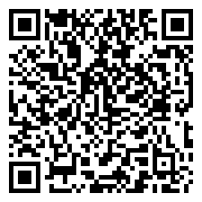
Please Complete An Evaluation Form
Your input is important!
TechEd Schedule Builder
CommNet station or PC
TechEd Mobile app
Phone or Tablet
QR code

Slide 39
Evaluate this session

Slide 40


© 2014 Microsoft Corporation. All rights reserved. Microsoft, Windows, and other product names are or may be registered trademarks and/or trademarks in the U.S. and/or other countries.
The information herein is for informational purposes only and represents the current view of Microsoft Corporation as of the date of this presentation. Because Microsoft must respond to changing market conditions, it should not be interpreted to be a commitment on the part of Microsoft, and Microsoft cannot guarantee the accuracy of any information provided after the date of this presentation. MICROSOFT MAKES NO WARRANTIES, EXPRESS, IMPLIED OR STATUTORY, AS TO THE INFORMATION IN THIS PRESENTATION.

