Slide 2
Next Generation Networking – SDN, NFV, & Cloud-Scale Fundamentals
CDP-B224
Bala Rajagopalan & Rajeev Nagar

Slide 3
Microsoft cloud platform
The platform for hybrid cloud enables IT to:
Customer
Empower enterprise mobility
Create the Internet of your things
Enable application innovation
Unlock insights on any data
Transform the datacenter
CONSISTENT PLATFORM
Service Provider
Microsoft
Development
Management
Identity
Data
Virtualization

Slide 4
Microsoft Azure: Productive platform for today and tomorrow's apps
14B+
weekly Microsoft Azure AD authentications
57%
of Fortune 500 use Microsoft Azure
1M+
Microsoft Azure SQL databases
2M+
requests per second
20T
storage objects in Microsoft Azure
250k
active websites
300M
Active Directory users
1M+
developers registered with Visual Studio Online
Innovation at global scale

Slide 5
Our approach: Azure innovation everywhere
Your datacenter
Microsoft Azure
Services
Azure Pack
Services
Consistency
Connectivity
Code
Infrastructure
System Center
Windows Server
Hyper-V
Infrastructure

Slide 6
Datacenter modernization is key to app innovation
Traditional datacenter
Tight coupling between infrastructure and apps
Expensive, proprietary, and vertically integrated hardware
Siloed infrastructure and operations
Highly customized processes and configurations
Software-defined datacenter
Loosely coupled apps, infrastructure resources, and physical hardware
Industry-standard, low cost hardware – optimal capital expenditure
Service-focused roles
Standardized, automated processes and configurations – minimizing complexity @ scale [optimizing operational costs]

Slide 7
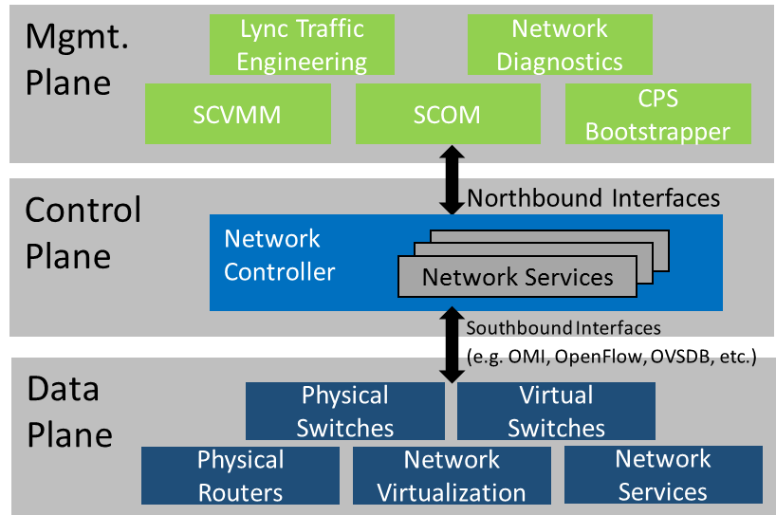
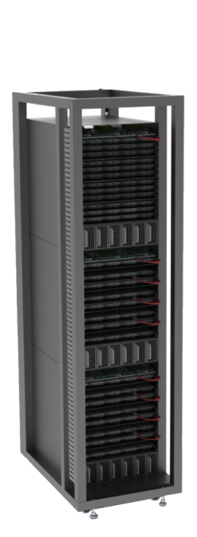
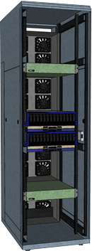
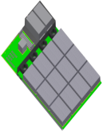
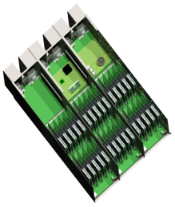
Disruptive technological trends
Disaggregated software stack
Disaggregation of hardware
Capable merchant silicon
Today
> 2014
Future
Fabric Integration
Subsystem Aggregation
Shared Power
Shared Cooling
Rack Management
Modular refresh
Rack Fabric
Optical Interconnects
Pooled compute
Pooled storage
Pooled memory
IO
X
Compute
X
CPU
• • •
CPU
Memory
X
SSD
• • •
SSD
Storage
X
HDD
• • •
HDD

Slide 8
Networking: Enable flexible workload placement & mobility
Customers require
Flexibility
Reliability and high-performance
Application/ Workload focus
Microsoft software-defined networking in your datacenter
Enhance virtual networking reliability, performance, and interoperability
Enable centralized configuration and management across virtual and physical networks
Transform the network cloud by incorporating technology disruptors
Enable seamless datacenter extensions for flexible workload placement and mobility

Slide 9
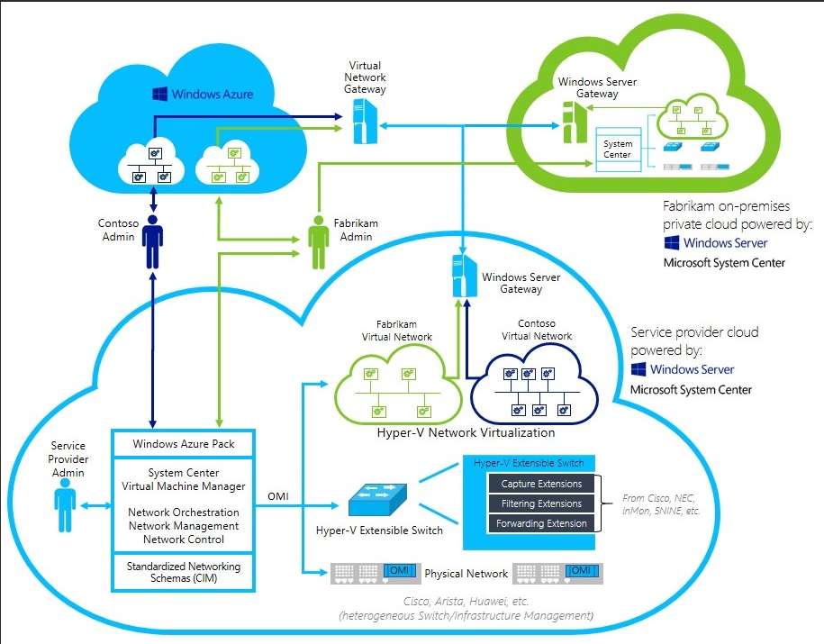
WS12R2: Delivering Networking Without Boundaries

Slide 10
Next Generation Networking: Key Deliverables
SDN Infrastructure | Network Function Virtualization | Cloud Scale Fundamentals
Scalable Network Controller encompassing physical and virtual infrastructural components | Infrastructure enabling service composition via tenant-defined service chaining | Converged fabric supporting virtualized tenant and RDMA-enabled disaggregated storage traffic, with quality-of-service guarantees
Enhanced interoperability at every layer in the stack | Included key virtualized services proven at very large scale in Azure | Very high-throughput & low-latency packet processing infrastructure
SCVMM integration for deployment, lifecycle management, and orchestration + Azure Pack for tenant self-service | Best-in-class performance for Linux based 3rd party virtual network appliances | Industry leading merchant silicon integration – focus on quality and optimal offload handling
 |  | Cloud oriented DNS (geo-location awareness, traffic management), & enhanced IPAM (planning + mgmt.)

Slide 11
SDN Infrastructure
Management plane
System Center
Microsoft Azure Pack
Network aware Applications (e.g. Lync)
Standardized Rest APIs
Integrated control: virtual & physical network
Network service lifecycle management
Network monitoring
SDN controller
Control plane
Standardized protocols for communication
Data plane
Distributed Network Services
Virtual Network
SDN v-Switch +
Distributed HNV Router
Virtual Edge Services
Performant data plane
Distributed forwarding/routing
High-value network services

Slide 12
Network Function Virtualization
Standardized Rest APIs
&
PowerShell
Network Service Managers
Software Load Balancer
Distributed
Firewall
Service Chaining – 3rd Party VNFs
HNV
L2/L3
Gateway
VPN
Gateway
Site-To-Site
Gateway
BGP Route Reflector
Appropriate South-Bound Transports & Schemas
HNV
L2/L3
Gateway
VPN
Gateway
Hyper-V Host
Site-To-Site
Gateway
Software Load Balancer
Host Agent
Service Chaining
SLB Agent
FW Agent

Slide 13
Cloud Scale Fundamentals
Converged Fabric | Packet Direct | Integrated Offload Management
Single NIC/fabric for RDMA-based storage access and tenant traffic | 10GB -------> 40GB/100GB | Joint focus on quality with partner ecosystem – stable & predictable behavior in cloud-scale demanding environments
Integrated with SDN v-Switch & multi-NIC teaming | Microsecond latency | Optimal silicon offload utilization: checksum offloads, LSO, RSC, RSS, VMQ, SR-IOV, NVGRE TO, Routable RDMA, VXLAN TO, PD integration
Integrated quality-of-service – fair sharing of bandwidth across different categories of network traffic | Multi-million PPS per core

Slide 14
Next Generation Networking
Service
Provider
One Platform
Consistent UX
Proven at Scale
Azure
Easily connect to your Enterprise, Azure or to other Service Provider clouds
Enterprise
Virtual Edge
VPN (incl. S2S)
Forwarding
Load Balancing
Network apps
Overlay
Network Controller
Any Virtual Appliance
Orchestration and Self Service
Chaining
Firewall
QoS
Other controllers
L2 Switch
L3 Router
Other 3rd Party Orchestrators
Underlay
VXLAN/NVGRE Gateways
OMI Switches
Existing network

Slide 15
Conventional Multi-Tier Application Deployment Leveraging Networking Enhancements

Slide 16
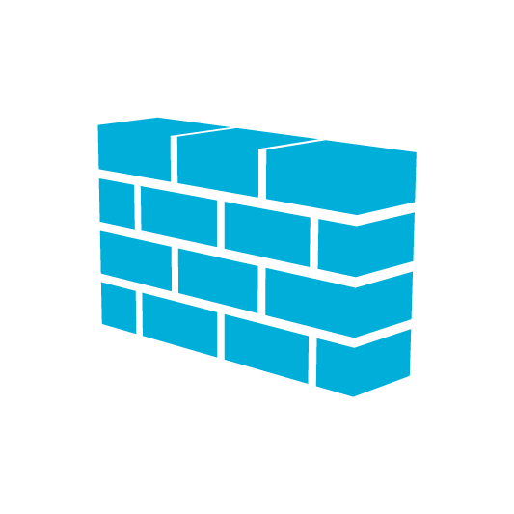
Conceptual Deployment Model
REST APIs
Presentation
Layer – Web
Tier
VM
VM
VM
Policy
Microsoft Azure
Policy Enforcement per VM/application
Load Balancer
S2S
VPN
GRE
Business Logic - Middle Tier
VM
VM
VM
Virtual Edge
Service Provider
V
Security Policy per virtual network and/or VM/application
P
Distributed Router
Connecting virtualized and non-virtualized workloads via Gateways
VM
VM
VM
Persistence (Data) Tier
Physical Network

Slide 17
Physical Network Topology
CA: 13.168.100.12
Presentation Tier
Business Logic & Persistence Tier
Client Host 1
CA: 13.168.100.20
DIP Host 24
Tenant 1 VIP: 10.0.0.3
PA: 192.168.100.210
Mux, NC, BGP Host
Cloud-Shop Client VM
Cloud-Shop Client VM
Hyper-V
Hyper-V
Load Balancer
Load Balancer
192.168.100.8
192.168.100.9
CA: 13.168.100.21
CA: 13.168.100.14
Client Host 2
BGP
NC
CA: 13.168.100.13
CA: 13.168.100.22
DIP Host 25
Hyper-V
Contoso Client VM
Contoso Client VM
PA: 192.168.100.211
Tenant 2 VIP: 10.0.0.5
Hyper-V
Hyper-V
CA: 13.168.100.10
CA: 13.168.100.18
CA: 13.168.100.19
DIP Host 26
Client A
CA: 13.168.100.11
Switch
PA: 192.168.100.212
Hyper-V

Slide 18
Video Cloud-Shop Application

Slide 19
Conceptual Deployment: Cloud-Shop
Client A
Client B
Policy
Load Balancer
Presentation Tier
IIS Dip 0
IIS Dip 1
IIS Dip 2
IIS Dip 3
Distributed Router
SQL
Persistence Tier

Slide 21
Video Contoso Content Streaming

Slide 22
Conceptual Deployment: Contoso
Client A
Client B
Policy
Load Balancer
Presentation Tier
IIS Dip 0
IIS Dip 1
IIS Dip 2
Distributed Router
IIS Media Server Instance
IIS Media Server Instance
Data Tier

Slide 24
Related content
Breakout Sessions
CDP-B223 Virtual Network Functions in the Next Release of Windows Server (Hall 8.1, Room H)
CDP-B330 Network Infrastructure Services in the Next Release of Windows Server for Datacenter Network Operations (Hall 8.0, Room B1)
CDP-B248 Software Defined Networking in the Next Release of Windows Server: Network Controller Fundamentals (Hall 8.0, Room A2)
CDP-B380 Deep Dive in the Microsoft Cloud Platform System Networking (Hall 8.0, Room D3)
CDP-B324 Deploying Hyper-V Network Virtualization (Hall 8.0, Room A2)

Slide 25
For more information
Windows Server
Windows Server Technical Preview
http://technet.microsoft.com/library/dn765472.aspx
System Center
System Center Technical Preview
http://technet.microsoft.com/en-us/library/hh546785.aspx
Azure Pack
Azure Pack
http://www.microsoft.com/en-us/server-cloud/products/ windows-azure-pack
Microsoft Azure
Microsoft Azure
http://azure.microsoft.com/en-us/
Come visit us in the Microsoft Solutions Experience (MSE)!
Look for the Cloud and Datacenter Platform area TechExpo Hall 7

Slide 26
Resources
Learning
Sessions on Demand
Microsoft Certification & Training Resources
http://channel9.msdn.com/Events/TechEd
www.microsoft.com/learning
TechNet
Developer Network
Resources for IT Professionals
http://microsoft.com/technet
http://developer.microsoft.com

Slide 27
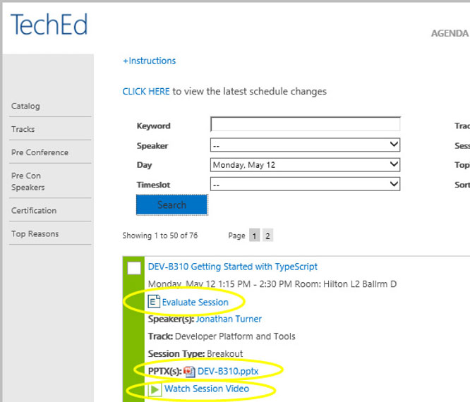
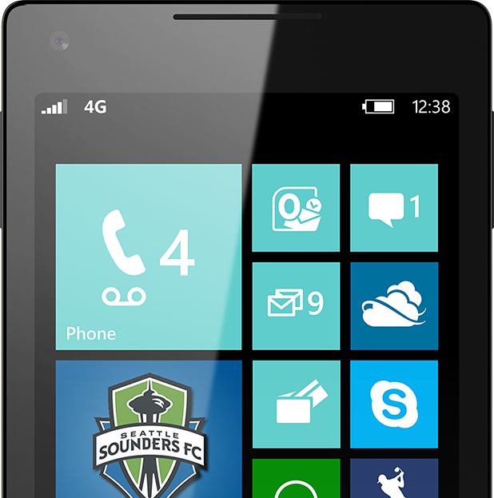
Please Complete An Evaluation Form Your input is important!
TechEd Schedule Builder
CommNet station or PC
TechEd Mobile app
Phone or Tablet
QR code

Slide 28
Evaluate this session

Slide 29
© 2014 Microsoft Corporation. All rights reserved. Microsoft, Windows, and other product names are or may be registered trademarks and/or trademarks in the U.S. and/or other countries.
The information herein is for informational purposes only and represents the current view of Microsoft Corporation as of the date of this presentation. Because Microsoft must respond to changing market conditions, it should not be interpreted to be a commitment on the part of Microsoft, and Microsoft cannot guarantee the accuracy of any information provided after the date of this presentation. MICROSOFT MAKES NO WARRANTIES, EXPRESS, IMPLIED OR STATUTORY, AS TO THE INFORMATION IN THIS PRESENTATION.

