Slide 1


Slide 2

Microsoft Azure Security and Compliance Overview
CDP-B230
Sarah Fender
Mark Perry

Slide 3
Agenda
Can the cloud be more secure than on-premises?
What technical and operational safeguards are in place?
What can I do to further ensure the security of my cloud deployments?
Where is my data and who can access it?
How do I meet my compliance obligations?

Slide 4
Can the cloud be more secure than on-premises?

Slide 5

CIOs are eager to realize cloud benefits
BENEFITS
2 weeks
to deliver new services vs. 6-12 months with traditional solution
(Case Study: HarperCollins Publishers)
$25,000
in the cloud would cost $100,000 on premises
(Microsoft Azure BI Team, STMG Proof Points Central)
Speed
Scale
Economics
Scale from
70%
Cloud Trend:
30,000 to
250,000
site visitors instantly
(Case Study: Autocosmos)
of CIOs will embrace a cloud-first strategy in 2016
(IDC CIO Agenda webinar)
430B+
Microsoft Azure AD authentications
280%
year-over-year
database growth in Microsoft Azure
50%+
of Fortune 500 use Microsoft Azure
AZURE ADOPTION

Slide 6
But only if they can be sure that security will be as good or better
Pre-adoption concern
Benefits realized
94%
60%
62%
45%
experienced security benefits they didn’t previously have
on-premise
cited concerns around data security as a barrier to adoption
said privacy protection increased as a result of moving to the cloud
concerned that the cloud would result in a lack of data control
Barriers to Cloud Adoption study, ComScore, September 2013

Slide 7

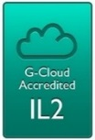










Trustworthy foundation
Built on Microsoft experience and innovation
Trustworthy
Computing
Initiative
Microsoft
Azure
1st Microsoft
Data Center
Assume Breach
FedRAMP/
FISMA
20+ Data Centers
Malware
Protection
Center
UK G-Cloud
Operations Security Assurance
Active
Directory
SOC 2
SOC 1
1989
1995
2000
2005
2010
Windows
Update
Security
Development Lifecycle
E.U. Data Protection Directive
CSA Cloud Controls Matrix
Global
Data Center
Services
Digital Crimes Unit
ISO/IEC 27001:2005
Microsoft Security
Response Center
HIPAA/
HITECH
PCI DSS Level 1

Slide 8

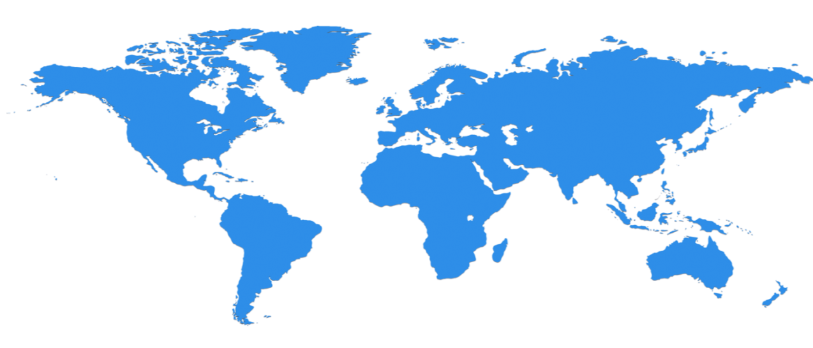

Trustworthy foundation
Microsoft operates more than 1M servers and 100+ datacenters in 40 countries
Chicago
Dublin
Quincy
Amsterdam
Beijing*
Boydton
Japan
Des Moines
Shanghai*
Cheyenne
Hong Kong
San Antonio
Singapore
Brazil
Australia
*operated by 21Vianet
*operated by 21Vianet

Slide 9
Trustworthy foundation
Security development lifecycle helps azure build more secure cloud services
Education
Process
Accountability
Administer and track
security training
Guide product teams to meet SDL requirements
Establish release criteria & sign-off as part of FSR
Incident
Response (MSRC)
Training
Requirements
Design
Implementation
Verification
Release
Response
Ongoing Process Improvements

Slide 10
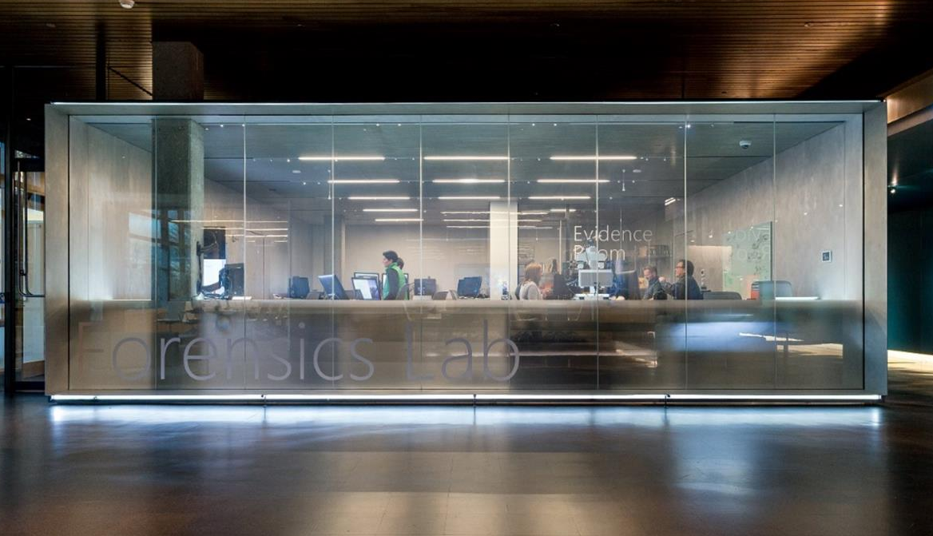
Trustworthy foundation
Digital Crimes unit disrupts some of the most difficult cyber threats facing SOCIETY
Mission:
Proactive malware disruption
  Feeds enable Azure AD reports on logins from compromised devices
IP crimes, including piracy
Protecting consumers, emphasizing vulnerable populations (children, disabled and the elderly)

Slide 11
Trustworthy foundation
Assume breach helps identify and address threats before they impact customers
Prevent Breach
Assume breach identifies & addresses potential gaps
Scope ongoing live site testing of security response plans to drastically improve mean time to detection & recovery
Reduce exposure to internal attack (ensuring once inside, attackers do not have broad access)
Periodic environment post breach
assessment & clean state
Threat model
Code review
Security testing
Assume Breach
War game exercises
Live site penetration testing
Centralized security
logging & monitoring

Slide 12
Shared responsibility
reduces security costs + Maintains Flexibility, access, & control
  On-Premises
  IaaS
  PaaS
  SaaS
Applications
Data
Users
Middleware
Operating System
Virtualization
Hardware
Networking
Physical Security
Customer
Microsoft

Slide 13


Transparency & independent verification
AIDs CUSTOMERS in meeting security & Compliance Obligations
Third-party verification
Access to
audit reports
Compliance packages
Best practices
and guidance
Security Response Center progress report
Security Intelligence report
Trust Center
Cloud Security Alliance

Slide 14
What technical and operational safeguards are in place?
What can I do to further ensure the security of my cloud deployments?

Slide 15
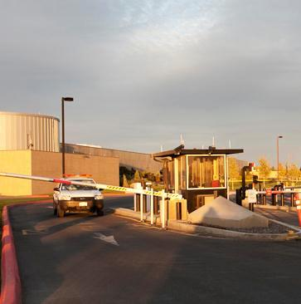
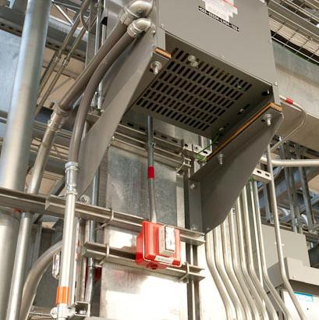
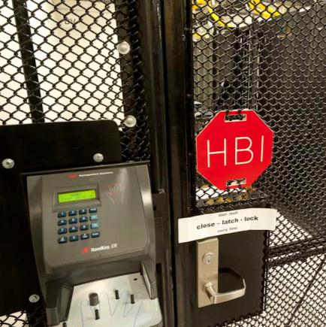
Physical data center security
Cameras
24X7 security staff
Barriers
Fencing
Alarms
Two-factor access control: Biometric readers & card readers
Security operations center
Seismic bracing
Days of backup power
Perimeter
Building
Computer room

Slide 16
Architecture
AZURE:
Centrally manages the platform and helps isolate customer environments using the Fabric Controller
Runs a configuration-hardened version of Windows Server as the Host OS
Uses Hyper-V, a battle tested and enterprise proven hypervisor
Runs Windows Server and Linux on Guest VMs for platform services
CUSTOMER:
Manages their environment through service management interfaces and subscriptions
Chooses from the gallery or brings their own OS for their Virtual Machines
End
Users
Microsoft Azure
Customer
Admin
Portal
SMAPI
Customer 1
Customer 2
Guest VM
Guest VM
Guest VM
Fabric
Controller
Hypervisor
Host OS
Azure Storage
SQL Database

Slide 17
Patch management
AZURE:
Applies regularly scheduled updates to the platform
Releases critical patches immediately
Rigorously reviews & tests all changes
CUSTOMER:
Applies similar patch management strategies for their Virtual Machines
Monthly MSRC Patch Review
Patching Rollout
Scanning
Audit Validation
Monitor 100,000+ vulnerability reports
Sourced from customers & worldwide network of security researchers
Prioritize critical updates
Monthly OS releases with patches
Scanning & reporting of all Azure VMs
Track & remediate any findings
Reconciliation report
Resolution summary

Slide 18


Monitoring & logging
Microsoft Azure
Enable
Monitoring Agent
AZURE:
Performs monitoring & alerting on security events for the platform
Enables security data collection via Monitoring Agent or Windows Event Forwarding
CUSTOMER:
Configures monitoring
Exports events to SQL Database, HDInsight or a SIEM for analysis
Monitors alerts & reports
Responds to alerts
Customer VMs
Portal
SMAPI
Guest VM
Guest VM
Cloud Services
Events
Azure Storage
HDInsight
Customer
Admin
Extract event information to SIEM or other Reporting System
SIEM Admin View
Event ID | Computer | Event Description | Severity | DateTime
1150 | Machine1 | Example security event | 4 | 04/29/2014
2002 | Machine2 | Signature Updated Successfully | 4 | 04/29/2014
5007 | Machine3 | Configuration Applied | 4 | 04/29/2014
1116 | Machine2 | Example security event | 1 | 04/29/2014
1117 | Machine2 | Access attempted | 1 | 04/29/2014
Alerting & reporting

Slide 19
Antivirus/antimalware
Microsoft Azure
AZURE:
Performs monitoring & alerting of antimalware events for the platform
Enables real time protection, on-demand scanning, and monitoring via Microsoft Antimalware for Cloud Services and Virtual Machines (now generally available)
CUSTOMER:
Configures Microsoft Antimalware or an AV/AM solution from a partner (Trend Micro, Symantec and now McAfee)
Extracts events to SIEM
Monitors alerts & reports
Responds to alerts
Enable & configure
antimalware
Customer VMs
Portal
SMAPI
Guest VM
Guest VM
Cloud Services
Azure Storage
Events
Customer
Admin
Extract Antimalware Health Events to SIEM or other Reporting System
SIEM Admin View
Event ID | Computer | Event Description | Severity | DateTime
1150 | Machine1 | Client in Healthy State | 4 | 04/29/2014
2002 | Machine2 | Signature Updated Successfully | 4 | 04/29/2014
5007 | Machine3 | Configuration Applied | 4 | 04/29/2014
1116 | Machine2 | Malware Detected | 1 | 04/29/2014
1117 | Machine2 | Malware Removed | 1 | 04/29/2014
Alerting & reporting

Slide 20
Threat defense
INTERNET
End Users
AZURE:
Performs big data analysis of logs for intrusion detection & prevention for the platform
Employs denial of service attack prevention measures for the platform
Regularly performs penetration testing
CUSTOMER:
Can add extra layers of protection by deploying additional controls, including DOS, IDS, web application firewalls
Conducts authorized penetration testing of their applications
THREAT DETECTION: DOS/IDS Capabilities
Microsoft Azure
Cloud Access & Firewall
Customer Environment
Virtual Network
DOS/IDS
Application Tier
Corp 1
VPN
DOS/IDS
Logic Tier
DOS/IDS
Database Tier

Slide 21
Network isolation
INTERNET
AZURE:
Does not enable general internet access by default, except remote administration endpoints configured when Virtual Machines are created in the Portal
CUSTOMER:
Configure endpoints for required access
Creates connections to other cloud and on-premises resources
Client
Client
Customer
Admin
Microsoft Azure
Portal
Smart API
Portal
SMAPI
Cloud Access
Layer
Web Endpoint (public access)
RDP Endpoint
(password access)
Customer 1
Customer 2
Deployment X
Deployment X
Deployment Y
VPN
VNET to VNET
Corp 1
Isolated Virtual Network
Isolated Virtual Networks

Slide 22
Virtual networks
AZURE:
Allows customers to create isolated virtual private networks
CUSTOMER:
Creates Virtual Networks with Subnets and Private IP addresses
Enables communications between their Virtual Networks
Can brings their own DNS
Can domain join their Virtual Machines
INTERNET
Client
Microsoft Azure
Cloud Access
RDP Endpoint
(password access)
Customer 1
Customer 2
Subnet 1
Subnet 2
Subnet 3
Deployment X
Deployment Y
Corp 1
VPN
VNET to VNET
DNS Server
Isolated Virtual Networks
Isolated Virtual Network

Slide 23

New! Network Security Groups (NSG)
  Grouping of network traffic rules as security group
  Security groups associated with virtual machines or virtual subnets
  Controlled access between machines in subnets
  Controlled access to and from the Internet
  Network traffic rules updated independent of virtual machines
Internet
Microsoft Azure
NSG
Front End Subnet
Back End Subnet
NSG
Virtual Network

Slide 24
VPN connections
Microsoft Azure
AZURE:
Enables connection from customer sites and remote workers to Azure Virtual Networks using Site-to-Site and Point-to-Site VPNs
Offers new forced tunneling capabilities to enable customers to mandate all internet-bound traffic go through the Site-to-Site tunnel
CUSTOMERS:
Configures the VPN client in Windows
Manages certificates, policies, and user access
Customer 1
Deployment X
Customer Site
Site-to-Site VPN
VPN
Point-to-Site VPN
Computers
Behind Firewall
Isolated Virtual Network
Remote Workers

Slide 25
ExpressRoute connections
Microsoft Azure
AZURE:
Offers private fiber connections via ExpressRoute
Enables access to Compute, Storage, and other Azure services
CUSTOMERS:
Establish connections to Azure at an ExpressRoute location
Directly connect to Azure from an existing WAN network (such as a MPLS VPN) provided by a network service provider
Can now authorize other Azure accounts to use a common ExpressRoute circuit
Manages certificates, policies, and user access
Customer 1
ExpressRoute
Peer
Deployment X
Site 1
WAN
Site 2
Isolated Virtual Network

Slide 26
Identity & access management
AZURE:
Uses Azure AD to govern access to the management portal with granular access controls for users and groups on subscription or resource groups
Provides enterprise cloud identity and access management for end users
Enables single sign-on across cloud applications
Offers Multi-Factor Authentication for enhanced security
CUSTOMER:
Centrally manages users and access to Azure, O365, and hundreds of pre-integrated cloud applications
Builds Azure AD into their web and mobile applications
Can extend on-premises directories to Azure AD
Azure
Active Directory
Cloud Apps
End Users & Administrators
Active Directory

Slide 27
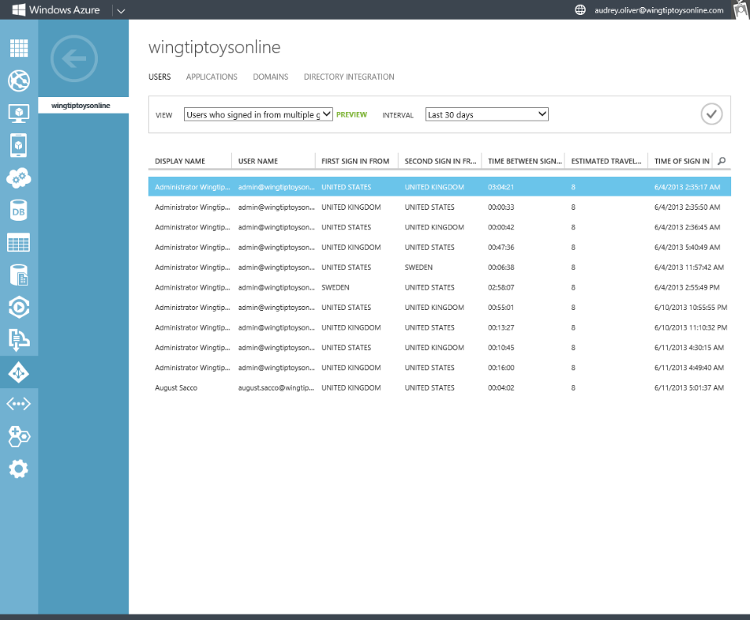
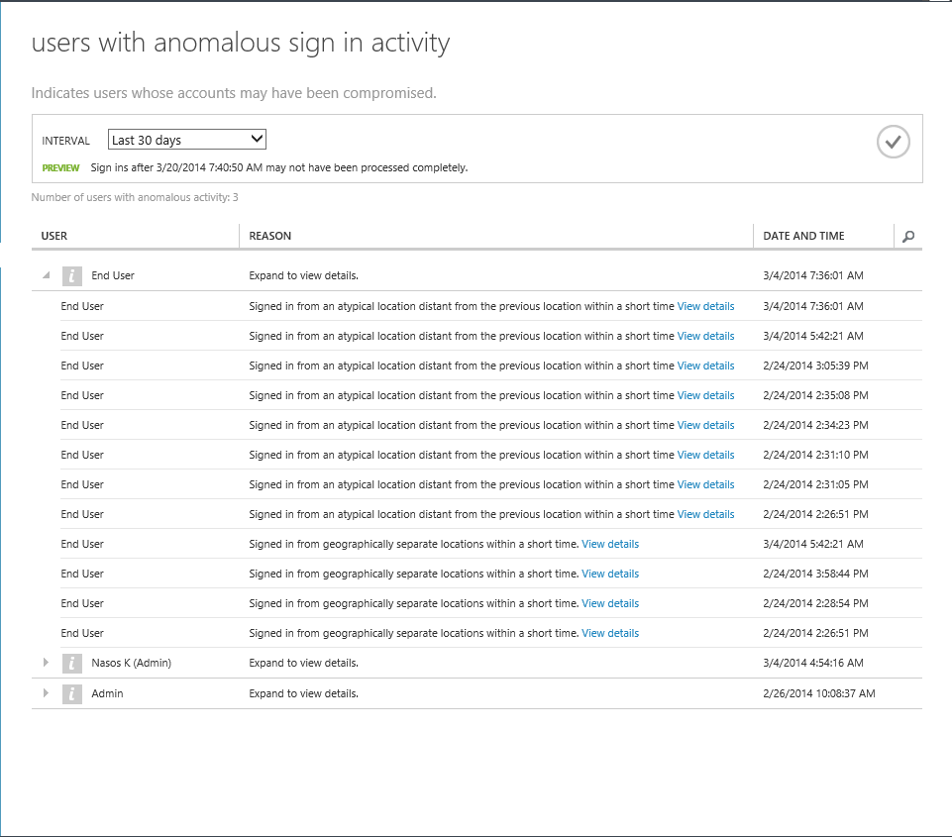
Access security & monitoring
User
Non-user
AZURE:
Uses password hashes for synchronization
Offers security reporting that tracks inconsistent traffic patterns, including:
  Sign ins from unknown sources
  Multiple failed sign ins
  Sign ins from multiple geographies in short timeframes
  Sign ins from suspicious IP addresses and suspicious devices
CUSTOMER:
Reviews reports and mitigates potential threats
Can enable Multi-Factor Authentication
XXXXX
XXXXX
XXXXX

Slide 28
Encryption in transit
AZURE:
Encrypts most communication between Azure datacenters
Encrypts transactions through Azure Portal using HTTPS
Supports FIPS 140-2
CUSTOMER:
Can choose HTTPS for REST API (recommended)
Configures HTTPS endpoints for application running in Azure
Encrypts traffic between Web client and server by implementing TLS on IIS
Azure
Data Center
Azure
Portal
Azure
Data Center

Slide 29



Encryption at rest
Virtual Machines:
Data drives – full disk encryption using BitLocker
Boot drives – BitLocker and partner solutions
SQL Server – Transparent Data and Column Level Encryption
Files & folders - EFS in Windows Server
Storage:
Bitlocker encryption of drives using Azure Import/Export service
StorSimple with AES-256 encryption
Applications:
Client Side encryption through .NET Crypto API
RMS Service and SDK for file encryption by your applications
Virtual Machines
SQL TDE
Bitlocker
Partners
EFS
Storage
Bitlocker
StorSimple
Applications
.NET Crypto
RMS SDK

Slide 30
Data segregation
End
Users
Storage isolation:
Access is through Storage account keys and Shared Access Signature (SAS) keys
Storage blocks are hashed by the hypervisor to separate accounts
SQL isolation:
SQL Database isolates separate databases using SQL accounts
Network isolation:
VM switch at the host level blocks inter-tenant communication
Microsoft Azure
Customer
Admin
Portal
SMAPI
Customer 1
Customer 2
Guest VM
Guest VM
Guest VM
Fabric
Controller
Hypervisor
Host OS
Azure Storage
Access
Control
SQL Database

Slide 31



Incident response
DevOps Engaged
Security Team
Engaged
Event Detected
Incident Assessment
Event
Start
Security Event Confirmed
Customer Notification
Customer Process
Step 1
AZURE:
Leverages a 9-step incident response process
Focuses on containment & recovery
Analyzes logs and VHD images in the event of platform-level incident and provides forensics information to customers when needed
Makes contractual commitments regarding customer notification
Determine Affected Customers
Determine Customer Impact
Azure Customer
Notification

Slide 32










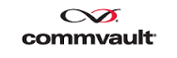

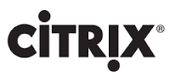
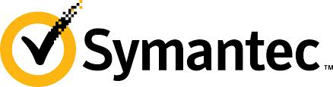






























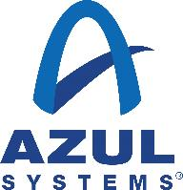



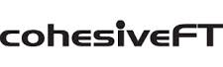














Expanded ecosystem of partner solutions
Security partners
Azure VMs now support multiple NICS, enabling a broader range of partner network security appliances.

Slide 33
Where is my data and who can access it?

Slide 34
Data location and redundancy
AZURE:
Creates three copies of data in the region configured by the customer
Offers geo-replication in a datacenter hundreds of miles away
Does not transfer Customer Data outside of a geo (ex: from US to Europe or from Asia to US)

Slide 35
Restricted Microsoft access
Just in Time &
Role-Based Access
  Microsoft Azure
Pre-screened Admin
requests access
BLOBS
TABLES
QUEUES
DRIVES
Leadership grants
temporary privilege
Microsoft Corporate Network
AZURE:
Does not permit standing access to the platform or customer Virtual Machines
Grants least privilege required to complete task
Requires multi-factor authentication for all administrative access
Audits and logs all access requests

Slide 36
Data destruction
  Index immediately removed from primary location
  Geo-replicated copy of the data (index) removed asynchronously
  Customers can only read from disk space they have written to
Data Deletion
Disk Handling
Wiping is NIST 800-88 compliant
Defective disks are destroyed

Slide 37
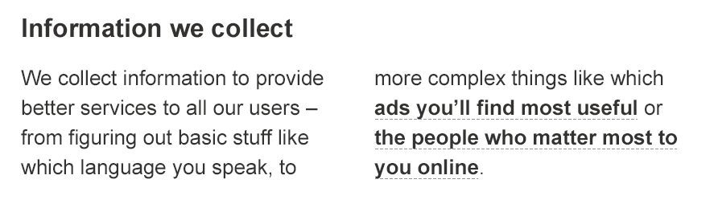
Data use policies
Read the fine print of other cloud service provider’s privacy statements
Azure does not share data with its advertiser-supported services
Azure does not mine Customer Data for advertising

Slide 38
Contractual commitments
Microsoft meets high bar for protecting privacy of EU customer data
Microsoft offers customers EU Model Clauses for transfer of personal data across international borders
Microsoft’s approach was approved by the Article 29 committee of EU data protection authorities – the first company to obtain this
EU Data Privacy Approval
Broad contractual scope
Microsoft makes strong contractual commitments to safeguard customer data covered by HIPAA BAA, Data Processing Agreement, & E.U. Model Clauses
Enterprise cloud-service specific privacy protections benefit every industry & region

Slide 39
Government access concerns
AZURE:
Does not provide any government with direct or unfettered access to your data.
Does not assist any government’s efforts to break our encryption or provide any government with encryption keys used to protect data in transit, or stored on our servers.
Does not engineer back doors into our products and we take steps to ensure governments can independently verify this.
If, as press reports suggest, governments are engaging in broader surveillance of communications, it is being done without the knowledge or involvement of Microsoft, and we are taking steps to enhance the security our customers’ data while it is in transit and at rest.
No Back Doors
Enhanced Security

Slide 40
Legal requests for customer data
AZURE:
Will not disclose Customer Data to a third party (including law enforcement, other government entity or civil litigant) except as you direct or required by law
Will attempt to redirect third party request to the customer
Will promptly notify the customer, unless legally prohibited from doing so, and if prohibited, will challenge the request in court
Will fight legal demands for customer data sored in another country
Publishes a Law Enforcement Request Report that provides insight into requests
Microsoft’s longstanding commitment to protecting customers’ privacy and security extend to how we respond to lawful government demands for customer information from every government, whether those requests are for the purposes of criminal law enforcement or national security.
Clear Principles and Advocacy
Transparency

Slide 41
Steps to enhance privacy and security
Publishing as much data as is permitted about volume, type, and impact of demands for customer data
Advocating for reforms in government surveillance practices including clear rules, greater transparency, and oversight
Further increasing transparency of our software code to help customers reassure themselves that our products do not contain back doors
Working for a global legal framework on governmental surveillance and data access
Strengthening encryption of customer data across our services and providing more customer choice in data storage location
Expanding legal protections for customers by agreeing to contest orders and warrants on jurisdictional grounds where possible

Slide 42

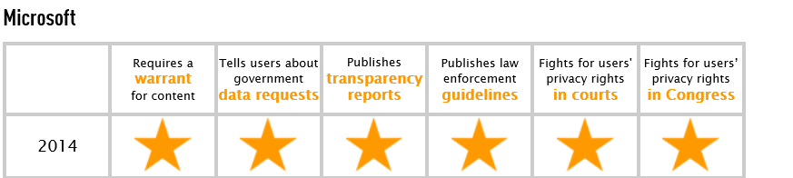
Industry recognition
https://www.eff.org/who-has-your-back-government-data-requests-2014

Slide 43
How do I meet my compliance obligations?

Slide 44
Simplified compliance
Information security standards
Effective controls
Government
& industry certifications
ISO 27001
SOC 1 Type 2
SOC 2 Type 2
FedRAMP/FISMA
PCI DSS Level 1
UK G-Cloud
HIPAA/HITECH
Australia IRAP
GxP Life Sciences

Slide 45
Continuous compliance approach
Security goals set in context of business and industry requirements
Security analytics & best practices deployed to detect and respond to threats
Benchmarked to a high bar of certifications and accreditations to ensure compliance
Continual monitoring, test and audit
Ongoing update of certifications for new services
Business Objectives
Industry Standards
& Regulations
Test and audit
Security analytics
Security Compliance
Framework
Security benchmark analysis
Risk management best practices
Certificates and Attestations

Slide 46
Microsoft commitment
Enhance Security
Protect
Privacy
Simplify Compliance
Unified platform for modern business

Slide 47
Recap
Can the cloud be more secure than on-premises?
What technical and operational safeguards are in place?
What can I do to further ensure the security of my cloud deployments?
Where is my data and who can access it?
How do I meet my compliance obligations?

Slide 48
Related content
CDP-B216 | Data Protection in Microsoft Azure
CDP-B305 TWC | A Game of Clouds: Black Belt Security for the Microsoft Cloud
CDP-B227 Introduction to Microsoft Azure Networking Technologies and What's New
Attend Ask The Experts
Find Me Later at the Azure Booth

Slide 49
DEV Track Resources
http://www.visualstudio.com
http://blogs.msdn.com/b/developer-tools/
http://msdn.microsoft.com/vstudio
visualstudio
@visualstudio
visualstudio

Slide 50

Resources
Learning
  Sessions on Demand
  Microsoft Certification & Training Resources
http://channel9.msdn.com/Events/TechEd
www.microsoft.com/learning
TechNet
Developer Network
  Resources for IT Professionals
http://microsoft.com/technet
http://developer.microsoft.com

Slide 51


Azure
Exams
Developing Microsoft Azure Solutions
EXAM
532
Implementing
Microsoft Azure Infrastructure Solutions
EXAM
533
(Coming soon)
Architecting Microsoft Azure Solutions
EXAM
534
http://bit.ly/
Azure-Cert
+
Classroom
training
(Coming soon)
Microsoft Azure Fundamentals
MOC
10979
Developing Microsoft Azure Solutions
MOC
20532
Implementing
Microsoft Azure Infrastructure Solutions
2
5
MOC
20533
5
http://bit.ly/
Azure-Train
Online
training
(Coming soon)
Microsoft Azure Fundamentals
MVA
(Coming soon)
Architecting Microsoft Azure Solutions
MVA
http://bit.ly/
Azure-MVA
Get certified for 1/2 the price at TechEd Europe 2014!
http://bit.ly/
TechEd-CertDeal

Slide 52


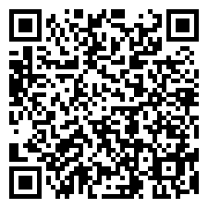
Please Complete An Evaluation Form
Your input is important!
TechEd Schedule Builder
CommNet station or PC
TechEd Mobile app
Phone or Tablet
QR code

Slide 53
Evaluate this session

Slide 54


© 2014 Microsoft Corporation. All rights reserved. Microsoft, Windows, and other product names are or may be registered trademarks and/or trademarks in the U.S. and/or other countries.
The information herein is for informational purposes only and represents the current view of Microsoft Corporation as of the date of this presentation. Because Microsoft must respond to changing market conditions, it should not be interpreted to be a commitment on the part of Microsoft, and Microsoft cannot guarantee the accuracy of any information provided after the date of this presentation. MICROSOFT MAKES NO WARRANTIES, EXPRESS, IMPLIED OR STATUTORY, AS TO THE INFORMATION IN THIS PRESENTATION.

