Slide 1


Slide 2

Sneak Peek into the Next Release of Windows Server Hyper-V
CDP-B246
Ben Armstrong

Slide 3
What is this about?
Giving you a detailed view of everything you can do with Hyper-V in Windows Server Technical Preview
It is not… A complete overview of everything that will be in the final release of Windows Server
It is not… A end-to-end story about what we are working on

Slide 4
Making Cloud Great

Slide 5
Rolling Cluster Upgrade
You can now upgrade a 2012 R2 Hyper-V cluster to Windows Server Technical Preview with:
No new hardware
No downtime
The ability to roll-back safely if needed
CDP-B354 Advantages of Upgrading Your Private Cloud Infrastructure in the Next Release of Windows Server

Slide 6
New VM Upgrade Process
Windows Server 2012 R2:
Hyper-V automatically upgrades virtual machines to the latest version
No ability to roll-back the upgrade process

Slide 7
New VM Upgrade Process
Windows Server Technical Preview:
Hyper-V will not automatically upgrade virtual machines
Upgrading a virtual machine is a manual operation that is separate from upgrading the host
Individual virtual machines can be moved back to earlier versions, until they have been manually upgraded

Slide 8
New VM Upgrade Process
Windows Server Technical Preview:
PowerShell only:
Update-VMConfigurationVersion

Slide 9
Demo: Upgrade

Slide 10
Tech Preview Bug!
Secure boot may not work on Generation 2 virtual machines after upgrade.
Solution:
Set-VMFirmware "VMName" -SecureBootTemplate MicrosoftWindows

Slide 11
Changing how we handle VM servicing
Windows Server 2012 R2:
VM drivers (integration services) updated with each new host release
Require that VM driver version matches the host
Drivers shipped with host operating system

Slide 12
Changing how we handle VM servicing
Windows Server Technical Preview:
VM drivers (integration services) updated when needed
Require latest available VM drivers for that guest operating system
Drivers delivered directly to the guest operating system via Windows Update

Slide 13
Secure Boot Support for Linux
Providing kernel code integrity protections for Linux guest operating systems.
Works with:
Ubuntu 14.04 and later
SUSE Linux Enterprise Server 12

Slide 14
Secure Boot Support for Linux
PowerShell to enable this:
Set-VMFirmware "Ubuntu" -SecureBootTemplate MicrosoftUEFICertificateAuthority
CDP-B233 Virtualizing Linux and FreeBSD Workloads on the Next Release of Windows Server Hyper-V

Slide 15
Distributed Storage QoS
Windows Server 2012 R2:
Introduced the ability to limit maximum IOPs for an individual virtual hard disk

Slide 16
Distributed Storage QoS
Windows Server Technical Preview :
Leveraging Scale Out File Server to allow you to:
Define IOPs reserves for important virtual hard disks
Define a IOPs reserve and limit that is shared by a group of virtual machines / virtual hard disks
CDP-B323 Delivering Predictable Storage Performance with Storage Quality of Service in the Next Release of Windows Server

Slide 17
Demos: Distributed Storage QoS
& Linux

Slide 18
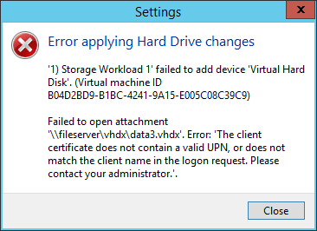
Tech Preview Bug!
Solution - Run:
reg add HKLM\System\CurrentControlSet\Control\Lsa\Kerberos\Parameters /v DevicePKinitEnabled /t REG_DWORD /d 0”

Slide 19
Working better at scale

Slide 20
Evolving Hyper-V Backup
New architecture to improve reliability, scale and performance.
Decoupling backing up virtual machines from backing up the underlying storage.
No longer dependent on hardware snapshots for core backup functionality, but still able to take advantage of hardware capabilities when they are present.

Slide 21
Built in change tracking for Backup
Most Hyper-V backup solutions today implement kernel level file system filters in order to gain efficiency.
Makes it hard for backup partners to update to newer versions of Windows
Increases the complexity of Hyper-V deployments
Efficient change tracking for backup is now part of the platform
CDP-B318 Building Scalable and Reliable Backup Solutions in the Next Release of Windows Server Hyper-V

Slide 22
VM Configuration Changes
New virtual machine configuration file
Binary format for efficient performance at scale
Resilient logging for changes
New file extensions
.VMCX and .VMRS

Slide 23
Demo:
VM Configuration

Slide 24
Solving operational problems

Slide 25
Production Checkpoints
Delivers the same Checkpoint experience that you had in Windows Server 2012 R2 – but now fully supported for Production Environments
Uses VSS instead of Saved State to create checkpoint
Restoring a checkpoint is just like restoring a system backup

Slide 26
Replica Support for Hot Add of VHDX
When you add a new virtual hard disk to a virtual machine that is being replicated – it is automatically added to the not-replicated set. This set can be updated online.
Set-VMReplication "VMName" -ReplicatedDisks (Get-VMHardDiskDrive "VMName")

Slide 27
Runtime Memory Resize
Dynamic memory is great, but more can be done.
For Windows Server Technical Preview guests, you can now increase and decrease the memory assigned to virtual machines while they are running.

Slide 28
Hot add / remove of network adapters
Network adapters can be added and removed from Generation 2 virtual machines while they are running.

Slide 29
Network Adapter Identification
You can name individual network adapters in the virtual machine settings – and see the same name inside the guest operating system.
PowerShell in host:
PowerShell in guest:
Add-VMNetworkAdapter -VMName “TestVM" -SwitchName "Virtual Switch" -Name "Fred" -Passthru |
Set-VMNetworkAdapter -DeviceNaming on
Get-NetAdapterAdvancedProperty | ?{$_.DisplayName -eq "Hyper-V Network Adapter Name"} | select Name, DisplayValue

Slide 30
Hyper-V Manager Improvements
Multiple improvements to make it easier to remotely manage and troubleshoot Hyper-V Servers:
Connecting via WinRM
Support for alternate credentials
  Requires that you have CredSSP enabled on server and client (http://blogs.msdn.com/b/powershell/archive/2008/06/05/credssp-for-second-hop-remoting-part-i-domain-account.aspx)
Connecting via IP address
Able to manage Windows Server 2012, 2012 R2 and Technical Preview from a single console

Slide 31
Demo: Operational Improvements

Slide 32
Tech Preview Bug!
I can’t see all the virtual machines in Hyper-V Manager!
Solution:
get-vm | ?{$_.heartbeat -eq "OKApplicationsUnknown"} | Disable-VMIntegrationService "Heartbeat"

Slide 33
Enhancing the platform

Slide 34
Hypervisor power management improvements
Updated hypervisor power management model to support new modes of power management.

Slide 35
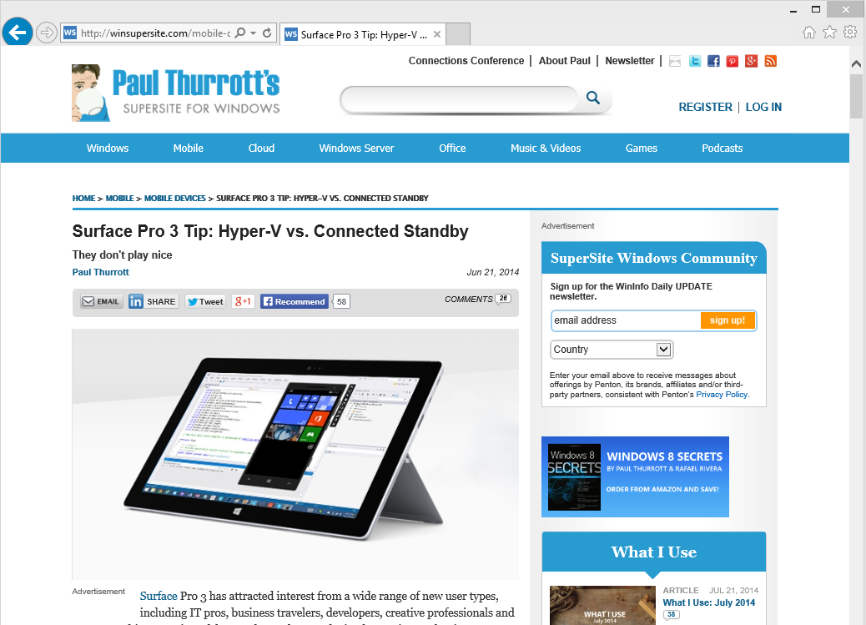
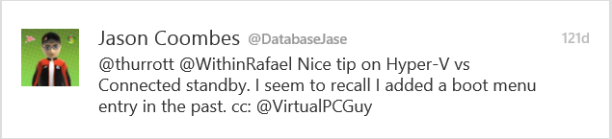
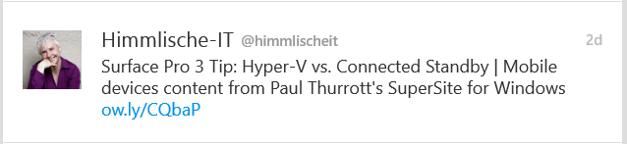
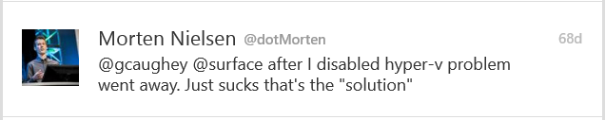
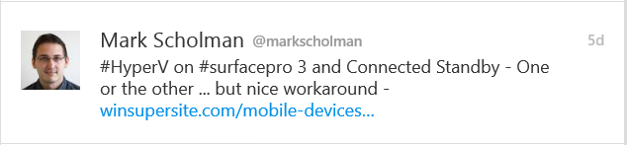
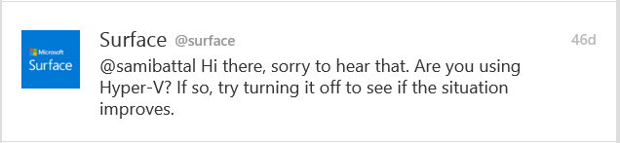
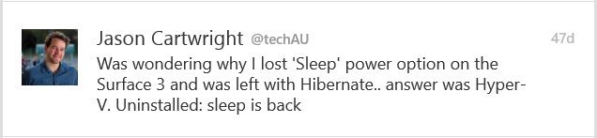
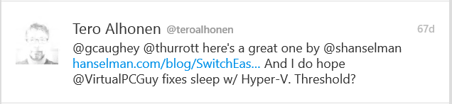
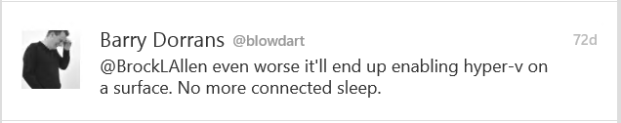
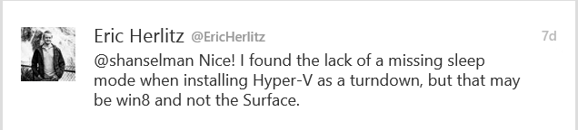

Slide 36
Hypervisor power management improvements
Updated hypervisor power management model to support new modes of power management.
Connected Standby works!

Slide 37
RemoteFX
Support for OpenGL 4.4 and OpenCL 1.1 API
Larger dedicated VRAM and configurable VRAM.

Slide 38
Hyper-V Cluster Management
Providing a single view of an entire Hyper-V cluster through WMI
“Just one big Hyper-V server”
Limited functionality at this point in time:
  Enumerate virtual machines
  Receive notification of live migration events
Root\HyperVCluster\v2

Slide 39
Demo: Multi-host Management

Slide 40
Summary
Lots of new functionality in Windows Server Technical Preview!
More to come in the future!
Please try out the new functionality – and provide us with feedback!
Demo scripts will be posted @ http://blogs.msdn.com/b/Virtual_PC_Guy

Slide 41
Related content
CDP-B225 Software Defined Compute in the Next Release of Windows Server Hyper-V
CDP-B224 Next Generation Networking in the Next Release of Windows Server: SDN, NFV and Cloud Scale Fundamentals
CDP-B222 Software Defined Storage in the Next Release of Windows Server

Slide 42
Related content
CDP-B354 Advantages of Upgrading Your Private Cloud Infrastructure in the Next Release of Windows Server
CDP-B318 Building Scalable and Reliable Backup Solutions in the Next Release of Windows Server Hyper-V
CDP-B323 Delivering Predictable Storage Performance with Storage Quality of Service in the Next Release of Windows Server
CDP-B341 Architectural Deep Dive into the Microsoft Cloud

Slide 43
Related content
CDP-B329 From Demo to Reality: Best Practices Learned from Deploying Windows Server 2012 R2 Hyper-V
CDP-B314 Microsoft Azure Site Recovery: Leveraging Azure as Your Disaster Recovery Site
CDP-B325 Design Scale-Out File Server Clusters with Direct Attach Storage in the Next Release of Windows Server
CDP-B233 Virtualizing Linux and FreeBSD Workloads on the Next Release of Windows Server Hyper-V

Slide 44

Resources
Learning
  Sessions on Demand
  Microsoft Certification & Training Resources
http://channel9.msdn.com/Events/TechEd
www.microsoft.com/learning
TechNet
Developer Network
  Resources for IT Professionals
http://microsoft.com/technet
http://developer.microsoft.com

Slide 45

For more information
Windows Server
Windows Server Technical Preview
http://technet.microsoft.com/library/dn765472.aspx
System Center
System Center Technical Preview
http://technet.microsoft.com/en-us/library/hh546785.aspx
Azure Pack
Azure Pack
  http://www.microsoft.com/en-us/server-cloud/products/
  windows-azure-pack
Microsoft Azure
Microsoft Azure
  http://azure.microsoft.com/en-us/
  Come visit us in the Microsoft Solutions Experience (MSE)!
  Look for the Cloud and Datacenter Platform area TechExpo Hall 7

Slide 46


Azure
Exams
Developing Microsoft Azure Solutions
EXAM
532
Implementing
Microsoft Azure Infrastructure Solutions
EXAM
533
(Coming soon)
Architecting Microsoft Azure Solutions
EXAM
534
http://bit.ly/
Azure-Cert
+
Classroom
training
(Coming soon)
Microsoft Azure Fundamentals
MOC
10979
Developing Microsoft Azure Solutions
MOC
20532
Implementing
Microsoft Azure Infrastructure Solutions
2
5
MOC
20533
5
http://bit.ly/
Azure-Train
Online
training
(Coming soon)
Microsoft Azure Fundamentals
MVA
(Coming soon)
Architecting Microsoft Azure Solutions
MVA
http://bit.ly/
Azure-MVA
Get certified for 1/2 the price at TechEd Europe 2014!
http://bit.ly/
TechEd-CertDeal

Slide 47



Please Complete An Evaluation Form
Your input is important!
TechEd Schedule Builder
CommNet station or PC
TechEd Mobile app
Phone or Tablet
QR code

Slide 48
Evaluate this session

Slide 49


© 2014 Microsoft Corporation. All rights reserved. Microsoft, Windows, and other product names are or may be registered trademarks and/or trademarks in the U.S. and/or other countries.
The information herein is for informational purposes only and represents the current view of Microsoft Corporation as of the date of this presentation. Because Microsoft must respond to changing market conditions, it should not be interpreted to be a commitment on the part of Microsoft, and Microsoft cannot guarantee the accuracy of any information provided after the date of this presentation. MICROSOFT MAKES NO WARRANTIES, EXPRESS, IMPLIED OR STATUTORY, AS TO THE INFORMATION IN THIS PRESENTATION.

