Slide 1


Slide 2

Converged Systems engineered for Microsoft Windows
Server 2012
CDP-B298
Stephan Schnellinger
Laurence Grizaud
Hans-Juergen Fuks

Slide 3
Agenda
ConvergedSystem portfolio overview
  Virtualization
  DB consolidation
  Deep dive on two selected SQL based solutions
  HP Converged System 300 for Microsoft Analytics Platform
  MS SQL Server 2014 on the HP ProLiant DL580 Gen8

Slide 4
Converged System overview

Slide 5
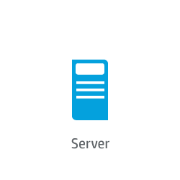

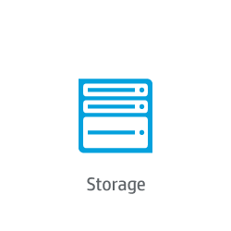




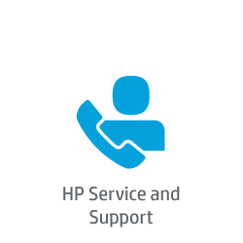
HP ConvergedSystems evolution
Servers
CloudSystem
Storage
CloudSystem
Networking
VirtualSystem
Security
ConvergedSystems
Management software
AppSystem
Services

Slide 6





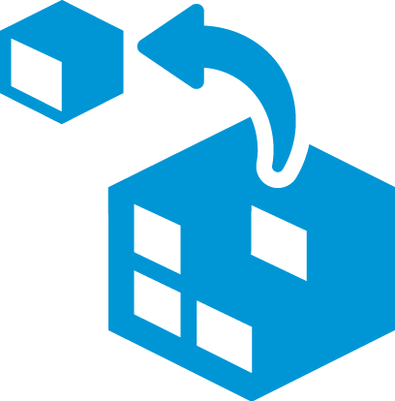
What’s a Converged System?
Parts
Experience
Network
Software
Private Cloud Systems
Services
Servers
Virtualization Systems
Storage
Converged System
Big Data Systems
Converged Infrastructure

Slide 7
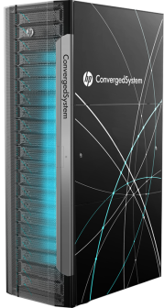



The new HP ConvergedSystem portfolio
Delivering a breakthrough total systems experience
Virtualization
HP ConvergedSystem
for Virtualization
HP ConvergedSystem
for DB consolidation
Cloud
HP CloudSystem
Big Data
HP ConvergedSystem
for MS APS
HP ConvergedSystem
for SAP HANA
Built on the industry’s best converged infrastructure with leading ISVs

Slide 8
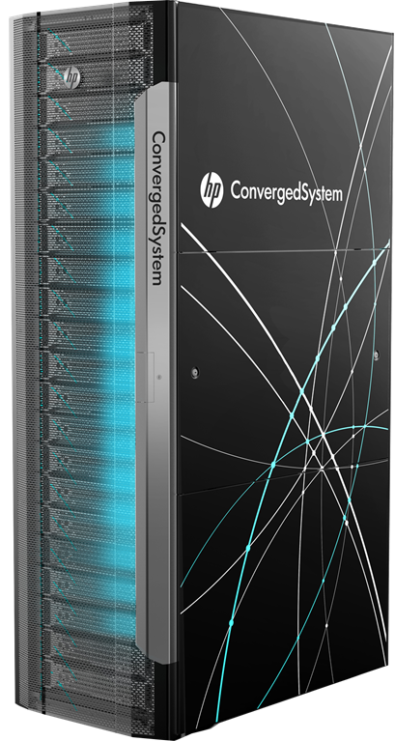


HP ConvergedSystem CS700x for Virtualization
The fastest way to virtualize with breakthrough TCO
on a cloud-compatible platform
50–1,000+ VMs
Simple to buy
Simple to deploy
Order to operations in as few
as 20 days
Simple to manage
Managed as one
Simple to support
One company: HP
Costs
~30% Lower entry point
Based on estimated list prices, and software license
cost savings

Slide 9

HP ConvergedSystem CS700x for DB consolidation
  Reducing the data center footprint and computing costs
  Starting your virtualization journey
  Standardizing technology in remote offices/branch offices (ROBOs)
  Scaling storage capacity to multiple terabytes
  Moving to a networked storage environment
  Consolidating databases enterprise-wide
  Providing mission-critical application support

Slide 10
  HP Converged System 300 for
  Microsoft Analytics Platform

Slide 11
Agenda
Short refresh on Fasttrack
Change in the datawarhouse world
ConvergedSystem 300 for Microsoft APS

Slide 12
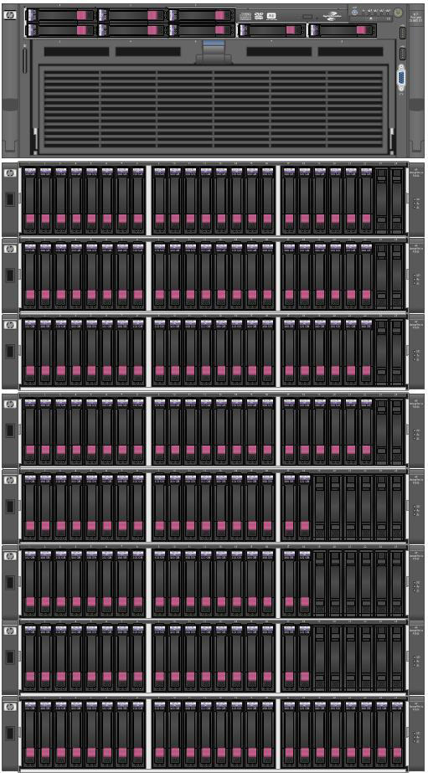
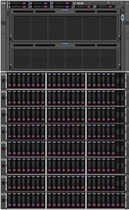
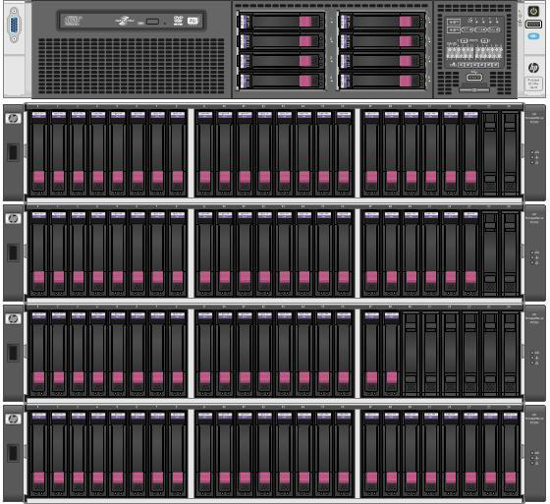
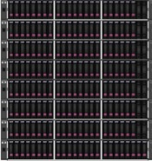
Microsoft SQL Server 2012
Fast Track Data Warehouse solutions
DL380p Gen8 + int SSD
DL380p Gen8 + MSA2040
DL380p Gen8 + 3PAR
DL580G7 + P2000
DL560p Gen8 + P2000
DL980G7 + P2000
4/11TB
30TB
30TB
60TB
50TB
85TB

Slide 13
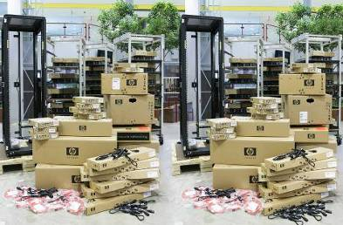
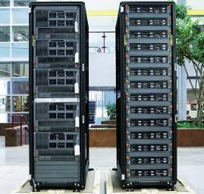
HP Factory Express services for Fast Track
Freeing up IT, getting more value!
Without HP Factory Express:
Complexity
Confusion
Slow time to solution
With HP Factory Express:
Faster time to solution
More available IT resources
Maximized IT investment

Slide 14

The Traditional Data Warehouse
BI & analytics
Dashboards
Reporting
…data warehousing has reached the most significant tipping point since its inception. The biggest, possibly most elaborate data management system in IT is changing.
–Gartner, “The State of Data Warehousing in 2012”
Data warehouse
ETL
Data sources
OLTP
ERP
CRM
LOB

Slide 15
The Traditional Data Warehouse
BI & analytics
2
Real-time
data
Dashboards
Reporting
Data warehouse
ETL
1
3
4
Increasing
data volumes
New data
sources & types
Cloud-born data
Data sources
Non-relational data
OLTP
ERP
CRM
LOB
Devices
Web
Sensors
Social

Slide 16





Microsoft’s Modern Data Warehouse
BI and analytics
Self-service
Corporate
Collaboration
Mobile
Machine Learning
Azure Machine Learning
SQL Server 2014
Data enrichment and federated query
Single query model
Extract, transform, load
Data quality
Master data management
Analytics Platform System
Azure HDInsight
Data management and processing
Data Platform
Box software
Appliances
Cloud
Box software
Appliances
Cloud
Data sources
Non-relational data
OLTP
ERP
CRM
LOB
Devices
Web
Sensors
Social

Slide 17
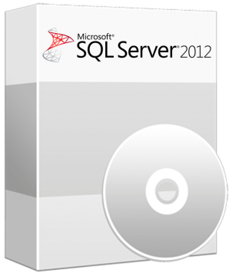
Moving from SQL
Server to APS
APS
Why?
Distributes data and query processing across multiple servers – eliminates bottlenecks inherent in SMP architecture
Integrated storage is more cost effective over most SAN systems – lowest DW Appliance $$/TB in the industry
Linear scale out to 6 petabytes of usable storage for DW
Significantly less performance tuning over an SMP solution
Seamless RDBMS and Hadoop integration with PolyBase
Management
Node
Compute
Node
Compute
Node
Control
Node
Compute
Node
Compute
Node
Compute
Node
Compute
Node

Slide 18
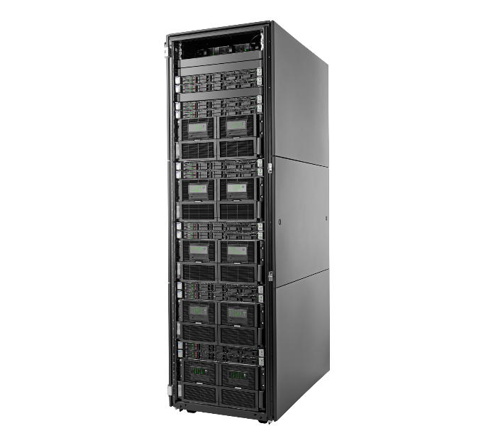
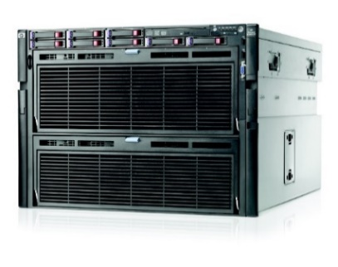
Parallel or not parallel?
Scale up (SMP)
  Traditional approach
  Build for specific requirement
  Build HA etc. additionally
  Maintain and Tune (Load/File Distribution)
  Unknown Future workloads
  Still a very good data mart solution in a Hub and Spoke architecture with SQL Server PDW
Scale out (MPP)
  Modern way of data warehousing
  Resilient & Predictable
  Big data / DW Best Practices in a box
  Deploy Fast and Drive Value
  Built-in HA
  Scalable (start small/grow when needed)
SQL Instance #8
Storage
SQL Instance #....
Storage
Storage
SQL Instance #4
Storage
SQL Instance
SQL Instance #3
Storage
SQL Instance #2
Storage
SQL Instance #1
Storage

Slide 19
Analytics Platform System
Microsoft’s Big Data Appliance
Prebuilt & performance-tuned appliance
Linear scale-out to petabytes of data
MPP design & in-memory columnstore
for 100x speed improvement
Dedicated region for Hadoop
Joining relational & non-relational data
with Polybase
MPP SQL Server
PolyBase
Hadoop

Slide 20
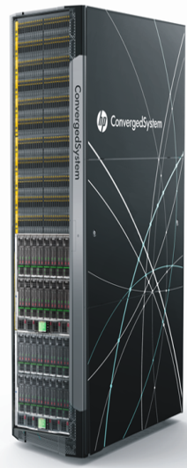
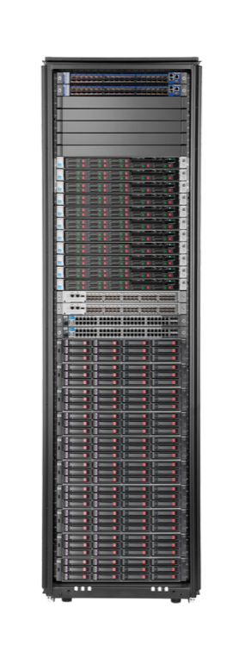
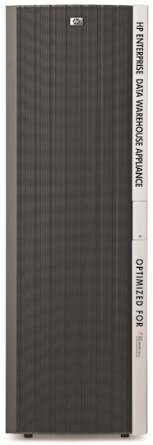
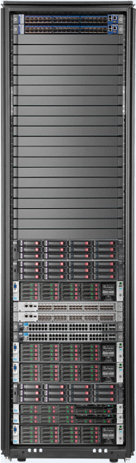
Giving you what you need … when you need it ..
HP’s rapid data warehouse appliance evolution
2014
HP ConvergedSystem 300 for
Microsoft Analytics Platform
New high-performance, high-availability platform
Fully integrated Hadoop
2013
HP AppSystem for Microsoft SQL Server 2012
Parallel Data Warehouse
Massive jump in scalability and functionality
Up to 6PB with Hadoop connector
2011
HP Enterprise Data Warehouse Appliance
1st HP/Microsoft DW appliance
Functionality
Scalability

Slide 21
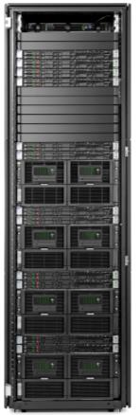
HP ConvergedSystem 300 for Microsoft Analytics Platform
    Next-generation data warehouse for mission-critical environments
    Factory built, appliance-based on HP Converged Infrastructure
    Pre-loaded with Microsoft software, integrated, tested, and tuned
    Architecture chosen for best data warehouse performance
    Single view of information across the enterprise
    New addition to the Converged Systems “Sharks” family
100X
Faster query speed¹
30%
Better scan rate¹
50%
Lower cost per TB²
¹ Than previous generations
² Than competitive offerings

Slide 22
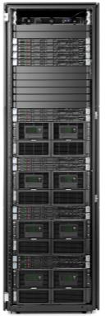




Integrated, enterprise-ready Apache Hadoop
HDInsight for consolidated querying of structured and unstructured data
Orchestration Server
Orchestration Server
Failover Server
HDInsight
Data Scale Unit
100% Apache Hadoop
  High performance tuned within the appliance
  Manageable, secured, and highly available
HDI Region
Base Scale Unit
PDW
Data Scale Unit
PDW Region
Base Scale Unit
  Leverage existing T-SQL skills
  Accessible insights with Microsoft business intelligence tools

Slide 23
A single appliance for rapid time-to-value
HP ConvergedSystem 300 for Microsoft Analytics: What’s in the box?
HP Deployment Accelerator Service (Onsite deployment services)
Microsoft Windows® 2012 and System Center software
Microsoft Parallel Data Warehouse (PDW) software³
HDInsight (Microsoft’s Hadoop-based distribution)
HP management tools and utilities
HP Converged Infrastructure: servers, storage, and networking
Collaborative support services from HP and Microsoft⁴
HP and partner assessment, design, and planning services
³ Priced separately
⁴ HP Proactive Care. Microsoft support priced and purchased separately

Slide 24
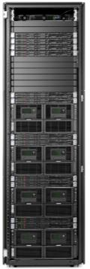

Base Parallel Data Warehouse (PDW) components
HP ConvergedSystem 300 for Microsoft Analytics Platform
Virtualized control and management node; failover node for high availability (HA)
InfiniBand (data network) and Ethernet (management network) connectivity
Orchestration Server
PDW Region Base Scale Unit (Control)
    1 x Orchestration Server (PDW)
    1 x Failover Server (PDW)
    1 x Optional Failover Server (PDW)
Failover Server
Failover Server
APS Rack & Network
    1 x HP 642 Shock Intelligent Series Rack
    2 x FDR InfiniBand
    2 x HP 5120 switches (2)
    2 x power distribution unit
      Choice of single-phase or multi-phase
      (priced separately)
PDW: Massive parallel
scale-out query processing
PDW Region Base Scale Unit (Processing)
    2 x PDW Data Servers (DL360p)
    1 x DAS Storage Block (DS6000)
      1 TB, 2 TB, or 3 TB choice
PDW Region Base Scale Unit

Slide 25
PLUS integrated analysis with Hadoop-based HDInsight
  Manage data of any size or type
    Relational or non-relational
  Perform more complex analysis faster
    SQL Server PDW’s PolyBase
    One appliance for integrated analysis of HDInsight non-relational and SQL Server PDW relational data
  100% Apache Hadoop-based data platform
  Scale quickly and easily
    Add up to 3 x HDI Data Scale Units and
    1 x HDI Failover Server per rack
Orchestration Server
HDI Region Base Scale Unit (Control)
    1 x Orchestration Server (HDInsight)
    1 x Failover Server (HDInsight)
Orchestration Server
HDI Region
Base Scale Unit
PDW Region Base Scale Unit
HDI Region Base Scale Unit
(Processing)
    2 x HDI Data Servers
    1 x DAS Storage Block
      1 TB, 2 TB, or 3 TB choice

Slide 26
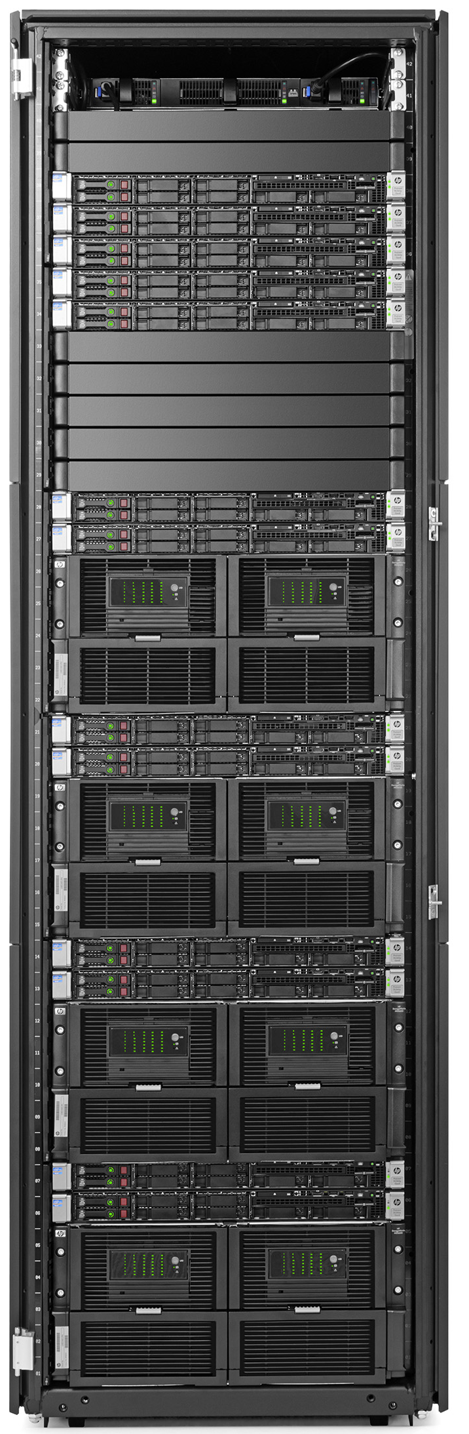
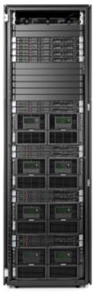
On-premise upgrade options
Increase capacity and/or functionality quickly with minimal downtime
Additional HA standby server
    1 x Optional Failover Server
Orchestration Server
HDI Region Base Scale Unit (Control)
    1 x Orchestration Server (HDInsight)
    1 x Failover Server (HDInsight)
Orchestration Server
Failover Server
Failover Server
Orchestration Server
Failover Server
HDI
Data Scale Unit
OR
HDI Region
Base Scale Unit
PDW
Data Scale Unit
PDW Data Scale Unit
    2 x PDW Data Servers
    1 x DAS Storage Block
      1 TB, 2 TB, or 3 TB choice⁶
PDW
Data Scale Unit
HDI Data Scale Units⁷
    4 x HDI Data Servers
    2 x DAS Storage Blocks
      1 TB, 2 TB, or 3 TB choice⁶
PDW Region
Base Scale Unit
PDW Region
Base Scale Unit
⁶ Must match existing capacity drives
⁷ All HDInsight nodes must be added at the same time

Slide 27
Flexible, mix-and-match PDW and HDInsight
From the factory or expandable in the field (examples )
Orchestration Server
Orchestration Server
Orchestration Server
Orchestration Server
Orchestration Server
Orchestration Server
Orchestration Server
Modular
Flexible
Cost-effective
HDI Region
Base Scale Unit
HDI
Data Scale Unit
HDI
Data Scale Unit
or
or
PDW
Data Scale Unit
HDI Region Base Scale Unit
HDI
Data Scale Unit
PDW
Data Scale Unit
PDW
Data Scale Unit
HDI Region Base Scale Unit
PDW Region Base Scale Unit
PDW Region Base Scale Unit
PDW Region Base Scale Unit
PDW Region Base Scale Unit

Slide 28
Massive scalability
HP ConvergedSystem 300 for Microsoft Analytics Platform
Up to 6 PB ⁵
(PDW Region)
Up to 1.2 PB (HDInsight Region)
Up to 64 nodes
per workload region
Base rack
Fully populated
base rack (8 nodes)
Easily expand by adding racks
⁵ Based on 5:1 compression

Slide 29
High-availability features for increased uptime
HP ConvergedSystem 300 for Microsoft Analytics Platform
NETWORK REDUNDANCY:
2 x InfiniBand Switches (Data)
2 x Ethernet Switches (Management)
SERVER REDUNDANCY:
All servers participate in an Active/Passive Windows Failover Cluster with the Failover Server.
An Optional Failover Server can be added as a second failover server.
POWER DISTRIBUTION UNIT REDUNDANCY:
2 x Single Phase or Three Phase (choice)
International or NA/JPN option
Securely manage and monitor power distribution from anywhere to prevent problems and speed response times.
SOFTWARE FAILOVER:
Each management (Orchestration) or processing (PDW and HDI) instance runs within a VM.
Any VM can failover to the Failover Server.
STORAGE REDUNDANCY:
All data is mirrored across electrically separated arrays.
Spare disks are available to rebuild a disk in the event of a failure.

Slide 30


Inside a Scale Unit – Physical View
PDW orchestration
PDW failover
Control and management functionality
Private Ethernet
network
Dual InfiniBand
Compute nodes access their local D6000 in their respective scale unit
Compute nodes
D6000
SAS
Node 1
Storage 1
Node 2
Storage 2
Base scale unit

Slide 31
Inside a PDW Scale Unit – Fabric View
Control Node
MAD
AD
VMM
PDW orchestration
PDW failover
Private Ethernet
network
Dual InfiniBand
Compute Node 1
iSCI 01
D6000
SAS
Node 1
Storage 1
Node 2
Compute Node 2
iSCI 02
Storage 2
Base scale unit

Slide 32
Inside the HDI Scale Unit – Fabric View
HHN
HSN
HMN
PDW orchestration
PDW failover
Private Ethernet
network
Dual InfiniBand
Data Node 1
Data Node 2
iSCSI 01
D6000
SAS
Node 1
Storage 1
Node 2
Data Node 3
Data Node 4
iSCSI 02
Storage 2
Base scale unit

Slide 33

Simplified management for increased ROI
Exclusive to HP: HP Support Pack
Validation of Microsoft Reference Architecture (MRA) compliance
Reports all serial numbers and rack locations of all devices
Diagnostic tools to validate configuration
Unique HP tools ensure solution runs at optimal performance and delivers expected return on investment (ROI)
Provide Proactive Care reporting for support
ConvergedSystem firmware/driver update package

Slide 34



Accelerated time-to-information-value
HP Services get you up and running … fast
Advise
Migrate & Deploy
Operate
Prepare your organization and environment
HP Migration Assessment for ConvergedSystem 300 for Microsoft Analytics Platform
HP Advisory Service for ConvergedSystem 300 for Microsoft Analytics Platform
  Smooth migration and speedy deployment
  HP Factory Express Integration and Onsite Start-up Services
  HP Deployment Accelerator Service for ConvergedSystem 300 for Microsoft Analytics Platform*
  HP Migration Service for ConvergedSystem 300 for Microsoft Analytics Platform*
Proactive support and organizational readiness
HP Proactive Care
Personalized Support Option
Proactive Select Credits
HP Education Services
* Included in the price of the appliance order

Slide 35




HP ConvergedSystem 300 for Microsoft Analytics Platform
HP + Microsoft deliver leading price/performance …
100x faster
query speed
30% better
scan rate
35% lower acquisition cost
50% lower cost/TB⁸
⁸ valueprism.com/resources/resources/Resources/PDW%20Compete%20Pricing%20FINAL.pdf

Slide 36
Results: Reporting
80x Faster
Criteria: 2x

Slide 37
Results: ETL for Current Database
With limited ETL tuning on 25% packages
3x Faster
Criteria: 2x

Slide 38
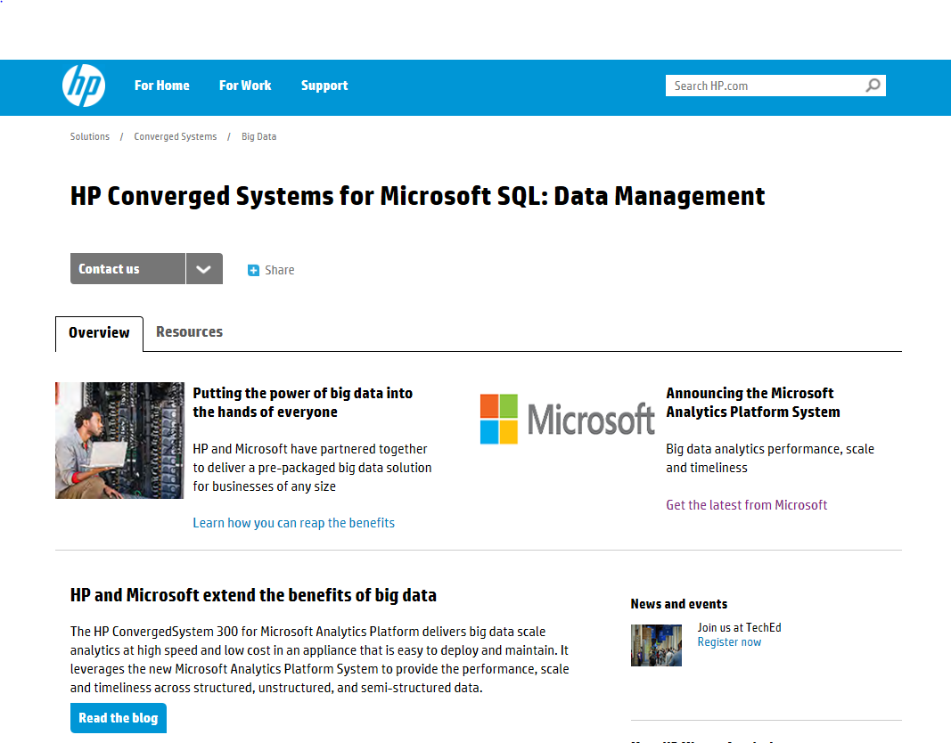
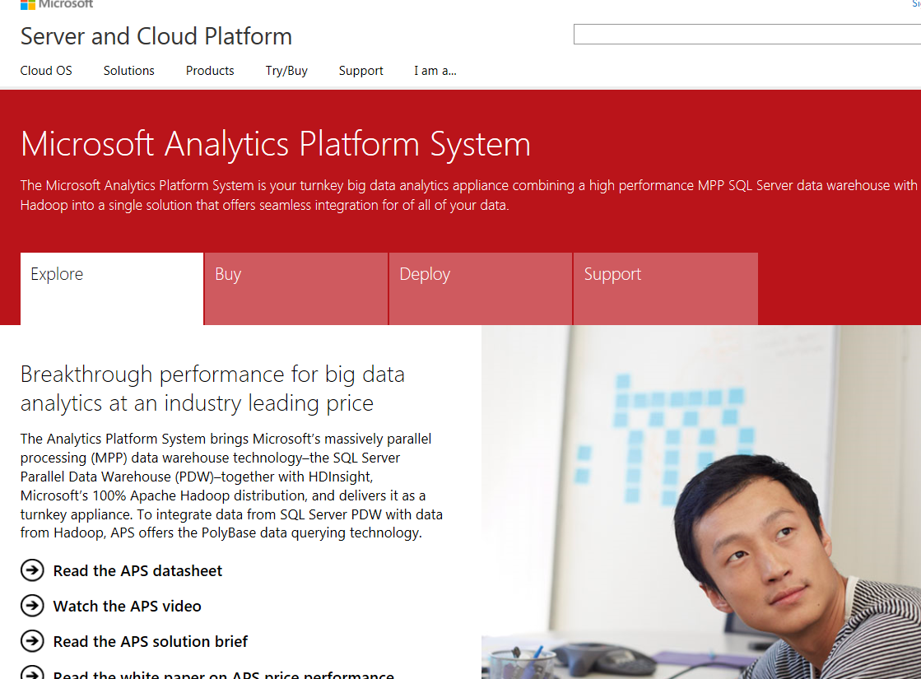
For more information
Hewlett Packard
  HP ConvergedSystem 300 for Microsoft Analytics Platform
  hp.com/go/convergedsystem/cs300aps
HP ActiveAnswers
  hp.com/solutions/activeanswers
Microsoft
  Microsoft Analytics Platform Server
  microsoft.com/aps

Slide 39
  MS SQL Server 2014 on the HP ProLiant DL580 Gen8

Slide 40



Unleash the power of your business data with HP ProLiant DL580 Gen8
Breakthrough 4-socket performance and scalability
Leading x86 availability and rock-solid reliability
Compelling efficiencies
2.3X performance (60 cores)
1.5X DDR3 memory slots (96 DIMMs)
2.7X IO bandwidth (5 x16 slots)
2X storage performance (12 G SAS)
1.2X internal SSD bays (10 bays)
HP Advanced Error Recovery
HP Memory Quarantine
HP Advanced Fault Resiliency
HP Advanced Event Reporting
Enhanced security
Proactive care support services
Consolidation savings
SW licensing cost savings
Integrated management (HP OneView)
Intelligent Gen8 (iLO 4) management
HP Smart Update Manager
Customer-inspired innovations

Slide 41
Demo
Scalability with SQL Server 2014 on the HP ProLiant DL580 Gen8

Slide 42
Fewer memory and processor based outages
HP Advanced Error Recovery
Recovery from uncorrectable processor, cache and memory errors during execution
HP Memory Quarantine
Recovery from uncorrectable memory errors which may cause a system crash
Uncorrectable error detected in processor, cache or memory under execution pipeline
MCA Recovery detects uncorrectable memory error
1
1
System keeps running and prevents crash
Processors
2
Os/hypervisor blocks use of bad memory location
2
Core
L1 Cache
Firmware informs OS, hypervisor and end-application
HP Memory quarantine tags memory location as bad and sends address to OS/hypervisor
4
L2 Cache
4
DRAM
Uncore
OS/hypervisor decides how to handle recovery
3
3
OS, hypervisor and end-application initiates recovery action – thread, process, VM, application kill/re-started
HP Advanced Error Recovery and HP Memory Quarantine require recovery awareness in OS, Hypervisor and End-application

Slide 43
Demo
Memory quarantine with MS SQL Server 2014 on the HP ProLiant DL580 Gen8

Slide 44



HP Universal Database Solution
High or Tiered performance for SQL Server 2014 Databases
DL580 Gen8 & 3PAR 7450 All-Flash Edition
High speed data and transactional processing without compromises
DL580 Gen8 & 3PAR 7400 Edition
Tiered performance designed for multiple workload consolidation
High OLTP performance at multiple capacities
Million+ OLTP transactions per minute
Optimized for multiple concurrent workloads
Powerful and easy to manage resource controls
Lower total cost of ownership (TCO)
Great price/performance for database consolidation
Flexible deployment options
Physical/Virtual NUMA aware topologies
Highly available and future proof
Tier 1 data services and upgradability
Highly available and future proof
Tier 1 data services and upgradability

Slide 45
MS SQL Server 2014 Data Warehouse Fast Track
DL580 Gen8 and HP PCIe LE Workload Accelerator 90 TB Reference Architecture
  High performance at low latencies
  Eliminate the complexity of appropriate sizing
  Reduce unnecessary scale-out infrastructure
HP ProLiant DL580 Gen8
4 x Intel Xeon E7-4890v2 (2.8GHz/15-core)
1.5 TB DDR3 Memory
2 x 500GB 7200RPM HDD for OS (RAID 1)
Windows Server 2012 R2
HP PCIe LE Workload Accelerator
6 x 5.2TB HP Workload Accelerator PCIe Flash devices for data and tempdb
2 x 1.3TB HP Workload Accelerator PCIe Flash devices for log (RAID 1)
© Copyright 2014 Hewlett-Packard Development Company, L.P. The information contained herein is subject to change without notice.

Slide 46
  Thank you for your attention, please visit us on our booth for any question you might have!

Slide 47
Backup

Slide 48

For more information
Windows Server
Windows Server Technical Preview
http://technet.microsoft.com/library/dn765472.aspx
System Center
System Center Technical Preview
http://technet.microsoft.com/en-us/library/hh546785.aspx
Azure Pack
Azure Pack
  http://www.microsoft.com/en-us/server-cloud/products/
  windows-azure-pack
Microsoft Azure
Microsoft Azure
  http://azure.microsoft.com/en-us/
  Come visit us in the Microsoft Solutions Experience (MSE)!
  Look for the Cloud and Datacenter Platform area TechExpo Hall 7

Slide 49

Resources
Learning
  Sessions on Demand
  Microsoft Certification & Training Resources
http://channel9.msdn.com/Events/TechEd
www.microsoft.com/learning
TechNet
Developer Network
  Resources for IT Professionals
http://microsoft.com/technet
http://developer.microsoft.com

Slide 50



Please Complete An Evaluation Form
Your input is important!
TechEd Schedule Builder
CommNet station or PC
TechEd Mobile app
Phone or Tablet
QR code

Slide 51
Evaluate this session

Slide 52


© 2014 Microsoft Corporation. All rights reserved. Microsoft, Windows, and other product names are or may be registered trademarks and/or trademarks in the U.S. and/or other countries.
The information herein is for informational purposes only and represents the current view of Microsoft Corporation as of the date of this presentation. Because Microsoft must respond to changing market conditions, it should not be interpreted to be a commitment on the part of Microsoft, and Microsoft cannot guarantee the accuracy of any information provided after the date of this presentation. MICROSOFT MAKES NO WARRANTIES, EXPRESS, IMPLIED OR STATUTORY, AS TO THE INFORMATION IN THIS PRESENTATION.

