Slide 1


Slide 2

Telemetry and Data Flow at Hyper-Scale: Azure Event Hubs
CDP-B307
Clemens Vasters
Architect, Microsoft Azure
@clemensv

Slide 3

Thank you for being here for the last session of TechEd!

Slide 4
Azure Service Bus
Azure Service Bus
Relay
NAT and Firewall Traversal Service
Request/Response Services
Unbuffered with TCP Throttling
Queue
Transactional Cloud AMQP/HTTP Broker
High-Scale, High-Reliability Messaging
Sessions, Scheduled Delivery, etc.
Topic
Transactional Message Distribution
Up to 2000 subscriptions per Topic
Up to 2K/100K filter rules per subscription
Notification Hub
High-scale notification distribution
Most mobile push notification services
Millions of notification targets
Event Hub
… this session …

Slide 5
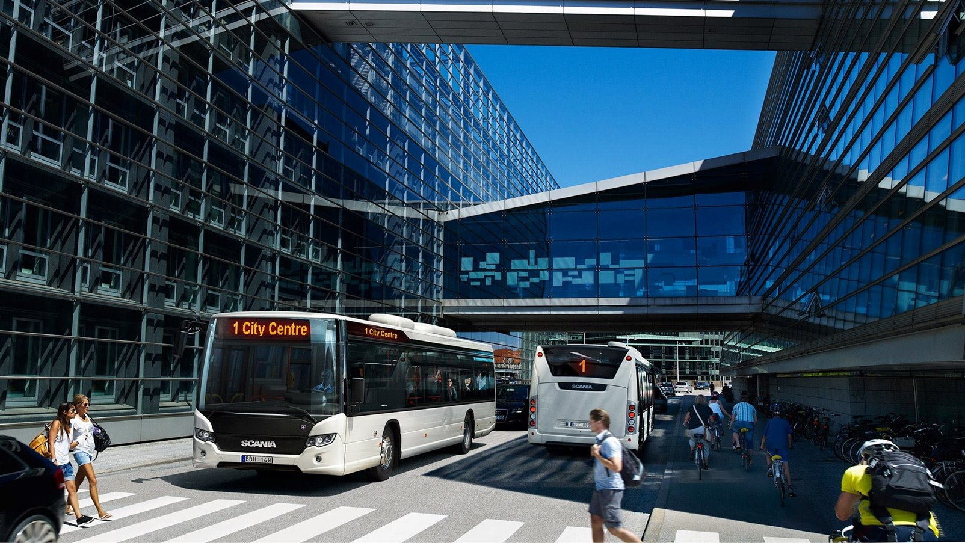
Intelligent Mobility and
Connected Car

Slide 6
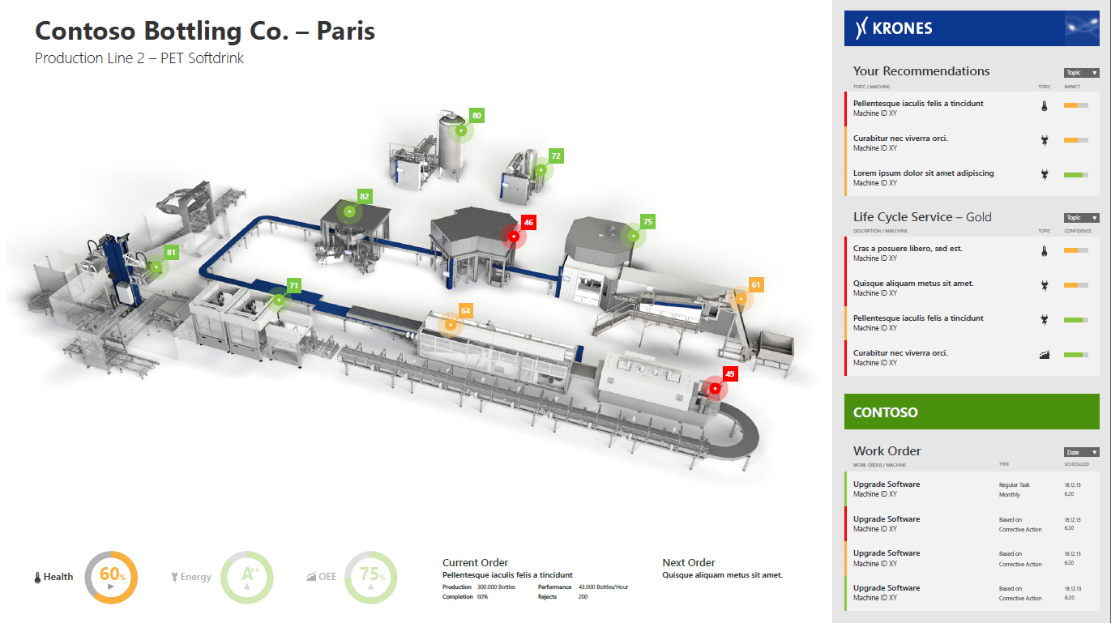
Industrial Automation

Slide 7
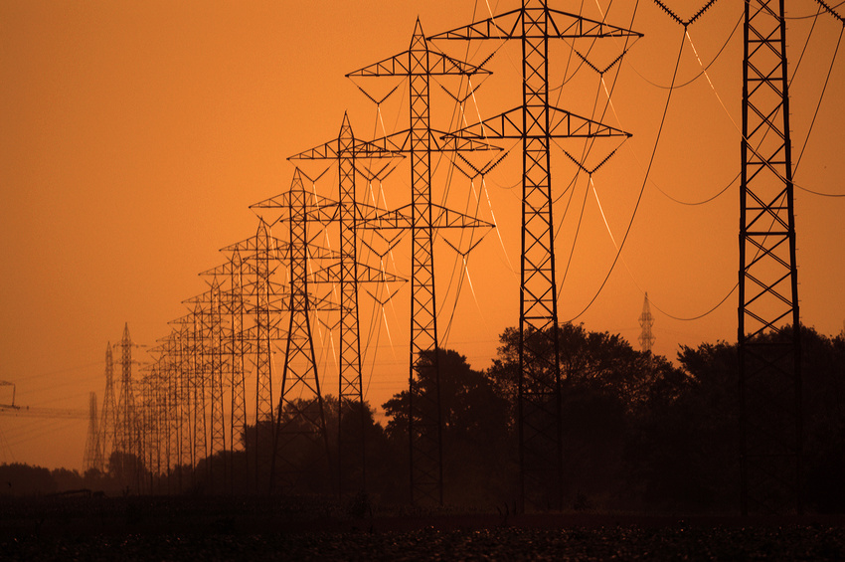
Energy Grid and Natural Resources

Slide 8

Games,
Television,
Consumer Web

Slide 9
Hyper Scale.
A Million Clients.
Concurrent.
100
10,000
1,000,000

Slide 10
Introducing Azure Event Hubs
IEventProcessor
Event Processor Host
Azure Event Hub
Direct
Receivers
> 1M Producers
> 1GB/sec
Aggregate
Throughput
Consumer Group(s)
Partitions
Event Producers
PartitionKey
Hash
AMQP 1.0
Credit-based flow control
Client-side cursors
Offset by Id or Timestamp
Throughput Units:
1 ≤ TUs ≤ Partition Count
TU: 1 MB/s writes, 2 MB/s reads
Up to 32 partitions via portal, more on request

Slide 11
Quick Excursion: What is AMQP 1.0?
Advanced Message Queueing Protocol v1.0, ISO/IEC 19464:2014
Bi-Directional, Reliable, Multiplexed Message Transfer
Common Type System: structure like JSON, richer value types for scientific and business apps, compact binary encoding
Credit-based flow control model, delivery settlement
A
Connection + Session
B
Link
Link Credit
-1
-1
-1
-1
-1
+5

Slide 12
Send/Receive Fundamentals
Sender Side
  Same sender model as Service Bus Queues and Topics at the protocol level
  Leverages the existing AMQP 1.0 and HTTPS protocol surface area for ‘send’
  Consistent security model with Service Bus, extended by publisher policies
  Simplified .NET programming model surface area (EventData)
Receiver Side
  Accommodates partitioned consumption with failover and leader election
  Efficient AMQP 1.0 consumer model with link-credit flow control
    Allows for one-by-one delivery to “endless push”
  Client-side cursors allowing to freely process and repeatedly reprocess the available retained event stream based on offsets or timestamps

Slide 13
Partitions
Segmentation of the event stream for scale-out
  Parallelism for consumers pulling events for processing
  Parallelism for producers sub mitting events
Default 16, minimum 8, self-service maximum 32
  Azure Support can enable up to 1024 (or more under special conditions)
  Maximum 10 Event Hubs per namespace
Sender usage of partitions
  Direct targeting with partition-id allowing for sender controlled segmentation
  Automatic hash-based distribution by PartitionKey or Publisher Identity
  Automatic random distribution

Slide 14
Throughput Units
Throughput Unit (TU): Quota and Billing Concept
  Write: Lesser of 1MByte/sec or 1000 message operations/sec (incl. management)
  Read: 2MByte/sec
  Included retention: 84GByte/day (24h at full ingress rate)
    Retention can be expanded w/ self-service up to 7 days, via Azure support up to 30 days
    Local-redundant Azure storage pricing for overages applies
Number of Partitions ≥ Throughput Units
  At most one throughput unit per partition, minimum is one
  10 partitions have 10 TU = 10 MByte/sec throughput ceiling
TUs are applied and enforced at the namespace level, i.e. across Event Hubs
  Maximum of 20 TUs per account in self-service.
  Further w/ commitments through Azure support (blocks of 20 up to 100, blocks of 100)
Billing
  TUs are billed by the hour (!) they are applied to a namespace (more on pricing later)

Slide 15
Publishers
Very many publishers
  Short-lived, low throughput: HTTPS
  Long-lived, high throughput: AMQP
    Long lived AMQP connections are billable, HTTPS requests are not; AMQP connection allowance included in tier
Publish to …
  PartitionId
    Direct
  PartitionKey
    PartitionKey selecting PartitionId
  Publisher Policy (<eh>/publishers/<name>)
    <name> overriding PartitionKey
Direct
Partitions
Event Producers
PartitionKey
Hash

Slide 16
Consumer Groups
Views on the Event Stream
  Conceptually similar to Topic subscriptions in that they are a ‘view’ on the event stream
  Organizational anchor for checkpointing (you)
  Anchor for creating per-partition receivers
  Default consumer group always present
  Can create up to 20 named consumer groups
“Receivers read through a consumer group”
Consumer Group(s)

Slide 17
Consumers
Receive from partitions via consumer groups
  Using .NET API or using generic AMQP 1.0 client (e.g. Apache Proton-C/J)
Cursors (offsets) solely maintained by clients; not like Queue/Topic
  Maximum flexibility for consumption
  Can act as raw event history store for retention duration
    Not an archive, but raw data value often deteriorates quickly
  Can synchronize across streams by timestamp
  Checkpoints must be maintained by clients
Direct support for external leader election models with epochs
Partition
Event Log
ID, Time, [Data]
ID, Time, [Data]
Time
ID, Time, [Data]
ID, Time, [Data]
ID, Time, [Data]
ID

Slide 18
Lease, IEventProcessor, ICheckpointManager
.NET API abstraction (considering for other SDKs)
Lease
  Partition lease abstraction for failover and scale inflate/deflate management
  Base class, represents externally acquired lease on leadership for the partition
ICheckpointManager
    Checkpoint storage abstraction for storing client offset in scale-out fabric
  Stores checkpoints (offsets for consumed events) in externally supplied store
IEventProcessor
  Event processor to handle batches of messages
  OpenAsync/ProcessEventsAsync/CloseAsync
  Registered on Consumer Group Client

Slide 19
Event Processor Host
NuGet package separate from SDK
Implements scale-out event processing over minimal dependencies on Azure
  Leader election through blob leases and blob lease breaking (stealing)
  Checkpointing in Azure Storage Blobs
  IEventProcessor supplied by user application
Alternatives
  Leader election via and checkpointing in ZooKeeper or DHTs
Coming very soon
  Storm Spout for Java using ZK

Slide 20
Demos
Enough said. Let’s see it.

Slide 21
Pricing
Basic: Up to 100 connections, no extension Standard: 1000 connections incl. | Price (US Dollars)
Throughput Unit Hour (Basic) | 0.015 | TU per hour
Throughput Unit Hour (Standard) | 0.03 | TU per hour
Ingress Events | 0.028 | per 1,000,000 events
Cost Brokered Connections (1k-100k) | 0.00004 | connection/hour
Cost Brokered Connections (100k-500k) | 0.00003 | connection/hour
Cost Brokered Connections (500k+) | 0.00002 | connection/hour
Storage Overage >TUs*84GB |  | local-redundant Azure storage charge-through

Slide 22
Summary
Massive scale event ingestion into the cloud
Unprecedented ease and scale
When can you have it? Now
  Service went into production this week
Where can you get information?
  http://azure.microsoft.com/en-us/services/event-hubs/

Slide 23

Resources
Learning
  Sessions on Demand
  Microsoft Certification & Training Resources
http://channel9.msdn.com/Events/TechEd
www.microsoft.com/learning
TechNet
Developer Network
  Resources for IT Professionals
http://microsoft.com/technet
http://developer.microsoft.com

Slide 24

For more information
Windows Server
Windows Server Technical Preview
http://technet.microsoft.com/library/dn765472.aspx
System Center
System Center Technical Preview
http://technet.microsoft.com/en-us/library/hh546785.aspx
Azure Pack
Azure Pack
  http://www.microsoft.com/en-us/server-cloud/products/
  windows-azure-pack
Microsoft Azure
Microsoft Azure
  http://azure.microsoft.com/en-us/
  Come visit us in the Microsoft Solutions Experience (MSE)!
  Look for the Cloud and Datacenter Platform area TechExpo Hall 7

Slide 25


Azure
Exams
Developing Microsoft Azure Solutions
EXAM
532
Implementing
Microsoft Azure Infrastructure Solutions
EXAM
533
(Coming soon)
Architecting Microsoft Azure Solutions
EXAM
534
http://bit.ly/
Azure-Cert
+
Classroom
training
(Coming soon)
Microsoft Azure Fundamentals
MOC
10979
Developing Microsoft Azure Solutions
MOC
20532
Implementing
Microsoft Azure Infrastructure Solutions
2
5
MOC
20533
5
http://bit.ly/
Azure-Train
Online
training
(Coming soon)
Microsoft Azure Fundamentals
MVA
(Coming soon)
Architecting Microsoft Azure Solutions
MVA
http://bit.ly/
Azure-MVA
Get certified for 1/2 the price at TechEd Europe 2014!
http://bit.ly/
TechEd-CertDeal

Slide 26
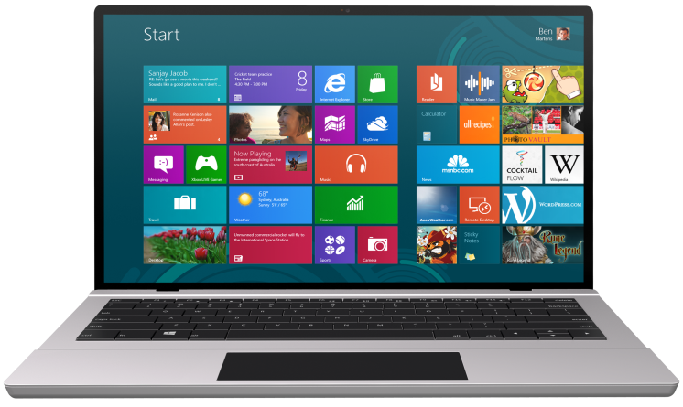


SUBMIT YOUR TECHED EVALUATIONS
We value your feedback!
Fill out an evaluation via
CommNet Station/PC: Schedule Builder
LogIn: europe.msteched.com/catalog
TechEd Mobile app
for session evaluations
is currently offline

Slide 27


© 2014 Microsoft Corporation. All rights reserved. Microsoft, Windows, and other product names are or may be registered trademarks and/or trademarks in the U.S. and/or other countries.
The information herein is for informational purposes only and represents the current view of Microsoft Corporation as of the date of this presentation. Because Microsoft must respond to changing market conditions, it should not be interpreted to be a commitment on the part of Microsoft, and Microsoft cannot guarantee the accuracy of any information provided after the date of this presentation. MICROSOFT MAKES NO WARRANTIES, EXPRESS, IMPLIED OR STATUTORY, AS TO THE INFORMATION IN THIS PRESENTATION.

