Slide 1


Slide 2

Microsoft Azure Site Recovery: Leveraging Microsoft Azure as your Disaster Recovery Site
CDP-B314
Kristian Nese, Lumagate
Manoj Kumar Jain, Microsoft Corporation

Slide 3
Session Objectives and Takeaways
Overview of Microsoft BCDR solution
Learn how to setup protection and recover to Microsoft Azure
Hear about experiences of a key Service Provider

Slide 4
Business Continuity
Challenges

Slide 5
Business Continuity Challenges
Data growth's impact on business continuity
Business Continuity
Roadblock
Too many complications, problems and mistakes
Too much data with insufficient protection
Not enough data retention
Time-intensive media management
Untested DR & decreasing recovery confidence
Increasing costs

Slide 6





Business Continuity Challenges
Bypassing the obstacles
Business Continuity
Roadblock
Automate, automate, automate
Too many complications, problems and mistakes
Tighter integration between systems & availability / data protection
Too much data with insufficient protection
Increase breadth and depth of continuity protection
Not enough data retention
Eliminate tape management
Time-intensive media management
Implement testable solutions for data recovery
Untested DR & decreasing recovery confidence
Achieve cost and operations stability
Increasing costs

Slide 7



Microsoft Solutions
Breadth & depth solutions for business continuity & disaster recovery
Integration of WSB/DPM with Microsoft Azure Backup
5
Orchestrated Physical, Hyper-V & VMware VM Replication & Recovery using Azure Site Recovery, between on-premises locations, or between on-premises & Microsoft Azure
}
6
2
Hyper-V Guest Clustering for app-
level HA, i.e. SQL Server AlwaysOn FCI
Centralized backup with Data Protection Manager
4
1
Hyper-V Failover
Clustering for VM Resilience
Simplified protection with Windows Server Backup
3

Slide 8
DR Solution

Slide 9


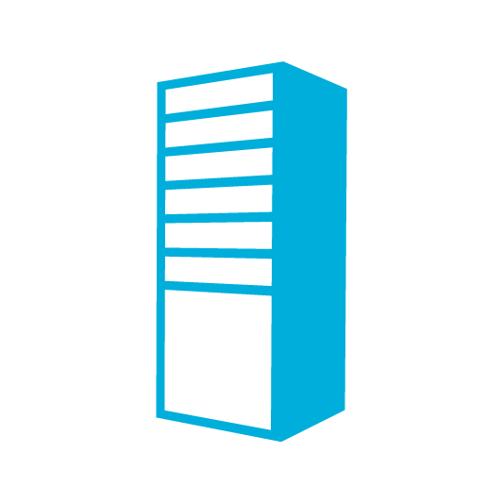
Microsoft’s Disaster Recovery Stack
e.g. SQL AlwaysOn
Apps
IIS
SQL
VM Replication with Hyper-V Replica
DR Orchestration
with
Microsoft Azure Site Recovery
VM or Physical Server Replication with Hyper-V Replica or InMage Scout
Storage Replication
Compute
Storage
Networks
Hyper-V, VMware or Physical
Hyper-V

Slide 10

On-premises to On-premises protection (Site-to-Site)
Orchestrated Disaster Recovery
On-premises to Azure protection (Site-to-Azure)
Microsoft Azure
Site Recovery
Microsoft Azure
Site Recovery
Microsoft Azure
Site Recovery
Microsoft Azure
Site Recovery
Orchestration Channel
Download InMage Scout
Orchestration and Replication: Hyper-V Replica, SQL AlwaysOn
Orchestration and Replication: InMage Scout
COMING SOON!
InMage Scout
Orchestration and Replication channel: InMage Scout
InMage Scout
InMage Scout
Replication channels:
Hyper-V Replica, SQL AlwaysOn, SAN
Primary Site
Recovery Site
Primary Site
Recovery Site
Primary Site
Primary Site
Hyper-V
Hyper-V
VMware / Physical
VMware / Physical
Hyper-V
VMware / Physical
Key features include:
Automated VM protection and replication
Remote health monitoring
Near zero RPO
No-impact recovery plan testing
Customizable recovery plans
Minimal RTO – few minutes to hours
Orchestrated recovery when needed
Replicate to – and recover in – Azure
Heterogeneous physical and virtual support

Slide 11
Using Azure as your DR site

Slide 12


Customer Workloads to Azure
for Windows Server 2012+ Hyper-V
DR Orchestration
Microsoft Azure
Site Recovery
DR Orchestration
SCVMM
&
DRP
Customer 1 DC
Extensible Data Channel
Target: Microsoft Azure
SCVMM
&
DRP
Microsoft Azure
Customer 2 DC

Slide 13
Use Cases
Disaster Recovery to Azure
  Single click Application recovery
  Compliance Assurance without impacting Production
  Disaster Avoidance – Hurricane warning
  Failover during real disasters – Fire, Earthquake etc.
  Failback to on-premises
Azure as a staging environment
Planned Migration to Azure

Slide 14
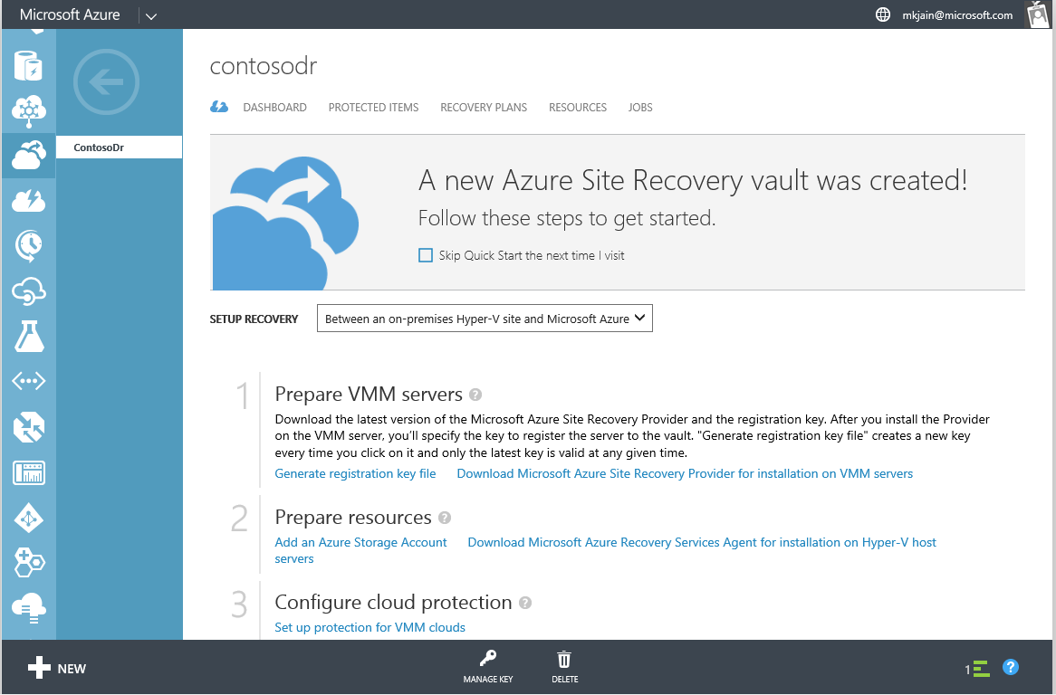
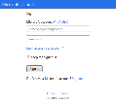
Microsoft Azure Site Recovery
How it works: initial configuration
Primary Site
System Center
Virtual Machine
Manager
1. Sign up
4. VMM Metadata pushed to Azure Site Recovery, outbound, over HTTPS
2. Create Recovery Vault and Download Provider + Registration file
3. Deploy Provider on VMM and Host Agent on Hosts
Secondary Site

Slide 15
Microsoft Azure Site Recovery
How it works: configuring protection and map networks
Primary Site
System Center
Virtual Machine
Manager
AD
SQL
7. Configure
Protection
of Clouds
LOB
5. On Primary Site, create VMM Clouds & add VMs
9. Map VM Networks from Primary to Secondary
8. Continuous
Health Monitoring
6. On Secondary Site, create corresponding Storage Accounts
Secondary Site

Slide 16

Resource mapping - networks
Contoso
Microsoft Azure
Network Marketing
Network Marketing Recovery
Network Mapping
Failover
Failover
Windows Gold
Microsoft Azure
Network Mapping
Network Sales
Network Sales Recovery

Slide 17
Networking considerations
Network Mapping
  Connects VMs to mapped Azure network post failover
  IP: On Failover dynamic IP to failed over VM is assigned from range specified in Azure virtual network
Connecting back to OnPrem
  Site to Site connection
  Point to Site connection
Transfer large data to Azure
  Use Express Route
  Inbuilt optimization to transfer only used blocks
  Certification with WAN Optimizers like Riverbed (74%)
  Throttling supported through Host Agent

Slide 18
Demo Setup
Microsoft Azure
Azure Prod Net
Azure Test Network
Sharepoint
RDS Server
SQL
Azure Storage
Azure P2S VPN
Azure S2S VPN
CORP VPN
Corporate Network
VPN Server
Sharepoint Server
RDS Server
SQL Server
Planned Failover
Test Failover

Slide 19
Demo
DRaaS with ASR

Slide 20

Microsoft Azure Site Recovery
Hyper-V Replica—replication engine
Upon site failure, VMs can be started on secondary site
Once Hyper-V Replica is enabled, VMs begin replication
  Integrated software-based VM replication: VM replication capabilities built into Windows Server 2012 R2 Hyper-V.
  Configurable replication frequencies of 30 seconds, 5 minutes and 15 minutes.
  Secure replication across network using certificates.
  Flexible solution, agnostic of network, server and storage hardware on either site.
  No need for other virtual machine replication technologies, reducing costs.
  Automatic handling of live migration.
  Simple configuration and management—either through Hyper-V Manager, PowerShell, or with
  Azure Site Recovery.
Once replicated, changes replicated on chosen frequency
Primary Site
Secondary Site
Initial Replica
Replicated Changes
CSV on
Block
Storage

Slide 21
Announcing Tenant Isolation for Hosted Workloads DR to Azure

Slide 22

Hosted Workloads to Azure – Tenant Isolation
Tenant-2
Tenant-1
Microsoft Azure Pack
VM Replication
Tenant-1
Tenant-1 Subscription
SCVMM
SA1
HSP Billing Account
Virtual Network
Failover
Tenant-2
VM Replication
Tenant-2 Subscription
SA2
Virtual Network
DR Orchestration
HSP Management
Subscription
DRP
ASR Vault
HSP Data Center
Microsoft Azure

Slide 23
Hosted Workloads to Azure – Tenant Isolation
HSP owns the billing of Azure subscriptions
HSP creates management subscription in which ASR vault is created and HSP SCVMM is registered
Tenants do not have access to management subscription
HSP creates new Azure subscription per tenant and makes tenant co-admin on it
Tenant VM replicates to the Storage Account in subscription created for tenant
Given managed DR focus, DR drills are triggered by HSP on behalf of tenants
During failover to Azure, VM instance comes up in Azure subscription created for tenant

Slide 24
Lumagate’s DRaaS Offering
Kristian Nese,
Lumagate

Slide 25
Background
Evry
  One of the biggest IT provider in the Nordics
  Cloud OS Network – Silver
Evry IaaS Cloud
  About 1000 VMs, 50+ Hyper-V hosts, 100s of LUN/CSV’s, multiple storage devices, multiple DCs
  Offer hybrid services to customers who have on-prem environments
Customers with on-premises datacenters
  Heterogeneous environments
    VMware
    Hyper-V
    Physical

Slide 26
Scenarios
Hoster-2-Hoster
  Internal DR for management VMs + tenant DR in conjunction with Azure Pack
Enterprise-2-Hoster
  DR from customers on-prem site to service provider cloud (both VMware and Hyper-V) exposed in WAP post failover
Hoster-2-Azure
  For internal workload, branch offices and LoB apps

Slide 27
Solution
  Azure Site Recovery is the heartbeat in all scenarios
Hoster-2-Hoster
  ASR orchestrate DR between primary and secondary VMM stamps and VMM Clouds
Enterprise-2-Hoster
  ASR orchestrates DR between customer VMM stamp and hoster VMM stamp (over VPN)
Hoster-2-Azure
  ASR orchestrates internal DR to Azure
  ASR orchestrates DR for customers using Evry’s Azure subscription as target

Slide 28
Demo
H2A
Kristian Nese

Slide 29
Capabilities Summary
At scale configuration
  Compute, storage and network
Variable RPO to meet needs of various apps
Azure VM auto-sized based on size of on-premises VM
  User can change per needs
Data resides in customer storage
  Stored securely using encryption
Automated failovers – test, planned and unplanned
Failback as first class gesture
Rich application level recovery
  Dependency groups
  Manual actions
  Azure Automation

Slide 30

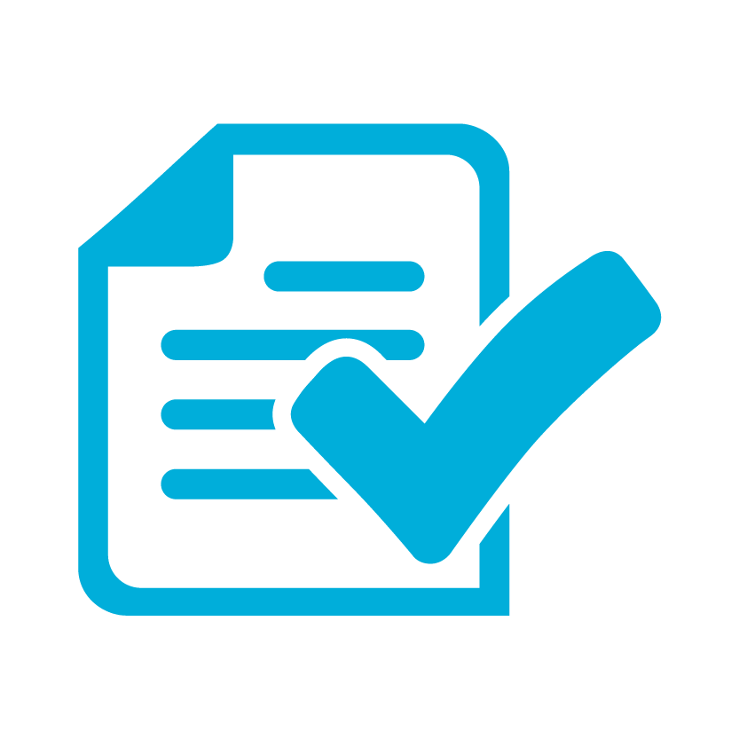
Azure Site Recovery
One solution for your entire Infrastructure
Business Continuity
DR Support for any Infrastructure on your on-premises (Hyper-V, VMWare, Physical)
Zero RPO/Near sync RPO solutions with Azure Site Recovery
Support for Enterprise Class Applications
Support for Enterprise scenarios: Shared Storage, raw devices, clustering, group consistency
Low TCO DR to Public Cloud or Service Provider Cloud
Simple, consistent, unified management experience

Slide 31
Related content
CDP-B319 Building Disaster Recovery-as-a-Service: New Opportunities for Service Providers with the Azure Pack and Azure Site Recovery
CDP-B328 Microsoft Migration Accelerator and Microsoft Azure Site Recovery Using InMage Scout
CDP-B314 Microsoft Azure Site Recovery: Leveraging Microsoft Azure as your Disaster Recovery Site
CDP-B339 Leveraging SAN Replication for Enterprise Grade Disaster Recovery with Azure Site Recovery and System Center
CDP-B239 How to Stay Calm When the Lights Go Out: Business Continuity in the Real World
CDP-B352 Stretching Failover Clusters and Using Storage Replica for Disaster Recovery in the Next Release of Windows Server
CDP-B334 Cloud Integrated Data Protection with System Center Data Protection Manager and Microsoft Azure Backup
CDP-B318 Building Scalable and Reliable Backup Solutions in the Next Release of Windows Server Hyper-V
CDP-B335 Hyper-V Best Practices for High-Availability with Failover Clustering
Find me later at the Business Continuity booth at the Microsoft Solutions Experience Location (MSE)
Find Me Later At Business Continuity Booth in the Cloud + Enterprise area

Slide 32
ASR resources
MKJain@microsoft.com
Documentation
  Tutorial
  Planning guide
  Deployment guide
Team Blogs:
  ASR: http://blogs.technet.com/b/scvmm/archive/tags/windows+azure+hyper_2d00_v+recovery+manager/default.aspx
  HVR: http://blogs.technet.com/b/virtualization/archive/tags/hvr/
Other blogs from MSFT
  In the Cloud – Brad Anderson’s blog post
  Scott Guthrie’s blog
  Windows Server blog with pointers to case studies

Slide 33
ASR Resources
Pricing Guide
Planning Guide
Capacity Planner Tool
Deployment Guide
Configuration Tutorials
WAN Optimization with Riverbed
InMage Website
ASR MSDN Forum
Azure Feedback Forum – ASR User Voice
ASR Wiki

Slide 34

For more information
Windows Server
Windows Server Technical Preview
http://technet.microsoft.com/library/dn765472.aspx
System Center
System Center Technical Preview
http://technet.microsoft.com/en-us/library/hh546785.aspx
Azure Pack
Azure Pack
  http://www.microsoft.com/en-us/server-cloud/products/
  windows-azure-pack
Microsoft Azure
Microsoft Azure
  http://azure.microsoft.com/en-us/
  Come visit us in the Microsoft Solutions Experience (MSE)!
  Look for the Cloud and Datacenter Platform area TechExpo Hall 7

Slide 35

Resources
Learning
  Sessions on Demand
  Microsoft Certification & Training Resources
http://channel9.msdn.com/Events/TechEd
www.microsoft.com/learning
TechNet
Developer Network
  Resources for IT Professionals
http://microsoft.com/technet
http://developer.microsoft.com

Slide 36


Azure
Exams
Developing Microsoft Azure Solutions
EXAM
532
Implementing
Microsoft Azure Infrastructure Solutions
EXAM
533
(Coming soon)
Architecting Microsoft Azure Solutions
EXAM
534
http://bit.ly/
Azure-Cert
+
Classroom
training
(Coming soon)
Microsoft Azure Fundamentals
MOC
10979
Developing Microsoft Azure Solutions
MOC
20532
Implementing
Microsoft Azure Infrastructure Solutions
2
5
MOC
20533
5
http://bit.ly/
Azure-Train
Online
training
(Coming soon)
Microsoft Azure Fundamentals
MVA
(Coming soon)
Architecting Microsoft Azure Solutions
MVA
http://bit.ly/
Azure-MVA
Get certified for 1/2 the price at TechEd Europe 2014!
http://bit.ly/
TechEd-CertDeal

Slide 37
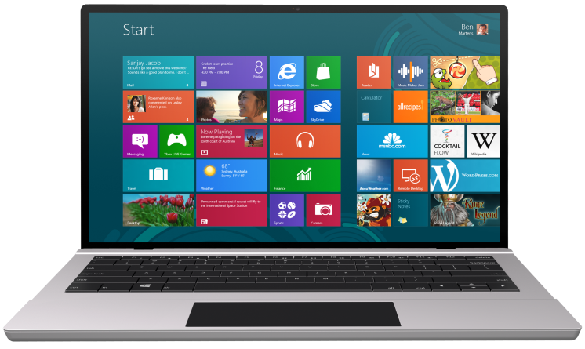


SUBMIT YOUR TECHED EVALUATIONS
We value your feedback!
Fill out an evaluation via
CommNet Station/PC: Schedule Builder
LogIn: europe.msteched.com/catalog
TechEd Mobile app
for session evaluations
is currently offline

Slide 38


© 2014 Microsoft Corporation. All rights reserved. Microsoft, Windows, and other product names are or may be registered trademarks and/or trademarks in the U.S. and/or other countries.
The information herein is for informational purposes only and represents the current view of Microsoft Corporation as of the date of this presentation. Because Microsoft must respond to changing market conditions, it should not be interpreted to be a commitment on the part of Microsoft, and Microsoft cannot guarantee the accuracy of any information provided after the date of this presentation. MICROSOFT MAKES NO WARRANTIES, EXPRESS, IMPLIED OR STATUTORY, AS TO THE INFORMATION IN THIS PRESENTATION.

Slide 39
Microsoft Azure Site Recovery
How it works: finalizing protection
Primary Site
10. Enable VM protection in VMM or in Azure Portal
System Center
Virtual Machine
Manager
AD
SQL
LOB
11. ASR uses the storage account specified and starts protecting using Hyper-V Replica Engine
IaaS Virtual Machine size picked based on on-premises VM
Secondary Site

Slide 40
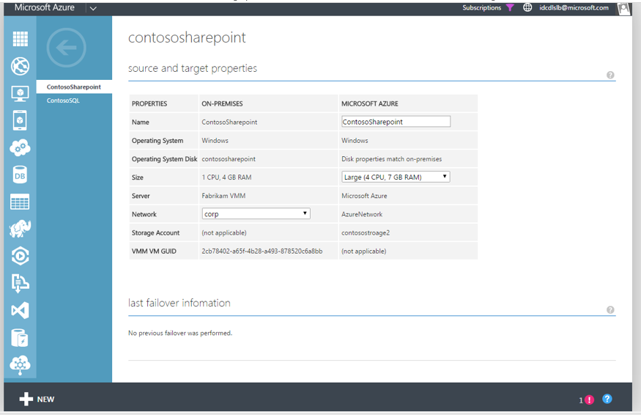
Microsoft Azure Site Recovery
  Enable Protection for a VM
Automatically map to closest Azure size - you can change.
Guest supported by Azure IAAS
VHDX is supported
Data VHD size supported upto 16TB
  16 disks of 1TB each
OS VHD size limited to 127 GB
Gen 2 not supported today

Slide 41

Microsoft Azure Site Recovery
How it works: recovery plans
Primary Site
System Center
Virtual Machine
Manager
AD
SQL
LOB
12. Create Recovery Plan
Secondary Site

Slide 42
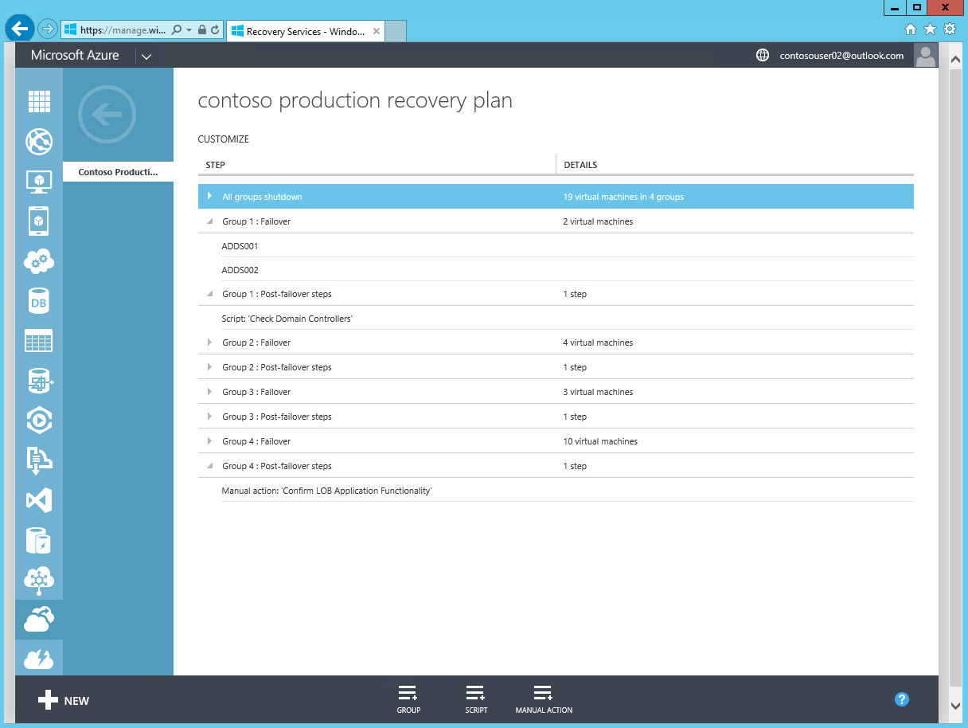
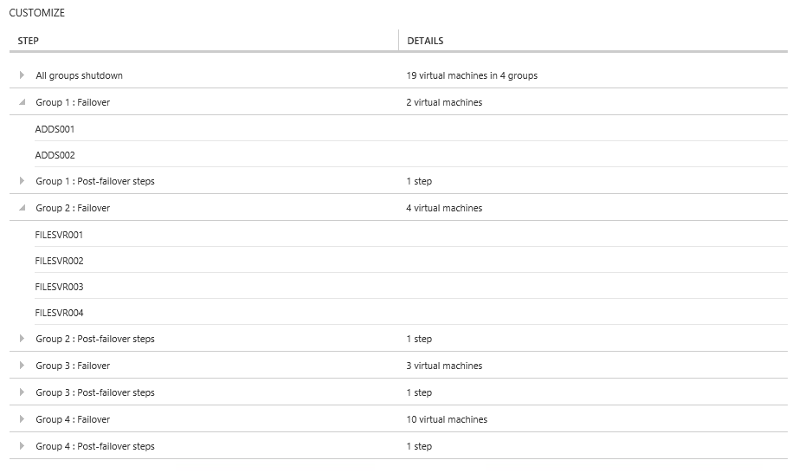
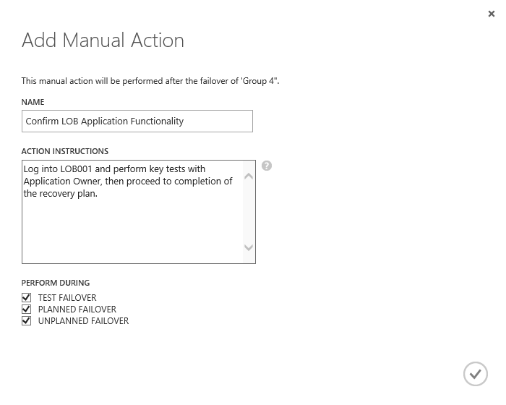
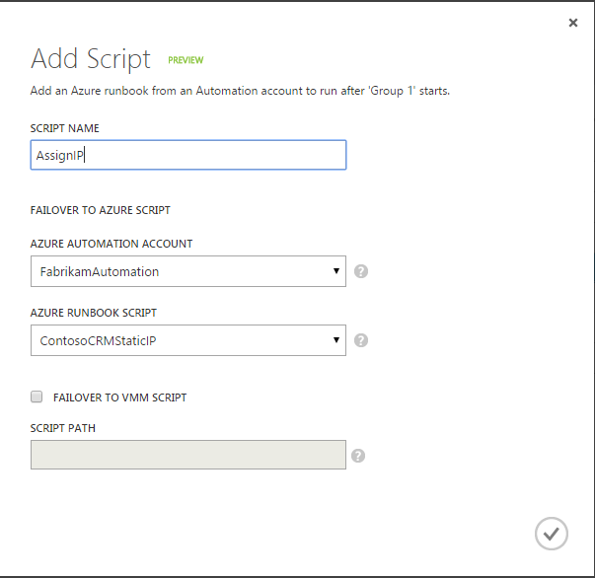
Microsoft Azure Site Recovery
Orchestrated recovery using recovery plans (RPs)
  Orchestrated steps for recovery: Recovery Plans help automate orderly recovery in the event of a site outage at primary DC.
  RPs typically model an application that needs to start up in a particular order.
  RPs consist of groups that contain list of protected virtual machines. The order the VMs failover is determined by the group they are within. VMs within a particular group failover in parallel.
  Script integration: Scripts can be added, to run before or after a specific group. Scripts could also allow integration with SQL Server AlwaysOn failover between sites.
  Manual actions: These can be added, to run before or after a selected group. These require some form of physical interaction by a user.

Slide 43
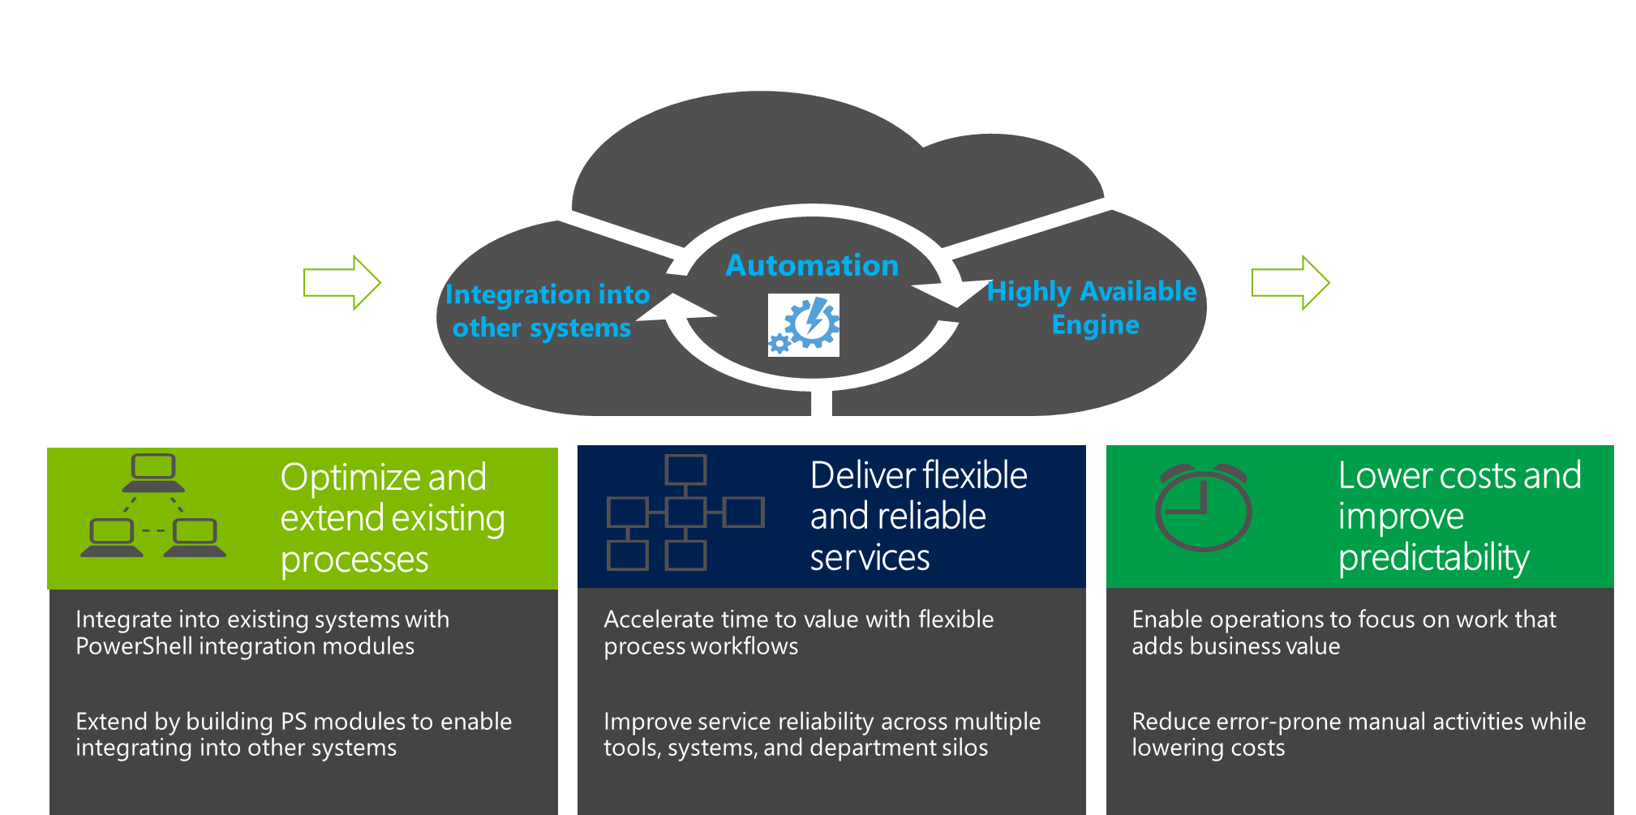
Azure Automation in each RP
Just announced general availability! Want to learn more?
CDP-B344 - Introduction to the New Microsoft Azure Automation Service (Oct 30th, 12 PM)

Slide 44

Microsoft Azure Site Recovery
How it works: Executing Recovery Plans
Primary Site
AD
System Center
Virtual Machine
Manager
AD
SQL
SQL
LOB
LOB
13. Execute Recovery Plan
15. When Primary Site is back online, execute a Failover to on-premises
14. Site Recovery Orchestrates VMs starting on Secondary Site
AD
SQL
LOB
Secondary Site

Slide 45
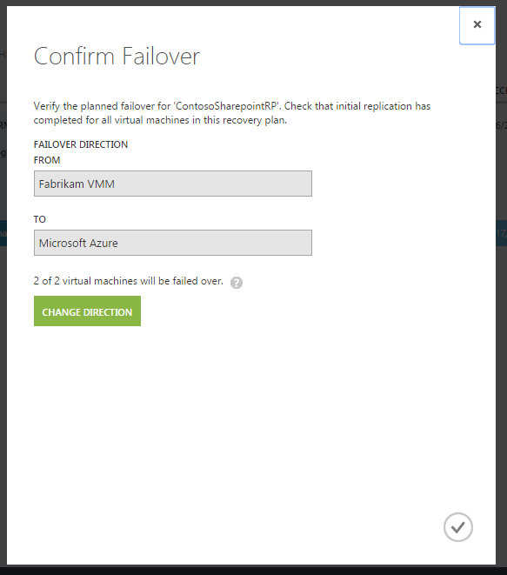
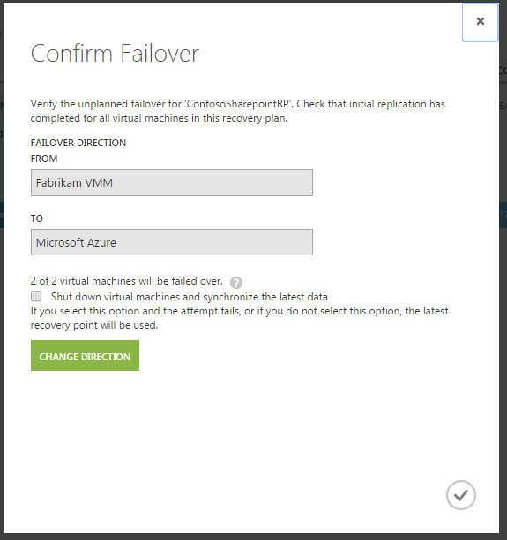
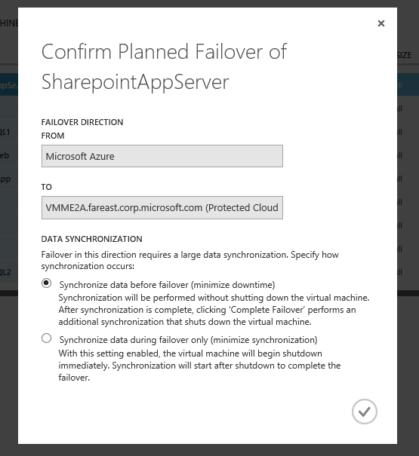
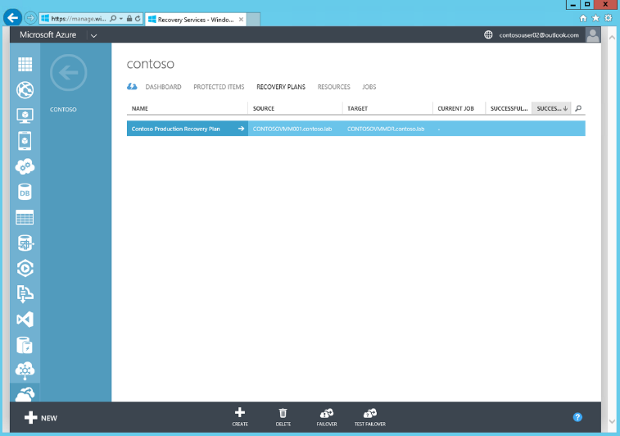
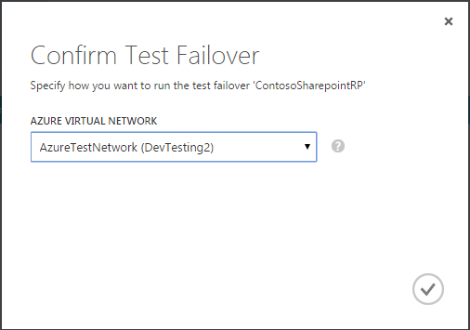
Microsoft Azure Site Recovery
Executing recovery plans
  Test failover: Useful to verify that your recovery plan and virtual machine failover strategy are working as expected.
  Simulates your failover and recovery mechanism into an isolated network(s), that you define, or that can be created automatically.
  Unplanned failover: Run an unplanned failover when a primary site experiences an unexpected incident, such as a power outage.
  Planned failover: Perform a complete failover and recovery in your recovery plans in a proactive, planned manner. Non-replicated changes are applied to the replica virtual machine loss before bringing the VM online ensuring zero data loss
  Flexible Failback: Flexible options for failback into on-premises environment.

