Slide 1


Slide 2

Running Linux in Microsoft Azure
Gebi Liang
CDP-B315

Slide 3
Why
Azure?
Hyper-scale
Enterprise Grade
Hybrid

Slide 4
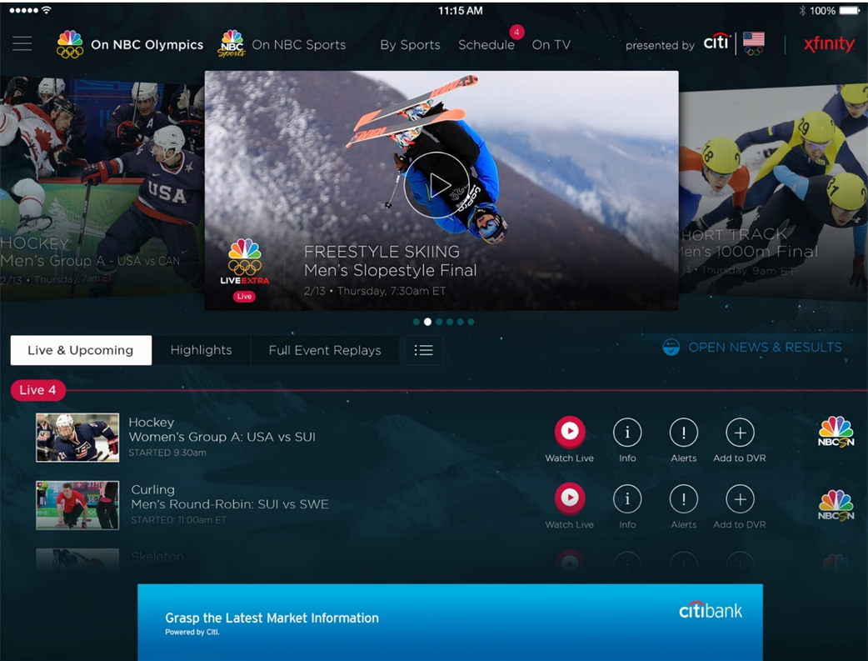
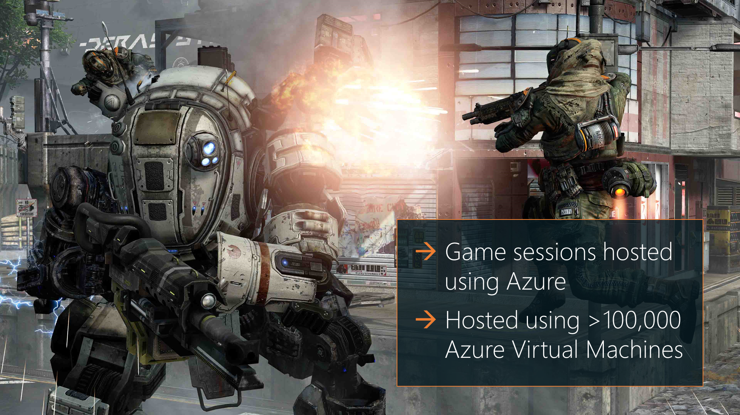

Olympics NBC Sports
Titanfall Launch
Hyper-scale
Live video encoding and streaming
Web + Mobile
100 Million viewers
2.1 Million concurrent HD viewers during the
US vs Canada hockey match
19 Regions around the world
Most regions of any public cloud provider
More coming !

Slide 5
Hyper-scale
Enterprise Grade

Slide 6
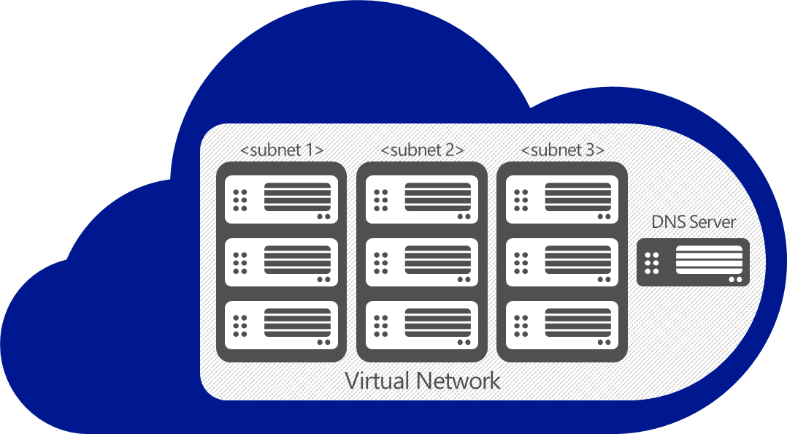

SSL (P2S)
VPN (S2S)
Partners (ExpressRoute)
WAN
Hyper-scale
GW
On-premises
Enterprise Grade
Hybrid
Enterprise Grade
VPN

Slide 7
Linux on Azure

Slide 8





Azure-Endorsed Linux Distributions
Created by partners, curated & tested by Microsoft
Standard Images
    Customers to contact Linux vendor/partner for Linux support
    Azure-related issues supported by Microsoft
Oracle
Linux
openSUSE
OpenLogic
CentOS-based
Canonical
Ubuntu
Premium Images
    Microsoft engages the Linux vendor/partner on behalf of the customer for support
    Includes updates, patches, and support through 24x7 web, email, chat and phone
    SUSE SLES 11SP3 only
SUSE Linux Enterprise Server

Slide 9
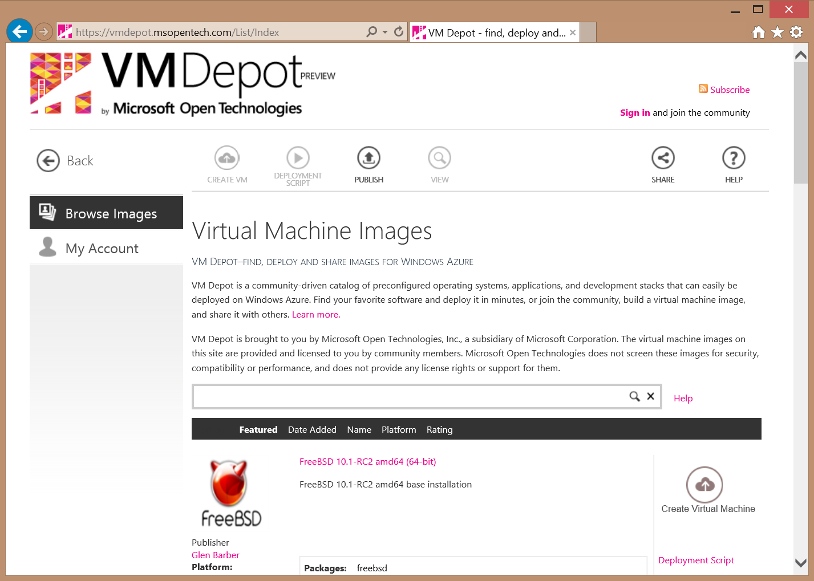











Getting Linux and FreeBSD Images
VM Depot
  Community created images made available through MSOPENTECH on VMDepot
  Available directly on VMDepot website for download, or browse/upload directly from Azure portal
Azure Marketplace
  1st party and 3rd party created and uploaded images
  Include both solution stacks and “vanilla” OS images
+ many more!

Slide 10
DEMO
Linux Images in Azure

Slide 11
Bring Your Own Linux or FreeBSD to Azure

Slide 12
What You Need to Do
Virtualize your OS on Hyper-V
Install the Microsoft Azure Linux Agent
Configure your VM for Azure

Slide 13
1 - Virtualizing Your OS on Hyper-V
Integration Services for Linux & FreeBSD
Hyper-V presents synthetic devices to the guest OS
  Synthetic devices seen by the guest OS are the same, regardless of the real hardware under Hyper-V
Guest OS needs drivers for these synthetic devices
  Just like an OS needs drivers for devices it sees when running on real hardware
Integration Services == the drivers for the Hyper-V synthetic devices
  They run in the guest OS so must follow the device driver model for that guest OS
  Also include some user-space daemons that interact with the drivers

Slide 14

Supported Linux Distributions
Kernel | Distribution | Version | LIS Availability
Red Hat Based | Red Hat Enterprise Linux and CentOS | 5.5 - 5.8, 6.0 – 6.3 | Download LIS 3.5 from Microsoft
 |  | 5.9, 5.10, 6.4 - 6.6 & 7.0 | LIS built-in and certified by Red Hat
 | Oracle Linux | 6.4, 6.5, 7.0 | LIS built-in and certified by Oracle
Oracle UEK | Oracle Linux | UEK R3 QU1, QU2, QU3 | LIS built-in and certified by Oracle
Linux Main | Ubuntu Server | 12.04 - 14.10 | LIS built-in
 | Debian | 7.0 - 7.4
 | SUSE Linux Enterprise Server | 11 SP2, 11 SP3, 12 | LIS built-in
 | openSUSE | 12.3
Kernel | Distribution | Version | LIS Availability
Red Hat Based | Red Hat Enterprise Linux and CentOS | 5.5 - 5.8, 6.0 – 6.3 | Download LIS 3.5 from Microsoft
 |  | 5.9, 5.10, 6.4, 6.5 | LIS built-in and certified by Red Hat
 | Oracle Linux | 6.4, 6.5 | LIS built-in and certified by Oracle
Oracle UEK | Oracle Linux | UEK R3 QU1, QU2 | LIS built-in and certified by Oracle
Linux Main | Ubuntu Server | 12.04 – 14.04 | LIS built-in
 | Debian | 7.0 - 7.4
 | SUSE Linux Enterprise Server | 11 SP2, 11 SP3 | LIS built-in
 | openSUSE | 12.3

Slide 15
2 - Azure Linux Agent
What It Does
  Provisioning of the image (host name, user account, SSH keys, disk mgmt)
  Manages networking (routes for DHCP servers, networking interface name)
  Kernel functions (virtual NUMA, Hyper-V entropy & SCSI timeouts)
  Redirects console to the serial port for debugging
How it Communicates
  A boot-time attached DVD for IaaS deployments.
  A TCP endpoint exposing a REST API used to obtain deployment and topology configuration.

Slide 16
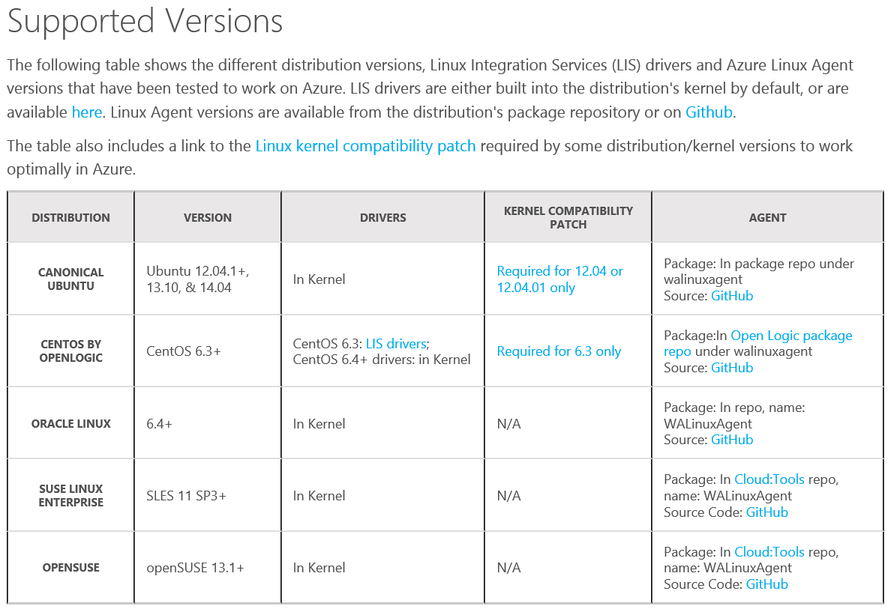
Azure Linux Agent Support Matrix

Slide 17
Installing the Azure Linux Agent
Available either included in Azure-endorsed Linux distributions or directly from Github
Installation using a RPM or DEB package is preferred
Manual installation by copying waagent to /usr/sbin/waagent and running:
# sudo chmod 755 /usr/sbin/waagent
# /usr/sbin/waagent -install -verbose

Slide 18
Azure Linux Agent Commands
install, uninstall, help, version
deprovision
  Deprovisions your VM in prep for provisioning in Azure
deprovision+user
  Deprovisions a previously run VM in Azure to enable capture and re-use
serialconsole
  Redirects output to ttyS0 for kernel bootup log for debuggin
daemon
  Runs the agent as a daemon to manage interaction with the platform

Slide 19
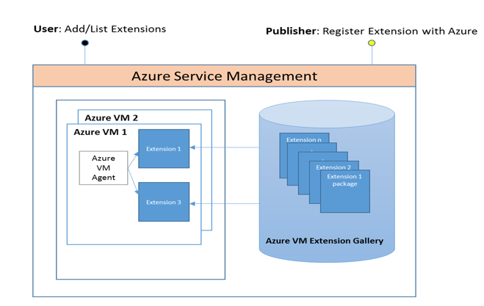
About VM Extensions
VM Extensions
  VM Extensions are software components that extend the functionality of the virtual machine
  Multiple extensions can be added, updated or removed
  Installed and managed by the Azure Linux Agent
Support for Linux
  The Azure Linux Agent can now support VM extensions
  Recent Ubuntu, SUSE and OpenLogic images have been updated to include the new agent

Slide 20
New VM Extensions for Linux
CustomScript: Run any script on a Linux VM
  Download files and run scripts from an Azure storage account
  Not limited to a specific scripting language
VMAccess
  Reset the password of the original provisioned user or create new user
  (Re)set SSH key for user
  Ensure SSH firewall port (22) is open
  Restore the SSH server configuration to a working default
OSPatching
  Extension enables scheduled/automatic updates for a Linux VM
  Coordinate patch schedule across multiple VMs
  Portal integration

Slide 21
DEMO
CustomScript & VMAccess VM Extensions

Slide 22
CustomScript Demo
$VmName = 'TechEdCScript'
#Parameter of extension
$fileUris = @("http://techedcustomscript.blob.core.windows.net/apache/install_apache.sh")
$commandToExecute = 'sh install_apache.sh'
#Type/name of the extension
$ExtensionName = 'CustomScriptForLinux'
$Publisher = 'Microsoft.OSTCExtensions'
$Version = '1.1'
[hashtable]$Param=@{};
$Param['fileUris'] = $fileUris;
$Param['commandToExecute'] = $commandToExecute;
$Param['timestamp'] = (Get-Date).Ticks
$PublicConfiguration = ConvertTo-Json $Param;
$vm = get-azurevm -ServiceName $VmName
$vm = Set-AzureVMExtension -ExtensionName $ExtensionName -VM $vm -Publisher $Publisher -Version $Version -PublicConfiguration $PublicConfiguration
$vm | Update-AzureVM

Slide 23
VMAccess Demo
$VmName = "TechEdVmAccess"
#Parameter of extension
$UserName = "azureuser"
$Password = "User@123"
#Type/name of the extension
$ExtensionName = 'VMAccessForLinux'
$Publisher = 'Microsoft.OSTCExtensions'
$Version = "1.0"
[hashtable]$Param=@{};
$Param['username'] = $UserName;
$Param['password'] = $Password;
$Param['expiration'] = '2016-01-01';
$PrivateConfig = ConvertTo-Json $Param;
$vm = get-azurevm $VmName
$vm = Set-AzureVMExtension -ExtensionName $ExtensionName -VM $vm -Publisher $Publisher -Version $Version -PrivateConfiguration $PrivateConfig
$vm |Update-AzureVM

Slide 24
VM Extensions for LInux
Released
CustomScript
VMAccess
OSPatching
Chef
Accessing the Extensions
Scripting: PowerShell, Xplat
Azure portal
Upcoming
VMSnapShot
VMMonitoring
DSC
VMEncryption

Slide 25
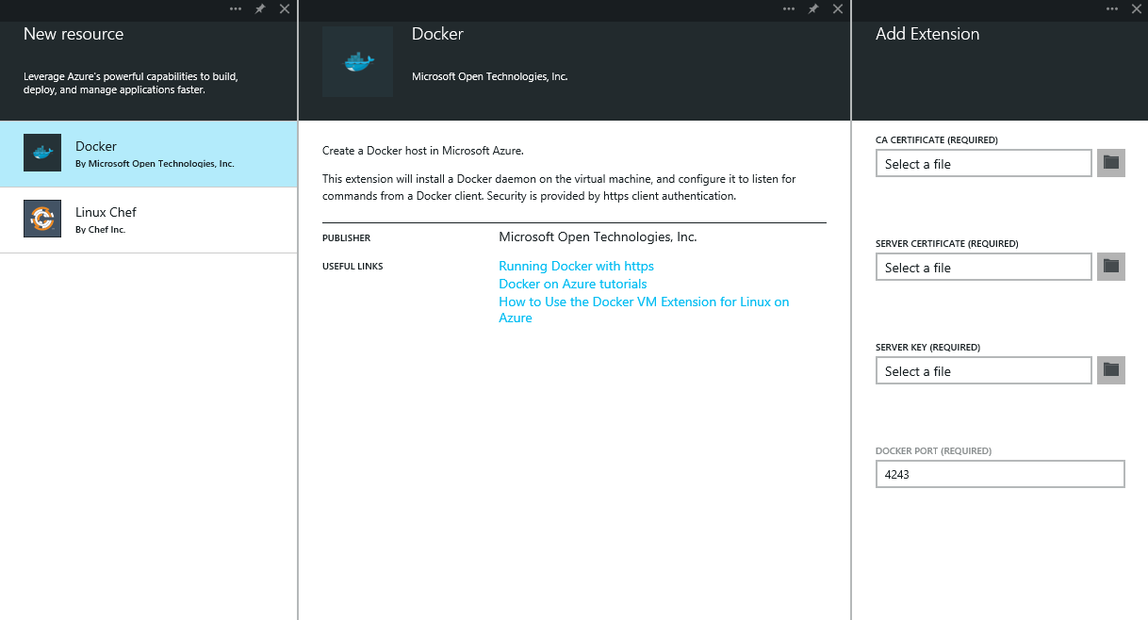
Partner Extensions
Chef: Client for Linux VMs
  Linux and Windows extension developed by Chef
  Currently supports Ubuntu and CentOS* VMs
    *Only Ubuntu VMs supported via portal currently
    http://azure.microsoft.com/blog/2014/04/16/freakin-delightful/
Docker
  Deploy Docker onto an Azure virtual machine via a VM extension
  Updates to CLI tools to easily deploy Docker-enabled VMs (Ubuntu)
  http://msopentech.com/blog/2014/06/09/docker-on-microsoft-azure/

Slide 26
3 - Configure Your VM for Azure
Prepare your VM to be uploaded to Azure
Create a storage account in Azure
Prepare the connection to Azure
Uploading the image to Azure

Slide 27
Preparing your VM for Upload
This is just a summary – there are different steps for different Linux distros
  Refer to this link for more info: http://azure.microsoft.com/en-us/documentation/articles/virtual-machines-linux-create-upload-vhd/#prepimage
Convert VHDX to VHD in Hyper-V Manager
Use standard partitions rather than LVM
Do not create swap space on the OS disk
Ensure SSH server is installed & configured to start on boot
Deprovision the VM

Slide 28
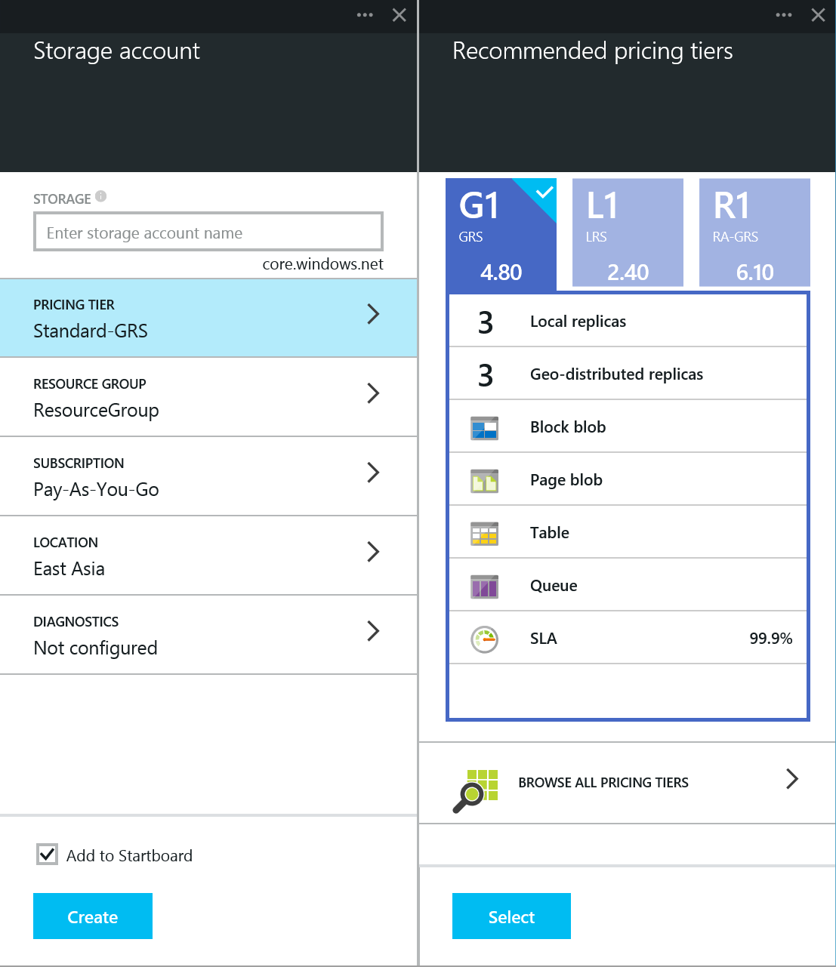
Create an Azure Storage Account
Enabling geo-distributed replicas recommended

Slide 29
Preparing the Connection to Azure
Adds the Azure account to Azure Powershell
Selects Azure subscription
  SubscriptionName is the name of the subscription that the Azure PowerShell cmdlets will use to read default values
Add-AzureAccount
Select-AzureSubscription –Subscriptionname $name

Slide 30
Uploading Your Image to Azure
From Azure PowerShell
  BlobStorageURL is the URL for the storage account that you created
  YourImagesFolder is the container within blob storage where you want to store your images
  VHDName is the label that appears in the Management Portal to identify the virtual hard disk.
  PathToVHDFile is the full path and name of the .vhd file.
‘Add-AzureVhd –Destination <BlobStorageURL>/<YourImagesFolder>/<VHDName> -LocalFilePath <PathToVHDFile>’

Slide 31
Middleware Deployment Guidance
Azure Deployment Guidance
Provide best Middleware deployment experience with Azure
Install, Config, performance tuning and best practices
Focusing on Top OSS Middleware
Tested on all supported distro for Azure
Long term: Developing tools/ solutions
Major Documents:
MySQL Performance Tuning
MySQL Cluster and HA
LAMP Stack/Tomcat Deployment
Hadoop/MongoDB/Cassandra Deployment
Incoming:
LDAP; SSL Load Balancer; Tomcat Cluster, Jboss
More… (open to suggestions)

Slide 32
In Summary
Azure is the best cloud for running your business from anywhere in the world
Support for Linux and FreeBSD in Azure is getting stronger everyday
Getting your Linux or FreeBSD workload into Azure is easy, using the tools you are familiar with

Slide 33
Microsoft
♥
Linux

Slide 34
Related content
Linux “Ask the Experts” – Today @ 6:30 in Hall 5, Table 13
Running Linux & FreeBSD on the Next Release of Windows Server CDP-B233

Slide 35
Links of Interest
Azure VM Linux Extension in Github
https://github.com/Azure/azure-linux-extensions
Linux/FreeBSD Virtual Machines on Hyper-V
  http://technet.microsoft.com/en-us/library/dn531030.aspx
Linux/FreeBSD Integration Services for Microsoft Hyper-V Forum
  https://social.technet.microsoft.com/Forums/en-US/home?forum=linuxintegrationservices&filter=alltypes&sort=lastpostdesc

Slide 36
Track resources
  https://github.com/Azure/azure-linux-extensions
Azure Linux VM Extensions in Github
  https://github.com/Azure/azure-linux-extensions
Resource 3
Resource 4

Slide 37

For more information
Windows Server
Windows Server Technical Preview
http://technet.microsoft.com/library/dn765472.aspx
System Center
System Center Technical Preview
http://technet.microsoft.com/en-us/library/hh546785.aspx
Azure Pack
Azure Pack
  http://www.microsoft.com/en-us/server-cloud/products/
  windows-azure-pack
Microsoft Azure
Microsoft Azure
  http://azure.microsoft.com/en-us/
  Come visit us in the Microsoft Solutions Experience (MSE)!
  Look for the Cloud and Datacenter Platform area TechExpo Hall 7

Slide 38

Claim your Visual Studio Online domain
MSDN subscribers, activate your Azure
benefits now
Simply get started @ http://aka.ms/teched-eu

Slide 39


Azure
Exams
Developing Microsoft Azure Solutions
EXAM
532
Implementing
Microsoft Azure Infrastructure Solutions
EXAM
533
(Coming soon)
Architecting Microsoft Azure Solutions
EXAM
534
http://bit.ly/
Azure-Cert
+
Classroom
training
(Coming soon)
Microsoft Azure Fundamentals
MOC
10979
Developing Microsoft Azure Solutions
MOC
20532
Implementing
Microsoft Azure Infrastructure Solutions
2
5
MOC
20533
5
http://bit.ly/
Azure-Train
Online
training
(Coming soon)
Microsoft Azure Fundamentals
MVA
(Coming soon)
Architecting Microsoft Azure Solutions
MVA
http://bit.ly/
Azure-MVA
Get certified for 1/2 the price at TechEd Europe 2014!
http://bit.ly/
TechEd-CertDeal

Slide 40
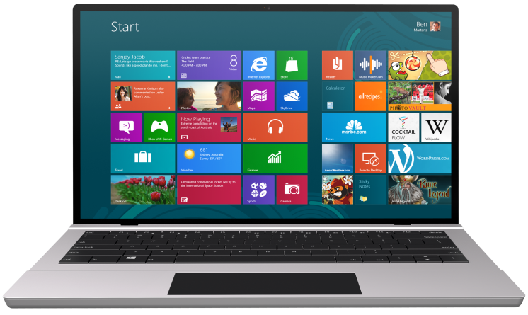


SUBMIT YOUR TECHED EVALUATIONS
We value your feedback!
Fill out an evaluation via
CommNet Station/PC: Schedule Builder
LogIn: europe.msteched.com/catalog
TechEd Mobile app
for session evaluations
is currently offline

Slide 41

Resources
Learning
  Sessions on Demand
  Microsoft Certification & Training Resources
http://channel9.msdn.com/Events/TechEd
www.microsoft.com/learning
TechNet
Developer Network
  Resources for IT Professionals
http://microsoft.com/technet
http://developer.microsoft.com

Slide 42

© 2014 Microsoft Corporation. All rights reserved. Microsoft, Windows, and other product names are or may be registered trademarks and/or trademarks in the U.S. and/or other countries.
The information herein is for informational purposes only and represents the current view of Microsoft Corporation as of the date of this presentation. Because Microsoft must respond to changing market conditions, it should not be interpreted to be a commitment on the part of Microsoft, and Microsoft cannot guarantee the accuracy of any information provided after the date of this presentation. MICROSOFT MAKES NO WARRANTIES, EXPRESS, IMPLIED OR STATUTORY, AS TO THE INFORMATION IN THIS PRESENTATION.

