Slide 2

Cluster-in-a-Box Meets Datacenter Convergence: Redefining Successful Private Cloud Deployments
John Loveall
Principal Program Manager
Microsoft
CDP-B321

Slide 3
Topics
The Cluster in a Box (CiB) Strategy
How Microsoft designed Windows Server to create converged systems
New CiB Solutions
  New generations of hardware and new product offerings for 2014
CiB Customer Applications
  Businesses building converged datacenters with CiB systems
Scaling Windows Storage to the Datacenter
  Beyond CiB: Extending Windows storage to Enterprise and Microsoft Cloud Platform System

Slide 4
The Cluster in a Box (CiB) Strategy
How Microsoft designed Windows Server to create converged systems

Slide 5

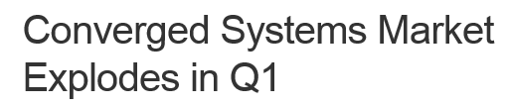

Converged infrastructure driving enterprise IT growth
Analysts forecast growth in the converged systems market ranging from 30 to 50+% through 2017

Slide 6
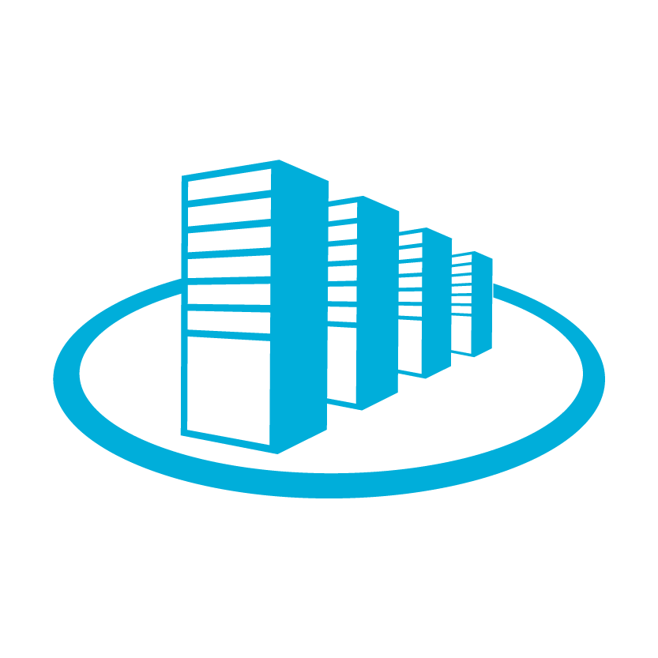
What are converged systems?
Hardware + Software
Customer does not have to do integration. One support call.
Compute + Storage + Networking
Full hardware solution
Integrated management tools
Full software solution (“Platform” or “Stack” systems include applications)
Leverages “software-defined”
Volume hardware and software-defined subsystems
Enabled for scale out and availability
Expansion simplified by scale-out support and integrated high-availability

Slide 7
Building a converged system:
Windows Server CiB
Building on CiB
Windows Storage Server 2008 R2
Windows Server 2012
Windows Server 2012 R2
Beyond CiB
High availability storage simplified
CiB debut: 2 node Hardware + Software
Integrated, single-pane server management
Scale Out File Server
Software defined storage (Storage Spaces)
Compute + Storage + Networking: First CiB with integrated switch
Scale Out: 4 node CiBs and SOFS enhancements
Microsoft Cloud Platform System
4 to 8 node enterprise storage systems
Storage Hardware + Software
Single pane clustering setup
CiB scales
CiB debuts

Slide 8
Extending the market for converged systems
CiB systems expand choices of cost and features
Features
Classic server system markets
High Availability
Simple OOBE
Storage Spaces configurations
HW RAID capability
SSD perf capability
Market expansion with CiB systems
Scale out Server Cluster
Cluster in a Box
Storage Arrays
(iSCSI/FC, SMB/NFS)
Optional JBOD
storage expansion
Extended scale out
Advanced replication
Advanced power management
Advanced performance options
…
Target markets for Cluster in a Box solutions
SMB
Branch
Private Cloud
Small to medium hosters
Single node servers
JBOD storage
$$
IT
Expertise
IT Generalist
IT Specialist
PB 1 - 3
PB 4+

Slide 9
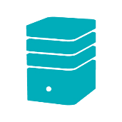

What hardware?
What are the hardware design goals for CiB?
What are the best system configurations?
Availability: Service and data remain available despite the failure and repair of any single component
Simplicity: Pre-configured, pre-cabled
Flexibility: Hardware expansion, placement, power
How can standard servers and direct-attached storage be used to build economical, high-availability systems?
How can systems be designed and prepared for fast, simple deployment?

Slide 10
System Design Considerations for CiBs
2-node Design Example (with Direct-Attached SAS)
Availability
At least one node and storage always available, despite failure or replacement of any component
Dual power domains
1/10G E or Infiniband
1/10G E or Infiniband
Network
Network
Server Enclosure
x8 PCIe
x8 PCIe
Server A
Server B
CPU
1/10G Ethernet cluster
connect (through midplane)
CPU
x8 PCIe
x8 PCIe
Simplicity
Pre-wired, internal interconnects between nodes, controllers, and storage
Storage Controller
x4 SAS (through midplane)
Storage Controller
x4 SAS
x4 SAS
SAS Expander
0
1
23
B ports
SAS Expander
A ports
…
Flexibility
PCIe slots for flexible LAN options
External SAS ports for JBOD expansion
Office-level power, cooling, and acoustics
to fit under a desk
External JBOD
SAS Expander
1
B ports
SAS Expander
0
…
23
A ports
Additional JBODs …

Slide 11



Component-level recommendations *
Storage vs. Hyper-V Server
Storage
Hyper-V
Entry to Medium: Single CPU/node
Performance with Dedup
  Consider 2nd CPU for large, active datasets (>1GB/s throughput)
PCIe
  Entry: 1 available x8 slot
  Performance: 2-3 available x8 slots
Entry: 8 cores (per server node)
For large capacity: 16+ cores (per server node)
PCIe
    Entry to medium capacity: 1 available x8 slot
CPU
Recommend 64GB per node
    Entry configuration: 32GB
Performance with dedup
  Consider additional memory for large, active datasets (>1GB/s throughput)
Entry: 128GB
For large capacity: >128GB
Memory
Heartbeat connection
  Recommend 10GbE
  Entry: 1GbE
External
  10+GbE or IB, with RDMA
  2x per server node
Heartbeat connection
  Recommend 10GbE
  Entry: 1GbE
External
  Entry: 2x 1GbE
  Large capacity: 2x 10GbE (also for scale out)
Network
SAS
Entry: HDDs acceptable
Recommend addition of SSDs
SAS
HDDs acceptable
Consider SSDs for I/O intensive workloads
Drives
* Note: These are guidelines only. System results are significantly dependent on the specific workloads and overall system configurations.

Slide 12
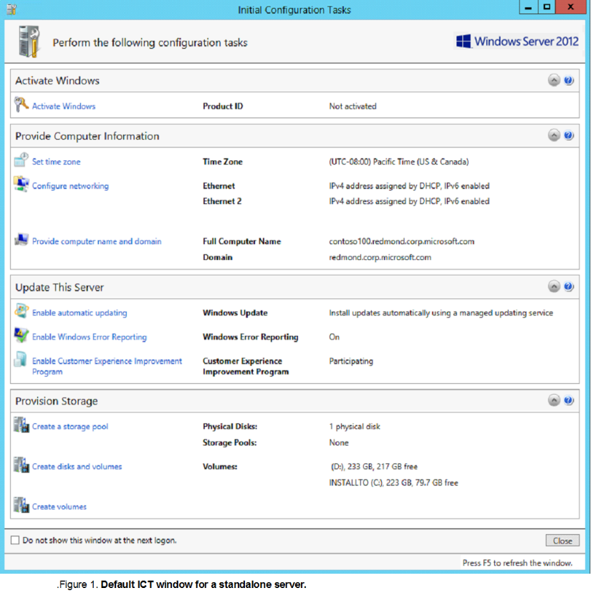
Out of Box Experience (OOBE)
Easy setup of Cluster in a Box systems
Fast
  ~10-40 minutes from power-on to operation
Simple
  Minimal steps with guided workflow
Single console
  Configure CiB’s from only one node
Extensible
  Customization framework enables unique OEM tasks that can include proprietary tools.

Slide 13
Video
Setting up a cluster in minutes using the Windows Server OOBE

Slide 14
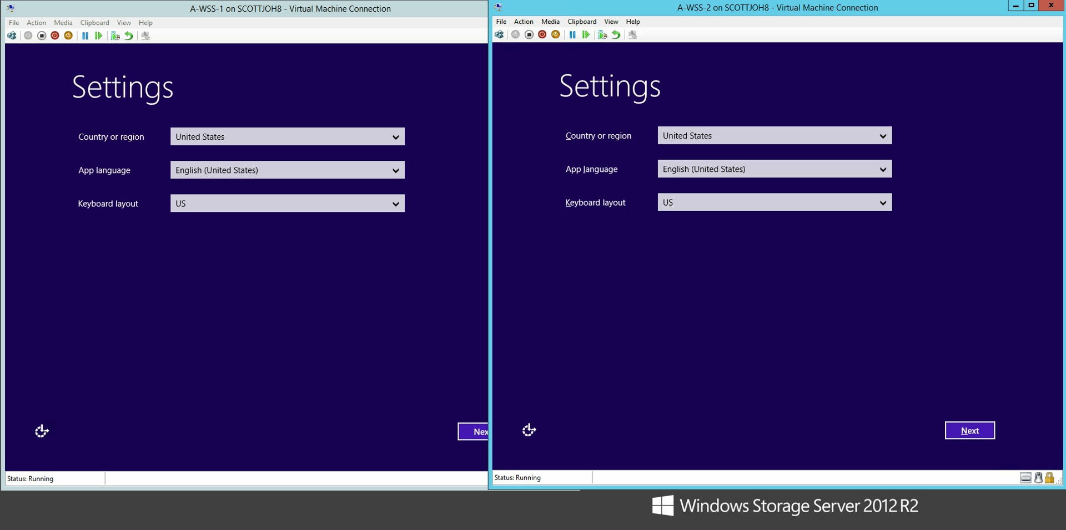
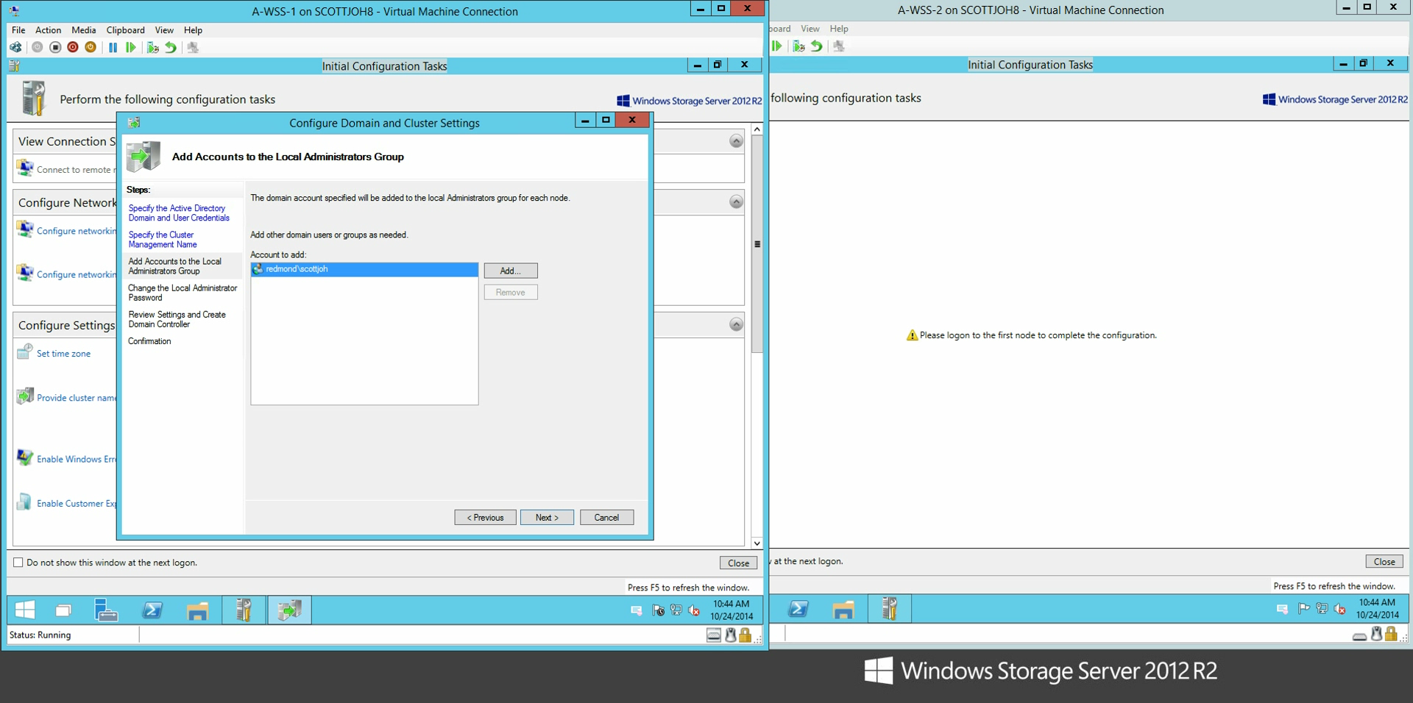
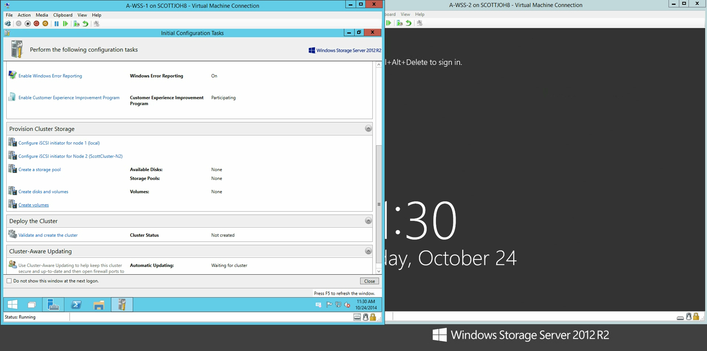
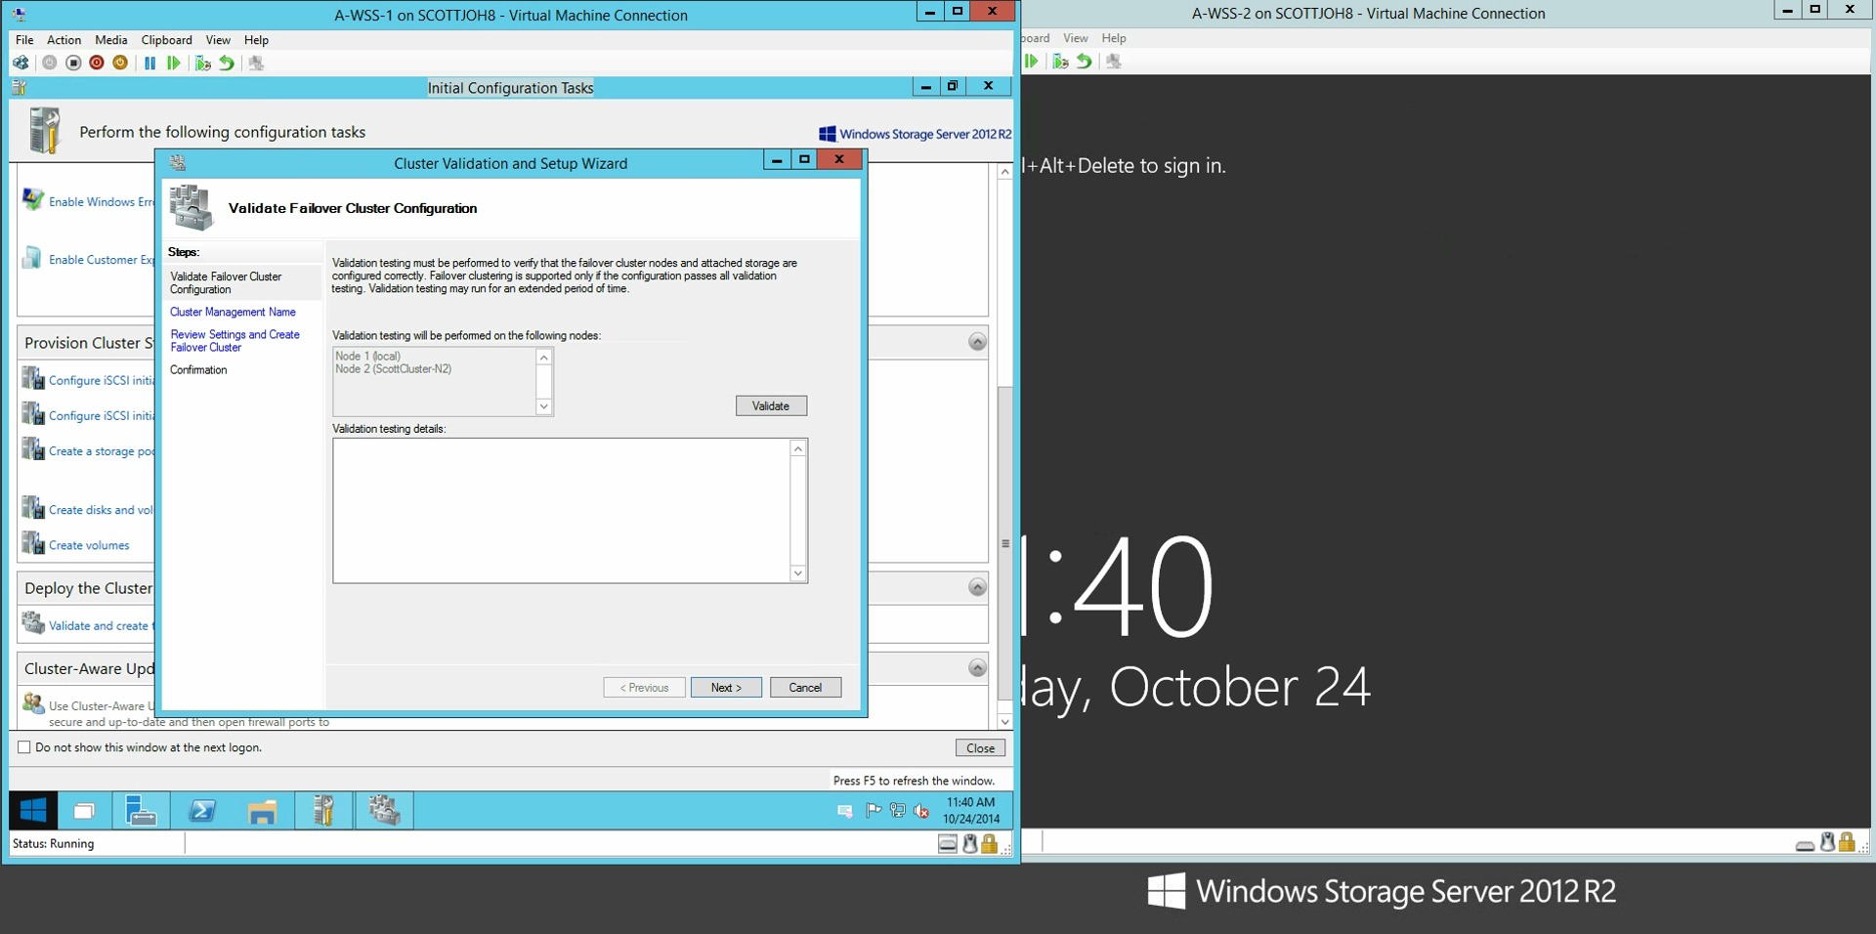
Node discovery and initial settings
Automated node discovery
Welcome Windows settings
0:00
0:04
Domain and cluster settings
Domain joined
Cluster settings updated
All nodes rebooted automatically
0:14
Provision clustered storage
Data & witness disks created & formated
0:19
Deploy cluster
0:21
Cluster created and ready!
    See step-by-step article on Technet: http://aka.ms/4nodeOOBE

Slide 15
New CiB Solutions
New generations of hardware and new product offerings

Slide 16
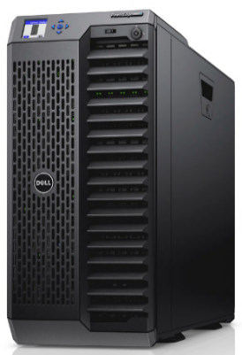
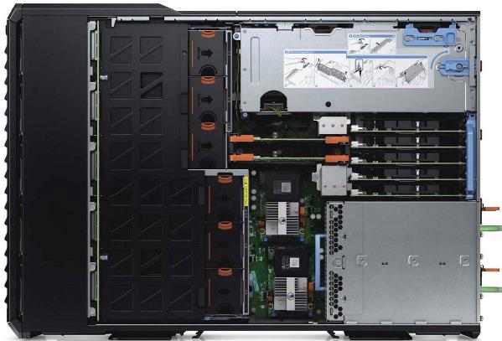
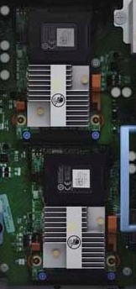
Dell PowerEdge VRTX
Shipping optional redundant PowerEdge Raid Controller (PERC)
  Provides fault tolerance within the chassis
  Active-Passive configuration
    If the Active PERC fails, the Passive PERC will become Active with no user intervention
    At TechEd TechExpo
    Booth 201
Dell PowerEdge VRTX
4-node Windows Server Cluster in a Box
Office level acoustics and power

Slide 17
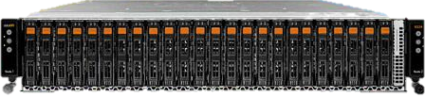
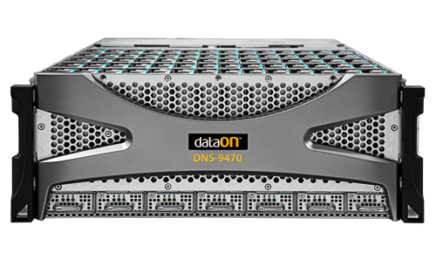
DataON
New CiB solutions for 2014
CiB-9224 Cluster-in-a-Box
  2U, 24-bay 2.5” Dual Node
  Next-generation Intel Xeon platform
  12Gb/s SAS
CiB-9740v2 Cluster-in-a-Box
  4U 70-bay 3.5” Dual Node
  12Gb/s SAS
  420TB capacity in a 4U (with supported 6TB drives)
DataON Management Utility Setup Tool (MUST™)
OOBE setup wizard
Storage/hardware status monitoring, event logs, alert notification
Recovery, including re-installation
Performance , with data collection and analysis
    At TechEd TechExpo
    Booth 10

Slide 18
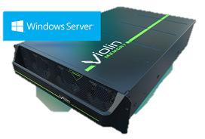
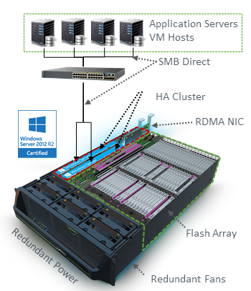
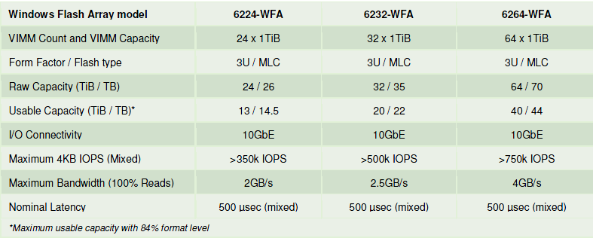
Violin Memory
Shipping Windows Flash Array (WFA)
    At TechEd TechExpo
    Booth 66
Windows Storage Server 2012 R2
Dual compute nodes (memory gateways)
  Each compute node has:
  Two Intel Xeon E5-2448L processors (8 cores, 20MB L3 cache)
  24GB of memory (upgradeable to 48GB)
Storage
  Violin Intelligent Memory Modules (VIMMs)
RDMA NIC options
  Chelsio T-520CR Dual-Port 10 Gigabit Ethernet adapters
  Mellanox ConnectX-3 Dual-Port VPI adapters (MCX354A-FCBT), 56Gb/s Infiniband or 40/56 Gigabit Ethernet per port
    Download new Microsoft whitepaper:
    Building High Performance Storage for Hyper-V Cluster on Scale-Out File Servers using Violin Windows Flash Arrays
    http://www.microsoft.com/en-us/download/details.aspx?id=44300

Slide 19
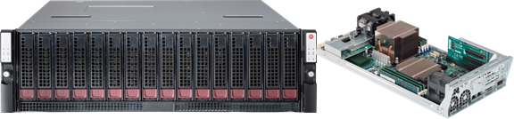
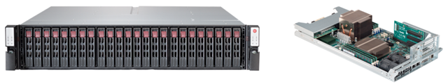
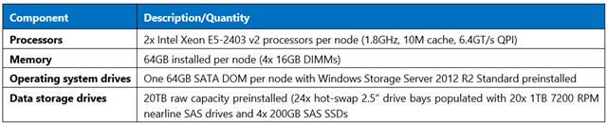
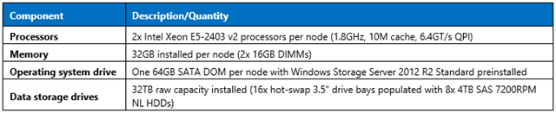
SuperMicro
Shipping two new Windows Storage Server 2012 R2 CiB storage solutions
Capacity: SSG-6037B-CIB032
3U, 16-bay, supports 16x 3.5" hot-swap drives (SAS1/SAS2) Raw capacity of 64 terabytes (TB) when fully populated with 4TB 3.5” SAS drives
Performance: SSG-2027B-CIB020H
2U, 24-bay, ships with 20x 1TB 2.5” hot-swap nearline SAS drives and 4x 200GB SAS SSDs.

Slide 20
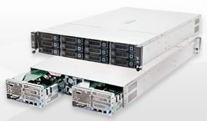
Quanta
Shipping upgraded Windows Storage Server 2012 R2 CiB
CB220
Windows Storage Server 2012 R2 Standard Edition
2U Chassis, 2 nodes
(2) Intel® Xeon® E5-2609 per node
(12) 2.5" or 3.5" SASII hot-plug HDDs per system
(2) 2.5" internal SATA for OS installation per node
Up to 48 TB (raw) internal capacity
(1) PCIe G3 x8 riser card for (1) PCIe slot and (1) Mezz slot
Value SKU
32 GB 1333MHz DDR3 RDIMM per node
Storage controller
  LSI SAS HBA 9211-8i
NICs:
  (2) Intel® I350 GbE RJ45 ports per node
Performance SKU
64 GB 1333MHz DDR3 RDIMM per node
Storage controller
  LSI Syncro CS
NICs:
  (2) Intel® I350 GbE RJ45 ports per node and (2) Intel® 10GbE SFP+ ports per node

Slide 21
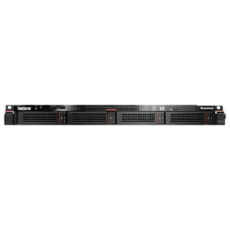
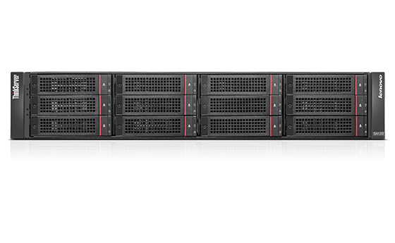
Lenovo
Shipping CA storage and application server configurations based on Windows Server 2012 R2 and LSI Syncro CS clustered RAID
ThinkServer RD340 / RD640 + SA120
1U or 2U servers
  2U rack-mountable disk array with 12 x 3.5" hot-swap HDD bays
ThinkServer Syncro CS 9286-8e 6Gb High Availability Enablement Kit by LSI®
“Microsoft® Windows® Server 2012 R2 features robust management tools and sophisticated virtualization features … for storage cluster deployments or … for application cluster failover.”
Lenovo

Slide 22
CiB Customer Applications
Businesses building converged datacenters with CiB systems

Slide 23
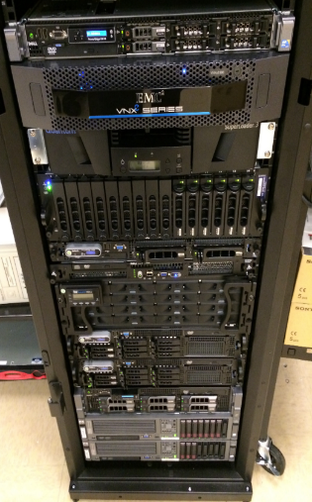
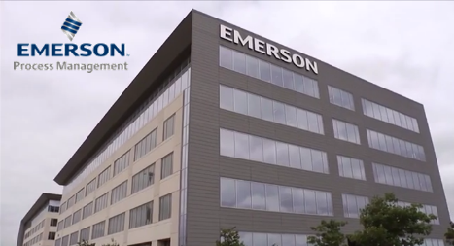
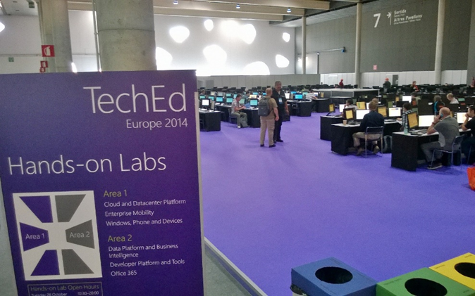
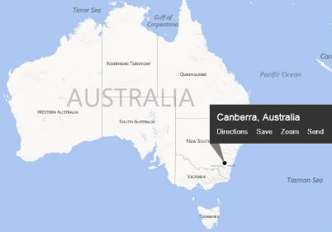
Case 1
Getting aging infrastructure under control
Upgrading the datacenter for a medium-sized business
Case 2
Make new deployments simple
Deploying new datacenters for multiple clients
Case 3
The need for speed
Using high-performance Windows storage for demanding datacenter requirements
Case 4
10,000+ VMs a day, every day
High-availability storage for the TechEd Hands-On Labs

Slide 24




Case 1: Virtualization server
Getting aging infrastructure under control
Biotech – Aaron Marks (DataON)
Customer
  Biotech company (Seattle-based, publically traded) creating oncology products that improve the lives and outcomes of cancer patients.
  Focus on therapeutic candidates aimed at targeting cancer in specific/effective ways
  Pipeline includes synthetic vaccines for a variety of cancer indications
IT Provider
Aaron Marks IT Consulting,
IT services and solution provider
Problem
Current production servers aging, ranging in age from 4-10 years old
Need for modernization and infrastructure restructuring
Upgrades needed for performance, security, compliance, and to enable the implementation of new technology solutions.

Slide 25

Biotech – Aaron Marks (DataON)
Workloads
Virtualized
AD FS 2.0 Proxy Server
AD Server – Tertiary (DC/GC/DNS)
Azure Active Directory (AAD) Sync + AD FS 2.0
BES 5 Server (Windows Server 2008)
CentOS Linux: Asterisk Server for VoIP conference phones
Exchange 2013 Hybrid Coexistence Server
Linux: VMware vCenter 4.1 Server
Management Server (RSAT + Other Tools)
Server 2008 R2 SSTP/PPTP VPN + ‘Remote Desktop Gateway’ Server
SharePoint 2007 Server
SharePoint 2010 Server
SharePoint 2013 Server
SQL Server 2008 R2 Standard
Ubuntu Linux: Clinical MySQL Database
Ubuntu Linux: Lab backups
Ubuntu Linux: Lab Freezer Monitoring
Ubuntu Linux: Lab MySQL Database
Physical
AD (DC/GC, DHCP)
AD (DC/GC, NPS, AD CS)
BackupExec 2010 R3
ERP application
ERP Terminal Server
Exchange 2007 Server
File servers (2)
Print server
SQL Server 2005 Standard (ERP SQL)
Previous hardware
Virtualization servers, vSphere 4.1 (2)
Dell R610, 64GB RAM, RAID1 146GB 15k SAS, 8x1GbE
Dell R620, 64GB RAM, RAID1 146GB 15k SAS, 8x1GbE,
Physical Servers (9)
Dell PowerEdge 2950, 16GB, 3x73GB 10k SAS, 4x1GbE
Dell PowerEdge 2950, 16GB, 3x73GB 10k SAS, 4x1GbE
Dell PowerEdge 1950, 16GB, 250GB (7.2k SATA), 2x1GbE
Dell R200, 4GB, 2x 160GB, 2x 1GbE
Dell R200, 4GB, 160GB (2x 160GB 7.2k SATA), 2x 1GbE
Dell R710, 4GB, 5x500GB RAID5, 4x1GbE
HP, 16GB, 3x RAID1 73GB SAS, 4x1GbE
HP, 16GB, 1x RAID1 73GB SAS, 4x1GbE
HP, 16GB, 1x RAID1 73GB SAS, 4x1GbE
Storage (3)
Dell MD3000 SAS DAS, 5TB (6x1TB 3.5” 7.2k RAID5)
EMC VNXe iSCSI SAN, 10TB (12x1TB 3.5” 7.2K RAID6)
Fiber Channel DAS, 2.4TB (16x300GB 3.5” 15k RAID6)
Photo courtesy Aaron Marks IT Consulting

Slide 26

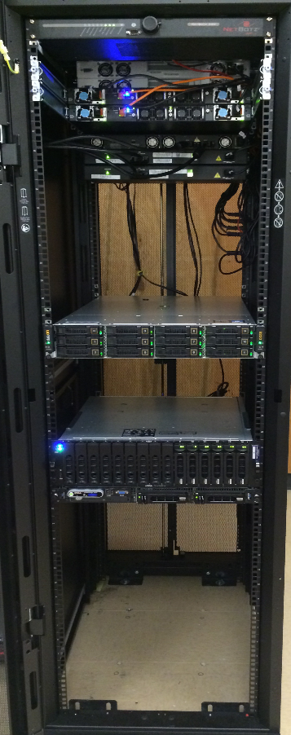
Biotech – Aaron Marks (DataON)
CiB solution
Workloads
All workloads running as Hyper-V VMs on CiB
  Windows Server 2012 R2 Datacenter
Servers + Storage
DataON CiB-9220V:
  Per node:
    256GB RAM, 128GB SSD SATA RAID1, 2x10GbE built-in + 2x10GbE SFP+
  Internal SAS JBOD:
    Storage Spaces Pool: 4x 200GB STEC SSD, 8x 4TB 7.2k SAS
      Storage Spaces Virtual Disks: 6TB Tiered Mirrored (primary VM storage), 4GB Mirrored (quorum), 8TB Parity (Local backup storage),
      Clustered Volumes: 6TB ReFS CSV for VMs, 4GB NTFS Quorum, 8TB ReFS CSV for Backups
Photo courtesy Aaron Marks IT Consulting

Slide 27
Results
✓ SOX compliance
  Compliance report reduced from 150 pages (2013) to 30 pages (2014 Q1)
  System Center DPM-based backup, self-contained in the CiB, solved all backup reporting and auditing problems.
  Change Management is vastly simplified by the new CiB, from check-pointing production systems, cloning systems to test changes, performing rollbacks from Hyper-V checkpoints or DPM backups.
  “Fully compliant change management has gone from being almost impossible to an afterthought.”
✓ Performance
  24 virtual machines running with up to 30 tested on CiB in production without any performance issues
  “Storage Spaces SSD auto-tiering in new CiB more than met the client’s IO needs”
  “The 256GB per-node in the CiB has allowed us to have up to 128GB of VMs running at any given time so that the entire environment can fail-over to a single node”
✓ Backup / DR
  “Licensing … Windows Server and the entire System Center suite, the client was able to back up their environment to a VM DPM server (located on the CiB) which is then backed-up off-site over a site-to-site VPN by a secondary/collocated DPM server.”
✓ Storage
  “Mirrored and Tiered Storage Spaces performance is awesome. The SSD tiering has exceeded our IO requirements meaning that we now have a solid foundation for the entire virtualization environment.”
✓ Future expansion
  “Adding a server now is as easy as duplicating our Library base VMs out of System Center Virtual Machine Manager. We can now create a new VM and have it up and running with VMM in under 2 minutes.”
Biotech – Aaron Marks (DataON)

Slide 28
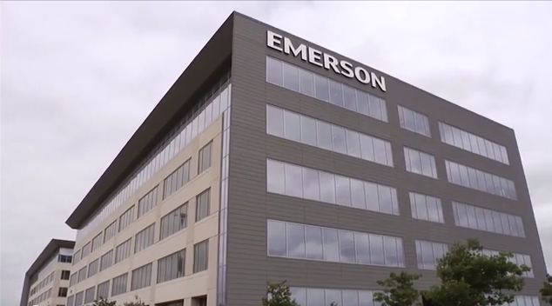

Case 2: Virtualization server
Make new deployments simple
Emerson (Dell)
Customer
Emerson Process Management
Global automation process and solution provider
Multi-industry, including oil & gas, power, food & beverage, pulp & paper, gas, pharmaceutical
Problem
Existing solution for Hyper-V virtualization cluster required:
12-16 hours to build
Significant IT expertise
½ rack footprint
Click to play case study video (courtesy Dell)

Slide 29
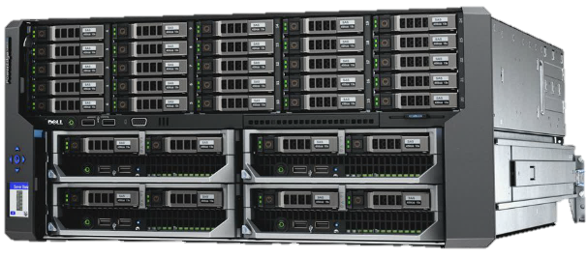
Emerson (Dell)
CiB solution & results
Servers
Dell PowerEdge VRTX
Results
“Within three hours we had a clustered, Hyper-V solution up and running.”
“With VRTX it really does come down to ease. It’s more ‘open and play’ as opposed to ‘open and build’.”
Form factor | Tower or 5U rack enclosure
Storage bays | Up to 12 x 3.5in NLSAS, SAS, or SAS SSD hot-plug drives (option 1)
 | Up to 25 x 2.5in NLSAS, SAS, or SAS SSD hot-plug drives (option 2)
Storage controllers | Single shared PERC8 with optional second redundant shared PERC8 available
Network | 1GbE internal switch module (standard) with 16 internal 1GbE ports and 8 external ports
PCIe expansion | 3 full-height/full-length slots (150W) with double-wide card support (225W) 5 low-profile/half-length slots (25W)
Power | 100V-240V auto-sensing redundant power supplies support 2+2 (AC redundancy), and 3+1 and 2+1 (power supply redundancy) modes

Slide 30

Case 3: Datacenter storage server
The need for speed
Australia DOD (Violin Memory)
Customer
Australia Department of Defense
  Canberra, Australia
  Base: HMAS Harman - Royal Australian Navy communication and logistics facility
Activities include communications, network operations, and information systems
Workloads
Monitoring/reporting on network performance, corporate and COTS applications and 94 software services
  110,000+ user network over 450 plus sites with over 550 data collection points
All processing needs to be completed within the allocated data load windows
  Software services: 5 minute window for data feeds from 200+ devices in 15 SQL instances
  BI: 15 minute data loads.
  Network performance and system analysis: data is loaded every 6 and 24 hours
Problems
Need for better server and storage consolidation
Increased performance
Desire to remove server layer between Hyper-V compute cluster and block storage (using SMB3 shared folders)

Slide 31
Australia DOD (Violin Memory)
Evaluation configuration
Compute servers
HP ProLiant DL580 Gen8
  15Core X4 socket, 120LP 256GB RAM, 4 Mellanox ConnectX-3 IPoIB Adapter
IBM System x3550 M4 Server
  24LP 64GB RAM, 4 Mellanox ConnectX-3 IPoIB Adapter
Storage
Violin Windows Flash Array V-6264
  2x 8-core Sandybridge CPU, 24GB DRAM per Memory Gateway, 44TB useable flash capacity, Windows Server 2012 R2
Configuration
LUN0 Quorum disk
LUN1 Scale Out File Server (SOFS) 1
LUN2 Scale Out File Server (SOFS) 2
IBM server mapped to SOFS 1 with 12 test files, 1 file per thread
    sqlio running 4k block, 12 Threads, 24 queue depth, 250 seconds, 10 second warm up
HP server mapped to SOFS 2 with 15 test files, affinity set to processors 0-15 on NUMA NODE 0
  sqlio running 4k block,15 threads, 64 Queue depth, 250 second test time, 10 second warm up

Slide 32
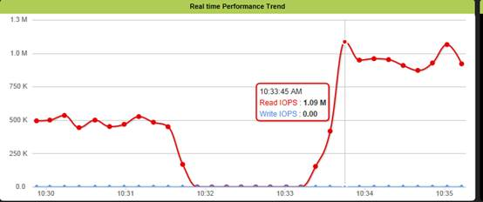
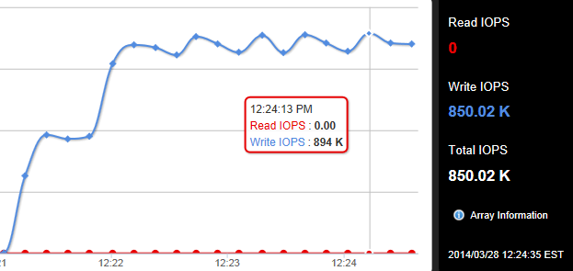
Australia DOD (Violin Memory)
Evaluation results
Read IOPS, Hyper-V config: 1.09M
Write IOPS, Hyper-V config: 894K
Conclusions & next steps
Met or exceeded all performance requirements
“This consolidated the storage requirements under one clustered storage array with all the benefits [Windows Storage Server 2012 R2] has to offer (SOFS, File server, vhdx Deduplication etc).”
“Within the virtual space utilizing SMB3 and RDMA we can now move all the system drives from the virtual server environment to Tier 2 HP storage allowing the WFA storage to be wholly used for the database drives.”

Slide 33

Case 4: TechEd Hands-On Labs (HOL) storage
10,000+ VMs a day, every day
TechEd HOL – holSystems (DataON)
Customer
TechEd 2014
TechEd North America is Microsoft’s premier technology conference for IT Professionals and Enterprise Developers
IT Provider
holSystems
Global provider of virtual machine platforms and management with a focus on training, demos, labs, and events
Workloads
For TechEd Hands-on Labs, deploy 3K to 4K labs per day
Requires 12K to 16K VMs
VMs need to deploy quickly and reliably
  Training VMs must deploy on-demand, yet only have a lifetime of about 45 minutes
Problems
Need less expensive, simpler storage solution
  Costs based on power, rack space, and administration
Need multiple, isolated fault domains to minimize impact of system failures

Slide 34
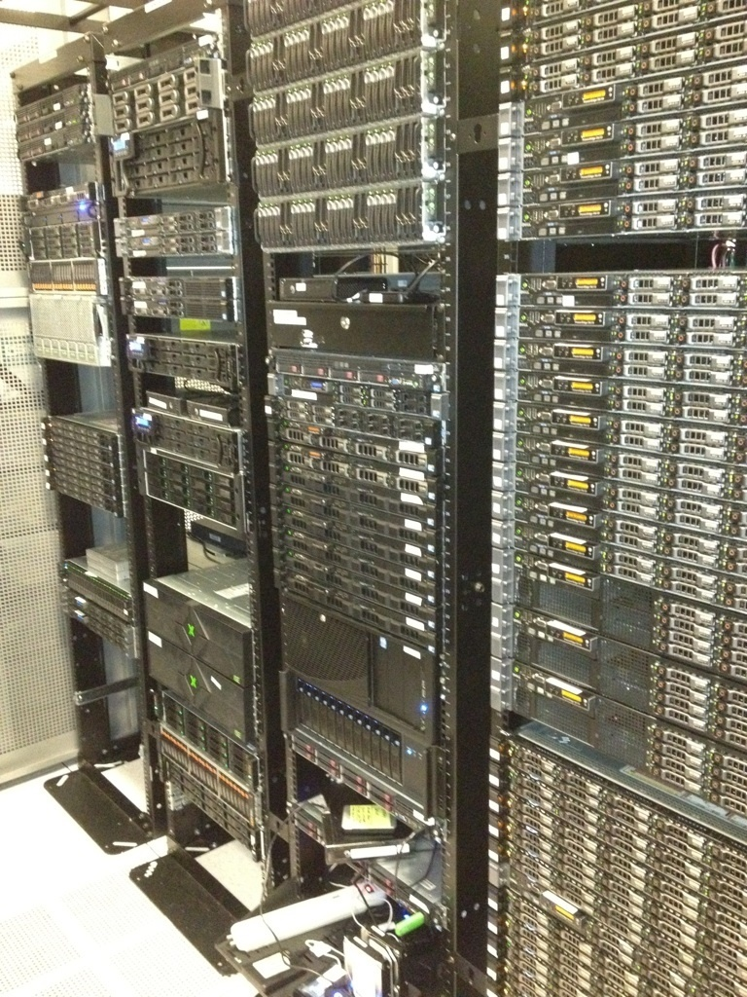
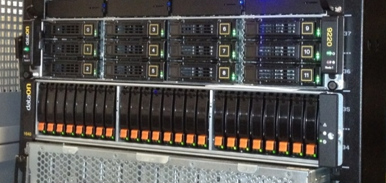
TechEd HOL – holSystems (DataON)
Existing Configuration
Discreet servers and external storage array
  Windows Server 2012, Windows Failover Cluster, Scale-Out File Server
  FibreChannel SAN storage
CiB solution
DataON CiB-9220 + JBOD (DNS-1640)
  CiB (hot tier)
    2U 12-bay Dual-Node cluster
    Per node: Dual Xeon E5-2620, 128GB, Dual 10GbE/s
    12 x SSD (hot tier) 400GB STEC SAS (4.8TB raw capacity)
  JBOD (cold tier)
    2u 24-bay JBOD
    24 x 10K SAS HDD 1.2TB (28.8TB raw capacity)
Results
“About as fast as FibreChannel but cheaper”
Deployed as multiple, small clusters to isolate fault domains
Windows Server Manager used for all deployment/configuration
“We used to rely on one expert that could do deployment. Now we can use two additional people.”
Photos courtesy holSystems

Slide 35
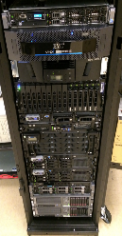


Case study information
Case 1
Getting aging infrastructure under control
Aaron Marks IT Consulting
Case study info: http://www.aaronmarks.com/#!case-studies/c1zqt
Aaron Marks, aaron@
DataON
Trenton Baker, trentonb@
Case 2
Make new deployments simple
Dell www.Dell.com/VRTX
aaronmarks.com
areasys.com
Case 3
The need for speed
Violin Memory Joseph Slember, joe@
Case 4
10,000+ VMs a day, every day
holSystems Corey Hines, corey.hynes@
DataON Trenton Baker, trentonb@
vmem.com
holsystems.com
areasys.com

Slide 36
Scaling Windows Storage to the Datacenter
Beyond CiB: Extending Windows storage to enterprise and Microsoft Cloud Platform System

Slide 37

Building on CiB for enterprise storage
Scaling storage capacity and connectivity
Hyper-V Servers
Scale Vertically
Add internal storage
Add JBOD expansion
Add RDMA NICs
Live Migrate Hyper-V Storage
Scale Horizontally
Expand capacity with additional clusters
Scale out with asymmetrical cluster
Scale Vertically
JBOD expansion
JBOD expansion
JBOD expansion
JBOD expansion
Live Migration
Hyper-V storage
Scale Horizontally

Slide 38
Example: Violin Windows Flash Array
Violin Windows Flash Array
Enterprise flash storage CiB
Windows Server 2012 R2
Scales from 2 to 8 nodes
Asymmetrical cluster
Scales out in 2 node increments
Enterprise-level performance
Evaluated in 4 node configuration:
Throughput: 2M random read IOPS and 1.6M random write IOPS
Bandwidth: 8.6 GB/s random read and 3.1 GB/s write
Latency: 4.5ms at 2M random read IOPs; 3.7-4ms for OLTP traffic at 1.15M IOPs.
    Download Microsoft whitepaper at: http://www.microsoft.com/en-us/download/details.aspx?id=44300

Slide 39
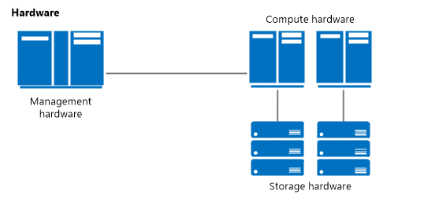
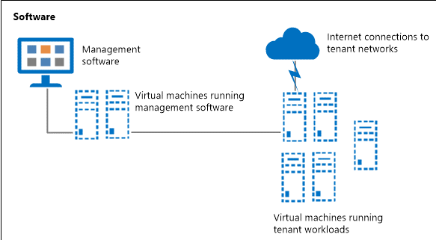
Designing a Windows Datacenter
What a datacenter solution needs
Converged / integrated hardware designs
Less expensive storage options
Simplified deployment and management tools
Scalability
Availability

Slide 40
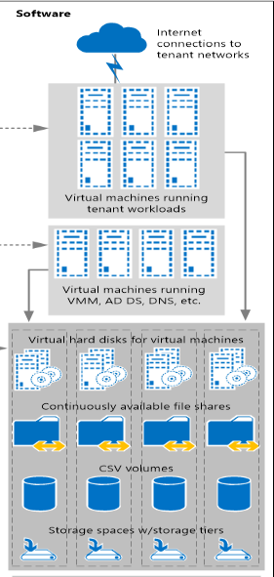
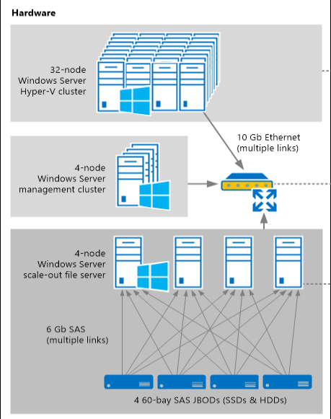
Scaling storage for datacenter deployments
N+2 redundancy
  4-node storage cluster
  4 JBODs
  Enclosure-aware 3-way mirror or dual parity
Performance
  SSDs configured in tiered Storage Spaces
  RDMA-capable NICs
Many details
  Drive firmware
  Expander configuration
  Disk controller supported configs
  …

Slide 41
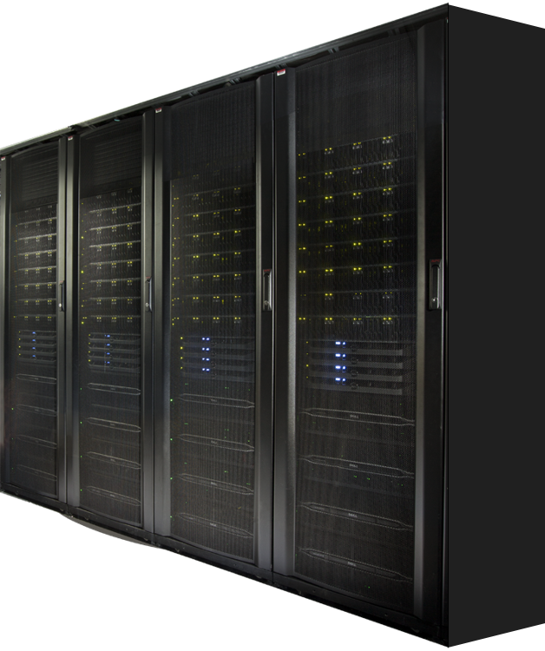
Windows Datacenter example
Microsoft Cloud Platform System
    For Enterprises and Service Providers
    Dell as Hardware partner
    Windows Server 2012 R2, System Center 2012 R2, WAP
    Microsoft-validated hardware and software
    Optimized for hosting Microsoft applications

Slide 42





Cloud Platform System - Capabilities
WINDOWS AZURE PACK
Pre-deployed infrastructure
  Switches, load balancer, storage, compute, network edge
  N+2 fault tolerant (N+1 networking)
Pre-configured as per best practices
Integrated Management
  Configure, deploy, patching
  Monitoring
  Backup and DR
  Automation
8000 VM’s*, 0.7 PB of usable workload storage
Optimized deployment and operations for Microsoft and other standard workloads
ADMIN
PORTAL
TENANT
PORTAL
SERVICE MANAGEMENT API
SYSTEM CENTER
SQL Server
SMB 3.0 &
STORAGE SPACES
HYPER-V
HOSTS
HYPER-V
NETWORKING
+ optimized racking and cabling for high density and reliability
Dell PowerEdge Servers
Dell Storage
Dell Networking
Dell Enterprise infrastructure
* VM Topology - 2vCPU, 1.75 GB Ram, 50 GB Disk

Slide 43
Rack 1
Agg Switches
Specific storage configuration
Access Switches
Access
Switches
Edge Cluster
Management Cluster
Compute Cluster
Storage Cluster
Space available
  Tenant: 152 terabytes
  Backup: 126 terabytes (+ deduplication)
4 JBODs
  192 HDDs @ 4 terabytes each = 768 terabytes RAW
  48 SSDs @ 800 terabytes each = 38 terabytes RAW
Storage Spaces configuration
  Tenant: 3-way mirror
  Backup: Dual parity
  Tiered storage
4 file servers
  128 GB memory
  3 x pools (2 x tenant, 1 x backup)
8 x 10 GbE RDMA for SMB3
\\SMBShare

Slide 44
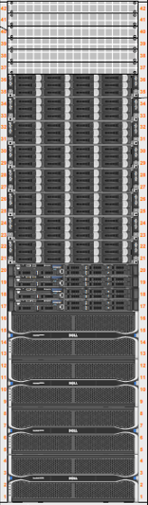
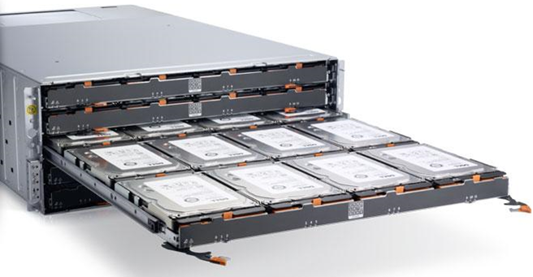

Specific storage hardware
Cloud Platform System specifications | Single rack (min configuration) | Four racks (max configuration)
Storage Dell PowerVault MD3060e | 4 JBOD enclosures = 768 terabytes RAW (0.7PB HDD; 12TB SSD) | 16 JBOD enclosures = 2.95 petabytes RAW (2.9PB HDD; 48TB SSD)
Storage Dell PowerEdge R620 v2 | 4 file server nodes (Dual socket E5-2650 v2; 128 GB) 10GbE Chelsio (iWARP/RDMA) | 16 file server nodes (Dual socket E5-2650 v2; 128 GB)

Slide 45
Software Defined Storage (SDS)
Build upon simple storage devices
  Mix of HDD and SSD housed in JBOD
  Multiple JBODs
  Multi-path IO to JBODs/disks
Software virtualizes, makes reliable, continuously available
  Storage Pools
  Storage Spaces (mirrored, parity)
  Write Back Cache
  Tiered storage (SSD/HDD)
  Clustered Storage (CSVFS)
  Continuously Available Storage (SMB3)
  Storage Migration

Slide 46
Calls to action
Investigate converged systems for your business
The industry is making large investments and you should take advantage of it!
Make all of your business systems highly-available, scalable, and efficient
The technology and solutions are here in a wide range of costs and features
Compare Windows Server solutions
Microsoft and our partners are producing great converged systems

Slide 47
Related content
Breakout Sessions
  CDP-B362 Architecting a Modern Datacenter: Windows Server 2012 R2 End-to-End Design
  CDP-B350 StorSimple 8000 Series: Enabling Enterprise Workloads for Microsoft Azure
  CDP-B361 Architecting Software Defined Storage: Design Patterns from Real-World Deployments
  CDP-B363 End-to-End Design for a Highly Available Datacenter
  CDP-B298 Converged Systems Engineered for Microsoft Windows Server
  CDP-B340 Using Tiered Storage Spaces for Greater Performance and Lower Costs
  CDP-B341 Architectural Deep Dive into the Microsoft Cloud Platform System
  CDP-B232 Introducing the NEW Microsoft Cloud Platform System

Slide 48

Resources
Learning
  Sessions on Demand
  Microsoft Certification & Training Resources
http://channel9.msdn.com/Events/TechEd
www.microsoft.com/learning
TechNet
Developer Network
  Resources for IT Professionals
http://microsoft.com/technet
http://developer.microsoft.com

Slide 49

For more information
Windows Server
Windows Server Technical Preview
http://technet.microsoft.com/library/dn765472.aspx
System Center
System Center Technical Preview
http://technet.microsoft.com/en-us/library/hh546785.aspx
Azure Pack
Azure Pack
  http://www.microsoft.com/en-us/server-cloud/products/
  windows-azure-pack
Microsoft Azure
Microsoft Azure
  http://azure.microsoft.com/en-us/
  Come visit us in the Microsoft Solutions Experience (MSE)!
  Look for the Cloud and Datacenter Platform area TechExpo Hall 7

Slide 50
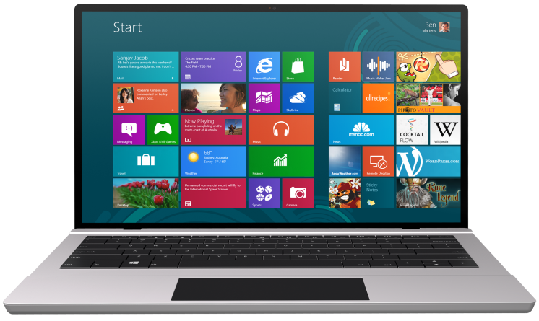


SUBMIT YOUR TECHED EVALUATIONS
We value your feedback!
Fill out an evaluation via
CommNet Station/PC: Schedule Builder
LogIn: europe.msteched.com/catalog
TechEd Mobile app
for session evaluations
is currently offline

Slide 51


© 2014 Microsoft Corporation. All rights reserved. Microsoft, Windows, and other product names are or may be registered trademarks and/or trademarks in the U.S. and/or other countries.
The information herein is for informational purposes only and represents the current view of Microsoft Corporation as of the date of this presentation. Because Microsoft must respond to changing market conditions, it should not be interpreted to be a commitment on the part of Microsoft, and Microsoft cannot guarantee the accuracy of any information provided after the date of this presentation. MICROSOFT MAKES NO WARRANTIES, EXPRESS, IMPLIED OR STATUTORY, AS TO THE INFORMATION IN THIS PRESENTATION.

