Slide 1


Slide 2

Cloud integrated backup – CDP – B 334
Shreesh Dubey – GPM Back-up
Bhasker Konakanchi – CPS Engineer
Islam Gomaa – CDM MVP
Dik van Brummen – CTO SaaSplaza

Slide 3
Key Takeaways
Protect Hyper V at Scale (Cloud Platform System)
Leverage Azure for Long Term Retention (LTR)
Protect workloads on VMWare & Azure

Slide 4
Cloud Inflection
Hyper-V Share
Service Provider Mindset

Slide 5



Microsoft Solutions
Breadth & depth solutions for business continuity & disaster recovery
Integration of WSB/DPM with Microsoft Azure Backup
5
Orchestrated Physical, Hyper-V & VMware VM Replication & Recovery using Azure Site Recovery, between on-premises locations, or between on-premises & Microsoft Azure
}
6
2
Hyper-V Guest Clustering for app-
level HA, i.e. SQL Server AlwaysOn FCI
Centralized backup with Data Protection Manager
4
1
Hyper-V Failover
Clustering for VM Resilience
Simplified protection with Windows Server Backup
3

Slide 6

Organization’s infrastructure evolution
Physical
Virtual
Hybrid Cloud
Cloud
On premises – built & managed infrastructure
Cloud – flexible, remote infrastructure
Microsoft Provides Backup Solutions Across All Four Scenarios

Slide 7
Protect Hyper V at scale (CPS)
Microsoft Cloud Platform System
Backup and de-duplication at Scale
Enterprise Level Reporting

Slide 8
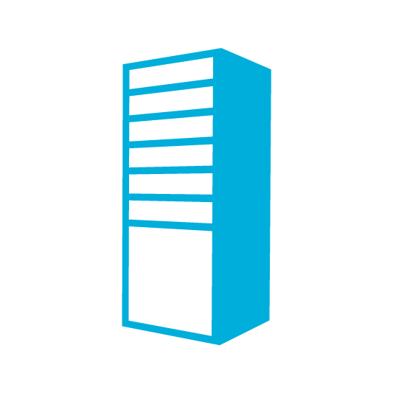
CPS Backup Workflow
Rack 1
Management Cluster
Protection Environment is pre-configured in CPS
DPM with De-Dup enabled Backup storage
MC protection pre-configured
Daily back-up for predictable SLA
Fabric level Consistency during MC restore
Central DPM console for management
BMC Switch
AD/DNS/DHCP (3)
Windows Server Backup
WDS (1)
WSUS (1)
WAP Tenant (2)
DPM (1)
(backing up Management cluster)
Agg Switches
ADFS (2)
SPF (2)
WAP Admin Portal/API, Service Reporting (3)
VMM (2)
VMM Library(1)
Access Switches
OM (3)
SMA (3)
Console (2)
SQL Cluster for dB’s (4 VM’s)
Access
Switches
Edge Cluster
Infra Cluster
System center
WAP
SQL
Management Cluster
Compute Cluster
Compute Cluster
Included Automation of backup admin tasks
Protect newly provisioned tenant VMs with a click
Clean up of protected data for the deleted VMs
Manage the Backup intent across DPM servers (retention range, backup windows)
Exclusion list – (VMs that don’t need to be protected based on patterns)
Tenant VMs
(Tenant’s Production workload)
Tenant VMs
(Tenant’s Production workload)
Tenant VMs
(Tenant’s Production workload)
2000
Storage Cluster
8 DPM Servers
DPM (2) (for backing up Host Tenant VMs)

Slide 9
Private Cloud Backup (Hyper-V)
SMB over Network
iSCSI or Fibre Channel
Reliable VM backups at scale
1
VMs
VMs
Traditional SAN
Scale-out File Server (SOFS)
Deduplication on DPM Storage
2
JBOD / Traditional SAN
Traditional SAN
Hyper-V over CSV
Hyper-V over SOFS

Slide 10
De-Dup Deployment guidance
Guidelines
Each attached VHD should be ≤ 1 TB
Time window for deduplication ≠ Time window for backup (no overlap)
Add VHDs as needed to the DPM server to increase storage
The attached VHDs can be spread over multiple SMB shares
DPM Server | Backup storage
Virtual machine | Virtual Hard Disks
on a Hyper-V Server | SMB share on a File Server
DPM 2012 R2 with UR3 | WS 2012 R2 November update
TechNet Article coming in November 2014

Slide 11
Demo
CPS Backup & De-dup

Slide 12
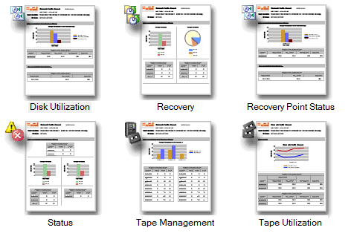
Currrent SC DPM Reporting
Single Standalone
DPM Server
Render
Reports
DPM DB
Old Scheme DPM Reports: for a single standalone server

Slide 13
New Extensible Reporting framework
Customizable
Write your own scripts
Design your own UI
Aggregation
All DPM data in SCOM DW
Scalable to any number of DPM Servers
Flexibility
Rich UI
No coding restrictions
Edit SQL queries
Documented views

Slide 14

Reporting Framework Architecture
DPM
Reports
Management Pack OR Custom Script to Query SCOM Data Warehouse
Render
Reports
Monitoring Data
SCOM Pulls Data From DPM Server Farm & Populates DW
Edit Script
& Query Views
Data Warehouse
Fetch Reporting Data from DW
DPM Recovery Job
DPM De-Duplication
DPM Disk Management
DPM Backup Job
DPM SLA Trend
DPM Disk Utilization
DPM Tape Management
DPM Tape Utilization
Multiple DPM Servers
[ Disk Tape & Cloud Backup ]
Publicly Documented SCOM Views

Slide 15
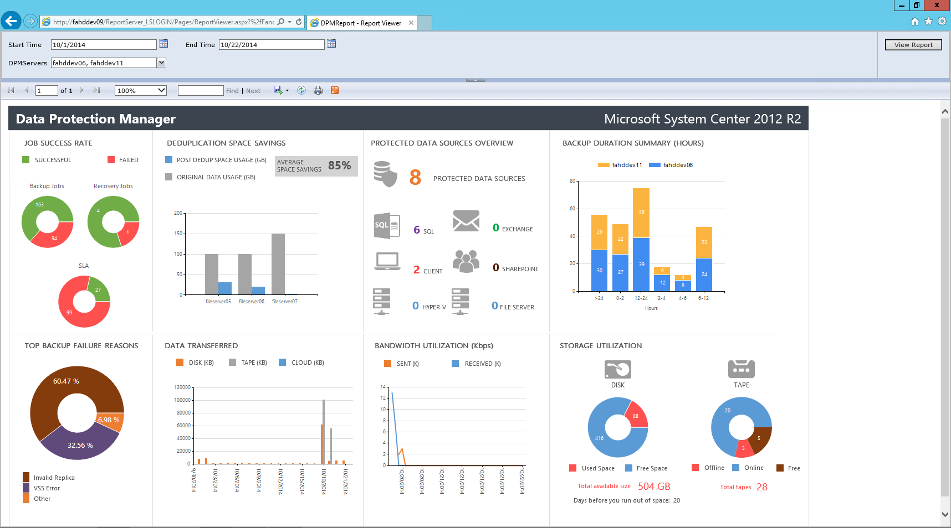

Slide 16
Demo
Enterprise Reporting Framework

Slide 17
Protecting to Azure
Long term retention

Slide 18
Replace tapes with Cloud
What is the TCO of 1 GB of backup on tape per month ?
$0.95*
What is the TCO of 1GB of backup on Azure per month ?
$0.28**
*Source: Gartner G00261961 - How to Determine If Cloud Backup Is Right for Your Servers, Published: 13 February
** Assumes Azure Backup at direct pricing of $0.20/GB/Month as of Oct 1 2014

Slide 19
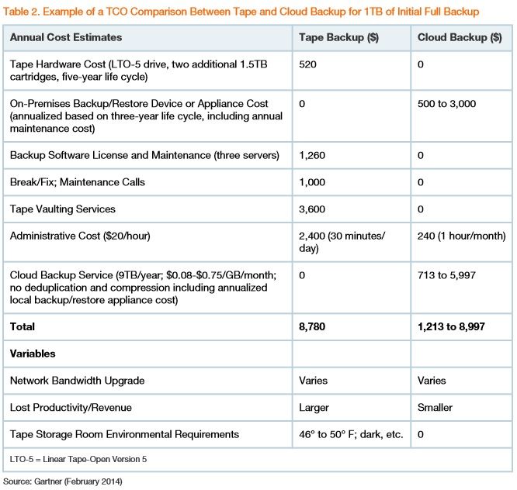
Gartner report and Azure Backup comparison
Azure Backup ($)
0
500
0
0
0
240 (1 hour/month)
1843.20
2583.20
Varies
Smaller
0
“Although tape media is very inexpensive, a majority of the cost of tape-based backup is the "soft" costs, which occur around backup software, maintenance and staff time”
- Gartner Report

Slide 20
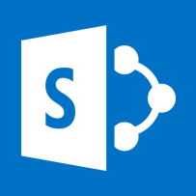


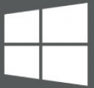

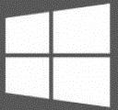
LTR: Retain data to Azure for years
Enterprise Office
DPM
SQL Server
Linux VMs
Hyper-V
Windows Server
Future URs
SharePoint
Exchange
Dynamics CRM
Windows (client)
Branch Office
Hyper-V VMs
Linux VM
Future URs
Recovery points | Retention Time
Daily | 120 days (4 months)
Weekly | 840 days (~ 2 years)
Monthly | 3360 days (~ 9 years)
SharePoint
Exchange
Dynamics CRM
SQL Server
Windows (client)
Windows Server

Slide 21
Other Azure Backup Roadmap
Increased data source limit (1.65TB per DS)
Support for all 64 bit WS servers
Expanded availability (China and Australia)
Import/Export and Express route (coming soon)
Central Console (coming soon)

Slide 22
Demo
DPM to Azure: Long term retention

Slide 23
Protecting Microsoft workloads
Microsoft workloads in VMWare
Microsoft workloads in Azure IaaS VM

Slide 24

DEMO: Protection on VMWare
VMWare ESXi Server 5.x environment
SQL Server
SharePoint
Exchange
File Server
DPM

Slide 25
Demo: Protect MS workloads in Azure
Azure VNet (customer)
Azure Backup service
Cloud service 1
Cloud service 2
Cloud service 3
SQL Server 1
SQL Server 3
DPM
Offsite/LTR
Web VM 1
SQL Server 2
Backup Vault
…
VHD
VHD
App VM 1
App VM 2
Web VM 3
Deploy an Azure IaaS VM with System Center DPM
http://aka.ms/ar2_dpmiaasvm

Slide 26
Deployment guidance
Installation prerequisites
Virtual network of DPM VM = Virtual network of VMs to be protected
Domain of DPM VM = Domain of VMs to be protected
Separate storage account for the DPM VM’s storage
System Center license mobility to run DPM in an IaaS VM
Scale as needed
DPM VM size | Backup scale
Standard tier - A2 | Up to 20 workloads (or) 2TB
Standard tier - A3 | Up to 40 workloads (or) 6TB
Standard tier - A4 | Up to 60 workloads (or) 12TB
More details here:
http://aka.ms/ar1_dpmsupportmatrix
http://aka.ms/ar1_faqdpmiaas

Slide 27
Workload support
Prerequisites
The workload version/edition must be supported in Azure
The workload version/edition must be supported by DPM
Support matrix
More details here: http://aka.ms/ar1_dpmsupportmatrix
Workload | Public cloud (Azure) | Private cloud
Windows Server | Yes* | Yes
SQL Server | Yes | Yes
Exchange | Not supported by Azure | Yes
SharePoint | Yes* | Yes
(*subset of editions supported on private clouds)

Slide 28
Sneak Preview
IaaS VM Protection

Slide 29
Customer Testimonial

Slide 30

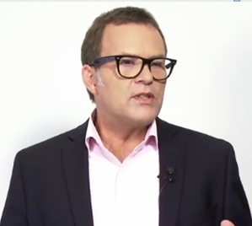
Operational Excellence
Dik van Brummen, CTO
October 31st, 2014

Slide 31
Company profile
#1 Partner for Microsoft Dynamics in the cloud worldwide
Global cloud platform for Microsoft Partners
Provisioning Microsoft Dynamics in a matter of minutes through the SaaSplaza Provisioning Panel, on Private Cloud and Azure
Highest levels of quality, security and innovation
Maintaining economy of scale and specialization

Slide 32
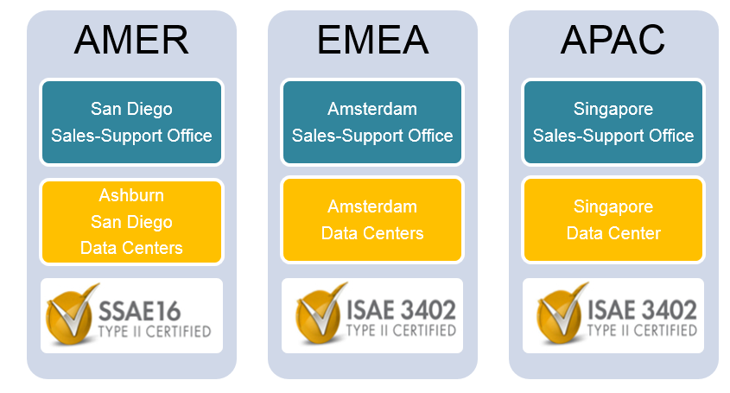
Global reach

Slide 33

Backup Challenges/Expectations
Reliable back-up at scale
  Protect VMs at scale > 3000 VMs
  Meet 100% backup SLA (at least one daily back-up)
Minimal impact on production systems
  IOPS
  CPU
  Network
Deduplication

Slide 34

Backup @ SaaSplaza

Slide 35
Results with SCDPM
Backup took 3-4 hours for DPM versus 9 hrs with previous backup solution
Dedup savings for DPM was ~75%

Slide 36
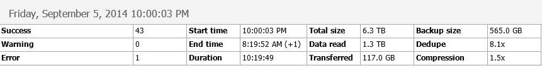
Previous Solution Backup Run
Previous Solution Backup Job
44 VM’s with a total 1.5TB of storage
Backup runs for 10 hours with inline deduplication
* Previous solution reports 6.3TB because we use Dynamically expanding VHDX files
*

Slide 37
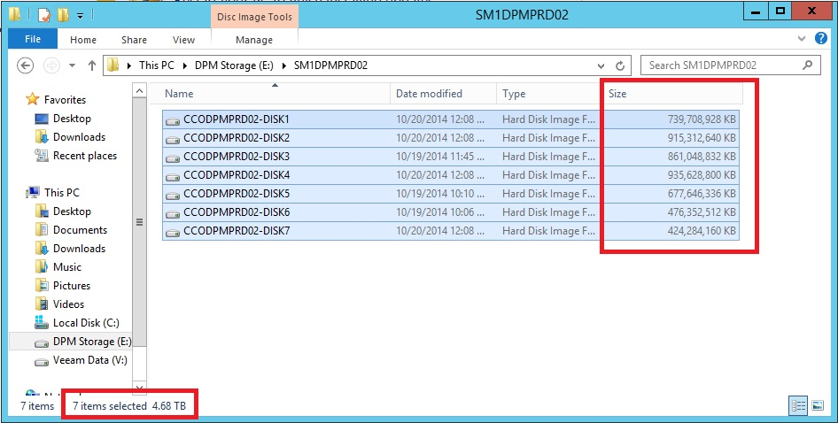
DPM Backup Run
61 VM’s with a total of almost 3TB storage
Backup runs between 3 – 4 hours
7 VHDX files, consuming 4.68TB of backup storage

Slide 38
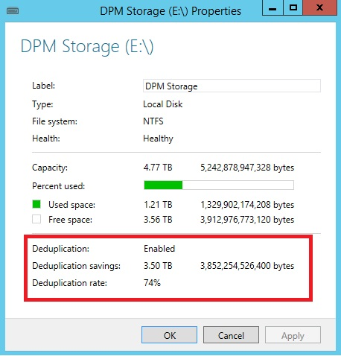
DPM Backup Run
DPM Backup Job
After the Dedupe Job is finished
DPM consumes 1.21TB of backup space
74% Dedupe!

Slide 39
Related content
CDP-B319 Building Disaster Recovery-as-a-Service: New Opportunities for Service Providers with the Azure Pack and Azure Site Recovery
CDP-B328 Microsoft Migration Accelerator and Microsoft Azure Site Recovery Using InMage Scout
CDP-B314 Microsoft Azure Site Recovery: Leveraging Microsoft Azure as your Disaster Recovery Site
CDP-B339 Leveraging SAN Replication for Enterprise Grade Disaster Recovery with Azure Site Recovery and System Center
CDP-B239 How to Stay Calm When the Lights Go Out: Business Continuity in the Real World
CDP-B352 Stretching Failover Clusters and Using Storage Replica for Disaster Recovery in the Next Release of Windows Server
CDP-B334 Cloud Integrated Data Protection with System Center Data Protection Manager and Microsoft Azure Backup
CDP-B318 Building Scalable and Reliable Backup Solutions in the Next Release of Windows Server Hyper-V
CDP-B335 Hyper-V Best Practices for High-Availability with Failover Clustering
Find me later at the Business Continuity booth at the Microsoft Solutions Experience Location (MSE)

Slide 40

Resources
Learning
  Sessions on Demand
  Microsoft Certification & Training Resources
http://channel9.msdn.com/Events/TechEd
www.microsoft.com/learning
TechNet
Developer Network
  Resources for IT Professionals
http://microsoft.com/technet
http://developer.microsoft.com

Slide 41



Please Complete An Evaluation Form
Your input is important!
TechEd Schedule Builder
CommNet station or PC
TechEd Mobile app
Phone or Tablet
QR code
SAMPLE

Slide 42
Evaluate this session
SAMPLE

Slide 43


© 2014 Microsoft Corporation. All rights reserved. Microsoft, Windows, and other product names are or may be registered trademarks and/or trademarks in the U.S. and/or other countries.
The information herein is for informational purposes only and represents the current view of Microsoft Corporation as of the date of this presentation. Because Microsoft must respond to changing market conditions, it should not be interpreted to be a commitment on the part of Microsoft, and Microsoft cannot guarantee the accuracy of any information provided after the date of this presentation. MICROSOFT MAKES NO WARRANTIES, EXPRESS, IMPLIED OR STATUTORY, AS TO THE INFORMATION IN THIS PRESENTATION.

