Slide 1
Lessons From Scale
Mark Russinovich
CTO, Azure

Slide 2
Stuff Everyone Knows About Cloud Development
Automate
Scale out
Test in production
Deploy early, deploy often
But there are many more rules…

Slide 3
Stories From the Trenches
All of these cases are real
Customer cases from Azure Customer Advisory Team (CAT) engagements
Azure cases caused outages in test or production
The names of the customers have been omitted to protect the guilty

Slide 4
Customer Lessons

Slide 5
Election Tracking “Vote early, vote often”

Slide 6
Who’s Winning?
Customer created service for reporting live tally of US Presidential, State and local elections
Served a major state’s September election results successfully
November election was coming – was the architecture going to handle the load?

Slide 7
Election Results Architecture
Voters
Web Role
1
2
…
n
Azure DB
Worker Role
Results
Main
Azure
Blob
…
…
…
Precincts

Slide 8
Disaster-Proof Deployment
Voters
Azure Traffic Manager
South Central US
North Central US
Web Role
1
2
…
n
Web Role
1
2
…
n
Azure DB
Worker Role
Azure DB
Worker Role
Results
Main
Results
Main
Azure
Blob
…
Azure
Blob
…
…
…
…
Precincts

Slide 9
Let Me Check That For You
Each web request results in about 10 SQL queries
Load estimate for November election:
Problem is that Azure DB scales to 5000 connections, 180 concurrent requests, 1000 requests per second
Solution: put a cache between the front-end and database with 40,000 requests/s per instance
Expected Load
Scenarios | Expected Page Views | Time Window (hrs) | Page View/sec | 10X/pvs DB Calls/sec
Average | 10,000,000 | 4 | 694 | 6,944
Peak Hour | 6,000,000 | 1 | 1,667 | 16,667

Slide 10
Election Results Architecture
Voters
Web Role
1
2
…
n
Azure DB
CacheWorker Role
Worker Role
Results
Main
Azure
Blob
…
…
…
Precincts

Slide 11
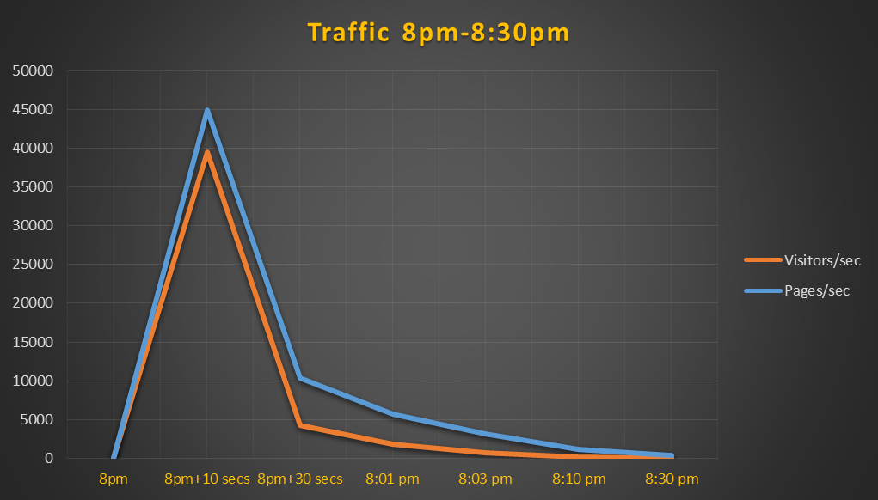
How’d I Do?

Slide 12
Whew, That Was a Good Call!
How the application would have performed without cache:
With cache:
Actual: if direct SQL DB Calls (~10X)
Time | Actual Page Views | Time Window (sec) | Page View/sec | Possible 10X DB Calls/sec | Est Capacity DIFF DB Calls/sec
8pm+10 secs | 448,932 | 10 | 44,893 | 448,932 | (447,932)
8pm+30 secs | 206,925 | 20 | 10,346 | 103,463 | (102,463)
8:01 pm | 171,231 | 30 | 5,708 | 57,077 | (56,077)
8:03 pm | 378,350 | 120 | 3,153 | 31,529 | (30,529)
8:10 pm | 494,423 | 420 | 1,177 | 11,772 | (10,772)
8:30 pm | 416,379 | 1200 | 347 | 3,470 | (2,470)
Actual: using Azure Cache (10X)
Time | Actual Page Views | Time Window (sec) | Page View/sec | Actual 10X Cache Calls/sec | Est Capacity DIFF Cache Calls/sec
8pm+10 secs | 448,932 | 10 | 44,893 | 448,932 | (288,932)
8pm+30 secs | 206,925 | 20 | 10,346 | 103,463 | 56,538
8:01 pm | 171,231 | 30 | 5,708 | 57,077 | 102,923
8:03 pm | 378,350 | 120 | 3,153 | 31,529 | 128,471
8:10 pm | 494,423 | 420 | 1,177 | 11,772 | 148,228
8:30 pm | 416,379 | 1200 | 347 | 3,470 | 156,530

Slide 13
Migration to PaaS “I’m tired of updating your OS”

Slide 14
To The Cloud!
Customer: software development company that produces solutions for the design, construction and operation of building, plant, civil, and geospatial infrastructure
Goal: move existing multi-tier application to the cloud
.NET, SQL
Leverage PaaS where possible
Match performance of existing deployment

Slide 15
Let’s Start Here
Web Role
1
2
…
n
PaaS design:
ASP.NET moved to Web Role
Application logic moved to Worker Role
SQL moved to IaaS SQL mirror
Scale testing results were…disappointing:
ApplicationWorker Role
IaaS
SQL
 | 200 User Test
 | On-Prem App | Azure
Total Counts For Test 1 (batch): | 33,174 | 10,135
Total Counts For Test 2 (interactive): | 114,497 | 39,341

Slide 16
Let’s Try This Instead…
On-prem architecture had combined web/app server
Inter-role communication introduced extra cross-server communication
Optimization: collapse Azure Web and Worker roles
Storage not optimized for IaaS SQL usage
Initial Configuration
Optimized Configuration
Data.VHD
Tempdb.VHD
Data+Tempdb.VHD
1844 IOPS 15.26 MB/sec
5379 IOPs
336.15 MB/sec

Slide 17
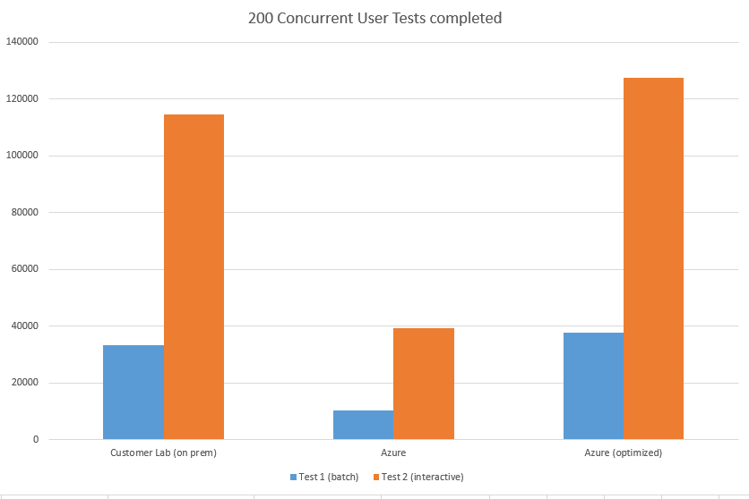
That Did the Trick
Performance tests of optimized configuration showed great performance:
Concurrent Users

Slide 18
Data Upload to Azure DB “Chew on this…”

Slide 19
What Does the Data Say?
Leading software company for advertising monetization created hybrid PaaS Azure solution
Architecture includes:
Daily activity and transaction history .csv file upload to Azure storage
Import to Azure DB
Trailing 7-day aggregate view for analytics and trending with HDInsight and prediction with CloudML
Ingestion Worker Role
Azure DB
Results
Azure
Blob
…
…
On-Prem Data Sources

Slide 20
Any Day Now…
Source data was over 100 CSV files between 10MB and 1.4GB
Average total ingest was around 40 GB
Customer wrote custom ETL process usng SqlBulkCopy
Problem: ingest took around 37 hours
Realization: Azure DB is a scale-out architecture

Slide 21
Keeping Up in Three Parts
1: move to Azure DB Premium
2: parallelize data upload by scaling the worker role to eight streams
3: create one table/day, view aggregates week of data
Result: optimized upload in < 3 hours
Today
Ingestion Worker Role
…
1
2
3
8
Today-1
Aggregate
…
Today-6
Azure
Blob
…
Azure DB
X
Today-7
On-Prem Data Sources

Slide 22
Movie Streaming “Now showing on Azure”

Slide 23
Cache Me If You Can
Startup (now large on-demand movie streaming company) started with pure PaaS streaming service
Built custom caching tier Worker Role
Caches movie metadata
If remote cache query > 2s, query database directly
Viewers
Web Role
…
WCF Client
WCF Client
WCF Client
WCF Binary Remoting over TCP
Cache
Worker
Roles
WCF Server
WCF Server
WCF Server
DB
Movie Metadata
Azure Blob
…
Movies

Slide 24
An Extra Cache Goes A Long Way
Problem: if cache role rebooted or updated, Web Role would overwhelm database
Solution: add a local cache to the Web Role
Viewers
Web Role
Cache
Cache
…
Cache
WCF Client
WCF Client
WCF Client
WCF Binary Remoting over TCP
Cache
Worker
Roles
WCF Server
WCF Server
WCF Server
DB
Azure Blob
…
Movies

Slide 25
Connected Cars “Calling all cars”

Slide 26
Connecting Azure with the World
Large connected car services company created new service on Azure
Goal: leverage Azure PaaS services
Dedicated Cache Worker Role
…
DB
NotificationsWorker Role
…
Admin Web Role
Message Processor Worker Role
…
User Services Web Role
Operations Service Bus Queue
Azure Blob
…

Slide 27
One By One
Performance measurements showed message process far less than 10,000/s required
Problem 1:
Synchronous message processing:
Fix: asynchronous (batch) receive:
Message Processor
Message 3
Message 2
Message 1
Message 1
Message 2
Message Processor
Message 3

Slide 28
Remove One Bottleneck, Find Another
Problem 2:
Processing one by one:
Fix: concurrent processing
Message 1
Message 2
Message Processor
Processed Message 3
Processed Message 2
Processed Message 1
Message 3
Message 1
Processed Message 1
Message 2
Message Processor
Processed Message 2
Message 3
Processed Message 3
http://msdn.microsoft.com/en-us/library/azure/hh528527.aspx

Slide 29
Smart Thermostats “Let me make you comfortable”

Slide 30
Your Temperature is Too High
Leading HVAC company created new temperature management service on Azure PaaS
Thermostats report temperature to cloud service
Cloud service serves as control point for devices and schedules to remotely set target temperatures
Initial product release failed to scale past more than 35,000 connected thermostats
Target was 100,000
Stretch goal was 150,000
Azure onboarding team called in…

Slide 31
Architecture
HVAC
Azure
Dealer Email
Thermostat
Azure Queue
Email Queue
Web Role
(Synchronous HTTP)
Building Router
Weather Request
Thermostat
Web Role
Mobile User Interface
Azure DB
Gateway
On-Prem
Weather WCF
Service
SMTP Relay

Slide 32
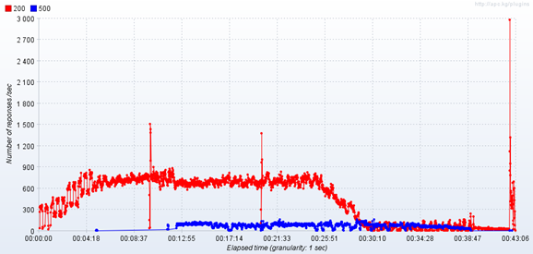
Initial Performance Results
12 A3 VMs

Slide 33
Don’t Wait Up For Me
Biggest issue: synchronous HTTP handler
Changed so only interactive queries synchronous
Single row updates to DB
Changed to multi-row batch updates
Single low-end Azure DB
Moved hot tables to premium DB
XML parameters preserved to DB
Convert XML to Table Valued Parameters
Single Azure Queue
Switch to multi-partition Service Bus queues

Slide 34
Updated Architecture
HVAC
Azure
Async and Writes
Service Bus
Worker Role
(write-leveling)
Thermostat
Web Role
(Synchronous HTTP)
Building Router
Sync and
Reads
Async Writes
Thermostat
Weather Query
Email Request
Web Role
Mobile User Interface
Azure DB
Gateway
Email Queue
On-Prem
Weather WCF
Service
SMTP Relay

Slide 35
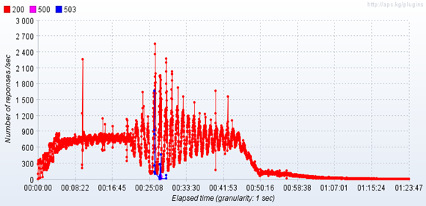
Much Better!
4 A3 VMs

Slide 36
Smart Card Service “Not as smart as it appears”

Slide 37
Azure Smart Card Provider
Leading smart card authentication company created Azure service for eCommerce
Traditional SOA with Web Role, Cache Role, and Azure DB
Problem: Web Role randomly crashed

Slide 38
Some Concurrency is Good
Analysis localized issues to Web Role posting jobs to local threads:
Two problems:
If backends go down or slow down, threads pile up and exhaust server resources
An exception on the thread takes down the process
Resolution: moved worker logic to Worker Role and connected to Web Role via Azure Storage queue

Slide 39
Azure Lessons

Slide 40
VIP Swap “I like your VIP better than mine”

Slide 41
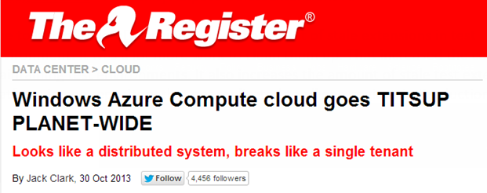
Really? Isn’t that a Bit Much?
Users started complaining that after a VIP swap that they could not perform operations on their cloud services
Was not detected by monitoring systems
Affected only a small number of customers

Slide 42
What’s a VIP Swap?
You can deploy two versions of a cloud service:
Production: has the DNS name and IP address of the cloud service you publish
Stage: has a temporary DNS name and IP address
To promote the Stage version to Production, you “VIP Swap”
Production VIP – VIP1
<dnsname>.cloudapp.net
Staging VIP – VIP2
<guid>.cloudapp.net
Port 80
Port 3389
Port 3390
Port 80
Port 3389
Port 3390
Role A
Role B
Role A’
Role B’

Slide 43
VIP Swap Internals
RDFE uses storage table rows to cache the state of cloud service deployments
Includes state of role instances and deployment slots
Row is updated by mutating operations like VIP Swap
It’s also updated by RDFE cache updating status of roles
Multiple roles updated via table conditional update (opportunistic concurrency)
Slot | VIP | Role A | Role B
Production | 168.133.1.22 | Healthy | Healthy
Stage | 168.124.33.22 | Healthy | Healthy
Slot | VIP | Role A | Role B
Stage | 168.124.33.22 | Healthy | Healthy
Production | 168.133.1.22 | Healthy | Healthy

Slide 44
The VIP Swap Bug
Bug in RDFE update caused race condition
Change would be overwritten, causing inconsistent state
RDFE does not allow update operations when it detects inconsistency
Race condition meant error rate was only marginally higher than normal and went undetected
Slot | VIP | Role A | Role B
Stage | 168.124.33.22 | Healthy | Healthy
Production | 168.133.1.22 | Healthy | Healthy
Slot | VIP | Role A | Role B
Stage | 168.124.33.22 | Healthy | Healthy
Stage | 168.124.33.22 | Healthy | Healthy
Slot | VIP | Role A | Role B
Production | 168.133.1.22 | Healthy | Healthy
Stage | 168.124.33.22 | Healthy | Healthy

Slide 45
VIP Swap Learnings
Root cause: developer claimed “unintuitive behavior of ADO.NET”
Rule: direct a slice of traffic to an updated version for several days
Increase traffic gradually
Set alerts based on difference in failure rates of two versions
Customer Traffic
5%
RDFE A
RDFE B
RDFE vNext

Slide 46
VIP Swap Learnings
Root cause: developer claimed “unintuitive behavior of ADO.NET”
Rule: direct a slice of traffic to an updated version for several days
Increase traffic gradually
Set alerts based on difference in failure rates of two versions
Customer Traffic
30%
RDFE A
RDFE B
RDFE vNext

Slide 47
VIP Swap Learnings
Root cause: developer claimed “unintuitive behavior of ADO.NET”
Rule: direct a slice of traffic to an updated version for several days
Increase traffic gradually
Set alerts based on difference in failure rates of two versions
Customer Traffic
50%
RDFE B
RDFE vNext

Slide 48
VIP Swap Learnings
Root cause: developer claimed “unintuitive behavior of ADO.NET”
Rule: direct a slice of traffic to an updated version for several days
Increase traffic gradually
Set alerts based on difference in failure rates of two versions
Customer Traffic
50%
RDFE vNext
RDFE vNext

Slide 49
Subscription Deletion “Oh no you didn’t”

Slide 50
Oops…
Operator was performing regular clean up of internal (Microsoft) Azure subscriptions
Wasn’t aware of new process to go through front-line support
Resulted in build-up of delete requests
Normal process bypassed and operator allowed to submit batch-delete
Several subscriptions had originally been created internal on behalf of partners, and got deleted
Front-line checks would have stopped the delete
Customers graciously let us know what had happened

Slide 51
Let’s Not Do That Again
All data was fortunately recovered because of data retention
From http://www.windowsazure.com/en-us/support/legal/subscription-agreement:
Subscription had to be manually recreated, however
Rule: use “soft delete”
Resources inaccessible by customer
Non-data resources (e.g. VMs) deleted
Timer set to delete after 90 days

Slide 52
Storage Certificate Expiration “Sorry I’m late, the alarm clock never rang”
http://blogs.msdn.com/b/windowsazure/archive/2013/03/01/details-of-the-february-22nd-2013-windows-azure-storage-disruption.aspx

Slide 53
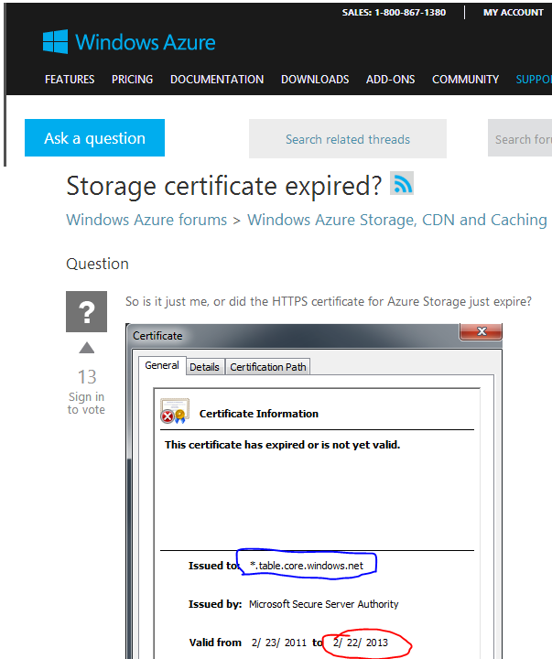
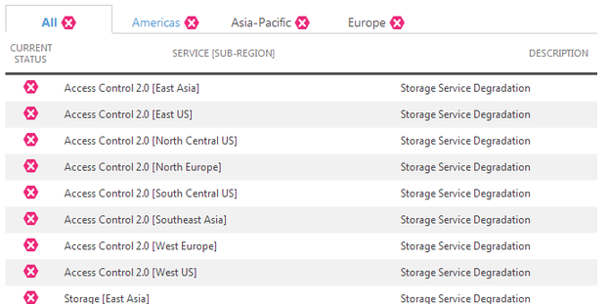
It’s Not You, It’s Me
SSL connections to Azure storage began failing at 12:29pm on February 22, 2013
Customers immediately noticed
We did, too

Slide 54
We Updated It, We Promise!
Certificates are managed by the “Secret Store”
Once a week an automated system scans the store
An alert is fired for certs within 180 days of expiration
Team obtains new cert and updates Secret Store
That process was followed
The breakdown:
On January 7, the storage team updated the three certs in question
Failed to flag that a storage deployment had a date deadline
Deployment was delayed behind other higher-priority update

Slide 55
Be Certain About Your Certs
The real breakdown was not monitoring production:
We now scan all service endpoints, internal and external, on a weekly basis
At 90 days until expiration, shows up on VP reports
Rule: service development requires thinking through the entire life-cycle of the software
We are working on “managed service identities” to fully automate non-PKI certs

Slide 56
Log As If That’s All You Have
A little more detail can go a long way…
Error log not reporting a name made correlation difficult:
Error message in test environment indicating a beta feature was missing was ambiguous:
Intermittent failures because of header incompatibility in test environment made troubleshooting painful:
System.Reflection.TargetInvocationException: Exception has been thrown by the target of an invocation. ---> Microsoft.ServiceModel.Web.WebProtocolException: Server Error: The service name is unknown (NotFound)
HTTP Status Code: 400. Service Management Error Code: MissingOrIncorrectVersionHeader. Message: The versioning header is not specified or was specified incorrectly.

Slide 57
Lessons From Scale
Cache aggressively to hide latency
Async with queues when possible
Process in batches to minimize round trips
Partition data and compute to scale out
Roll out with monitored slices
Log excessively

