Slide 1


Slide 2

Lessons Learned from a Customer Integrating a Custom Portal with the Azure Pack
CDP-B338
Victor Arzate – Program Manager (Microsoft)
Markus Klein – Cloud Architect (bytesatwork GmbH)

Slide 3
Agenda
The customer
The Cloud OS and Azure Pack
Lessons learned from integrating a custom portal with the Azure Pack
  1) Integrating a custom portal with Azure Pack
  2) Missing reseller role in Azure Pack
  3) Role-based access control

Slide 4
The Customer

Slide 5
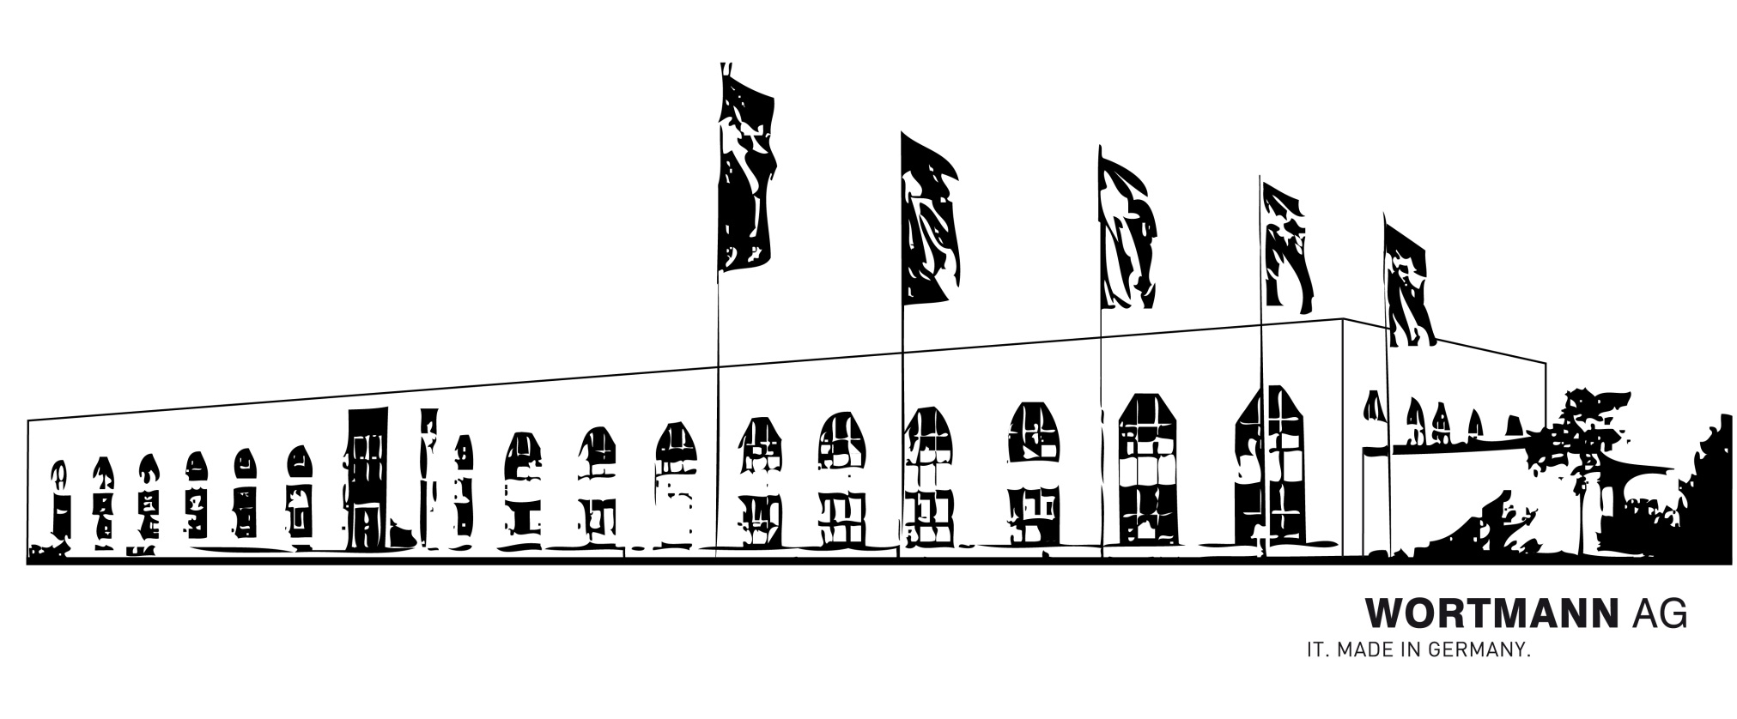
Wortmann AG

Slide 6
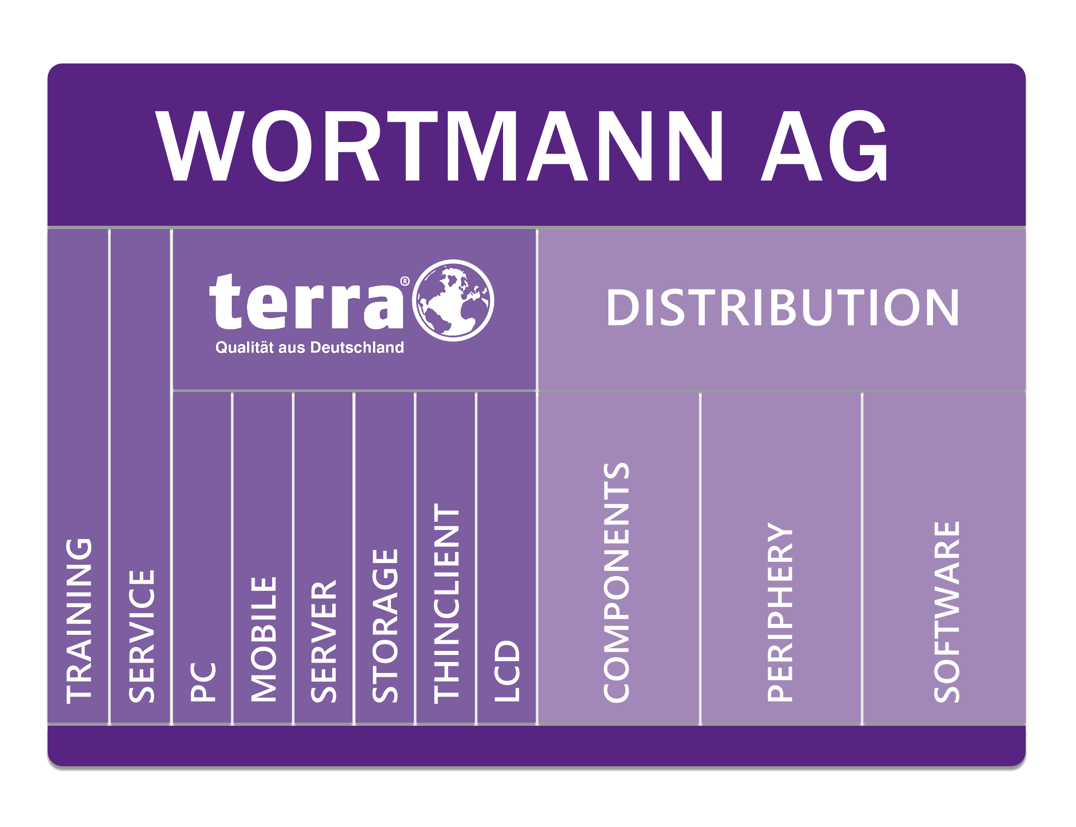
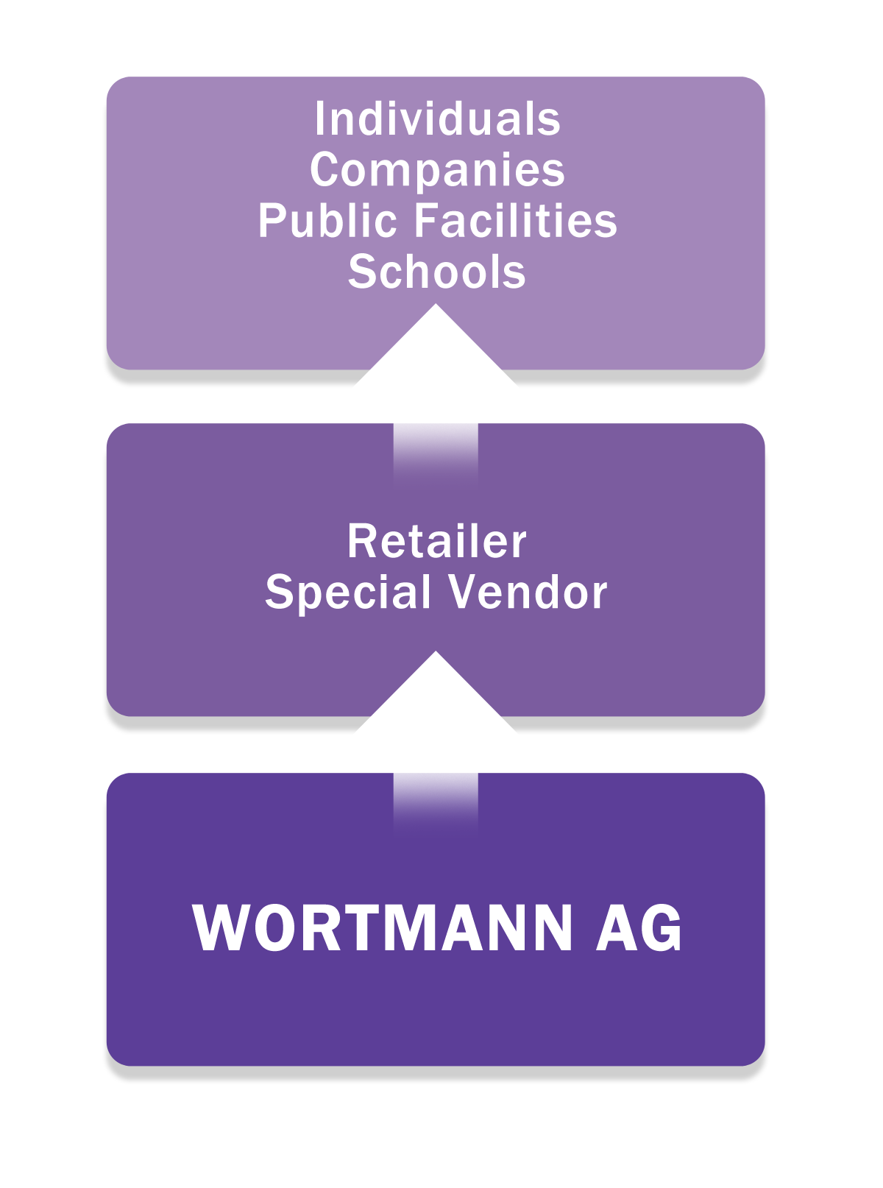
Wortmann AG
Manufacturer, distributor and service provider for resellers and systems integrators
The product strategy
The indirect sales

Slide 7
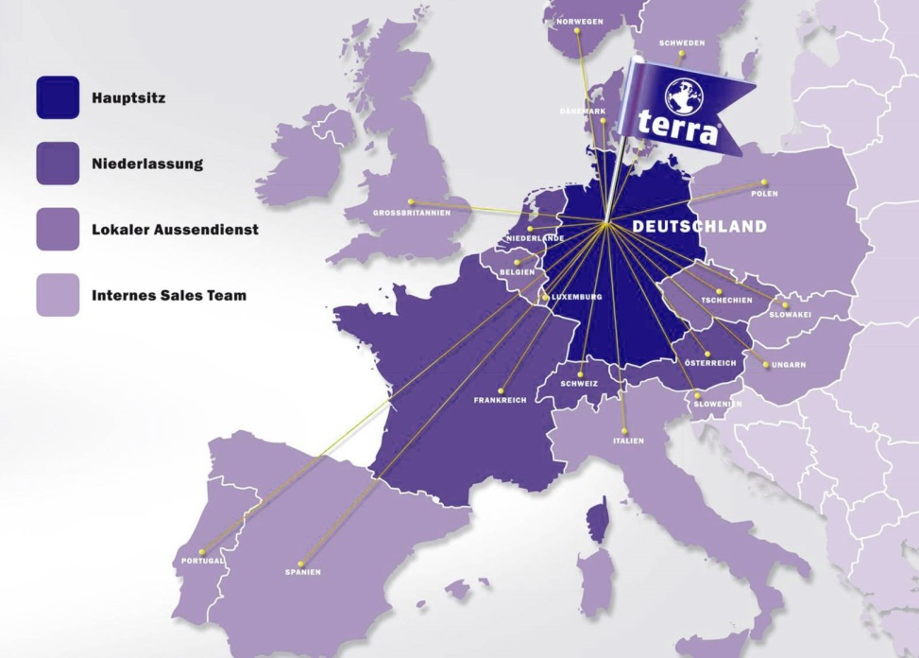
Import and export as core competence
WORTMANN AG serves customers from the European Union, North and Eastern Europe, the Middle East and Africa.
The expansion focuses however on countries bordering on Germany like Austria, Switzerland, Spain, France and the Benelux countries.

Slide 8
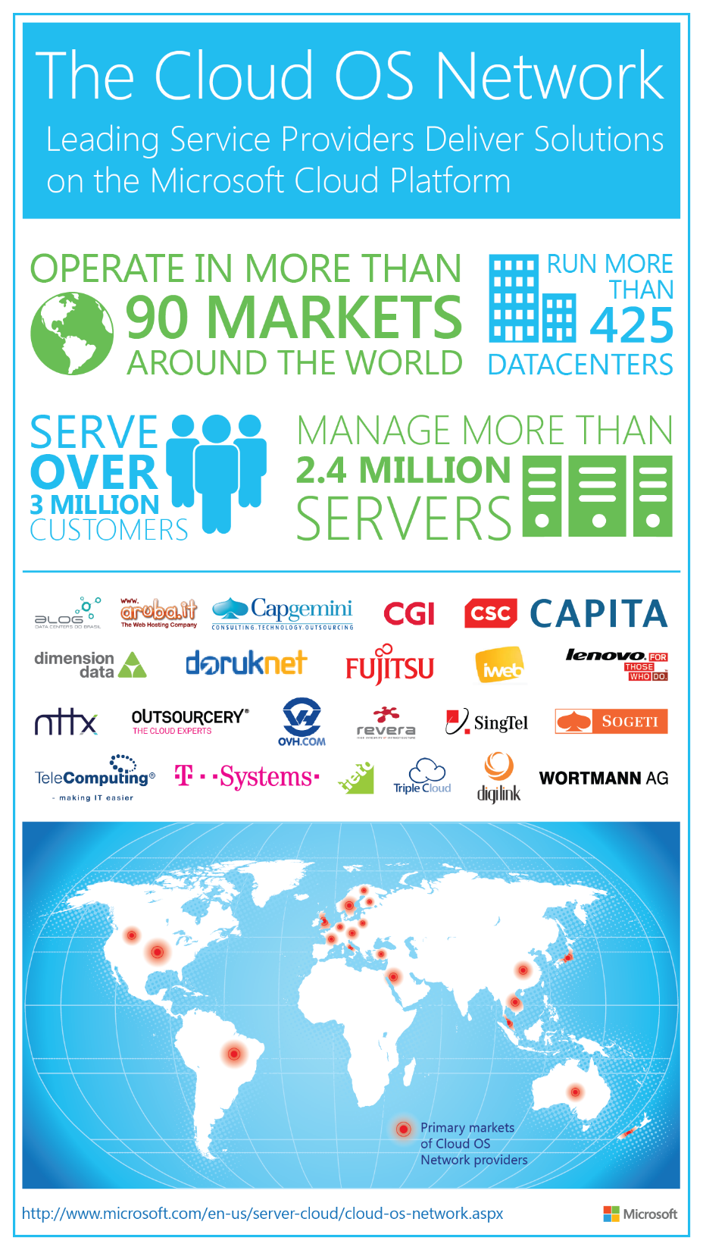
Wortmann and the COSN Program
… Microsoft introduced the Cloud OS Network, a worldwide group of more than 25 leading cloud service providers who have embraced our Cloud OS vision and will deliver hosted services built on the Microsoft Cloud Platform, which includes Windows Server with Hyper-V, System Center and the Windows Azure Pack. This announcement represents important progress against our goals and strategy for Cloud OS

Slide 9
The Cloud OS

Slide 10
Customer
ONE
Consistent
Platform
Service
Provider
Microsoft

Slide 11
Why choosing the Cloud OS
The Cloud OS Enables all the characteristics of a Cloud Service
  On-demand Self-Service
  Broad Network Access
  Rapid Elasticity
  Resource Pooling
  Measured Service
Microsoft’s answer:
The Cloud OS

Slide 12
Bringing Microsoft’s learnings to Wortmann’s datacenter
Windows Server
High performance
storage on industry-
standard hardware
Windows Server
Multi-tenant environments
with isolation
Software-defined networking
Policy-based automation
Application
elasticity
Microsoft Azure
Microsoft Azure

Slide 13








Cloud OS Consistent Experiences
Windows Azure
Customer
Service Provider
Web Sites
Apps
Database
VMs
Service
Plans
Users
Web Sites
Apps
Database
VMs
Subscriber Self-Service
Portal
Self Service Portal Moves On-Premises
Provider Portal
Consumer Self-Service
Portal
Service Management API
Common Mgt. Experience
Service Management API
Future Services
Worker
Role
Web
Sites
VMs
SQL
Service
Bus
Caching
Other
Services
CDN.
Media,, etc.
Cloud-Enabled Services Move On-Premises
Web
Sites
VMs
SQL
Service
Bus
R2 w/ Service Provider Foundation
Workloads
R2
Consistent Dev. Experience

Slide 14

Azure Pack
Management Portal
Service Management REST API
Web sites
Virtual machines
Service bus
Virtual Networks
Database
Web Platform application Services (PaaS)
Infrastructure Services (IaaS)
Reliable Messaging
Virtual Networking
SQL Server & MySQL Database

Slide 15
Azure Pack Sites & Endpoints
Portal
API
Resource Providers
Infrastructure
Admin Site
Admin Authentication Site
Tenant Site
Tenant Authentication Site
Configuration Site
Tenant API
Tenant Public API
Admin API
Virtual Machines
Web Sites
Service Bus
SQL RP
My SQL RP
Monitoring
Web App Gallery
PowerShell Modules
Usage
Usage Collector

Slide 16
WAP Component Interaction
AD FS
Admin Portal
Tenant
Portal
SQL Cluster
Management
Databases
Admin
API
Tenant Public API
Infrastructure Services
Tenant
API

Slide 17
Service Management APIs
Admin API
Tenant API
Tenant Public API
Provides Access to Admin Functionality
Claims based Authentication
Resource Management
Used for Automation, Panel/Portal Integration, Admin PowerShell
Provides Access to Tenant Functionality
Claims based Authentication
Provides access to all subscriptions
Used for Automation (triggered by Admin), Panel/Portal Integration
Provides Access to Tenant Functionality
Certificate based Authentication
Provides access to the subscription that the certificate is tied to
Tenant PowerShell

Slide 18
Portal Login Scenario using Claims
STEPS
1. User without Claims
Identity
Provider with Secure Token Service
ASP.Net
2. User is redirected to STS (multiple redirects*)
4
ADFS
3. User Enters Credentials
4. User is authenticated & Claim Token is issued to the user
3
3rd party
User
2
5. User uses claim to access Portal
1
Portal
6. Portal Grants access to Resources
5
6

Slide 19
Azure Pack PowerShell
Admin | Tenant
Management of Admin resources | Management of Tenant resources available under a specific subscription
Claims based authentication | Certificate based authentication
Connects to the Admin \ Tenant API | Connects to the Tenant Public API
Available with WAP | Available with the Microsoft Azure SDK (Open Source)
WAP Service Management Plan & Add-On management Tenant & Subscription management Resource Provider Management | Resource Management

Slide 20
Lessons learned

Slide 21
1) Integrating a custom portal with the Azure Pack

Slide 22
Wortmann’s Vision
Wortmann is a local OEM, Distributor of MS Software and will become Hosting Service Provider
Wortmann recognizes that their HW sales will reduce long term, as Cloud Solutions will gain popularity.
Wortmann aims to play a key role in the local ecosystem
  Wortmann‘s Active Value Added Reseller (VAR) Channel = 10,000 Partner
  Wortmann‘s VAR Partner Program includes 1,500 Partner
  Wortmann‘s pre-registered 700+ Partner for their Terra Partner Cloud
  Wortmann‘s Partner sell into Mid Market incl. Several niche markets
Wortmann wants to bring the Cloud business into the Channel

Slide 23
Extensibility Options in Azure Pack
Services
Plans
Users
Automation
Admin Site
Web Sites
Apps
Database
VMs
Tenant
Site
PowerShell
Theming Tenant Portal
Custom Tenant Portal
Custom Resource Provider
Service Management API
Web
Sites
VMs,
Networks,
Automation
Database
SQL Sever
MySQL
Service
Bus
Custom
Resource
Providers
w/ Service Provider Foundation
& Service Management Automation

Slide 24
Challenges of adopting Azure Pack
Requirement to add other Wortmann offerings
  Housing
  Hosting
Build to order functionality
  Support to fully customize and create end customer quotes

Slide 25
Challenges of adopting Azure Pack
Minimize impact to resellers and end users
  Not easy to retrain 700+ resellers
  Portal had to be very simple for end users to place orders and consume services
  Portal should be familiar with the tools they’re used to
  Should reflect Wortmann’s corporate identity
Maximize PowerShell automation as much as possible
How to leverage WAP APIs?
  Infrastructure team know System Center, but no DEV background
  Developers know how to write code, but no System Center background

Slide 26

Wortmann portal integration with WAP
PowerShell used for deployment of tenant workloads from Wortmann’s custom portal

Slide 27
Custom Portal Sample
Used the Sample Portal based on WAP, SPF and VMM for guidance on how to work with the APIs
  Latest version available here: http://blogs.technet.com/b/privatecloud/archive/2014/06/26/sample-portal-code-based-on-windows-azure-pack-service-provider-foundation-and-virtual-machine-manager-version-2.aspx
Scenarios covered in this sample portal:
  Control Panel or Portal Integration
    Authentication, list plans, subscriptions, quota
  VM Clouds Resource Provider (SPF)
    List VMs for a subscription (tenant)
    Common actions on VMs: Start, Stop, Create VM, Console Connect

Slide 28


Cloud OS (IaaS)
Service Management API / Service Provider Foundation
Virtual Machines
Virtual Machine
Manager
Virtual Machine Roles
Virtual Machine
Manager
VM networks
Virtual Machine
Manager
Automation
SMA
Microsoft System Center 2012 R2
Windows Server 2012 R2

Slide 29
terraCLOUD Portal
Wortmann terraCLOUD portal
Billing
Service Management API / Service Provider Foundation
Housing
Physical Servers
Hosting
Physical Servers
SaaS
(in the future)
Virtual Machines
Virtual Machine
Manager
Virtual Machine Roles
Virtual Machine
Manager
VM networks
Virtual Machine
Manager
Automation
SMA
Microsoft System Center 2012 R2
Windows Server 2012 R2

Slide 30
Demo – terraCLOUD Portal
Markus Klein

Slide 31
2) Missing reseller in Azure Pack

Slide 32
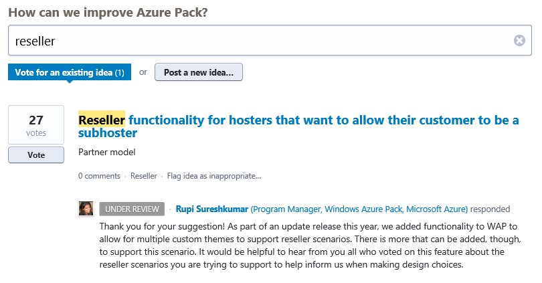
Challenges
No reseller model in place
  Reseller is key for Wortmann’s business model
Idea listed in the Azure Pack forum

Slide 33
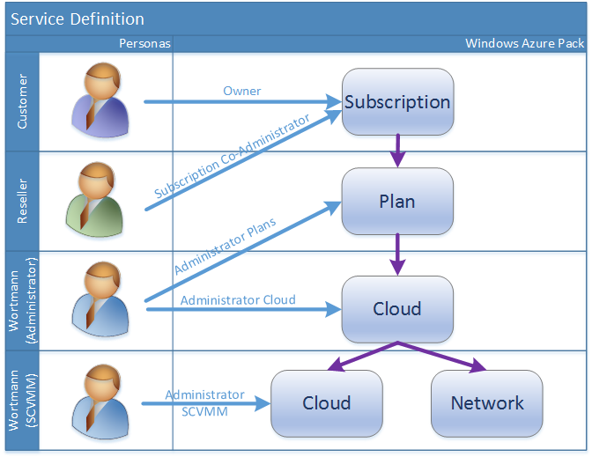
Implementation: Use co-admin
Tenant (Service Consumer)
Re-seller (Service Reseller)
Wortmann (Service Provider)
Use Modern UI (Portal) to order, consume Cloud Services
Assigned as Owner of WAP Subscription
Perform VM Operations (Start, Stop, Backup, …)
Use Cloud Center (Portal) to manage Cloud Services
Re-seller → Tenants (1:many)
Assigned as Co-Admin in WAP Subscription (Tenant)
Manages user accounts for Re-sellers & Tenants
Wortmann → Re-sellers (1:many)
Creates Plan for Re-sellers & Subscribes Tenants to it

Slide 34
3) Role-Based Access Control

Slide 35
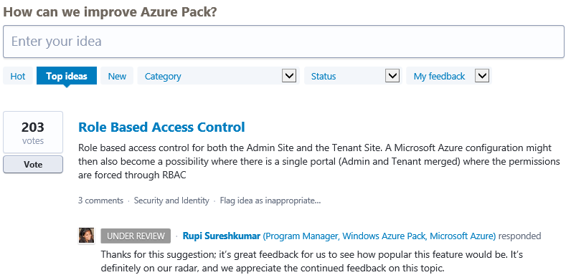
RBAC
Only show users what they’re entitled to see
Number 1 required suggestion in the Azure Pack forum

Slide 36
Demo – Single portal for Reseller and Tenants
Markus Klein

Slide 37
Putting all together

Slide 38
Demo – Buying a Cloud Service in the terraCLOUD portal
Markus Klein

Slide 39
Summary

Slide 40
Flexible and Friendly Framework
Azure Pack can be customized in depth thanks to the Service Management APIs
Azure Pack APIs are comparable to Azure API
Rich PowerShell cmdlets to manage Azure Pack resources

Slide 41
Questions

Slide 42
Appendix

Slide 43
Sample Code – Admin API
Creating a user

Slide 44
Sample Code – Tenant API
Retrieving a plan

Slide 45
Sample Code – Tenant API
Get the quotas with specific state from a plan

Slide 46
Sample Code – Tenant API
Return quotas for networking settings in the plan

Slide 47
Sample Code – Tenant API
Return quota from a specific network ID

Slide 48
Related content
CDP-B416 Azure Pack Extensibility
CDP-B353 Automated Workload Provisioning with the Azure Pack and Windows PowerShell
CDP-B332 Azure Pack Roadmap and Ecosystem
CDP-B327 Planning and Designing Management Stamps with the Azure Pack

Slide 49
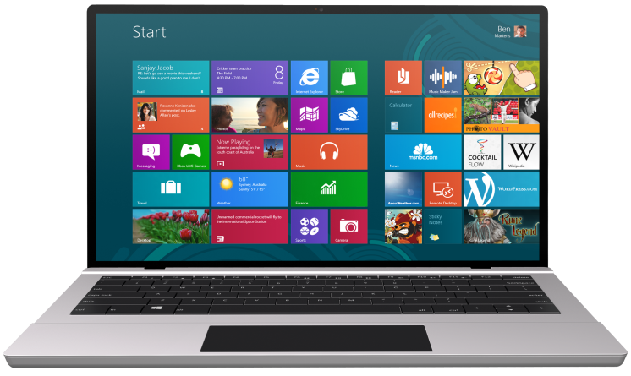


SUBMIT YOUR TECHED EVALUATIONS
We value your feedback!
Fill out an evaluation via
CommNet Station/PC: Schedule Builder
LogIn: europe.msteched.com/catalog
TechEd Mobile app
for session evaluations
is currently offline

Slide 50

Resources
Learning
  Sessions on Demand
  Microsoft Certification & Training Resources
http://channel9.msdn.com/Events/TechEd
www.microsoft.com/learning
TechNet
Developer Network
  Resources for IT Professionals
http://microsoft.com/technet
http://developer.microsoft.com

Slide 51


© 2014 Microsoft Corporation. All rights reserved. Microsoft, Windows, and other product names are or may be registered trademarks and/or trademarks in the U.S. and/or other countries.
The information herein is for informational purposes only and represents the current view of Microsoft Corporation as of the date of this presentation. Because Microsoft must respond to changing market conditions, it should not be interpreted to be a commitment on the part of Microsoft, and Microsoft cannot guarantee the accuracy of any information provided after the date of this presentation. MICROSOFT MAKES NO WARRANTIES, EXPRESS, IMPLIED OR STATUTORY, AS TO THE INFORMATION IN THIS PRESENTATION.

