Slide 1


Slide 2

Leveraging SAN Replication for Enterprise Grade Disaster Recovery with Azure Site Recovery and System Center
CDP-B339
Abhishek Agrawal, PM Lead, Microsoft
Hector Linares, Principal PM, Microsoft
Karsten Bott, Microsoft Evangelist, EMC
Pavel Lobanov, Reference Architect, NetApp

Slide 3
Session Objectives and Takeaways
Session Objective(s):
Lap around Microsoft’s Business Continuity Solutions
Explain benefits of supporting SAN based replication technology with Azure Site Recovery and VMM
Perform Hyper-V VM protection and recovery with storage partner solutions
Explain the standards based work that enables this solution
TAP Signup
Portal and Download Links

Slide 4
Lap Around Microsoft’s Business Continuity Solutions

Slide 5
Business Continuity Challenges
App and Data Growth’s Impact on business continuity
Business Continuity
Roadblock
Too many complications, problems and mistakes
Too much data with insufficient protection
Not enough data retention
Time-intensive media management
Untested DR & decreasing recovery confidence
Increasing costs

Slide 6





Business Continuity Challenges
Bypassing the obstacles
Business Continuity
Roadblock
Automate, automate, automate
Too many complications, problems and mistakes
Tighter integration between systems & availability / data protection
Too much data with insufficient protection
Increase breadth and depth of continuity protection
Not enough data retention
Eliminate tape management
Time-intensive media management
Implement testable solutions for data recovery
Untested DR & decreasing recovery confidence
Achieve cost and operations stability
Increasing costs

Slide 7



Microsoft Solutions
Breadth & depth solutions for business continuity & disaster recovery
Integration of WSB/DPM with Microsoft Azure Backup
5
Orchestrated Physical, Hyper-V & VMware VM Replication & Recovery using Azure Site Recovery, between on-premises locations, or between on-premises & Microsoft Azure
}
6
2
Hyper-V Guest Clustering for app-
level HA, i.e. SQL Server AlwaysOn FCI
Centralized backup with Data Protection Manager
4
1
Hyper-V Failover
Clustering for VM Resilience
Simplified protection with Windows Server Backup
3

Slide 8
Azure Site Recovery

Slide 9

Azure Site Recovery: Year So Far…
On-premises to On-premises protection
GA January 2014
Azure Site Recovery: DR Orchestration between on-premises Hyper-V Sites
Microsoft Azure
Site Recovery
Communication Channel
Replication channel:
Hyper-V
Replica, SQL AlwaysOn
Windows Server
Windows Server
Primary Site
Recovery Site

Slide 10
Azure Site Recovery: Year So Far…
On-premises to On-premises protection
GA July 2014
Azure Site Recovery: DR Orchestration between on-premises VMware Sites with InMage
Microsoft Azure
Site Recovery
Download Scout
InMage Scout
Replication channel: InMage Replication
InMage Scout
Physical/VMWare
VMWare
Primary Site
Recovery Site

Slide 11
Azure Site Recovery: Year So Far…
Protect to Azure
GA October 2014
Azure Site Recovery: DR Orchestration between on-premises and Microsoft Azure
Microsoft Azure
Site Recovery
Orchestration and Replication: Hyper-V Replica, SQL AlwaysOn
Windows Server
Primary Site

Slide 12
Announcing Today
On-premises to On-premises protection
Public Preview Nov 2014
Public Preview of Azure Site Recovery with SAN Replication Support
Microsoft Azure
Site Recovery
Communication Channel
Windows Server
SAN Replication
Windows Server
Primary Site
Recovery Site

Slide 13
Double-click on SAN Replication Support
Hector Linares, Microsoft

Slide 14
Introducing ASR with SAN Replication
  Take advantage of SAN Replication capabilities provided by enterprise storage partners, across both FC & iSCSI storage
  Supports asynchronous replication for flexibility or synchronous replication for the lowest RPO/RTO
Full Disaster Recovery orchestration for SAN storage
Support for applications that require DR with shared storage, such as SQL Server, SharePoint, SAP etc.
Integrated with Azure Site Recovery for streamlined, consistent experience.
On-premises to On-premises protection
  SAN Replication
Key Value Propositions
Microsoft Azure
Site Recovery
Communication Channel
Partner Integration
  Integration with SAN via SMI-S – VMM will discover and enumerate existing storage.
  VMM provides comprehensive SAN management capabilities within console
Windows Server
SAN Replication
Windows Server
Primary Site
Recovery Site

Slide 15








Azure Site Recovery with SAN Replication
Storage Partners
Partner | Availability | Device
EMC | With Preview | VMAX
 |  | VNX & VNX/e
NetApp | With Preview | FAS (8.2 C-MODE)
HP | With Preview | 3PAR
HDS | In Development | VSP
Fujitsu | In Development | Eternus
Dell | In Development | Compellent
Huawei | In Development | OceanStor
IBM | In Development | XIV
Supported on System Center 2012 R2 VMM (with UR5 Preview)
Public Availability: Mid November 2014

Slide 16
Refresher: Azure Site Recovery Capabilities
Hypervisor Replication
Configure Endpoints
Enable Protection
Site to Site DR
Site to Azure DR
Planned Failover
Unplanned Failover
Test Failover

Slide 17
Refresher: ASR with Hyper-V Replica
Setting it up…
  Sign up for service
  Create Recovery Vault
  Install DRA plugin
  Publish VMM clouds
  Configure clouds
  Pair networks
  Pair classifications
  Create Protected VM
  Add VM(s) to Recovery Plan

Slide 18
Consistent Azure Site Recovery Capabilities
SAN Replication
Configure Endpoints
Enable Protection
Site to Site DR
Site to Azure DR
Planned Failover
Unplanned Failover
Test Failover

Slide 19
SAN Replication
Setting it up…
  Pair SAN endpoints (=)
  Install SMI-S Provider (=)
  Add SMI-S Provider to VMM (=)
  Create CSVs (=)
  Add CSVs to Replication Groups (▲)
  Add RGs to Cloud (▲)
  Sign up for service (=)
  Create Recovery Vault (=)
  Install DRA plugin (=)
  Publish VMM clouds (=)
  Pair clouds (=)
  Pair networks (=)
  Pair classifications (=)
  Pair storage pools (▲)
  Start SAN replication (▲)
  Create Protected VM (=)
  Add VM(s) to Recovery Plan (=)
  ▲ New step = No change

Slide 20
Demo
Configure Shared Storage
Create Replication Groups
Configure Storage Mapping
Enable Storage Replication
Deploy VM on Protected Storage
Karsten Bott, EMC

Slide 21
SAN Replication Configuration in Depth

Slide 22
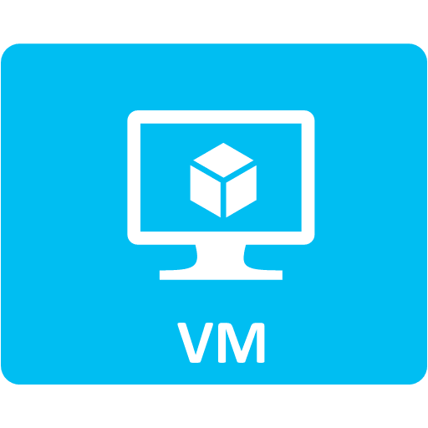











Standards Based
Management
Extensive Device Support
SAN, NAS, FC Switch
VM, Host, and Cluster
Storage Management
End to End
Discovery and Mapping
Allocation and
Assignment
Storage Automation
Built in Context
Storage Classification
Management of Pools,
LUNs, File Shares,
Zones, Zone Aliases
Cloud Integration
for Self-Service
Storage Monitoring
and Capacity Trending
Scalable
Provisioning
Hybrid Cloud Scenarios
Insight
Flexibility
Automation

Slide 23
Standards Based Storage Management
Windows Server
Server Manager
ISV or
Storage Vendor
Applications
System Center
Virtual Machine
Manager
Storage Management API (WMI)
CIM Pass Through
SMP
Based
Subsystem
Storage
Spaces
Enclosure
SMI-S
Compliant
Subsystem
SMI-S
Compliant
NAS
SMI-S
Compliant
FC Switch

Slide 24
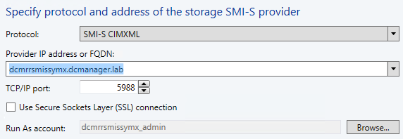
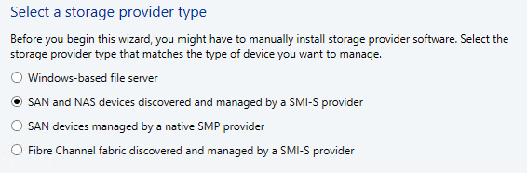
Initial Storage Discovery
Configure devices for replication (device console)
Install SMI-S provider
Add provider to VMM
Enumerate Storage Pools
Enumerate Endpoints
Enumerate Initiators
Discover ComputerSystem
Enumerate Properties

Slide 25
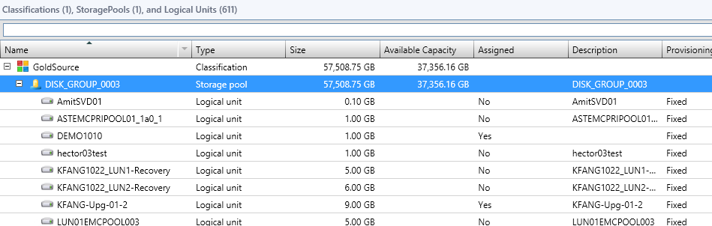
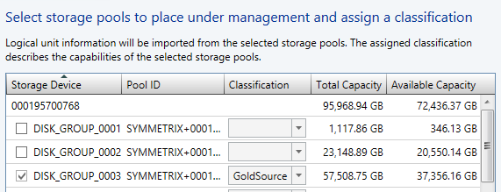
Storage Provisioning
Add storage pools to VMM
Enumerate StorageVolume
Enumerate SPCs

Slide 26
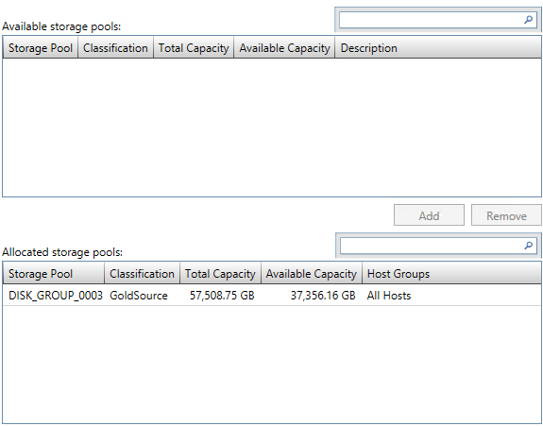
Storage Provisioning
Allocate storage pools to host groups

Slide 27
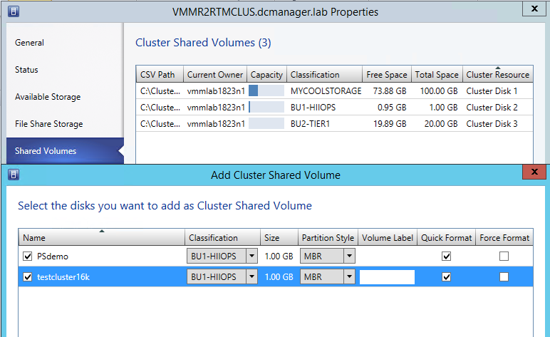
Storage Provisioning
Assign storage to Hyper-V clusters

Slide 28
What is a Replication Group?
Primary
Secondary

Slide 29
What is a Replication Group?
Primary
Secondary

Slide 30
Enabling Storage Replication
Automated Storage Pairing (RG → Storage Pool)
L1
L1’
L2
L2’
L3
L3’
RG
RG
Pair Storage
Enable Replication
Primary
Secondary

Slide 31
Enabling Storage Replication
Manual Storage Pairing (RG → RG)
L1
L1’
L2
L2’
L3
L3’
RG
RG
Pair Storage + Enable Replication
Primary
Secondary

Slide 32
Workload Deployment
Enable protection in hardware profile
Placement finds suitable cluster
L1
L2
L3
L1’
L2’
L3’
RG
RG
Replicating
Primary
Secondary

Slide 33
Workload Deployment
VM deployment to protected storage
VM deployed CSVs VM configuration registered
CSVs not exposed to servers
VM exists in VMM database Capacity reserved for failover
L1
L2
L3
L1’
L2’
L3’
RG
RG
Replicating
Primary
Secondary

Slide 34
Workload Migration
Enable protection in migration wizard
Placement finds suitable cluster
Create Recovery Plans for storage protected VMs
L1
L2
L3
L1’
L2’
L3’
RG
RG
Replicating
Primary
Secondary

Slide 35
Recovery of VM Workloads

Slide 36
Demo
Add VMs/Replication groups to Recovery Plan
Planned Failover of Recovery Plan
Pavel Lobanov, NetApp

Slide 37
Workload Failover
Planned Failover
Reverse Replication
Synchronizing
Synchronized
L1’
L2’
L3’
L1
L2
L3
L1’
L2’
L3’
L1
L2
L3
RG
RG
RG
RG
Replicating
Replicating
Failover
Primary
Secondary

Slide 38
Workload Failover
Unplanned Failover
Synchronizing
Broken
L1’
L2’
L3’
L1
L2
L3
L1’
L2’
L3’
L1
L2
L3
RG
RG
RG
RG
Replicating
Failover
Primary
Secondary

Slide 39
Workload Failover
Test Failover
Synchronizing
L1
L2
L3
L1’
L2’
L3’
L1’’
L2’’
L3’’
RG
RG
Snapshot/Clone
RG
Replicating
Primary
Secondary

Slide 40
Demo
Failover SQL guest cluster with shared storage
Abhishek Agrawal, Microsoft

Slide 41
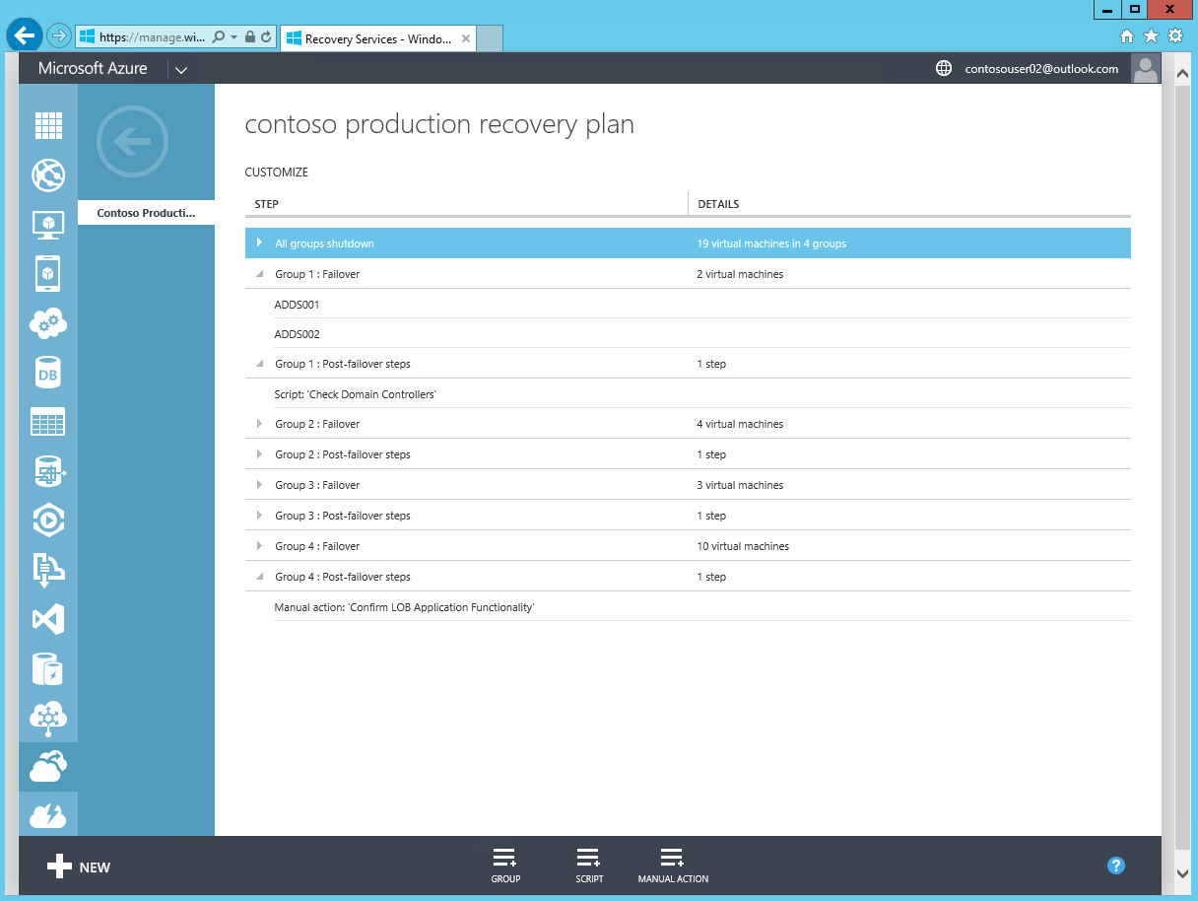
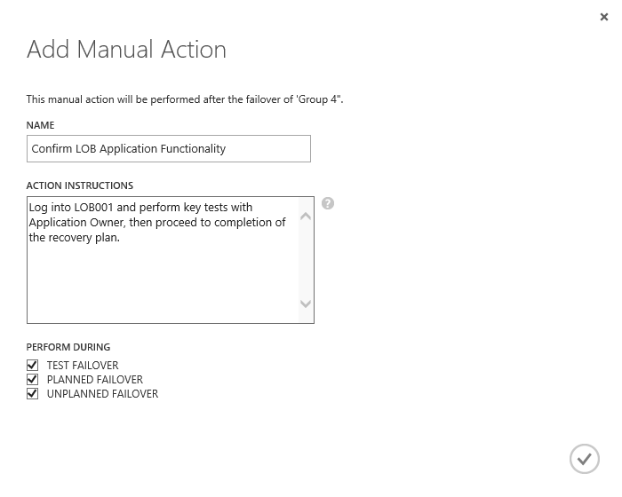
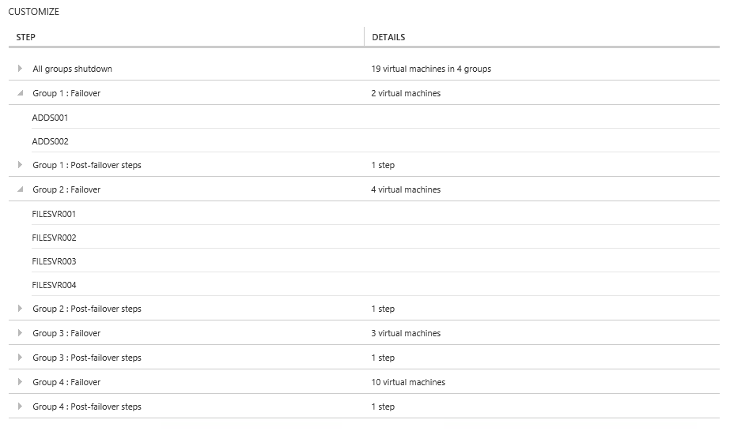
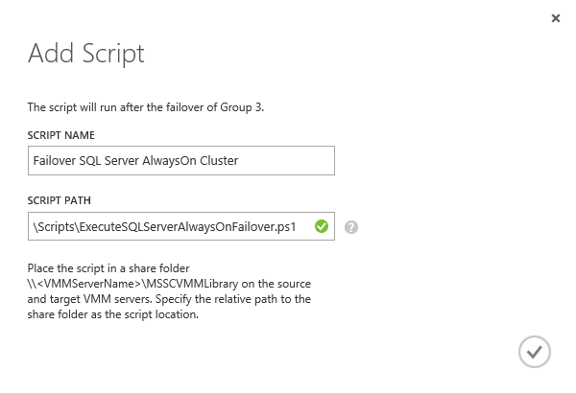
Orchestrated Recovery using Recovery Plans
  Recovery Plans help automate the orderly recovery in the event of a site outage at the primary datacenter.
  Recovery Plans consist of a series of groups that contain a list of protected virtual machines. The order the VMs failover is determined by the group they are within. VMs within a particular group failover in parallel
  Recovery plans typically model an application that needs to start up, or failover, in a particular order.
  Orchestrated Steps for Recovery
Script Integration
Scripts can be added, to run before or after a specific group in a recovery plan. Scripts could also allow integration with SQL Server AlwaysOn failover between sites.
Manual Actions
Manual actions can also be added, to run before or after a selected group. These require some form of physical interaction by a particular user before recovery plan continues.

Slide 42
Software Requirements

Slide 43
Software Requirements
VMM UR5
VMM UR5 Preview
VMM UR5
July
2014
October
2014
November
2014
VMM UR5 Preview
VMM UR5
January
2015
VMM UR3
VMM UR4
VMM Update Roll Up
System Center 2012 R2 VMM UR5 Preview required
Windows Server 2012, 2012R2 Hyper-V hosts
Azure Site Recovery with SAN Replication will be available starting Mid November 2014
Latest ASR Provider is required
Obtain latest SMI-S Provider Updates from storage partners directly

Slide 44



Azure Site Recovery
One solution for your entire Infrastructure
Business Continuity
DR Support for any Infrastructure on your on-premises (Hyper-V, VMWare, Physical)
Zero RPO/Near sync RPO solutions with Azure Site Recovery
Support for Enterprise Class Applications
Support for Enterprise scenarios: Shared Storage, raw devices, clustering, group consistency
Low TCO DR to Public Cloud or Service Provider Cloud
Simple, consistent, unified management experience

Slide 45
Session Objectives and Takeaways
Session Objective(s):
Discuss Microsoft BCDR solution
Explain benefits of supporting SAN based replication technology with Azure Site Recovery and VMM
Perform Hyper-V VM protection and recovery with storage partner solutions
Explain the standards based work that enables this solution
TAP Signup (contact abhiag@microsoft.com , hectorl@microsoft.com)
UR5 Preview Download (KB3011473 Available Nov 12)

Slide 46
Related Content
CDP-B328 Microsoft Migration Accelerator and Microsoft Azure Site Recovery Using InMage Scout
CDP-B314 Microsoft Azure Site Recovery: Leveraging Microsoft Azure as your Disaster Recovery Site
CDP-B339 Leveraging SAN Replication for Enterprise Grade Disaster Recovery with Azure Site Recovery and System Center
CDP-B239 How to Stay Calm When the Lights Go Out: Business Continuity in the Real World
CDP-B352 Stretching Failover Clusters and Using Storage Replica for Disaster Recovery in the Next Release of Windows Server
CDP-B334 Cloud Integrated Data Protection with System Center Data Protection Manager and Microsoft Azure Backup
CDP-B318 Building Scalable and Reliable Backup Solutions in the Next Release of Windows Server Hyper-V
CDP-B335 Hyper-V Best Practices for High-Availability with Failover Clustering
Find me later at the Business Continuity booth at the Microsoft Solutions Experience Location (MSE)

Slide 47
ASR Resources
Pricing Guide
Planning Guide
Capacity Planner Tool
Deployment Guide
Configuration Tutorials
WAN Optimization with Riverbed
InMage Website
ASR MSDN Forum
Azure Feedback Forum – ASR User Voice
ASR Wiki

Slide 48

For more information
Windows Server
Windows Server Technical Preview
http://technet.microsoft.com/library/dn765472.aspx
System Center
System Center Technical Preview
http://technet.microsoft.com/en-us/library/hh546785.aspx
Azure Pack
Azure Pack
  http://www.microsoft.com/en-us/server-cloud/products/
  windows-azure-pack
Microsoft Azure
Microsoft Azure
  http://azure.microsoft.com/en-us/
  Come visit us in the Microsoft Solutions Experience (MSE)!
  Look for the Cloud and Datacenter Platform area TechExpo Hall 7

Slide 49

Resources
Learning
  Sessions on Demand
  Microsoft Certification & Training Resources
http://channel9.msdn.com/Events/TechEd
www.microsoft.com/learning
TechNet
Developer Network
  Resources for IT Professionals
http://microsoft.com/technet
http://developer.microsoft.com

Slide 50


Azure
Exams
Developing Microsoft Azure Solutions
EXAM
532
Implementing
Microsoft Azure Infrastructure Solutions
EXAM
533
(Coming soon)
Architecting Microsoft Azure Solutions
EXAM
534
http://bit.ly/
Azure-Cert
+
Classroom
training
(Coming soon)
Microsoft Azure Fundamentals
MOC
10979
Developing Microsoft Azure Solutions
MOC
20532
Implementing
Microsoft Azure Infrastructure Solutions
2
5
MOC
20533
5
http://bit.ly/
Azure-Train
Online
training
(Coming soon)
Microsoft Azure Fundamentals
MVA
(Coming soon)
Architecting Microsoft Azure Solutions
MVA
http://bit.ly/
Azure-MVA
Get certified for 1/2 the price at TechEd Europe 2014!
http://bit.ly/
TechEd-CertDeal

Slide 51



Please Complete An Evaluation Form
Your input is important!
TechEd Schedule Builder
CommNet station or PC
TechEd Mobile app
Phone or Tablet
QR code

Slide 52
Evaluate this session

Slide 53


© 2014 Microsoft Corporation. All rights reserved. Microsoft, Windows, and other product names are or may be registered trademarks and/or trademarks in the U.S. and/or other countries.
The information herein is for informational purposes only and represents the current view of Microsoft Corporation as of the date of this presentation. Because Microsoft must respond to changing market conditions, it should not be interpreted to be a commitment on the part of Microsoft, and Microsoft cannot guarantee the accuracy of any information provided after the date of this presentation. MICROSOFT MAKES NO WARRANTIES, EXPRESS, IMPLIED OR STATUTORY, AS TO THE INFORMATION IN THIS PRESENTATION.

