Slide 1
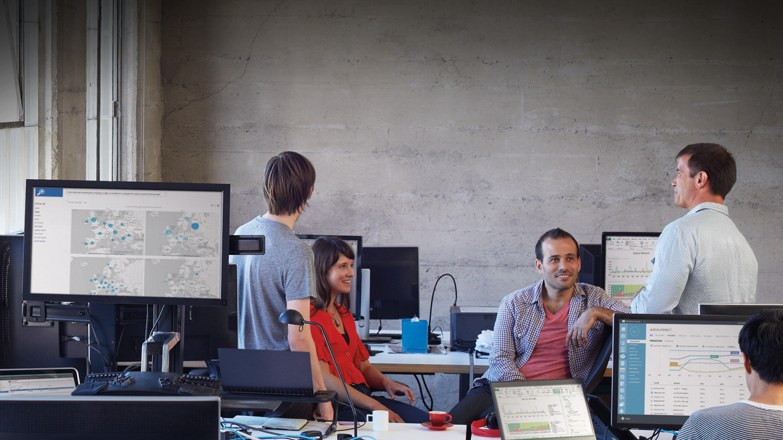

Slide 2

Architectural Deep Dive Microsoft Cloud Platform System
CDP-B341
Jim Pinkerton
Spencer Shepler
Microsoft Corp

Slide 3
Agenda
CPS Architecture Overview
CPS Architecture Dive:
Networking
Compute
Storage
Management Overview

Slide 4

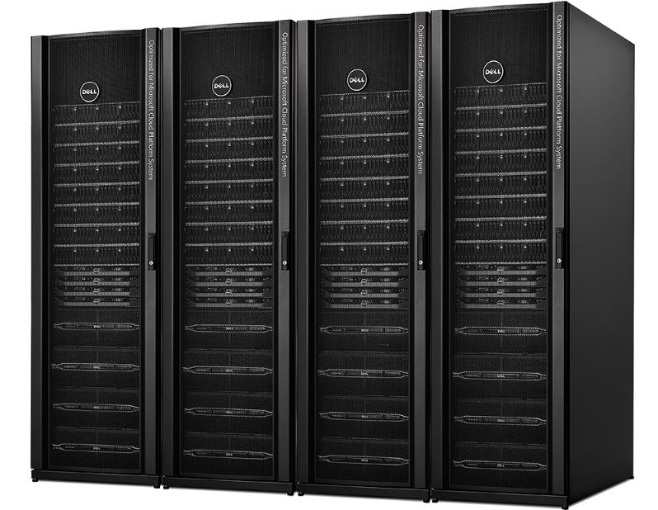
Microsoft Cloud Platform System - powered by Dell
Azure-consistent Cloud in a Box
Windows Server 2012 R2, System Center 2012 R2, Windows Azure Pack
Microsoft-designed architecture based on Public Cloud learning
Microsoft-led support & orchestrated updates
Optimized run-books for Microsoft applications
Dell PowerEdge servers
Dell dense Storage enclosures
Dell Networking switches
Tightly integrated components
Microsoft-led support & orchestrated updates

Slide 5
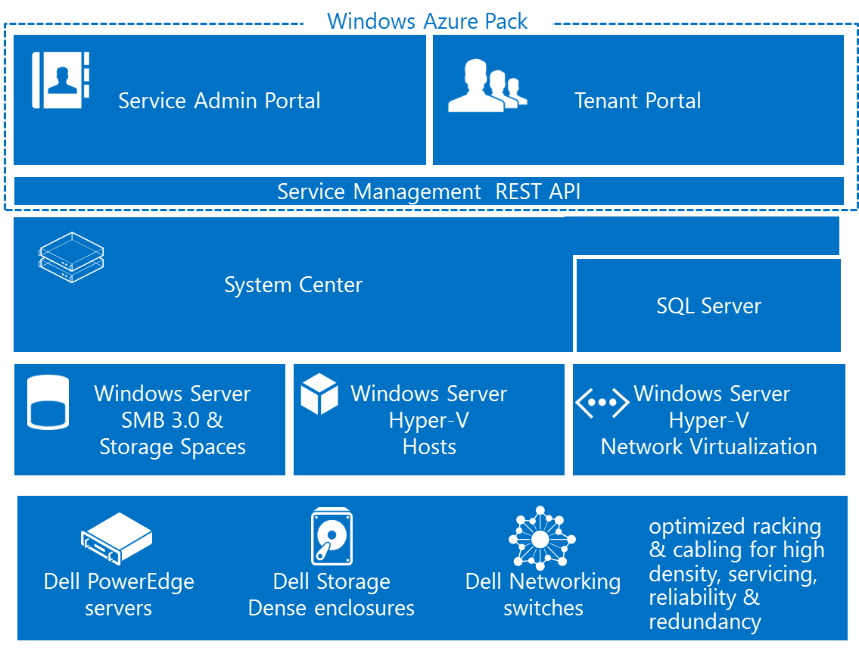
$97B
46%
Global cloud market in 2015
Public cloud service of net new growth in IT spend
Cloud Platform System - Capabilities
Pre-deployed infrastructure
  Switches, load balancer, storage, compute, network edge
  N+2 fault tolerant (N+1 networking)
Pre-configured as per best practices
Integrated Management
  Configure, deploy, patching
  Monitoring
  Backup and DR
  Automation
Up to 8000 VM’s* and 1.1 PB of total storage
Optimized deployment and operations for Microsoft and other standard workloads
* VM Topology - 2vCPU, 1.75 GB Ram, 50 GB Disk

Slide 6




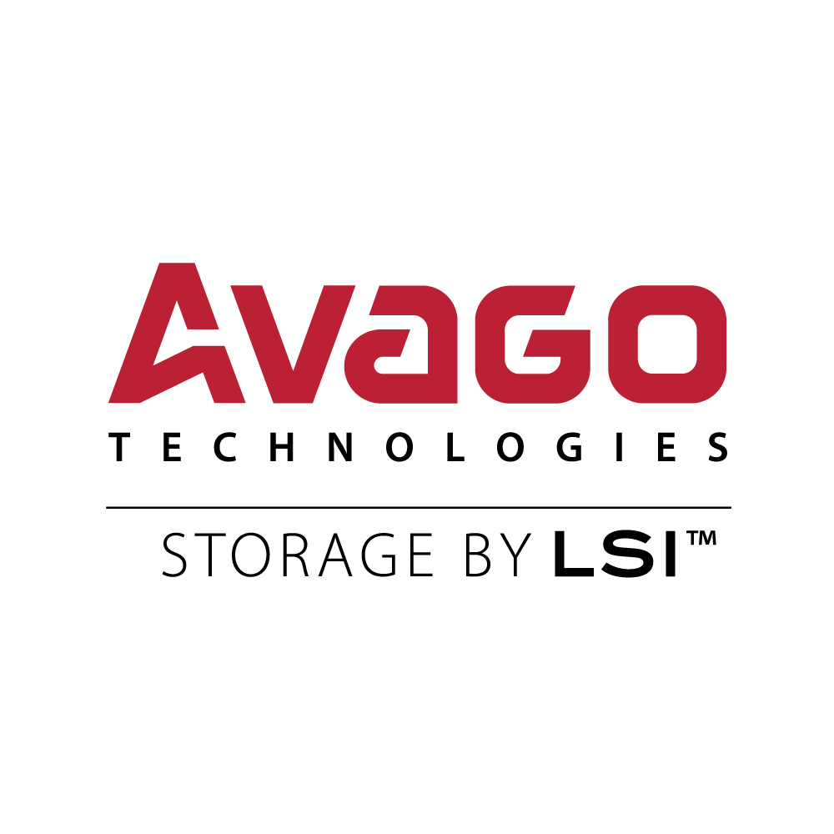
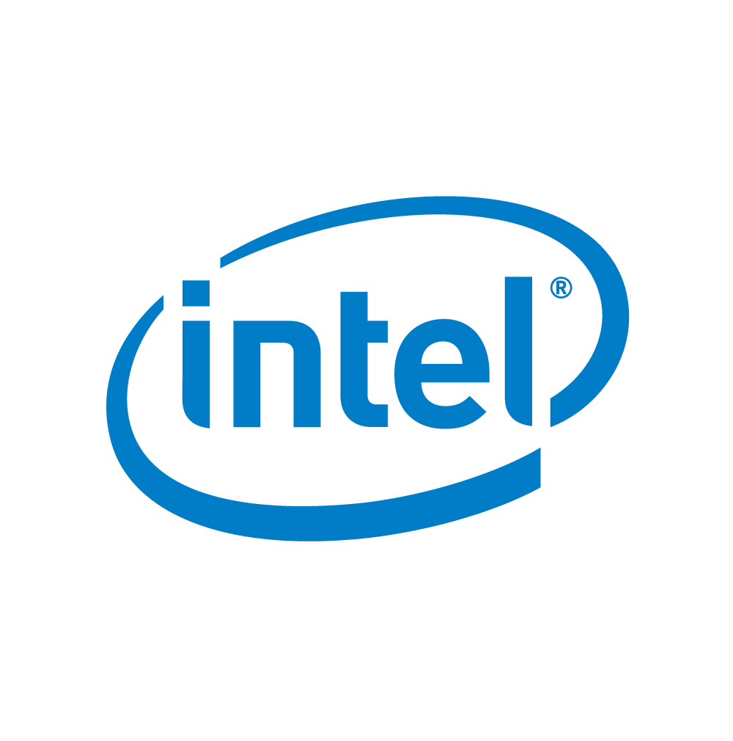
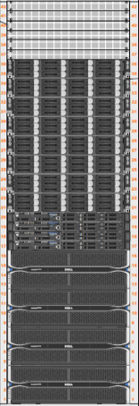
CPS – Cloud in a Box
Per Rack
(1-4 racks)
512 Cores
8TB RAM
262 TB usable storage
1360 Gb/s internal
rack connectivity
560 Gb/s inter-rack connectivity
60 Gb/s external
2322 Lbs
42U
16.6 KW Maximum
Networking
  5 x Force 10 – S4810P (64 port @ 10GbE - Data)
  1 x Force 10 – S55 (48 port @ 1GbE – Management)
Compute Scale Unit (32 x Hyper-V hosts)
  Dell PowerEdge C6220ii – 4 Compute Nodes per 2U
    Dual socket Intel IvyBridge (E5-2650v2 @ 2.6GHz)
    256 GB memory
    2 x 10 GbE Mellanox NIC’s (LBFO Team, NVGRE offload)
    2 x 10 GbE Chelsio (iWARP/RDMA)
    1 local SSD @ 200 GB (boot/paging)
Storage Scale Unit (4 x File Servers, 4 x JBODS)
  Dell PowerEdge R620v2 Servers (4 Server for Scale Out File Server)
    Dual socket Intel IvyBridge (E5-2650v2 @ 2.6GHz)
    2 x LSI 9207-8E SAS Controllers (shared storage)
    2 x 10 GbE Chelsio T520 (iWARP/RDMA)
  PowerVault MD3060e JBODs (48 HDD, 12 SSD)
  4 TB HDDs and 800 GB SSDs

Slide 7
Azure Consistent Innovative Architecture
Same hypervisor
  In CPS, all management functions have been virtualized
IaaS and PaaS solution
  Azure Portal
  Azure Web Sites
Efficient use of hardware
  Efficient packing of VMs
  Efficient packing of storage
  State of the art network offloads
Dynamic scaling
  Dynamic VM scaling
  Integrated load balancer
  Incremental Hardware scaling

Slide 8
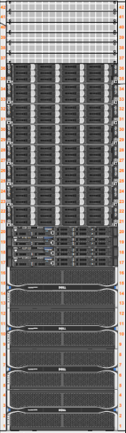
Flat Network – Efficient Resource Packing
Traditional Deployment
Within rack: 1360 gb/sec
Off-rack typically 10-20 gb/sec
VM and storage placement is critical
  Orphaned resources are common
CPS Deployment
Flat network between racks
  560 gb/sec off-rack connectivity
Equal Cost Multi-Path Routing (ECMP)
  Network fault tolerance
VMs and storage can be placed anywhere resources are available
Off Rack
Bottleneck
$$$
Director Class Switch
$
TOR
TOR
$
TOR
TOR
TOR
TOR
$
TOR
TOR
TOR
TOR

Slide 9
Network Performance
Test Configuration
  1 VM to 1 VM, on 2 servers, LACP teaming
  RSS enabled in host and VM
  VMQueue enabled on the port
  CTSTraffic load generator,
    100 TCP Streams,
    64 Kbyte IOs
Variables
  NVGRE Task Offload (on/off)
  CPU Architecture
  East/West throughput
  Type of Gateway
CPS Results
  18 gigabits/sec - east/west (VM to VM)
  10 gigabits/sec - forwarding gateway
  8 gigabits/sec - NAT gateway
  1.8 gigabits/sec – Site-to-Site Gateway (encrypted)
CPS

Slide 10
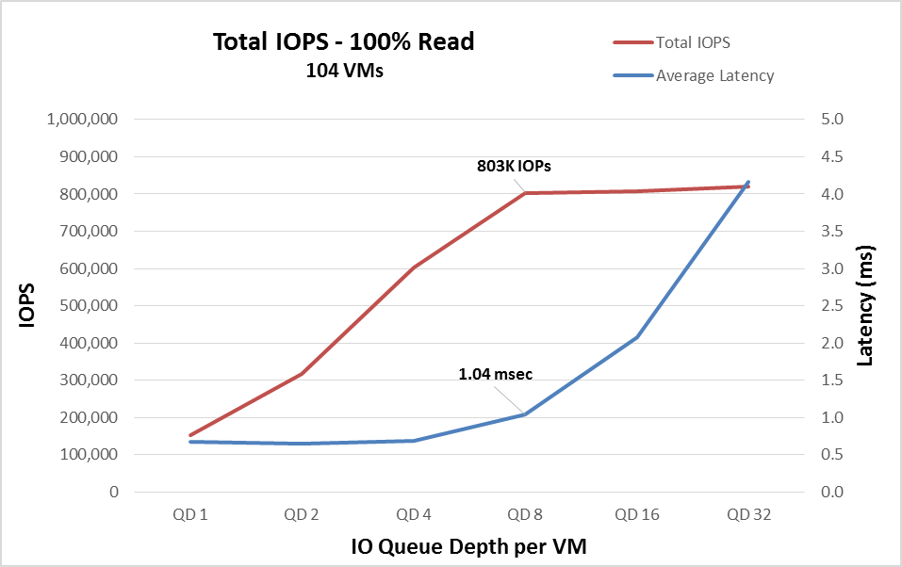
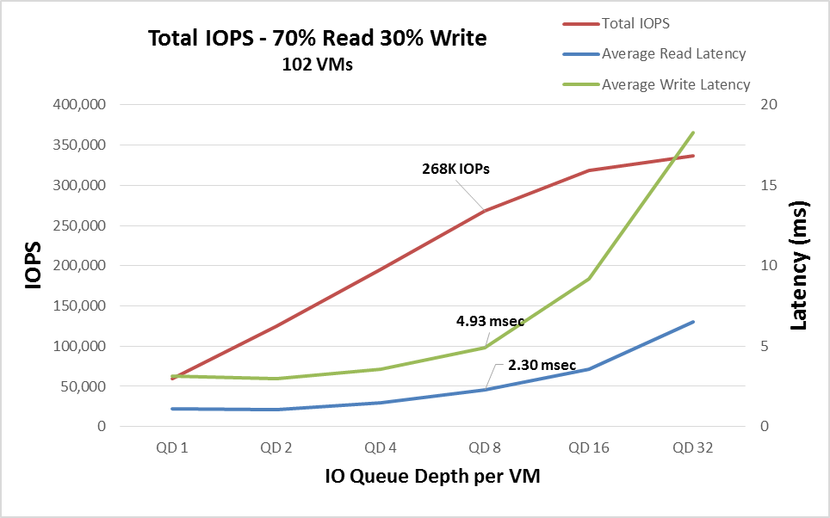
Storage Scale Unit (SSU) Performance
Test Configuration
  ~100 VMs, on 14 servers
  Diskspd Load generator in each VM, single threaded
  Random 8 KB IO, using RDMA offload NICs
  Single SSU (4 servers), 14* tenant volumes
  Spaces tiering placed all IOs in SSD Tier
Variables
  Queue depth (number of outstanding IOs per VM)
    Total IO queued to SSU is ~100*QD
Single SSU Results (IOPs, Latency)
  100% Read (non-saturated)
    803K IOPs, queue depth of 8 per VM
    1.0 ms avg latency
    1.7 ms 95th percentile
  70%/30% Read/Write (non-saturated)
    268K IOPs, queue depth of 8 per VM
    Reads: 2.3 ms avg, 5.7 ms 95th percentile
    Writes: 4.9 ms avg, 43.8 ms 95th percentile
*16 volumes available in racks 2-4

Slide 11
Dynamic Scaling
VM Role Instance
VM Role enables dynamic VM scaling
Load Balancer automatically reconfigured as VMs scale
"ResourceDefinition": {
  "ScaleOutSettings": {
  "InitialInstanceCount": "1", "MaximumInstanceCount": "5", "MinimumInstanceCount": "1", "UpgradeDomainCount": "1" },
VM
VM
VM
SQL
External
Network
Hardware
Load Balancer
VM
VM
SQL
VM
Database
Tier
VM
Web Tier

Slide 12
Optimized for Enterprise and Hosters
Low operational overhead
  Transparent patching
  Integrated management
  Integrated and tested at full scale
Highly fault tolerant
  N+2 for compute and storage
  N+1 for networking
Converged Infrastructure
  Storage, Compute, Networking, Management

Slide 13
Highly Fault Tolerant
All systems are active-active
N+2 Fault Tolerant for
  HDD and SSD
  Storage Servers
  Compute Servers
N+1 Fault Tolerant for:
  SAS network (cable, HBA)
  JBOD
  Ethernet network (cable, switch)
Illustrative of the CPS Architecture
All links not shown for clarity

Slide 14
Converged Infrastructure
Converged Solution Combines:
Software Defined Storage
Software Defined Network
Software Defined Compute
Integrated Management
Rack 1
Rack 2
Rack 3
Rack 4
Network Scale Unit
Network Scale Unit
Network Scale Unit
Network Scale Unit
Edge Host Group
Compute Scale Unit
ComputeScale Unit
ComputeScale Unit
ComputeScale Unit
Net Edge
Net Edge
Net Edge
Net Edge
Mgmt Host Group
Mgmt
Tenant Compute
Tenant Compute
Tenant Compute
Tenant
Compute
Compute Host
Group
Storage Scale Unit
Storage Scale Unit
Storage Scale Unit
Storage Scale Unit
Storage
Storage
Storage
Storage
Legend
Network Scale Unit
Compute Scale Unit
Storage Scale Unit

Slide 15
Inside CPS Networking

Slide 16
CPS Three Physical Networks
Front End Network
Back End Network
Tenant Network Content
  Tenant node-to-node
    Includes Tenant node to Tenant file server
  Tenant to HNV Gateway
  HNV Gateway to extranet
  Tenant to hardware Load Balancer
DataCenter (DC) Network Content
  Bulk data
    Live migration
    Tenant storage to “scale out file server”
    CSV & Spaces Redirection
    Backup
  Management (System Center, etc.)
  Cluster heartbeat
Management Network
Connectivity to the BMC and switch management ports
1 gigabit ethernet

Slide 17
Logical networks
Infrastructure
Host management
Clustering
Live migration
Storage
Management VM communication
BMCManagement
Host BMCs
Cloudbuilder
Services
Platform as a service (PaaS) workloads
External
Front-end for load balancer
NAT for virtual networks
Site-to-site endpoints
Tenant workloads
NetworkVirtualization
NVGRE encapsulated packets only
Stamp private address space
SwitchManagement
Network device management
LoadBalancer
Backend for load balancer.
Service instance VMs
Stamp private addres space
Forwarding Gateway Front-ends (optional)
Point-to-point routing for NVGRE gateway when used in forwarding mode

Slide 18
Specific Network Configuration – Additional Detail
Mgmt.
LM
Cluster
Storage
Datacenter Network
Physical Switch
Edge Cluster
Edge Cluster
Edge Cluster
Edge Cluster
Physical Switch
Management
Compute
Storage
Net Edge
Physical Switch
Access Switches
To Other Racks
}
Services Network (VLAN)
External Network (VLAN)
Tenant Network
Physical Switch
HNV Network (VLAN)
Physical Switch
Physical Switch
Load Balancer Network (VLAN)
Agg
Switches
BMC
Network
Physical Switch

Slide 19
Restricting Access with ACLs
Restrict at entry point into network
Block tenants on External from accessing stamp
Block tenants on tenant networks from accessing stamp
Restrict access to BMC and switch management networks
Finer grain control can be manually applied to Hyper-V virtual switch ports

Slide 20
Access control between logical networks
Infrastructure
No Restrictions
BMCManagement
Restrict inbound
Services
Inbound only accessible via VIP
Outbound only to External
Enforced by Load Balancer
External
Restrict outbound to “Corp Private” and “Stamp Private”
NetworkVirtualization
No Restrictions
SwitchManagement
Restrict inbound
LoadBalancer
Inbound only accessible via VIP
Outbound only to External
Enforced by Load Balancer
Forwarding Gateway Front-ends (optional)
Restrictions on CA space
Same as external, with optional exception

Slide 21
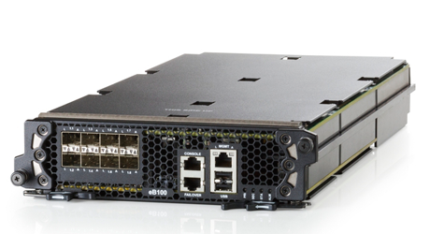
L4-L7: Load Balancing
CPS includes a hardware load balancer for:
Management services
Platform as a service (PaaS) services
Tenant workloads
Included in stamp
(2) F5 VIPRION 2200 chassis
(2) VIPRION 2100 module (one per chassis)
Photo Courtesy of F5

Slide 22
L4-L7: Load balancer logical connectivity
Infrastructure
VMM
Windows Azure Pack Tenant Portal
Services
Windows Azure Web Sites
Service Bus
Public
SQL/MySQL
Load Balancer
Tenant VM 1
Tenant VM 2
Tenant VM N
Load Balancer
R
R
External
R
Internet

Slide 23
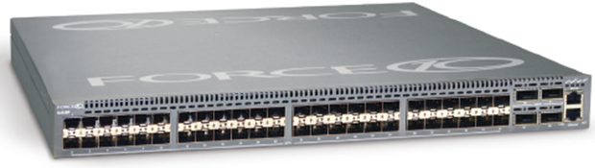
Specific network hardware
CPS specifications | Single rack (Min configuration) | Four racks (max configuration)
Network Dell Force 10 S4810P | 6 x switches (2 x Agg; 2 x Tenant; 2 x DC) 48 x 10 GbE SFP+; 4 x 40 GbE QSFP+ | 20 x switches (4 x Agg; 8 x Tenant; 8 x DC) 48 x 10 GbE SFP+; 4 x 40 GbE QSFP+
Network Dell Force 10 S55 | 1 x switch (BMC and management) 1 GbE (iDrac connectivity) | 4 x Switch (BMC and management) 1 GbE (iDrac connectivity)
Photo Courtesy of Dell

Slide 24
Inside CPS Compute

Slide 25
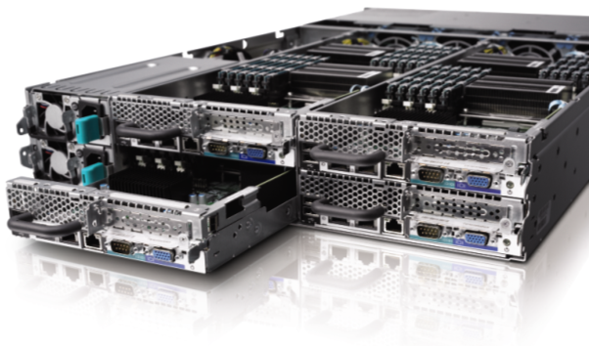
PowerEdge C for CSU
4 nodes in 2U chassis
Dual socket IvyBridge (E5-2650v2 @ 2.6GHz)
256 GB memory (16 x 16GB RDIMMs)
10GbE Mellanox Connect-3 Pro (2 Ports SFP+)
10GbE Chelsio (iWARP/RDMA, 2 x SFP+)
1 local SSD (boot/paging)
Dual Power Supplies
Photos Courtesy of Dell

Slide 26
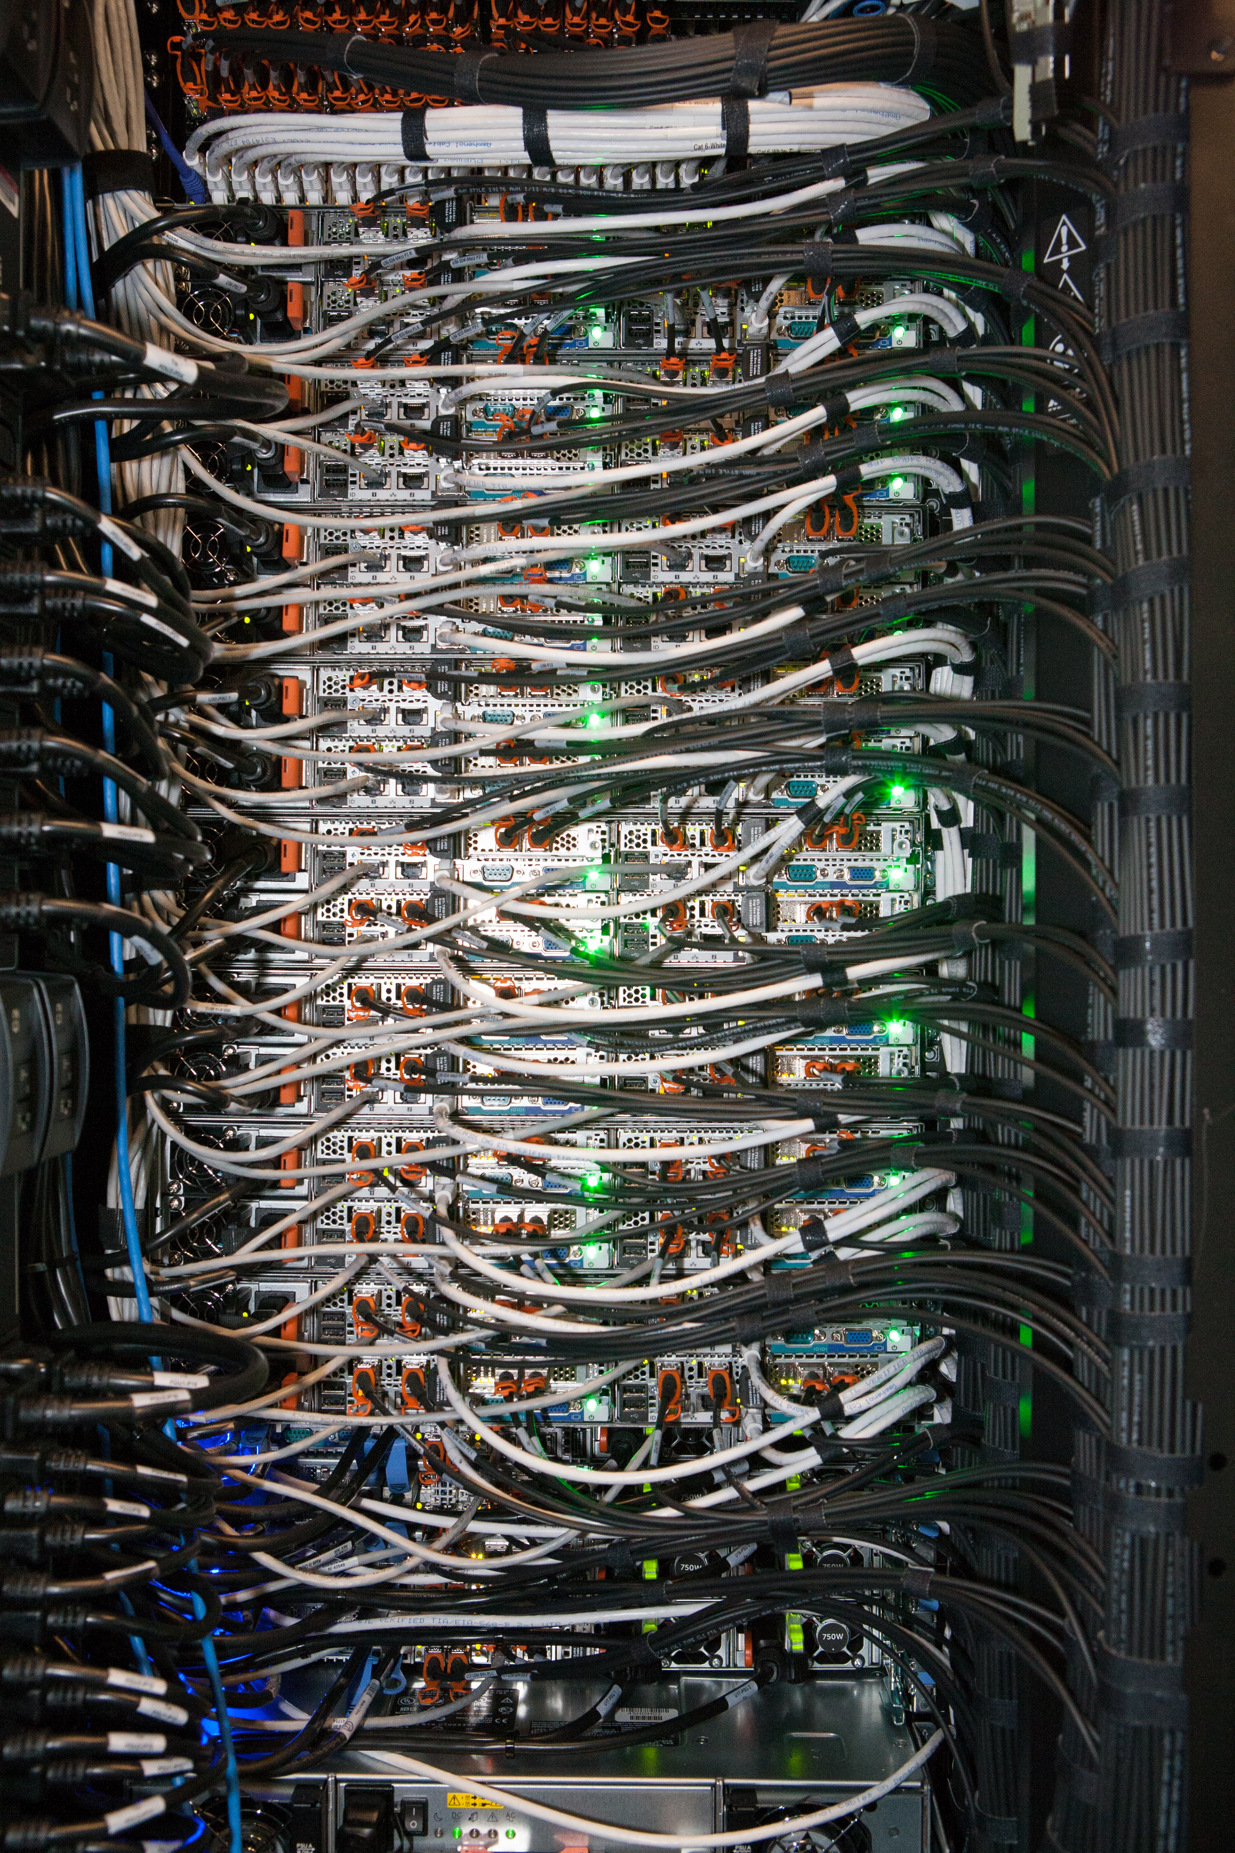
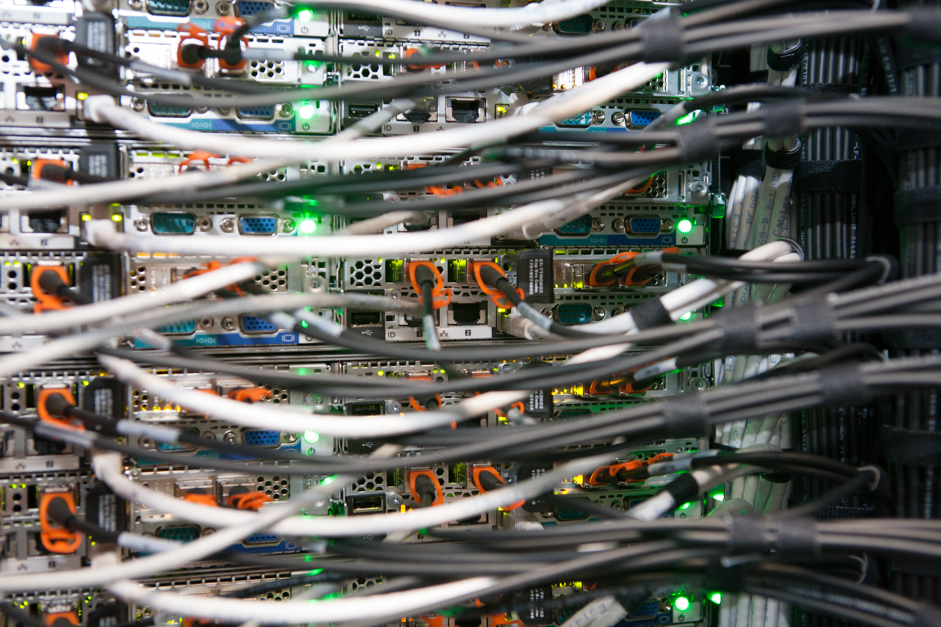

Slide 27
Compute Node Network Connectivity

Slide 28
Host networking – CSU and MSU nodes
CSU and MSU node
To border device(s)
VM Policies:
Network virtualization
QOS
Security (ACLs)
To Tenant/DC switches
In other stamps
Aggregate L3 Switches
BMC Switch
BMC
Tenant 1 L3 Switch
VM
MC-LAG
Mellanox
Virtual Switch
VM
Tenant 2 L3 Switch
Team
To Agg Switches
Mellanox
VM
Datacenter 1 L3 Switch
Chelsio
Dedicated to host functions:
Host management
SMB with RDMA
Live migration
Clustering
VM
Chelsio
Datacenter 2 L3 Switch

Slide 29
Inside CPS Storage

Slide 30
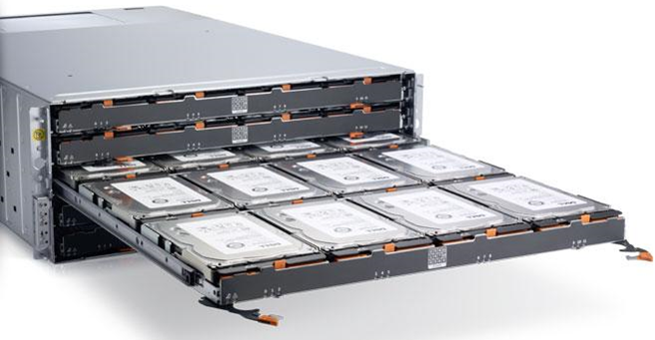
Specific storage hardware
Cloud Platform System specifications | Single rack (min configuration) | Four racks (max configuration)
Storage Dell PowerVault MD3060e | 4 JBOD enclosures = 768 terabytes RAW (0.7PB HDD; 12TB SSD) | 16 JBOD enclosures = 2.95 petabytes RAW (2.9PB HDD; 48TB SSD)
Storage Dell PowerEdge R620 v2 | 4 file server nodes (Dual socket E5-2650 v2; 128 GB) 10GbE Chelsio (iWARP/RDMA) | 16 file server nodes (Dual socket E5-2650 v2; 128 GB)
Photos Courtesy of Dell

Slide 31
Storage networking – SSU nodes
To border device(s)
To Tenant/DC switches
In other stamps
Aggregate L3 Switch
SSU node
BMC Switch
BMC
Tenant 1 L3 Switch
MC-LAG
Mellanox
Unused & disabled
Tenant 2 L3 Switch
Mellanox
To Agg Switches
Datacenter 1 L3 Switch
Chelsio
Direct to OS for:
Scale out file server management
SMB with RDMA
Clustering
Chelsio
Datacenter 2 L3 Switch

Slide 32
CPS Storage Configuration
Storage Scale Unit hardware (4x4)
  4x Dell PowerEdge R620v2 Servers
    Dual socket Intel IvyBridge (E5-2650v2 @ 2.6GHz)
    128GB memory
    2x LSI 9207-8E SAS Controllers (shared storage)
    2x 10 GbE Chelsio T520 (iWARP/RDMA)
  4x PowerVault MD3060e JBODs
    48x 4TB HDDs → 192HDD / 768TB RAW
    12x 800GB SSDs → 48SSD / 38TB RAW
Storage Spaces configuration
  3 x pools (2 x tenant, 1 x backup)
  VM storage:
    16x enclosure aware, 3-copy mirror @ ~9.5TB
    Automatic tiered storage, write-back cache
  Backup storage:
    16x enclosure aware, dual parity @ 7.5TB
    SSD for logs only
  24TB of HDD and 3.2TB of SSD capacity left unused for automatic rebuild
  Available space
    Tenant: 156 terabytes
    Backup: 126 terabytes (+ deduplication)

Slide 33
Enclosure and Physical Disk Allocation
Tenant
Tenant
Backup
48 HDD
12 SSD
16 HDD
5
SSD
16 HDD
5
SSD
16 HDD
2
SSD
16 HDD
5
SSD
16 HDD
5
SSD
16 HDD
2
SSD
48 HDD
12 SSD
16 HDD
5
SSD
16 HDD
5
SSD
16 HDD
2
SSD
16 HDD
5
SSD
16 HDD
5
SSD
16 HDD
2
SSD
48 HDD
12 SSD
16 HDD
5
SSD
16 HDD
5
SSD
16 HDD
2
SSD
16 HDD
5
SSD
16 HDD
5
SSD
16 HDD
2
SSD
48 HDD
12 SSD
16 HDD
5
SSD
16 HDD
5
SSD
16 HDD
2
SSD
16 HDD
5
SSD
16 HDD
5
SSD
16 HDD
2
SSD

Slide 34
Tenant Pool Virtual Disk Configuration
  64 HDDs
  20 SSDs
  Tiered Space
  ResiliencySettingName == Mirror
  PhysicalDiskRedundancy == 2
  NumberOfColumns == 4
  WriteCacheSize == 1GB
  Tiering (SSD == 555 GiB, HDD == 9 TiB)
  Interleave == 64KiB
  IsEnclosureAware == $true
  RetireMissingPhysicalDisks == Always
Device type | drive count | Not allocated | Available device count | size (GB) | size (GiB) | Total Size | Virtual Disk Formatting Ratio (3-way) | Pool Available for Virtual Disk | Virtual Disks per pool | Tier size per virtual disk | Total Virtual Disk Size
4 TB HDD | 64 | 6 | 58 | 4000 | 3725 | 216067 | 0.33 | 72022 | 8 | 9003 | 9558
800 GB SSD | 20 | 2 | 18 | 800 | 745 | 13411 | 0.33 | 4470 | 8 | 555

Slide 35
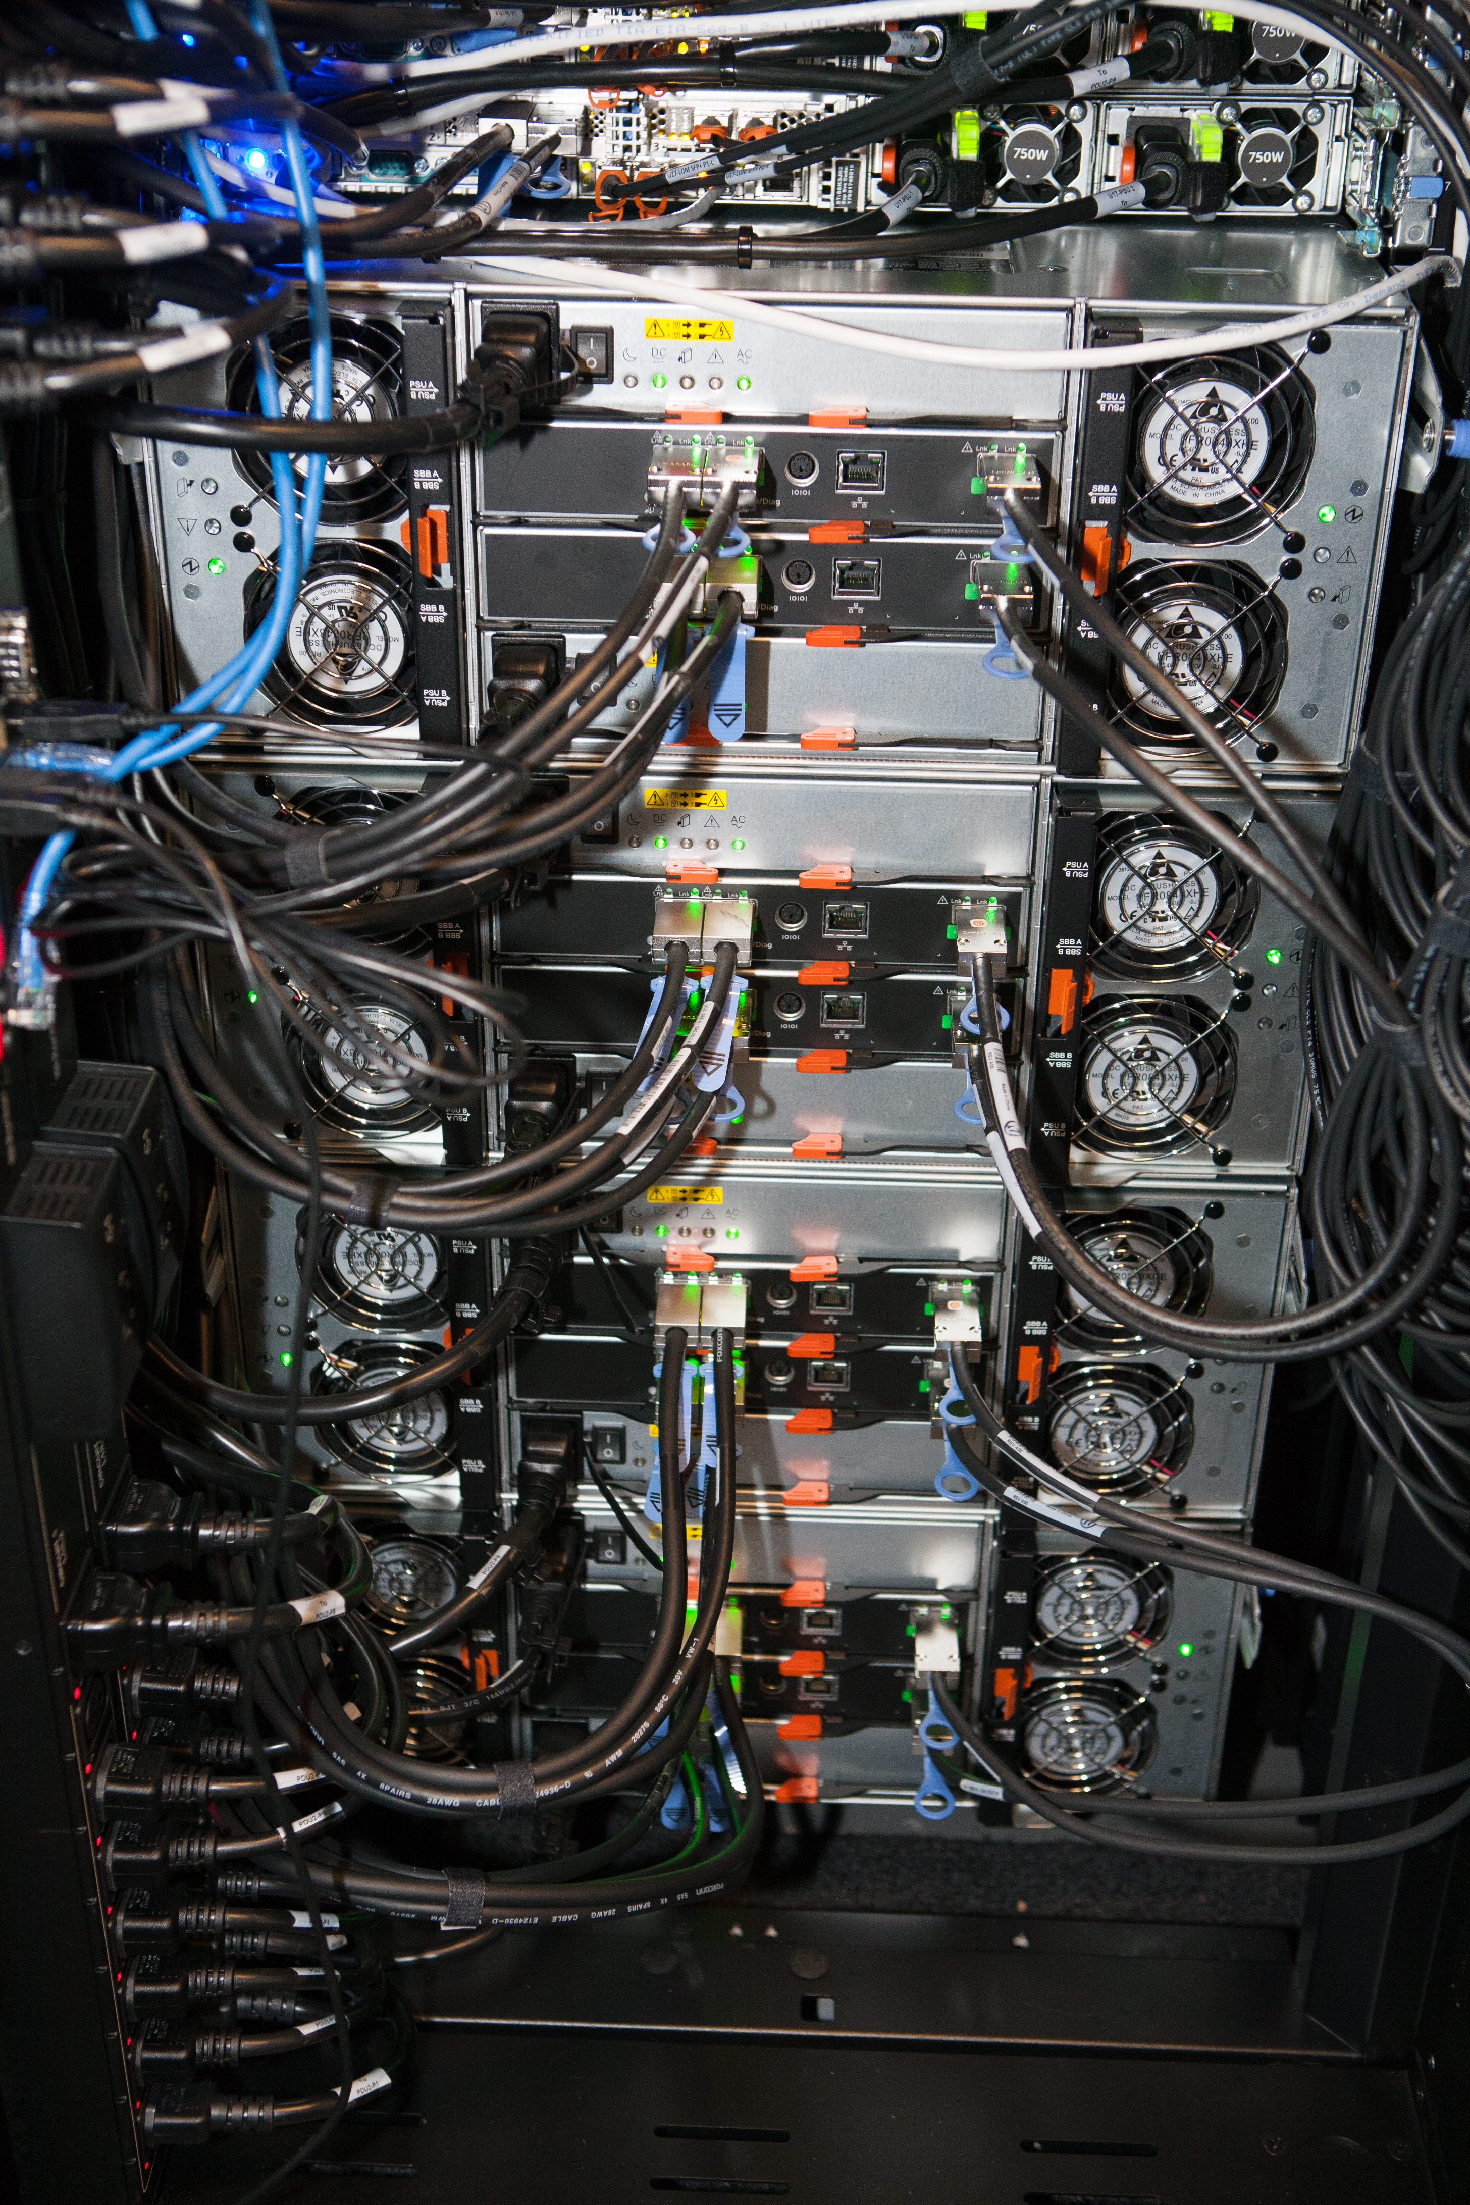
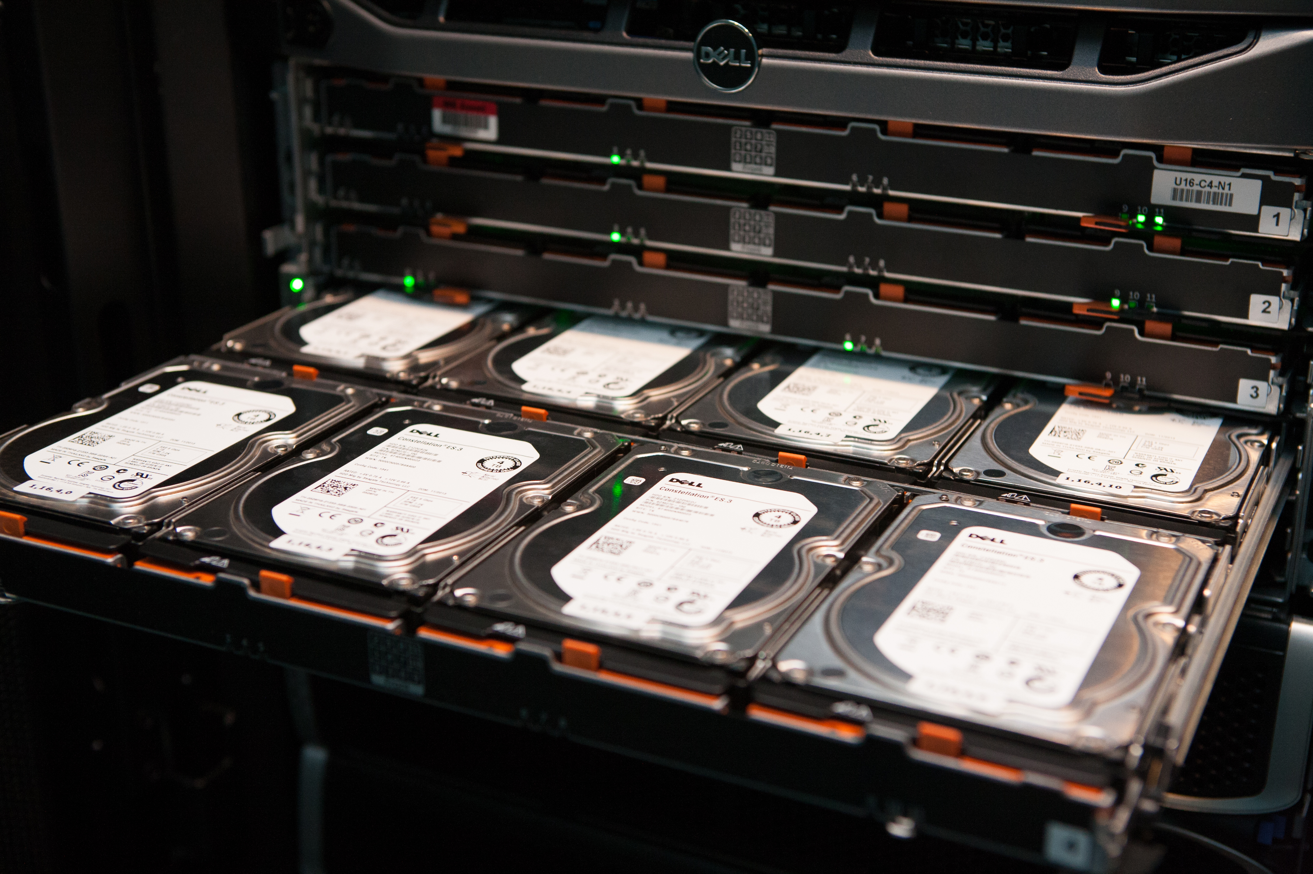

Slide 36
Inside Management

Slide 37
Management Cluster
Mgmt AD
AD/DNS/DHCP (3)
WDS (1)
WSUS (1)
WAP Tenant API (2)
WAP Admin Portal/API, Service Reporting (3)
ADFS (2)
IaaS RP (SPF) (2)
SMA (3)
Deployed for HA
VMM (2)
OM (3)
Console (2)
VMM Library (1)
Service Templates
SQL Cluster for dB’s (4 VM’s)
(VMM, OM, SPF, WSUS, SMA, WAP, DW, Analysis Services)
DPM (1) (for backing up Management cluster)
30 VM’s on a 6 x node Hyper-V failover cluster

Slide 38
Summary
CPS – A ready to run Azure consistent cloud in your datacenter
Microsoft validated, single vendor point of contact for support
Software defined innovations for cost optimized solution

Slide 39
Related content
  CDP-B323: Delivering Predictable Storage Performance with Storage Quality of Service in Windows Server vNext
  CDP-B349: Storage Management in a Hybrid Cloud Environment with Windows Server and System Center
  CDP-B325: Designing Scale-Out File Server with DAS Storage in Windows
  CDP-B380 Deep Dive into Networking for the Microsoft Cloud Platform System
  CDP-B340 Using Tiered Storage Spaces for Greater Performance and Lower costs
  CDP-B353 Automated Workload Provisioning with the Azure Pack and Windows PowerShell
  CDP-B334 Cloud Integrated Data Protection with System Center Data Protection Manager and Microsoft Azure Backup
  CDP-B319 Building Disaster Recovery-as-a-Service: New Opportunities for Service Providers with the Azure Pack and Azure Site Recovery
Find Us Later At the CPS Booth

Slide 40

For more information
Windows Server
Windows Server Technical Preview
http://technet.microsoft.com/library/dn765472.aspx
System Center
System Center Technical Preview
http://technet.microsoft.com/en-us/library/hh546785.aspx
Azure Pack
Azure Pack
  http://www.microsoft.com/en-us/server-cloud/products/
  windows-azure-pack
Microsoft Azure
Microsoft Azure
  http://azure.microsoft.com/en-us/
  Come visit us in the Microsoft Solutions Experience (MSE)!
  Look for the Cloud and Datacenter Platform area TechExpo Hall 7

Slide 41

Resources
Learning
  Sessions on Demand
  Microsoft Certification & Training Resources
http://channel9.msdn.com/Events/TechEd
www.microsoft.com/learning
TechNet
Developer Network
  Resources for IT Professionals
http://microsoft.com/technet
http://developer.microsoft.com

Slide 42


Azure
Exams
Developing Microsoft Azure Solutions
EXAM
532
Implementing
Microsoft Azure Infrastructure Solutions
EXAM
533
(Coming soon)
Architecting Microsoft Azure Solutions
EXAM
534
http://bit.ly/
Azure-Cert
+
Classroom
training
(Coming soon)
Microsoft Azure Fundamentals
MOC
10979
Developing Microsoft Azure Solutions
MOC
20532
Implementing
Microsoft Azure Infrastructure Solutions
2
5
MOC
20533
5
http://bit.ly/
Azure-Train
Online
training
(Coming soon)
Microsoft Azure Fundamentals
MVA
(Coming soon)
Architecting Microsoft Azure Solutions
MVA
http://bit.ly/
Azure-MVA
Get certified for 1/2 the price at TechEd Europe 2014!
http://bit.ly/
TechEd-CertDeal

Slide 43
Office 365
Exams
Managing Office 365 Identities and Requirements
EXAM
346
Deploying
Office 365 Services
EXAM
347
http://bit.ly/
O365-Cert
+
Classroom
training
Introduction
to Office 365
FLC
40041
Managing Office 365 Identities and Services
MOC
20346
Designing for Office
365 Infrastructure
5
MOC
10968
3
http://bit.ly/
O365-Training
Online
training
Office 365
Fundamentals
MVA
Managing Office 365 Identities and Services
MVA
http://bit.ly/
O365-MVA
Get certified for 1/2 the price at TechEd Europe 2014!
http://bit.ly/
TechEd-CertDeal

Slide 44



Please Complete An Evaluation Form
Your input is important!
TechEd Schedule Builder
CommNet station or PC
TechEd Mobile app
Phone or Tablet
QR code

Slide 45
Evaluate this session

Slide 46


© 2014 Microsoft Corporation. All rights reserved. Microsoft, Windows, and other product names are or may be registered trademarks and/or trademarks in the U.S. and/or other countries.
The information herein is for informational purposes only and represents the current view of Microsoft Corporation as of the date of this presentation. Because Microsoft must respond to changing market conditions, it should not be interpreted to be a commitment on the part of Microsoft, and Microsoft cannot guarantee the accuracy of any information provided after the date of this presentation. MICROSOFT MAKES NO WARRANTIES, EXPRESS, IMPLIED OR STATUTORY, AS TO THE INFORMATION IN THIS PRESENTATION.

