Slide 1


Slide 2

New Capabilities in Windows Server vNext when Upgrading your
Private Cloud Infrastructure
CDP-B354
Rob Hindman
Taylor Brown

Slide 3

Agenda
Introduction
  Assumptions
  Your feedback
Enhancements in Windows vNext
  Clustering
  Scale-Out File Server
  Hyper-V
Conclusion
Q/A

Slide 4
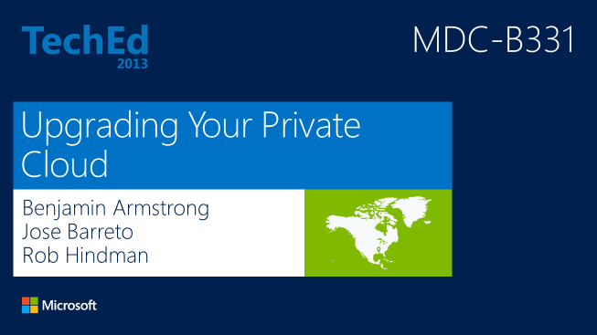
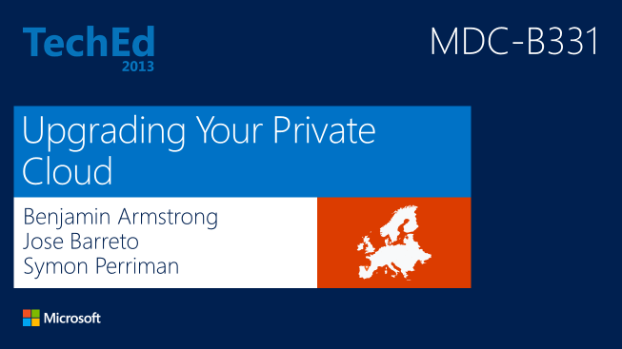
Upgrading Your Private Cloud

Slide 5
Assumptions

Slide 6
Assumptions…
You want to upgrade your Private Cloud infrastructure

Slide 7
Assumptions…
What you care about most is…
users of your Private Cloud infrastructure
do not notice that it is being upgraded

Slide 8
Assumptions…
Buying new hardware in order to upgrade..
will really slow down the process

Slide 9
Assumptions…
Just because you are upgrading software right now…
does not mean that SLAs no longer apply

Slide 10
Assumptions…
Maintaining high-availability…
throughout the upgrade process is important

Slide 11
Assumptions…
Guest operating systems are upgraded…
with a different cadence / process
to that of virtual infrastructure

Slide 12
“A Basic Model for Private Cloud”
Windows Server 2012 R2 Cluster(s)
Scale-Out File Server
Management
System Center Components
Windows Server 2012 R2 Cluster(s)
Hyper-V
Hyper-V
Compute
Hyper-V
Hyper-V
Windows Server 2012 R2 Cluster(s)
Scale-Out File Server
Storage
Scale-Out File Server

Slide 13
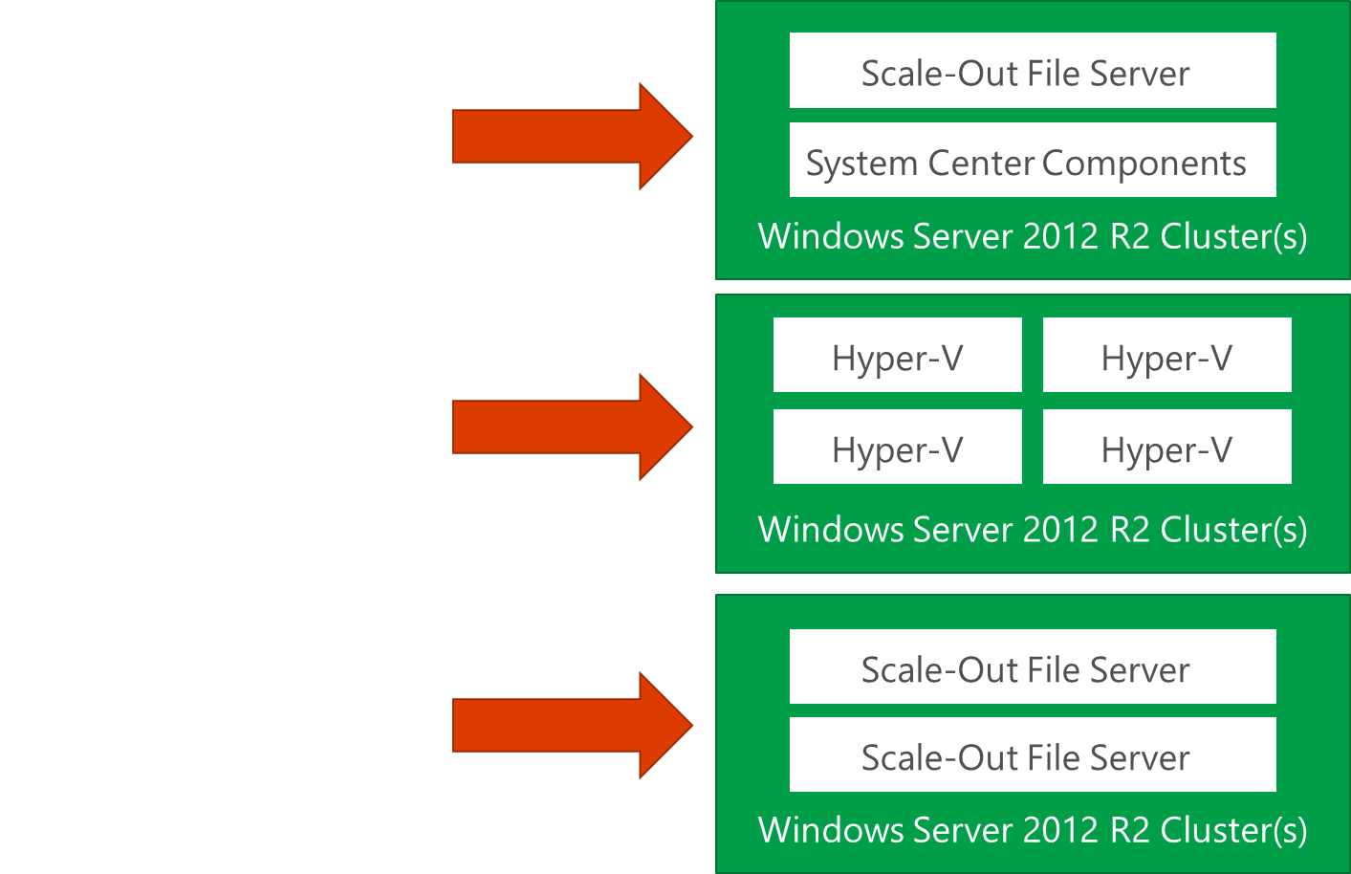
Order Of Operations…
Start with management
  Operating systems and clusters
  System Center Components
  Management can drive the rest of the upgrade
Next - Compute or Storage?
  Really doesn’t matter...
  Complete the upgrade of each layer before
  starting the upgrade of subsequent layers

Slide 14
Feedback

Slide 15
We Listened to Your Feedback – The Positive…
Great value
Useful innovations
Faster pace of release cycles
Flexibility of deploying on diverse hardware
  Several storage topologies supported: SAN, JBOD, etc.
Scalability of the Scale-out File Server
  SMB3 Continuously Available (CA) File handles
  Add nodes to scale
Hyper-V improvements
  Generation 2 VMs
  Guest Clusters with Shared VHDx

Slide 16
We Listened to Your Feedback – To Improve…
New Features Require OS Upgrade and…
  Upgrading the OS is difficult
  Large scale and increased release cadence results in sticking with older versions
  Additional hardware/capacity required for OS Upgrade
Specific Requests…
  Don’t require new clusters to be created
  Don’t require the cluster to be stopped
  Don’t require any Hyper-V or Scale-out File Server down-time
Make it easy, make it “just work”

Slide 17
Foundation
Windows Failover Clustering
Rob Hindman

Slide 18
“A Basic Model for Private Cloud”
Windows Server 2012 R2 Cluster(s)
Scale-Out File Server
Management
System Center Components
Windows Server 2012 R2 Cluster(s)
Hyper-V
Hyper-V
Compute
Hyper-V
Hyper-V
Windows Server 2012 R2 Cluster(s)
Scale-Out File Server
Storage
Scale-Out File Server

Slide 19
Foundation For High Availability
Windows Server 2012 R2 Cluster(s)
Scale-Out File Server
Management
System Center Components
Windows Server 2012 R2 Cluster(s)
Hyper-V
Hyper-V
Compute
Hyper-V
Hyper-V
Windows Server 2012 R2 Cluster(s)
Scale-Out File Server
Storage
Scale-Out File Server

Slide 20
Introducing:
Cluster OS Rolling Upgrade

Slide 21
Cluster OS Rolling Upgrade
Windows
Server
2012 R2
Failover
Cluster
Windows
Server
vNext
Failover
Cluster
How?

Slide 22
Cluster OS Rolling Upgrade
“Mixed-OS Mode” is a new state that allows Windows Server 2012 R2 and Windows Server vNext nodes in the same cluster
Windows
Server
2012 R2
Failover
Cluster
Mixed OS Mode
2012 R2 & v.Next
Failover
Cluster
Windows
Server
vNext
Failover
Cluster

Slide 23
Cluster OS Rolling Upgrade
A Mixed-OS Mode cluster can be reverted back to
Windows Server 2012 R2
Windows
Server
2012 R2
Failover
Cluster
Mixed OS Mode
2012 R2 & v.Next
Failover
Cluster
Windows
Server
vNext
Failover
Cluster

Slide 24
Cluster OS Rolling Upgrade
  Mixed OS mode is a transition state
    Optimizations don’t run
    New features are not available
    Do not plan on running your cluster in Mixed OS Mode for longer than one month
Windows
Server
2012 R2
Failover
Cluster
Mixed OS Mode
2012 R2 & v.Next
Failover
Cluster
Windows
Server
vNext
Failover
Cluster

Slide 25
Cluster OS Rolling Upgrade: Implementation
Cluster components are versioned:
ClusterFunctionalLevel property
vNext nodes can join a Windows Server 2012 R2 Cluster
User-driven PowerShell cmdlet to upgrade the cluster:
Update-ClusterFunctionalLevel
All cluster resources receive upgrade notifications

Slide 26

Cluster OS Rolling Upgrade Process
Start with a Windows Server 2012 R2 cluster
  All nodes running Windows Server 2012 R2
  The workload supports Cluster OS Rolling Upgrade process
Failover Cluster
Windows Server 2012 R2
Windows Server 2012 R2
Windows Server 2012 R2
Windows Server 2012 R2
Windows Server 2012 R2
Cluster Functional Level = Windows Server 2012 R2

Slide 27

Cluster OS Rolling Upgrade Process
Migrate Workloads Off Cluster Node
  Pause | Drain the node
Failover Cluster
Windows Server 2012 R2
Windows Server 2012 R2
Windows Server 2012 R2
Windows Server 2012 R2
Windows Server 2012 R2
Cluster Functional Level = Windows Server 2012 R2

Slide 28
Cluster OS Rolling Upgrade Process
Evict Idle Cluster Node
Failover Cluster
Windows Server 2012 R2
Windows Server 2012 R2
Windows Server 2012 R2
Windows Server 2012 R2
Windows Server 2012 R2
Cluster Functional Level = Windows Server 2012 R2

Slide 29
Cluster OS Rolling Upgrade Process
Re-Provision Node
  Install New OS
  Install and Configure any Workload Requirements
Failover Cluster
Windows Server 2012 R2
Windows Server 2012 R2
Windows Server 2012 R2
Windows Server 2012 R2
Windows Server vNext
Cluster Functional Level = Windows Server 2012 R2

Slide 30
Cluster OS Rolling Upgrade Process
Re-Add Node To Cluster
  Using Cluster UI or PowerShell
  Cluster Functional Level Remains Windows Server 2012 R2
Failover Cluster
Windows Server 2012 R2
Windows Server 2012 R2
Windows Server 2012 R2
Windows Server 2012 R2
Windows Server vNext
Cluster Functional Level = Windows Server 2012 R2

Slide 31
Cluster OS Rolling Upgrade Process
Ready To Migrate Workloads Back
  Migrate workloads to Windows Server vNext Node
  Validate functionality
Failover Cluster
Windows Server 2012 R2
Windows Server 2012 R2
Windows Server 2012 R2
Windows Server 2012 R2
Windows Server vNext
Cluster Functional Level = Windows Server 2012 R2

Slide 32
Cluster OS Rolling Upgrade Process
Repeat For Remaining Nodes
Failover Cluster
Windows Server 2012 R2
Windows Server vNext
Windows Server vNext
Windows Server vNext
Windows Server vNext
Cluster Functional Level = Windows Server 2012 R2

Slide 33
Cluster OS Rolling Upgrade Process
All Nodes Are Upgraded
  Cluster Functional Level remains Windows Server 2012 R2
  Functionality is limited to Windows Server 2012 R2 levels
  Still possible to add a Windows Server 2012 R2 node to the cluster
Failover Cluster
Windows Server vNext
Windows Server vNext
Windows Server vNext
Windows Server vNext
Windows Server vNext
Cluster Functional Level = Windows Server 2012 R2

Slide 34
Cluster OS Rolling Upgrade Process
Upgrade Functional Level
  Cluster Functional Level upgraded To Windows Server vNext:
    Update-ClusterFunctionalLevel cmdlet
  New functionality added in Windows Server vNext enabled
  No longer possible to add a Windows Server 2012 R2 node to the cluster
Failover Cluster
Windows Server vNext
Windows Server vNext
Windows Server vNext
Windows Server vNext
Windows Server vNext
Cluster Functional Level = Windows Server vNext

Slide 35
Cluster OS Rolling Upgrade Process
Upgrade is completed
Failover Cluster
Windows Server vNext
Windows Server vNext
Windows Server vNext
Windows Server vNext
Windows Server vNext
Cluster Functional Level = Windows Server vNext

Slide 36
Foundation of Private Cloud Upgrade
Windows Server 2012 R2 Cluster(s)
Windows Server vNext Cluster(s)
Scale-Out File Server
Scale-Out File Server
Management
System Center Components
System Center Components
Windows Server 2012 R2 Cluster(s)
Windows Server vNext Cluster(s)
Hyper-V
Hyper-V
Hyper-V
Hyper-V
Compute
Hyper-V
Hyper-V
Hyper-V
Hyper-V
Windows Server 2012 R2 Cluster(s)
Windows Server vNext Cluster(s)
Scale-Out File Server
Scale-Out File Server
Scale-Out File Server
Storage
Scale-Out File Server

Slide 37
Cluster OS Rolling Upgrade Applied To:
Scale-out File Servers
Rob Hindman

Slide 38
Best Practices With Cluster OS Rolling Upgrade with Scale-out File Server
Back-up important data before Cluster OS Rolling Update
  Backup cluster
  Backup workload data
Check your uptime commitments and “Failover Capacity”
  Optionally add capacity to maintain (or increase) availability during upgrade
    Two-node Scale-out File Server clusters will not be able to Failover while one node has been evicted
Some Operations will not be supported in Mixed-Mode
  Provisioning new storage
  Changing storage formats before Cluster OS Rolling Upgrade is complete
Storage Pool can be upgraded after Cluster OS Rolling Upgrade using Update-StoragePool cmdlet.

Slide 39

Cluster OS Rolling Upgrade :: Scale Out File Server
Starting point…
SMB3 Client
SMB3 Client
SMB3 Client
SMB3 Client
SMB3 Client
SMB3 Client
Scale Out File Server
Windows Server 2012 R2
Windows Server 2012 R2
Windows Server 2012 R2
Windows Server 2012 R2
Cluster Functional Level = Windows Server 2012 R2

Slide 40
Cluster OS Rolling Upgrade :: Scale Out File Server
In Progress…
SMB3 Client
SMB3 Client
SMB3 Client
SMB3 Client
SMB3 Client
SMB3 Client
Scale Out File Server
Windows Server 2012 R2
Windows Server 2012 R2
Windows Server vNext
Windows Server vNext
Cluster Functional Level = Windows Server 2012 R2

Slide 41
Cluster OS Rolling Upgrade :: Scale Out File Server
Upgrade Completed…
SMB3 Client
SMB3 Client
SMB3 Client
SMB3 Client
SMB3 Client
SMB3 Client
Scale Out File Server
Windows Server vNext
Windows Server vNext
Windows Server vNext
Windows Server vNext
Cluster Functional Level = Windows Server vNext

Slide 42
Demo:
Cluster OS Rolling Upgrade of Scale-out File Server

Slide 43
Compute
Hyper-V
Taylor Brown

Slide 44
Hyper-V with Windows Server 2012 R2
Introduced Cross Version Live Migration
  Great Feature But…
  Only enabled migrations from Windows Server 2012 to Windows Server 2012 R2
  Private cloud upgrade required two clusters (2012 and 2012 R2 cluster)
  High availability gap during cross cluster migration
Cross Version Shared Nothing Migration
  Great feature but…
  Same challenges with cross version live migration
  Required copying potentially large amounts of data
  Often required additional storage

Slide 45
Introducing
Cross Version Mobility

Slide 46
Cross Version Mobility
Full support for Cluster OS Rolling upgrades
Full support for non-clustered environments
Bidirectional live migration support between
Windows Server 2012 R2 and Windows Server vNext
  and saved states…
  and shared nothing live migration…
  and Hyper-V replication…

Slide 47
and...

Slide 48
No More
Integration Component
Upgrades!

Slide 49
Integration Components
IC version no longer tied to Hyper-V host version
  Windows Server 2012 R2 IC’s will be the starting point
  Guests OS versions before 2012 R2 get updated to Windows Server 2012 R2 IC’s
Updates To IC’s distributed through normal channels
  Windows Update
  Windows Download Center
  Linux package managers
Windows Server 2012 R2 IC’s coming to WU soon
  First for virtual machines running on Windows Server Technical Preview
  Next virtual machines running on Windows Server 2012 R2

Slide 50
Hyper-V Replica
Replication from Windows Server 2012 R2 to
Windows Server vNext
Replication from Windows Server vNext to
Windows Server 2012 R2 (with compatible vm configuration version)
Cluster OS Rolling Upgrade support
Support for upgrading VM configuration version
(source and destination both must be upgraded)

Slide 51
Hyper-V
VM Configuration Version
Taylor Brown

Slide 52
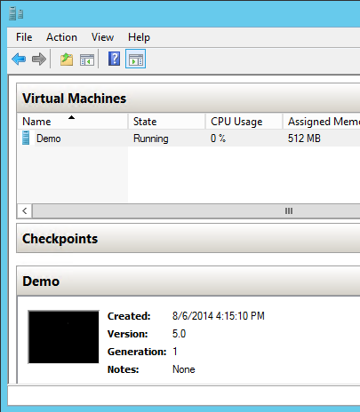
Hyper-V Configuration Versioning
What is configuration version?
  Configuration files
  Saved State/Snapshot files
What OS versions support
what configuration versions?
OS Version | Supported VM Versions
Windows Server 2008: | Version 1.0
Windows Server 2008 SP1: | Version 2.0
Windows Server 2008 R2: | Version 3.0
Windows Server 2012: | Version 4.0
Windows Server 2012 R2: | Version 5.0, Version 4.0*
Windows Server vNext: | Version 6.0, Version 5.0**, Version 4.0*
* Configuration version is automatically upgraded to minimum supported version
** Supported in down-level mode.

Slide 53
Interacting with Hyper-V configuration version
PowerShell cmdlets
Get-VM (version property)
Update-VMConfigurationVersion
Hyper-V Manager support coming…
Requirements to Upgrade Configuration Version
  Virtual machine must be off
  Saved state and online checkpoints must be discarded
  Cluster functional level must have been upgraded

Slide 54
Cluster OS Rolling Upgrade Applied To:
Hyper-V
Taylor Brown

Slide 55

Cluster OS Rolling Upgrade :: Compute Cluster
Initial state
Compute Cluster
Windows Server 2012 R2
Windows Server 2012 R2
Windows Server 2012 R2
Windows Server 2012 R2
Cluster Functional Level = Windows Server 2012 R2

Slide 56
Cluster OS Rolling Upgrade :: Compute Cluster
In process….
Compute Cluster
Windows Server 2012 R2
Windows Server vNext
Windows Server vNext
Windows Server vNext
Cluster Functional Level = Windows Server 2012 R2

Slide 57
Cluster OS Rolling Upgrade :: Compute Cluster
Upgrade compleated
Compute Cluster
Windows Server 2012 R2
Windows Server 2012 R2
Windows Server 2012 R2
Windows Server 2012 R2
Cluster Functional Level = Windows Server vNext

Slide 58
Demo:
Cross Version Mobility and
VM Configuration Version

Slide 59
Best Practices and Recommendations
Backup important VMs and data
  Infrastructure and workload VMs
  Make sure you test restore as well…
Validate your infrastructure
  Capacity
    How much failover capacity do you have…
    What happens if a production node fails while your upgrading?
  Hardware
    Are compute nodes supported by Windows Server vNext (SLAT/EPT)?
    Do you have all the drivers required?
Leverage a Test VM to validate upgraded nodes

Slide 60
Conclusion

Slide 61
“A Basic Model for Private Cloud”
Windows Server 2012 R2 Cluster(s)
Scale-Out File Server
Management
System Center Components
Windows Server 2012 R2 Cluster(s)
Hyper-V
Hyper-V
Compute
Hyper-V
Hyper-V
Windows Server 2012 R2 Cluster(s)
Scale-Out File Server
Storage
Scale-Out File Server

Slide 62
Enabled in the foundation
Management
Compute
Storage
Windows Server vNext Cluster(s)
Windows Server vNext Cluster(s)
Windows Server vNext Cluster(s)
Scale-Out File Server
Hyper-V
Hyper-V
Scale-Out File Server
System Center Components
Hyper-V
Hyper-V
Scale-Out File Server
Failover Cluster
Windows Server vNext
Windows Server vNext
Windows Server vNext
Windows Server vNext
Windows Server vNext
Cluster Functional Level = Windows Server vNext

Slide 63
Carried into the workloads
Managment
Storage
Compute
Compute Cluster
Windows Server 2012 R2
Windows Server 2012 R2
Windows Server 2012 R2
Windows Server 2012 R2
Cluster Functional Level = Windows Server vNext

Slide 64

Summary
Simple
Rolling Upgrades with Win2012 R2 and vNext nodes within the same cluster
Easily roll in nodes with new OS version
Cluster
Win2012 R2
Win2012 R2
vNext
Seamless
Zero downtime cloud upgrades for
Hyper-V and Scale-out File Server

Slide 65
Related content
Storage Sessions in chronological order
  CDP-B232: Introducing the NEW Microsoft Cloud Platform System (Tuesday Oct 28 3:15 PM)
  CDP-B225: Software Defined Compute in the Next Release of Windows Server Hyper-V (Tuesday Oct 28 1:30 PM)
  CDP-B318: Building Scalable and Reliable Backup Solutions in the Next Release of Windows Server Hyper-V (Tuesday Oct 28 1:30 PM)
  CDP-B325: Designing Scale-Out File Server with DAS Storage in Windows (Friday Oct 31 8.30 AM)
  CDP-B323: Delivering Predictable Storage Performance with Storage Quality of Service in the Next Release of Windows Server (Wednesday Oct 29 8:30 AM)
  Find us later at Storage and Hyper-V Booths

Slide 66
Track resources
Microsoft Storage
  http://Microsoft.com/storage
Windows Server Technical Preview (Storage)
  http://blogs.technet.com/b/josebda/archive/2014/10/03/windows-server-technical-preview-storage-survival-guide.aspx

Slide 67

For more information
Windows Server
Windows Server Technical Preview
http://technet.microsoft.com/library/dn765472.aspx
System Center
System Center Technical Preview
http://technet.microsoft.com/en-us/library/hh546785.aspx
Azure Pack
Azure Pack
  http://www.microsoft.com/en-us/server-cloud/products/
  windows-azure-pack
Microsoft Azure
Microsoft Azure
  http://azure.microsoft.com/en-us/
  Come visit us in the Microsoft Solutions Experience (MSE)!
  Look for the Cloud and Datacenter Platform area TechExpo Hall 7

Slide 68


Azure
Exams
Developing Microsoft Azure Solutions
EXAM
532
Implementing
Microsoft Azure Infrastructure Solutions
EXAM
533
(Coming soon)
Architecting Microsoft Azure Solutions
EXAM
534
http://bit.ly/
Azure-Cert
+
Classroom
training
(Coming soon)
Microsoft Azure Fundamentals
MOC
10979
Developing Microsoft Azure Solutions
MOC
20532
Implementing
Microsoft Azure Infrastructure Solutions
2
5
MOC
20533
5
http://bit.ly/
Azure-Train
Online
training
(Coming soon)
Microsoft Azure Fundamentals
MVA
(Coming soon)
Architecting Microsoft Azure Solutions
MVA
http://bit.ly/
Azure-MVA
Get certified for 1/2 the price at TechEd Europe 2014!
http://bit.ly/
TechEd-CertDeal

Slide 69

Resources
Learning
  Sessions on Demand
  Microsoft Certification & Training Resources
http://channel9.msdn.com/Events/TechEd
www.microsoft.com/learning
TechNet
Developer Network
  Resources for IT Professionals
http://microsoft.com/technet
http://developer.microsoft.com

Slide 70



Please Complete An Evaluation Form
Your input is important!
TechEd Schedule Builder
CommNet station or PC
TechEd Mobile app
Phone or Tablet
QR code

Slide 71
Evaluate this session

Slide 72


© 2014 Microsoft Corporation. All rights reserved. Microsoft, Windows, and other product names are or may be registered trademarks and/or trademarks in the U.S. and/or other countries.
The information herein is for informational purposes only and represents the current view of Microsoft Corporation as of the date of this presentation. Because Microsoft must respond to changing market conditions, it should not be interpreted to be a commitment on the part of Microsoft, and Microsoft cannot guarantee the accuracy of any information provided after the date of this presentation. MICROSOFT MAKES NO WARRANTIES, EXPRESS, IMPLIED OR STATUTORY, AS TO THE INFORMATION IN THIS PRESENTATION.

Slide 73
Feedback
Please send feedback on the Windows Server v.Next Cluster OS Rolling Upgrade feature directly to Program Managers:
Rob Hindman: robhind@Microsoft.com
Taylor Brown: taylorb@Microsoft.com

Slide 74
Cluster OS Rolling Upgrade
Frequently Asked Questions

Slide 75
Frequently Asked Questions (FAQ)
(1) How long can clusters run in Mixed-OS Mode?
    Between two and four weeks. Cluster OS Rolling Upgrade can be quick – it usually takes only a couple of hours - we will be providing guidance and documentation to customers that we will support a cluster running in mixed-os mode (WS.2012 R2 and WS.Threshold nodes) for between two weeks and four weeks. There are many improvements in v.Next clusters that customers will want to take advantage of as soon as possible.
(2) Will you have end-user documentation?
    Yes. TechNet documentation for Cluster OS Rolling Upgrade in v.Next Technical Preview has already been published.

Slide 76
Frequently Asked Questions (FAQ)
(3) Will you back-port this feature to Windows Server 2012, or Windows Server 2008 R2, or Windows Server 2008?
No – at this time, we do not plan on back-porting this feature.
(4) Will you support “in-place upgrade” for the individual cluster node instead of “clean OS install?”
No – most customers have told us that they prefer a clean (fresh) install of Windows Server.

Slide 77
Frequently Asked Questions (FAQ)
(5) Will you support Preview-to-RTM Cluster OS Rolling Ugrade?
No. Our mission is to smoothly transition customers from RTM release to v.Next RTM release. Customers should not take the Preview release into production.
(6) Does the Windows Server 2012 R2 cluster need to be fully patched before we can start with the Cluster OS Rolling Upgrade process?
Yes. The Windows Server 2012 R2 cluster must have all of the latest recommended patches installed prior to starting the Cluster OS Rolling Upgrade process.

Slide 78
Frequently Asked Questions (FAQ)
(7) Cluster Aware Updating (CAU) Work in Mixed-OS Mode?
Yes. CAU will continue to work while the cluster in running in Mixed-OS Mode, appropriately patching Windows Server 2012 R2 and Windows Server vNext nodes as needed. Please be aware that CAU uses node drain, and may take nodes out of the cluster during Cluster OS Rolling Upgrade – some customers turn CAU off while upgrading their clusters with the Cluster OS Rolling Upgrade process. (see Stop-CauRun PowerShell cmdlet)
(8) Can I run Update-ClusterFunctionalLevel while nodes are OFF or Paused?
No. All cluster nodes must be on (in active membership) for the Update-ClusterFunctionalLevel to work.

Slide 79
Understanding
Cluster OS Rolling Upgrade
Version Numbers

Slide 80
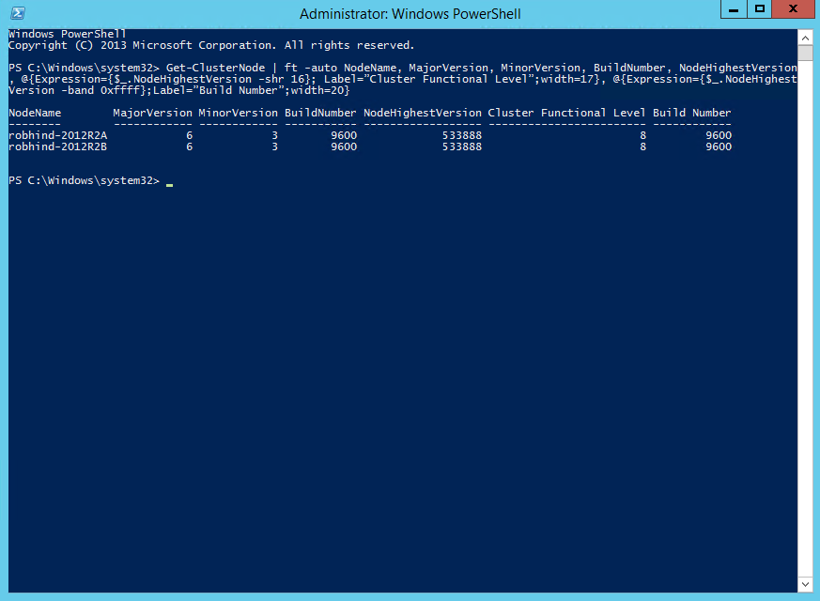
Windows Server 2012 R2
Get-ClusterNode | ft -auto NodeName, MajorVersion, MinorVersion, BuildNumber, NodeHighestVersion, @{Expression={$_.NodeHighestVersion -shr 16}; Label=”Cluster Functional Level”;width=17}, @{Expression={$_.NodeHighestVersion -band 0xffff};Label=”Build Number”;width=20}
NodeName MajorVersion MinorVersion BuildNumber NodeHighestVersion Cluster Functional Level Build Number
-------- ------------ ------------ ----------- ------------------ ------------------------ ------------
robhind-2012R2A 6 3 9600 533888 8 9600
robhind-2012R2B 6 3 9600 533888 8 9600

Slide 81
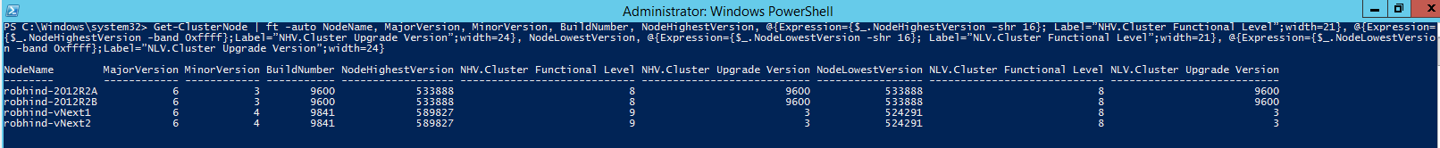
Mixed-OS Mode (from a v.Next node)
Get-ClusterNode | ft -auto NodeName, MajorVersion, MinorVersion, BuildNumber, NodeHighestVersion, @{Expression={$_.NodeHighestVersion -shr 16}; Label=”NHV.Cluster Functional Level”;width=21},
@{Expression={$_.NodeHighestVersion -band 0xffff};Label=”NHV.Cluster Upgrade Version”;width=24},
NodeLowestVersion,
@{Expression={$_.NodeLowestVersion -shr 16}; Label=”NLV.Cluster Functional Level”;width=21}, @{Expression={$_.NodeLowestVersion -band 0xffff};Label=”NLV.Cluster Upgrade Version”;width=24}
NodeName MajorVersion MinorVersion BuildNumber NodeHighestVersion NHV.Cluster Functional Level NHV.Cluster Upgrade Version NodeLowestVersion NLV.Cluster Functional Level NLV.Cluster Upgrade Version
-------- ------------ ------------ ----------- ------------------ ---------------------------- --------------------------- ----------------- ---------------------------- ---------------------------
robhind-2012R2A 6 3 9600 533888 8 9600 533888 8 9600
robhind-2012R2B 6 3 9600 533888 8 9600 533888 8 9600
robhind-vNext1 6 4 9841 589827 9 3 524291 8 3
robhind-vNext2 6 4 9841 589827 9 3 524291 8 3

Slide 82
v.Next, but still CFL=8 (from a v.Next node)
Get-ClusterNode | ft -auto NodeName, MajorVersion, MinorVersion, BuildNumber, NodeHighestVersion, @{Expression={$_.NodeHighestVersion -shr 16}; Label=”NHV.Cluster Functional Level”;width=21},
@{Expression={$_.NodeHighestVersion -band 0xffff};Label=”NHV.Cluster Upgrade Version”;width=24},
NodeLowestVersion,
@{Expression={$_.NodeLowestVersion -shr 16}; Label=”NLV.Cluster Functional Level”;width=21}, @{Expression={$_.NodeLowestVersion -band 0xffff};Label=”NLV.Cluster Upgrade Version”;width=24}
NodeName MajorVersion MinorVersion BuildNumber NodeHighestVersion NHV.Cluster Functional Level NHV.Cluster Upgrade Version NodeLowestVersion NLV.Cluster Functional Level NLV.Cluster Upgrade Version
-------- ------------ ------------ ----------- ------------------ ---------------------------- --------------------------- ----------------- ---------------------------- ---------------------------
robhind-vNext1 6 4 9841 589827 9 3 524291 8 3
robhind-vNext2 6 4 9841 589827 9 3 524291 8 3

Slide 83
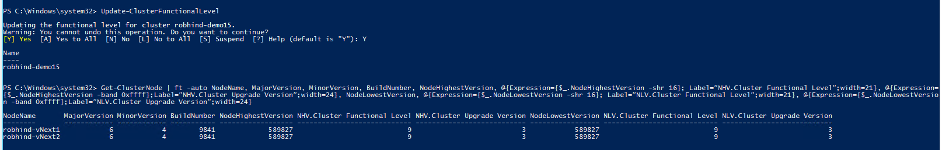
CFL=9, after Update-ClusterFunctionalLevel
Get-ClusterNode | ft -auto NodeName, MajorVersion, MinorVersion, BuildNumber, NodeHighestVersion, @{Expression={$_.NodeHighestVersion -shr 16}; Label=”NHV.Cluster Functional Level”;width=21},
@{Expression={$_.NodeHighestVersion -band 0xffff};Label=”NHV.Cluster Upgrade Version”;width=24},
NodeLowestVersion,
@{Expression={$_.NodeLowestVersion -shr 16}; Label=”NLV.Cluster Functional Level”;width=21}, @{Expression={$_.NodeLowestVersion -band 0xffff};Label=”NLV.Cluster Upgrade Version”;width=24}
NodeName MajorVersion MinorVersion BuildNumber NodeHighestVersion NHV.Cluster Functional Level NHV.Cluster Upgrade Version NodeLowestVersion NLV.Cluster Functional Level NLV.Cluster Upgrade Version
-------- ------------ ------------ ----------- ------------------ ---------------------------- --------------------------- ----------------- ---------------------------- ---------------------------
robhind-vNext1 6 4 9841 589827 9 3 589827 9 3
robhind-vNext2 6 4 9841 589827 9 3 589827 9 3

Slide 84
Cluster OS Rolling Upgrade
Mixed-OS Mode Events

Slide 85
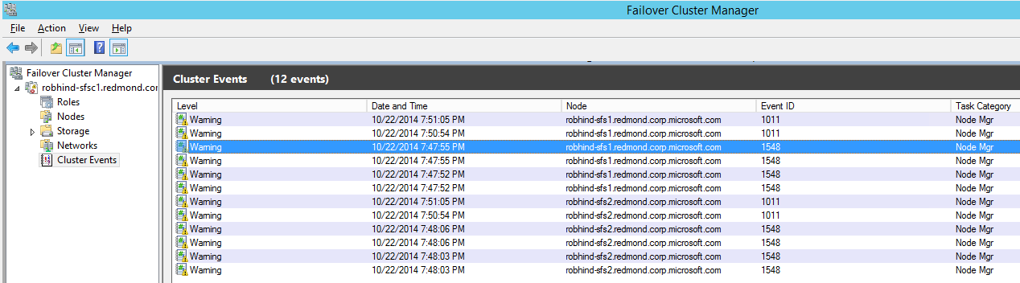
Event 1548: Mixed-OS Mode Detected

