Slide 1


Slide 2
CSI: Windows
Techniques for Finding the Cause of the Unexpected System Takeovers
CDP_B370
Paula Januszkiewicz
MVP: Enterprise Security, MCT
CQURE: CEO, Penetration Tester / Security Expert
CQURE Academy: Trainer
Contact: paula@cqure.us | http://cqure.us

Slide 3


Slide 4

Tools!
Check out the following link:
  Our tools: http://cqure.pl ➔ Tools

Slide 5
Agenda
Fundamental Research
System Mechanisms
1
2
3
4
Live Analysis of Situation
Summary

Slide 6
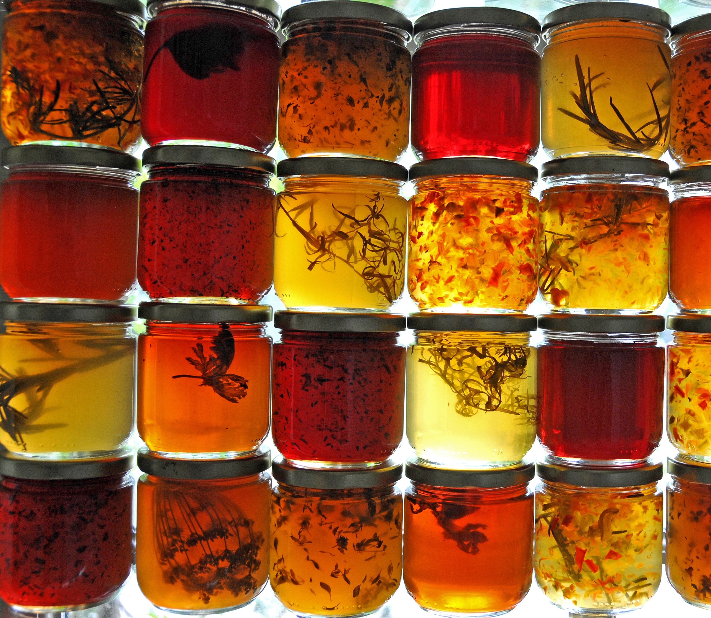

Preserving Evidence
  Disk Data
  Files from disk
  Non-file data (e.g.. NTFS Journal, VSS)
  Memory ➔ Memory Dump
  Virtual Machine state
  Disk and Memory
  Backup ➔ To revert back to the past events

Slide 7
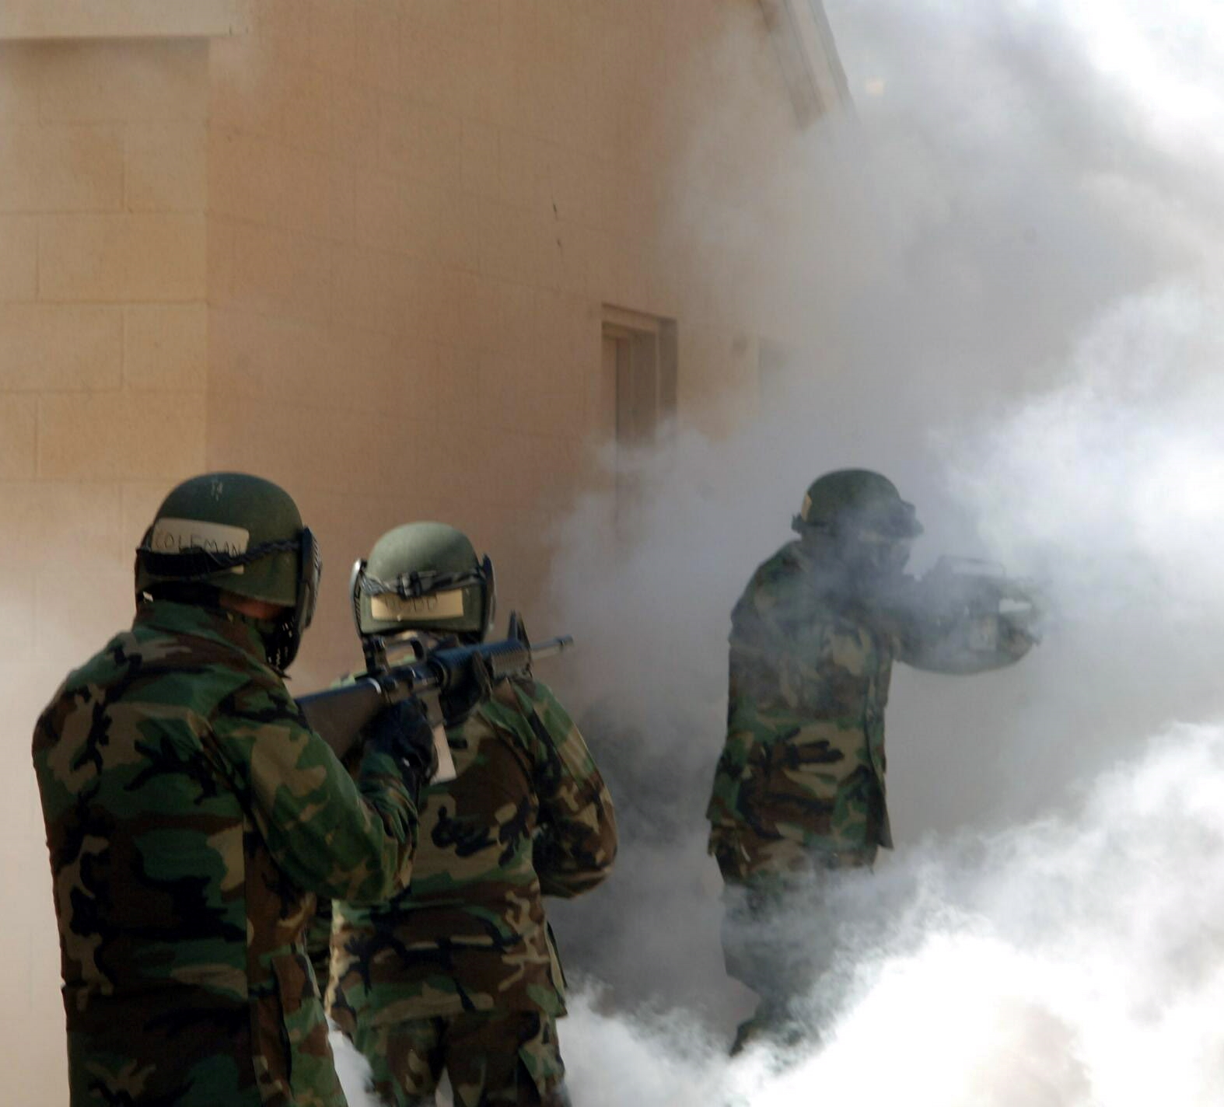
Basic Terrain Orientation
Accounts
Groups
Processes
Network Activity
  ➔ Connections
  ➔ Resolver cache
  ➔ Arp cache

Slide 8
Basic Terrain Orientation
CSI Fundamentals

Slide 9
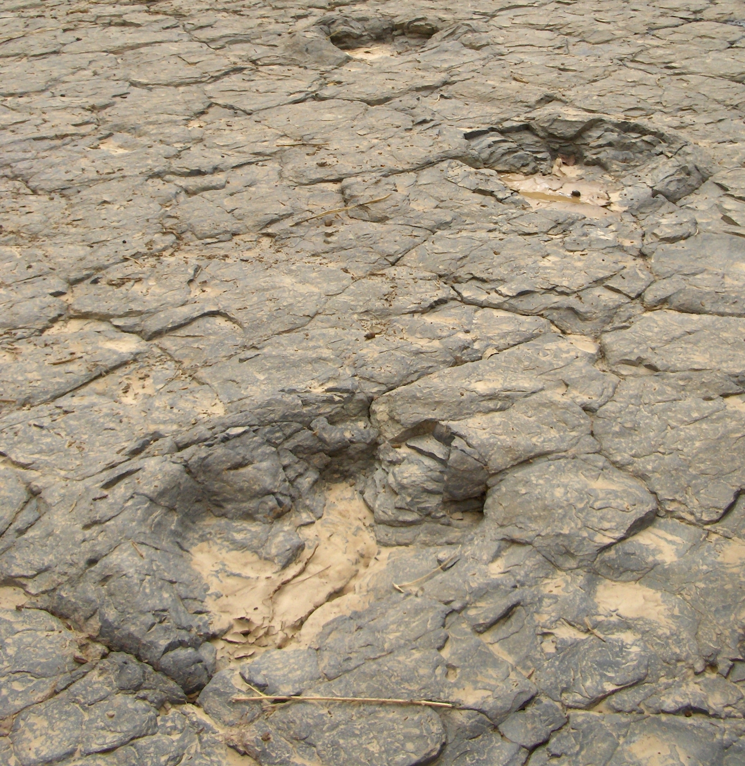
Typical Traces
Logs
  Security Log
  RDP Operational Log
  Application Logs
Windows Explorer
  Profile, NTUSER
  Run dialog
  Most Recently Used (MRU)
  Management Console (MMC)
  Remote Desktop connections
  Prefetch files
  Recent documents

Slide 10
Typical Traces
CSI Fundamentals

Slide 11
Agenda
Fundamental Research
System Mechanisms
1
2
3
4
Live Analysis of Situation
Summary

Slide 12

Bumper

Slide 13
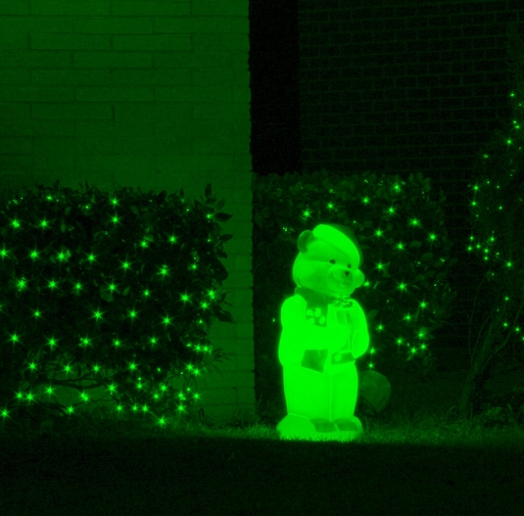
Analyzing Malware
Static Analysis
  Dissasembly, code review, memory dumps
  IDA Pro, PeBrowse, PeBear, IlSpy, Volatility
  VirusTotal, Upx
Dynamic Analysis
  WinDBG, Xperf
  Sniffers/Analyzers,
  Event Log (Windows 8.1 only)
  Sysinternals: Procexp, Procmon
  Ollydb, Frst
Sandbox
Virtualization PROs
Virtualization CONs

Slide 14
CSI Scenario
Something is going on

Slide 15
Agenda
Fundamental Research
System Mechanisms
1
2
3
4
Live Analysis of Situation
Summary

Slide 16
Bumper
How to Guard your Yard?

Slide 17
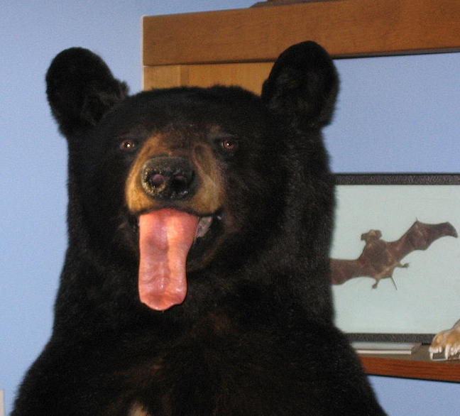
Fooling auditors
Log manipulations
  Erasing logs
  Playing with data
Dual booting
  Absent data
Modification of the files
  File metadata
  NTFS journal
  Deleting files
Dirty Games
  Locking Handles

Slide 18
NTFS Journal

Slide 19
File Recovery

Slide 20

Keeping data secret
  Extension change
  Joining files
  Alternative data streams
  Embedding
  Playing with the content
  Steganography
  Hiding data
  Encryption
  File level games
  Disk level games

Slide 21
Embedding Techniques

Slide 22
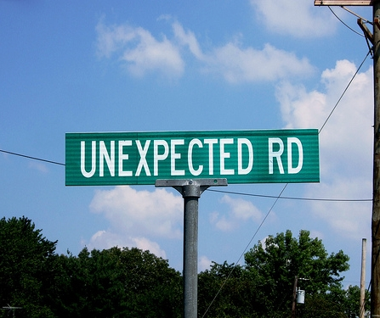
Preparing for unexpected
  Windows logs
  Application logs
  Audit logs
  Subscriptions
  SIEM systems
  Service oriented NOT server oriented
Logging
Keeping logs intact
Backup and Recovery

Slide 23

Photo by turkguy19 (Flickr)

Slide 24
Nom, Nom, Nom ;>

Slide 25
Agenda
Fundamental Research
System Mechanisms
1
2
3
4
Live Analysis of Situation
Summary

Slide 26
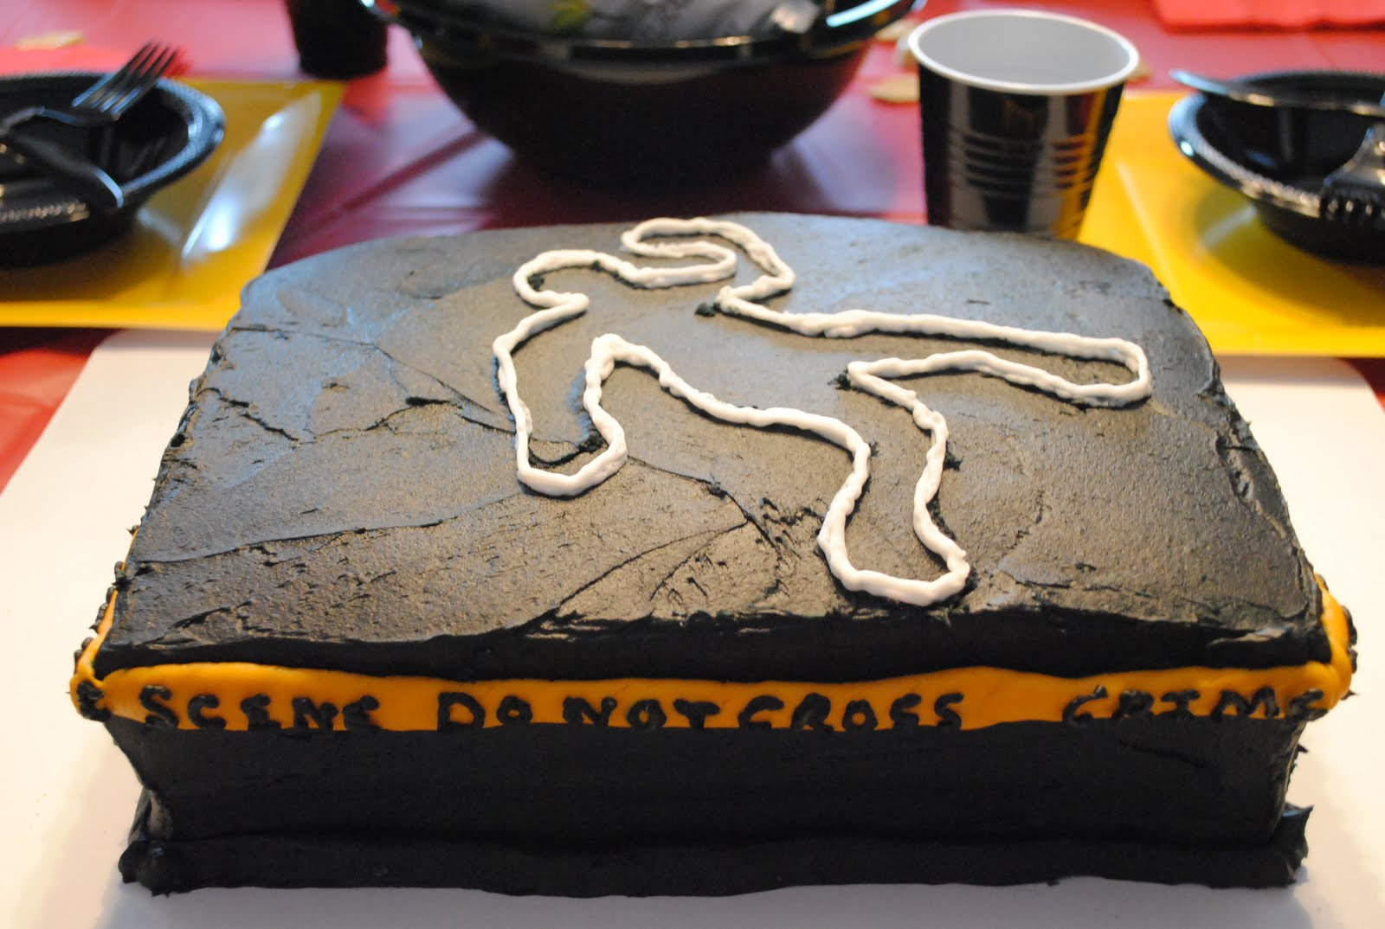
Summary: CSI
Keep safe
Start the investigation
Analyze collected data
Search for correlations
Automate reactions

Slide 27

For more information
Windows Server
Windows Server Technical Preview
http://technet.microsoft.com/library/dn765472.aspx
System Center
System Center Technical Preview
http://technet.microsoft.com/en-us/library/hh546785.aspx
Azure Pack
Azure Pack
  http://www.microsoft.com/en-us/server-cloud/products/
  windows-azure-pack
Microsoft Azure
Microsoft Azure
  http://azure.microsoft.com/en-us/
  Come visit us in the Microsoft Solutions Experience (MSE)!
  Look for the Cloud and Datacenter Platform area TechExpo Hall 7

Slide 28

Resources
Learning
  Sessions on Demand
  Microsoft Certification & Training Resources
http://channel9.msdn.com/Events/TechEd
www.microsoft.com/learning
TechNet
Developer Network
  Resources for IT Professionals
http://microsoft.com/technet
http://developer.microsoft.com

Slide 29


Azure
Exams
Developing Microsoft Azure Solutions
EXAM
532
Implementing
Microsoft Azure Infrastructure Solutions
EXAM
533
(Coming soon)
Architecting Microsoft Azure Solutions
EXAM
534
http://bit.ly/
Azure-Cert
+
Classroom
training
(Coming soon)
Microsoft Azure Fundamentals
MOC
10979
Developing Microsoft Azure Solutions
MOC
20532
Implementing
Microsoft Azure Infrastructure Solutions
2
5
MOC
20533
5
http://bit.ly/
Azure-Train
Online
training
(Coming soon)
Microsoft Azure Fundamentals
MVA
(Coming soon)
Architecting Microsoft Azure Solutions
MVA
http://bit.ly/
Azure-MVA
Get certified for 1/2 the price at TechEd Europe 2014!
http://bit.ly/
TechEd-CertDeal

Slide 30


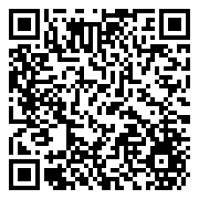

Please Complete An Evaluation Form
Your input is important!
TechEd Schedule Builder
CommNet station or PC
TechEd Mobile app
Phone or Tablet
QR code

Slide 31
Evaluate this session

Slide 32


© 2014 Microsoft Corporation. All rights reserved. Microsoft, Windows, and other product names are or may be registered trademarks and/or trademarks in the U.S. and/or other countries.
The information herein is for informational purposes only and represents the current view of Microsoft Corporation as of the date of this presentation. Because Microsoft must respond to changing market conditions, it should not be interpreted to be a commitment on the part of Microsoft, and Microsoft cannot guarantee the accuracy of any information provided after the date of this presentation. MICROSOFT MAKES NO WARRANTIES, EXPRESS, IMPLIED OR STATUTORY, AS TO THE INFORMATION IN THIS PRESENTATION.

