Slide 1
Malware Hunting with the Sysinternals Tools
Mark Russinovich
CTO, Azure

Slide 2
“When combining the results from all four AV engines, less than 40% of the binaries were detected.”
Source:
CAMP: Content-Agnostic Malware Protection
Proceedings of 20th Annual Network & Distributed System Security Symposium
https://www.cs.jhu.edu/~moheeb/aburajab-ndss-13.pdf

Slide 3
About this Talk
Learn about Sysinternals tools and techniques for analyzing and cleaning malware
  Professional antimalware analysis requires years of deep training
  But even for professionals, Sysinternals tools can prove useful
Analyzing:
  Understanding the impact of malware
  Can be used to understand malware operation
  Generates road map for cleaning infestations
Cleaning:
  Removing an infestation of a compromised system
  Attempting a clean can also reveal more information about malware’s operation

Slide 4
Malware Cleaning Steps
Disconnect from network
Identify malicious processes and drivers
Terminate identified processes
Identify and delete malware autostarts
Delete malware files
Reboot and repeat

Slide 5
Identifying Malware Processes

Slide 6
What Are You Looking For?
Investigate processes that…
…have no icon
…have no description or company name
…unsigned Microsoft images
…live in Windows directory or user profile
…are packed
…include strange URLs in their strings
…have open TCP/IP endpoints
…host suspicious DLLs or services

Slide 7
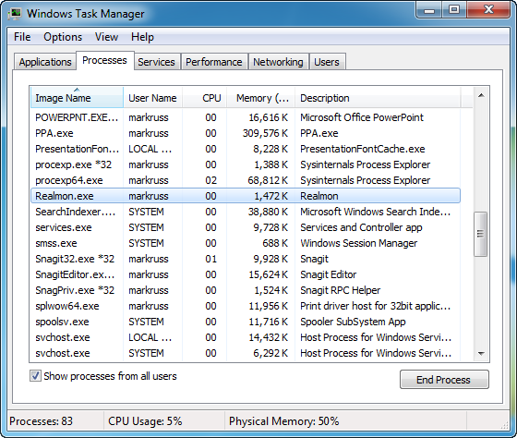
What About Task Manager?
Task Manager provides little information about images that are running

Slide 8
Process Explorer
Process Explorer is “Super Task Manager”
Has lots of general troubleshooting capabilities:
  DLL versioning problems
  Handle leaks and locked files
  Performance troubleshooting
  Hung processes
We’re going to focus on its malware cleaning capabilities

Slide 9
The Process View
The process tree shows parent-child relationships
Icon, description, and company name are pulled from image version information
  Most malware doesn’t have version information
  What about malware pretending to be from Microsoft?
    We’ll deal with that shortly…
Use the Window Finder (in the toolbar) to associate a window with its owning process
Use the Search Online menu entry to lookup unknown processes
  But malware often uses totally random or pseudo-random names

Slide 10
Refresh Highlighting
Refresh highlighting highlights changes
  Red: process exited
  Green: new process
Change duration (default 1 second) in Options
Press space bar to pause and F5 to refresh
Cause display to scroll to make new processes visible with Show New Processes option
We’ll see how to spot short-lived processes later…

Slide 11
Process-type Highlights
Blue processes are running in the same security context as Process Explorer
Pink processes host Windows services
Purple highlighting indicates an image is “packed”
  Packed can mean compressed or encrypted
  Malware commonly uses packing (e.g. UPX) to make antivirus signature matching more difficult
  Packing and encryption also hide strings from view
There are a few other colors, but they’re not important for malware hunting

Slide 12
Tooltips
Process tooltips show the full path to the process image
Malware more often hides behind Svchost, Rundll32, Dllhost and WMIPrsve
  Tooltip for Rundll32 processes shows hosted DLL
  Dllhost tooltip shows hosted COM server
  Tooltip for service processes shows hosted services

Slide 13
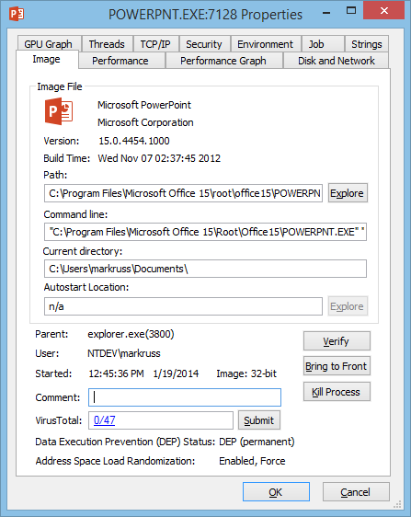
Detailed Process Information
Double-click on a process to see more information
Pages relevant to malware analysis:
  Image: signing status, start time, version, autostart location
  TCP/IP: open endpoints
  Strings: printable strings in main executable

Slide 14
Image Verification
All (well, most) Microsoft code is digitally signed
  Hash of file is signed with Microsoft’s private key
  Signature is checked by decrypting signed hash with the public key
You can selectively check for signatures with the Verify button on the process image tab
  Select the Verify Image Signatures option to check all
  Add the Verified Signer column to see all
Note that verification will connect to the Internet to check Certificate Revocation List (CRL) servers

Slide 15
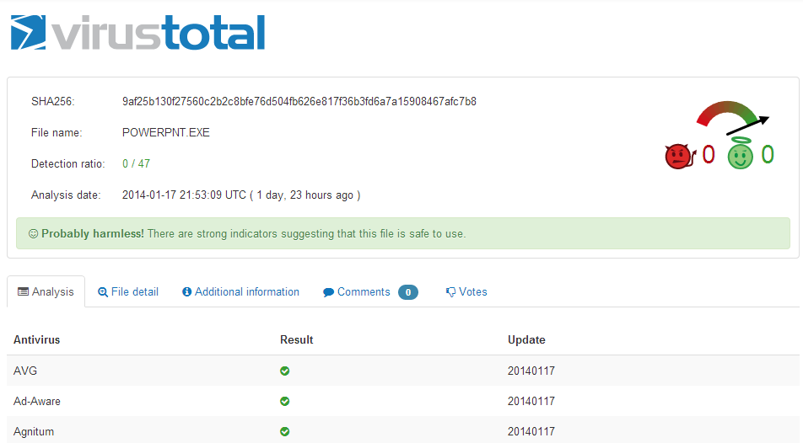

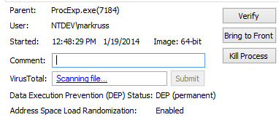
New: VirusTotal Integration
VirusTotal.com is Antivirus-as-a-Service (AaaS)
You can have Process Explorer
check file hashes
  Check all displayed files with Options->Check VirusTotal
  Results reported in VirusTotal column as well as DLL and process properties
  Uploads hashes
  Reports results as positive detection rate or “Unknown”
You can submit unknown files for scanning
  Options->Submit Unknown Executables submits all portable executable (PE) images < 32 MB in size
  Can submit on-demand with context menu or properties dialog

Slide 16
Sigcheck
Scan the system for suspicious executable images
Use –v to check VirusTotal:
  -v to submit hashes (-vs to submit files for scanning)
  -vr to open the VirusTotal report
Look for same characteristics as suspicious processes
  Be especially wary of items in the \Windows directory and the \Users\<username>\Appdata directories
  Investigate all unsigned images
  Examine images with high entropy (> 7)
sigcheck -e –vs -vr -u -s c:\

Slide 17
Strings
On-disk and in-memory process strings are visible on the Strings tab
  There’s only a difference if the image is compressed or encrypted
Strings can help provide clues about unknown processes
  Look for URLs, names and debug strings
You can also dump strings with the command-line Strings utility from Sysinternals
strings <file>

Slide 18
The DLL View
Malware can hide as a DLL inside a legitimate process
  We’ve already seen this with Rundll32 and Svchost
  Typically loads via an autostart
  Can load through “dll injection”
  Packing highlight shows in DLL view as well
Open the DLL view by clicking on the DLL icon in the toolbar
  Shows more than just loaded DLLs
  Includes .EXE and any “memory mapped files”
Can search for a DLL with the Find dialog
DLL strings are also viewable on the DLL properties

Slide 19
Terminating Malicious Processes
Don’t kill the processes
  Malware processes are often restarted by watchdogs
Instead, suspend them
  Note that this might cause a system hang for Svchost processes
  Record the full path to each malicious EXE and DLL
After they are all asleep then kill them
  Watch for restarts with new names…

Slide 20
Cleaning Autostarts

Slide 21
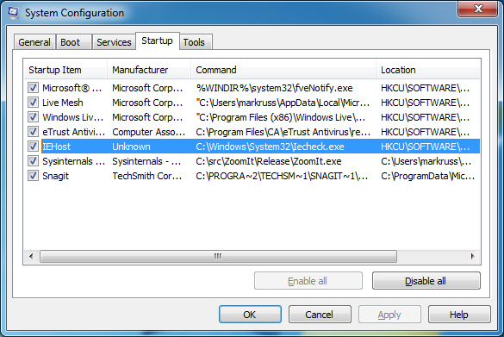
Investigating Autostarts
Windows Msconfig (Start->Run->Msconfig) falls short
  It knows about few locations
  It provides little information

Slide 22
Autoruns
Shows every place in the system that can be configured to run something at boot & logon
  Standard Run keys and Startup folders
  Shell, userinit
  Services and drivers
  Tasks
  Winlogon notifications
  Explorer and IE addins (toolbars, Browser Helper Objects, …)
  More and ever growing…
Each startup category has its own tab and all items display on the Everything tab
  Startup name, image description, company and path

Slide 23
Identifying Malware Autostarts
Zoom-in on add-ons (including malware) by selecting these filter options:
  Verify Code Signatures
  Hide Microsoft Entries
Select an item to see more in the lower window
  Online search unknown images
  Double-click on an item to look at where its configured in the Registry or file system
Has other features:
  Can also show empty locations (informational only)
  Includes compare functionality
  Includes equivalent command-line version, Autorunsc.exe

Slide 24
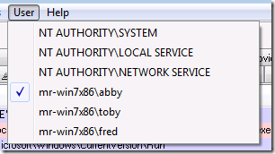
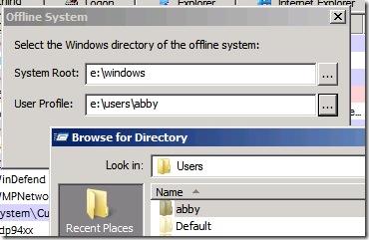
Alternate Profiles and Offline Scanning
If a specific account is infected, you can use Autoruns from another:
If the system can’t be cleaned online, Autoruns can be used offline:

Slide 25
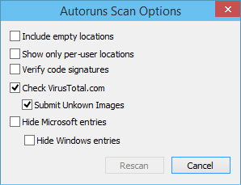
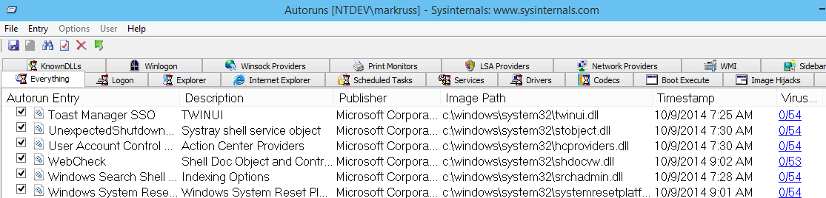
New: VirusTotal Integration
You can have Autoruns check
VirusTotal for hashes
  Option to submit files for scanning
Will be posted to Sysinternals
next week!

Slide 26
Deleting Autostarts
Delete suspicious autostarts
  You can disable them if you’re not sure
After you’re done do a full refresh
If they come back, run Process Monitor to see who’s putting them back
  You might have misidentified a malware process
  It might be a hidden, system, or legitimate process

Slide 27
Tracing Malware Activity

Slide 28
Tracing Malware
Tracing activity can reveal the system impact of malware
  Tracing shows initial infection, before cloaking is applied
  Can reveal the internals of “buddy system” and other infection-protection mechanisms
Process Monitor makes tracing easy
  A simple filter can identify all system modifications
  Investigating stacks can distinguish legitimate activity from malicious activity
  It will often show you the cause for error messages
  It many times tells you what is causing sluggish performance
When in doubt, run Process Monitor!

Slide 29
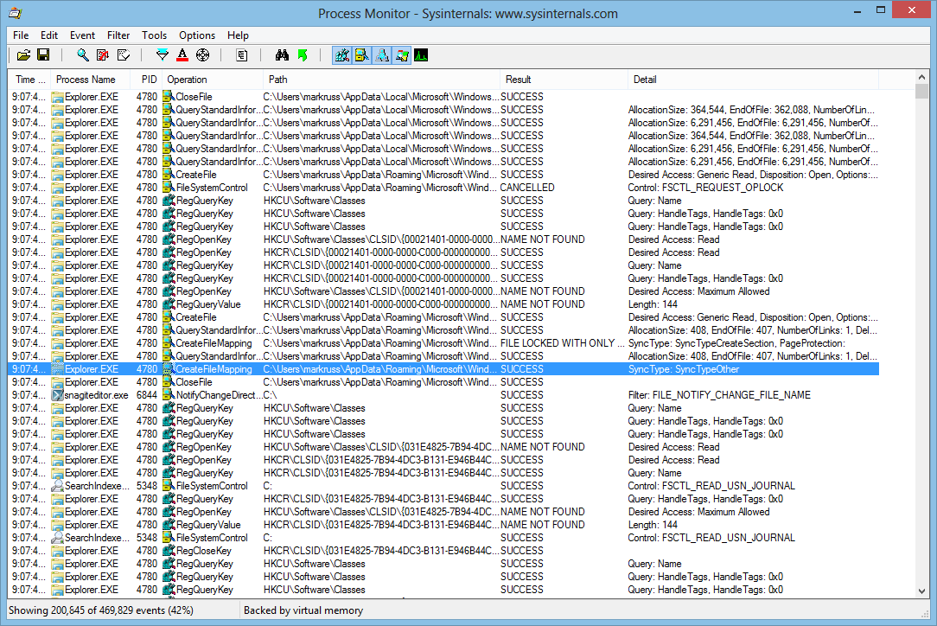
Event Classes
File system (Filemon)
  Includes I/O command input and output details
Registry (Regmon)
  Includes all data
Process
  Process create and exit
  Thread create and exit
  Image loads, including drivers
Network
  ETW network tracing
Profiling
  Thread statck snapshots

Slide 30
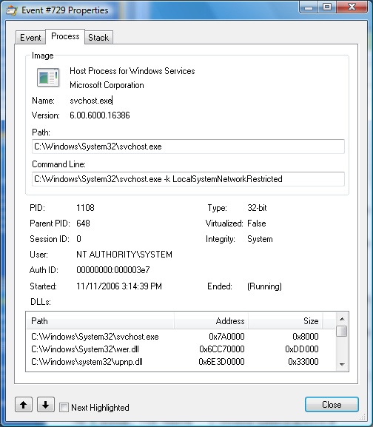
Event Properties
Event details
  Duration, process, thread,
  details, etc.
Process information
  Command line
  User
  Session and logon session
  Image information
  Start time
Thread stack at time of event

Slide 31
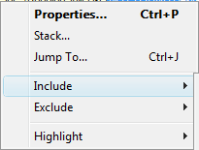
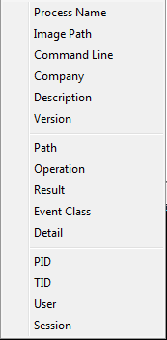

Filtering
To filter on a value, right-click on the line and select the attribute from the Include, Exclude or Highlight submenus
When you set a highlight
filter you can move
through highlighted event
properties

Slide 32
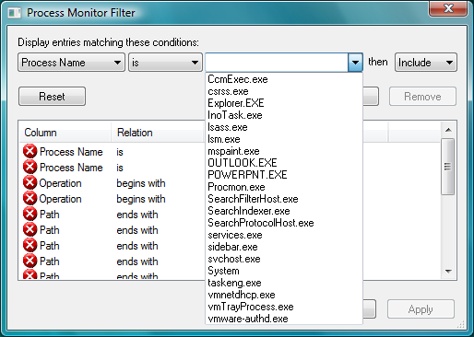
Advanced Filters
Multiple-filter behavior:
  Values from different attributes are AND’d
  Values for the same attribute are OR’d
Use Edit Filter context menu for quick configuration
More complex filtering is available in the Filter dialog
  Outlook-style rule definition
You can save and restore
filters
Filter for watching malware
impact:
“Category is Write”

Slide 33
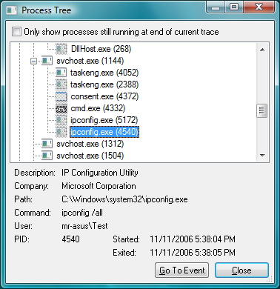
The Process Tree
Tools->Process Tree
  Shows all processes that have been seen in the trace (including parents)
  Can toggle on and off terminated processes
The process tree provides an easy way to see process relationships
  Short-lived processes
  Command lines
  User names

Slide 34
Malware Forensics

Slide 35
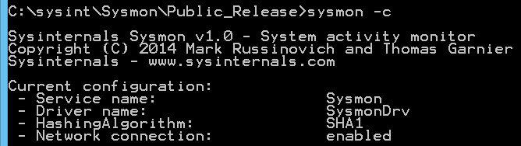
Announcing: System Monitor (Sysmon)
Background system monitoring utility
  Record system events to the Windows event log
  Can be used for system anomaly detection
  Forensics can trace intruder activity across the network
Written for use in Microsoft corporate network
  To understand attacker behavior and tools
  Significant contributions by Thomas Garnier
  Public version has reduced functionality
Installs as service/driver
  No reboot required
  Captures events from early in
  the boot process

Slide 36
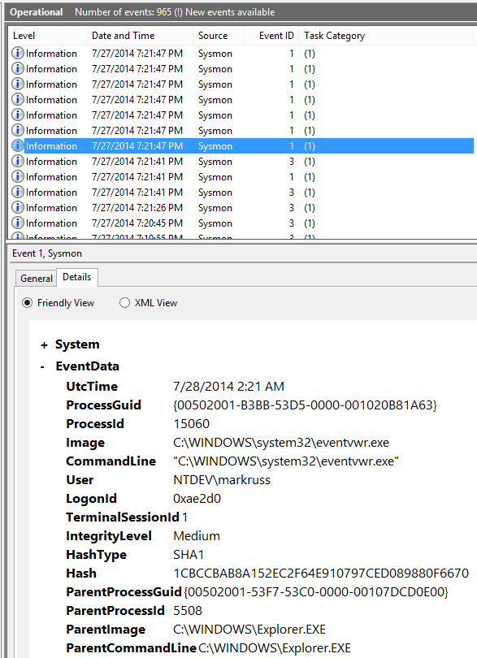
Sysmon Events
Process create:
  Image file and image file hash
  Command line
  Parent image and command line
  GUID for process ID-independent tracking
Network connections:
  Process name
  IP addresses and ports
  Host and port names
File create timestamp change
  Process responsible
  Original and new timestamp

Slide 37
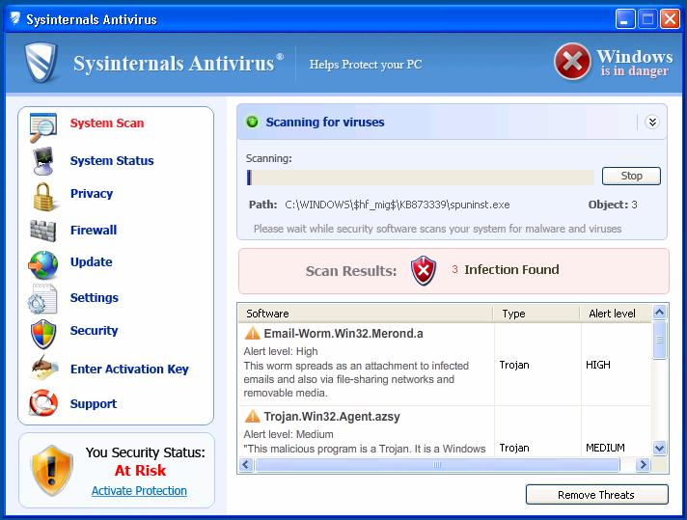
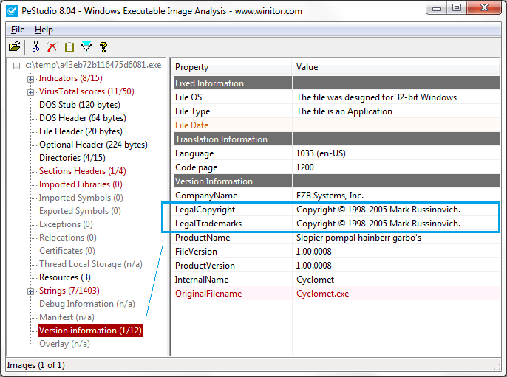
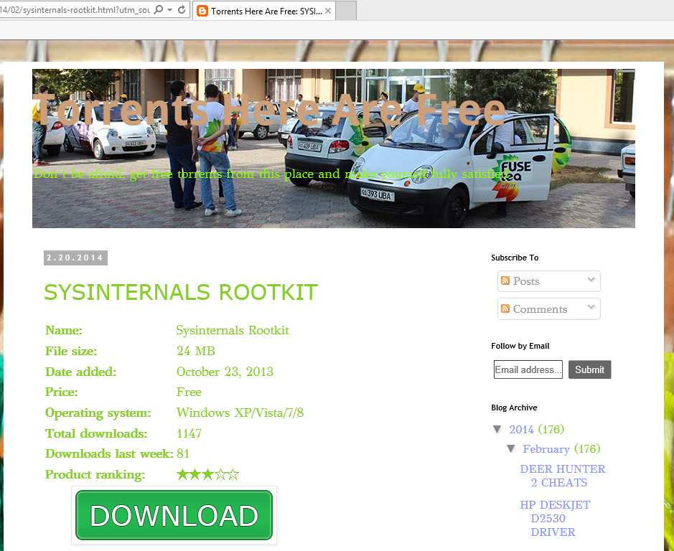
Scareware

Slide 38
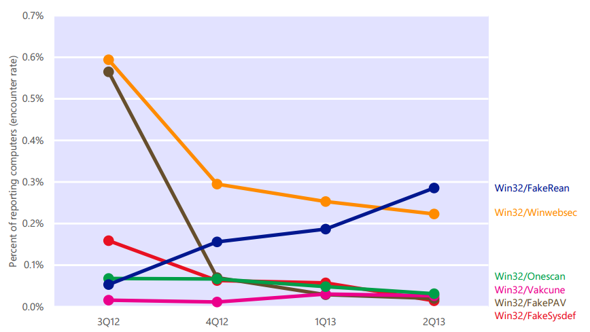
Analyzing FakePav
http://www.microsoft.com/security/portal/threat/encyclopedia/Entry.aspx?Name=Rogue%3AWin32%2FFakePAV

Slide 39
UnwantedSoftware

Slide 40
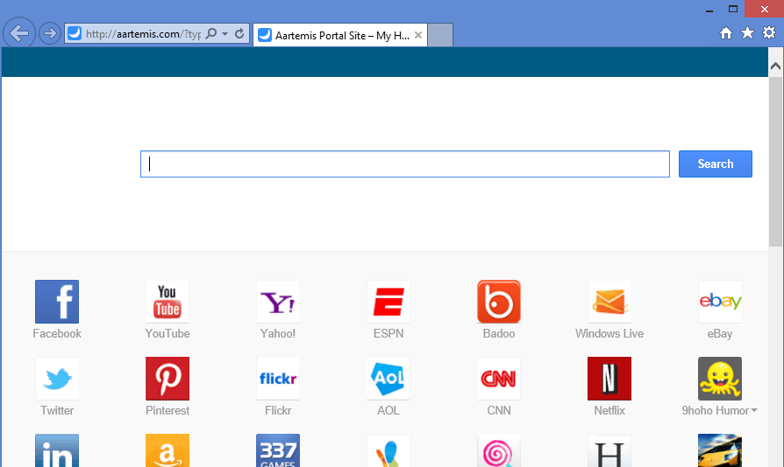
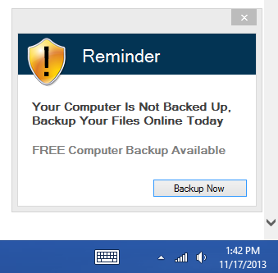
The Case of the Unwanted Software
Mom complained about two symptoms:
  Her IE home page was hijacked
  She got toast from a backup program

Slide 41
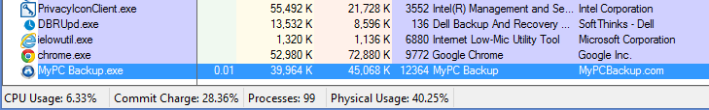
The Case of the Unwanted Software (Cont)
I went after the backup toast first
Launched Process Explorer and used window finder to identify offending process:

Slide 42
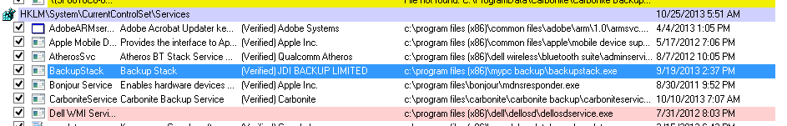
The Case of the Unwanted Software (Cont)
Launched Autoruns and disabled related processes:

Slide 43
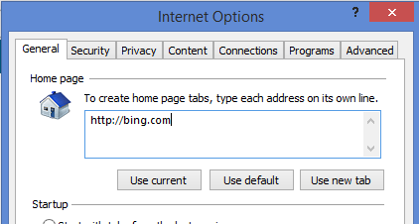
The Case of the Unwanted Software (Cont)
To find home page hijack, first looked at home page setting
  Saw that it was Bing:
But IE launched a different page, so captured an IE startup trace with Procmon…

Slide 44
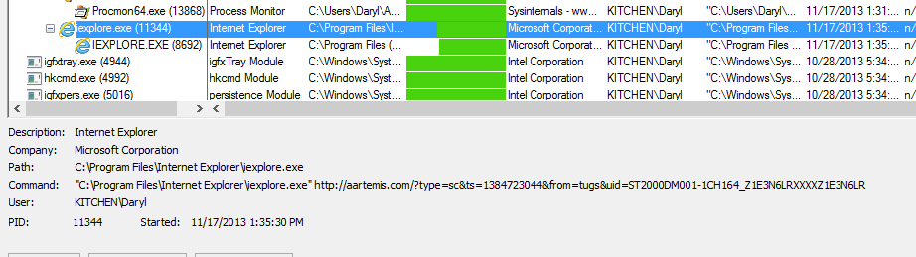
The Case of the Unwanted Software: Solved
Looked at IE command line and saw parameter:
Opened IE shortcut link and deleted command line: problem solved

Slide 45
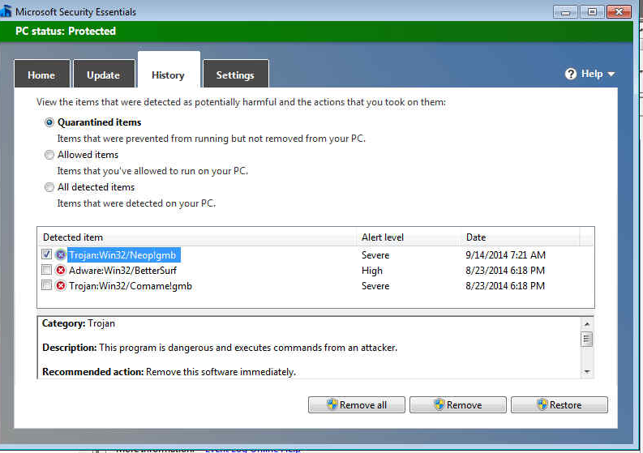
The Case of My Mom’s Chronically Infected PC
Mom’s PC repeatedly infected with malware
  Either MS Security Essentials or I would clean it
  Made her standard user
  She still got infected
Installed Sysmon
to hope to trace the
cause
Sure, enough,
system was reinfected

Slide 46
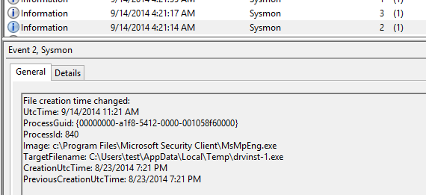
The Case of My Mom’s Chronically Infected PC
Remotely connected and downloaded Sysmon log
Searched for drvinst and found MSEE cleaning infection at 9/14/14 7:21 AM EST, but no suspicious entries nearby:

Slide 47
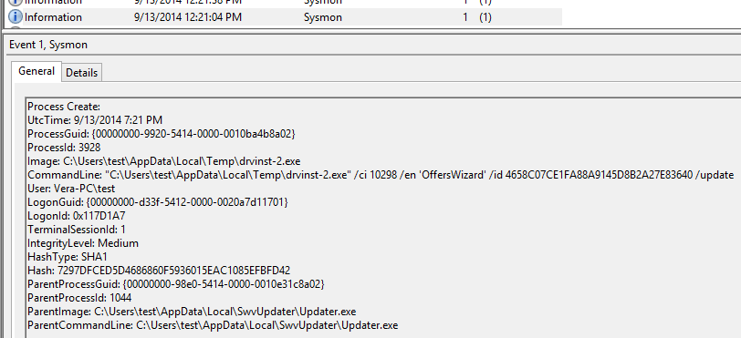
The Case of My Mom’s Chronically Infected PC
Searched again for drvinst and came across Drvinst-2.exe launch
Launched by SwvUpdater, so searched for that…

Slide 48
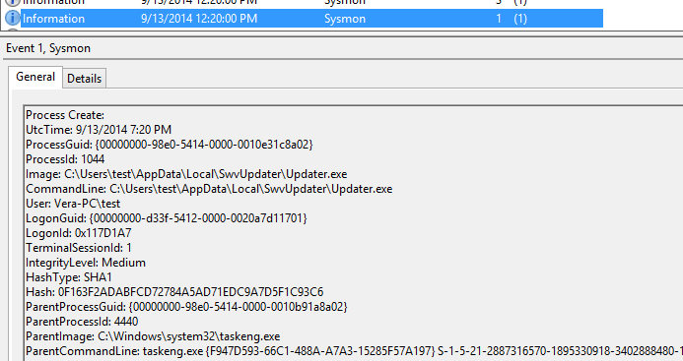
The Case of My Mom’s Chronically Infected PC
Saw entry that showed it was launched by scheduled task:

Slide 49
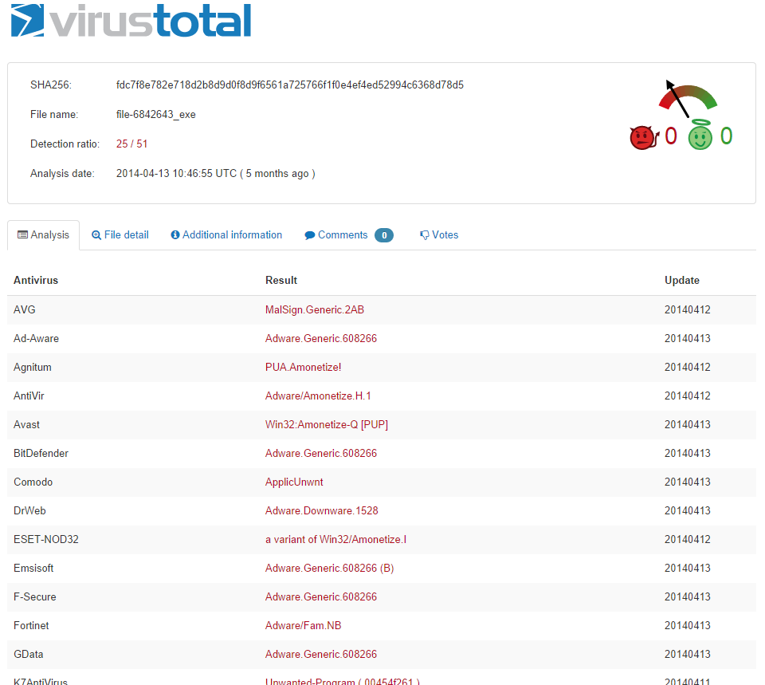
The Case of My Mom’s Chronically Infected PC
Used Sigcheck to submit it to VirusTotal
  Many engines flagged it as malicious
  Sadly, MSEE did not (subsequently submitted to MS)
How could I have missed it?

Slide 50
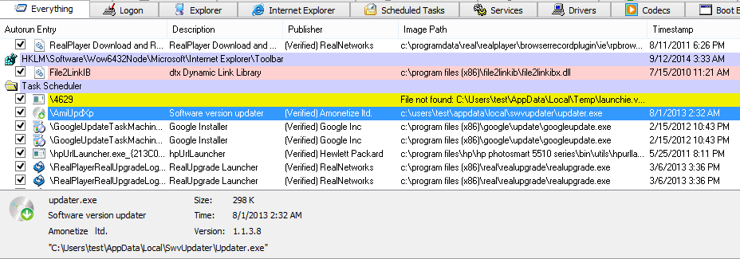
The Case of My Mom’s Chronically Infected PC: Solved
Opened Autoruns and found its scheduled task:
Had overlooked it in cleanings because of generic description and valid signature
Disabled it: problem solved

Slide 51
Ransomware

Slide 52
Analyzing Win32.Ransom.FS
http://www.microsoft.com/security/portal/threat/encyclopedia/entry.aspx?Name=Trojan%3AWin32%2FRansom.FS

Slide 53
Corporate Infections

Slide 54
The Case of the Infected Excel Application
Company’s systems were exhibiting signs of malware infection
  Emails sent to user contact lists
  Popups
  Seemed related to particular Excel file, Holiday.xls
Antimalware scans didn’t find anything
Company contacted Microsoft support

Slide 55
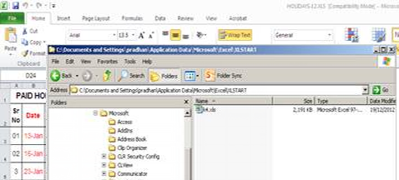
The Case of the Infected Excel Application (Cont)
Support engineer noticed an Excel file, k4.xls, in user’s Xlstart directory:
Deleted it, but it recreated when Excel started

Slide 56

The Case of the Infected Excel Application (Cont)
Captured a Process Monitor trace of Excel startup
Saw Excel launch command prompt to create K4.xls file and then hide it:

Slide 57
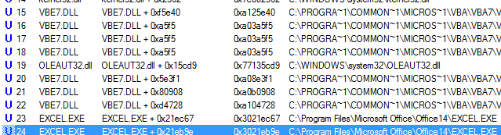
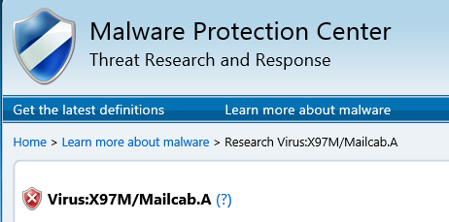
The Case of the Infected Excel Application: Solved
Looked at thread stack and saw that a VB script was responsible:
Submitted holiday.xls to
antimalware team:
  Confirmed it was X97M/Mailcab.A
  Signatures updated

Slide 58
Malware Advances

Slide 59
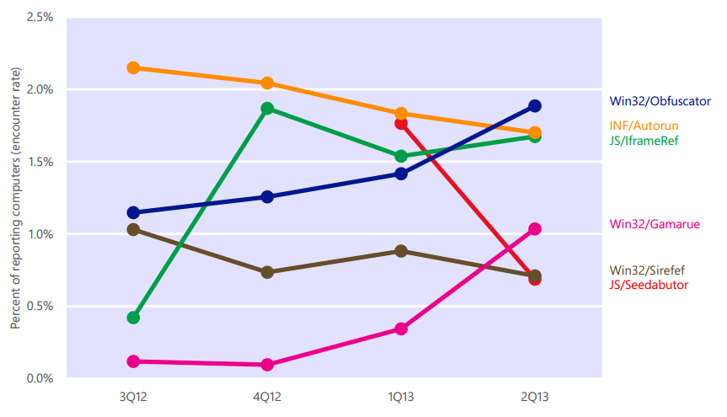
Analyzing and Cleaning Sirefef
Give a man a stolen credit card & he'll eat like a king for a day. Teach a man to phish and he'll be set for life.
-- Ancient Nigerian proverb
http://www.microsoft.com/security/portal/threat/encyclopedia/entry.aspx?Name=Win32%2FSirefef

Slide 60
Summary

Slide 61
The Future of Malware
We’ve seen the trends:
  Malware that pretends to be from Microsoft or other legitimate companies
  Malware protected by sophisticated rootkits
  Malware that has stolen certificates
Cleaning is going to get much, much harder
  Targeted and polymorphic malware won’t get AV/AS signatures
  Malware can directly manipulate Windows structures to cause misdirection
  All standard tools will be directly attacked by malware
  There will be more un-cleanable malware
You can’t know you’re infected unless you find a symptom
Prevent and Detect

Slide 62



My Cyberthrillers:
www.russinovich.com
Zero Day: cyberterrorism
Trojan Horse: state-sponsored cyberwarfare
Rogue Code: financial cybercrime and insider threats

Slide 63
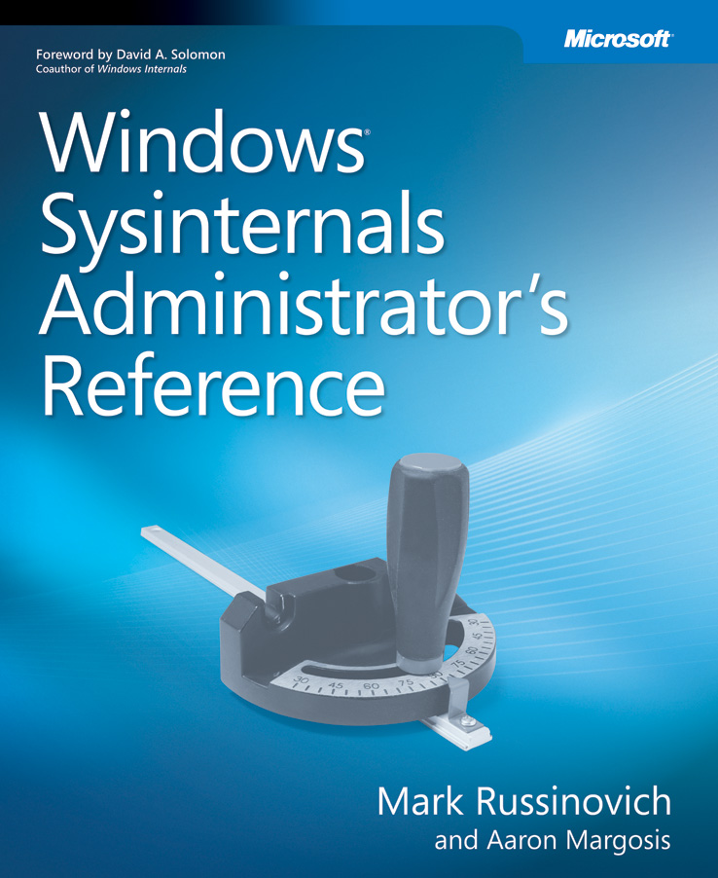
The Sysinternals Administrator’s Reference
The official guide to the Sysinternals tools
  Covers every tool, every feature, with tips
  Written by Mark Russinovich and
  Aaron Margosis
Full chapters on the major tools:
  Process Explorer
  Process Monitor
  Autoruns
Other chapters by tool group
  Security, process, AD, desktop, …

