Slide 2
Connecting SAP and Microsoft BI Platform DBI-B212
Justin Martinson, Sr. Product Marketing Manager
Sanjay Soni, Sr. Technical Product Marketing Manager
Arun Justus, Technology Advisor BI

Slide 3
Session Objectives And Takeaways
Session Objectives
Partnership Recap
SAP Environment Overview
Understand the Scenarios and Options for Connecting SAP and Microsoft BI Environments
Co-exist with SAP
Prerequisites
Good understanding of Microsoft’s BI stack including Power BI

Slide 4
Innovating For Your Success!

Slide 5
SAP Microsoft New Partnership
Cloud
Business Intelligence
Interoperability
Mobility
SAP Applications on Microsoft Azure
Power BI/Excel Connector for SAP BOBJ BI
SAP Gateway for Microsoft Office/Office 365
SAP mobile apps for Windows 8 and Windows Phone 8
REDMOND, Wash., and WALLDORF, Germany – May 19th , 2014:
Steve Lucas, President SAP Platform Solutions at SAP AG
“We are proud of how we listened to our customers and together developed and will continue to develop innovative new programs focused on the cloud, mobility, and interoperability that will provide unparalleled value for our customers.”
Scott Guthrie, Executive Vice President Cloud and Enterprise at Microsoft Corp
“Our expanded partnership with SAP demonstrates our continued commitment to deliver the applications and services our customers need — in their private clouds, service provider clouds, Windows Azure and Microsoft Office.”

Slide 6
SAP – (Short) Overview

Slide 7
The Evolution of SAP ERP and SAP BI
Front End
SAP NetWeaver Portal
SAP NetWeaver Gateway
SAP BEx*
Crystal Reports Enterprise
Web Intelligence Design Studio
Dashboard / XCelsius
BO for MS Office
BO for OLAP (Web)
SAP Business Objects Enterprise (Universe)
Back End
SAP NetWeaver
BW Accelerator*
SAP NetWeaver
MDM
SAP Business Suite
ERP (aka SAP ECC or SAP R/3)
Financials
Operations
Human Resources
Corporate Services
CRM, SCM
SAP NetWeaver
Business Warehouse (aka SAP BW)
SAP BusinessObjects Data Services
Data Integrator
Data Quality
3rd-Party Databases and Applications
Database
Database Layer: SAP HANA, SAP Sybase, SAP MaxDB, SQL Server, Oracle, DB2, …

Slide 8
BI Connectivity Scenarios

Slide 9
Microsoft BI Integration Scenarios for SAP
Self-Service BI
Corporate BI (Centralized, Managed)
Discover
Power Query in Excel
Integrate
Integration Services
SQL Server Data warehouse
Analyze
Power Pivot
PivotTable in Excel
Report
Reporting Services

Slide 10
SAP BI Architecture and Connectivity
Front Room
SAP NetWeaver Portal
SAP NetWeaver Gateway
SAP BEx*
Crystal Reports Enterprise
Web Intelligence Design Studio
Dashboard / XCelsius
BO for MS Office
BO for OLAP (Web)
SAP Business Objects Enterprise (Universe)
Back Room
SAP NetWeaver
BW Accelerator*
SAP NetWeaver
MDM
SAP Business Suite
ERP (aka SAP R/3)
Financials
Operations
Human Resources
Corporate Services
CRM, SCM
SAP NetWeaver
Business Warehouse
SAP BusinessObjects Data Services
Data Integrator
Data Quality
3rd-Party Databases and Applications
Database
Database Layer: SAP HANA, SAP Sybase, SAP MaxDB, SQL Server, Oracle, DB2, …
Copy Data
Live Data

Slide 11
Microsoft BI Integration Scenarios for SAP
Self-Service BI
Corporate BI (Centralized, Managed)
Discover
Power Query in Excel
Integrate
Integration Services
Into SQL Server DW
From SAP HANA, ERP, BW
Analyze
Power Pivot, PivotTable in Excel
Report
Reporting Services

Slide 12
Self-Service BI Scenario – Power Query Excel Connectivity to SAP BusinessObjects BI
Front Room
SAP NetWeaver Portal
SAP NetWeaver Gateway
SAP BEx*
Crystal Reports Enterprise
Web Intelligence Design Studio
Dashboard / XCelsius
BO for MS Office
BO for OLAP (Web)
SAP Business Objects Enterprise (Universe)
Power Query
Back Room
SAP NetWeaver
BW Accelerator*
SAP NetWeaver
MDM
SAP Business Suite
ERP
Financials
Operations
Human Resources
Corporate Services
CRM, SCM
SAP NetWeaver
Business Warehouse
SAP BusinessObjects Data Services
Data Integrator
Data Quality
3rd-Party Databases and Applications
Database
Database Layer: SAP HANA, SAP Sybase, SAP MaxDB, SQL Server, Oracle, DB2, …

Slide 13
Self-Service BI Scenario – Power Query Excel Connectivity to SAP BusinessObjects BI
Discover
SAP BusinessObjects BI
Power Query
Use Case:
Customer is using SAP BO and wants to enable self-service BI with the Microsoft Stack
Key advantages:
Excel users have seamless and direct access to SAP data exposed via SAP BusinessObjects BI Universes
Semantic layer of SAP BusinessObjects BI Universes hides the complexity of the underlying SAP data source
Customers can leverages existing investments in Microsoft and SAP BI technologies (dual vendor strategy)
SAP data can be loaded into Excel table or Power Pivot data model
Joint initiative of SAP and Microsoft
Requirements:
Excel 2010 or Excel 2013 with Power Query add-in with SAP BO Universe connectivity (available since May 2014)
SAP BusinessObjects BI 4.1 SP2 or higher

Slide 14
Demo
Excel Connectivity to SAP BusinessObjects BI Universes

Slide 15
Microsoft BI Integration Scenarios for SAP
Self-Service BI
Corporate BI (Centralized, Managed)
Discover
Power Query in Excel
Integrate
Integration Services
Into SQL Server DW
From SAP HANA, ERP, BW
Analyze
Power Pivot, PivotTable in Excel
Report
Reporting Services

Slide 16
Self-Service BI Scenario: Power Pivot Power Pivot to SAP via NetWeaver Gateway
Front Room
SAP NetWeaver Portal
SAP NetWeaver Gateway
SAP BEx*
Crystal Reports Enterprise
Web Intelligence Design Studio
Dashboard / XCelsius
Power Pivot
BO for MS Office
BO for OLAP (Web)
SAP Business Objects Enterprise (Universe)
Back Room
SAP NetWeaver
BW Accelerator*
SAP NetWeaver
MDM
SAP Business Suite
ERP
Financials
Operations
Human Resources
Corporate Services
CRM, SCM
SAP NetWeaver
Business Warehouse
SAP BusinessObjects Data Services
Data Integrator
Data Quality
3rd-Party Databases and Applications
Database
Database Layer: SAP HANA, SAP Sybase, SAP MaxDB, SQL Server, Oracle, DB2, …

Slide 17
Self-Service BI Scenario: Power Pivot Power Pivot to SAP via NetWeaver Gateway
Analyze
SAP ERP SAP BW
SAP NetWeaver Gateway
Power Pivot
Use Case:
Customer wants to expose (smaller) SAP data sets to Microsoft self-service BI
Key advantages:
NetWeaver Gateway enables standard OData access to SAP
NetWeaver Gateway supports other use cases, e.g. R/W integration with SharePoint, Office, mobile apps
Multitude of data sources are supported – Function Modules, BAPIs, ABAP objects
Works with SAP ERP, SAP CRM, … SAP BW, SAP HANA
Requirements:
SAP NetWeaver Gateway, some coding required on SAP side
Excel 2010 or Excel 2013

Slide 18
Demo
SAP NetWeaver Gateway

Slide 19
Self-Service BI Scenario: Excel Pivot PivotTable/Charts with SAP OLEDB Provider for SAP BW and HANA
Front Room
SAP NetWeaver Portal
SAP NetWeaver Gateway
SAP BEx*
Crystal Reports Enterprise
Web Intelligence Design Studio
Dashboard / XCelsius
BO for MS Office
BO for OLAP (Web)
SAP Business Objects Enterprise (Universe)
Back Room
SAP NetWeaver
BW Accelerator*
SAP NetWeaver
MDM
SAP Business Suite
ERP
Financials
Operations
Human Resources
Corporate Services
CRM, SCM
SAP NetWeaver
Business Warehouse
SAP BusinessObjects Data Services
Data Integrator
Data Quality
PivotTable
3rd-Party Databases and Applications
Database
Database Layer: SAP HANA, SAP Sybase, SAP MaxDB, SQL Server, Oracle, DB2, …

Slide 20
Self-Service BI Scenario: Excel Pivot PivotTable/Charts with SAP OLEDB Provider for SAP BW and HANA
Analyze
SAP BW SAP HANA
Excel PivotTable
Use Case:
Online Analysis (live data) of SAP BW or HANA data with native Excel and Excel Services
Key Advantages:
SAP delivered component
Works in Excel and Excel Services (SharePoint on-premise, but not Office 365)
Username/password authentication
Requirements:
Installation of required drivers

Slide 21
Demo
Excel PivotTable against SAP HANA
with a self defined HANA data model

Slide 22
Microsoft BI Integration Scenarios for SAP
Self-Service BI
Corporate BI (Centralized, Managed)
Discover
Power Query in Excel
Integrate
Integration Services
Into SQL Server DW
From SAP HANA, ERP, BW
Analyze
Power Pivot, PivotTable in Excel
Report
Reporting Services

Slide 23
Corporate BI Scenario: Data Integration Microsoft Connector for SAP NetWeaver BI (SAP BW)
Front Room
SAP NetWeaver Portal
SAP NetWeaver Gateway
SAP BEx*
Crystal Reports Enterprise
Web Intelligence Design Studio
Dashboard / XCelsius
BO for MS Office
BO for OLAP (Web)
SAP Business Objects Enterprise (Universe)
Back Room
SAP NetWeaver
BW Accelerator*
SAP NetWeaver
MDM
SAP Business Suite
ERP
Financials
Operations
Human Resources
Corporate Services
CRM, SCM
SAP NetWeaver
Business Warehouse
SAP BusinessObjects Data Services
Data Integrator
Data Quality
3rd-Party Databases and Applications
Database
Database Layer: SAP HANA, SAP Sybase, SAP MaxDB, SQL Server, Oracle, DB2, …

Slide 24
Corporate BI Scenario: Data Integration Microsoft Connector for SAP NetWeaver BI (SAP BW)
Integrate
SQL Server Integration Services
SQL Server Data Warehouse
SAP BW
Use Case:
Build a data mart with Microsoft BI on top of SAP BW with large data amounts
Key advantages:
SAP certified for unloading data from SAP BW
Supports delta extraction and packaging; well suited for large amounts of data
Supports parallel extraction
Requirements:
Open Hub Services license and configuration in SAP BW
Works with Integration Services

Slide 25
Corporate BI Scenario: Data Integration Theobald Software - Xtract IS (works through SSIS)
Front Room
SAP NetWeaver Portal
SAP NetWeaver Gateway
SAP BEx*
Crystal Reports Enterprise
Web Intelligence Design Studio
Dashboard / XCelsius
BO for MS Office
BO for OLAP (Web)
SAP Business Objects Enterprise (Universe)
Back Room
SAP NetWeaver
BW Accelerator*
SAP NetWeaver
MDM
SAP Business Suite
ERP
Financials
Operations
Human Resources
Corporate Services
CRM, SCM
SAP NetWeaver
Business Warehouse
SAP BusinessObjects Data Services
Data Integrator
Data Quality
3rd-Party Databases and Applications
Database
Database Layer: SAP HANA, SAP Sybase, SAP MaxDB, SQL Server, Oracle, DB2, …

Slide 26
Corporate BI Scenario: Data Integration Theobald Software - Xtract IS (works through SSIS)
Integrate
SAP ERP SAP BW
SQL Server Integration Services
SQL Server Data Warehouse
Use Case:
Most commonly used and recommended choice for building a DWH with MS BI on top of SAP
Key advantages:
Easy to install with Setup Wizard
Access to virtually any SAP data object
SAP table, query, BAPI, BW cube, OHS, hierarchy, BW loader, report, Delta Queue
In any type of SAP system (SAP ERP, SAP CRM,… SAP BW)
SSO enabled via SNC (Secure Network Communication)
Easy to use. Search/browse for data objects in SAP by description

Slide 27
Demo
Theobald Software - Xtract IS

Slide 28
Corporate BI Scenario: Data Integration Simplement Data Liberator
Front Room
SAP NetWeaver Portal
SAP NetWeaver Gateway
SAP BEx*
Crystal Reports Enterprise
Web Intelligence Design Studio
Dashboard / XCelsius
BO for MS Office
BO for OLAP (Web)
SAP Business Objects Enterprise (Universe)
Back Room
SAP NetWeaver
BW Accelerator*
SAP NetWeaver
MDM
SAP Business Suite
ERP (aka SAP R/3)
Financials
Operations
Human Resources
Corporate Services
CRM, SCM
SAP NetWeaver
Business Warehouse
SAP BusinessObjects Data Services
Data Integrator
Data Quality
3rd-Party Databases and Applications
Database
Database Layer: SAP HANA, SAP Sybase, SAP MaxDB, SQL Server, Oracle, DB2, …

Slide 29
Corporate BI Scenario: Data Integration Simplement Data Liberator
Integrate
ETL
SAP ERP
Simplement Data Liberator
SQL Server Data Warehouse
Use Case:
Build a “near real time” data warehouse with SQL Server with SAP data
Key Advantages:
Well suited for large volumes of reporting data
Security context and hierarchies are replicated with data
Based on “hot standby” database technology
Licensed separately
Not certified by SAP
Useful for near real time replication

Slide 30
Microsoft BI Integration Scenarios for SAP
Self-Service BI
Corporate BI (Centralized, Managed)
Discover
Power Query in Excel
Integrate
Integration Services
Into SQL Server DW
From SAP HANA, ERP, BW
Analyze
Power Pivot, PivotTable in Excel
Report
Reporting Services

Slide 31
Corporate BI Scenario: Direct Reporting SQL Reporting Services to SAP BW
Front Room
SAP NetWeaver Portal
SAP NetWeaver Gateway
SAP BEx*
Crystal Reports Enterprise
Web Intelligence Design Studio
Dashboard / XCelsius
BO for MS Office
BO for OLAP (Web)
SAP Business Objects Enterprise (Universe)
Back Room
SAP NetWeaver
BW Accelerator*
SAP NetWeaver
MDM
SAP Business Suite
ERP
Financials
Operations
Human Resources
Corporate Services
CRM, SCM
SAP NetWeaver
Business Warehouse
SAP BusinessObjects Data Services
Data Integrator
Data Quality
3rd-Party Databases and Applications
Database
Database Layer: SAP HANA, SAP Sybase, SAP MaxDB, SQL Server, Oracle, DB2, …

Slide 32
Corporate BI Scenario: Direct Reporting SQL Reporting Services to SAP BW
Report
SQL Server Reporting Services
SAP BW
Use Case:
Customer is using Reporting Services and wants to create reports with SAP BW data
Key Advantages:
Enables direct reporting against SAP BW (live data)
In addition, enables RS data feed into Power Pivot
Delivered with Reporting Services - no separate install
SSO supported via SAP logon tickets (requires ticket issuing system)

Slide 33
Corporate BI Scenario: Direct Reporting Theobald Xtract RS
Report
SQL Server Reporting Services
SAP ERP SAP BW
Use Case:
Customer is using Reporting Services to create reports with SAP ERP or BW data
Key Advantages:
Easy to install & Easy to use. Search for data objects in SAP
Access to virtually any SAP data object
SSO enabled via SNC (Secure Network Communication)
Licensed separately
Useful for ANY SAP object (BAPIs, tables, etc.)

Slide 34
Recap: SAP-Microsoft-BI Connectivity
Front Room
SAP NetWeaver Portal
SAP NetWeaver Gateway
SAP BEx*
Crystal Reports Enterprise
Web Intelligence Design Studio
Dashboard / XCelsius
BO for MS Office
BO for OLAP (Web)
SAP Business Objects Enterprise (Universe)
Back Room
SAP NetWeaver
BW Accelerator*
SAP NetWeaver
MDM
SAP Business Suite
ERP (aka SAP R/3)
Financials
Operations
Human Resources
Corporate Services
CRM, SCM
SAP NetWeaver
Business Warehouse
SAP BusinessObjects Data Services
Data Integrator
Data Quality
3rd-Party Databases and Applications
Database
Database Layer: SAP HANA, SAP Sybase, SAP MaxDB, SQL Server, Oracle, DB2, …
Copy Data
Live Data

Slide 35
Co-exist with SAP

Slide 36
What do we see with at customers?
Customer Situation | Microsoft Option
Needing Reporting & Analytics on top of SAP ERP | BI stack with SQL Server DW or APS
Evaluating HANA as long term strategy Database and Application platform | - APS or SQL Server DW alongside HANA - HANA for SAP Business Suite and Microsoft stack for all non-SAP related workloads
Using SAP Data Services as Integration Layer | SAP Data Services for integration between SAP and MS BI stack
Investing long term on All-Up SAP strategy (no MS BI at any level) | Power BI (self-service)

Slide 37
Summary
Microsoft BI can be combined with SAP data in several different scenarios
Microsoft BI can be an alternative to SAP BI
No “one-fits-it-all” approach
Understand your situation

Slide 38
Announcing New White Paper
“Microsoft BI and SAP” – Technical Paper on key scenarios and interoperability solutions between Microsoft BI stack and SAP systems, May 2014
Available for download today
http://download.microsoft.com/download/8/D/A/8DA93EB7-4024-4C01-8464-A57044A99B7E/Microsoft_BI_and_SAP_white_paper.pdf

Slide 39
Related content
Find Us Later At Data Platform & BI MSE

Slide 40
Track resources
PowerBI.com
www.microsoft.com/en-us/powerBI/SAP.aspx

Slide 41
DBI Track resources
27 Hands on Labs + 8 Instructor Led Labs in Hall 7
Free SQL Server 2014 Technical Overview e-book
microsoft.com/sqlserver and Amazon Kindle Store
Free online training at Microsoft Virtual Academy
microsoftvirtualacademy.com
Try new Azure data services previews!
Azure Machine Learning, DocumentDB, and Stream Analytics

Slide 42
Resources
Learning
Sessions on Demand
Microsoft Certification & Training Resources
http://channel9.msdn.com/Events/TechEd
www.microsoft.com/learning
TechNet
Developer Network
Resources for IT Professionals
http://microsoft.com/technet
http://developer.microsoft.com

Slide 43
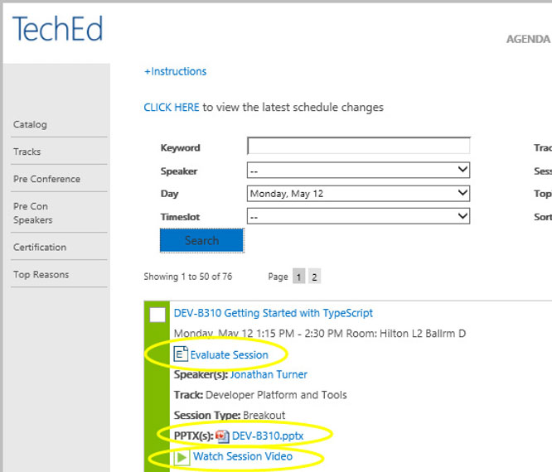
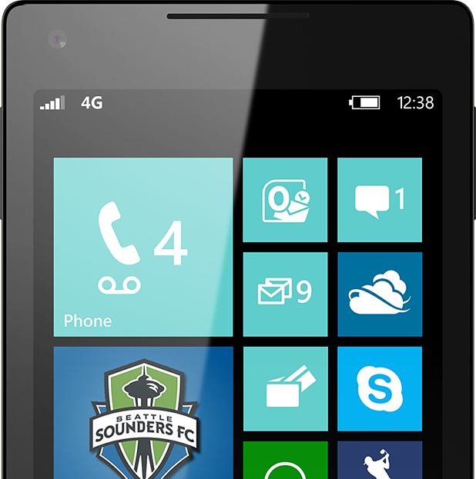
Please Complete An Evaluation Form Your input is important!
TechEd Schedule Builder
CommNet station or PC
TechEd Mobile app
Phone or Tablet
QR code

Slide 44
Evaluate this session

Slide 45
© 2014 Microsoft Corporation. All rights reserved. Microsoft, Windows, and other product names are or may be registered trademarks and/or trademarks in the U.S. and/or other countries.
The information herein is for informational purposes only and represents the current view of Microsoft Corporation as of the date of this presentation. Because Microsoft must respond to changing market conditions, it should not be interpreted to be a commitment on the part of Microsoft, and Microsoft cannot guarantee the accuracy of any information provided after the date of this presentation. MICROSOFT MAKES NO WARRANTIES, EXPRESS, IMPLIED OR STATUTORY, AS TO THE INFORMATION IN THIS PRESENTATION.

