Slide 2
Introducing Microsoft Azure Machine Learning
DBI-B218
Raymond Laghaeian

Slide 3
Agenda:
Overview of Machine Learning
Overview of Azure ML
Demo

Slide 4
Overview of Machine Learning

Slide 5
I believe over the next decade computing will become even more ubiquitous and intelligence will become ambient...This will be made possible by an ever-growing network of connected devices, incredible computing capacity from the cloud, insights from big data, and intelligence from machine learning.

Slide 6
“If you invent a breakthrough in Artificial Intelligence, so machines can learn, that is worth 10 Microsofts”

Slide 7
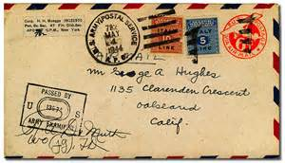
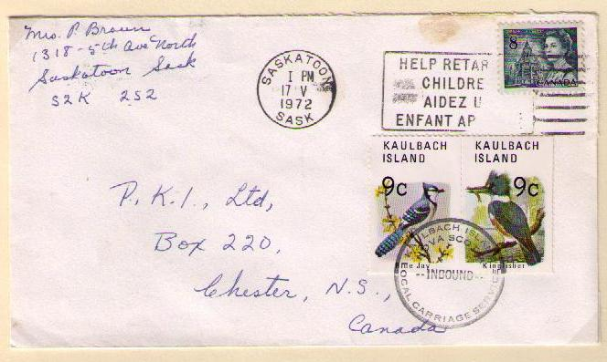
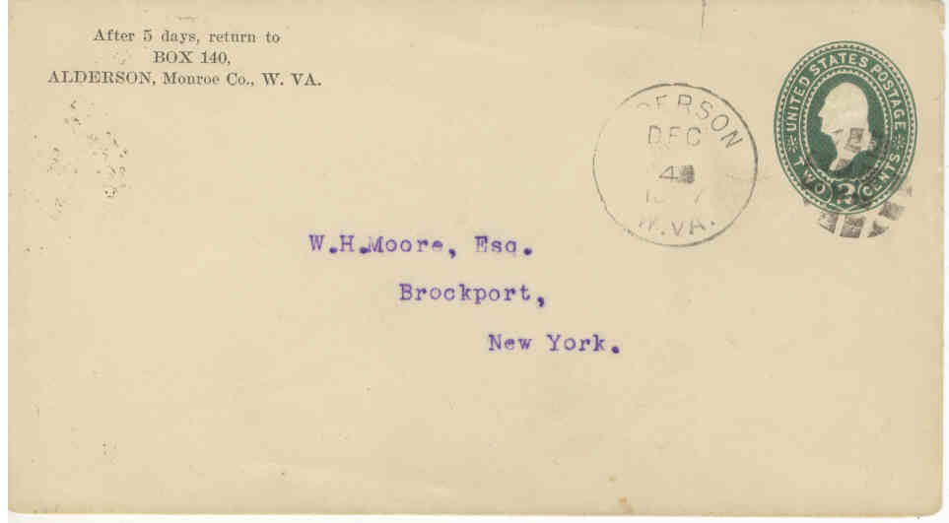
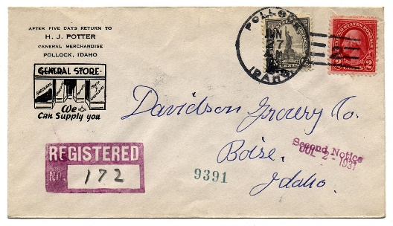

Slide 8
1 | 1 | 5 | 4 | 3
7 | 5 | 3 | 5 | 3
5 | 5 | 9 | 0 | 6
3 | 5 | 2 | 0 | 0
Training examples
Training labels
Accurate digit classifier
2
Machine learning system

Slide 9
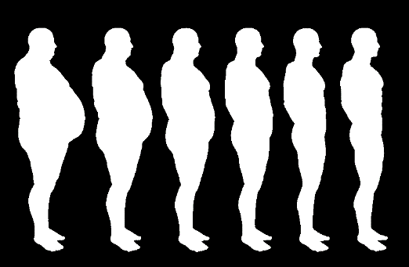
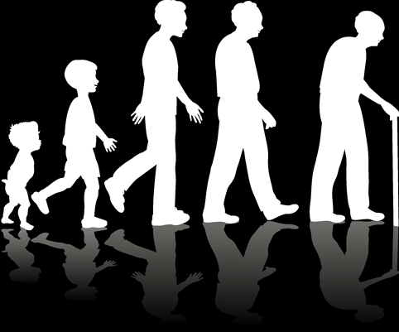

Slide 10
training data (expensive)
synthetic training data (cheaper)
ML system

Slide 11
Machine Learning
“The goal of machine learning is to build computer systems that can adapt and learn from their experience.”
– Tom Dietterich

Slide 12
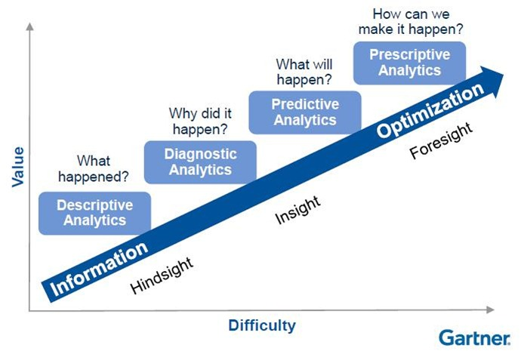
Types of Analytics
Traditional BI
Deployed ML

Slide 13
Can Machine Learning Help Me?
Yes
Automated prediction is core
Lots of past data already available
Magic numbers in current prediction system
No
Prediction is small part of experience
No past data available
Many business-rules govern the experience
Predictions do not have a predictable pattern

Slide 14
Classes of Learning Problems
Classification: Assign a category to each item (Chinese | French | Indian | Italian | Japanese restaurant).
Regression: Predict a real value for each item (stock/currency value, temperature).
Ranking: Order items according to some criterion (web search results relevant to a user query).
Clustering: Partition items into homogeneous groups (clustering twitter posts by topic).
Dimensionality reduction: Transform an initial representation of items into a lower-dimensional representation while preserving some properties (preprocessing of digital images).

Slide 15
Key Concepts
Data
Learning
Model
Prediction
Parameters
Decision Making
Utility Function

Slide 16
Steps to build a Machine Learning Solution
1
De/Refine business problem
5
Monitor model’s performance
2
Extract data
1
Define Target / Metric
5
Evaluate Model
2
Extract Derived Features
4
Deploy model
3
Develop model through iterations
4
Fit Model
3
Select Features

Slide 17
Feature engineering is the key…
Feature engineering: when you use your knowledge about the data to create fields that make machine learning algorithms work better.
It is easily the most important factor in determining the success of a machine learning project
How does one engineer a good feature? Rule of thumb is to try to design features where the likelihood of a certain class goes up monotonically with the value of the field.
Great things happen in machine learning when human and machine work together, combining a person’s knowledge of how to create relevant features from the data with the machine’s talent for optimization..

Slide 18
More data beats a cleverer algorithm…
More data wins. There’s increasingly good evidence that, in a lot of problems, very simple machine learning techniques can be levered into incredibly powerful classifiers with the addition of loads of data.
Once you’ve defined your input fields, there’s only so much analytic gymnastics you can do.
Computer algorithms trying to learn models have only a relatively few tricks they can do efficiently, and many of them are not so very different. Performance differences between algorithms are typically not large. Thus, if you want better classifiers:
Engineer better features
Get your hands on more high-quality data

Slide 19
Data Science Complexity
Data Science is far too complex today
Access to quality ML algorithms, cost is high.
Must learn multiple tools to go end2end, from data acquisition, cleaning and prep, machine learning, and experimentation.
Ability to put a model into production.
This must get simpler, it simply won’t scale!

Slide 20
Introducing Azure ML

Slide 21
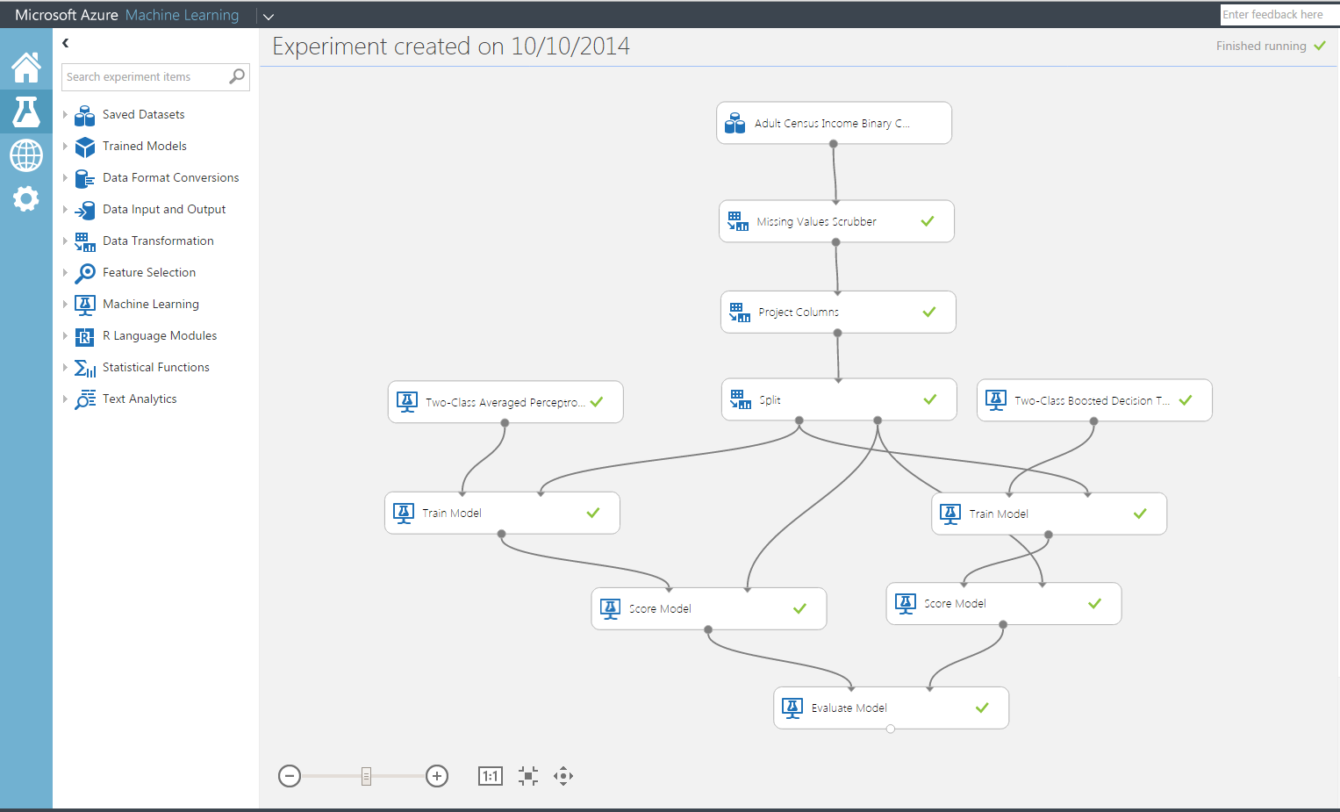
Microsoft Azure Machine Learning Features and Benefits
Reduce complexity to broaden participation
Accessible through a web browser, no software to install;
Collaborative work with anyone, anywhere via Azure workspace
Visual composition with end2end support for data science workflow;
Best in class ML algorithms;
Extensible, support for R OSS.

Slide 22
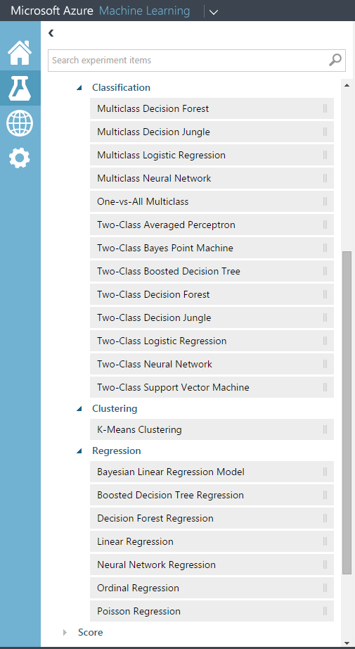
Microsoft Azure Machine Learning Features and Benefits
Rapid experimentation to create a
better model
Immutable library of models, search discover and reuse;
Rapidly try a range of features, ML algorithms and modeling strategies;
Quickly deploy model as Azure web service to our ML API service.

Slide 23
Microsoft Azure Machine Learning Publish as Azure ML Web Service
☁
☁
☁
IT Pro
consume
publish
+
ML API Service
ML Studio
enterprise
customer
data
scientist
• Highly scalable services built on Azure. Eliminate upfront costs for hardware resources.
• Scored in batch-mode or request-response mode;
• Actively monitor models in production to detect changes;
• Telemetry and model management (retrain).

Slide 24
Business problem to business value
Data
Microsoft Azure Machine Learning
API
Cloud
HDInsight
SQL Server VM
SQL DB
Blobs & tables
Local Files
ML Studio
Microsoft Azure portal
Workspace
Publish API in minutes
Local
Desktop files
Excel spreadsheet
Other data files on PC
Storage space
Web
Devices Applications Dashboards
Business problem
Modeling
Deployment
Business value

Slide 25
Demo: Azure ML

Slide 26
Other Resources

Slide 27
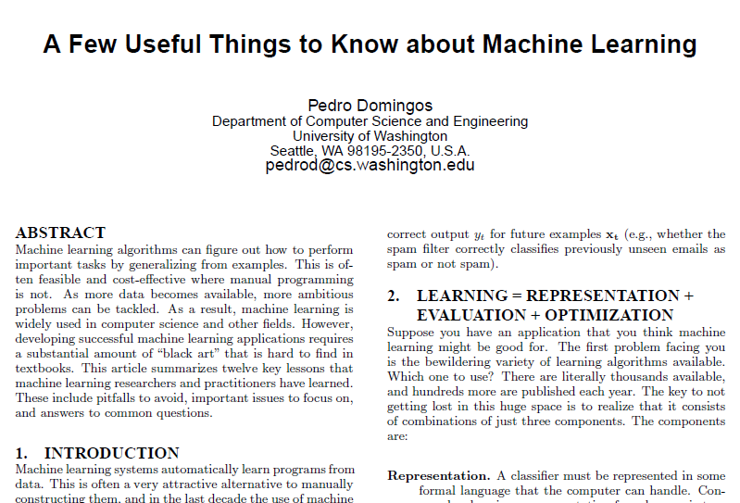

Slide 28
Want to understand the what, why, and how of predictive analytics?
Here’s a short, ordered reading list designed to get you up to speed fast…
The Signal And The Noise: Why So Many Predictions Fail — but Some Don’t by Nate Silver.
Nate Silver built an innovative system for predicting baseball performance and predicted the 2008 and 2012 elections within a hair’s breadth. The New York Times publishes FiveThirtyEight.com, where Silver is one of the nation’s most influential political forecasters. Why read: This book will inspire your “predictive” imagination and ground you in realities of predictive analytics.
Predictive Analytics: The Power To Predict Who Will Click, Buy, Lie, or Die by Eric Siegel.
Eric Siegel has written a very accessible book on how predictive analytics works. It’s chock-full of dozens of real-world examples, such as how Chase Bank predicted mortgage risk (before the recession), IBM Watson won Jeopardy!, and Hewlett-Packard predicted employee flight risk. Why read: Predictive Analytics is a perfectly paced explanation of how predictive analytics works and a repository of dozens of real examples across many use cases.
Uncontrolled: The Surprising Payoff Of of Trial-and-Error For Business, Politics, and Society by Jim Manzi.
Predictive analytics is not magic — it’s science. Jim Manzi reminds us of the power of the scientific method and reveals the shocking truth that many huge societal and business decisions are made based on misinterpreted data and statistics. Why read: Controlled experimentation amplifies the results of predictive analytics and helps avert the risk of inaccurate predictions.
Data Mining: Practical Machine Learning Tools and Techniques by Ian H. Witten, Eibe Frank, and Mark Hall.
If you write code or have a computer science background, you’ll probably want to know the gory details of how predictive analytics works. Why read: Data Mining provides a thorough grounding in machine learning concepts as well as practical advice on applying machine learning tools and techniques in real-world data mining situations.

Slide 29
Archive

Slide 30
What is Data Science?
Data science
is the study of the generalizable extraction of knowledge from data (Wikipedia)
is getting predictive and/or actionable insight from data (Neil Raden)
involves extracting, creating, and processing data to turn it into business value. – Vincent Granville (Developing Analytic Talent: Becoming a Data Scientist )

Slide 31
Why Learn?
Learn it when you can’t code it (e.g. Recognizing Speech/image/gestures)
Learn it when you can’t scale it (e.g. Recommendations, Spam & Fraud detection)
Learn it when you have to adapt/personalize (e.g. Predictive typing)
Learn it when you can’t track it (e.g. AI gaming, robot control)

Slide 32
DBI Track resources
27 Hands on Labs + 8 Instructor Led Labs in Hall 7
Free SQL Server 2014 Technical Overview e-book
microsoft.com/sqlserver and Amazon Kindle Store
Free online training at Microsoft Virtual Academy
microsoftvirtualacademy.com
Try new Azure data services previews!
Azure Machine Learning, DocumentDB, and Stream Analytics

Slide 33
Resources
Learning
Sessions on Demand
Microsoft Certification & Training Resources
http://channel9.msdn.com/Events/TechEd
www.microsoft.com/learning
TechNet
Developer Network
Resources for IT Professionals
http://microsoft.com/technet
http://developer.microsoft.com

Slide 34
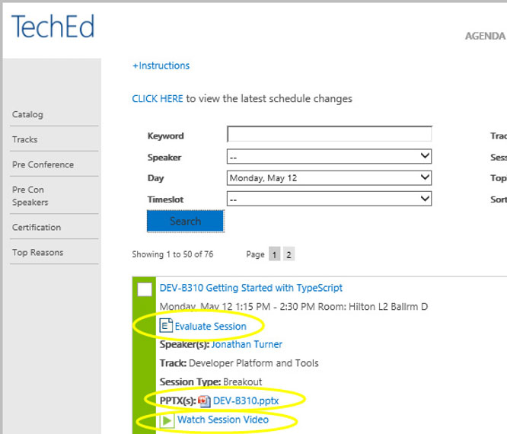
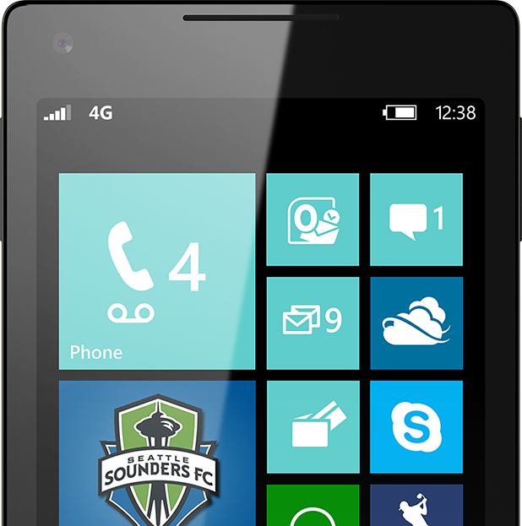
Please Complete An Evaluation Form Your input is important!
TechEd Schedule Builder
CommNet station or PC
TechEd Mobile app
Phone or Tablet
QR code

Slide 35
Evaluate this session

Slide 36
© 2014 Microsoft Corporation. All rights reserved. Microsoft, Windows, and other product names are or may be registered trademarks and/or trademarks in the U.S. and/or other countries.
The information herein is for informational purposes only and represents the current view of Microsoft Corporation as of the date of this presentation. Because Microsoft must respond to changing market conditions, it should not be interpreted to be a commitment on the part of Microsoft, and Microsoft cannot guarantee the accuracy of any information provided after the date of this presentation. MICROSOFT MAKES NO WARRANTIES, EXPRESS, IMPLIED OR STATUTORY, AS TO THE INFORMATION IN THIS PRESENTATION.

