Slide 1


Slide 2

Analytics Platform System Overview (APS)
DBI-B310
Franz Robeller
Lionel Pénuchot

Slide 3







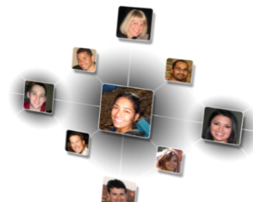

The World of Data HAS CHANGED
10x increase every five years
Data
explosion
Consumerization of IT
4.3 connected devices per adult
85% from new data types
27%
using social media input
By 2015, organizations integrating high-value, diverse, new information types and sources into a coherent information management infrastructure will outperform their industry peers financially by more than 20%.
– Gartner, Regina Casonato et al., “Information Management in the 21st Century

Slide 4


New World of Big Data & DW – Yet another ‘Hype’?
BI and analytics
Dashboards
Reporting
… data warehousing has reached the most significant tipping point since its inception. The biggest, possibly most elaborate data management system in IT is changing.
– Gartner, “The State of Data Warehousing in 2012”
Data warehouse
ETL
Data sources
OLTP
ERP
CRM
LOB

Slide 5



Today, a new set of questions are being asked of the business
  What’s the social sentiment for my brand or products?
  How do I optimize my fleet based on weather and traffic patterns?
  How do I better predict future outcomes?
Social and web analytics
Live data
feeds
Advanced analytics

Slide 6
Global Trends
From BIG DATA
To “Internet of Things” (IoT)

Slide 7
Internet of Things (IoT) - Definition
The Internet of Things (IoT) is a scenario in which objects, animals or people are provided with unique identifiers and the ability to transfer data over a network without requiring human-to-human or human-to-computer interaction. IoT has evolved from the convergence of wireless technologies, micro-electromechanical systems (MEMS) and the Internet.

Slide 8
Impact on the Traditional Data Warehouse
BI and analytics
2
Real-time
data
Dashboards
Reporting
Data warehouse
ETL
1
3
4
Increasing
data volumes
New data
sources and types
Cloud-born
data
Data sources
Non-relational data
OLTP
ERP
CRM
LOB
8
Devices
Web
Sensors
Social

Slide 9



Microsoft Data Warehouse Vision
Make SQL Server the fastest and most affordable database for customers of all sizes.
Massive scalability
at a low cost
Flexibility and choice
Complete data
warehouse solution
Simplified data warehouse management

Slide 10


The Modern Data Warehouse
BI AND ANALYTICS
Self-service
Corporate
Collaboration
Mobile
Predictive
DATA ENRICHMENT AND FEDERATED QUERY
Single query model
Extract, transform, load
Data quality
Master data management
DATA MANAGEMENT AND PROCESSING
✓
Relational
Non-relational
Analytical
Streaming
Internal and external
INFRASTRUCTURE
Data sources
Non-relational data
OLTP
ERP
CRM
LOB
Devices
Web
Sensors
Social

Slide 11
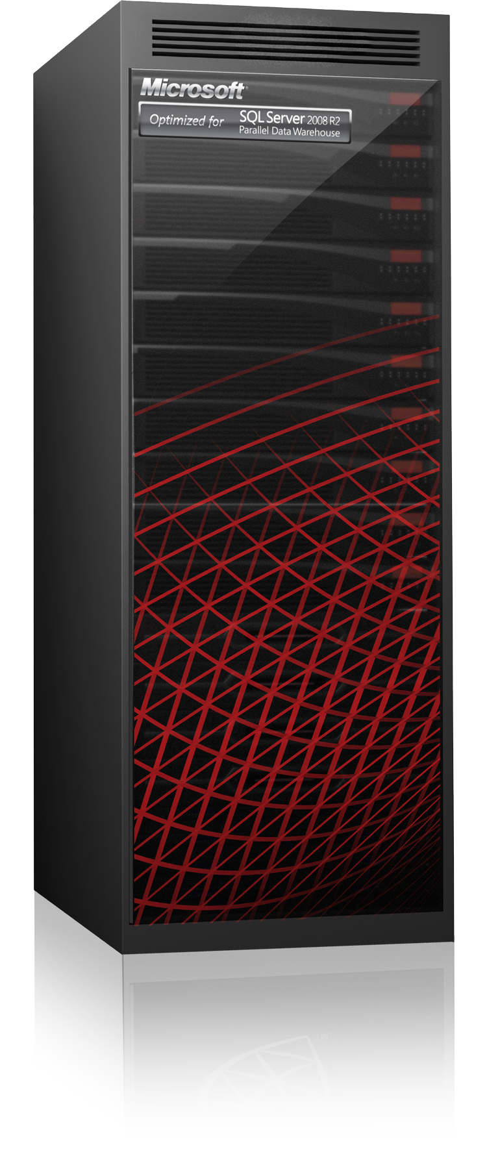






Introducing Microsoft Analytics Platform System
Appliance experience
Pre-built hardware + software appliance
Co-engineered with HP, Dell and Quanta*
Pre-built hardware
Pre-installed software
Appliance installed in 1–2 days
Support
Microsoft provides first call support; hardware partner provides onsite break/fix support
*Quanta not available in all countries or regions
Plug and play
Built-in best practices
Save time

Slide 12
Microsoft Data Warehousing Solutions
Microsoft SQL Server
Microsoft Analytics Platform System
Scalable and reliable symmetric multiprocessing (SMP) and non unified memory architecture (NUMA) platforms for data warehousing on any hardware | Appliance for high-end massively parallel processing (MPP) data warehousing
Ideal for data marts or small to mid-sized enterprise data warehouses (EDWs) | Ideal for high-scale or high-performance data marts and EDWs
Software only | Data warehouse appliance (fully-integrated software and hardware)
10s of TB | 10s of TB – 6 PB (PDW – compressed) 24 TB – 1.2 PB (Hadoop – uncompressed)

Slide 13
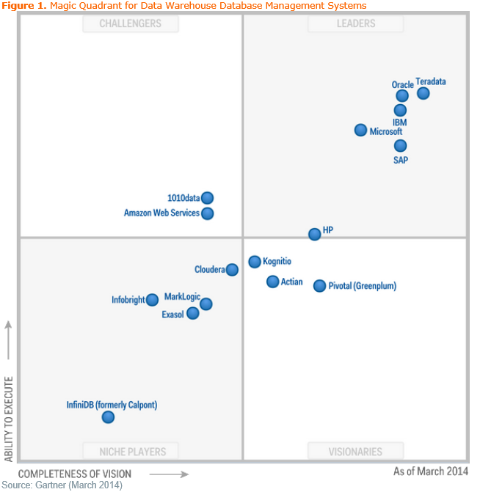
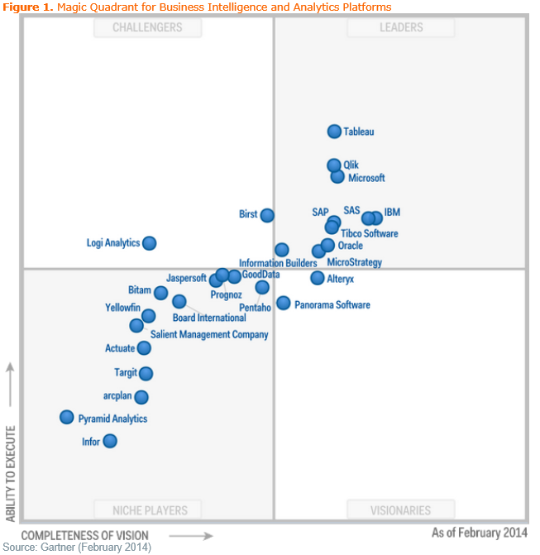
Gartner Magic Quadrant Leader
“Microsoft offers appliances, reference architectures including a variety of hardware, prebuilt offerings built to customer selections then delivered ready to run, software licensing and managed services data warehouses.”- Gartner, March 7th, 2014
[Gartner, Inc., Magic Quadrant for Data Warehouse Database Management Systems Magic Quadrant, Mark A. Beyer, Roxane Edjlali, March 2014.
The Magic Quadrant is copyrighted 2014 by Gartner, Inc. and is reused with permission. The Magic Quadrant is a graphical representation of a marketplace at and for a specific time period. It depicts Gartner's analysis of how certain vendors measure against criteria for that marketplace, as defined by Gartner. Gartner does not endorse any vendor, product or service depicted in the Magic Quadrant, and does not advise technology users to select only those vendors placed in the "Leaders" quadrant. The Magic Quadrant is intended solely as a research tool, and is not meant to be a specific guide to action. Gartner disclaims all warranties, express or implied, with respect to this research, including any warranties of merchantability or fitness for a particular purpose.

Slide 14
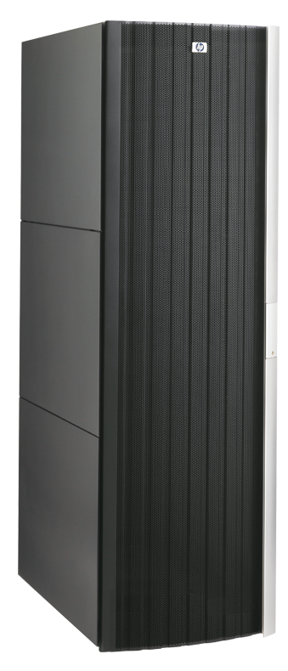
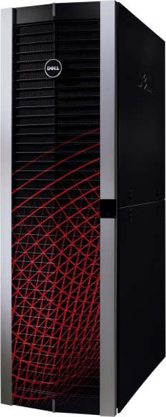
Tier-1 enterprise data warehouse appliance offering
  High scalability from tens to thousands of terabytes
  High performance through the massively parallel processing (MPP) system
Flexibility and choice
  Choice of deployment options through distributed architecture
Most comprehensive solution
  Complete data warehouse solution spanning desktop, enterprise data warehouse, and data marts
Microsoft Analytics Platform System

Slide 15

Scale out relational data to petabytes
Relational
Scale out technologies in SQL Server Parallel Data Warehouse
Massively Parallel Processing (MPP) parallelizes queries
Multiple nodes with dedicated CPU, memory, storage
Incrementally add HW for near linear scale to multi-PB
Handles query complexity and concurrency at scale
No fork-lift of prior warehouse to increase capacity
  Scale OUT
From Terabytes to Multi-Petabytes

Slide 16
Scale out non-relational data
Non-relational
Scale out non-relational data in HDInsight (for Azure or PDW)
  Scale OUT
Create Hadoop cluster for your data requirements
Seamlessly add more compute to fit your demand
Scales out linearly
Shut down clusters when you are done
Scale Out “Big Data”

Slide 17





Challenges for a modern data warehouse
Keep existing & legacy investment
Acquire Big Data solution
Buy new tier-one hardware appliance
Acquire business intelligence & tools
Limited
scalability and ability to handle new data types
Significant training and data silos
High acquisition and migration costs
Complex with low adoption

Slide 18
Hardware and Software Engineered Together
Analytics Platform System
SQL Server
Parallel Data
Warehouse
PolyBase
Microsoft HDInsight

Slide 19



Microsoft Analytics Platform System
Enterprise-Ready
Big Data/IoT platform
Next-Generation
Performance at Scale
Engineered for
Optimal Value

Slide 20




Hadoop Alone is NOT the Answer to All Challenges
Hadoop Ecosystem
Move HDFS into the Warehouse Before Analysis
New data sources
Learn new skills
T-SQL
Devices
Web
Sensor
Social
New data sources
HDFS
(Hadoop)
Build
Integrate
Manage
Maintain
Support
HDFS
(Hadoop)
ETL
Warehouse
“New” data sources
Devices
Web
Sensor
Social

Slide 21
APS Delivers Enterprise-Ready Hadoop with HDInsight
SQL Server
Parallel Data
Warehouse
  High performance and tuned within the appliance
  End-user authentication with Active Directory
PolyBase
Microsoft HDInsight
100-percent Apache Hadoop
  Managed and monitored using System Center
  Accessible insights for everyone with Microsoft BI tools

Slide 22
Connecting Islands of Data with PolyBase
Select…
Result set
  Provides a single T-SQL query model for PDW and Hadoop with rich features of T-SQL, including joins without ETL
  Uses the power of MPP to enhance query execution performance
  Supports Windows Azure HDInsight to enable new hybrid cloud scenarios
  Provides the ability to query non-Microsoft Hadoop distributions, such as Hortonworks and Cloudera
SQL Server
Parallel Data
Warehouse
Microsoft Azure
HDInsight
Hortonworks for
Windows and Linux
Cloudera
PolyBase
Microsoft HDInsight

Slide 23
Microsoft Analytics Platform System
Enterprise-Ready
Big Data/IoT platform
Next-Generation
Performance at Scale
Engineered for
Optimal Value

Slide 24
Clustered Columnstore Index
Why is a Clustered Columnstore Index Important?
  Saves space
  Provides easier management by eliminating maintenance of secondary indexes
  Supports all PDW data types, including high-precision decimal data types and more
91% savings
In-Memory Columnstore is featured in the storage engine in PDW V2
Space used = table space + index space

Slide 25
Updatable Columnstore Index
Deltastore (Rowstore)
C1
C2
C3
C4
C5
C6
INSERT
Values always inserted into deltastore
C1
C2
C3
C4
C5
C6
DELETE
Logical operation that does not physically remove a row until REBUILD is performed
tuple mover
UPDATE
DELETE followed by INSERT
Columnstore
BULK INSERT
If a batch is less than 100,000, values are inserted into deltastore; if it’s greater than 100,000, they go into columnstore
SELECT
Unifies data from column and rowstores through an internal UNION operation

Slide 26


Distributed Parallel Query Execution
Create query plan
1
SQL queries sent to control node
Appliance
Compute
2
Control node creates query execution plan
User query
Management
Compute
Client
Control
3
Query plan creates distributed queries to run on each compute node
Compute
Query results
Compute
4
Distributed queries sent to compute nodes (all running in parallel)
Aggregate query results
Compute nodes process query plan operations in parallel
5
Control node collects query results and returns them to user

Slide 27









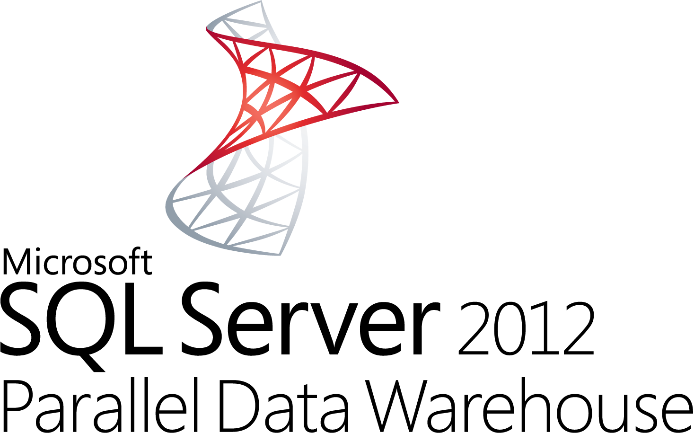

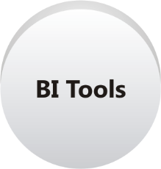
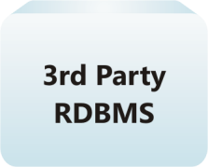

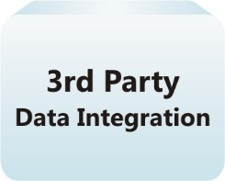


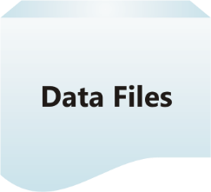
Distributed Data Warehouse Architectures
Departmental Reporting
Regional
Reporting
Fast Track Data Warehouse
High-Performance Reporting
Microsoft Analytic Platform System (APS)
Analysis Services
H-Bridge
HDFS Data Nodes
Unstructured data
ETL Tools

Slide 28
Demo
Parallel Data Warehouse

Slide 29
Microsoft Analytics Platform System
Enterprise-Ready
Big Data/IoT platform
Next-Generation
Performance at Scale
Engineered for
Optimal Value

Slide 30
Lowest Price Per TB for Data Warehouse Appliances
Price per terabyte for leading vendors
Significantly lower price per terabyte than the closest competitor
Price per terabyte for user-available storage (compressed)
$30
$25
$20
$15
Thousands
$10
Lower storage costs
with Windows Server 2012
Storage Spaces
$5
$0
Oracle
EMC
IBM
Teradata
Microsoft
NOTE: Orange line indicates average price per terabyte.

Slide 31
Introducing the Microsoft Analytics Platform System
Enterprise-Ready
Big Data/IoT platform
Next-Generation
Performance at Scale
Engineered for
Optimal Value
Relational and non-relational data in a single appliance
Enterprise-ready Hadoop
Integrated querying across Hadoop and PDW using T-SQL
Direct integration with Microsoft BI tools such as Microsoft Excel
Near real-time performance with In-Memory Columnstore
Ability to scale out to accommodate growing data
Removal of data warehouse bottlenecks with MPP SQL Server
Concurrency that fuels rapid adoption
Industry’s lowest data warehouse appliance price per terabyte
Value through a single appliance solution
Value with flexible hardware options using commodity hardware

Slide 32
Hardware Architecture Overview (PDW+HDI)
HST01
HST01
AD01
WDS
VMM
CTL
PDW Region
HST02
HST02
AD02
HST03
HST03
HHN01
HSN01
HMN01
HDI Region
HST04
HST04
Direct attached SAS
Direct attached SAS
HSA04
HSA04
JBOD
Data 3
Data 4
JBOD
HDI Region
HSA03
HSA03
Data 1
Data 2
IB and
Ethernet
IB and
Ethernet
HSA02
HSA02
JBOD
Compute 2
JBOD
PDW Region
HSA01
HSA01
Compute 1

Slide 33
Virtual Machine Architecture Overview (PDW Region)
Window Server 2012 R2 Standard
PDW engine
DMS Manager
SQL Server 2014 Enterprise Edition (PDW build)
Shell databases just as in older versions
Software details
General details
  All hosts run Windows Server 2012 R2 Standard
  All virtual machines run Windows Server 2012 R2 Standard as a guest operating system
  All fabric and workload activity happens in Hyper-V virtual machines
  Fabric virtual machines and CTL share one server
  Lower overhead costs especially for small topologies
  PDW Agent runs on all hosts and all virtual machines and collects appliance health data on fabric and workload
  DWConfig and Admin Console continue to exist
  Minor extensions expose host-level information
  Windows Storage Spaces handles mirroring and spares and enables use of lower cost DAS (JBODs)
PDW workload details
  SQL Server 2014 Enterprise Edition (PDW build) control node and compute nodes for PDW workload
Storage details
  2 Files on 2 LUNs per Filegroup, 8 Filegroups per compute node
  Each LUN is configured as RAID 1
  ➔Large numbers of spindles are used in parallel
HST01
Base unit
AD01
WDS
VMM
CTL
HST02
AD02
HSA02
JBOD
Compute 2
HSA01
IB and
Ethernet
Compute 1
Direct attached SAS
Window Server 2012 R2 Standard
DMS Core
SQL Server 2014 Enterprise Edition (PDW build)

Slide 34
Virtual Machine Architecture Overview (HDI Region)
Window Server 2012 R2 Standard
Windows HDI distribution software (version 2.x)
Software details
General details
  All hosts run Windows Server 2012 R2 Standard
  All virtual machines run Windows Server 2012 R2 Standard as a guest operating system
  All HDI workload activity happens in Hyper-V virtual machines
  Lower overhead costs especially for small topologies
  Windows Storage Spaces handles mirroring and spares and enables use of lower cost DAS (JBODs) rather than SAN
HDI workload details
  Windows HDI Head-/Security-/Management- node and Data nodes for HDI workload
Storage details
  16 Data Disks per Data Node
  No RAID 1 – single drives only!
  But each file is stores 3 times in HDFS
HST03
Base unit
HHN01
HSN01
HMN01
HST04
HSA04
JBOD
Data 3
Data 4
HSA03
IB and
Ethernet
Data 1
Data 2
Direct attached SAS
Window Server 2012 R2 Standard
Windows HDI distribution software (version 2.x)

Slide 35
Failover Functionality
Sample: PDW Region (Base Unit - HP)
Details
Failover Cluster Manager starts virtual machine on a new host after failure
Cluster Shared Volumes
  Enables all nodes to access the LUNs on the JBOD as long as at least one of the hosts attached to the JBOD is active
  Uses SMB3 protocol
Failover details
  One cluster across the whole appliance
  Virtual machine images are automatically started on new host in the event of failover
  Rules enforced by affinity and anti-affinity maps
  Failback continues to be through CSS
  Uses Windows Failover Cluster Manager
Adding Passive Unit increases HA capacity
  Enables another virtual machine to fail without disabling the appliance
  All hosts connected to a single JBOD cannot failover
HST01
AD01
WDS
VMM
CTL
Base Unit
HST01
HST02
AD01
WDS
VMM
CTL
AD02
Compute 2
Base Unit
HST03
HST02
AD02
Compute 2
CTL
Passive Unit
HSA02
JBOD
HSA02
Compute 2
HSA01
IB &
Ethernet
Compute 1
Direct attached SAS

Slide 36
Replace Node
Sample: PDW Region (Base Unit - HP)
Details
Single type of node
  Sole differentiator—storage attached vs. storage unattached
  Execution commonality regardless if host is being replaced
Workloads migrate with virtual machines
  Replace Node follows a subset of the bare metal provisioning
    using WDS and executes the APS Setup.exe with the replace node action specified, along with the necessary information targeting the replacement node
  Workload virtual machines do not have to be re-provisioned
Workload virtual machines are failed back using Windows Failover Cluster Manager
  Failback still incurs small downtime
  May be a small performance impact by failed over compute nodes; documentation will suggest fail-back
  Currently not using Live Migration for failover and failback
HST01
AD01
WDS
VMM
CTL
Base Unit
HST02
AD02
Compute 2
HSA02
JBOD
HSA02
Compute 2
HSA01
IB and
Ethernet
Compute 1
Direct attached SAS

Slide 37
Add Unit: Scaling from 2 to 56 Nodes
Sample: PDW Region (Base Unit - HP)
Details
HST01
AD01
WDS
VMM
CTL
Addition to the appliance is in the form of one or more scale units
IHV owns installation and cabling of new scale units
Software provisioning consists of three phases
  Bare metal provisioning of new nodes (online since AU1)
  Provisioning of workload virtual machines (online since AU1)
  Redistribution of data (offline)
CSS assistance (may have to help prepare user data)
  Tools to validate environment/data transition
  Develop strategy for successful addition
  Deleting old data
  Partition switching from largest tables
  CRTAS to move data off appliance temporarily
Base Unit
HST02
AD02
HSA04
HSA04
JBOD
Compute 4
JBOD
Compute 4
HSA03
HSA03
Compute 3
Compute 3
HSA02
JBOD
Compute 2
HSA01
IB and
Ethernet
Compute 1
PDW Region must have enough free space to re-distribute the largest table.
Direct attached SAS

Slide 38
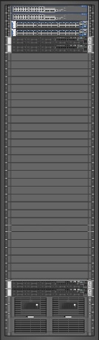
Minimum Topology: PDW Region only
Min

Slide 39


Minimum Topology: PDW + HDI Region
Min

Slide 40
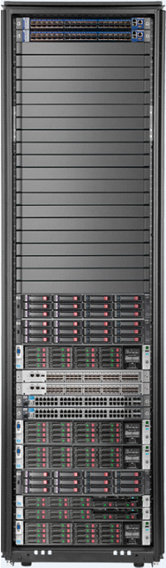



Seamlessly Add Capacity
Start Small Linearly Scale OUT
Smallest (53TB) To Largest (6PB)
Start small with a warehouse capacity of several terabytes
Add capacity up to 6 Petabytes (PB)
Add
capacity
Add
capacity
Start small
and grow
Largest warehouse
PB
53 TB
6 PB

Slide 41
Scaling Out Your Data to Petabytes
Extend

Slide 42
Internet of Things (IoT) - Microsoft
With Microsoft, you can do the following:
Build on what already works
Lean on trusted support and expertise
Unlock innovation with a cohesive platform and skilled partners
➔Microsoft’s Analytic Platform System is the perfect backbone for storing IoT-data

Slide 43
Related content
DBI-B311 Microsoft Analytics Platform System – Deep Dive
(Thursday, October 30 12:00 PM-1:15 PM )
DBI-B337 Polybase in the Modern Data Warehouse
(Friday, October 31 8:30 AM - 9:45 AM)

Slide 44

Questions?

Slide 45
DBI Track resources
27 Hands on Labs + 8 Instructor Led Labs in Hall 7
Free SQL Server 2014 Technical Overview e-book
  microsoft.com/sqlserver and Amazon Kindle Store
Free online training at Microsoft Virtual Academy
  microsoftvirtualacademy.com
Try new Azure data services previews!
  Azure Machine Learning, DocumentDB, and Stream Analytics

Slide 46

Resources
Learning
  Sessions on Demand
  Microsoft Certification & Training Resources
http://channel9.msdn.com/Events/TechEd
www.microsoft.com/learning
TechNet
Developer Network
  Resources for IT Professionals
http://microsoft.com/technet
http://developer.microsoft.com

Slide 47



Please Complete An Evaluation Form
Your input is important!
TechEd Schedule Builder
CommNet station or PC
TechEd Mobile app
Phone or Tablet
QR code

Slide 48
Evaluate this session

Slide 49


© 2014 Microsoft Corporation. All rights reserved. Microsoft, Windows, and other product names are or may be registered trademarks and/or trademarks in the U.S. and/or other countries.
The information herein is for informational purposes only and represents the current view of Microsoft Corporation as of the date of this presentation. Because Microsoft must respond to changing market conditions, it should not be interpreted to be a commitment on the part of Microsoft, and Microsoft cannot guarantee the accuracy of any information provided after the date of this presentation. MICROSOFT MAKES NO WARRANTIES, EXPRESS, IMPLIED OR STATUTORY, AS TO THE INFORMATION IN THIS PRESENTATION.

