Slide 1


Slide 2

Introducing Azure Data Factory
DBI-B317
Mike Flasko

Slide 3
Agenda
Why Azure Data Factory?
What is a Data Factory?
  Overview
  Example: Customer Profiling (game log analytics)
Public Preview – get started today

Slide 4


Agenda
BI and analytics
… data warehousing has reached the most significant tipping point since its inception. The biggest, possibly most elaborate data management system in IT is changing.
– Gartner, “The State of Data Warehousing in 2012”
Dashboards
Reporting
Data warehouse
ETL
Data sources
OLTP
ERP
CRM
LOB

Slide 5
The “Traditional” Data Warehouse
BI and analytics
2
Real-time
data
Dashboards
Reporting
Data warehouse
ETL
1
3
4
Increasing
data volumes
New data
sources & types
Cloud-born
data
Data sources
Non-Relational Data
OLTP
ERP
CRM
LOB
5
Devices
Web
Sensors
Social

Slide 6
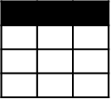
Evolving Approaches to Analytics
Extract
Transform
Load
EDW
(SQL Svr, Teradata, etc)
OLTP
…
ETL Tool
(SSIS, etc)
Transformed Data
BI Tools
Original Data
ERP
LOB
Data Marts
Data Lake(s)
Dashboards
Apps

Slide 7
Evolving Approaches to Analytics
Extract
Transform
Load
EDW
(SQL Svr, Teradata, etc)
OLTP
…
ETL Tool
(SSIS, etc)
Transformed Data
BI Tools
Original Data
ERP
LOB
Data Marts
Data Lake(s)
Dashboards
Social
Ingest (EL)
Apps
Devices
Sensors
Original Data
Web

Slide 8
Evolving Approaches to Analytics
Extract
Transform
Load
EDW
(SQL Svr, Teradata, etc)
OLTP
…
ETL Tool
(SSIS, etc)
Transformed Data
BI Tools
Original Data
ERP
LOB
Data Marts
Data Lake(s)
Dashboards
Social
Ingest (EL)
Apps
Devices
Scale-out Storage & Compute
(HDFS, Blob Storage, etc)
Sensors
Original Data
Web
Streaming data
Transform & Load

Slide 9
Evolving Approaches to Analytics
Extract
Transform
Load
EDW
(SQL Svr, Teradata, etc)
OLTP
…
ETL Tool
(SSIS, etc)
Transformed Data
BI Tools
Original Data
ERP
LOB
Data Marts
Data Lake(s)
Dashboards
Social
Ingest (EL)
Apps
Devices
Scale-out Storage & Compute
(HDFS, Blob Storage, etc)
Sensors
Original Data
Web
Streaming data
Transform & Load

Slide 10
Evolving Approaches to Analytics
Data Hub
(Storage & Compute)
Data Sources
(Import From)
Ingest
Pipeline
of Activities
BI Tools
Data Marts
Move data among Hubs
Data Lake(s)
Dashboards
Data Hub
(Storage & Compute)
Data Sources
(Import From)
Ingest
Move to data mart, etc
Apps
Pipeline
of Activities
Information Production:
Connect & Collect
Transform & Enrich
Publish

Slide 11
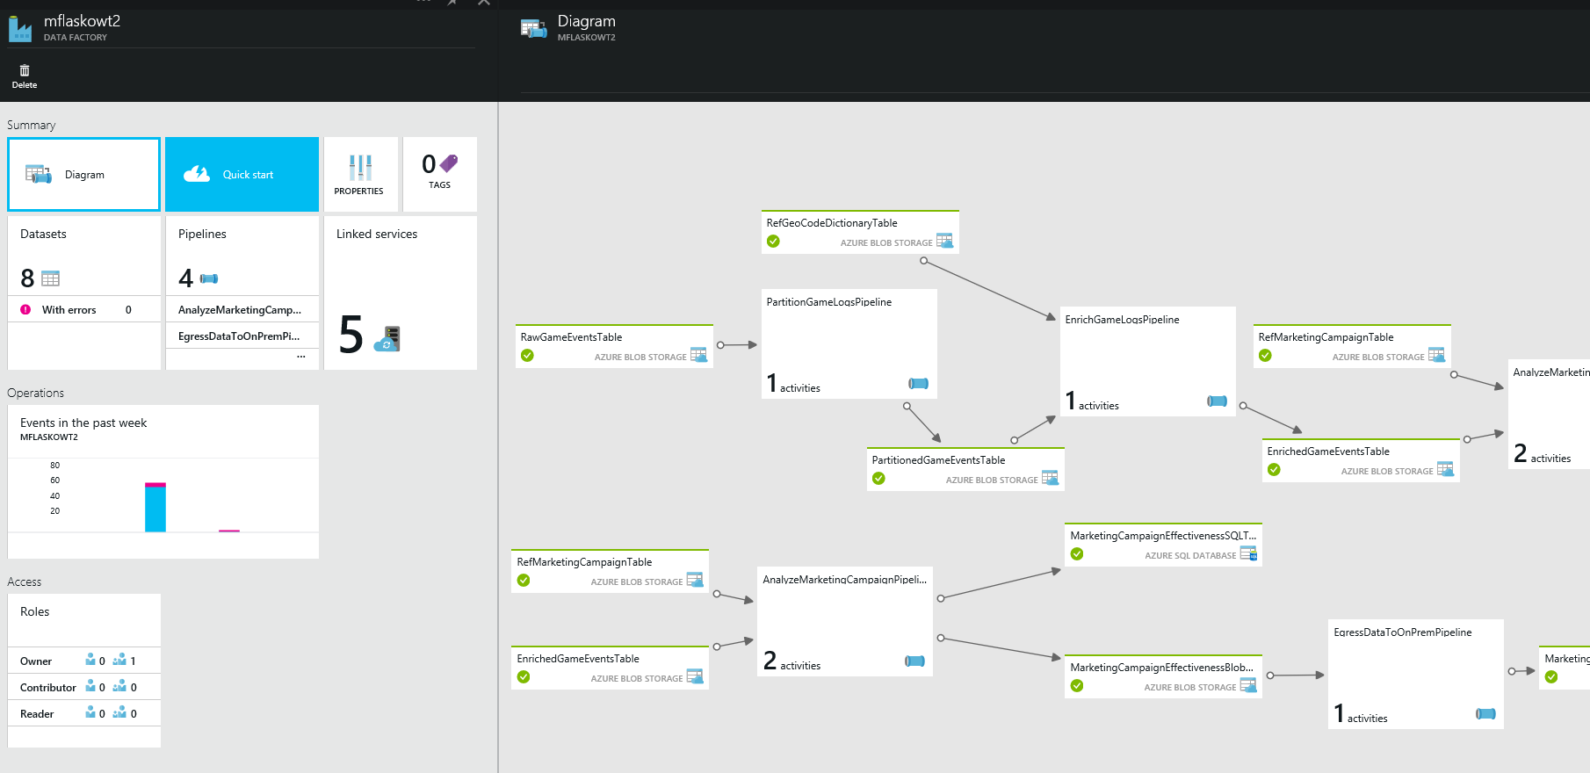
Operationalizing Information Production With Data Factory
Coordination & Scheduling
Monitoring & Mgmt
Data Lineage
Data Connector:
Import from source to Hub
Data Hub
(Storage & Compute)
Data Sources
(Import From)
Pipeline
of Activities
BI Tools
Data Connector:
Import/Export among Hubs
Data Marts
Data Lake(s)
Data Connector:
Import from source to Hub
Data Connector:
Export from Hub to data store
Dashboards
Data Hub
(Storage & Compute)
Data Sources
(Import From)
Apps
Pipeline
of Activities
Information Production:
Connect & Collect
Transform & Enrich
Publish

Slide 12
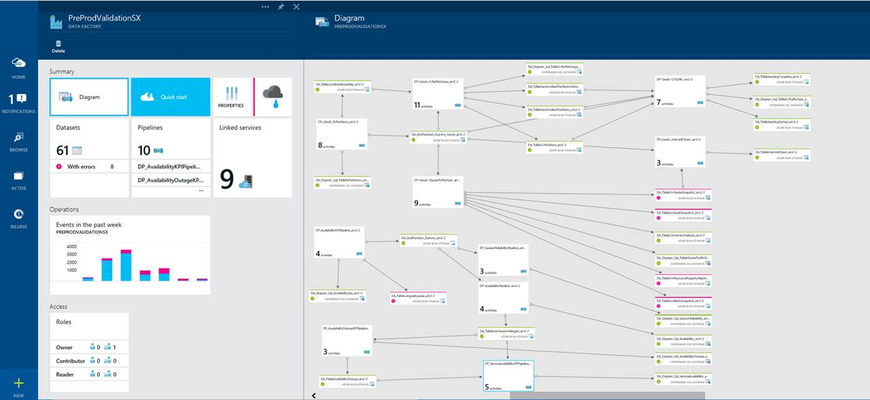
Operationalizing Information Production With Data Factory

Slide 13
Azure Data Factory Overview
New Azure service for data developers & IT
Compose data processing, storage and movement services to create & manage analytics pipelines
Initially focused on Azure & hybrid movement to/from on premises SQL Server. Overtime will expand to more storage & processing systems throughout
Rich, simple end-to-end pipeline monitoring and management

Slide 14
Example Scenario:
Customer Profiling (game usage analytics)

Slide 15
Customer Profiling – Game Usage Analytics
Log Files Snippet (10s of TBs per day in cloud storage)
2277,2013-06-01 02:26:54.3943450,111,164.234.187.32,24.84.225.233,true,8,1,2058
2277,2013-06-01 03:26:23.2240000,111,164.234.187.32,24.84.225.233,true,8,1,2058-2123-2009-2068-2166
2277,2013-06-01 04:22:39.4940000,111,164.234.187.32,24.84.225.233,true,8,1,
2277,2013-06-01 05:43:54.1240000,111,164.234.187.32,24.84.225.233,true,8,1,2058-225545-2309-2068-2166
2277,2013-06-01 06:11:23.9274300,111,164.234.187.32,24.84.225.233,true,8,1,223-2123-2009-4229-9936623
2277,2013-06-01 07:37:01.3962500,111,164.234.187.32,24.84.225.233,true,8,1,
2277,2013-06-01 08:12:03.1109790,111,164.234.187.32,24.84.225.233,true,8,1,234322-2123-2234234-12432-344323
…
New User Activity Per Week By Region
profileid | day | state | duration | rank | weaponsused | interactedwith
1148 | 6/2/2013 | Oregon | 216 | 33 | 1 | 5
1004 | 6/2/2013 | Missouri | 22 | 40 | 6 | 2
292 | 6/1/2013 | Georgia | 201 | 137 | 1 | 5
1059 | 6/2/2013 | Oregon | 27 | 104 | 5 | 2
675 | 6/2/2013 | California | 65 | 164 | 3 | 2
1348 | 6/3/2013 | Nebraska | 21 | 95 | 5 | 2
User Table
UserID | FirstName | LastName | State | …
2277 | Pratik | Patel | Oregon
664432 | Dave | Nettleton | Washington
8853 | Mike | Flasko | California

Slide 16
Data Factory Walkthrough

Slide 17
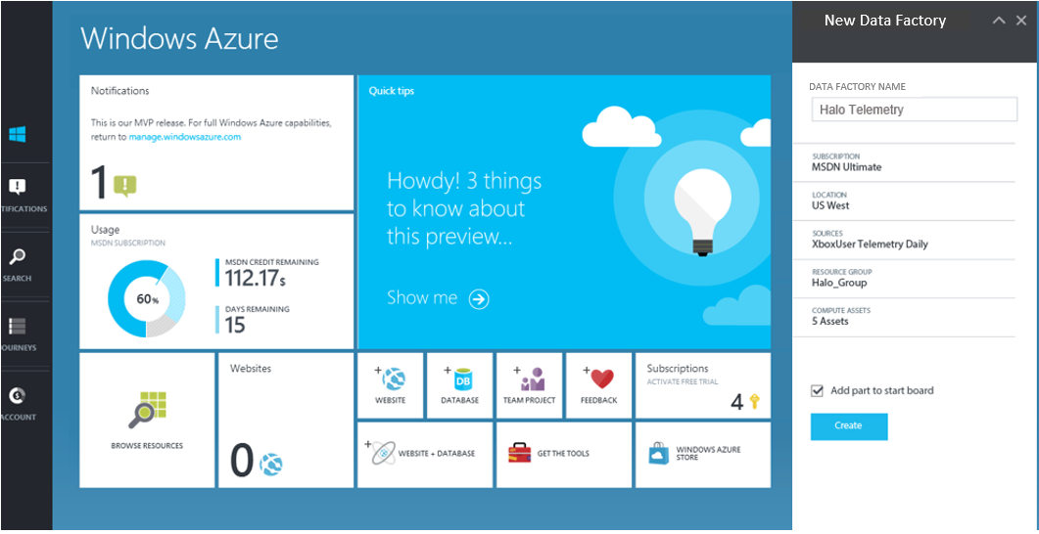
Step 1: Create a Data Factory
New-AzureDataFactory
-Name “GameTelemetry“
-Location “West-US“
New-AzureDataFactory
-Name “HaloTelemetry“
-Location “West-US“

Slide 18
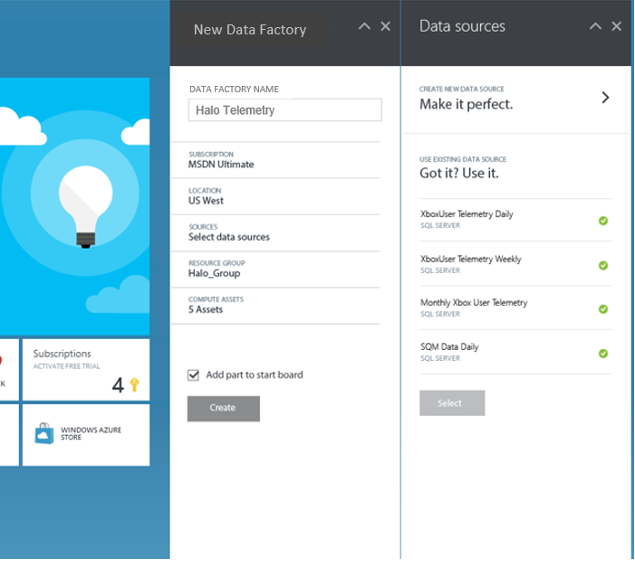
Step 2: Add Data Sources
New-AzureDataFactoryLinkedService
-Name "MyHDInsightCluster“
-DataFactory“GameTelemetry"
-File HDIResource.json
New-AzureDataFactoryLinkedService
-Name "MyStorageAccount"
-DataFactory“GameTelemetry"
-File BlobResource.json

Slide 19
Example: Game Logs, Customer Profiling
Azure Data Factory
New User View
1000’s Log Files
On Premises SQL Server
Azure Blob Storage

Slide 20
Example: Game Logs, Customer Profiling
Azure Data Factory
New Users
View Of
New User Activity
Game Usage
View Of
New User View
1000’s Log Files
On Premises SQL Server
Azure Blob Storage

Slide 21
Example: Game Logs, Customer Profiling
Azure Data Factory
Pipeline
New Users
Copy “NewUsers” to Blob Storage
Cloud New Users
View Of
View Of
New User Activity
Game Usage
View Of
New User View
1000’s Log Files
On Premises SQL Server
Azure Blob Storage

Slide 22
Example: Game Logs, Customer Profiling
Azure Data Factory
Pipeline
New Users
Copy NewUsers to Blob Storage
Cloud New Users
View Of
New User Activity
Pipeline
Geo Dictionary
Mask & Geo-Code
Geo Coded Game Usage
Game Usage
View Of
HDInsight
New User View
1000’s Log Files
On Premises SQL Server
Azure Blob Storage

Slide 23
Example: Game Logs, Customer Profiling
Azure Data Factory
Pipeline
New Users
Copy NewUsers to Blob Storage
Cloud New Users
Pipeline
View Of
Join & Aggregate
New User Activity
Pipeline
Geo Dictionary
Runs On
View Of
Mask & Geo-Code
Geo Coded Game Usage
Game Usage
View Of
HDInsight
New User View
1000’s Log Files
On Premises SQL Server
Azure Blob Storage

Slide 24
Example: Game Logs, Customer Profiling
Azure Data Factory
Pipeline
New Users
Copy NewUsers to Blob Storage
Cloud New Users
Pipeline
View Of
Join & Aggregate
New User Activity
Pipeline
Geo Dictionary
Runs On
View Of
Mask & Geo-Code
Geo Coded Game Usage
Game Usage
View Of
HDInsight
New User View
1000’s Log Files
On Premises SQL Server
Azure Blob Storage

Slide 25
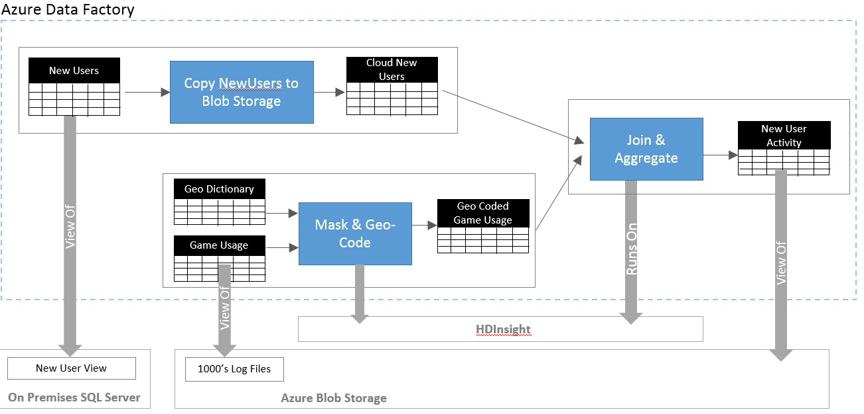
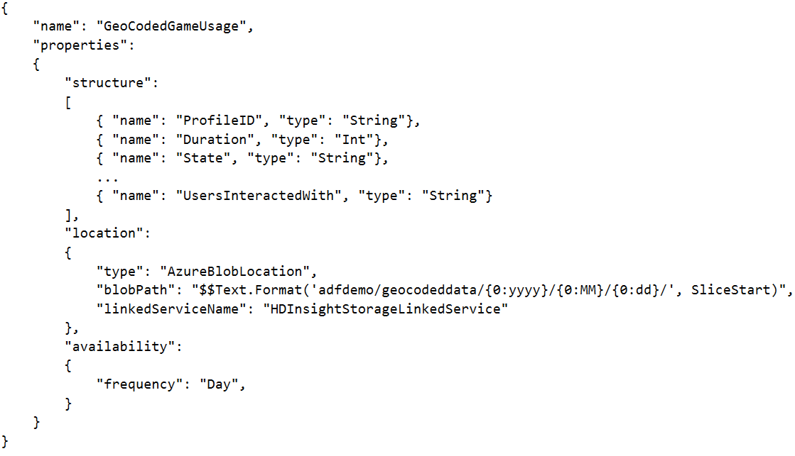
Step 3: Define Tables & Pipelines
“GeoCoded Game Usage” Table:

Slide 26
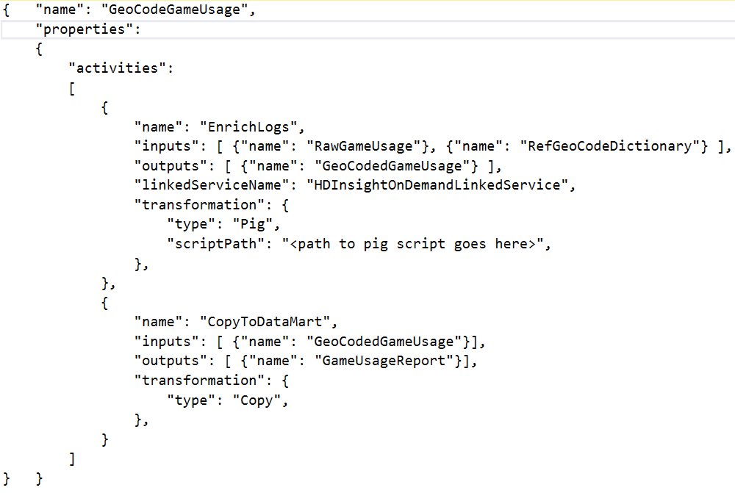
Step 3: Define Tables & Pipelines
Pipeline Definition:
Activity
Activity

Slide 27
Step 4: Deploy & Start
// Deploy Table
New-AzureDataFactoryTable
-DataFactory“GameTelemetry“
-File NewUserActivityPerRegion.json
// Deploy Pipeline
New-AzureDataFactoryPipeline
-DataFactory “GameTelemetry“
-File NewUserTelemetryPipeline.json
// Start Pipeline
Set-AzureDataFactoryPipelineActivePeriod
-Name “NewUserTelemetryPipeline“
-DataFactory “GameTelemetry“
-StartTime 10/29/2014 12:00:00

Slide 28
Incremental Data Production
A Slice is a logical, time-based partition of a dataset
Defined as a property in the dataset definition:
Each run of an Activity produces/changes the data in one` slice/partition of a Table
"availability": { "frequency": "Day", interval": 1 }
Activity: (e.g. Hive):
Hourly
GameUsage
Activity
12-1
Activity run 1
Activity run 2
1-2
Activity run 3
2-3

Slide 29

Incremental Data Production
Hourly
GameUsage
12-1
1-2
2-3
Geo-Coded
GameUsage
Daily
Dataset3
Monday
Tuesday
Hive Activity
GeoCodeDictionary
Wednesday
Daily
Dataset2
Monday
Tuesday
Wednesday

Slide 30
Step 4: Monitor and Manage
Is my data successfully getting produced?
Is it produced on time?
Am I alerted quickly of failures?
What about troubleshooting information?
Are there any policy warnings or errors?

Slide 32

Custom Actions
Allows running any .NET code wrapped within an ADF activity
Can be used to connect to new sources/destination
Can be used to create custom transformation activities
Example: Invoke Azure ML model
SDK for custom activity creation:

Slide 33
Example: Using custom activities to ingest data from twitter and invoke an Azure ML model

Slide 34
Step 7: Consume
Easily move data to my existing data marts for consumption by my existing BI tools
  Azure DB
  SQL Server on premises

Slide 35
ADF Pricing Per Month
Automation & Management
Data Transformation & Movement
Low Frequency | $0.60 | $0.48 | $1.50 | $1.20
High Frequency | $1.00 | $0.80 | $2.50 | $2.00
 | 0-100 activities | 100+ activities | 0-100 activities | 100+ activities
 | Cloud |  | On Premises
Automation/Coordination Layer
(Coordination, Scheduling, Management)
Note: public preview = 50% discount on the rates shown above
Resources Used to Execute Activities in a Pipeline:
Execution Layer
(Data Storage & Processing)
HDInsight (hrs)
Compute/VM (hrs)
Data Transfer (GB)

Slide 36
Data Factory – Available Today
Coordination:
  Rich scheduling
  Complex dependencies
  Incremental rerun
Authoring:
  JSON & Powershell/C#
Management:
  Lineage
  Data production policies (late data, rerun, latency, etc)
Hub: Azure Hub (HDInsight + Blob storage)
  Activities: Hive, Pig, C#
  Data Connectors: Blobs, Tables, Azure DB, On Prem SQL Server, MDS [internal]

Slide 37
Related content
DBI-219: Introduction to Hadoop through Azure HDInsight
DBI-B411: Extending your Hadoop distributions in the cloud

Slide 38
Questions
Contact me: mike.flasko@microsoft.com

Slide 39
DBI Track resources
27 Hands on Labs + 8 Instructor Led Labs in Hall 7
Free SQL Server 2014 Technical Overview e-book
  microsoft.com/sqlserver and Amazon Kindle Store
Free online training at Microsoft Virtual Academy
  microsoftvirtualacademy.com
Try new Azure data services previews!
  Azure Machine Learning, DocumentDB, and Stream Analytics

Slide 40

Resources
Learning
  Sessions on Demand
  Microsoft Certification & Training Resources
http://channel9.msdn.com/Events/TechEd
www.microsoft.com/learning
TechNet
Developer Network
  Resources for IT Professionals
http://microsoft.com/technet
http://developer.microsoft.com

Slide 41



SUBMIT YOUR TECHED EVALUATIONS
We value your feedback!
Fill out an evaluation via
CommNet Station/PC: Schedule Builder
LogIn: europe.msteched.com/catalog
TechEd Mobile app
for session evaluations
is currently offline

Slide 42


© 2014 Microsoft Corporation. All rights reserved. Microsoft, Windows, and other product names are or may be registered trademarks and/or trademarks in the U.S. and/or other countries.
The information herein is for informational purposes only and represents the current view of Microsoft Corporation as of the date of this presentation. Because Microsoft must respond to changing market conditions, it should not be interpreted to be a commitment on the part of Microsoft, and Microsoft cannot guarantee the accuracy of any information provided after the date of this presentation. MICROSOFT MAKES NO WARRANTIES, EXPRESS, IMPLIED OR STATUTORY, AS TO THE INFORMATION IN THIS PRESENTATION.

