Slide 1


Slide 2

SQL Server Hybrid Features
DBI-B331
Luis Vargas
Senior Program Manager Lead

Slide 3
Key Takeaway
SQL Server integrates cloud services from Azure
providing end-to-end experiences
that are optimized and use familiar interfaces

Slide 4
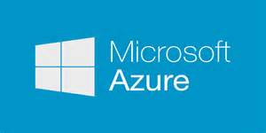

Hybrid Cloud
  Environment that combines resources from on-premise and cloud
    Physical Machines
    VMs
    Storage
    Domain Controllers
    Databases
  SQL Server on-premise using cloud resources
  SQL Server on cloud using on-premise resources
SQL Server & Hybrid Cloud

Slide 5
  SQL Server on-premise using cloud resources

Slide 6


Cloud resources
Azure Storage
    Unlimited storage
    No data loss
      3 local sync copies and 3 remote async copies
      Automated data verification
    Highly available (transparent request routing)
    Low cost: $0.02 p/GB/month
Azure VMs
    VMs hosted in Azure
    Created from Microsoft Gallery Images or your own Images
    Elastic: 1 core, 2 GB RAM, 1 TB data → 16 cores, 56 GB RAM, 16 TB data
    Highly available (automated VM healing)
    Cost: $0.40 p/h for SQL Standard on 4-core, 8GB RAM
VM

Slide 7
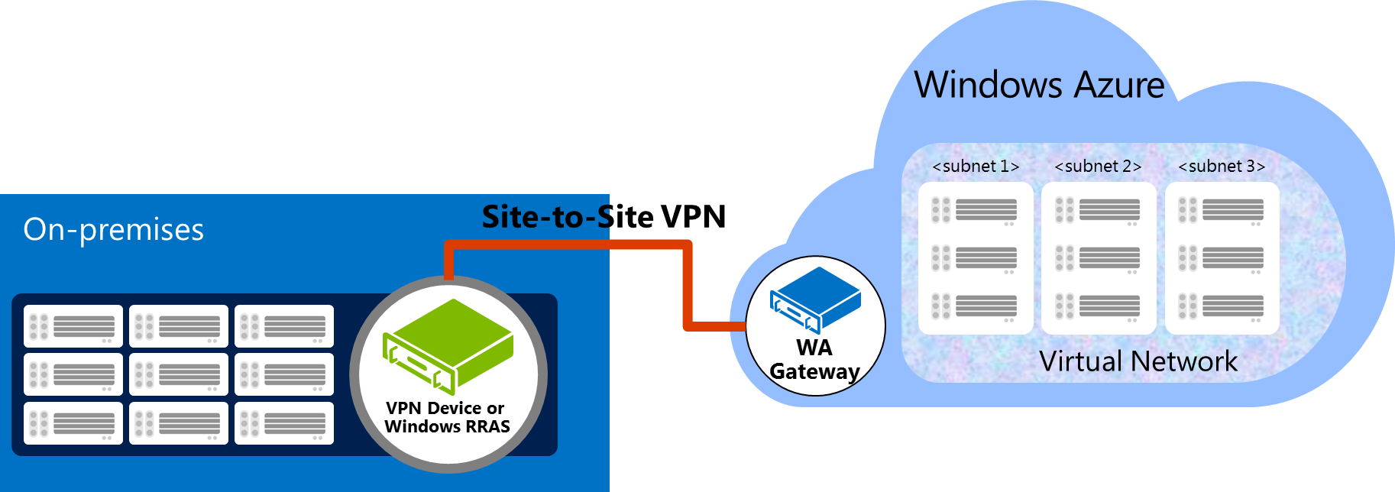


Accessing cloud resources
  Over the Internet
      Public endpoints
      Free
  Over a site-to-site VPN tunnel
      VPN Device or Windows Server RRAS
      Encrypted (IKE, AES)
      ~8MB p/sec (480MB p/min, 28GB p/hour)
      Free

Slide 8
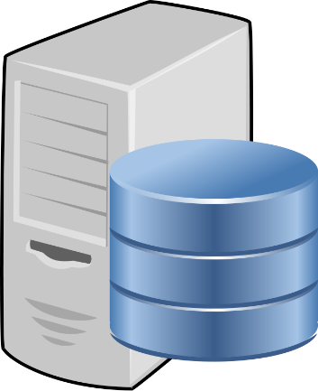

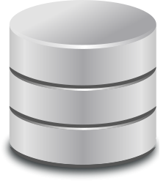



SQL Server on-premise using cloud resources
Backup to Azure Storage
Optionally Managed
On Premise
Data Files in Azure Storage
Microsoft Azure
Azure Storage
AlwaysOn
Replica in Azure VM
Primary
Secondary

Slide 9

SQL Server on-premise using cloud resources
  Microsoft owns both SQL Server and Microsoft Azure
  Thus it can provide end-to-end experiences that are optimized and use familiar interfaces

Slide 10
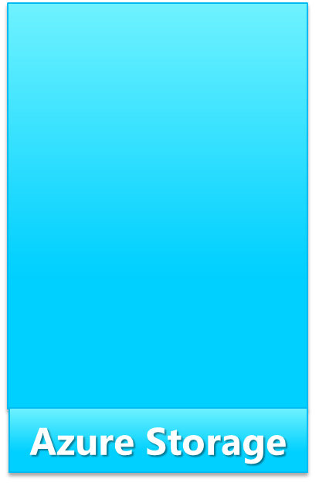


Backup to Windows Azure Storage
Databases can be backed up to Azure Storage
Backups can be restored from on-premise or an Azure VM
Benefits
Unlimited low-cost storage
Off-site (compliance)
No device management
Media safety (geo-redundant)
Encrypted and compressed
Accessibility
  SSMS, T-SQL, PowerShell
  Azure Portal, CloudExplorer
On-premise
Backup
Restore
Azure VM
Restore
Encryption
  Certificates (AES256, AES128)
Compression

Slide 11


Backup to Windows Azure Storage - Scenarios
  Recovery
  Data
    Media failure or user action (e.g. DROP TABLE)
    Restore to on-premise SQL Server
    Disaster
      Restore to Azure VM
  Dev/Test
  Restore to Azure VM

Slide 12
Demo
Backup/Restore to/from Azure Storage

Slide 13

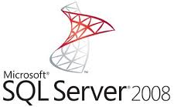
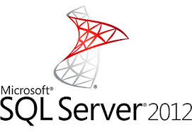

Backup to Windows Azure Storage Tool
Downloadable tool that allows backup to Azure Storage from previous versions of SQL Server
Copies backups from local directories to Azure Storage
  Benefits
  Single backup strategy to cloud across SQL Server 2005, 2008, 2008 R2, 2012, and 2014
  Provides backup encryption
  Easy configuration

Slide 14
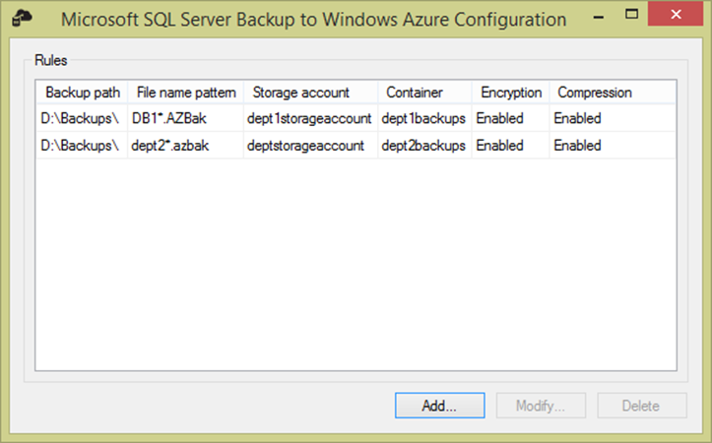
Backup to Windows Azure Storage Tool

Slide 15
Managed Backup
Feature that automates SQL Server backups to Azure Storage based on workload
It also automates the backup retention (configurable)
  Benefits
    No need to define & manage backup policy
    Logic based on customer feedback
  Ensures a consistent backup chain
    Full backup taken when needed
  Some or all DBs
  Retries on errors (e.g. network)
Plus same as before:
Unlimited low-cost storage
Off-site (compliance)
No device management
Media safety (geo-redundant)
Encrypted and compressed
Accessibility
  SSMS, T-SQL, PowerShell
  Azure Portal, CloudExplorer

Slide 16
Demo
Enable and trigger Managed Backup

Slide 17
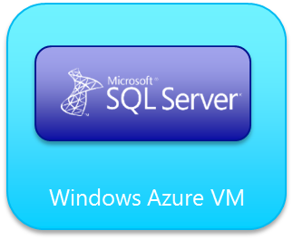
Data Files in Azure Storage
Store historical/cold DBs in Azure Storage
Secure access via Transparent DB Encryption
Read workloads optimized via Buffer Pool
DBs can be attached by another server or Azure VM (basic migration/recovery)
Unlimited low-cost storage
Media safety (geo-redundant)
Accessibility/Programmability
  T-SQL, PowerShell
  Azure Portal, CloudExplorer
Encrypted and compressed
On-Premise
Attach
DB1
HOT
DB2
HOT
DB3
COLD
Attach
Encryption
  TDE
Compression

Slide 18
Demo
Create Database in Azure Storage

Slide 19
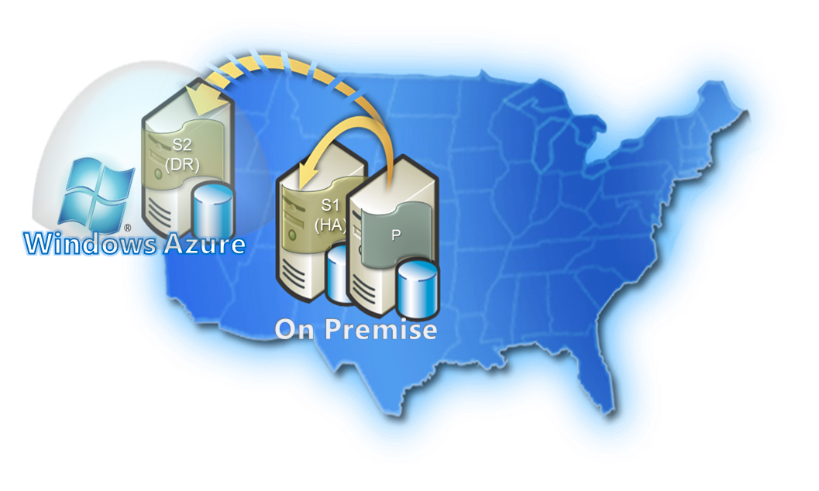
AlwaysOn Replicas in Azure VMs
Extend AlwaysOn Availability Groups with replicas in Azure VMs
  Benefits
    Low TCO
      Just VM and Storage, free ingress traffic
      No DR site cost (rent, hardware, ops)
    Any Azure region (America, Europe, Asia)
    Azure Storage guarantees no data loss
    Azure VM is highly available

Slide 20
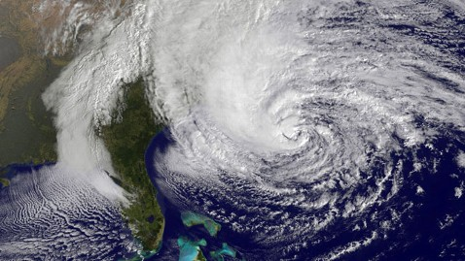
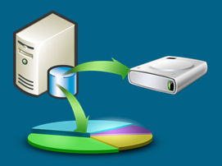
Backup to Windows Azure Storage - Scenarios
  Disaster Recovery
  Manually failover to (warm) secondary replica
  Offload work off the primary
  Read workloads (Reporting, BI)
  Backups (compliance)

Slide 21
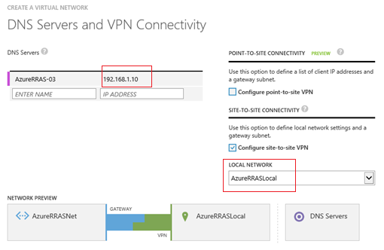
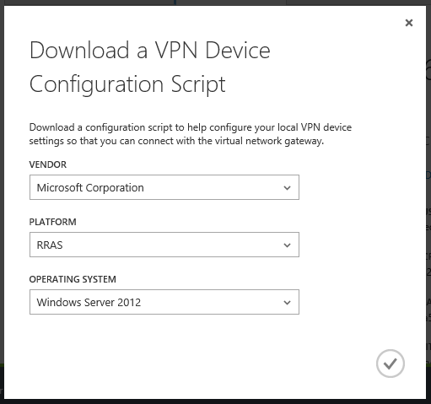
Before extending AlwaysOn configuration
Configure site-to-site VPN tunnel between on-premise and Azure
  Tutorial: http://msdn.microsoft.com/en-us/library/dn636917.aspx

Slide 22
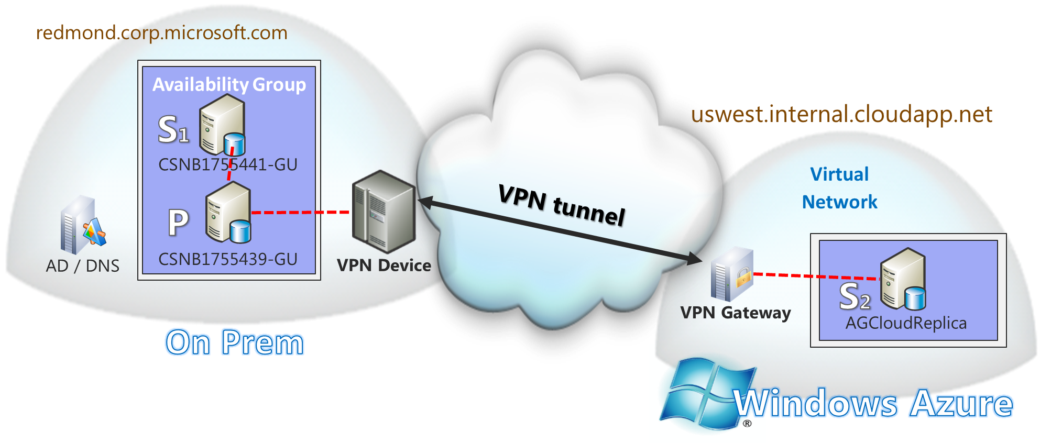
AlwaysOn Replica in Azure - Sample Deployment
Windows Cluster

Slide 23
Demo
Adding a Replica in an Azure VM

Slide 24





Dealing with lots of data in Hybrid Cloud
  Azure Import service
  Ship backups to Azure Storage via physical drives (max 4TB each)
    Encrypted with BitLocker
  Recommended for backups larger than 1 TB
  Windows Azure Express Route service
  Dedicated network link to an Azure data center
    Many providers (A&T, Equinix, Verizon, BT, Level3, ..)
  Guaranteed high bandwidth (up to 10Gbps)
  Recommended for workloads generating more than 20 MBPs

Slide 25
  SQL Server on cloud using on-premise resources

Slide 26



SQL Server on cloud using on-premise resources
  Provisioning an Azure VM with SQL Server
  Microsoft Gallery
    SQL 2014 (Enterprise , Standard, Web, OLTP Optimized, DW Optimized)
    SQL 2012 (Enterprise , Standard, Web, OLTP Optimized, DW Optimized)
    SQL 2008 R2 (Enterprise, Standard, Web)
  Your own Images
  Migrating on-prem DBs to Azure
  SQL Server Deployment Wizard
  Accesing on-premise resources (requires site-to-site VPN tunnel)
  Active Directory
    Join VM to on-premise Windows Domain to use Windows logins and policies
  Other SQL Server(s)
    Configure Linked Servers

Slide 27
Demo
Provisioning a SQL VM with VPN tunnel access

Slide 28
Questions?

Slide 29
Resources
  SQL Server Hybrid
  http://msdn.microsoft.com/en-us/library/dn606154.aspx
  SQL Server on Azure VM
  http://msdn.microsoft.com/en-us/library/azure/jj823132.aspx
luis.vargas@microsoft.com

Slide 30
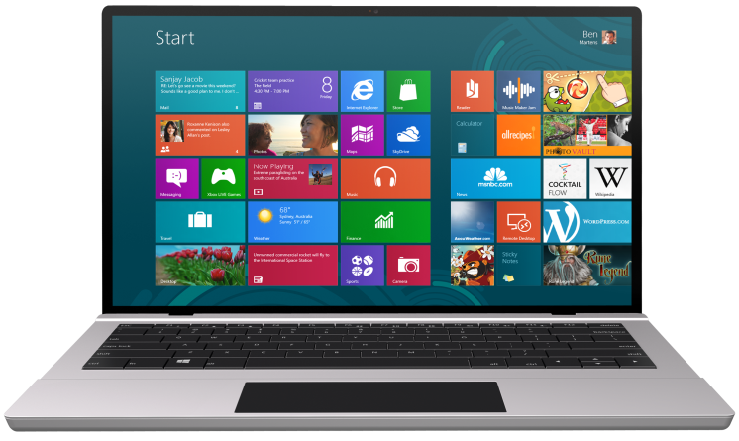


SUBMIT YOUR TECHED EVALUATIONS
We value your feedback!
Fill out an evaluation via
CommNet Station/PC: Schedule Builder
LogIn: europe.msteched.com/catalog
TechEd Mobile app
for session evaluations
is currently offline

Slide 31

Resources
Learning
  Sessions on Demand
  Microsoft Certification & Training Resources
http://channel9.msdn.com/Events/TechEd
www.microsoft.com/learning
TechNet
Developer Network
  Resources for IT Professionals
http://microsoft.com/technet
http://developer.microsoft.com

Slide 32


© 2014 Microsoft Corporation. All rights reserved. Microsoft, Windows, and other product names are or may be registered trademarks and/or trademarks in the U.S. and/or other countries.
The information herein is for informational purposes only and represents the current view of Microsoft Corporation as of the date of this presentation. Because Microsoft must respond to changing market conditions, it should not be interpreted to be a commitment on the part of Microsoft, and Microsoft cannot guarantee the accuracy of any information provided after the date of this presentation. MICROSOFT MAKES NO WARRANTIES, EXPRESS, IMPLIED OR STATUTORY, AS TO THE INFORMATION IN THIS PRESENTATION.

