Slide 2
Ask The Experts
Key and floorplan
Cloud and Datacenter Platform
Data Platform and Business Intelligence
Developer Platform and Tools
Enterprise Mobility
Office 365
Windows
Microsoft Azure
Trustworthy Computing
Following this session at 18:30
in Hall 5
Meet with Microsoft Product Experts
Snacks and Beverages Served
CDP
DEV
AZR
TWC
EM
OFC
WIN
DBI

Slide 3

Azure Virtual Machines Deployment Scenarios
DBI-B334
Brian Benz
Luis Carlos Vargas Herring

Slide 4
Azure IaaS, PaaS, SaaS
  Packaged Software
  Infrastructure
(as a Service)
  Platform
(as a Service)
  Software
(as a Service)
Applications
Applications
  You manage
Applications
Applications
Data
  You manage
Data
Data
Data
Runtime
Runtime
Runtime
Runtime
  Managed by vendor
  You manage
Middleware
Middleware
Middleware
Middleware
  Managed by vendor
O/S
O/S
O/S
O/S
Virtualization
Virtualization
  Managed by vendor
Virtualization
Virtualization
Servers
Servers
Servers
Servers
Storage
Storage
Storage
Storage
Networking
Networking
Networking
Networking

Slide 5
Application Scenarios
Web Sites
Cloud Services
Virtual Machines
Modern web apps
Perfect if your app consists of client side markup and scripting, server side scripting and a database. Powerful capability to scale out and up as needed.
Multi-tier applications
Cloud-based applications that separate application logic into multiple tiers (i.e. caching middle tier, async background processes processing) using both Web and Worker Roles
Enterprise server applications
Run your existing enterprise applications in the cloud, such as SQL Server, SharePoint Server or Active Directory.
Continuous development
Deploy directly from your source code repository, using Git or Team Foundation Service.
Apps that require advanced administration
Cloud-based applications that require admin access, remote desktop access or elevated permissions
Porting existing line of business apps
Choose an image from the library or upload your own VHD.
Popular open source apps
Launch a professional looking site with a few clicks using apps like WordPress, Joomla!, Drupal, DotNetNuke and Umbraco
Apps that require advanced networking
Cloud-based applications that require network isolation for use with Azure Connect or Azure Virtual Network
Windows or Linux operating system
Support for Windows Server, along with community and commercial versions of Linux. Connect virtual machines with cloud services to take full advantage of PaaS services.

Slide 6






Azure Virtual Machines – OS Options
Ubuntu
CentOS
OpenSUSE and SUSE Enterprise
Oracle Linux
Windows Server 2008 and 2012

Slide 7
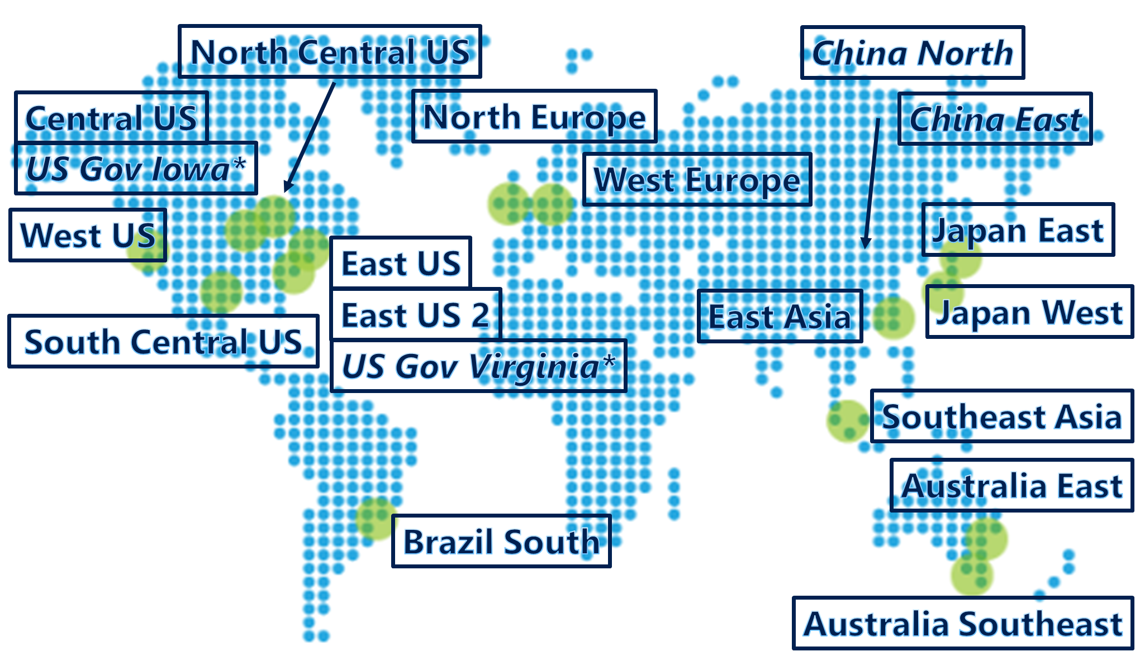



Top application patterns
Develop and Test in Azure
Lift and Shift your production apps
Extend your infrastructure
  For Disaster Recovery
  For Hybrid Topologies that support Application bursting
Cloud Scale
Your Datacenter,
or Your Hoster
Windows Azure
Virtual Network
Active Directory
Production environment
SharePoint
SQL
Server
Start VMs and app development in Azure
Internet
Your
Datacenter

Slide 8



Infrastructure Scenarios: Opportunities
1
Convert Physical Servers or Virtual Machines running Oracle to run on Hyper-V using Virtual Machine Manager 2012 SP1
2
Move Virtual Instances from Hyper-V to Azure IaaS
Azure IaaS
Hyper-V
Hyper-V
Move
P2V
Physical
Server
V2V
P2V
3
Move running Virtual Instances from Customer to any Hyper-V Implementations
Migrate
VMware
Hosted
Hyper-V
Hyper-V
Live Migration
Amazon
Customer
Host

Slide 9
New Cloud Deployment Options
PRIVATE CLOUD
with
Windows Server Hyper-V
Extend Windows Server: Virtualize App and Database deployments
Migrate off unsupported hypervisors and standardize on Hyper-V
Use System Center for “single pane of glass” management of Oracle workloads on Windows across private, hybrid, and public cloud deployments
PUBLIC CLOUD
with
Azure
Perform dev & test in the cloud for apps and databases
Extend datacenter capacity by scaling out middleware
Instantly spin up VMs with software pre-installed
zzzz

Slide 10
Develop, test, run your apps
Test and development on-premises
Limited hardware budget
Limited software licensing
Resource contention with VMs
Compromised developer agility
Realistic scale tests often challenging
Developers
Use VMs
Your Datacenter
Provision VMs
VMs in test/dev environment
IT Admin

Slide 11
Develop, test, run your apps
Developers
Use VMs
Provision VMs
Test and development using Azure
Cost effective (pay for what you use)
Improved developer agility with platform services
Ready to use gallery of images
Ship tested in realistic scale scenarios
Use existing development tools & languages
Access on-premise resources if necessary
Manage environment
IT Admin

Slide 12
Virtual Machines and Cloud Services

Slide 13
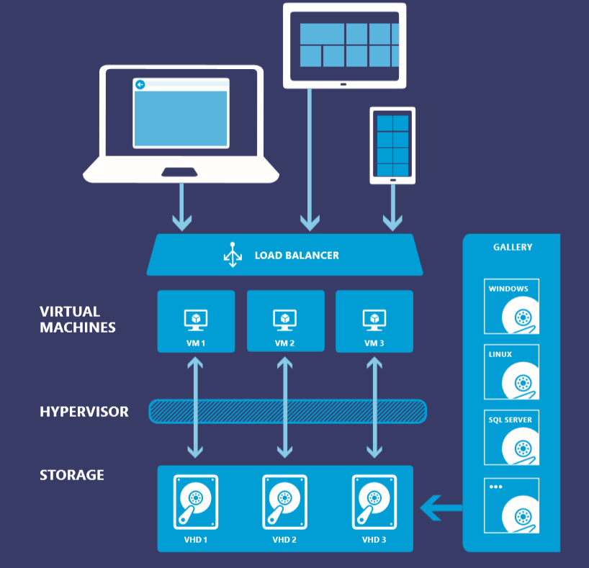
Azure VM: Quick primer
Region 1
Region 19
…
Datacenter 1
Datacenter n
Datacenter network
Cluster
1
Cluster
2
…
Cluster
n
Azure Server
Azure Server
Azure Server
Azure Server
Azure Server
Azure Server
Azure Server
Azure Server
Scale Unit

Slide 14

Cloud Services, Roles, and Instances
WEB ROLE
Cloud Service is a…
Management
Configuration
Security
Networking
Service Model
boundary
VM 1
VM 2
VM 3
ROLES
INSTANCES
WORKER ROLE
VM 4
VM 5
VM…

Slide 15
Cloud Services with Virtual Machines
Multiple Virtual Machines can be hosted within the same cloud service
Cloud Service
VM 1
VM 2
VM 3
VM 4

Slide 16



Multiple Cloud Services Configuration
LB
WEB
AD/DC/DNS
RDBMS
NoSQL
AD 1
Cloud Service 2
80/443
VPN Tunnel
Corp Users
Cloud Service 1
Azure
OnPrem

Slide 17
Scripting Capabilities
Full Support for IaaS
Azure PowerShell Cmdlets
Cross Platform Scripting Built on node.js
Capabilities
  Provisioning, Removal
  Reboot, Start
  Import and Export VM settings
  Support for Windows and Linux VMs
  Domain Join at Provision for Windows
  Fully Customize VM with Data Disks and Endpoint Configuration
  Automate Virtual Network Settings

Slide 18
What can you do with PowerShell?
Automation
Query, Manage and Configure Virtual Machines across multiple subscriptions,
cloud services and storage accounts.
Provision Fully Configured Virtual Machines
Domain Joined
Storage and Networking Configured
Virtual Networking
Completely Configure VNETs from a Script

Slide 19
Images & Disks

Slide 20
Disks and Images
OS Images
Microsoft
Partner
User
Base OS image for new Virtual Machines
Sys-Prepped/Generalized/Read Only
Created by uploading or by capture
Disks
OS Disks
Data Disks
Writable Disks for Virtual Machines
Created during VM creation or during upload of existing VHDs.

Slide 21
Image Mobility
On-Premises
Cloud
MyApp.vhd

Slide 22
Bring Your Own Server/VHD
On-Premises
Cloud
MyApp.vhd
On Premises Virtual Server
Provision VM from Image or Disk using portal, script or API
Use Case
Forklift Migration of VMs
Sys Prepped Images
VHD Must Be Fixed Disk
* CSUpload Can Convert on Upload
Upload VHD
Create Disk or
Image

Slide 23
Imaging VMs in the Cloud
Cloud
Identical/similar deployment instances using common OS image as start
Base.VHD
Boot
VM
Customize
VHD
Generalize
VHD
Capture
VM
Capture VM Saves Customized Image to Your Image Library

Slide 24
Virtual Machine Availability

Slide 25

Service Level Agreements
Availability set
99.95% for multiple role instances
  4.38 hours of downtime per year
Server 1
Server 2
What’s included
  Compute Hardware failure (disk, cpu, memory)
  Datacenter failures - Network failure, power failure
  Hardware upgrades, Software maintenance – Host OS Updates
What is not included
  VM Container crashes, Guest OS Updates
SLA 99.95

Slide 26
Fault and Update Domains
Fault Domains
  Represent groups of resources anticipated to fail together
  i.e. Same rack, same server
  Fabric spreads instances across fault at least 2 fault domains
Update Domains
  Represents groups of resources that will be updated together
  Host OS updates honour service update domains
  Specified in service definition
  Default of 5 (up to 20)
Fabric spreads role instances across Update Domains and Fault Domains

Slide 27
Fault and Update Domains
Fault Domain
Fault Domain
Rack
Rack
Web Role
UD #1
UD #2
INSTANCE
INSTANCE
INSTANCE
INSTANCE
Worker Role
UD #1
UD #2
INSTANCE
INSTANCE
INSTANCE
INSTANCE

Slide 28
Virtual Machine Availability Sets
Update Domains are honored by host OS updates
Fault Domain
Fault Domain
Rack
Rack
Virtual Machine
Virtual Machine
Availability Set
WP1
WP2
UD #1
UD #2
Availability Set
Virtual Machine
Virtual Machine
MySQL1
MySQL2
UD #1
UD #2

Slide 29
Disks

Slide 30
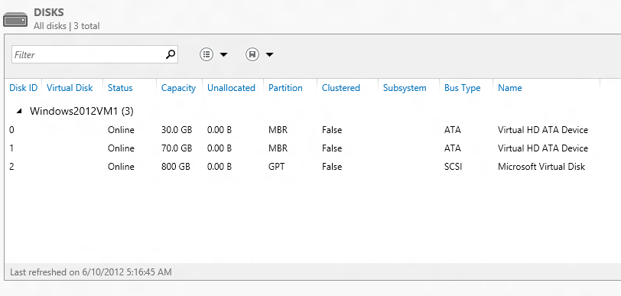
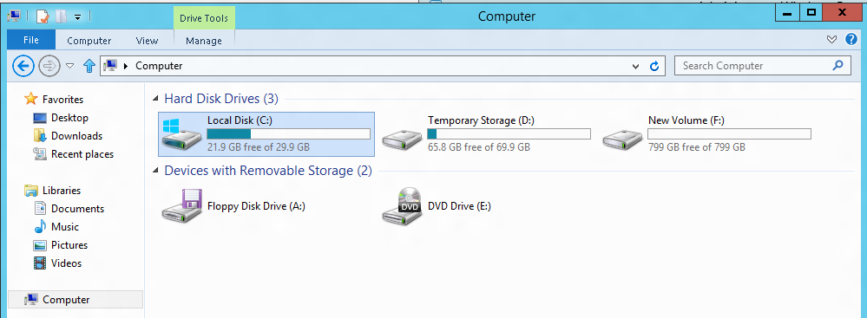
VM disk layout
OS Disk
Persistent
SATA
Drive C:

Slide 31
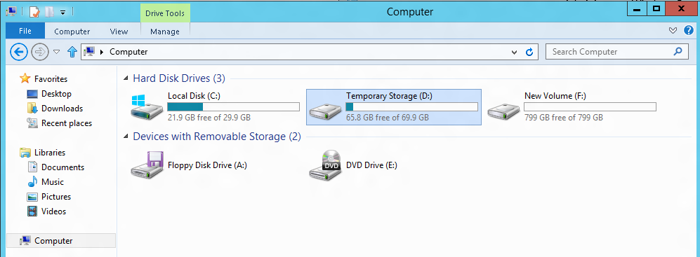
VM disk layout
Temporary Storage Disk
Local (Not Persistent)
SATA
Drive D:

Slide 32
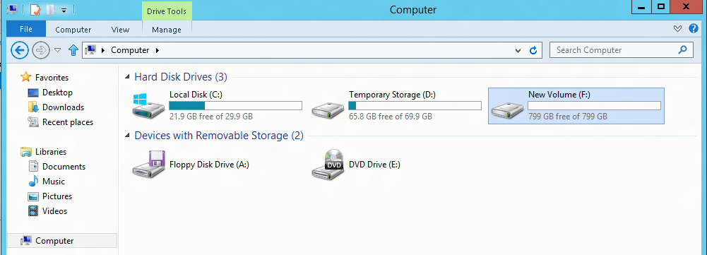
VM disk layout
Data Disk(s)
Persistent
SCSI
Customer Defined Letter

Slide 33
Persistent Disk Management
Capability | OS Disk | Data Disk
Host Cache Default | ReadWrite | None
Max Capacity | 127 GB | 1 TB
Imaging Capable | Yes | No
Hot Update | Cache Setting Requires Reboot | Change Cache Without Reboot, Add/Remove without Reboot.
C:\ = OS Disk
D:\ = Non-Persistent Cache Disk
E:\, F:\. G:\ ... Data Disks

Slide 34
Disk Caching
Disk Type | Default | Supported
OS Disk | ReadWrite | Read-only and ReadWrite
Data Disk | None | None, Read-only and ReadWrite
Modify using Set-AzureOSDisk or Set-AzureDataDisk

Slide 35

Persistent Disks and Highly Durable
Azure Storage (Disaster Recovery)
Azure Storage
Virtual Machine

Slide 36
Persistent Disks and Highly Durable
Azure Storage (Disaster Recovery)
Azure Storage
Virtual Machine
Virtual
Machine

Slide 37
Luis Carlos Vargas Herring – SQL Server Deployment Scenarios

Slide 38






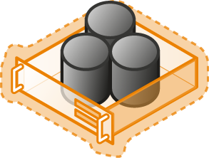
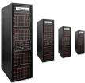

SQL Server Cloud Continuum
Hybrid
Cloud
On premises
Shared
Lower cost
SaaS
PaaS
Azure SQL Database
IaaS
Virtualized Databases
SQL Server in Azure VM
Virtual
Virtualized Machines
Dedicated
Higher cost
SQL Server Private Cloud
Physical
Virtualized Machines
SQL Server
Off premises
Physical Machines
High Control | High Maintenance
Low Control | Low Maintenance

Slide 39
Azure SQL Database & SQL Server in Azure VM
SQL Server in Azure VM
Azure SQL Database
You access a VM with SQL Server
You manage SQL Server and Windows: High Availability, Backups, Patching
Full on-premise compatibility
Different VM sizes: A0 (1 core, 1GB mem, 1TB) to A16 (16 cores, 112GB mem, 16TB)
VM availability SLA: 99.95%: Can achieve higher availability (~99.99%) configuring AlwaysOn
Reuse on-premise infrastructure (e.g. Active Directory)
You can run any SQL Server version and edition
You access a DB
DB is fully managed: High Availability, Backups, Patching
Runs latest SQL Server version, based on Enterprise edition
Incomplete on-premise compatibility (e.g. no jobs, linked servers, FileStream)
Different DB sizes: Basic (2GB, 5tps) to Premium (500GB, 735tps)
DB availability SLA: 99.99%
Migrate existing apps
A few SQL Servers
Build new apps
Tens to hundreds of DBs

Slide 40
SQL Server in Azure VM – Deployment options
Less than 1 TB
Deployment Wizard
Full Backup/Restore to new/existing VM
Supported for all SQL Server versions/editions
Minutes of downtime: stop workload, backup log and restore, change connections
AlwaysOn Failover
Full Backup/Restore + active replication to existing VM
Supports SQL12+ Enterprise edition
More than 1 TB
Azure Import Service
Physically ship full backup in encrypted drive (FedEx/DHL)
Backup is stored in Azure Storage
Restore Backup to a VM
Seconds of downtime: connections move
Requires a VPN tunnel between on-prem and Azure

Slide 41
Brian Benz – Oracle, NoSQL, Hadoop Deployment Scenarios

Slide 42

HDInsight Supports Hive
SQL-like queries on Hadoop data in HDInsight
HDInsight provides easy-to-use graphical query interface for Hive
HiveQL is a SQL-like language (subset of SQL)
Hive structures include well-understood database concepts such as tables, rows, columns, partitions
Compiled into MapReduce jobs that are executed on Hadoop
Dramatic performance gains with Stinger/Tez
Stinger is a Microsoft, Hortonworks and OSS driven initiative to bring interactive queries with Hive
Brings query execution engine technology from Microsoft SQL Server to Hive
Performance gains up to 100x
Sample Query
Microsoft contribution to Apache code
1400s
32x Speedup
44.3s
40X
Speedup
100x
Speedup
35.1s
15s
Hive 10
HDP 1.3 /
Hive 11
HDP 2.0
HDP 2.1
Hadoop 2.0

Slide 43

HDInsight Supports HBase
NoSQL database on data in HDInsight
  Columnar, NoSQL database
  Runs on top of the Hadoop Distributed File System (HDFS)
  Provides flexibility in that new columns can be added to column families at any time
HMaster
Coordination
Name Node
Region Server
Region Server
Region Server
Region Server
Job Tracker
Data Node
Data Node
Data Node
Data Node
Task Tracker
Task Tracker
Task Tracker
Task Tracker

Slide 44

HDInsight Supports Mahout
Machine learning library
  A library of machine learning algorithms to execute on data in HDFS
  Algorithms are not dependent on size of data and can scale with large datasets
  Library includes: Collaborative Filtering, Classification, Clustering, Dimensionality Reduction, Topic Models

Slide 45

HDInsight Supports Storm
Coming Q4, CY2014
Stream analytics for Near-Real Time processing
  Consumes millions of real-time events from a scalable event broker (i.e.; Apache Kafka, Azure Event Hub)
  Performs time-sensitive computation
  Output to persistent stores, dashboards or devices
Bolt
Bolt
Spout
Bolt
Spout
Bolt

Slide 46


Connect Cloud Hadoop With On-premise
Cloud Hadoop
Hybrid = On-premises + Cloud
Hortonworks On-Prem Hadoop Moves Data To HDInsight
Analytics Platform System can query HDInsight and join with on-prem
HDInsight
Cloud
On-premises Hadoop
APS
Appliances
Software

Slide 47

Scenarios For Deploying Hadoop As Hybrid
HDInsight
HDInsight
HDInsight
Cloud
Cloud
Cloud
Cloud
Develop/POC
Bursting
Backup/archive
On-premises Hadoop
APS
Appliances
Software

Slide 48
Other Resources
Microsoft Open Technologies: http://msopentech.com/
VM Depot: http://vmdepot.msopentech.com
Azure development: http://azure.microsoft.com/documentation/
SDKs and Command Line Tools: http://azure.microsoft.com/downloads/
Microsoft Scripting Center: http://technet.microsoft.com/en-us/scriptcenter/bb410849.aspx
Microsoft Web Platform Installer:
http://www.microsoft.com/web/downloads/platform.aspx
Azure Script Center: http://azure.microsoft.com/en-us/documentation/scripts/

Slide 49
Thanks!
Questions?
@bbenz
Luis.Vargas@Microsoft.com

Slide 50


Claim your Visual Studio Online domain
MSDN subscribers, activate your Azure
benefits now
Simply get started @ http://aka.ms/teched-eu

Slide 51

Resources
Learning
  Sessions on Demand
  Microsoft Certification & Training Resources
http://channel9.msdn.com/Events/TechEd
www.microsoft.com/learning
TechNet
Developer Network
  Resources for IT Professionals
http://microsoft.com/technet
http://developer.microsoft.com

Slide 52
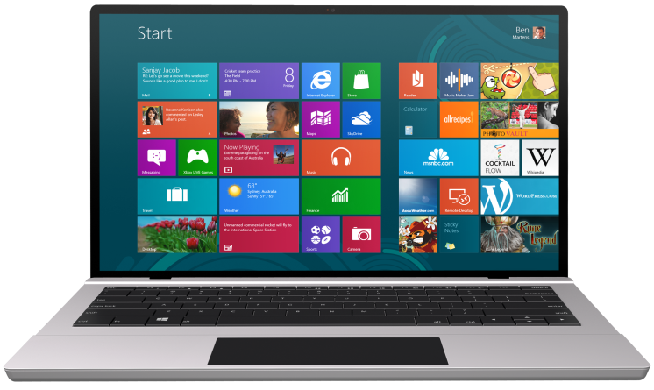


SUBMIT YOUR TECHED EVALUATIONS
We value your feedback!
Fill out an evaluation via
CommNet Station/PC: Schedule Builder
LogIn: europe.msteched.com/catalog
TechEd Mobile app
for session evaluations
is currently offline

Slide 53
Ask The Experts
Key and floorplan
Cloud and Datacenter Platform
Data Platform and Business Intelligence
Developer Platform and Tools
Enterprise Mobility
Office 365
Windows
Microsoft Azure
Trustworthy Computing
Following this session at 18:30
in Hall 5
Meet with Microsoft Product Experts
Snacks and Beverages Served
CDP
DEV
AZR
TWC
EM
OFC
WIN
DBI

Slide 54

© 2014 Microsoft Corporation. All rights reserved. Microsoft, Windows, and other product names are or may be registered trademarks and/or trademarks in the U.S. and/or other countries.
The information herein is for informational purposes only and represents the current view of Microsoft Corporation as of the date of this presentation. Because Microsoft must respond to changing market conditions, it should not be interpreted to be a commitment on the part of Microsoft, and Microsoft cannot guarantee the accuracy of any information provided after the date of this presentation. MICROSOFT MAKES NO WARRANTIES, EXPRESS, IMPLIED OR STATUTORY, AS TO THE INFORMATION IN THIS PRESENTATION.

