Slide 1


Slide 2

Hadoop For Windows
DBI-B335
Rohit Bakhshi

Slide 3

Speaker
Rohit Bakhshi
Product Manager
Hortonworks

Slide 4
Agenda
Modern Data Architecture
Hadoop for Windows
Hortonworks Data Platform under the covers
Q&A

Slide 5
Modern Data Architecture

Slide 6

What Makes Up Big Data?
BIG DATA
Mobile Web
Transactions +
Interactions + Observations
= BIG DATA
Petabytes
Sentiment
SMS/MMS
User Click Stream
Speech to Text
Terabytes
WEB
Social Interactions & Feeds
Web logs
Spatial & GPS Coordinates
A/B testing
Behavioral Targeting
Sensors / RFID / Devices
Gigabytes
CRM
Business Data Feeds
Segmentation
Dynamic Pricing
External Demographics
Customer Touches
Search Marketing
ERP
User Generated Content
Megabytes
Affiliate Networks
Purchase detail
Purchase record
Payment record
Support Contacts
HD Video, Audio, Images
Dynamic Funnels
Offer details
Offer history
Product/Service Logs
Increasing Data Variety and Complexity

Slide 7







A data architecture under pressure from new data
OLTP, ERP, CRM Systems
APPLICATIONS
Business
Analytics
Custom Applications
Packaged
Applications
Unstructured documents, emails
Server logs
DATA SYSTEM
2.8 ZB in 2012
REPOSITORIES
85% from New Data Types
Sentiment, Web Data
RDBMS
EDW
MPP
15x Machine Data by 2020
40 ZB by 2020
Sensor. Machine Data
Source: IDC
SOURCES
Geolocation
Existing Sources
(CRM, ERP, Clickstream, Logs)
Clickstream

Slide 8



Hadoop within an emerging Modern Data Architecture
APPLICATIONS
OLTP, ERP, CRM Systems
Business
Analytics
Custom Applications
Packaged
Applications
Unstructured documents, emails
DEV & DATA TOOLS
Build & Test
Server logs
DATA SYSTEM
REPOSITORIES
Data Access
OPERATIONS TOOLS
Sentiment, Web Data
RDBMS
EDW
MPP
Operations
Provision, Manage &
Monitor
Governance
& Integration
Security
Data Management
Sensor. Machine Data
SOURCES
OLTP, ERP, CRM Systems | Documents, Emails | Web Logs, Click Streams | Social Networks | Machine Generated | Sensor Data | Geolocation Data
Geolocation
Clickstream

Slide 9
Hadoop for Windows

Slide 10

HDP for Windows
BATCH, INTERACTIVE & REAL-TIME DATA ACCESS
Hortonworks
Data Platform (HDP)
The Only Completely Open Distribution for Apache Hadoop
Fundamentally Versatile and Comprehensive enterprise capabilities
Wholly Integrated for deep ecosystem interoperability
Hortonworks Data Platform 2.2
GOVERNANCE
SECURITY
OPERATIONS
Data Workflow, Lifecycle & Governance
Falcon
Sqoop
Flume
WebHDFS
Script
Pig
SQL
Hive
Java
Scala
Cascading
NoSQL
HBase
Stream
Storm
In-Memory
Spark
Search
Solr
Others
ISV Engines
Authentication
Authorization
Accounting
Data Protection
Storage: HDFS
Resources: YARN
Access: Hive, …
Pipeline: Falcon
Cluster: Knox
Cluster: Ranger
Provision, Manage & Monitor
Ambari
Zookeeper
Tez
Tez
Tez
Slider
Slider
YARN: Data Operating System
(Cluster Resource Management)
Scheduling
Oozie
HDFS
(Hadoop Distributed File System)
1
°
°
°
°
°
°
°
°
°
°
°
°
°
°
°
°
°
°
°
°
°
°
°
°
°
°
°
°
°
Deployment Choice
Linux
Windows
On-Premises
Cloud

Slide 11

HDP: Enterprise Data Platform
HDP certifies the most recent & stable community innovation
Hadoop
&YARN
Pig
Hive & HCatalog
HBase
Phoenix
Storm
Spark
Solr
Tez
Slider
Falcon
Sqoop
Flume
Ambari
Oozie
Zookeeper
Knox
Ranger
0.14.0
1.7.0
HDP 2.2
0.14.0
1.2.0
4.10.0
October
0.98.4
0.60
0.5.1
0.6.0
0.4.0
2014
2.6.0
4.2
0.9.3
1.5.0
4.1.0
0.5.0
4.7.2
1.4.5
0.13.0
1.5.1
3.4.5
HDP 2.1
0.12.1
0.98.0
0.4.0
0.5.0
2.4.0
4.0.0
1.4.0
4.0.0
April
0.12.0
0.9.1
3.4.5
0.4.0
2014
1.4.4
1.4.4
2.2.0
0.12.0
0.96.1
HDP 2.0
1.3.1
3.3.2
October
2013
Hortonworks Data Platform 2.2
Data Management
Data Access
Governance
& Integration
Operations
Security
* version numbers are targets and subject to change at time of general availability in accordance with ASF release process

Slide 12











Seamless Interoperability
Integrations with Microsoft tools for native big data analysis
APPLICATIONS
New!
Power BI
DEV & DATA TOOLS
OPERATIONAL TOOLS
DATA SYSTEM
a
INFRASTRUCTURE
HDInsight
Azure
xΩ
SOURCES

Slide 13
HDP: Powered by Apache Hadoop
HDP certifies the most recent & stable community innovation
Hadoop
&YARN
Pig
Hive & HCatalog
HBase
Phoenix
Storm
Spark
Solr
Tez
Slider
Falcon
Sqoop
Flume
Ambari
Oozie
Zookeeper
Knox
Ranger
0.14.0
1.7.0
HDP 2.2
0.14.0
1.2.0
4.10.0
October
0.98.4
0.60
0.5.1
0.6.0
0.4.0
2014
2.6.0
4.2
0.9.3
1.5.0
4.1.0
0.5.0
4.7.2
1.4.5
0.13.0
1.5.1
3.4.5
HDP 2.1
0.12.1
0.98.0
0.4.0
0.5.0
2.4.0
4.0.0
1.4.0
4.0.0
April
0.12.0
0.9.1
3.4.5
0.4.0
2014
1.4.4
1.4.4
2.2.0
0.12.0
0.96.1
HDP 2.0
1.3.1
3.3.2
October
2013
Hortonworks Data Platform 2.2
Data Management
Data Access
Governance
& Integration
Operations
Security
* version numbers are targets and subject to change at time of general availability in accordance with ASF release process

Slide 14
Apache Hadoop
Open Source Data Management
Scalable
Linearly scale to store Petabytes of data
Reliable
Redundant storage protects against node failures
Flexible
Store all types of data, apply flexible schemas for analysis and sharing
Economical
Utilize cose efficient commodity hardware
Achieve high cluster utilization
HDFS
Distributed across “nodes”
Natively redundant
Single File System
Storage
YARN
Cluster Resource Manager
Built in Fault Tolerance
High Cluster Utilization
Processing

Slide 15



YARN: Data Operating System
ResourceManager
Scheduler
NodeManager
NodeManager
NodeManager
NodeManager
map _{1.1}
nimbus₀
vertex_{1.1.1}
vertex_{1.2.2}
NodeManager
NodeManager
NodeManager
NodeManager
map_{1.2}
Batch
Interactive SQL
vertex_{1.1.2}
nimbus₂
NodeManager
NodeManager
NodeManager
NodeManager
nimbus₁
Real-Time
vertex_{1.2.1}
reduce_{1.1}

Slide 16
Right Tool for the Right Usage
SCALE (storage & processing)
Traditional
Database
EDW
MPP
Analytics
NoSQL
Hadoop
Platform
schema
Required on write
Required on read
speed
Reads are fast
Writes are fast
governance
Standards and structured
Loosely structured
processing
Limited, no data processing
Processing coupled with data
data types
Structured
Multi and unstructured
best fit use
Interactive OLAP Analytics
Complex ACID Transactions
Operational Data Store
Data Discovery
Processing unstructured data
Massive Storage/Processing

Slide 17
Maximize Hadoop Deployment Choice
Hortonworks Data Platform (HDP) for Windows
  100% Apache open source Hadoop software for Windows Server
Microsoft Azure HDInsight
  Hadoop-based managed service in the cloud via Microsoft Azure
Microsoft Analytics Platform System (APS)
  Scale-out appliance with data warehousing and Hadoop in one box
All offerings co-engineered by Hortonworks and Microsoft
  Enjoy seamless interoperability across on-premises and cloud

Slide 18
HDP under the covers

Slide 19
HDP 2.2: Core Platform
DATA ACCESS
Data Operating System of Hadoop
Single Cluster, Shared Data Set, Multiple Workloads
Support a range of access patterns
Shared operational services
Batch
Map Reduce
Script
Pig
SQL
Hive/Tez, HCatalog
NoSQL
HBase
Accumulo
Stream
Storm
Search
Solr
Others
In-Memory Analytics,
ISV engines
DATA MANAGEMENT
YARN : Data Operating System
HDFS
(Hadoop Distributed File System)
1
°
°
°
°
°
°
°
°
°
°
°
°
°
°
°
°
°
°
°
°
°
°
°
°
°
°
°
°
°
°
°
N

Slide 20



Flexible Ingest into HDP
HORTONWORKS
DATA PLATFORM (HDP)
For Windows
RPC
REST (HTTP)
C LibHDFS
Sqoop
Flume

Slide 21
SQL Access: Stinger Initiative
Stinger Initiative
Next generation SQL based interactive query in Hadoop
Speed
  Interactive Hive Query response
Scale
  queries that scale from TB to PB
SQL
  broadest range of SQL semantics for analytic applications
Business Analytics
Custom
Apps
SQL
Apache Hive
Apache
MapReduce
Apache
Tez
Apache YARN
HDFS
(Hadoop Distributed File System)
1
°
°
°
°
°
°
°
°
°
°
°
°
°
°
°
°
°
°
°
N
Apache Hive Contribution… an Open Community at its finest
1,672
145
44
~390,000
13
Jira Tickets Closed
Developers
Companies
Lines Of Code Added… (2x)
Months

Slide 22
Apache Tez (“Speed”)
Replaces MapReduce as primitive for Hive, Pig, etc
  Task with pluggable Input, Processor and Output
Task
Input
Processor
Output
Tez Task - <Input, Processor, Output>

Slide 23
Hive with Tez as execution engine
SELECT a.state, COUNT(*), AVERAGE(c.price)
FROM a
JOIN b ON (a.id = b.id)
JOIN c ON (a.itemId = c.itemId)
GROUP BY a.state
Tez avoids unneeded writes to HDFS
Hive – MR | Hive – Tez
M
M
M
SELECT a.state,
c.itemId
M
M
M
SELECT a.state
SELECT b.id
R
R
R
R
SELECT b.id
HDFS
M
M
M
M
JOIN (a, c)
SELECT c.price
M
M
R
R
R
HDFS
JOIN (a, c)
R
HDFS
JOIN(a, b)
GROUP BY a.state
COUNT(*)
AVERAGE(c.price)
M
M
JOIN(a, b)
GROUP BY a.state
COUNT(*)
AVERAGE(c.price)
R
R

Slide 24
Hive: Enhanced SQL Semantics
Hive SQL Datatypes |  | Hive SQL Semantics
INT |  | SELECT, INSERT
TINYINT/SMALLINT/BIGINT |  | GROUP BY, ORDER BY, SORT BY
BOOLEAN |  | JOIN on explicit join key
FLOAT |  | Inner, outer, cross and semi joins
DOUBLE |  | Sub-queries in FROM clause
STRING |  | ROLLUP and CUBE
TIMESTAMP |  | UNION
BINARY |  | Windowing Functions (OVER, RANK, etc)
DECIMAL |  | Custom Java UDFs
ARRAY, MAP, STRUCT, UNION |  | Standard Aggregation (SUM, AVG, etc.)
DATE |  | Advanced UDFs (ngram, Xpath, URL)
VARCHAR |  | Sub-queries for IN/NOT IN, HAVING
CHAR |  | Expanded JOIN Syntax
 |  | INTERSECT / EXCEPT
SQL Compliance
Hive provides a wide array of SQL datatypes and semantics so your existing tools integrate more seamlessly with Hadoop
Hive 0.11
Hive 0.12 (HDP 2.0)
Hive 0.13 (HDP 2.1)

Slide 25
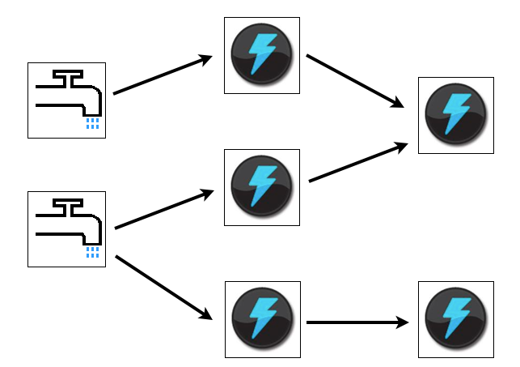
Stream Processing
Apache Storm
  Real-time event processing for sensor and business activity monitoring
  Scale: Ingest millions of events per second. Fast query on petabytes of data
  Implement new real time business cases with your Hadoop platform
http://storm.incubator.apache.org/

Slide 26
NoSQL Database
Store and Process Petabytes of Data
Scale out on Commodity Servers
High Performance
Highly Available
Integrated with YARN
SQL Interface
NoSQL
HBase
YARN : Data Operating System
HDFS
(Permanent Data Storage)
1
°
°
°
°
°
°
°
°
°
°
°
°
°
°
°
°
°
°
°
N

Slide 27

HDP Search
Apache Solr
  High performance indexing and simple UI for advanced search applications
Search Web App
MapReduce Indexing Job
Query
Response
HTML
PDF
Word
XML
Logs
…
Solr
Solr
Solr
Raw Files
Indexed Documents
°
°
°
°
°
°
Lucene
°
°
°
°
°
°
°
°
°
°
°
°
HDFS
(Hadoop Distributed File System)

Slide 28
All Processing on Shared Infrastructure
Script
Pig
SQL
Hive
Java
Scala
Cascading
Others
Engines
HBase
NoSQL
Accumulo
NoSQL
Storm
Stream
Spark
In-Memory
Others
Engines
Solr
Search
Others
ISV Engines
Kafka
Tez
Tez
Tez
Tez
Slider
Slider
Slider
Slider
YARN: Data Operating System
(Cluster Resource Management)
HDFS
(Hadoop Distributed File System)
1
°
°
°
°
°
°
°
°
°
°
°
°
°
°
°
°
°
°
°
°
°
°
°
°
°
°
°
°
°
°
°
°
°
°
°
°
°
°
°
°
°

Slide 29
YARN: Next Generation Hadoop
Single Use System
Batch Apps
Multi Use Data Platform
Batch, Interactive, Online, Streaming, …
1st Gen
of Hadoop
2nd Gen of Hadoop
Classic Hadoop Apps
Flexible Data
Processing
Hive, Pig, others…
Online Data
Processing
HBase, Accumulo
Stream
Processing
Storm
others
…
Batch
MapReduce
Batch & Interactive
Tez
MapReduce
(cluster resource management
& data processing)
Efficient Cluster Resource
Management & Shared Services
(YARN)
HDFS
(redundant, reliable storage)
Redundant, Reliable Storage
(HDFS)

Slide 30
Data Governance & Integration
Apache Falcon
  Simplified Data Governance for Enterprise Hadoop
Provides key governance framework for:
  Acquisition & processing of data sets
  Replication & Retention of datasets
  Redirect datasets to non-Hadoop extensions
  Provides audit trail & lineage

Slide 31
Apache Falcon
Define sophisticated Worklows and DLM Policies
  Enable audit, compliance, and data re-processing
Staged Data
Cleansed Data
Conformed Data
Presented Data
Retain 5 Years
Retain 3 Years
Retain 3 Years
Retain Last Copy Only

Slide 32

Apache Falcon
Disaster Recovery and Backup between environments
Publishing data between environments for Discovery
Site to Site
Site to Cloud

Slide 33

Extend with the Cloud
Cloud Hadoop
  Hybrid = On-premises + Cloud
  Constraints of on-premises
  Scale constrained to on-premise procurement
  Capex up front costs
  Expertise for tuning and deployment
  Benefits of Cloud
  Unlimited elastic scale
  Auto geo redundancy
  No hardware costs
  Pay only for what you need
HDInsight
Cloud
On-premises Hadoop
APS
Appliances
Software

Slide 34
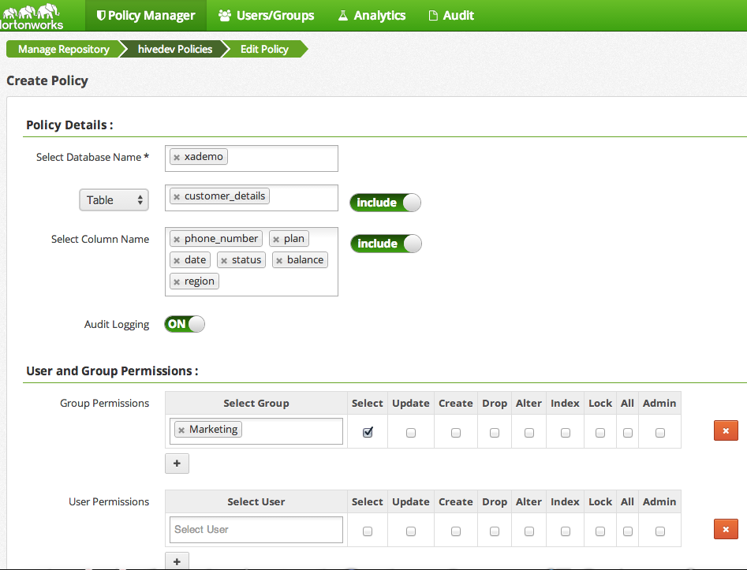
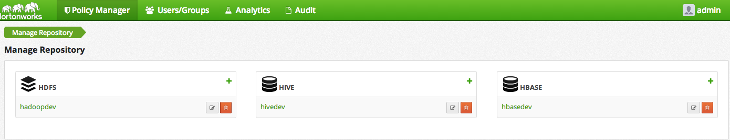
Central Security Administration
HDP Advanced Security
Single Pane of Glass
Centralizes administration of security policy across entire HDP
Project: Apache Ranger

Slide 35
Perimeter Security
Apache Knox
  A common place to preform authentication across Hadoop and all related projects
  Integrated to LDAP and AD
  Secure interfaces for:
  WebHDFS, WebHCAT, Oozie, Hive & HBase
  Broad community effort, Incubated with Microsoft, broad set of developers invovled

Slide 36
Apache Knox: Perimeter Security
Identity Providers
HDP Cluster 1
Firewall
Enterprise
Identity
Provider
LDAP/AD
Firewall
Masters
NN
JT
Web
HCat
Oozie
Browser
DN
TT
DMZ
Hive
HBase
YARN
REST
Client
Knox Gateway
GW
HDP Hadoop Cluster 2
JDBC
Client
Masters
NN
JT
Web
HCat
Oozie
DN
TT
A stateless reverse proxy instance deployed in DMZ
-Requests streamed through GW to Hadoop services after auth.
-URLs rewritten to refer to
gateway
Hive
HBase
YARN

Slide 37
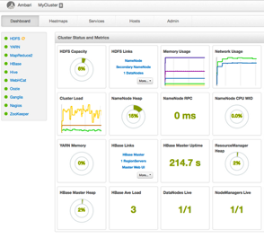



Operating Enterprise Hadoop
Ambari: Deploy, Manage, Monitor
AMBARI WEB
REST APIs
compute
&
storage
.
.
.
AMBARI SERVER
PROVISION | MANAGE | MONITOR
PROVISION
MANAGE
.
.
.
.
MONITOR
.
.
.
compute
&
storage

Slide 38
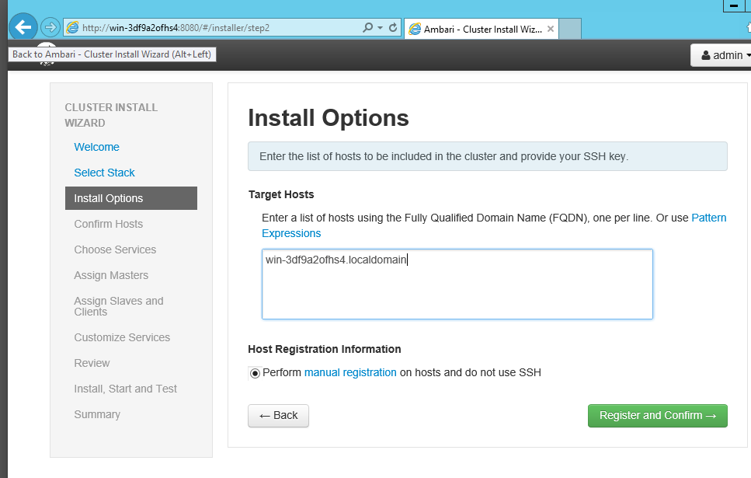
Ambari: Deploy on Windows

Slide 39
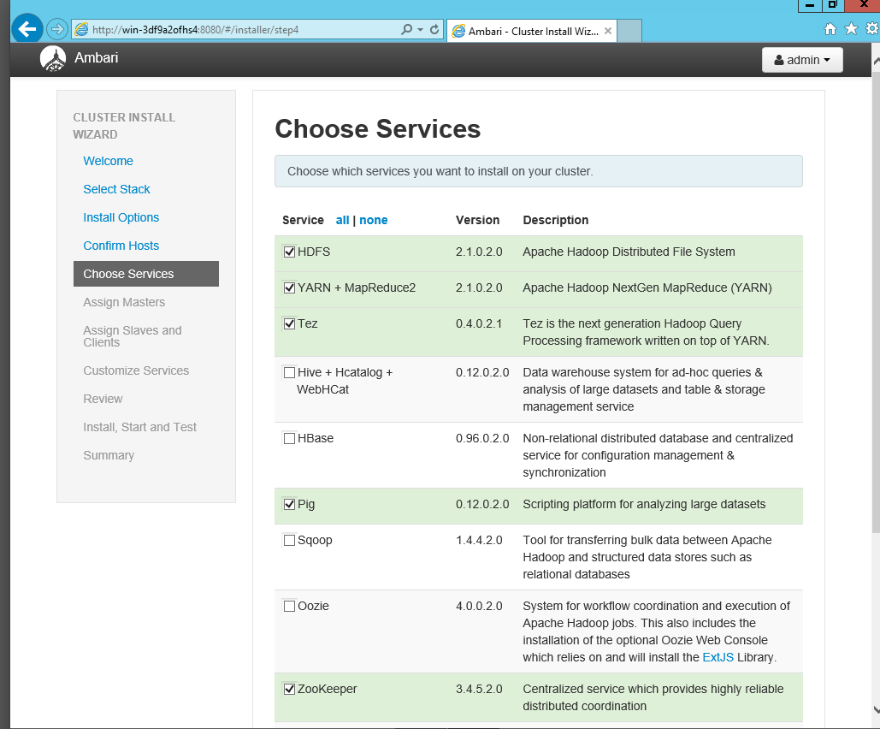
Ambari: Deploy on Windows

Slide 40
Ambari: Manage on Windows

Slide 41
Ambari: Monitor on Windows

Slide 42


Ambari SCOM
  Enables Microsoft System Center Operations Manager (SCOM) to monitor Hadoop
  Ambari SCOM Management Pack gives insight into the performance and health of Hadoop
  Ambari SCOM leverages the Ambari framework to aggregate and expose Hadoop metrics
Ambari SCOM Server aggregates + exposes Hadoop metrics
HADOOP
Storage & Process
at Scale
Ambari SCOM
Mgmt
Pack
Ambari
SCOM
Server
Ambari SCOM monitors health + alerts in case of problems

Slide 43
For More Information
Web
  hortonworks.com/products/hdp-windows/
  hortonworks.com/labs/microsoft/
  microsoft.com/bigdata
Training
  hortonworks.com/hadoop-training/hadoop-on-windows/
Online documentation
  docs.hortonworks.com
Forums
  hortonworks.com/community/forums/

Slide 44
Questions?

Slide 45
DBI Track resources
27 Hands on Labs + 8 Instructor Led Labs in Hall 7
Free SQL Server 2014 Technical Overview e-book
  microsoft.com/sqlserver and Amazon Kindle Store
Free online training at Microsoft Virtual Academy
  microsoftvirtualacademy.com
Try new Azure data services previews!
  Azure Machine Learning, DocumentDB, and Stream Analytics

Slide 46

Resources
Learning
  Sessions on Demand
  Microsoft Certification & Training Resources
http://channel9.msdn.com/Events/TechEd
www.microsoft.com/learning
TechNet
Developer Network
  Resources for IT Professionals
http://microsoft.com/technet
http://developer.microsoft.com

Slide 47



SUBMIT YOUR TECHED EVALUATIONS
We value your feedback!
Fill out an evaluation via
CommNet Station/PC: Schedule Builder
LogIn: europe.msteched.com/catalog
TechEd Mobile app
for session evaluations
is currently offline

Slide 48


© 2014 Microsoft Corporation. All rights reserved. Microsoft, Windows, and other product names are or may be registered trademarks and/or trademarks in the U.S. and/or other countries.
The information herein is for informational purposes only and represents the current view of Microsoft Corporation as of the date of this presentation. Because Microsoft must respond to changing market conditions, it should not be interpreted to be a commitment on the part of Microsoft, and Microsoft cannot guarantee the accuracy of any information provided after the date of this presentation. MICROSOFT MAKES NO WARRANTIES, EXPRESS, IMPLIED OR STATUTORY, AS TO THE INFORMATION IN THIS PRESENTATION.

