Slide 1


Slide 2

Extending Your Hadoop Distributions in the Cloud
DBI-B411
Matt Winkler – @mwinkle
Microsoft – Big Data

Slide 3
Agenda
Motivations
IaaS Patterns
Hadoop as a Service
Hybrid Scenarios
Next steps

Slide 4
Why Cloud?
Elasticity
Cost Optimization
Economic flexibility
Support for bursting workloads
Global footprint

Slide 5
Why On-Premises?
Compliance requirements
Specific control over hardware/networking
Integration requirements for additional apps to be close to cluster

Slide 6
When Cloud?
Data born in the cloud
Global apps
Satisfy geopolitical or compliance constraints
Dev/Test
Backup
Geo-Redundancy
Bursting to cloud

Slide 7
IaaS – Run YOUR HADOOP in the Cloud
IaaS offerings across the cloud providers offer:
  OS choice
  Node configuration
  Customized networking topology
  Repeatable, scriptable deployments
You still have to:
  Set up the cluster
  Manage data movement into the cluster
  Integrate with your other applications
  Manage patching and updates of OS and apps
  Obtain support and/or licenses

Slide 8
Demo
IaaS Deployment Through Azure Marketplace

Slide 9
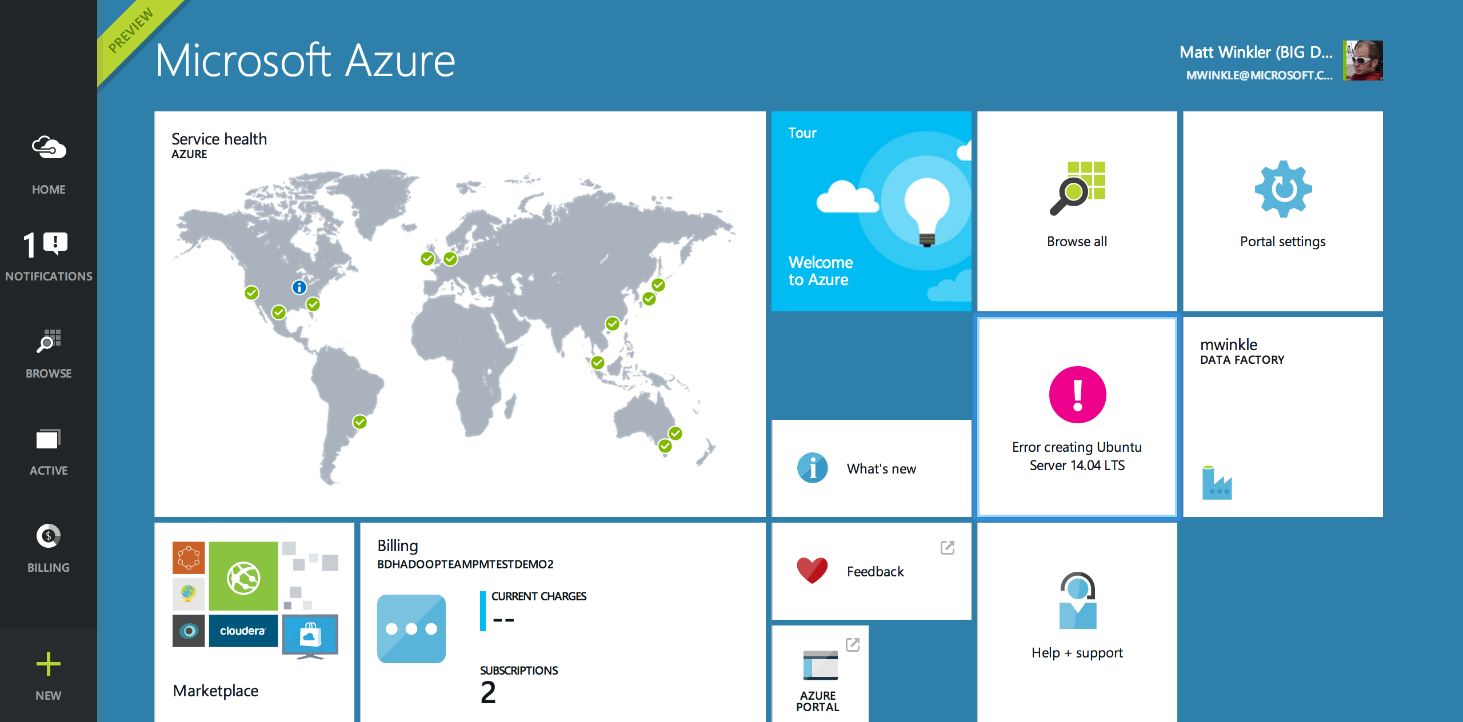

Slide 10
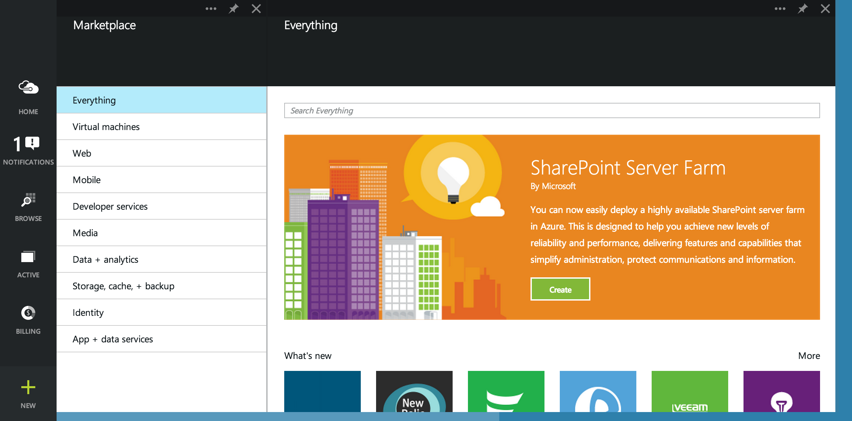

Slide 11
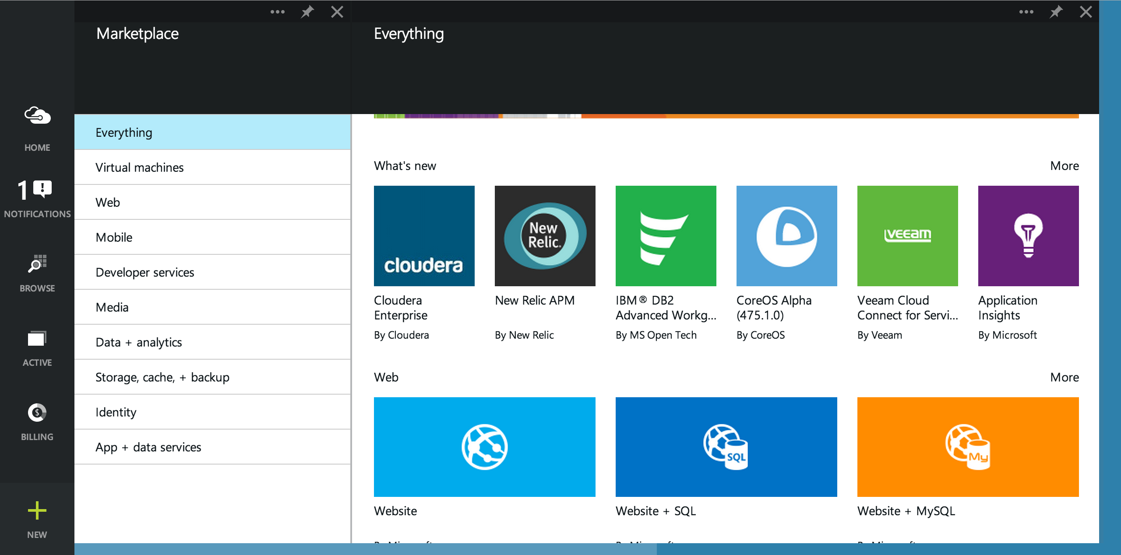

Slide 12
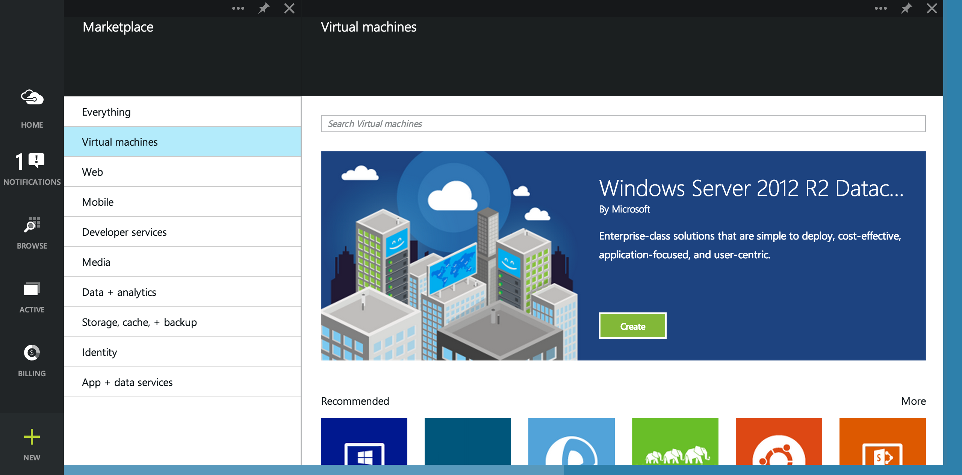

Slide 13
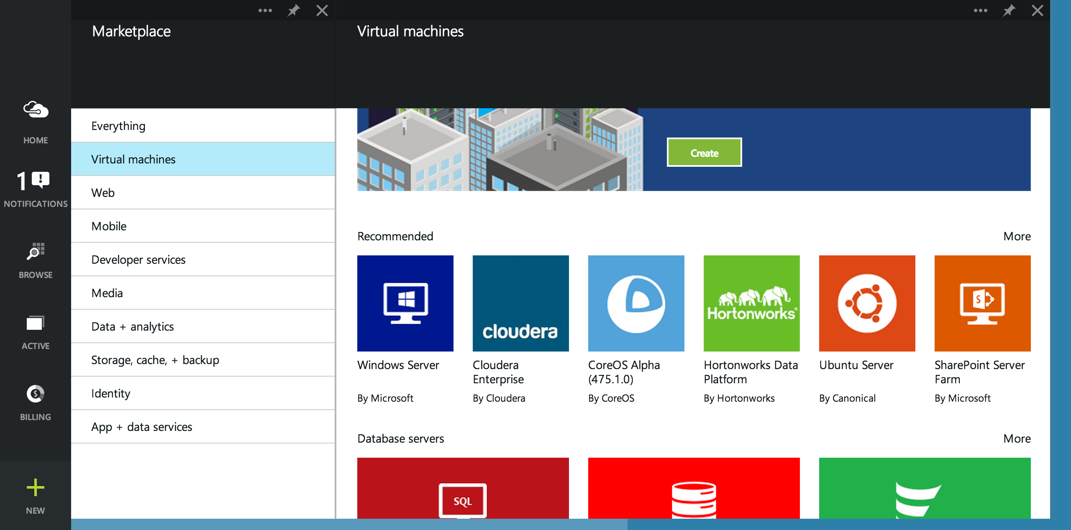

Slide 14
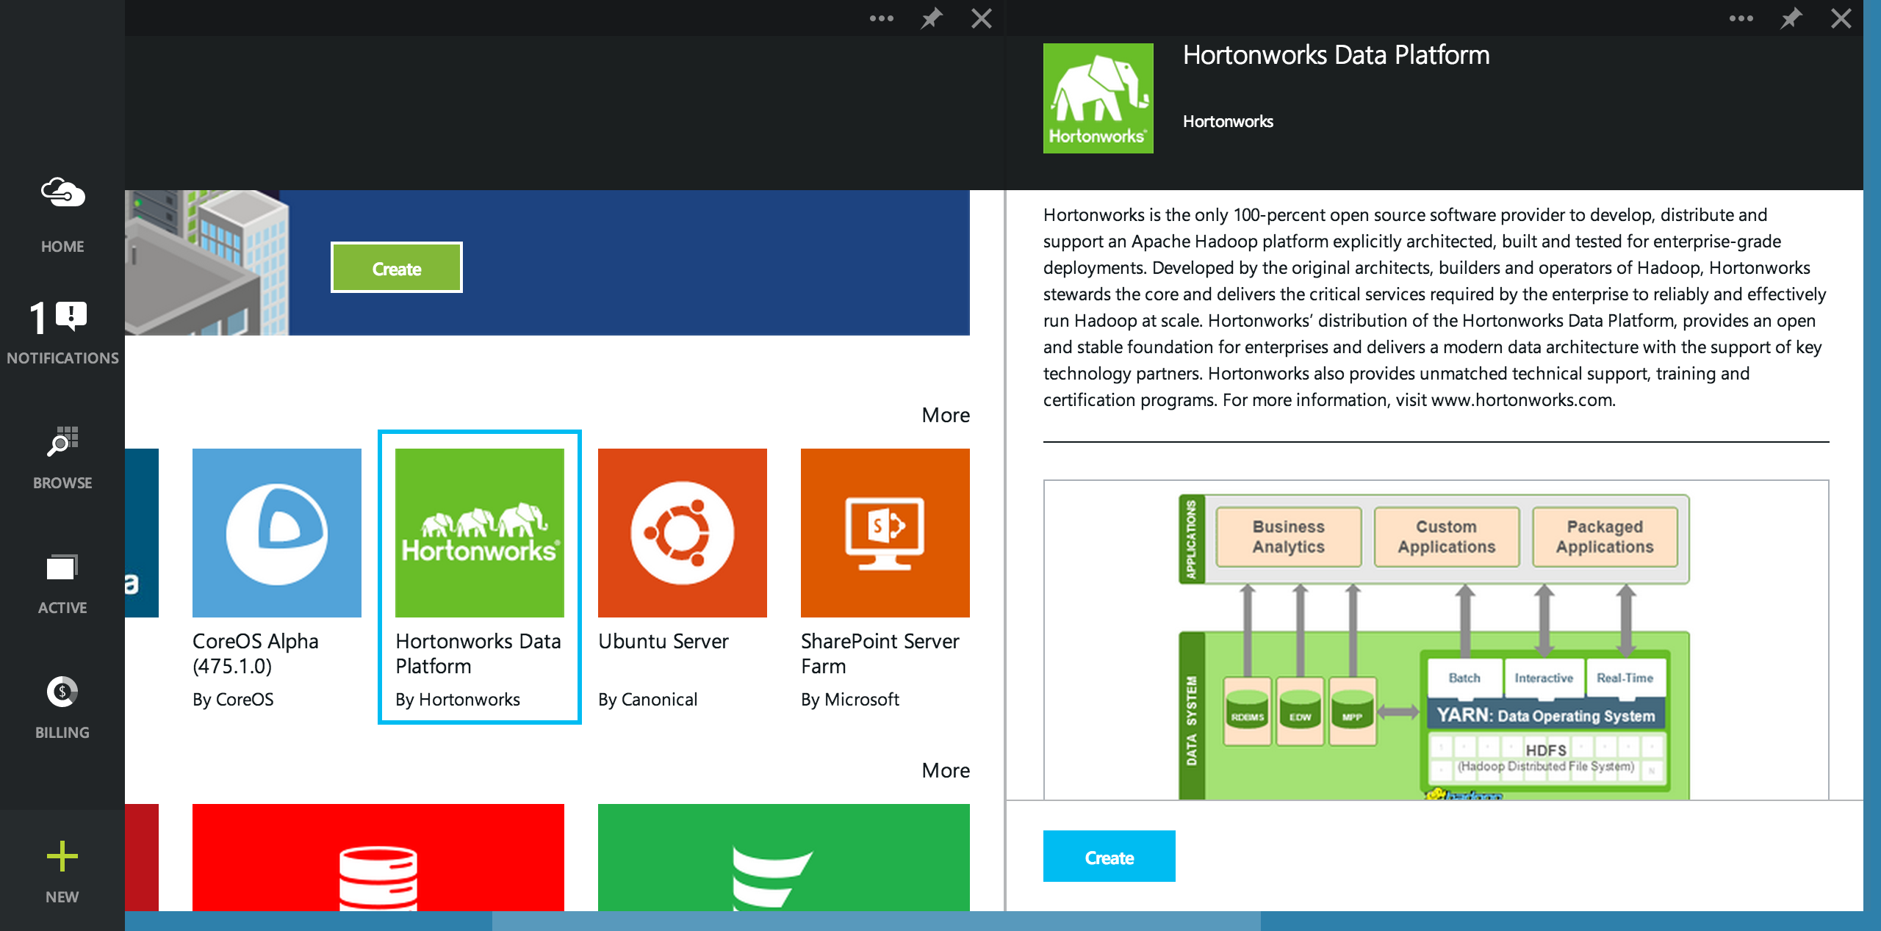

Slide 15
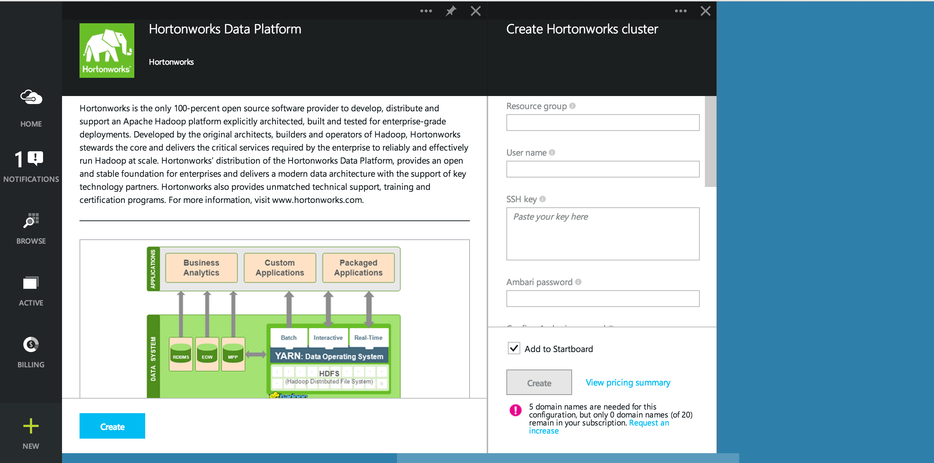

Slide 16
Leverage Cloud Storage For Flexibility
Cloud storage enables economic flexibility, scale and rich features
Size clusters independent of storage needs
Clusters become stateless to operate across the data
Price continues decreasing
Geo-Redundancy allows for business continuity/disaster recover planning

Slide 17
Cloud Storage Usage Patterns
HDFS within the cluster
  Move data in from cloud storage on boot
  (optional) backup/age data to cloud storage
  (optional) move data out to cloud storage to rebuild cluster
Default file system using cloud storage connectors
  To Hadoop apps, they just see a path to data and most things “just work”
  Apps which rely specifically on HDFS may encounter compat issues
  The physics change in exchange for flexibility

Slide 18
Configuring Azure Blob Storage in Hadoop (on Linux)

Slide 19
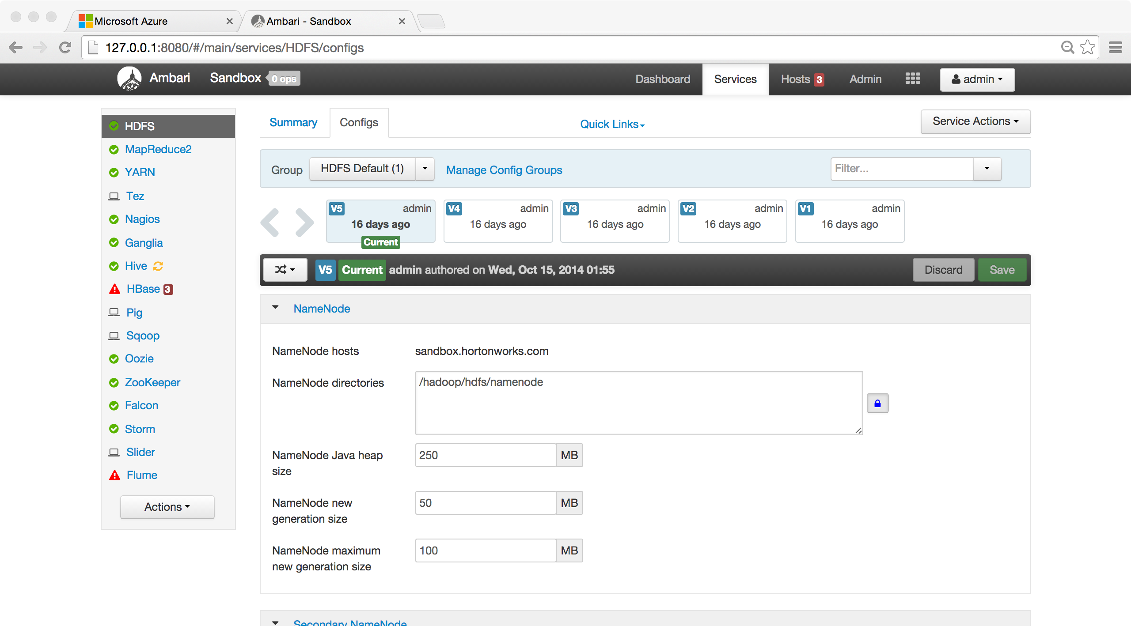

Slide 20
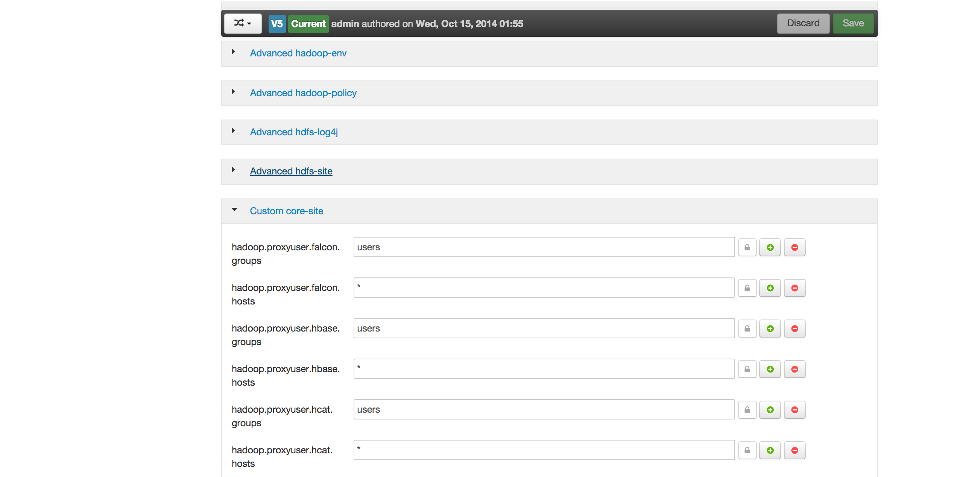

Slide 21
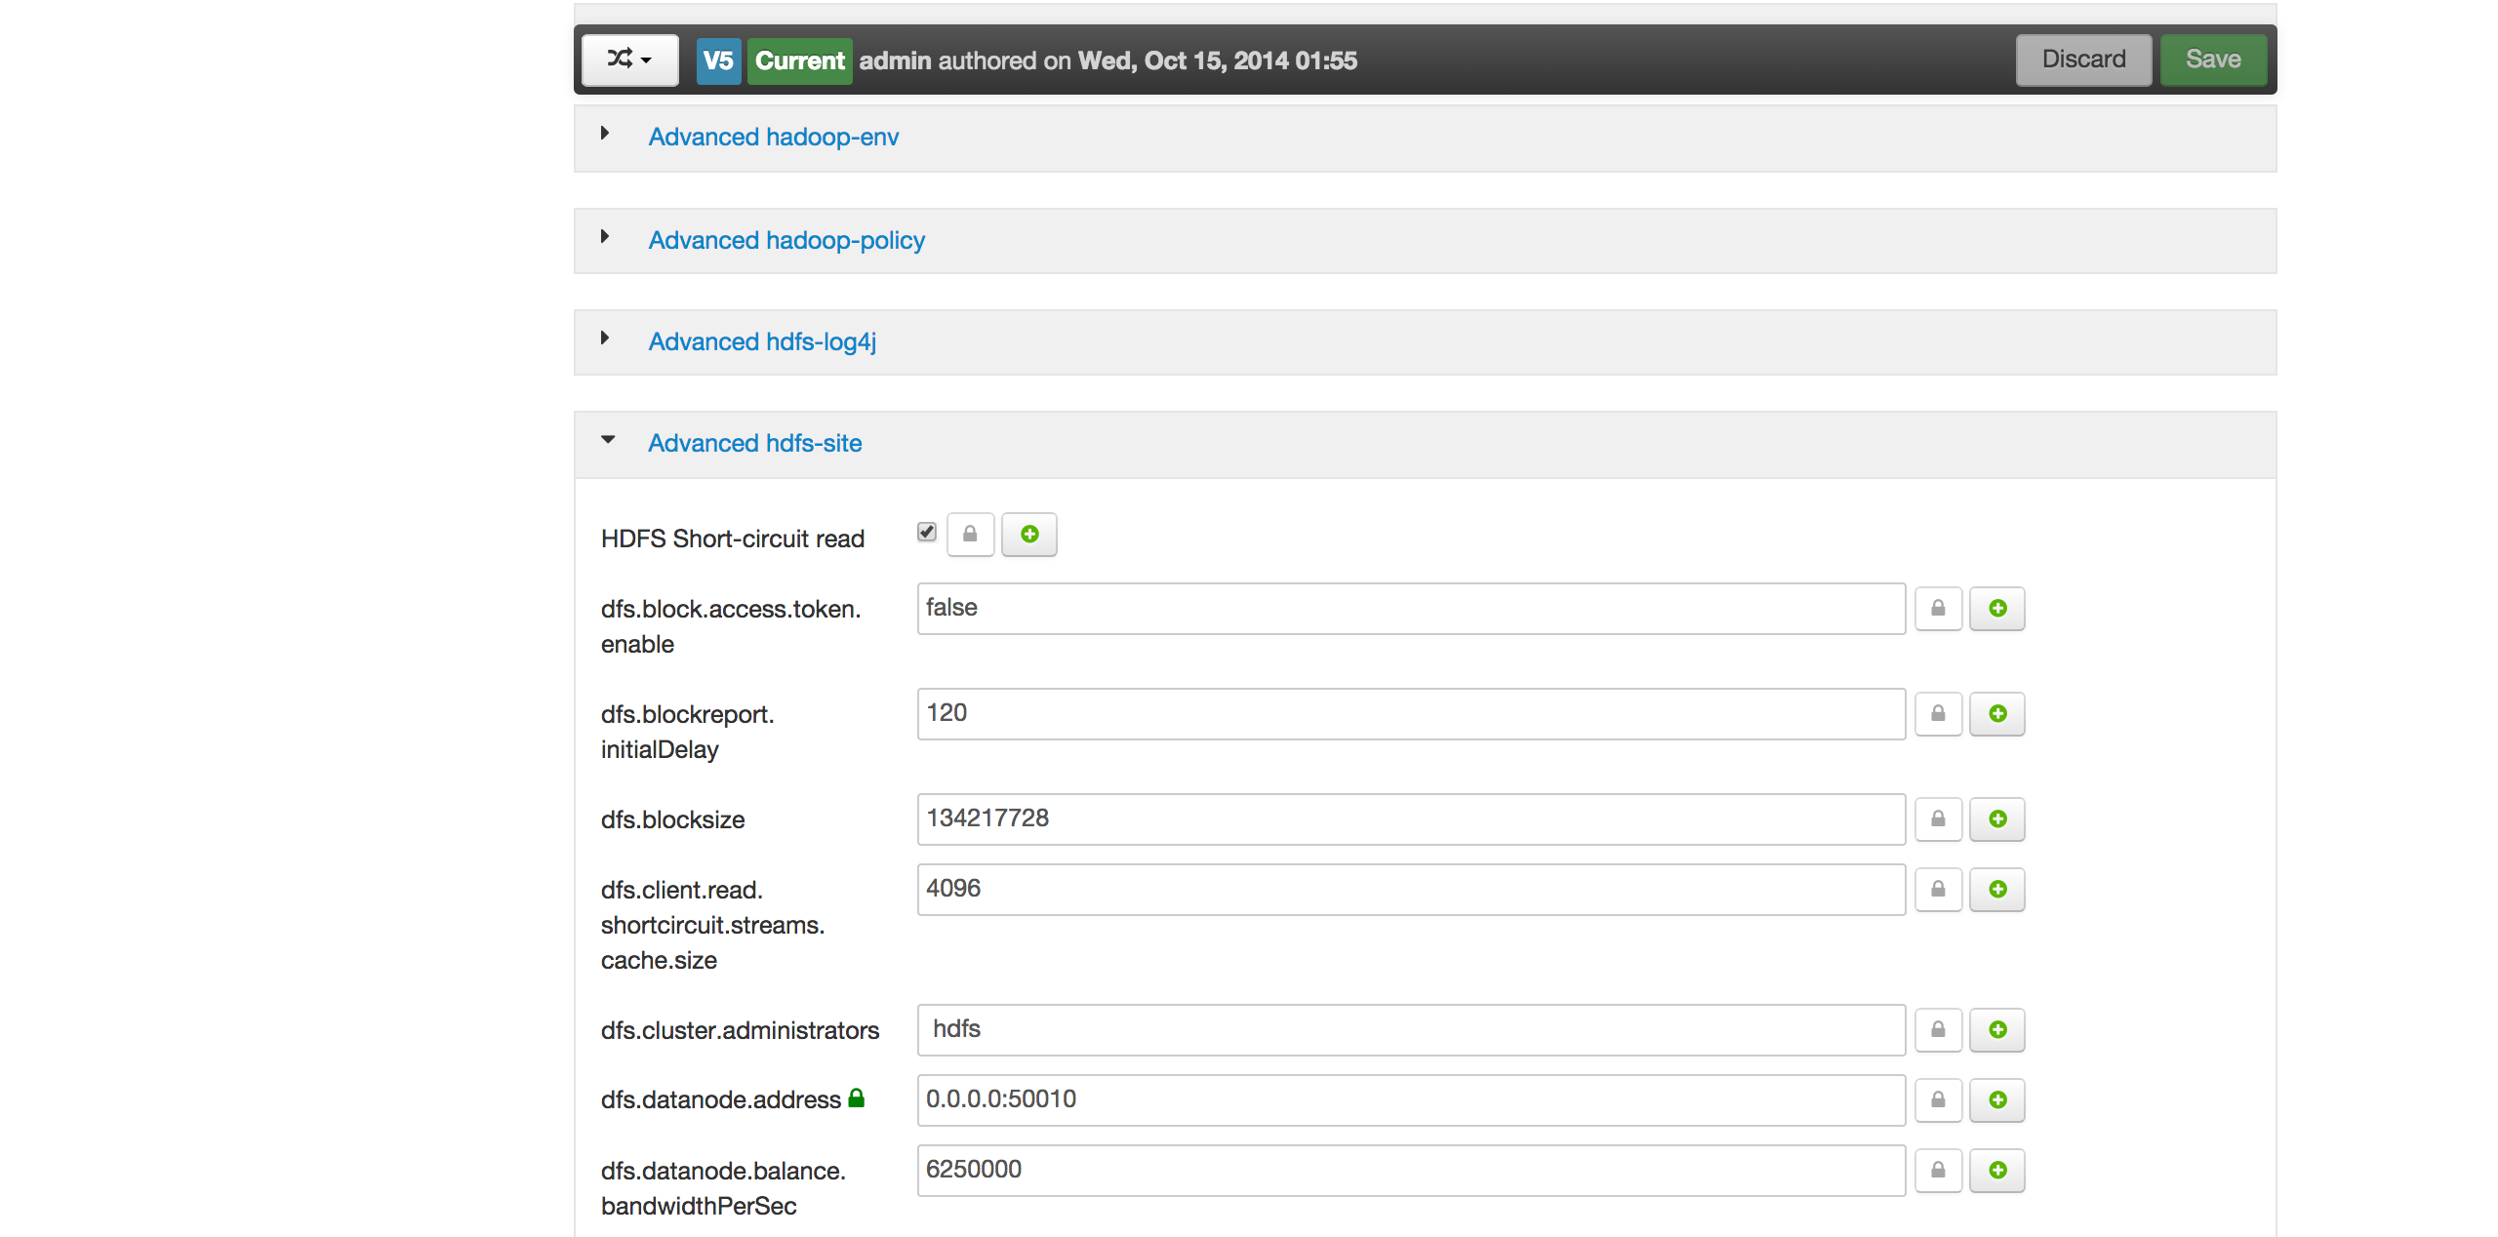

Slide 22
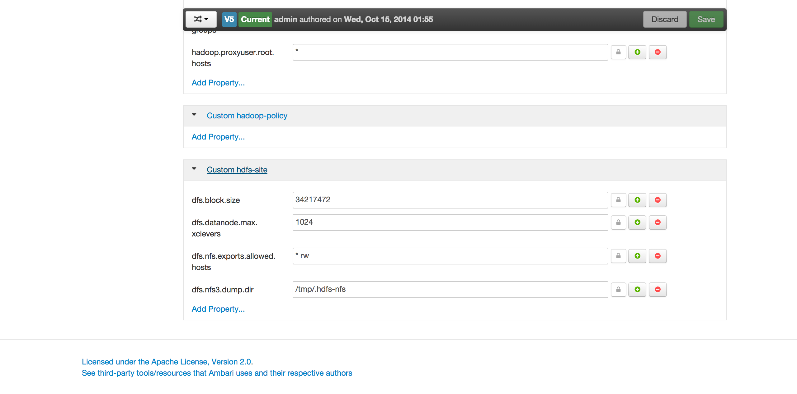

Slide 23
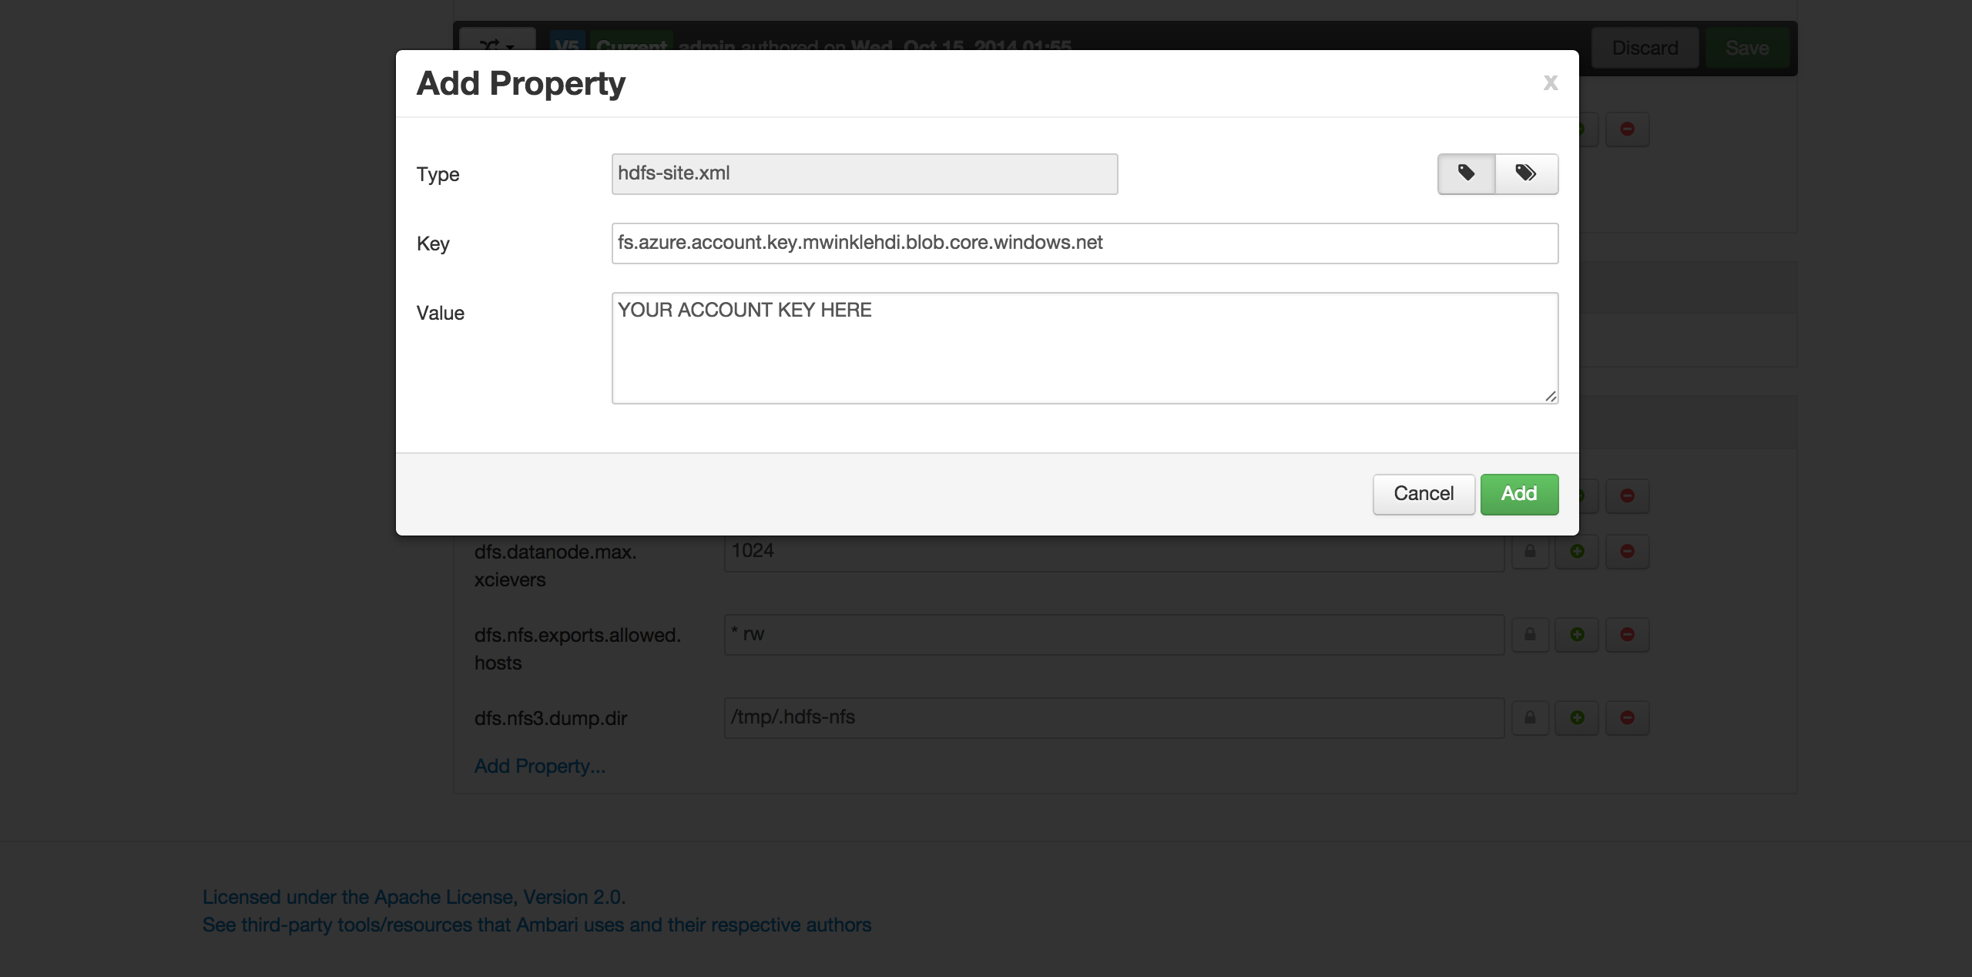

Slide 24
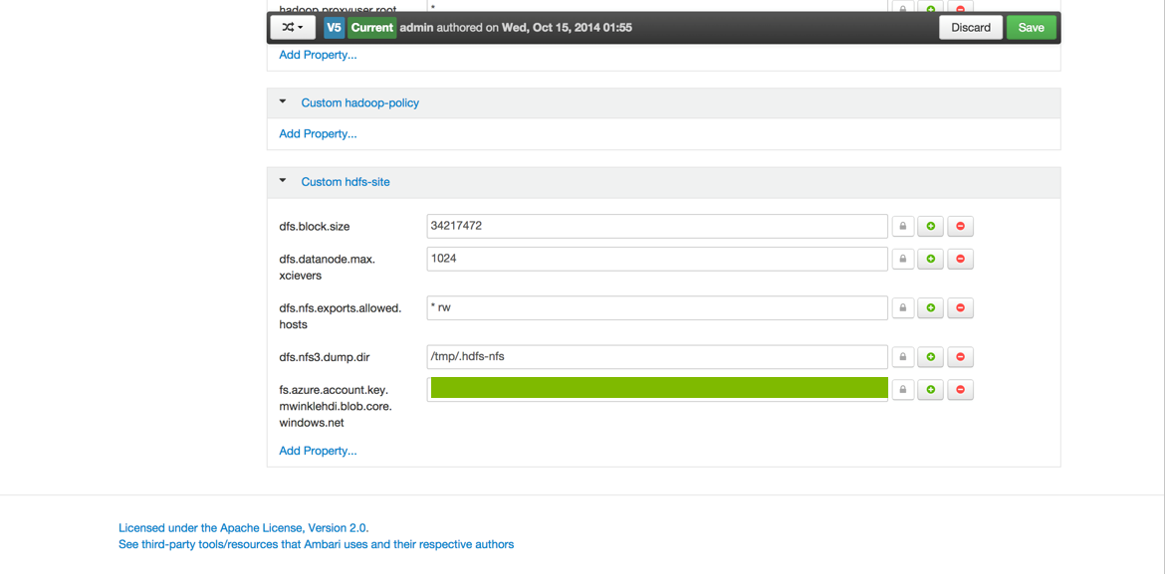

Slide 25
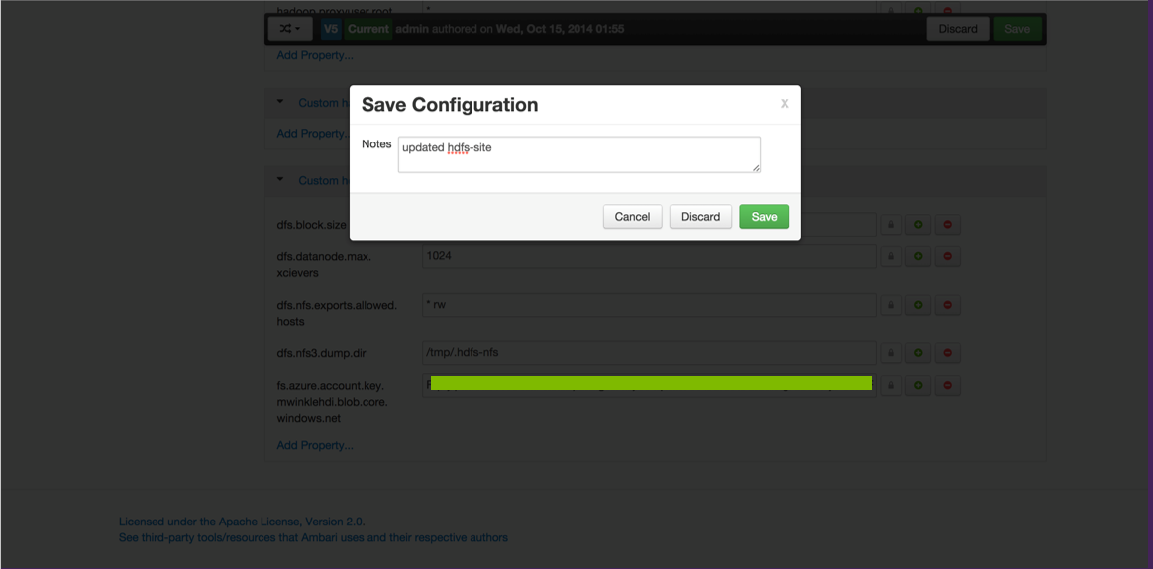

Slide 26
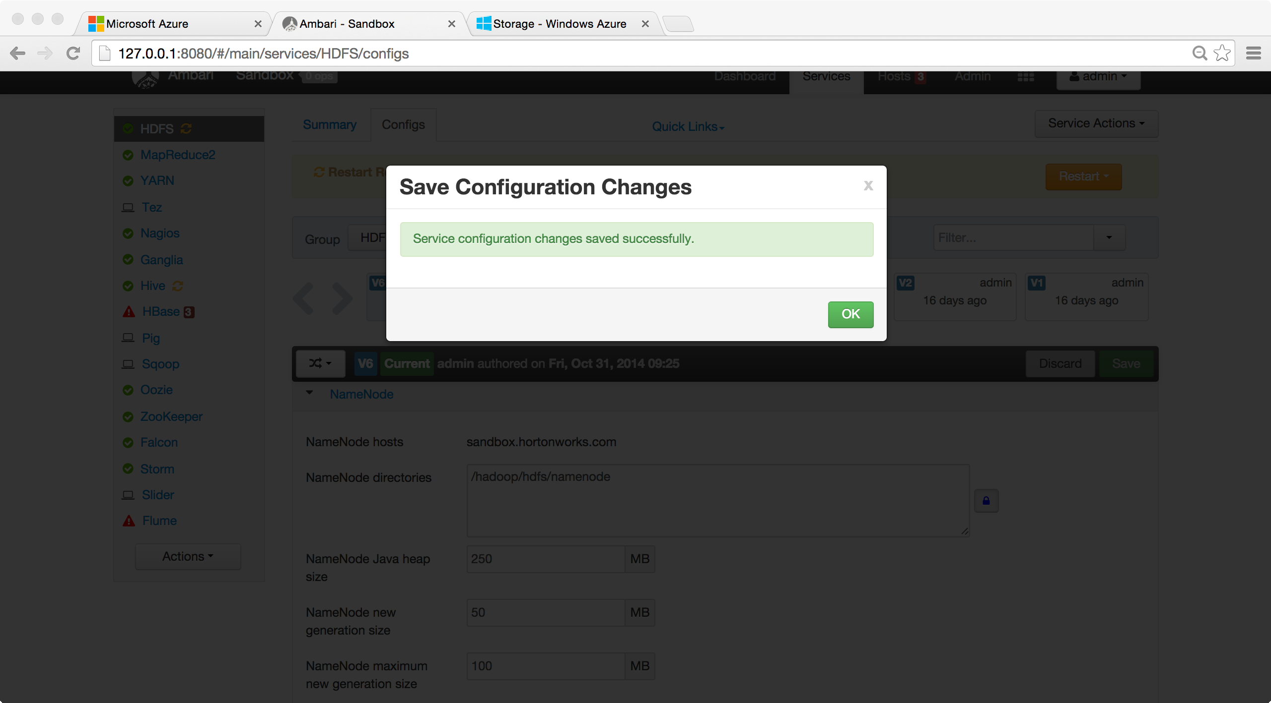

Slide 27
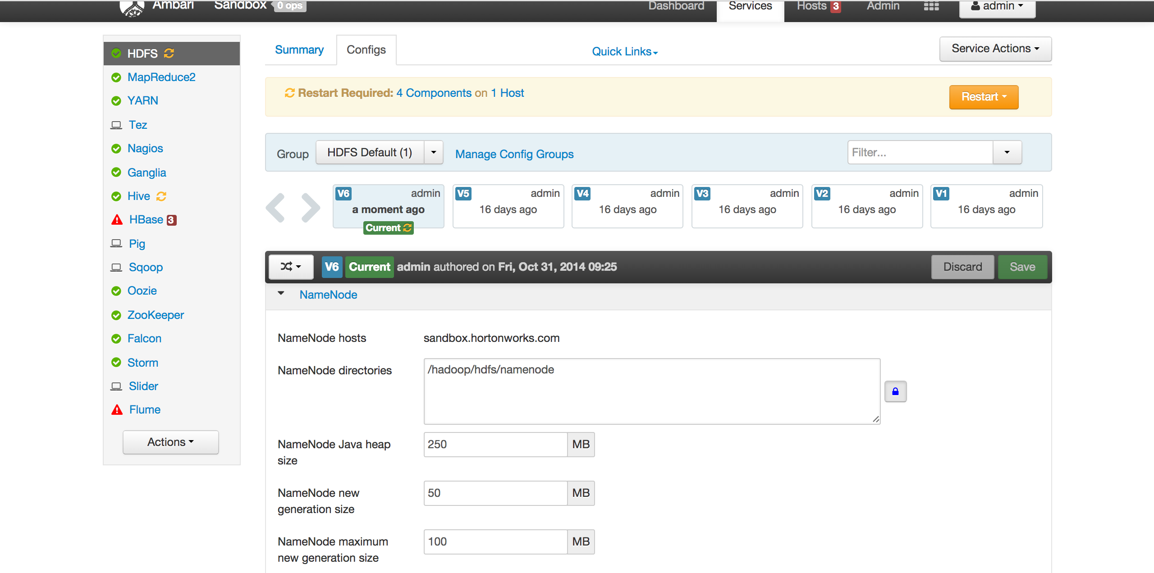

Slide 28
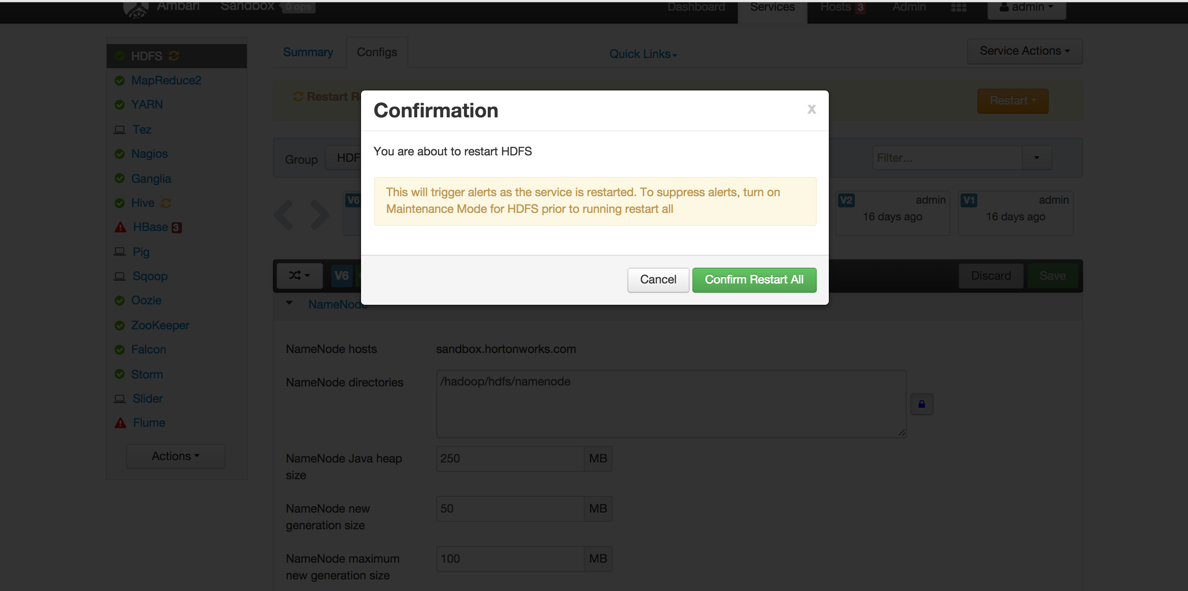

Slide 29
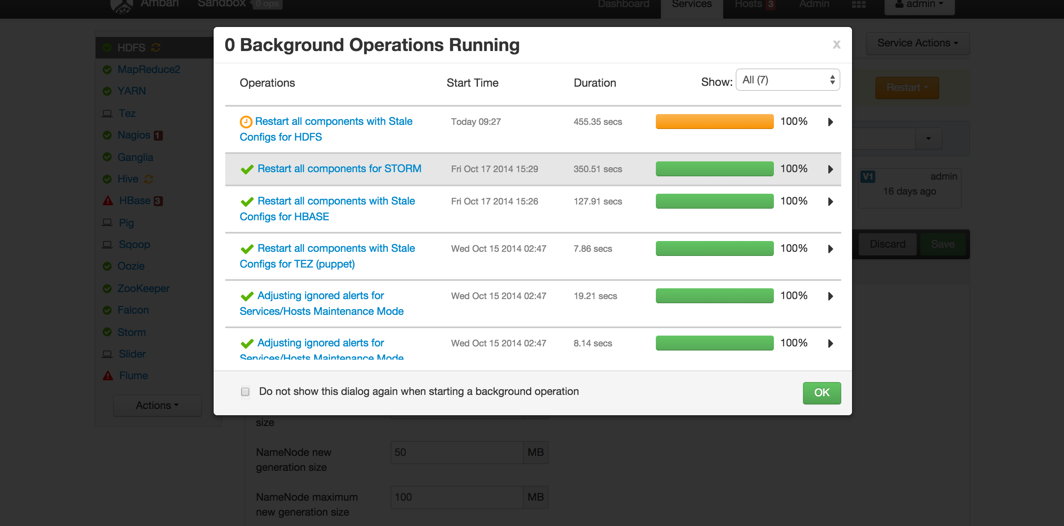

Slide 31


Leveraging Hadoop As a Service
Hadoop Services
Cluster creation on demand
Default integration with cloud storage
Integration across services and apps
Higher level abstractions
API set for integrating into apps
Azure HDInsight
Clusters provisioned on top of Azure Blob storage
Deploy globally, including China
Deploy clusters of any size
Entire stack supported by Microsoft
Some example services
Azure Active Directory
Scheduler
Azure SQL Database
Service Bus
Azure Web Site
Express Route
Multi-Factor Authentication

Slide 32
Using HDInsight

Slide 33
Hybrid Scenarios
Key scenarios
Offsite backup
Dev/Test
Burst to Cloud
The decision is not an XOR, it’s on-premises AND cloud

Slide 34
Demo
On-Premises
Microsoft
Azure
Hadoop Cluster (HDP 2.1)
Running on CentOS
Hive
Hadoop cluster deployed to IaaS
HDInsight (Hadoop)
MR
Tez
Falcon
YARN
HDFS
Azure Storage

Slide 35
Conclusions
Choices for the Hadoop in the cloud range from IaaS to Hadoop as a Service
Patterns are complimentary
Usage of blob store enables flexibility
Hybrid scenarios build on blob store

Slide 36
DBI Track resources
27 Hands on Labs + 8 Instructor Led Labs in Hall 7
Free SQL Server 2014 Technical Overview e-book
  microsoft.com/sqlserver and Amazon Kindle Store
Free online training at Microsoft Virtual Academy
  microsoftvirtualacademy.com
Try new Azure data services previews!
  Azure Machine Learning, DocumentDB, and Stream Analytics

Slide 37
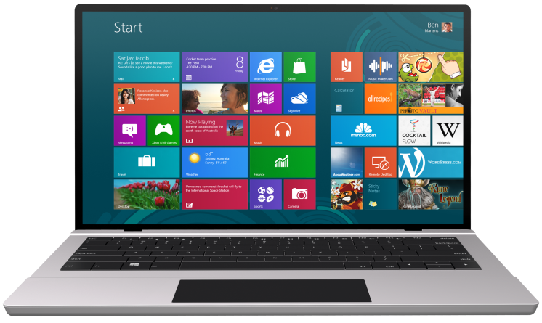


SUBMIT YOUR TECHED EVALUATIONS
We value your feedback!
Fill out an evaluation via
CommNet Station/PC: Schedule Builder
LogIn: europe.msteched.com/catalog
TechEd Mobile app
for session evaluations
is currently offline

Slide 38

Resources
Learning
  Sessions on Demand
  Microsoft Certification & Training Resources
http://channel9.msdn.com/Events/TechEd
www.microsoft.com/learning
TechNet
Developer Network
  Resources for IT Professionals
http://microsoft.com/technet
http://developer.microsoft.com

Slide 39


© 2014 Microsoft Corporation. All rights reserved. Microsoft, Windows, and other product names are or may be registered trademarks and/or trademarks in the U.S. and/or other countries.
The information herein is for informational purposes only and represents the current view of Microsoft Corporation as of the date of this presentation. Because Microsoft must respond to changing market conditions, it should not be interpreted to be a commitment on the part of Microsoft, and Microsoft cannot guarantee the accuracy of any information provided after the date of this presentation. MICROSOFT MAKES NO WARRANTIES, EXPRESS, IMPLIED OR STATUTORY, AS TO THE INFORMATION IN THIS PRESENTATION.

