Slide 2
Tabular Deep Dive
DBI-414
Taylor Clark
Program Manager
Software Engineer

Slide 3
Today we’ll look at
The tools for building with tabular
The Vertipaq engine
Processing of a tabular model
Tips for optimization

Slide 4
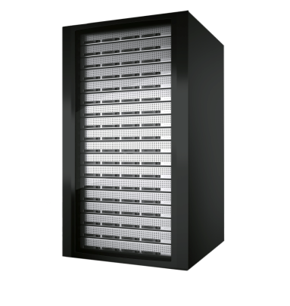
Seamless Transition of the BI Semantic Model Across BI Spectrum
Personal BI
Team BI
Corporate BI
Our Context
BI Solution created by power user. Context is for a small team & it’s managed on a server.
The Org’s Context
BI Solution created by IT, Established corporate context & is reusable, scalable and backed up.
My Context
BI solution created by user. Context is only for user & exists as document.
PowerPivot for Excel
PowerPivot for SharePoint
Analysis Services
Empowered
Aligned

Slide 5
Design Tools
PowerPivot for Excel
SQL Server Data Tools
Feels like Excel
Feels like Visual Studio
One file, Save to SharePoint
It’s a project (business case, budget, dates)
Optimized for BI Pros
Teams building BI solutions
Rapid response to business problems
Larger data volumes
Deployment scripts, versions
Optimized for Excel power user
Solutions live for weeks or months
Source Control, TFS
Personal Team Corporate

Slide 6
Corporate BI Advantages
Partitions, Direct Query
Scalability
SSMS, AMO, PowerShell, SSIS Packages
Manageability
Row level security
Security
Integrated source control, Team Build, Deployment wizard
Development Tools

Slide 7
Demo
Using the tools

Slide 8
Vertipaq

Slide 9
VertiPaq Design Principles
Performance, Performance, Performance

Slide 10
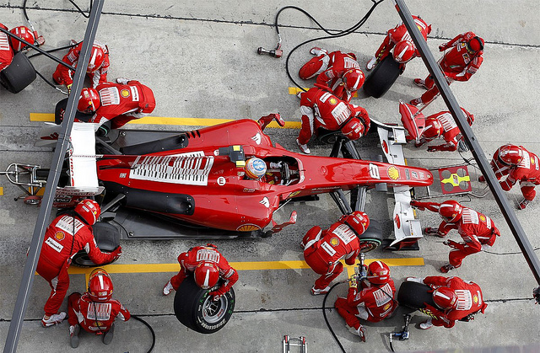
VertiPaq Design Principles
Query Performance >> Processing Performance

Slide 11
VertiPaq Design Principles
Accommodate changes without forcing reload, if possible

Slide 12
The life of a model
1. Read data from source
2. Encoding
3. Compression
4. Process Recalc

Slide 13
VertiPaq Storage
T1
(C1,C2,C3)
T2
(C1,C2)
CC1
CC1
1
2
3
Partition 1
Partition 1
5
4
Partition 2
6
P2
Dictionary
Col. Segment
Hierarchy
Relationship
1
Table data stored in segments & dictionaries per column
5
Partitions are a group of segments and intended for data management
2
Calculated columns are stored like regular columns
6
Any table can have partitions, defined independently of other tables. Partitions are only for segment data
3
Hierarchies can provide quicker access for querying
4
Relationship structures are created to accelerate lookups across tables, remove hard coupling between tables

Slide 14
Encoding – Build the dictionary
Products = 13M rows
Color
Red
Red
Green
Blue
Red
Blue
Green
Green
Green
Red
Blue
Blue
…
Color
1
1
2
3
1
3
2
2
2
1
3
3
…
Data IDs

Slide 15
Column Encoding
Value
Simple arithmetic
1.5, 3.0, 4.5
X10: 15, 30, 45
/15: 1, 2, 3

Slide 16
Column Encoding
Value
Simple arithmetic
Hash
Forced on Text data types
Slower than value
Tips
Change Text to Number if possible
Change Decimal to Currency if feasible
Avoid re-encoding by ordering data

Slide 17
Encoding
Products = 13M rows
Color
Red
Red
Green
Blue
Red
Blue
Green
Green
Green
Red
Blue
Blue
…
Color
1
1
2
3
1
3
2
2
2
1
3
3
…
Products[Color] dictionary
Data IDs
Key | Value
1 | Red
2 | Green
3 | Blue

Slide 18
Column Encoding
Value
Simple arithmetic
Hash
Forced on Text data types
Slower than value
Tips
Change Text to Number if possible
Change Decimal to Currency if feasible
Avoid re-encoding by customizing data load

Slide 19
Column Segments and Dictionaries
Products = 13M rows
Segment 1 = 8M rows
Segment 2 = 5M rows
Color
Red
Red
Green
Blue
Red
Blue
Green
Green
Green
Red
Blue
Blue
…
Color
1
1
2
3
1
3
2
2
2
1
3
3
…
Color
…
2
1
1
2
3
3
3
2
1
1
2
…
Products[Color] dictionary
Key | Value
1 | Red
2 | Green
3 | Blue

Slide 20
Controlling Segment Size and Compression
DefaultSegmentRowCount – # of rows in the segment
0 – default: 8M for Analysis Services, 1M for PowerPivot
Value must be power of 2, should be at least 1M
Larger => generally better compression, faster queries with lower overhead
Smaller => smaller working set during processing
ProcessingTimeboxSecPerMRow
-1 – default: 10 sec
Smaller => greedy algorithm gives most gains in the beginning
Larger => almost always better compression, higher query performance
Increase for large number of columns (~>200)
Reported in profiler & DISCOVER_STORAGE_TABLE_COLUMN_SEGMENTS

Slide 21
Controlling Segment Size and Compression
The following example shows the change in processing time and compression on a 4 billion row table.
With the default setting, the table compressed to 41GB
ProcessingTimeboxSecPerMRow = 0, DefaultSegmentRowCount = 16M, the table compressed to 25GB.
With the default, processing completed in 5.5 hours. With the changes, processing completed in 21 hours.

Slide 22
Compression
Occurs per segment
Gives improved compression
Segments may compress differently, but decompress to the same ID
Segment 1 contains 3 unique encoded values
Segment 2 contains 2 unique encoded values
Color (encoded)
1
1
2
3
…
Color (encoded)
2
1
1
2
…

Slide 23
Compression
Occurs per segment
Gives improved compression
Segments may compress differently, but decompress to the same ID
Segment 1 requires 2 bits to compress
Segment 2 contains 2 unique encoded values
Color (encoded)
0x1
0x1
0x10
0x11
…
Color (encoded)
2
1
1
2
…

Slide 24
Compression
Occurs per segment
Gives improved compression
Segments may compress differently, but decompress to the same ID
Segment 1 requires 2 bits to compress
Segment 2 requires 1 bit to compress
Color (encoded)
0x1
0x1
0x10
0x11
…
Color (encoded)
0x1
0x0
0x0
0x1
…

Slide 25
Processing Architecture

Slide 26
Processing options
Data
T1
Data
Recalc
Full: Data and Recalc
Default: Data and Recalc if needed
Clear: Remove Data
Add: Creates new segments and merges
Defrag: Defragment dictionaries for a table
CC1
Hierarchies
Relationships

Slide 27
Processing Phases
Segment N
Segment N +1
Read & Encode Data
Segment N
Read & Encode Data
Segment N + 1
Build calc cols, hier, relationships
t
Compress
Segment N
Compress
Segment N+1

Slide 28
Special case of 3rd segment
First segment can “stretch” to be twice as large
Optimizes for smaller lookup tables
Segment 1 + 2
Segment 3
Read & Encode Data
Segment (until 2*segment_size)
Split
Read & Encode Data
Segment 3
t
Compress
Segment 1
Compress
Segment 3
Compress
Segment 2

Slide 29
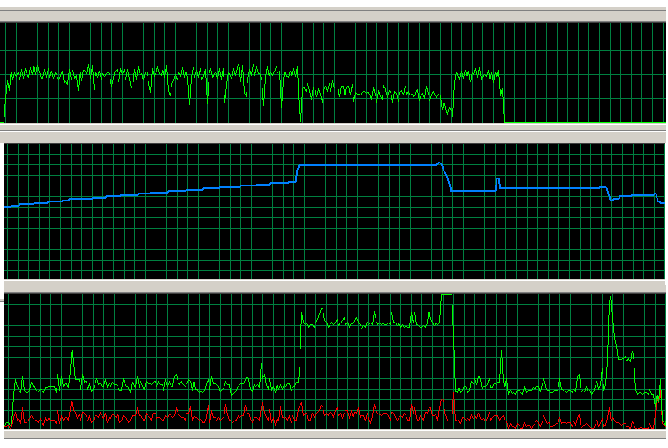
Processing - Memory & CPU usage
Network
Split
Segment 1 + 2
Segment 3
Memory
Read & Encode Data
Segment (until 2*segment_size)
Read & Encode Data
Segment 3
Compress Segment 1
Compress
Segment 3
Calc cols, hier, rels.
Compress Segment 2
CPU

Slide 30
Incremental Processing
Typical
Create new partitions for new data
ProcessData on new partition or to reload into existing tables
ProcessRecalc to rebuild calc columns, hierarchies, relationships
Avoid
Multiple ProcessFull – each causes a Recalc, unless in a single transactional batch

Slide 31
Advanced Processing
Parallel processing
Use single transaction batch for processing tables in parallel
No parallel processing of a table’s partitions in SQL Server 2012
Use ProcessDefrag periodically
Deleting partitions may leave outdated values in dictionaries
Remove unused columns
Make sure you modify source query as well
Merge partitions to reduce segment fragmentation
Error handling
RI violations assigned a blank value, no error during processing

Slide 32
Server Memory Map
Server memory
DB1
DB2
DB1~
New, not committed part of the database
FE
VertiPaq caches
VertiPaqMemoryLimit – 60 %
TotalMemoryLimit – 80 %
VertiPaqPagingPolicy enables use of system paging
Dictionaries need to remain in memory

Slide 33
Querying
Queries
Two formula engines: MDX, DAX
FE calls into VertiPaq to retrieve data
Query logic pushed to VertiPaq where possible
A VertiPaq query executes in parallel, one core per segment
Optimized for execution on compressed format
VertiPaq-level caching for chatty FE/VertiPaq communication
Events in profiler
MDX
DAX
VertiPaq

Slide 34
VertiPaq Query Performance
Scans @ 5B+ rows/s
1B+ rows of data
Scans @ 20B+ rows/s
10B+ rows of data

Slide 35
Demo
Inspecting Query Evaluation

Slide 36
Rich & Fast
DAX/MDX
VertiPaq Query
Rich
Single threaded per query
Designed for expressivity
Simple
One core per segment
Optimized for speed
More pushed down over time

Slide 37
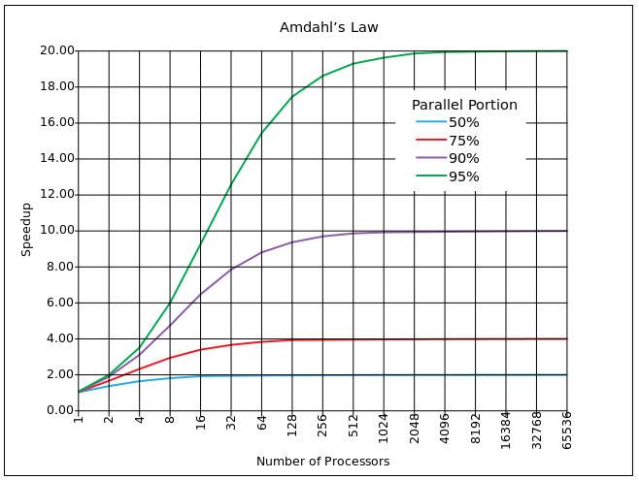
Why raw speed counts . . .
Vertipaq → Performance, Performance, Performance
Amdahl's law: Establishes the maximum expected improvement to an overall system when only part of the system is improved.
The speedup of a program using multiple processors in parallel computing is limited by the time needed for the sequential fraction of the program.

Slide 38
Related content
Breakout Sessions
DBI-B319 Improving Power Pivot Data Models for Microsoft Power BI
DBI-B412 Querying in DAX
DBI-B213 Deployment and Best Practices for Power BI for Office 365
Lab
DBI-H328 Developing, Deploying and Managing a Tabular Data Model in Microsoft SQL Server 2014
Find Me Later At Ask The Experts
Data Discovery and Vizualization – Table 54

Slide 39
DBI Track resources
27 Hands on Labs + 8 Instructor Led Labs in Hall 7
Free SQL Server 2014 Technical Overview e-book
microsoft.com/sqlserver and Amazon Kindle Store
Free online training at Microsoft Virtual Academy
microsoftvirtualacademy.com
Try new Azure data services previews!
Azure Machine Learning, DocumentDB, and Stream Analytics

Slide 40
Resources
Learning
Sessions on Demand
Microsoft Certification & Training Resources
http://channel9.msdn.com/Events/TechEd
www.microsoft.com/learning
TechNet
Developer Network
Resources for IT Professionals
http://microsoft.com/technet
http://developer.microsoft.com

Slide 41
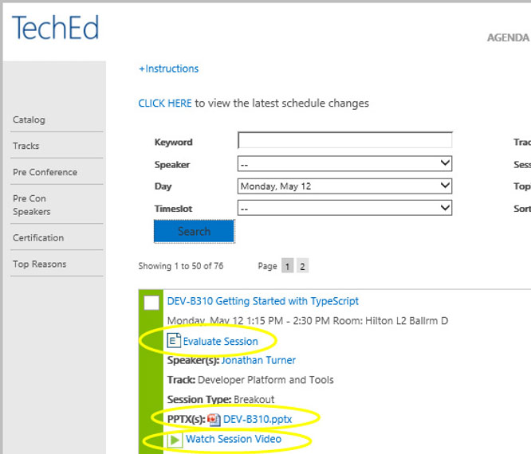
Please Complete An Evaluation Form Your input is important!
TechEd Schedule Builder
CommNet station or PC
TechEd Mobile app
Phone or Tablet
QR code

Slide 42
Evaluate this session

Slide 43
© 2014 Microsoft Corporation. All rights reserved. Microsoft, Windows, and other product names are or may be registered trademarks and/or trademarks in the U.S. and/or other countries.
The information herein is for informational purposes only and represents the current view of Microsoft Corporation as of the date of this presentation. Because Microsoft must respond to changing market conditions, it should not be interpreted to be a commitment on the part of Microsoft, and Microsoft cannot guarantee the accuracy of any information provided after the date of this presentation. MICROSOFT MAKES NO WARRANTIES, EXPRESS, IMPLIED OR STATUTORY, AS TO THE INFORMATION IN THIS PRESENTATION.

