Slide 2
Office 365 developer kickoff
DEV-B207
Brian Jones
Group Program Manager
Jeremy Thake
Technical Product Manager

Slide 3
Agenda
Our vision
What’s new?
Futures
Calls to action

Slide 4
Our vision

Slide 5



Today
EXTEND OFFICE
EVERYWHERE
CONNECT TO
OFFICE 365 SERVICES
BUILD USING
AN OPEN PLATFORM
Users and
groups

Slide 6


Where are we?
FY13
FY14
FY15
2013
2014
2015
Launched
Office 365
Re-imagine campaign
Over
Expanding
endpoints & API reach
1200
with over
apps
3,500,000
Mobile
Story
More than
downloads
3,400,000
Transforming
existing
solutions
142+
400+
Office developers
Petabytes of
data in Office 365
New
markets
opening
March 2013
Target
More than
10Mil
1,000,000
Skilling up
developers
worldwide devs
SharePoint developers

Slide 7
We’re listening
Office clients coverage
Deploy across Office 365 web UI
More SharePoint APIs and Office APIs
Call other services simplify authentication/authorization

Slide 8
What’s new?

Slide 9
Today
EXTEND OFFICE
EVERYWHERE
CONNECT TO
OFFICE 365 SERVICES
BUILD USING
AN OPEN PLATFORM
Users and
groups

Slide 10
What’s New
EXTEND OFFICE
EVERYWHERE
CONNECT TO
OFFICE 365 SERVICES
BUILD USING
AN OPEN PLATFORM
My Apps
Users and
groups

Slide 11
Why?
Deeper integration across the user experience
First class citizen alongside our apps
Much higher discoverability
SharePoint level apps didn’t always “fit”
First use of Azure AD auth flow to leverage Office 365 APIs

Slide 12
DEMO:
App Launcher and My Apps

Slide 13
DEMO:
Xero

Slide 14
Acquisition
Tenant registered application through Azure Management Portal
Signing into web applications with Office 365 creds
From the
Office Store
COMING SOON!

Slide 15
DEMO:
SmartSheet

Slide 16
What’s New
EXTEND OFFICE
EVERYWHERE
CONNECT TO
OFFICE 365 SERVICES
BUILD USING
AN OPEN PLATFORM
Users and
groups
Files
My Apps
Users and
groups
Mail
Calendar
Contacts

Slide 17
Robust Office 365 APIs
Designed for openness and flexibility
Enabling a consistent development platform
Powering a world
of devices
https://api.office.com/discovery/me

Slide 18
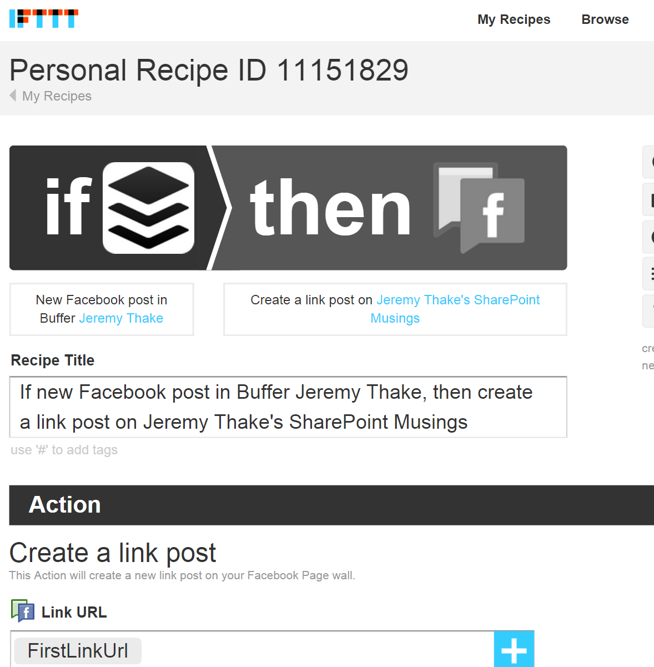
IFTTT
XXX Million users
Connected services
100’s channels
1000’s actions

Slide 19
DEMO:
IFTTT Channels

Slide 20
DEMO:
DocuSign

Slide 21
DEMO:
API Sandbox

Slide 22


What’s New
EXTEND OFFICE
EVERYWHERE
CONNECT TO
OFFICE 365 SERVICES
BUILD USING
AN OPEN PLATFORM
Users and
groups
Files
My Apps
z
Mail
Calendar
Contacts

Slide 23
.NET SDK
ASP.NET MVC
ASP.NET
WebForms
WPF

Slide 24
DEMO:
Visual Studio 2013 Tools

Slide 25
Cross platform
ASP.NET MVC
ASP.NET
WebForms
WPF

Slide 26
Native
ASP.NET MVC
ASP.NET
WebForms
WPF

Slide 27
Office 365 API SDK
ASP.NET MVC
ASP.NET
WebForms
WPF

Slide 28
DEMO:
Property Manager demo in iOS

Slide 29
DEMO:
Research Tracker on Android

Slide 30
Launch Partners

Slide 31
What’s New
EXTEND OFFICE
EVERYWHERE
CONNECT TO
OFFICE 365 SERVICES
BUILD USING
AN OPEN PLATFORM
Users and
groups
Files
My Apps
z
Mail
Calendar
Contacts

Slide 32



Vision
EXTEND OFFICE
EVERYWHERE
CONNECT TO
OFFICE 365 SERVICES
BUILD USING
AN OPEN PLATFORM
Delve
Users and
groups
Files
My Apps
z
Video Portal
Mail
Calendar
Contacts

Slide 33
DEMO:
File Extensions

Slide 34
DEMO:
Outlook Hover cards

Slide 35

Vision
EXTEND OFFICE
EVERYWHERE
CONNECT TO
OFFICE 365 SERVICES
BUILD USING
AN OPEN PLATFORM
Delve
Users and
groups
Files
Mail
Calendar
Users and
groups
Files
My Apps
z
Video Portal
Contacts
Office Graph
Presentations
Documents
Mail
Calendar
Contacts
Spreadsheets
Lync
OneNote
Yammer

Slide 36
Microsoft Graph

Slide 37






Vision
EXTEND OFFICE
EVERYWHERE
CONNECT TO
OFFICE 365 SERVICES
BUILD USING
AN OPEN PLATFORM
Delve
Users and
groups
Files
Mail
Calendar
My Apps
z
Video Portal
Contacts
Office Graph
Presentations
Documents
Spreadsheets
Lync
OneNote
Yammer

Slide 38
DEMO:
Office on the iPad with Apps for Office

Slide 39
Vision
EXTEND OFFICE
EVERYWHERE
CONNECT TO
OFFICE 365 SERVICES
BUILD USING
AN OPEN PLATFORM
Delve
z
Users and
groups
Files
Mail
Calendar
My Apps
Video Portal
Contacts
Office Graph
Presentations
Documents
Spreadsheets
Lync
OneNote
Yammer

Slide 40


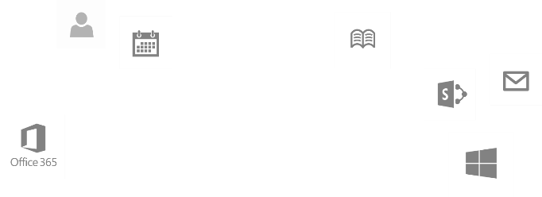
dev.office.com
Sign up
http://dev.office.com/build
Explore
http://api.Microsoft.com
Get trained
http://dev.office.com/training

Slide 41
Vote and giveaways

Slide 42
Resources

Slide 43
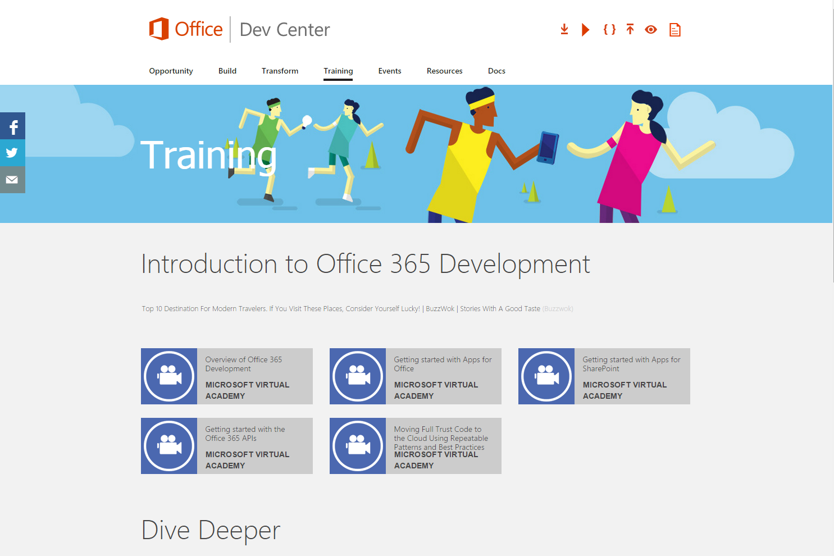
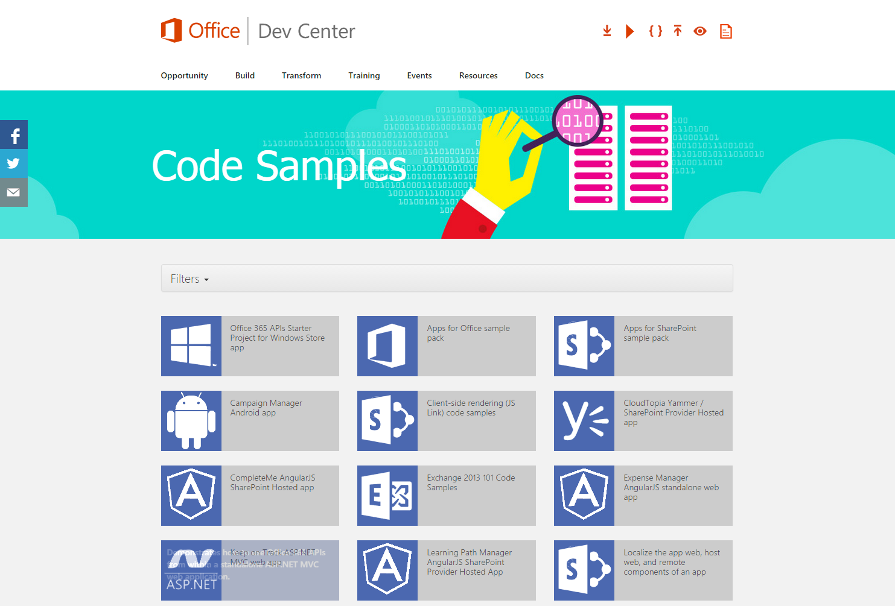
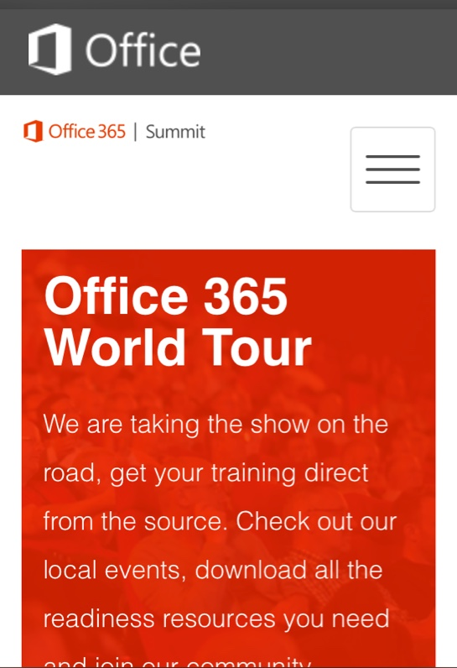
Building skills
Microsoft Virtual Academy
  dev.office.com/training
Code Samples
  dev.office.com/code-samples
DX Office 365 Dev Camps
Office 365 Summit
Developer Tracks
  summit.office.com

Slide 44

Developer Patterns & Practices
Transform your code
Providing App Model Patterns for common SharePoint
Full Trust Code and Office Add-in scenarios
60+ Visual Studio projects
Common scenarios
Branding
Site provisioning
Remote event receivers
Large file support
Taxonomy driven navigation
And much more… aka.ms/OfficeDevPnP

Slide 45
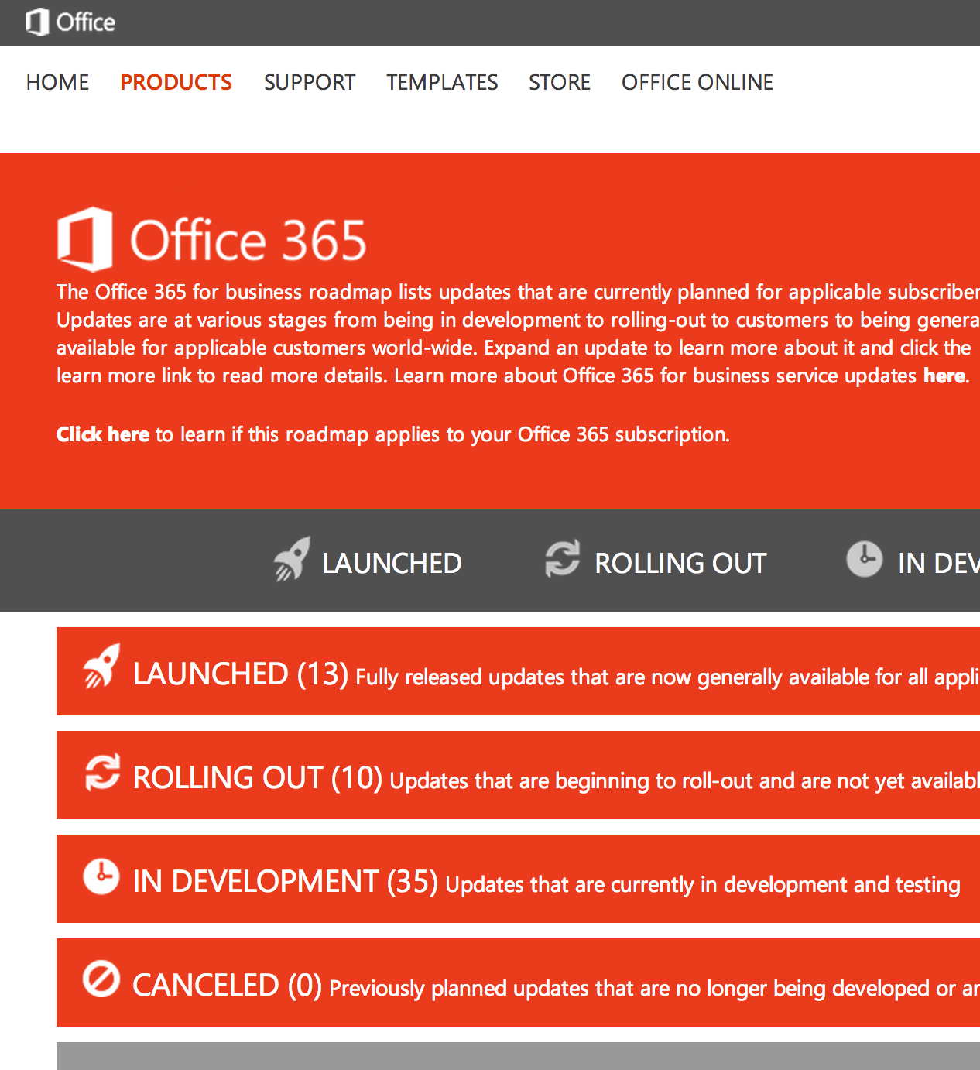
Roadmap
Monthly updates
Associated blog posts
www.office.com/roadmap

Slide 46
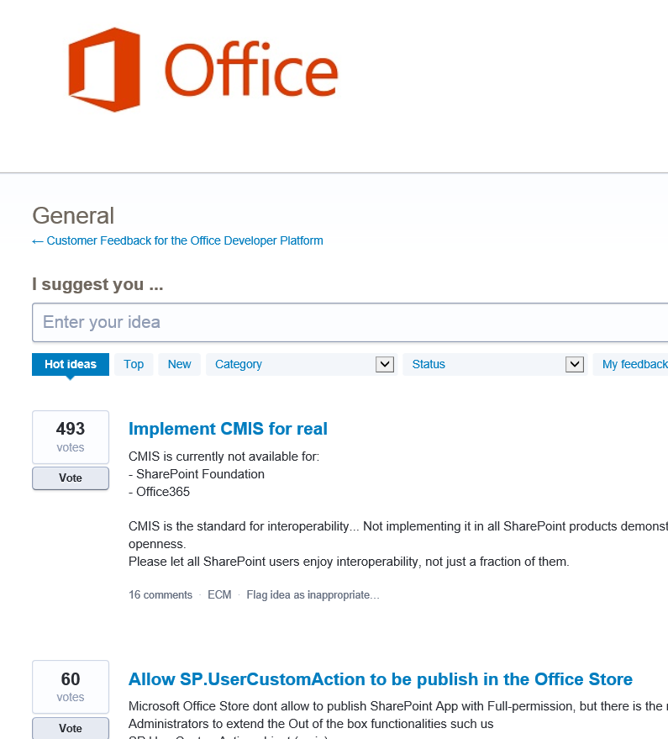

Customer feedback
Yammer
Office 365 Technical Network
Stackoverflow
UserVoice
Developer focused
Bi-weekly triage
Link to roadmap to show actions
http://aka.ms/OfficeDevFeedback

Slide 47

Resources
Learning
  Sessions on Demand
  Microsoft Certification & Training Resources
http://channel9.msdn.com/Events/TechEd
www.microsoft.com/learning
TechNet
Developer Network
  Resources for IT Professionals
http://microsoft.com/technet
http://developer.microsoft.com

Slide 48

DEV Track Resources
http://www.visualstudio.com
http://blogs.msdn.com/b/developer-tools/
http://msdn.microsoft.com/vstudio
visualstudio
@visualstudio
visualstudio

Slide 49


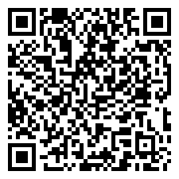
Please Complete An Evaluation Form
Your input is important!
TechEd Schedule Builder
CommNet station or PC
TechEd Mobile app
Phone or Tablet
QR code

Slide 50
Evaluate this session

Slide 51


© 2014 Microsoft Corporation. All rights reserved. Microsoft, Windows, and other product names are or may be registered trademarks and/or trademarks in the U.S. and/or other countries.
The information herein is for informational purposes only and represents the current view of Microsoft Corporation as of the date of this presentation. Because Microsoft must respond to changing market conditions, it should not be interpreted to be a commitment on the part of Microsoft, and Microsoft cannot guarantee the accuracy of any information provided after the date of this presentation. MICROSOFT MAKES NO WARRANTIES, EXPRESS, IMPLIED OR STATUTORY, AS TO THE INFORMATION IN THIS PRESENTATION.

