Slide 2
Building End-to-End Web Apps Using TypeScript
DEV-B212
Gil Fink

Slide 3
Agenda
Introduction to TypeScript
Building a Simple App with TypeScript
Summary

Slide 4
Wait! JavaScript End to End?

Slide 5
"JavaScript is the assembly language of the Web"
Erik Meijer

Slide 6
“You can write large programs in JavaScript. You just can’t maintain them”
Anders Hejlsberg

Slide 7
The Alternatives
We have several alternatives:
Hard core JavaScript development
JavaScript preprocessors
CoffeeScript – http://coffeescript.org
Dart – http://dartlang.org
Clojurescript - https://github.com/clojure/clojurescript
Script# - http://scriptsharp.com/

Slide 8
What is TypeScript?
“TypeScript is a typed superset of JavaScript that compiles to plain JavaScript” ~typescriptlang.org

Slide 9
Hello TypeScript
Gil Fink

Slide 10
TypeScript Key Features
Support standard JavaScript code with static typing
Encapsulation through classes and modules
Support for constructors, properties and functions
Interfaces and enums support
Lambda and generics support
Intellisense and syntax checking

Slide 11
From TypeScript to JavaScript
TypeScript Code
JavaScript Code
TypeScript Compiler
class Greeter {
greeting: string;
constructor(message: string) {
this.greeting = message;
}
greet() {
return “Hi," + this.greeting;
}
}
var Greeter = (function () {
function Greeter(message) {
this.greeting = message;
}
Greeter.prototype.greet = function () {
return “Hi," + this.greeting;
};
return Greeter;
})();
tsc.js

Slide 12
TypeScript Type Annotations
You can add type annotations to variables and functions
var str: string = ‘hello’; // str is annotated as string
function foo(name: string) : string { // both parameter and function annotated
return ‘hello’ + name;
}

Slide 13
Classes and Interfaces
You can define classes
You can define interfaces
And implement them later
interface IGreeter {
greet(): void;
}
class Greeter implements IGreeter{
greeting: string;
greet() {
console.log(this.greeting);
}
}
var Greeter = (function () {
function Greeter() {
}
Greeter.prototype.greet = function () {
console.log(this.greeting);
};
return Greeter;
})();

Slide 14
Modules
You define modules to wrap classes, interfaces and functionality
Use import and export keywords
module app {
export interface IGreeter {
greet(): void;
}
export class Greeter implements IGreeter {
greeting: string;
greet() {
console.log(this.greeting);
}
}
}
var app;
(function (app) {
var Greeter = (function () {
function Greeter() {
}
Greeter.prototype.greet = function () {
console.log(this.greeting);
};
return Greeter;
})();
app.Greeter = Greeter;
})(app || (app = {}));

Slide 15
Classes, Modules and Interfaces
Gil Fink

Slide 16
Building a Simple End-to-End App with TypeScript
Gil Fink

Slide 17
Questions?

Slide 18
Summary
Open source language that compiles into JavaScript
Key features:
Code encapsulation
Maintainable code
Tooling support
Learn TypeScript today!

Slide 19
Resources
TypeScript – http://www.typescriptlang.org
TypeScript Source Code - https://github.com/Microsoft/TypeScript
Definitely Typed –https://github.com/borisyankov/DefinitelyTyped
My Website – http://www.gilfink.net
Follow me on Twitter – @gilfink

Slide 20
DEV Track Resources
http://www.visualstudio.com
http://blogs.msdn.com/b/developer-tools/
http://msdn.microsoft.com/vstudio
visualstudio
@visualstudio
visualstudio

Slide 21
Thank You!

Slide 22
Resources
Learning
Sessions on Demand
Microsoft Certification & Training Resources
http://channel9.msdn.com/Events/TechEd
www.microsoft.com/learning
TechNet
Developer Network
Resources for IT Professionals
http://microsoft.com/technet
http://developer.microsoft.com

Slide 23
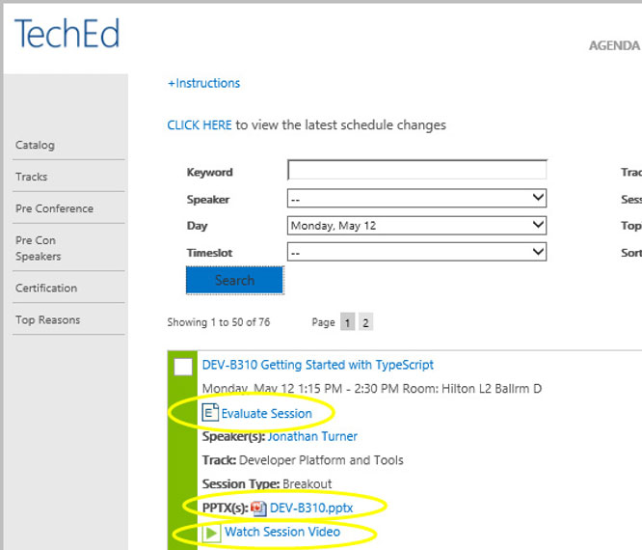
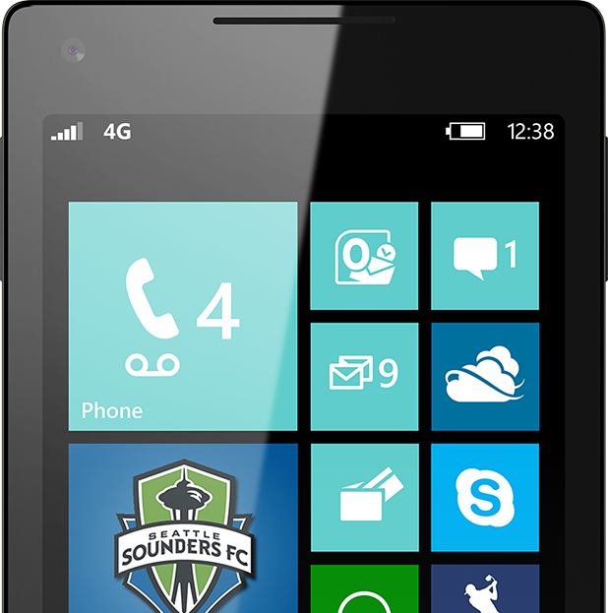
Please Complete An Evaluation Form Your input is important!
TechEd Schedule Builder
CommNet station or PC
TechEd Mobile app
Phone or Tablet
QR code

Slide 24
Evaluate this session

Slide 25
© 2014 Microsoft Corporation. All rights reserved. Microsoft, Windows, and other product names are or may be registered trademarks and/or trademarks in the U.S. and/or other countries.
The information herein is for informational purposes only and represents the current view of Microsoft Corporation as of the date of this presentation. Because Microsoft must respond to changing market conditions, it should not be interpreted to be a commitment on the part of Microsoft, and Microsoft cannot guarantee the accuracy of any information provided after the date of this presentation. MICROSOFT MAKES NO WARRANTIES, EXPRESS, IMPLIED OR STATUTORY, AS TO THE INFORMATION IN THIS PRESENTATION.

